Slide 1
Git in action
tangdeping
July 24, 2016

Slide 2
About me
Web, RESTful, Golang, etcd
DevOps
Leader of common services
tdp100.github.com

Slide 3
Agenda
History of Git
Design of Git
Commands of Git
Git and Gitlab
Best Practices in DevOps

Slide 4
History of Git
I've never actually used CVS for the kernel
BitKeeper is commercial software
Git: a reliable, high performance, distributed content management thing, and the key word here is actually the "distributed" part
https://en.wikipedia.org/wiki/Concurrent_Versions_System
See: Tech Talk: Linus Torvalds on Git

Slide 5






Design of Git
Distributed
git
repo
git
repo
git
repo
git
repo
Local & Remote
Pull & Push
git
repo

Slide 6







Workflow
add
commit
Working dir
Index(stage)
HEAD

Slide 7
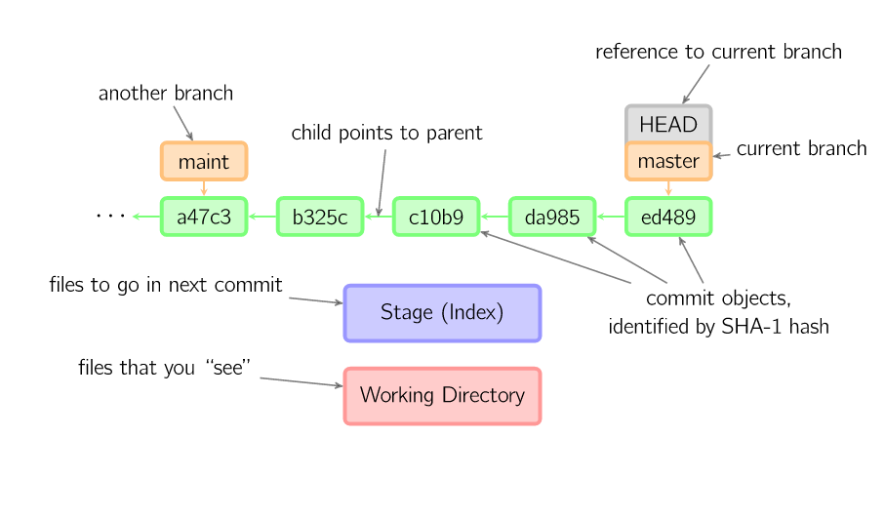
Pointer
HEAD~2
HEAD~

Slide 8
Commands of Git
1.For local Git repo
add
commit
checkout
reset
merge
rebase
cherry-pick
stash
2. For remote Git repo
clone
pull
push
remote
3. For Git tool
log
status
config
http://marklodato.github.io/visual-git-guide/index-en.html

Slide 9
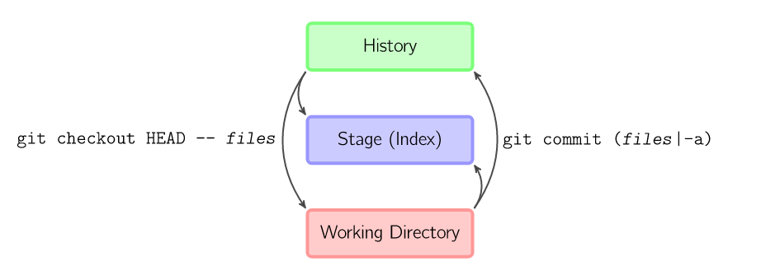
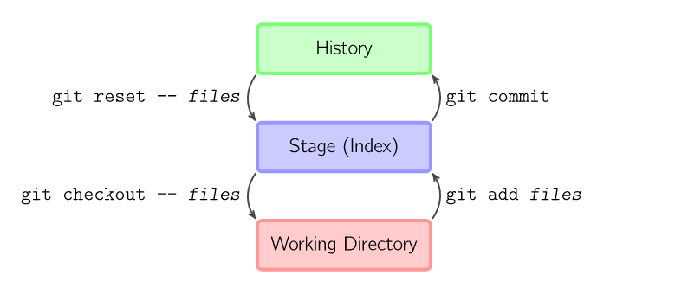
add/commit/checkout/reset

Slide 10
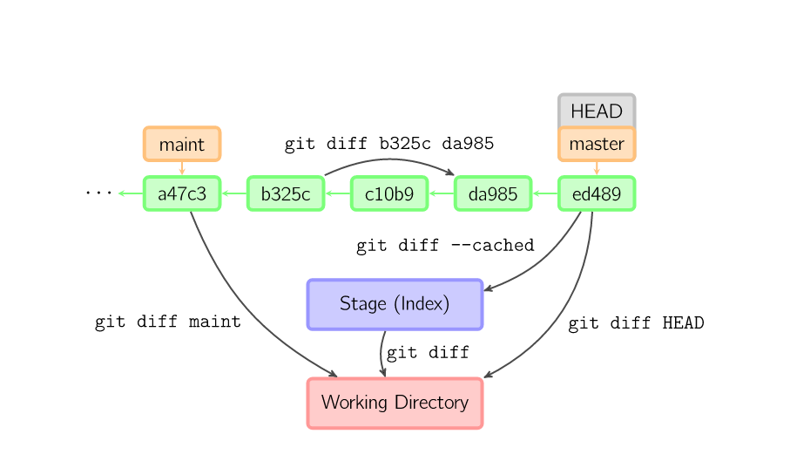
Diff

Slide 11
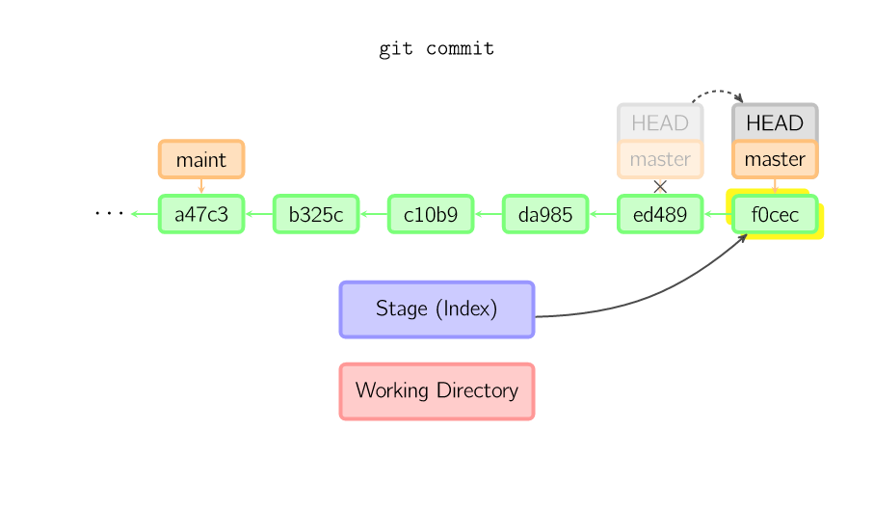
commit

Slide 12
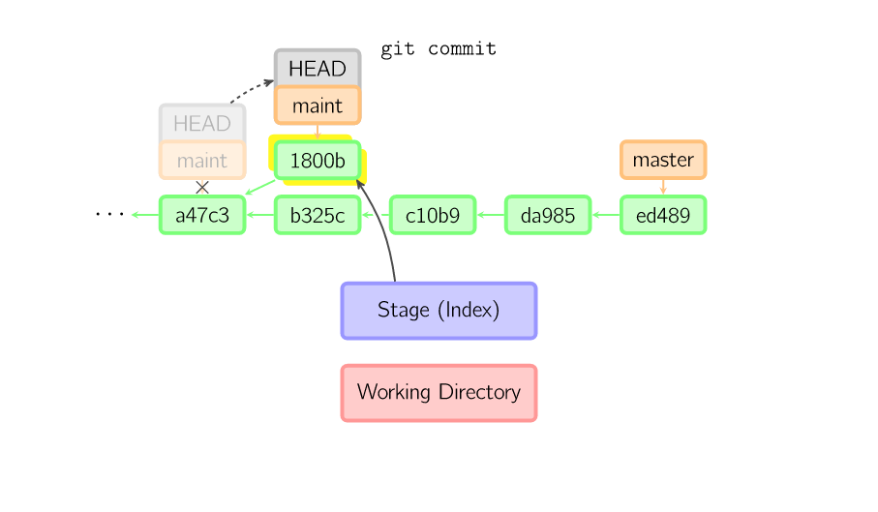
need merge

Slide 13
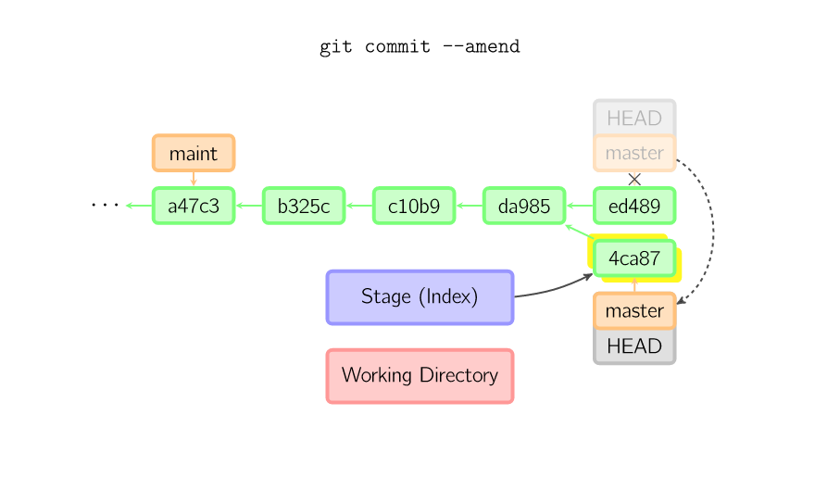
commit --amend

Slide 14
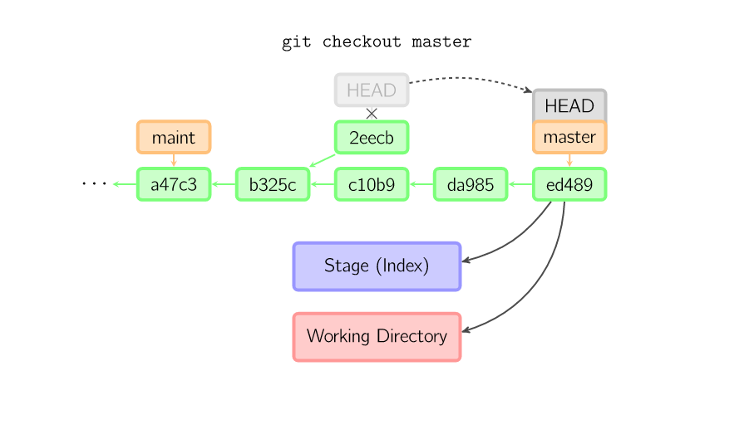
checkout

Slide 15
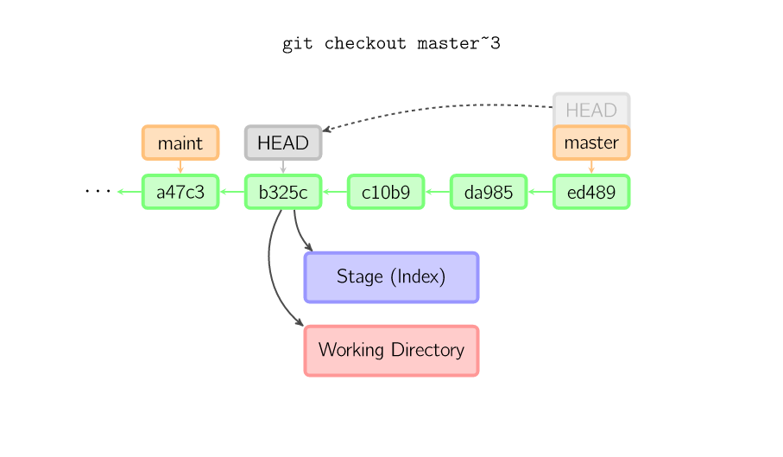

Slide 16
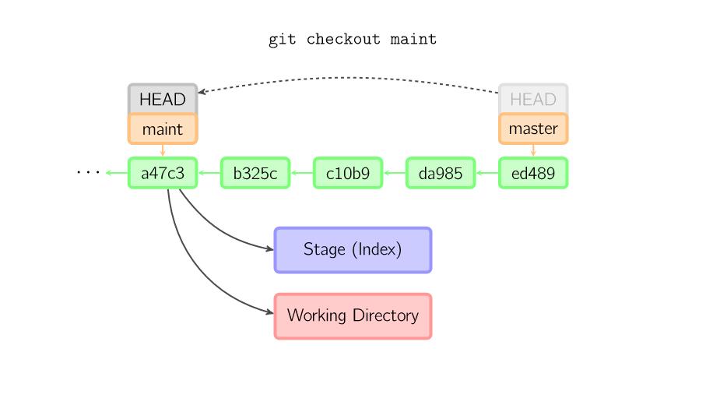

Slide 17

Do not change HEAD pointer

Slide 18
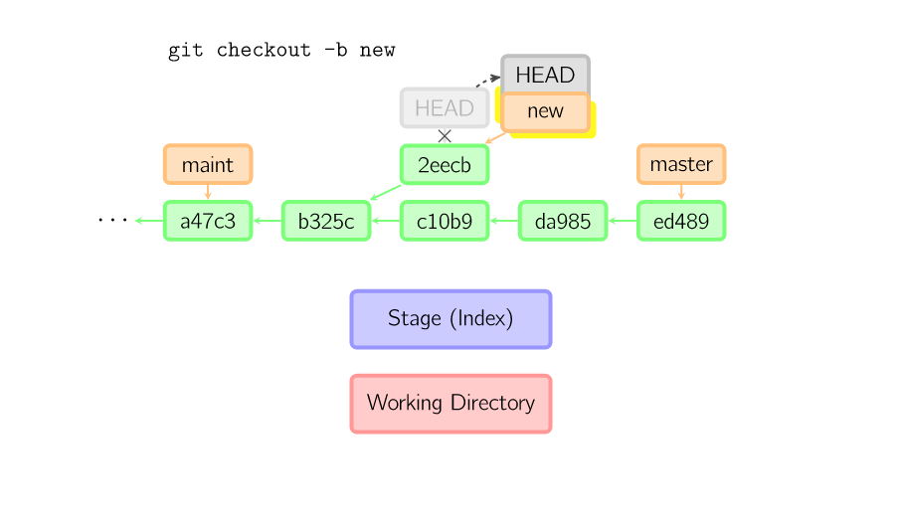
checkout -b new

Slide 19
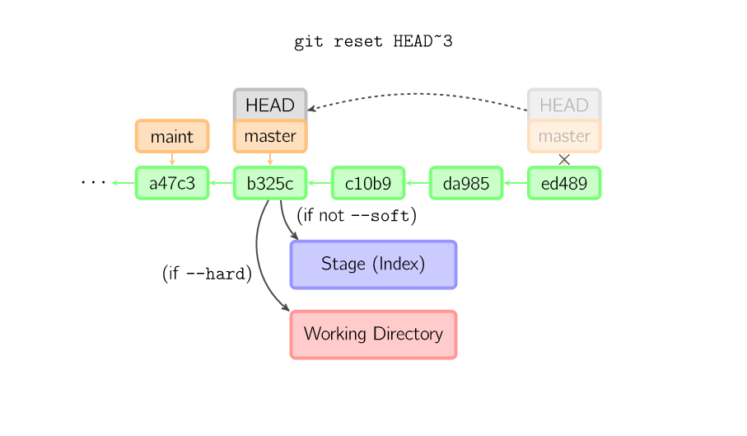
reset

Slide 20
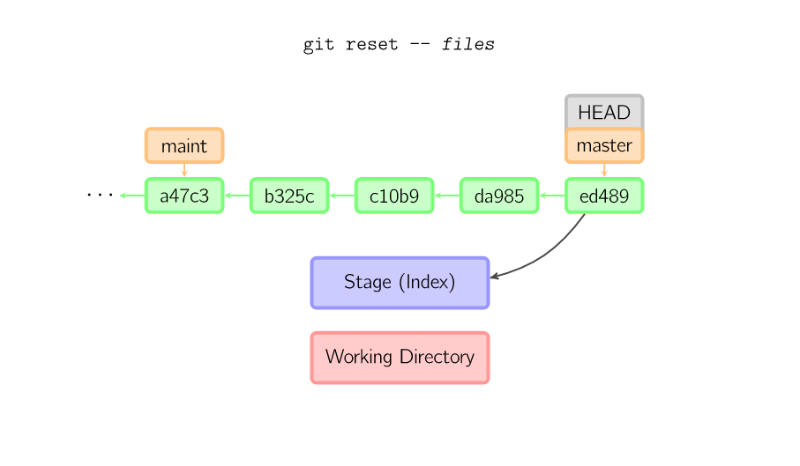

Slide 21
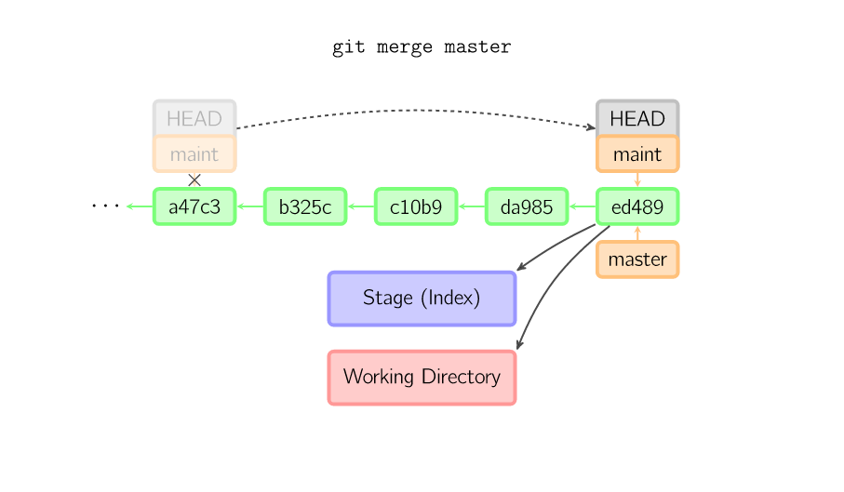
merge
fast-forward

Slide 22
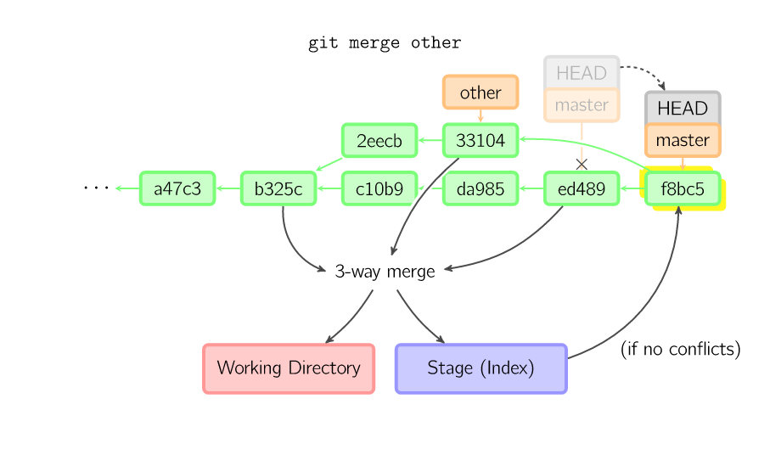
three-way merge

Slide 23
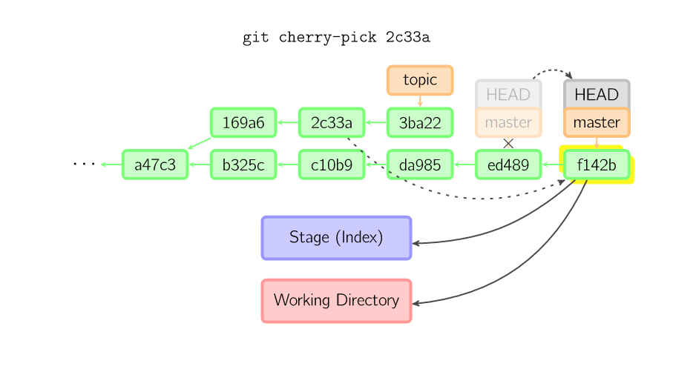
cherry-pick(copy)

Slide 24
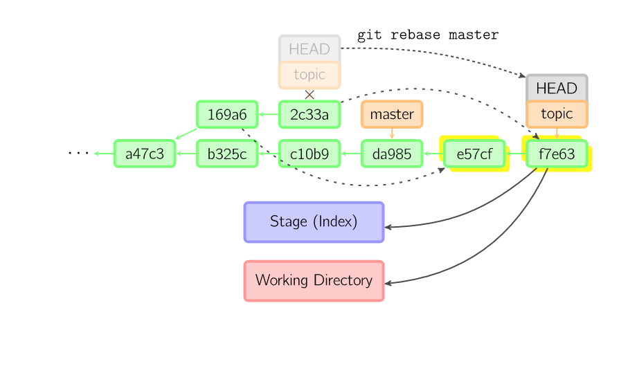
rebase(copy)

Slide 25
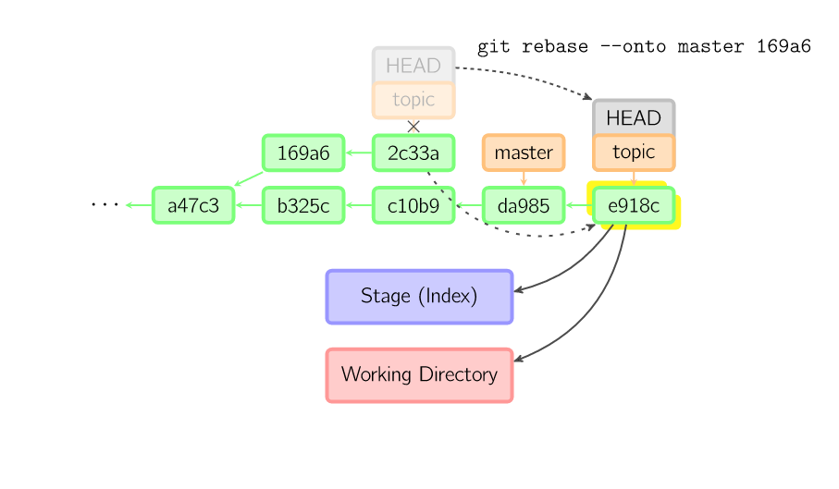
rebase - -onto
The command replays onto master the most recent commits on the current branch

Slide 26
Git and GitLab
Create organisation
Create repo
Setting: members, privileges
SSH token

Slide 27
Best Practices in DevOps
Team Culture, +1
Branch, tdp/feature
Codereview
Style of code and comments
Wiki of markdown

Slide 28
End

