Slide 1
Web Framework
tdp100

Slide 2
why do we need it?

Slide 4
front end
UI Component
CSS Lib(layout system)
Page Routing(single page)
Ajax or Utils
Dependency Manage
I18n
Performance(cache)
Fixture
Deploy

Slide 5
back end
Authentication
Safety(XSS, CSRF)
Stateless(memcached/redis?)
Restful framework
Proxy(pass through api to backend service)
Load balance(ECMP+DR?)
Inject service dynamically
Traffic control

Slide 6
UI Framework

Slide 7



stack
ui framework
framework.css
components
(director)
service
ui-router
fixture
bootstrap
(layout system)
angularjs
requirejs/typescript

Slide 8
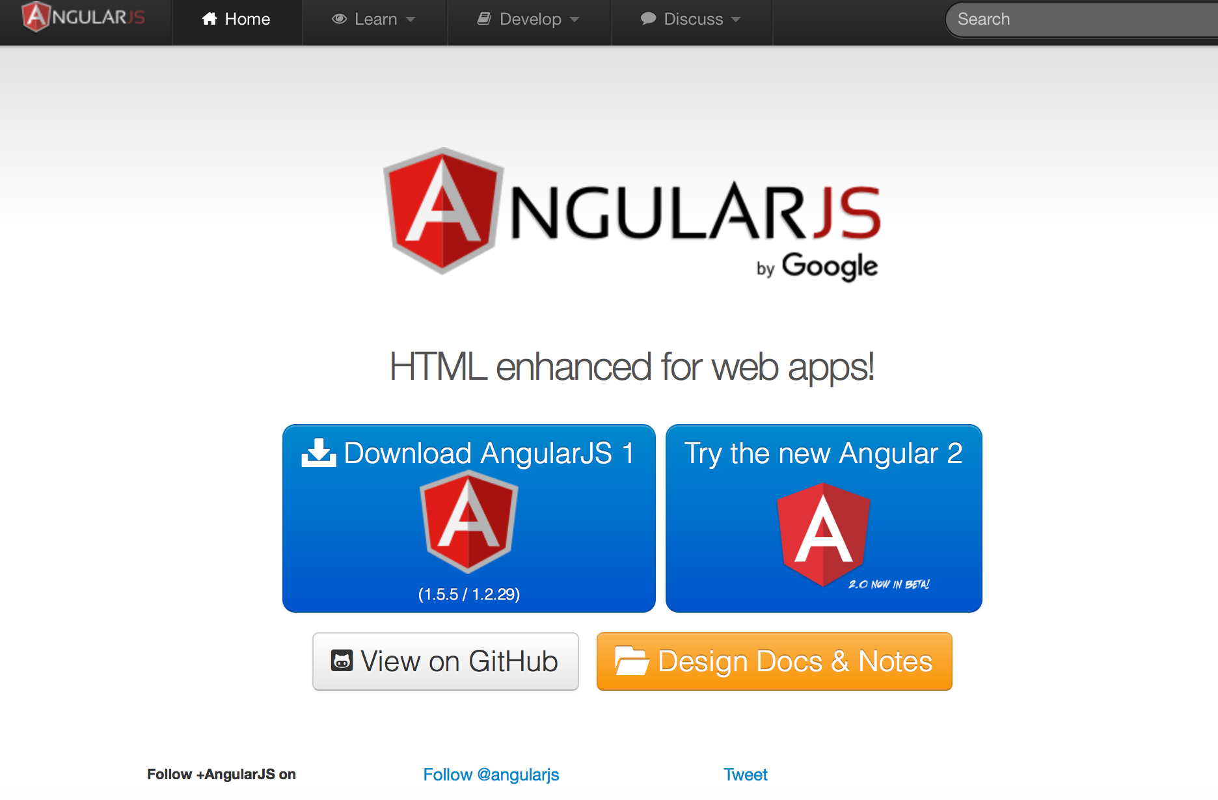
AngularJS
https://www.angularjs.org

Slide 9
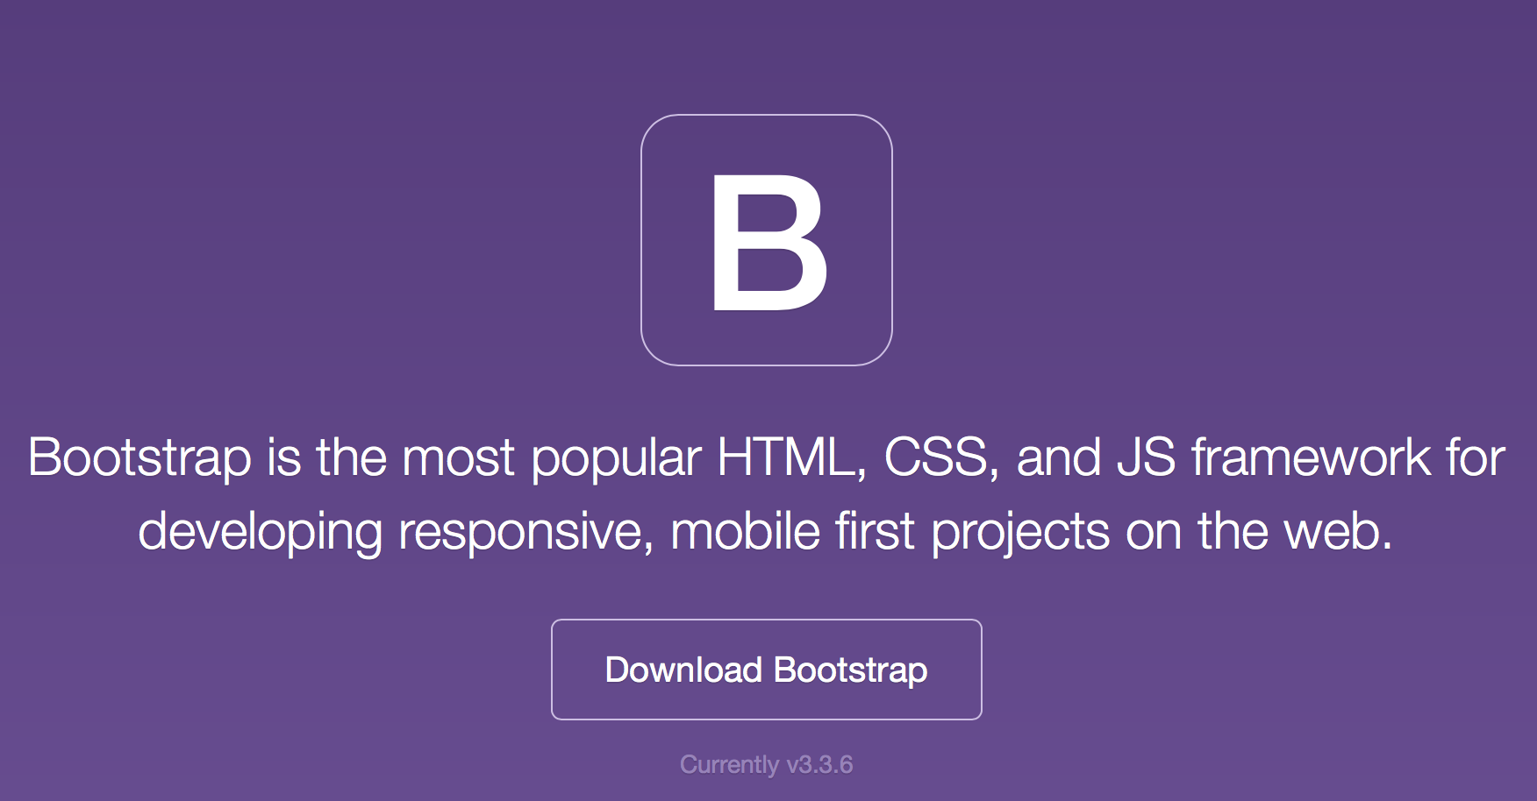
Bootstrap
layout system
https://getbootstrap.com

Slide 10
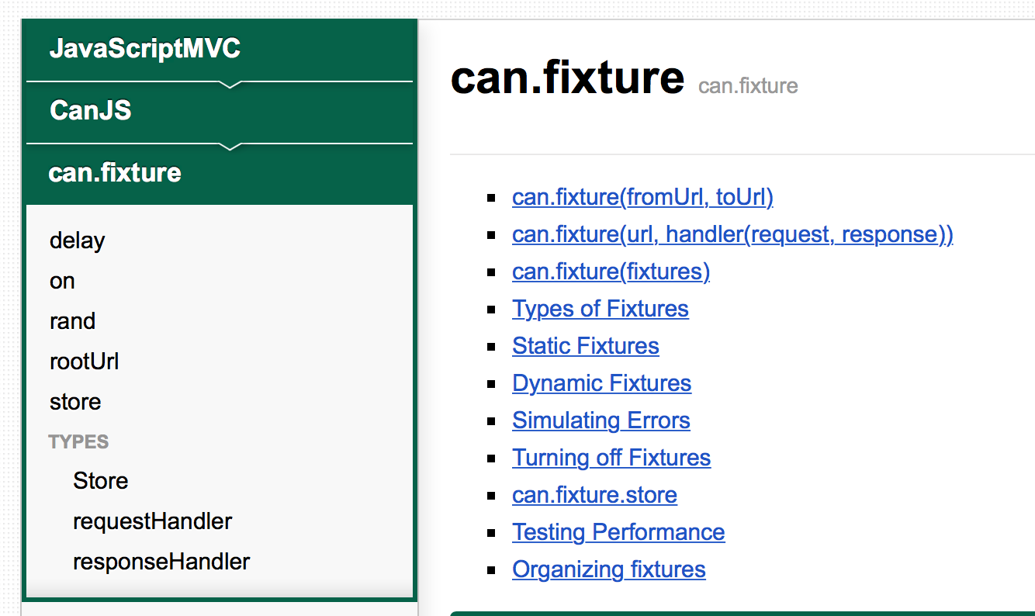
Fixture
see: http://www.javascriptmvc.com/docs/can.fixture.html

Slide 11
Cache
Generate hash-code by proxy dynamically
Replace content’s uri with hash-code for html or css file
browser
proxy
webapp
get http://hostname:port/uri
query version to generate hash-code and cache
/uri
<a href=“xxx”/>
/uri
<a href=“/aaa?hash=xxx”/>
get http://hostname:port/aaa?hash=xxx

Slide 12
I18n
Separate business code from i18n files
Keep enough space for word, german especially

Slide 13
But, you should rebuild them together

Slide 14
backend framework

Slide 15
stack
session-lib
auth-lib
safety-lib
proxy-lib
autoload api-config file

Slide 16
stateless
webapp cluster
store session
memcached/redis
back service

Slide 17
API
RESTful API
Have nothing to do with language
Open source
go http2
restlet+netty
node.js+express

Slide 18
Traffic Control
Set max connection number
Aspects: user, api, task time?

Slide 19
Load balance
4/7 LB
Health Check
Open Source
ECMP+LVS(DR)+NGINX
ECMP+LVS(fullnat)
Keepalived +LVS

Slide 20
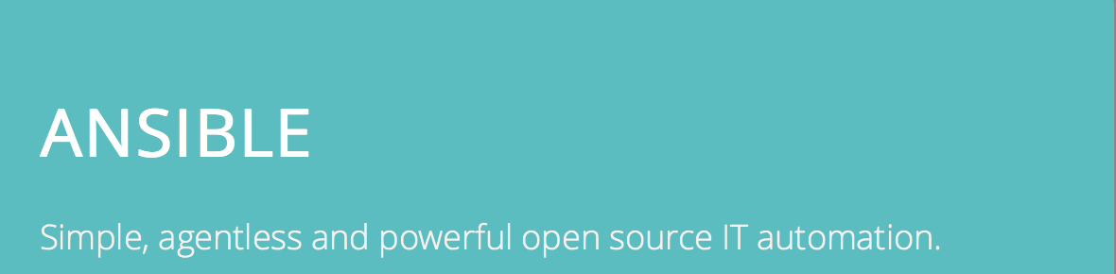
Deploy
http://docs.ansible.com

Slide 21

Monitor
http://www.zabbix.com

Slide 22
Network
DMZ(web app)
Public Service Zone

Slide 23
END

