Slide 1
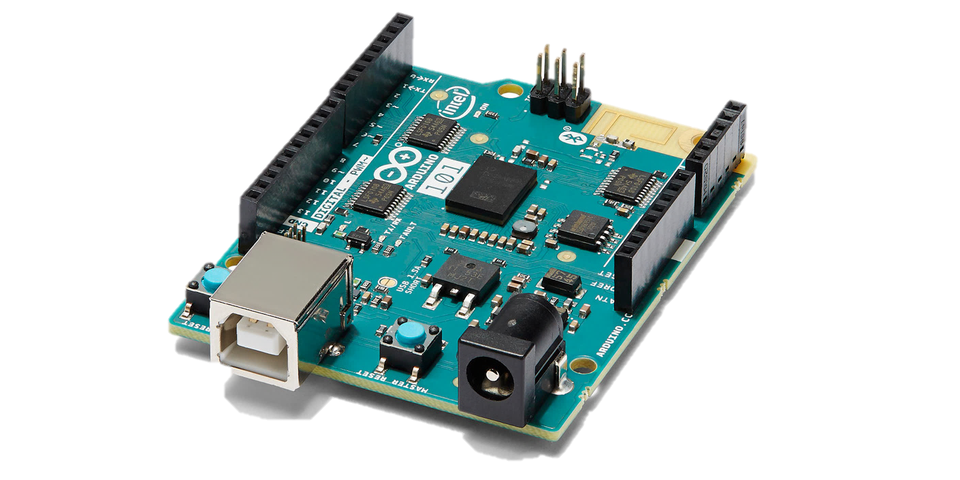
Arduino gyroscope/accelerometer sense axes
Z
X
Y

Slide 2
Definitions/Acronyms
DCM – Direction Cosine Matrix – A 3x3 matrix used to express a rotation or current orientation.
IMU – Inertial Measurement Unit, a 6-degree of freedom (6DOF) sensor containing a 3-axis gyroscope and 3-axis accelerometer
Accelerometer – Measures “Specific Force” or non-gravitational force per unit mass. An accelerometer at rest will measure approximately 1 “G” (or ~9.81 m/s^2) opposite gravity
Gyroscope (in this context) – Electronic device that measures rotational rate (radians/sec) in each axis.
LMS – Least Mean Squres, an adaptive filtering algorithm
RLS – Recursive Least Squares, another adaptive filtering algorithm. Has a faster convergence time than LMS but is more computationally intensive to update

Slide 3
Basic Orientation Sensing (Tends to be noisy or drifts)
Gyro Data (XYZ)
Angular Rate
Convert to DCM
(3x3)
New Attitude Est (3x3)
Convert to Euler Angles (Ψ,Θ, Φ), optional
x
Tends to drift, integrates bias in gyroscope
Previous Attitude Est (3x3)
Delay
roll (Ψ)= atan2(ay, az)
pitch(Θ) = -sin(ax)
Tends to be noisy and not always valid due to actual acceleration. Only measures two orientation axes.
Accelerometer Data
Is total acceleration magnitude ~1G?
YES
No
No valid measurement

Slide 4
Adaptive Data flow block Diagram
[0
0
9.81]
Gravity @Local level
Accelerometer Output Estimate (assuming stationary) (3x1)
Gyro Data (XYZ)
Angular Rate
Convert to DCM
(3x3)
New Attitude Est (3x3)
x
x
Previous Attitude Est (3x3)
Delay
Adaptive filter
+
-
Σ
Current Attitude Est (3x3)
Combine these in some way
Accelerometer Data

Slide 5
Another Possible Approach
Gyro Data (XYZ)
Angular Rate
New Attitude Est (3x3)
Convert to Euler Angles (Ψ,Θ, Φ)
Ψ
Adaptive Filter
Convert to DCM
(3x3)
x
Θ
εΨ, εΘ
Current Attitude Est (3x3)
-
Σ
εΨ, εΘ
+
-
Σ
+
Accelerometer Data
roll (Ψ)= atan2(ay, az)
pitch(Θ) = -sin(ax)
Ψ
Is total acceleration magnitude ~1G?
YES
Θ
No
No valid measurement

Slide 6
Geometric Update equations
Find DCM update equation based on gyroscope output
[constants: R2D = pi/180. dt = 1/fs]
gx, gy, gz = gyroscope x/y/z “Delta Theta” (angular rate * dt)
imu_dcm_x = [...
1, 0, 0;
0, cos(gx), -sin(gx);
0, sin(gx), cos(gx)];
imu_dcm_z = [...
cos(gz), -sin(gz), 0;
sin(gz), cos(gz), 0;
0, 0, 1];
imu_dcm_y = [...
cos(gy), 0, sin(gy);
0, 1, 0;
-sin(gy), 0, cos(gy)];
Transition_dcm = (imu_dcm_x * imu_dcm_y * imu_dcm_z)’;
Find Euler angles based on DCM;
current_attitude_dcm(j,:,:) = temp_attitude;
current_attitude_euler(j,1) = [atan2( DCM_BI(2,3), DCM_BI(3,3))]; %roll
current_attitude_euler(j,2) = [asin(DCM_BI(1,3))]; %pitch
current_attitude_euler(j,3) = [atan2(DCM_BI(1,2), DCM_BI(1,1))];%yaw
Find Euler angles based on accelerometer reading (a tilt sensor, essentially)
Assumes no acceleration (if magnitude of acceleration is ~1G then this is probably true)
Accelerometer outputs: ax, ay, az (normalized in “G’s”, or divided by 9.81)
Roll = atan2(ay,az);
Pitch = -asin(ax);

Slide 7
References
Rotational equations (including complementary filter)
http://www.starlino.com/dcm_tutorial.html
RLS Algorithm
http://zone.ni.com/reference/en-XX/help/372357A-01/lvaftconcepts/aft_rls_algorithms/
http://www.cs.tut.fi/~tabus/course/ASP/LectureNew10.pdf
http://ens.ewi.tudelft.nl/Education/courses/ee4c03/slides/10_rls.pdf
LMS Algorithm
http://www.eit.lth.se/fileadmin/eit/courses/ett042/LEC/notes2.pdf
https://en.wikipedia.org/wiki/Least_mean_squares_filter
http://cwww.ee.nctu.edu.tw/course/asp/ASP04.pdf

