Slide 1
medd sim
Giving your team the tools to practice the moments that matter,
before they matter.

Slide 2
MEDD Sim is the simulation studio you control.
Build any AI-powered coach, role-play, examiner or supporting asset in minutes—then stitch them into learning pathways that turn high-stakes conversations into rehearsed performances.

Slide 3
Our vision
[Professional working on laptop]
is to make deliberate practice a daily norm.

Slide 4
The problem we face
Problem 1
Nobody enjoys role-plays, so they tend to be a filler session at sales meetings or a dreaded component of SFE.
Problem 2
When managers are stretched thin, coaching is usually the first thing that is dropped.
Problem 3
Most professionals love the results of coaching. They just don't love the feeling of being exposed.

Slide 5
How we fix it
A behaviour rehearsal engine:
build scenarios, practice in private,
and make it happen in the real world.
1. Total Control
User-generated agents: build from templates or scratch for sales, business coaching, patient simulations, OSCE-style examiners
2. Content Studio
Custom Notebook LM style tools to generate all types of resources with a click of a button.
3. BYO Rubric
Standardise coaching and feedback style based on the company's subscribed format.
4. Learning Pathways
Create structured learning pathways for product launches, clinical training, business acumen, and performance evaluation.
5. Security
• MEDD servers
• Isolated instance
• No LLM training
• RAG (retrieval augmentation)

Slide 6
Build any coaching or roleplay experience
Roleplay any customer
Create agents with specific personas, objections, and buying motives. Then set the temperature for real-world conversations.
Coach any situation
Develop a coach for any situation using best practice templates for sales, business, HR and much more...
Workforce Readiness
Create learning modules and simulations for orientation, performance reviews, compliancy training.
Patient case study
Take therapy development to the next level by adding AI patient case-study simulations to CPD presentations.
Examiner Mode
Create an OSCE agent to assess any clinical, technical, or knowledge-based scenario with a custom rubric.
User-created Sims
Let the team create personalised coaching, role-play, or assessment simulations tailored to their goals.
Create from templates, build from scratch, or go full service

Slide 7
How it Works
Register to medd to access the sim dashboard and set up your account. Select a subscriber package.
Onboard the team using the onboarding tools and assign user types.
Create your first agent, learning pathway, roleplay, gamified campaign or LearnDash course.
Build patient simulation case studies and CPD education for therapy development activities.
1
2
3
4

Slide 8
Security and governance
Private by design - secure by default
Data boundary
🔒
• No model training
• Customer isolation (separate instance - no sharing)
• Configurable retention
Access & oversight
• Role-based access (learner/assessor/admin)
• Admin governance (scenario approval, assessor assignment)
• Optional transcript controls (on/off, redaction)
Audit & compliance
• Audit logs (who did what, when)
• Rubric versioning (which rules + content were used)
• Exportable evidence accessible by admin/end-user

Slide 9
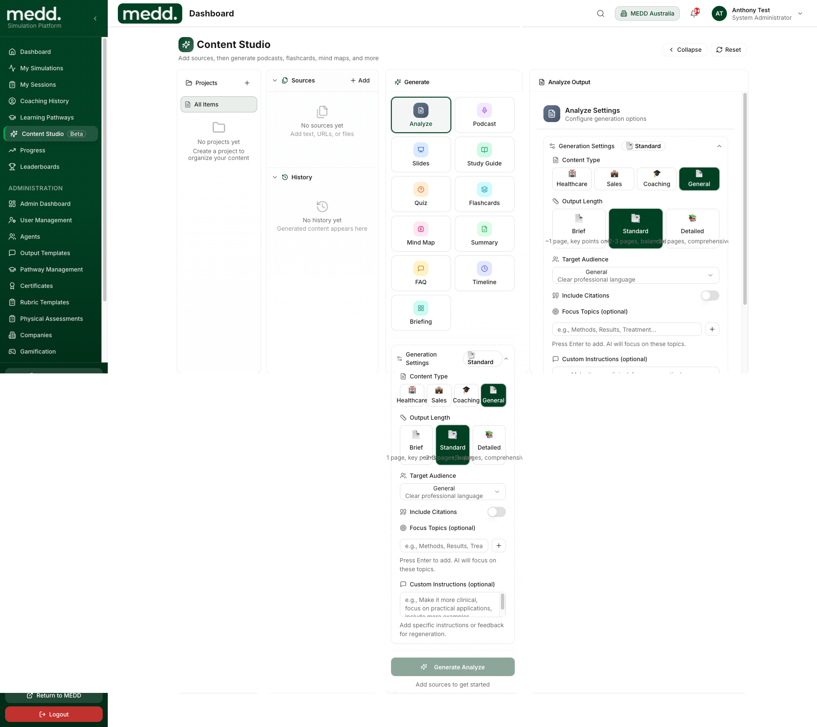
Demo

Slide 10
Pricing
AFFORDABLE
Essential — $39/user/month
Professional — $79/user/month
Enterprise — Custom
Best for individual users and small teams
• 10 mins video / 60 mins audio per user/month
• Unlimited agent types
• Learning pathways
• Templates + custom rubrics
• Content Studio: 2 sessions/month
• Email support
Overage: $0.59(V)-$0.16(A)/min
Best for coordinated training programs
• Pooled: 25 mins video × seats/month
• 90 mins audio × seats/month
• Everything in Essential
• Team analytics + gamification
• Pooled Content Studio
• Email + message support
Overage: $0.37(V)-$0.11(A)/min
Best for organisations
• Custom instance
• High pooled allowances
• SSO & advanced governance
• Volume rates
• Dedicated success manager
• Phone support

Slide 11
Content Studio
Generate learning materials in seconds
Create podcasts, flashcards, quizzes, mind maps, summaries, FAQs, briefings, and more — all from your source content.
• Healthcare, Sales, Coaching content types
• Brief, Standard, or Detailed outputs
• Custom instructions for regeneration

Slide 12
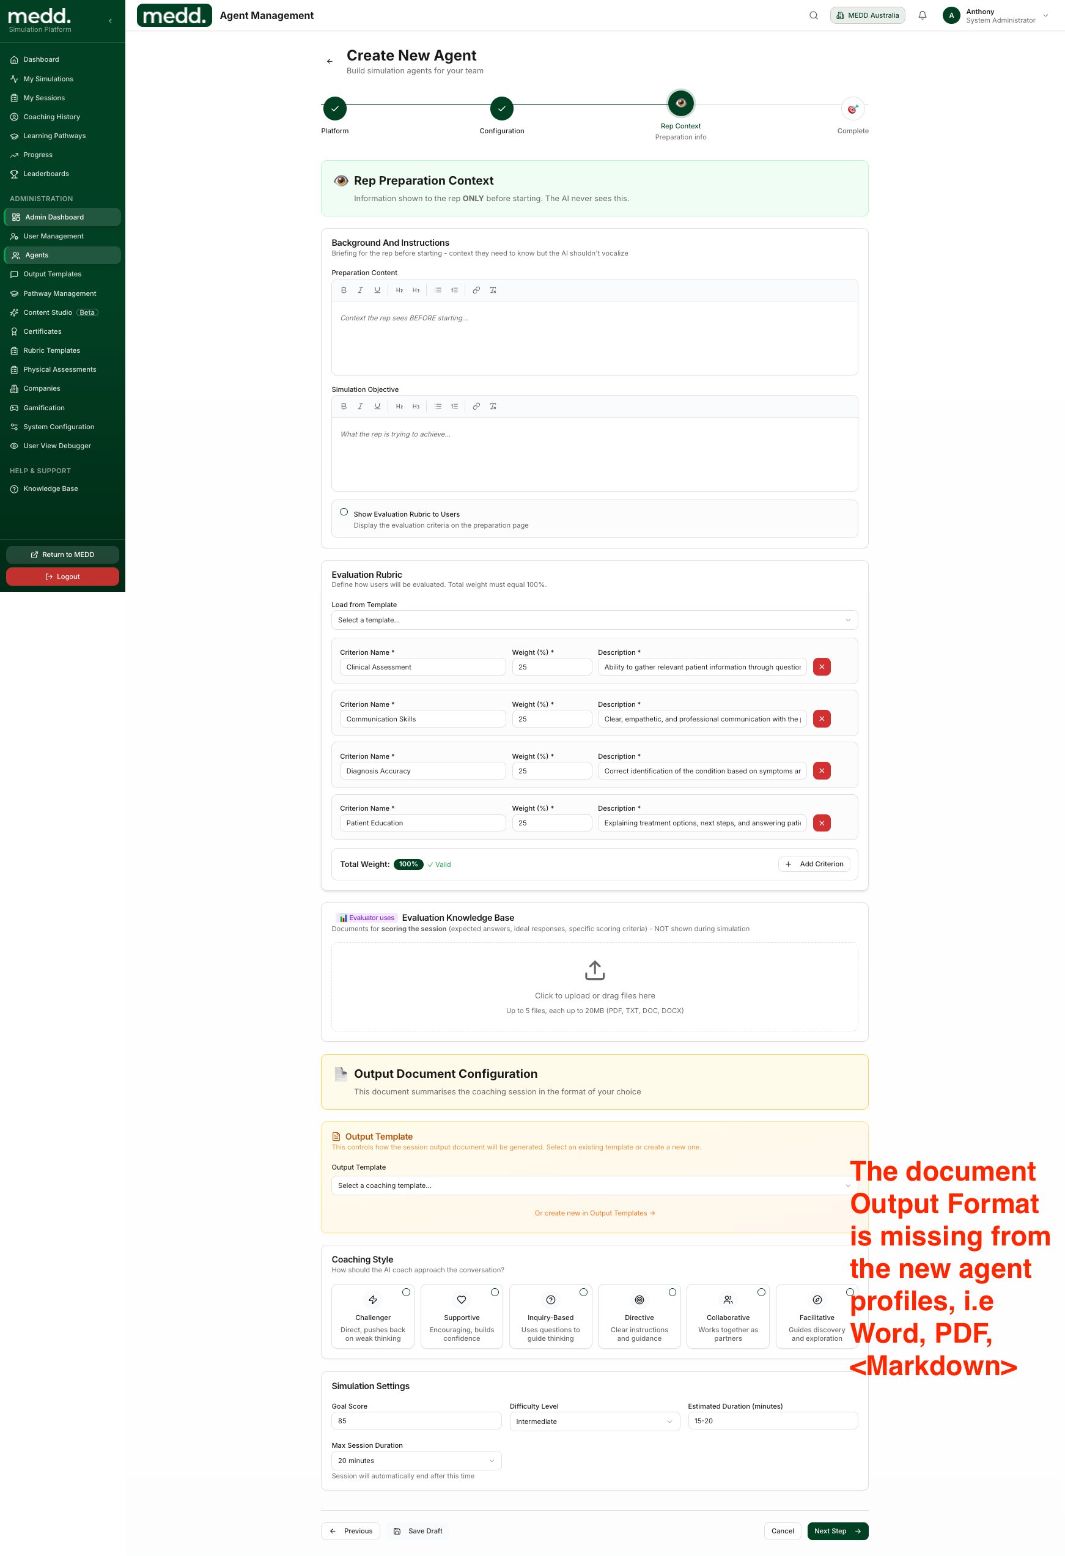
Agent Builder
Create custom AI agents with full control
Define preparation context, simulation objectives, evaluation rubrics, and coaching styles — all in one intuitive interface.
• Custom evaluation criteria with weighted scoring
• 6 coaching styles: Challenger to Facilitative
• Configurable difficulty and duration

Slide 13
medd sim
Ready to transform how your team practices?
Turn high-stakes conversations into rehearsed performances.
Start Free Trial
📧 hello@medd.com.au | 🌐 sim.medd.com.au

