Slide 1

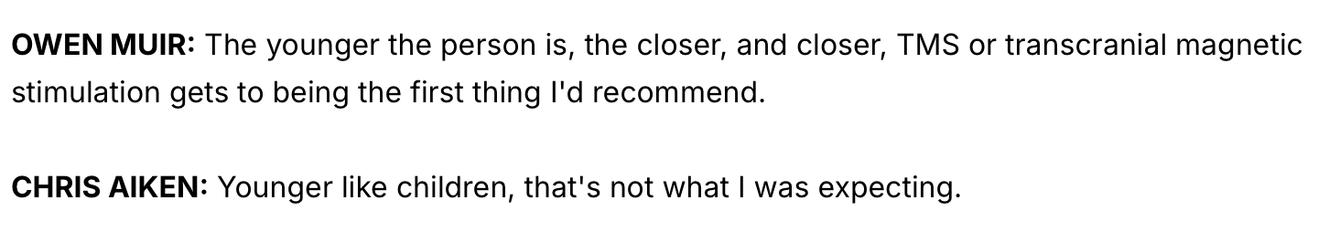
Not what I was expecting either ….

Slide 2
Plan
TMS for MDD in adolescents
Steve White
6/18/26
How does TMS work?
Why TMS for adolescents?
Does TMS work in this population?

Slide 3
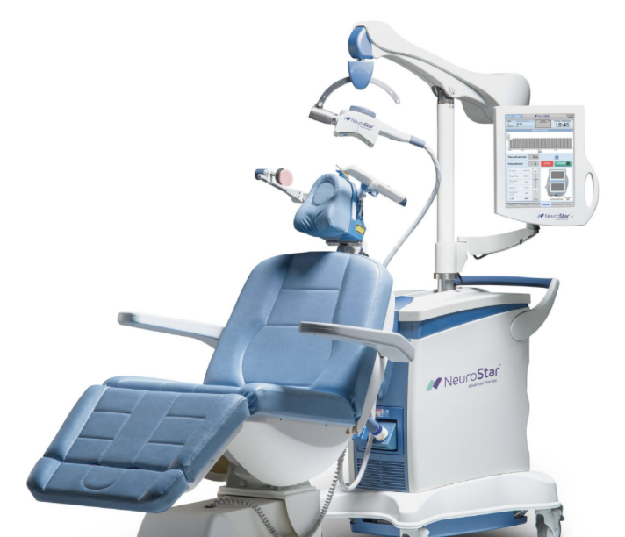
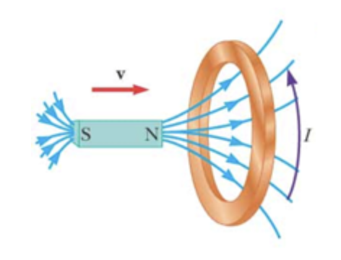
1. How does TMS work?

Slide 4
1. How does TMS work?
¯\_(ツ)_/¯

Slide 5
2. Why TMS for adolescents?
Antidepressants cause SIB in young people
Adolescents frequently present in crisis
want treatment that works fast
Young people have more neural plasticity

Slide 6
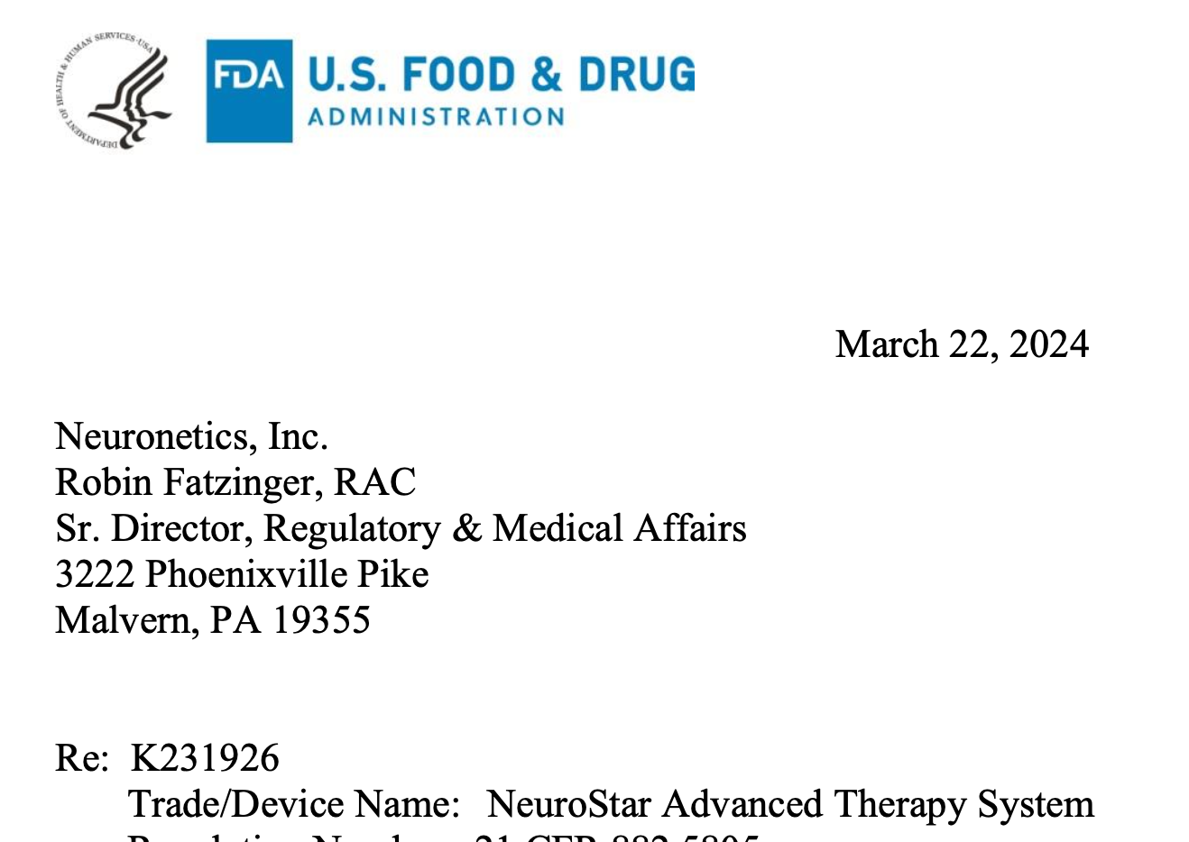
FDA cleared TMS in 2024

Slide 7
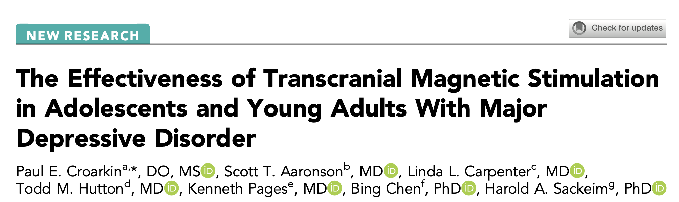
3. Does TMS work in this population?
Main study cited in FDA approval
Large Observational study
n = 682 for adolescent group (ages 12-19)

Slide 8
Results
 | TMS group
Pre | 18.95
Post
Control group
Scores are PHQ-9
27.5% in remission (PHQ < 5)
9.84
“[Time] heals, and the Doctor takes the Fees.” – adapted from Ben Franklin

Slide 9
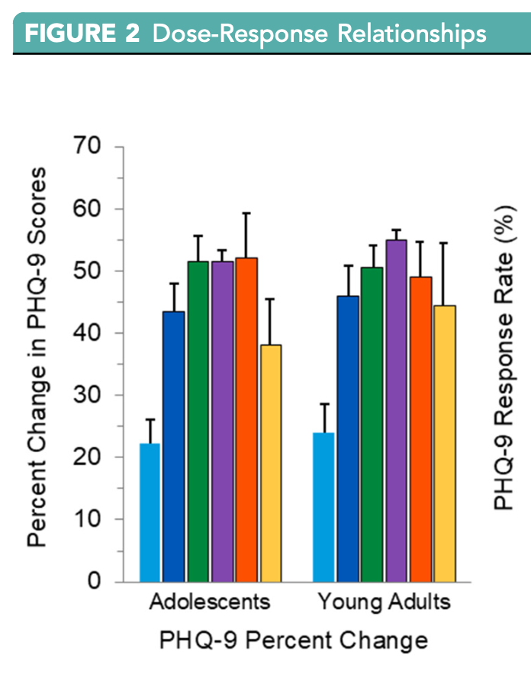
Dose-response?
They put a lot of stock in the dose-response relationship

Slide 10
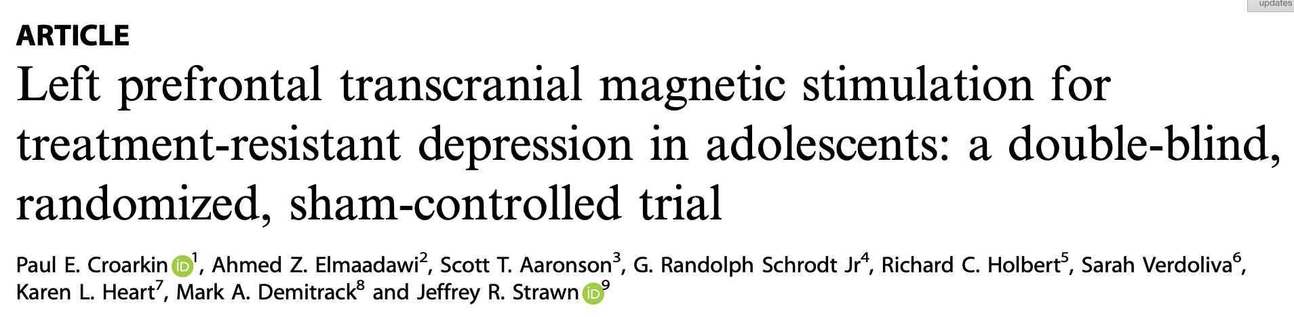

RCT evidence
monotherapy
adolescents (mean age ~17.5)
treatment-resistant depression (most w/ multiple failed antidepressant trials)
n $≈$ 50 in each group

Slide 11
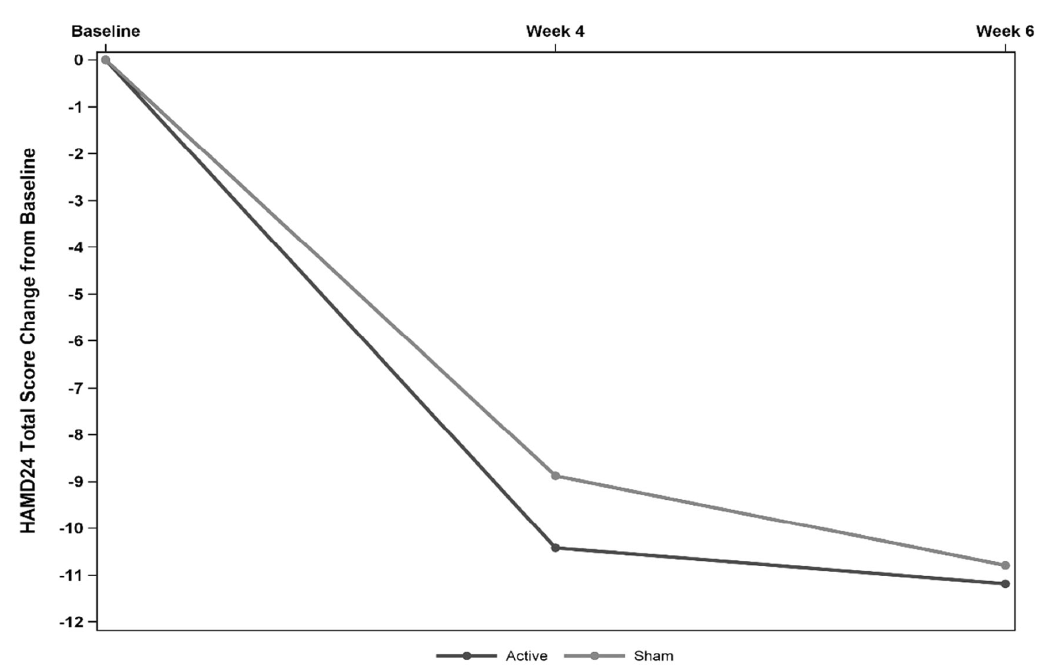
Results

Slide 12
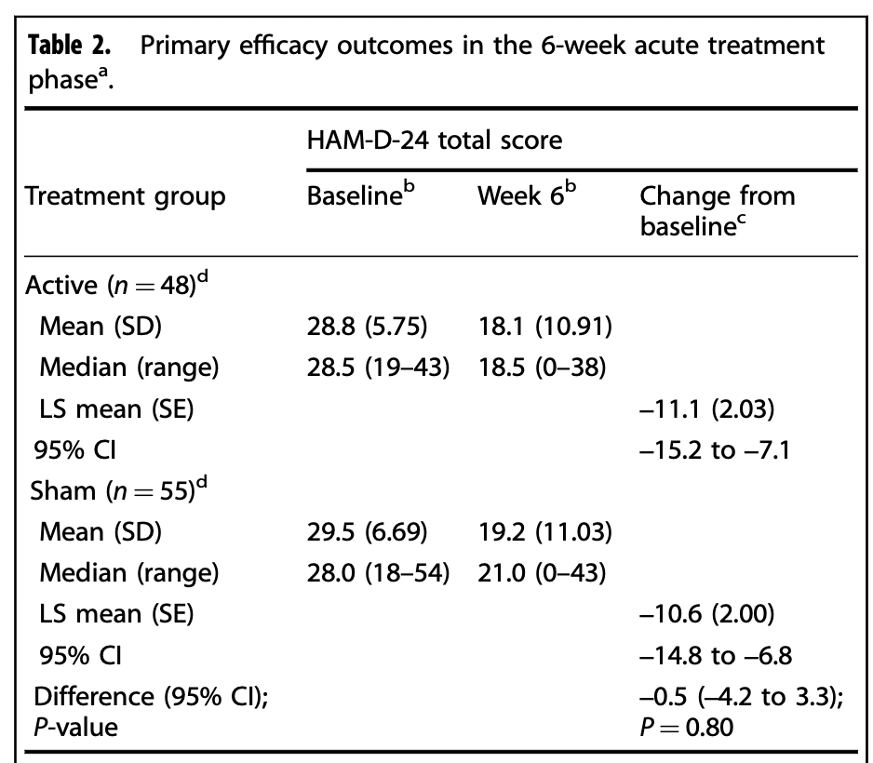

Slide 13
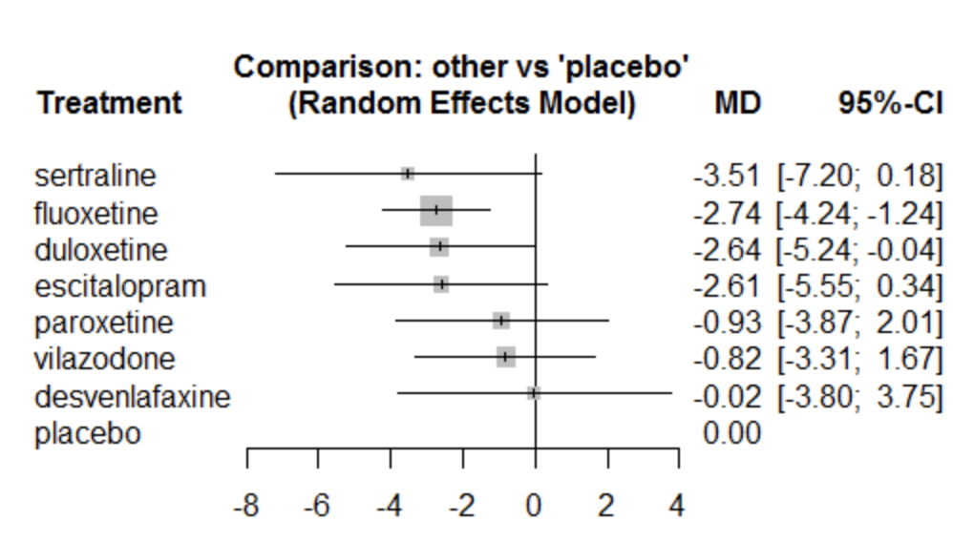
Reminder: SSRI effect sizes
Forest plot from Cochrane review

Slide 14

Power?!?!?!?
Rule of thumb: $n≈16/d^{2}$
SSRIs reduce CDRS by ~2 points, d $≈0.2$
suggests reasonable sample is n = 400 per arm

Slide 15
4. Obligatory speculation about the future
Lots of variation in technique – frequency, targeting w/ fMRI, SAINT protocol in adults
Lots of trials in China in the past couple years

Slide 16
Summary
TMS as currently implemented probably doesn’t have specific benefits for DSM IV/5 “major depressive disorder” on average in adolescents
Maybe it does in specific subpopulations or maybe it will with protocol changes
The government will still spend your tax $s on it

