Slide 1


Sources: OHSU.edu
BestNeighborhood.org (from ACS data?)

Slide 2
Are the recommended screening tools for adult ADHD useful?
Steve White
2/20/25

Slide 3



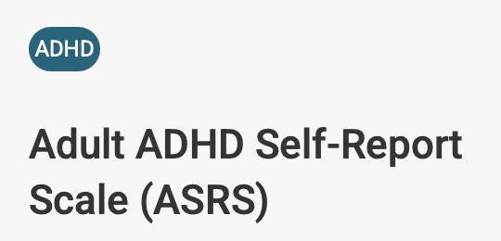

Recommendations
AAFP: many
WHO: ASRS
Big APA: ASRA
Little APA: ASRA
Notes:
Organization logos from their websites, www.apa.org and www.psychiatry.org

Slide 4
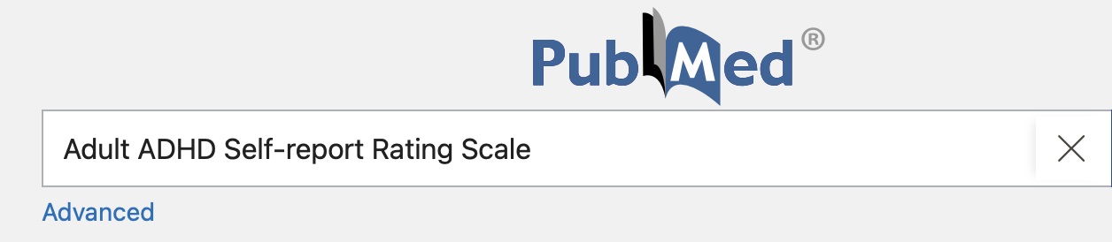
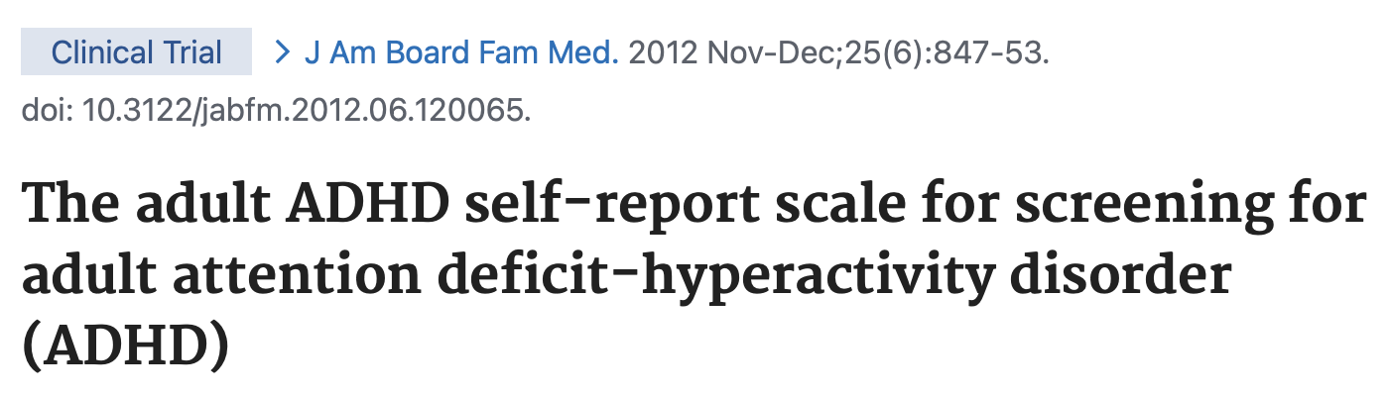
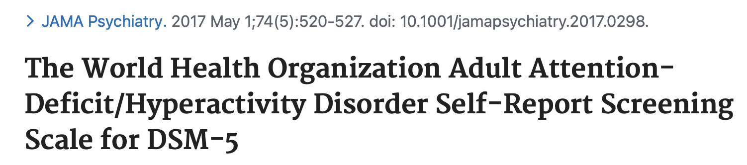

Slide 5
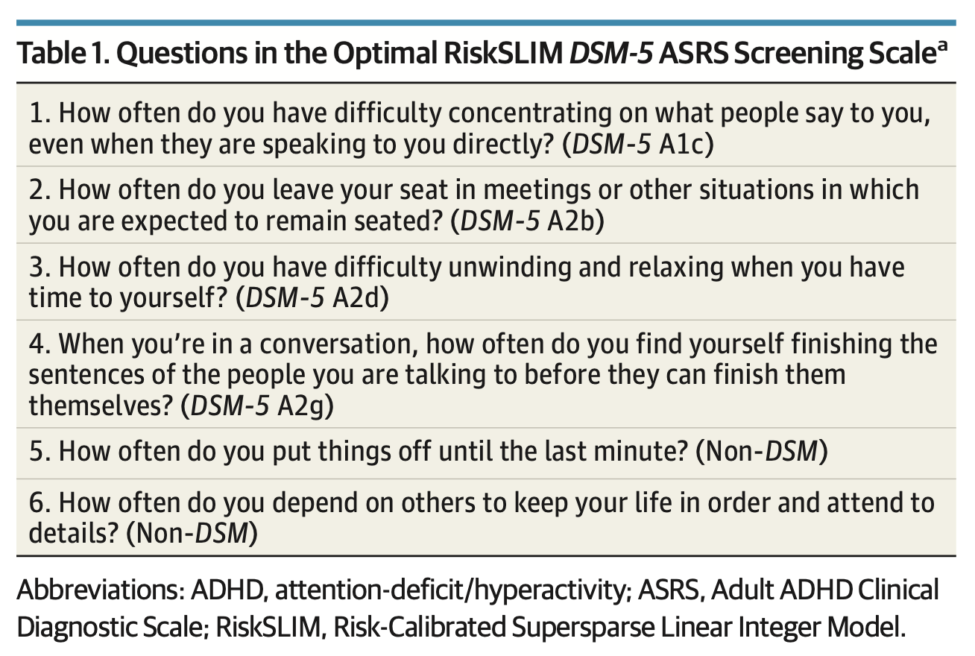
Response options are “never,” “rarely,” “sometimes,” “often,” and “very often.” maximum score = 25 points

Slide 6
Receiver Operating Characteristic Curve
random
guessing
perfect
test

Slide 7
Receiver Operating Characteristic Curve
cutoff | sensitivity | specificity
13 | 93.1% | 63.0%

Slide 8
Receiver Operating Characteristic Curve
cutoff | sensitivity | specificity
14 | 91.9% | 74.0%

Slide 9
Receiver Operating Characteristic Curve
cutoff | sensitivity | specificity
15 | 89.0% | 81.1%

Slide 10
Receiver Operating Characteristic Curve
cutoff | sensitivity | specificity
16 | 82.7% | 86.6%

Slide 11
Receiver Operating Characteristic Curve
cutoff | sensitivity | specificity
17 | 76.3% | 92.9%

Slide 12
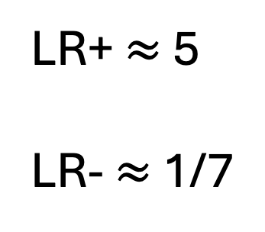
Receiver Operating Characteristic Curve
cutoff | sensitivity | specificity
15 | 89.0% | 81.1%
best
cutoff
LR+ $≈$ 5
LR- $≈$ 1/7

Slide 13
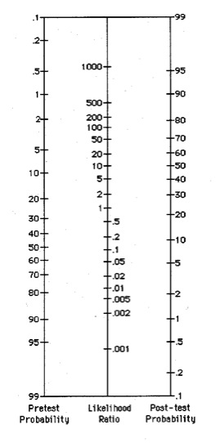
Screen (-):
Pretest Pr() = 20%
Postpost Pr = 3.4%
Source: Queen’s College SOM, healthsci.queensu.ca

Slide 14
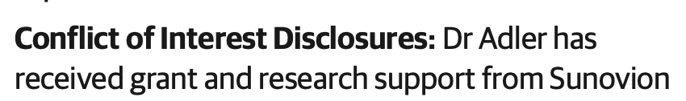

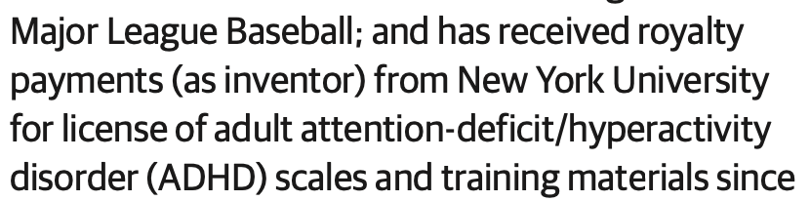
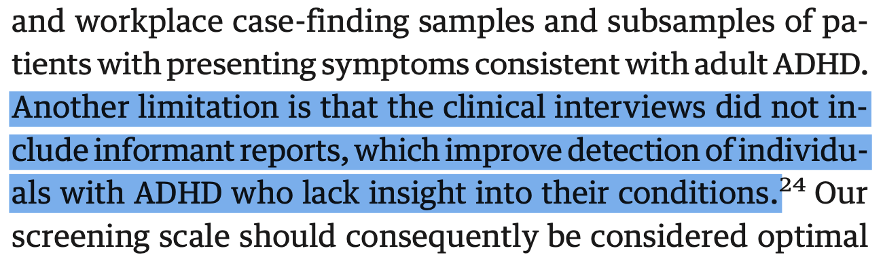
Limitations
1. Conflicts of interest?
2. No collateral informants
. . .

Slide 15
Is the ARSA screener
Are recommended screening tools for adult ADHD useful?
Maybe, but I’m skeptical
Notes:
Stamp: https://www.qclabels.com/rejected-date-inspection-self-inked-stamp/sku-is-0114
Block: https://cdn.nba.com/teams/legacy/www.nba.com/nuggets/sites/nuggets/files/52563801_10.jpg
Mutumbo gloating: https://www.basketballnetwork.net/.image/t_share/MTg3MTYwOTUzNDIzNDcyNTI2/dikembe-1.jpg

Slide 16
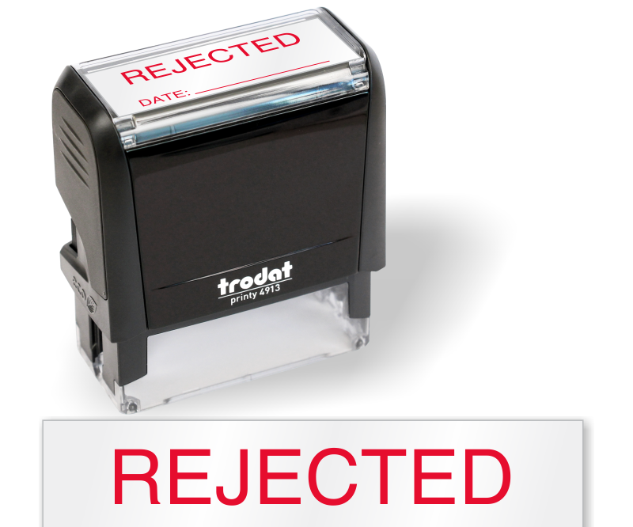

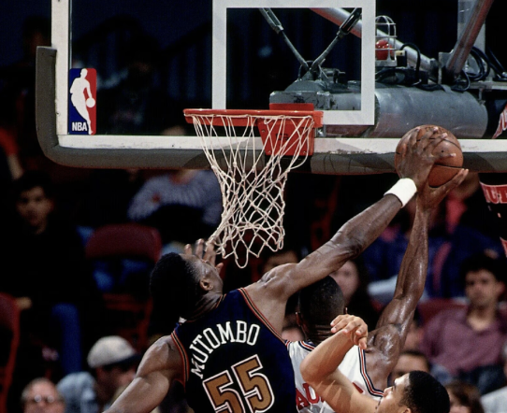
Is the ARSA
Are recommended screening tools for adult ADHD useful?
Notes:
Stamp: https://www.qclabels.com/rejected-date-inspection-self-inked-stamp/sku-is-0114
Block: https://cdn.nba.com/teams/legacy/www.nba.com/nuggets/sites/nuggets/files/52563801_10.jpg
Mutumbo gloating: https://www.basketballnetwork.net/.image/t_share/MTg3MTYwOTUzNDIzNDcyNTI2/dikembe-1.jpg

