Slide 1
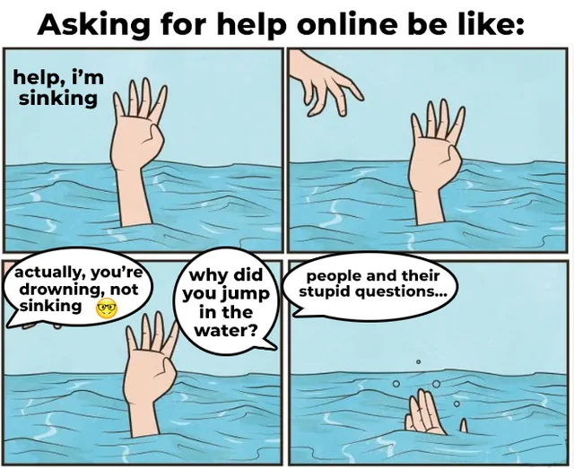
you
me
questions
are also
appreciated

Slide 2
NEURO709A Case Presentation
Steve White
9/11/26

Slide 3
HPI: ~40yo F post-op day 0 from o/p L vocal cord repair
CC: left arm and leg weakness, double vision, can't swallow, can't walk
diplopia = at rest, worse looking R or L, maybe worse at night
mouth = tried to eat toast, chew ok, can’t swallow
symptoms present most of the time, just worse in flares, uses walker
thinks “uncontrolled pain” (6/10 s/p IV hydromorphone) and being “freaked out” from being awake during the surgery contributed
onset in 2023
PMH: ____, ____, idiopathic urinary retention, chronic abdominal pain, PTSD 2/2 hx abuse, 2x SA, hx NSSI, hx recurrent syncope, esosinophilic esophagitis, asthma
Meds: buprenorphine for bladder spasm, _____, ______, duloxetine, dupilumab, gabapentin, omeprazole
SHx: former physical therapist FHx: unremarkable

Slide 4
Exam:
CN: can’t elevate eyes, no ptosis, no deconjugate gaze, no dysarthria, voice is a little hoarse
motor: 4/5 L UE, ~5/5 LLE, o/w 5/5, give-way weakness on L elbow extension
reports fatigue doing repetitive arm abduction within ~10s, bl UE strength 4/5 afterward
sensory: unremarkable
reflexes: 3+ bilaterally in the five common spots, no clonus, Babinski (-), Hoffman (-)
other: single breath count = 12
SLP cleared for regular diet after their exam

Slide 5
Labs/Imaging:
MRI spine and brain: unremarkable (done in 2023)
What other tests do you want?
Serologies: MG panel (AchR, MusK, etc) – negative
Voltage-gated Ca channel - negative
Repetitive Nerve Stimulation: (2023) L arm and leg – normal, no decrement
(2026) R arm and leg – normal, no decrement
MRI of chest to look for?
MRI for thymoma: c/w thymic hyperplasia
(Removed and pathology showed reactive hyperplasia)

Slide 6
Localization / DDx
Cerebrum – MS
Cerebellum -
Brainstem – stroke, MS/NMO
Cord – MS/NMO
Nerve roots/plexus -
Peripheral nerves -
NMJ – myasthenia gravis, LEMS
Muscles -
Systemic – gabapentin toxicity
Other?
functional neurologic disorder

Slide 7
More history:
Dx functional neurologic d/o by neurologist in 2024
Dx seronegative MG after that by a naturopath(?)
recurrent admission for respiratory crisis
- low SBC, NIFs
- always good pCO2 on ABG
- vocal cord damage the surgery was for
was iatrogenic, from an intubation
pyridostigmine helped, then didn’t per chart hx
IVIG caused “rapid” improvement, but “wears off”
initial presenting sxs in 2023 included L leg sensory loss, didn’t have diplopia

Slide 8
10-minute FND crash course
Notes:
Roughly 8-10 minutes. Three questions. Warn them up front that the science section is "real but modest" so nobody senior objects.

Slide 9
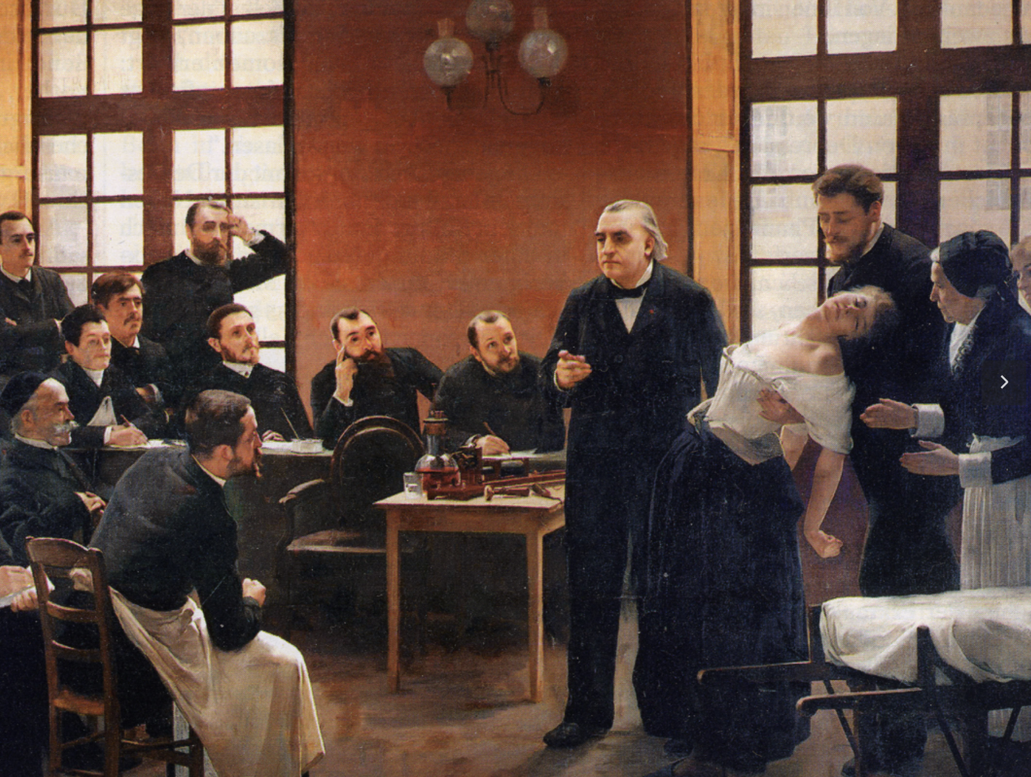
Old view: “hysteria” → “conversion”
Charcot → Freud
an unbearable event or wish gets “converted” into a body symptom
classic example: catch your spouse in bed with someone → go blind
treatment: hypnosis
Espay et al., JAMA Neurology 2018;75:1132–1141
Notes:
Briquet showed prior abuse raised the risk; Freud moved the focus from events to repressed (usually sexual) wishes "converted" into symptoms. The old model never explained how a wish becomes a weak leg, why the same exposure gives different people different symptoms, the long latency, or the many patients with no event at all. Room for a Charcot/Salpetriere image here if you want one.

Slide 10
New view (in DSM 5)
a psychological stressor often not present, so not required (physical injury may be more common precipitant, Stone 2009)
Dx focuses on positive signs to rule in (not just a “diagnosis of exclusion”)
Also possible to have FND and organic disease together
(10-20% or more of patient with epilepsy have PNES in some samples)
But . . . childhood emotional neglect (OR = 5.6), physical abuse (OR 3.9), and sexual abuse (3.3) are still risk factors.
Ludwig et al., Lancet Psychiatry 2018;5:307–320 (meta-analysis, 34 case-control studies, 1,405 patients, Stone et al., J Psychosom Res 2009;66:383–390)
Notes:
Ludwig 2018 is the definitive risk-factor dataset (Edinburgh group; Stone and Nicholson senior authors). Childhood emotional neglect OR 5.6, physical abuse OR 3.9, sexual abuse OR 3.3, stressful life event in the year before onset OR 2.8. Two points beat any single number: all 13 studies that specifically screened found patients with no stressor (range 0-77%), and against psychiatric rather than healthy controls the effect drops from OR 8.6 to OR 2.0 -- adversity is a general psychiatric risk factor, not something specific to FND. That is why DSM-5 dropped the requirement.

Slide 11

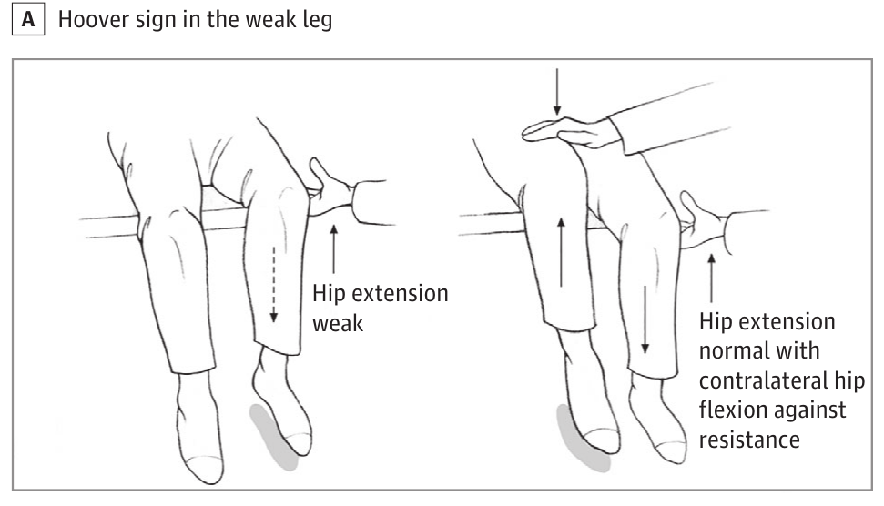
Example (+)-sign
voluntary pathway: “weak”
automatic pathway: normal
Espay et al., JAMA Neurology 2018 (Figure A)

Slide 12
Other positive “signs”
Normal function (e.g. strength, movement) seen
- often when patient is distracted
- e.g. demonstrates strength with habitual movements like adjusting in bed
Abnormal movements worsen when attended to
Anatomic incoherence
e.g. numb from wrist forward, fingers weak
High variability, e.g. inconsistent performance, give-way weakness

Slide 13
Pertinent Positives for FND | Pertinent Negatives against MG (or other “organic”)
strength ≈ normal on exam, but can’t walk without a walker (impairment ≪ disability) SBC = 12 between extended of fluent speech give-way weakness; “fatigue” reported before any decrement “can’t swallow” → SLP: regular diet worse with pain and fear | no ptosis 4 antibodies negative; RNS normal ×2 pyridostigmine failed; worse on IVIG / steroids / azathioprine MRI brain + spine normal → not MS / cord

Slide 14
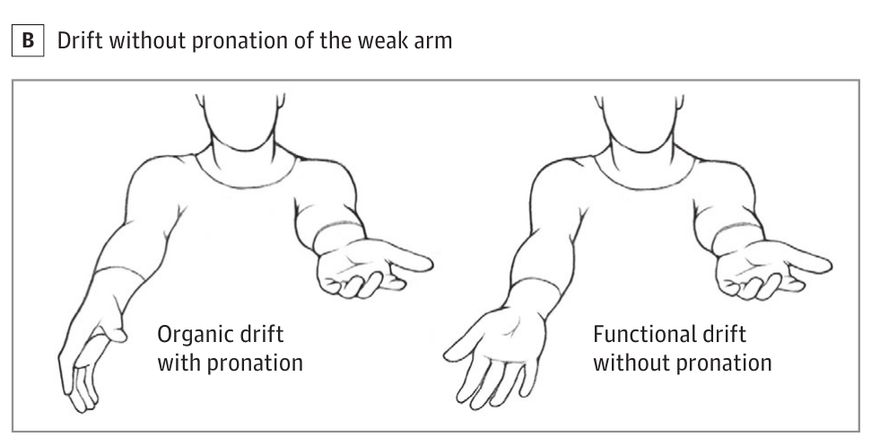
How good are the signs?
Good in some small studies:
sign | sensitivity | specificity
Hoover’s sign | 63% | 100%
hip abductor sign | 100%* | 100%*
drift without pronation | 100% | ~93%
Honest answer:
¯\_(ツ)_/¯
Daum et al., JNNP 2014;85:180–190 (systematic review) · McWhirter 2011 · Sonoo 2004 · Daum & Aybek 2013 · figure: Espay 2018

Slide 15
Pathophysiology
Not much is known reliable.
Limitations of almost the entire literature:
1. small samples so lots of false positives, poor replication
2. data is not pre vs post comparisons (hard to infer causes)
3. debatable controls: functional tremor should be compared with other tremor
FND imaging “continues to lag behind other prevalent neuropsychiatric disorders” — Perez et al. 2021
Perez et al., NeuroImage Clin 2021;30:102623 · Bègue et al., NeuroImage Clin 2019 (“a software and hardware problem?”) · Hallett 2022
Notes:
Say this plainly and nobody senior will object -- it is the field's own audit. The useful takeaway: the model is coherent and partially tested (it predicted the loss of sensory attenuation and intentional binding before they were measured), but it is a maintenance account with no biomarker, no causal account of onset, and no mechanism-targeted therapy.

Slide 16
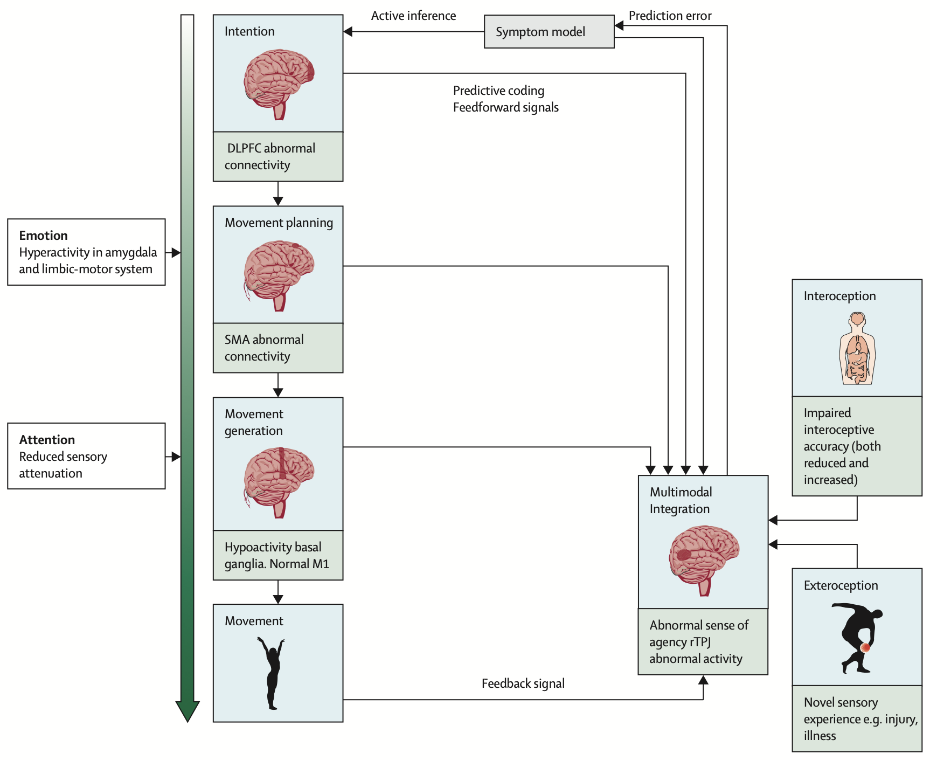
Hallett et al. (2022)’s very busy model

Slide 17
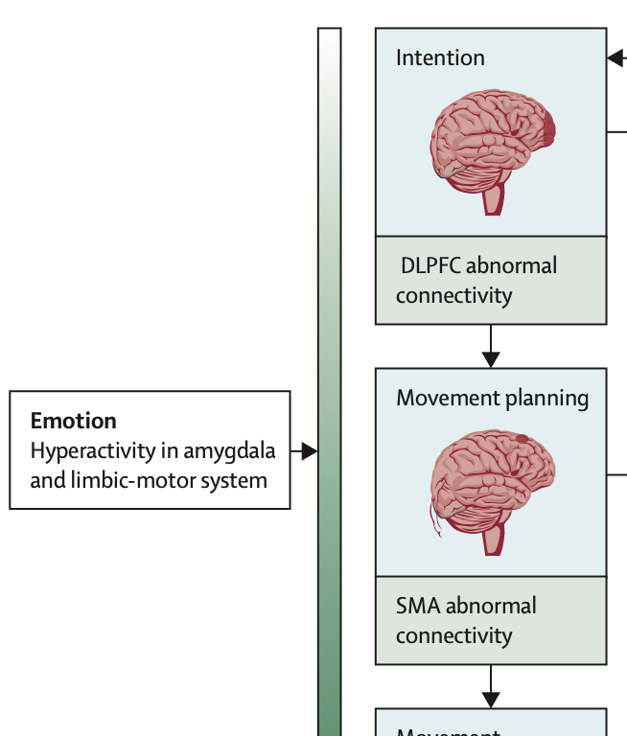
1. limbic -> supplementary motor area connections are stronger in FND

Slide 18
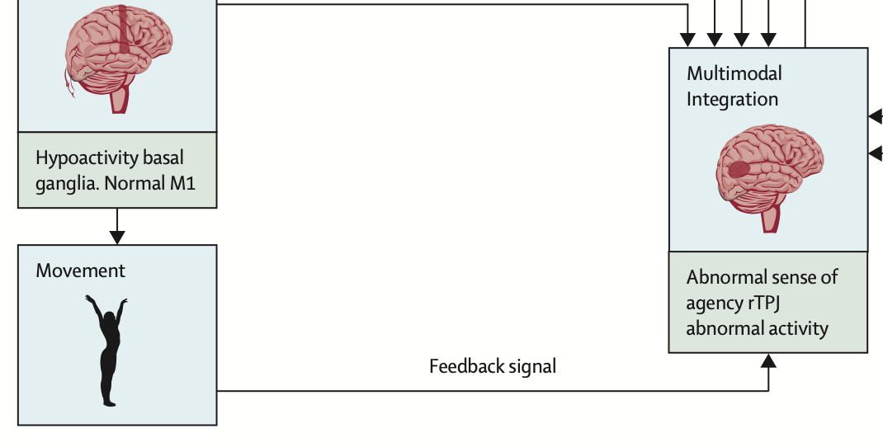
2. “did I do that?” detector (rTPJ) less active

Slide 19
science → treatment?
finding | treatment
limbic system over-active | benzos?
rTPJ / agency offline | TMS to the rTPJ?
better with distraction | cognitive and PT approaches
note: no drugs shown to help!
Espay 2018 · Bennett/Stone 2021 · Pollak et al., JNNP 2014 (TMS: effects likely cognitive-behavioural, not cortical)
Notes:
The joke is on purpose: the naive mapping from finding to drug is exactly what the field warns against. Benzodiazepines, gabapentinoids and opioids are the drugs FND clinics most often taper. TMS: small, mostly unblinded studies that cannot separate cortical from expectation effects.

Slide 20
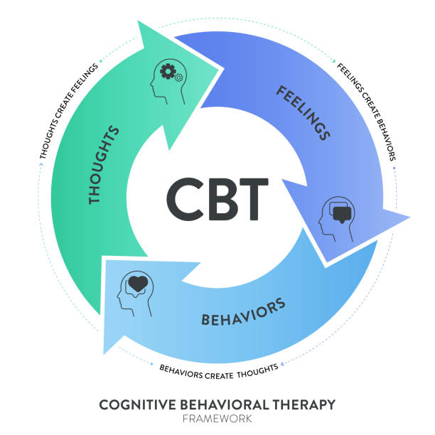
More on CBT/PT
1. Cognitive: show patient (e.g. on video) their muscles work
2. Exercises where they practice while distracted or using “new” movements
- “get the milk” instead of “walk to fridge” or “move that leg”
3. Behavioral experiments: Recognize catastrophic thinking (“I will fall”) and then test prediction
Source: Clinical Psychologist Newcastle
Notes:
Nielsen 2015 consensus: retrain automatic rather than consciously controlled movement; external goal focus; weight-shifting before complex movement; novel movements access normal patterns; video/mirror feedback; avoid the aids and guarding that reinforce the symptom model. The sequence: demonstrate normal movement is accessible -> reduce attention/threat/avoidance -> practise automatic movement -> generalise to daily life.

Slide 21
Evidence on treatment efficacy
Physio4FMD (Nielsen et al., Lancet Neurol 2024)
treatment | specialist physio, 9 sessions + follow-up
control | referral to community neuro-physio
primary: SF-36 physical function, 12 mo | +3.5 (95% CI −2.3 to 9.3), p = 0.23
secondary: “my symptoms improved” | OR 2.3 (1.4–3.9) favoring specialist PT
Nielsen G, et al. Lancet Neurology 2024;23:675–686 (PMID 38768621)
Notes:
Glenn Nielsen (physiotherapist-researcher, St George's London) with Edwards, Stone and Carson -- the field testing its own consensus protocol. 179 specialist vs 176 TAU; 89 excluded for pandemic interruption; primary analysis 138 vs 103. Primary null. Secondaries favoured specialist PT: self-rated improvement OR 2.3, SF-36 mental health +5.4 (0.9-9.8), more confidence in the diagnosis; post hoc 49% vs 38% gained >=10 points. The CI excludes a large effect on physical function but not a modest one. Honest summary: specialist PT was not better than generic PT on physical function at a year, but patients felt more improved.

Slide 22
“Is she faking?”
no clinical test can distinguish malingering from FND
You can’t read people’s minds.
Prognosis for FND is terrible: 40% no improvement @ 7 year f/u
only 20% with remission
be nice
Gelauff et al., JNNP 2014;85:220 · Gelauff et al., Brain 2019;142:2137 · Sharpe et al., Psychol Med 2010;40:689

Slide 23
Summary
FND is ruled in on the exam (inconsistency, incongruence) although in practice you also evaluate other causes and try to rule them out
the science is in early stages, it has identified was candidate connections and regions that seem important
treatment is with a combination of psychotherapy and physical therapy techniques that help people access their (in principle working) motor areas, often by helping them distract themselves while they practice using these areas of their brain
Notes:
Close by pointing back at the room: they re-ran the chart's reasoning in fifteen minutes and got to the right answer; her doctors took two years and a thymectomy.

