Slide 1
Cobenfy
Steve White
8/22/25

Slide 2
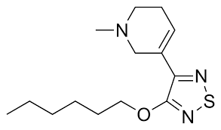
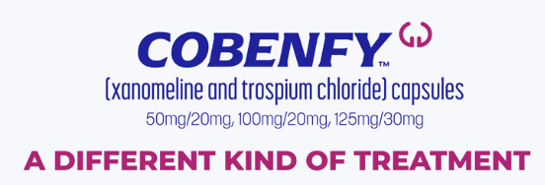
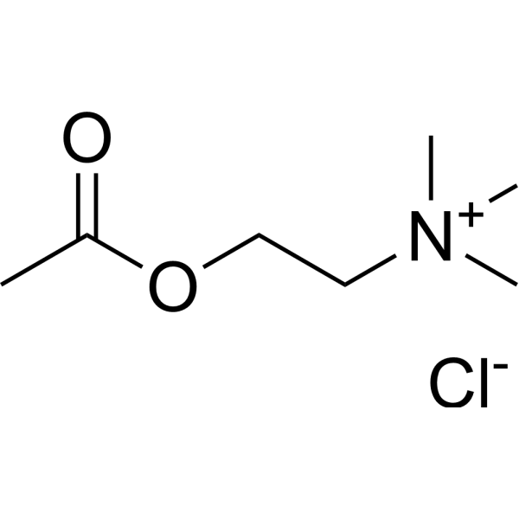
Background
FDA approval 9/26/2024
xanomeline
ACh

Slide 3
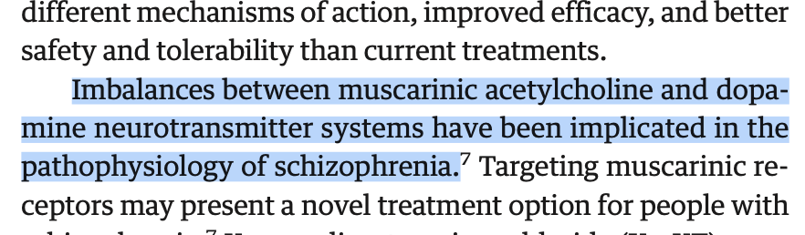
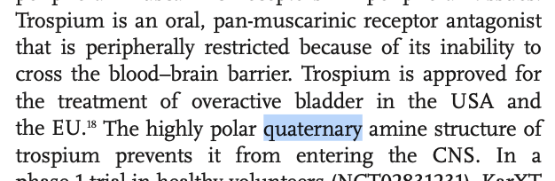
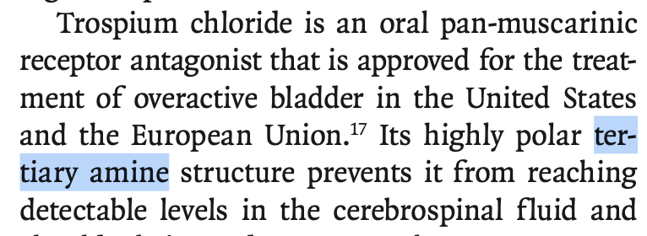
new antipsychotic class
preferential M₁, M₄ binding in CNS
Why combine with trospium?

Slide 4
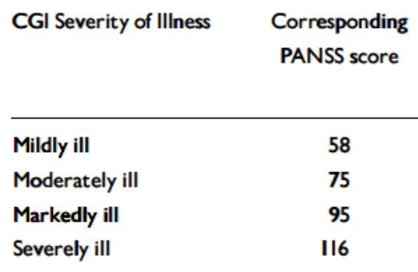
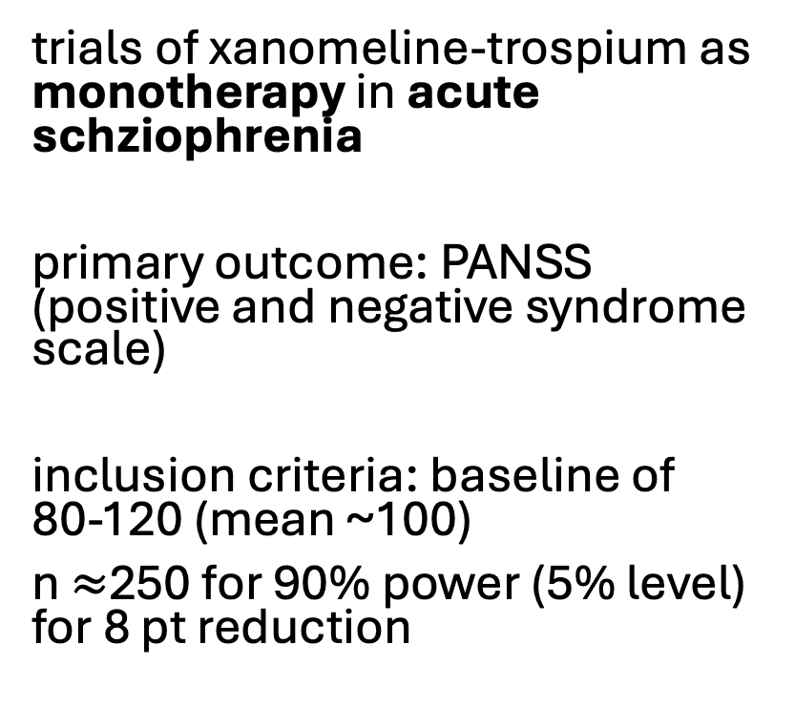
Trials EMERGENT 2 and 3 (similar)
trials of xanomeline-trospium as monotherapy in acute schziophrenia
primary outcome: PANSS (positive and negative syndrome scale)
inclusion criteria: baseline of 80-120 (mean ~100)
n $≈$250 for 90% power (5% level) for 8 pt reduction
source: doi:10.1192/bjp.191.50.s7

Slide 5
trial quality
Good | Balance good (next slide) ITT Power OK
Bad
Unclear
“mixed model for repeated measures with likelihood based modeling to handle incomplete data . . . include[ing] terms for . . . treatment by visit interaction, site, . . . and baseline PANSS scores.”
monotherapy
attrition expected to be ~30% but <10%, similar by groups
“history of treatment resistance to antipsychotic medication were excluded”

Slide 6
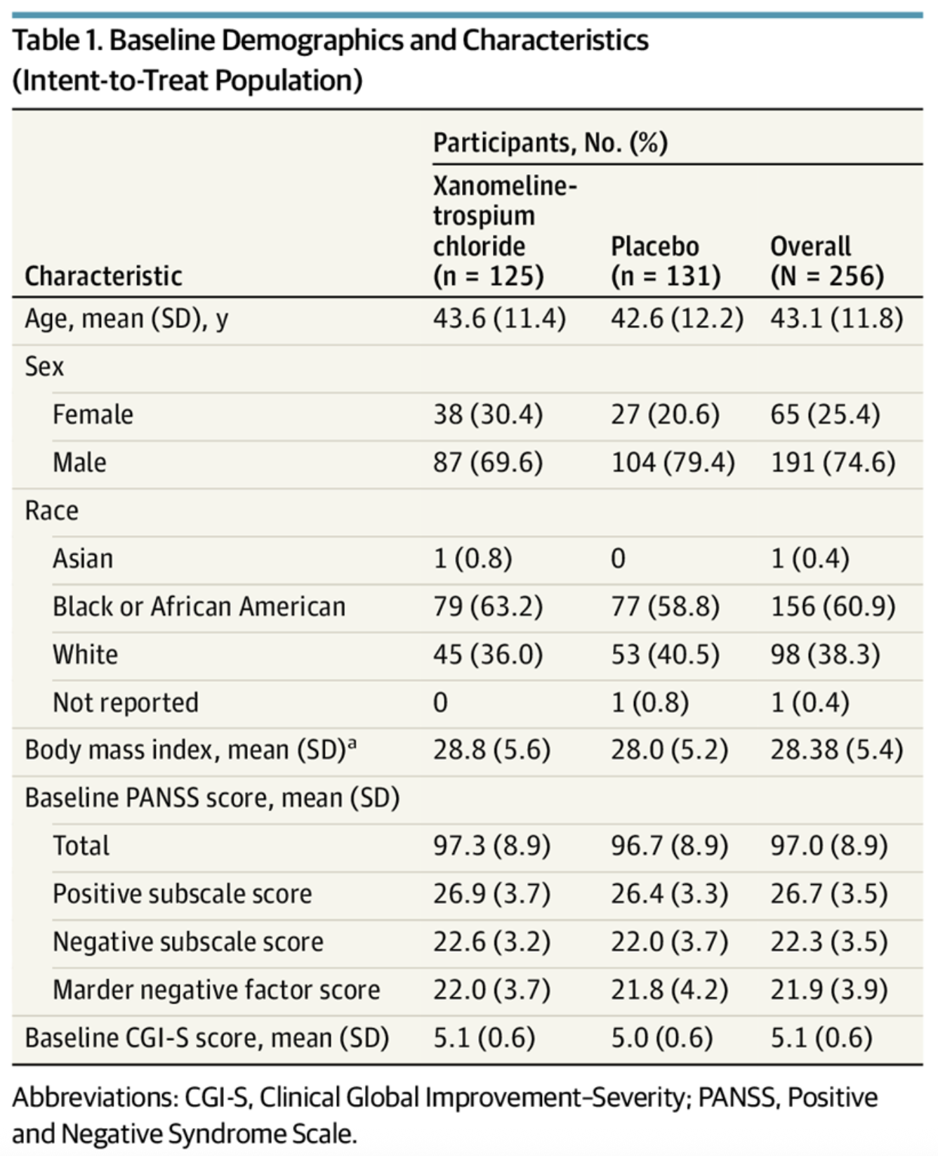
Balance Table
60% Black because of site locations

Slide 7
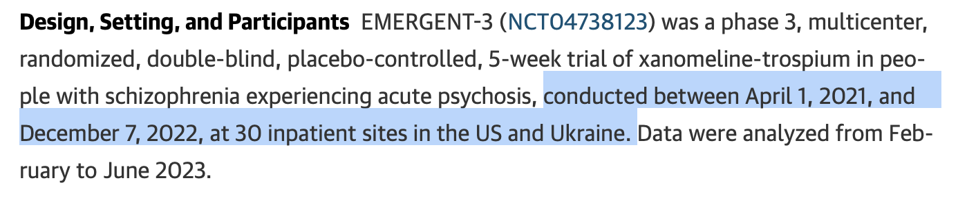
random

Slide 8
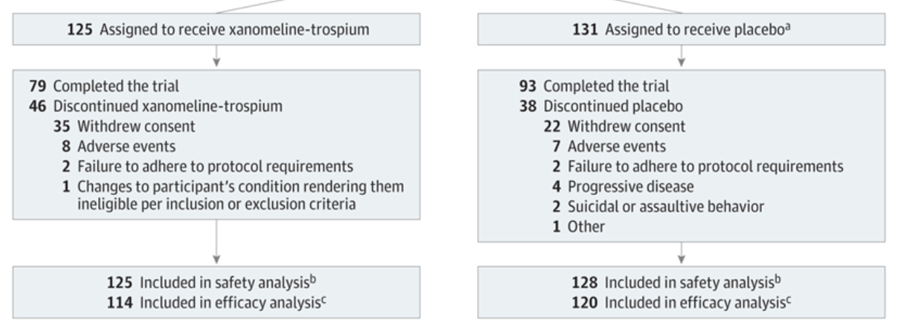
Attrition not that bad
8.8% vs 8.4%
But a lot of imputation/carry forward/modeling of what would have happened for people who discontinue

Slide 9
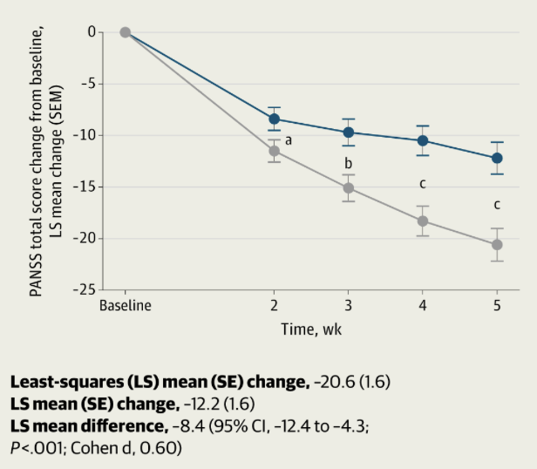
Results

Slide 10
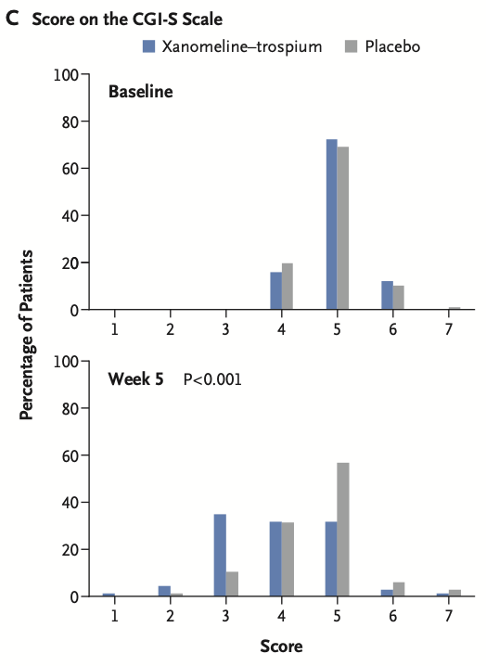
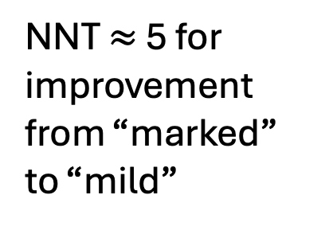
I like this POV
NNT $≈$ 5 for improvement from “marked”
to “mild”

Slide 11
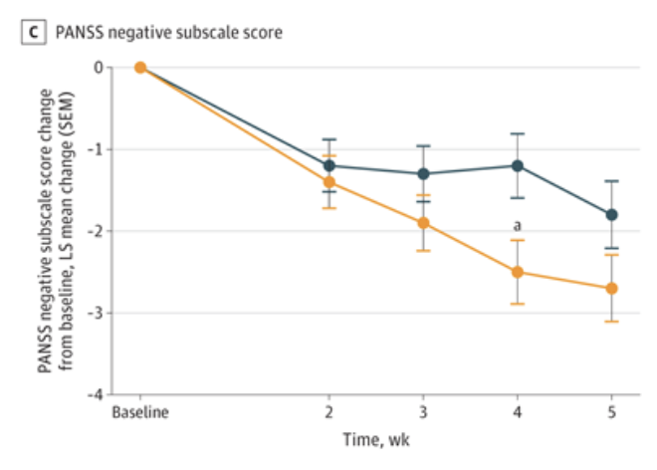
negative subscale

Slide 12
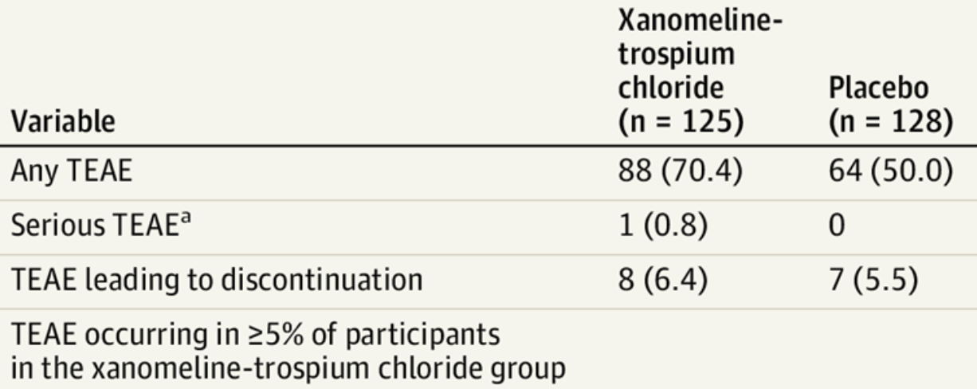
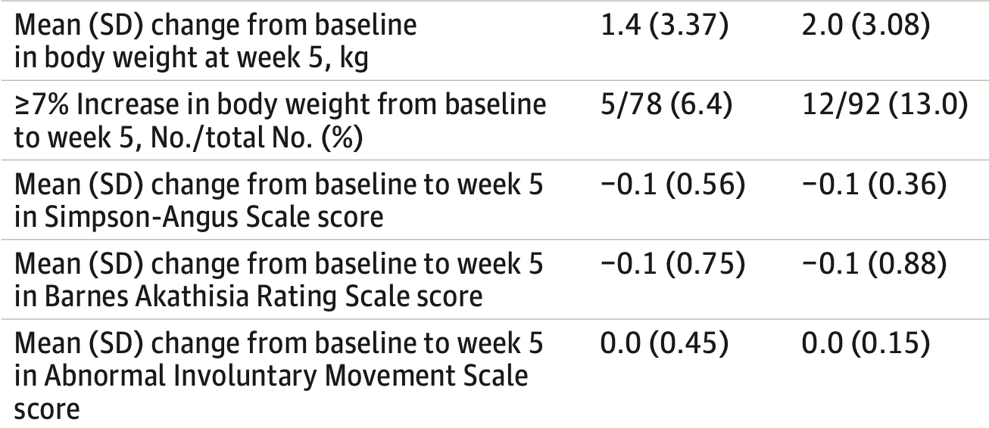
tolerability
(for EPS)
(for TD, confused about this)

Slide 13
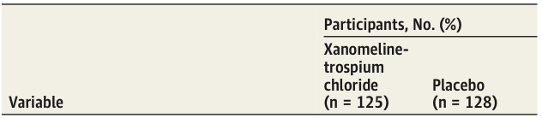
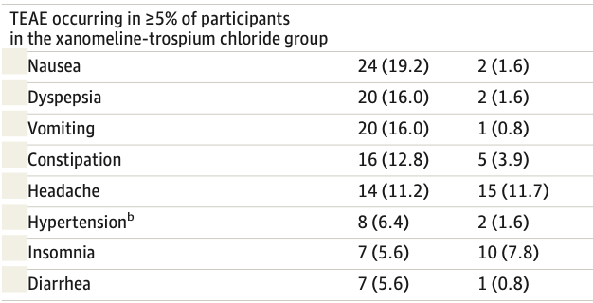
random anticholinergic SE

Slide 14
open questions
long term outcomes?
effects in combination w/ other drugs?
helpful if traditional antipsychotics fail?

Slide 15

should it be on formulary?
effect size: 8 pts, d = 0.6
big? small?
Cost $≈$ $20,000/year
should it be on formulary?
DALY = 16 hours/day x 365 days x $40/hour = $233,600
Common disability weights for psychotic d/o ~0.6
severe vs mild reduction of 0.2?!!??!
benefit = 0.2 x $233,600 = $46,720 so benefit > cost

Slide 16
