Slide 1
Triads e Pepe

Slide 2
What this talk is About
Use KDB+/Q for generating jazz music (lines)
based on George Garzone’s concepts
Inputs are a few musical parameters
  Starting note
  Triad Quality
  Step
  How many triads in the output
outputs midi files

Slide 3
Who I Am
Steve Wirts
  Software developer 25 years in NYC area
  KDB/Q+, Java, Javascript, Smalltalk
  Currently at Virtu

Slide 4
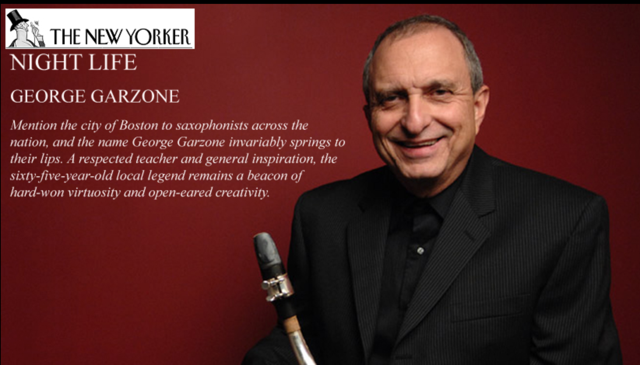
George Garzone
elite world renown jazz musician (saxophone)
currently faculty at Berkelee
historically significant jazz innovator

Slide 5

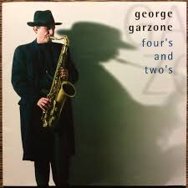



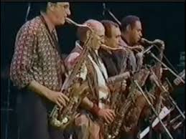
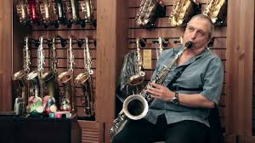
George Garzone

Slide 6
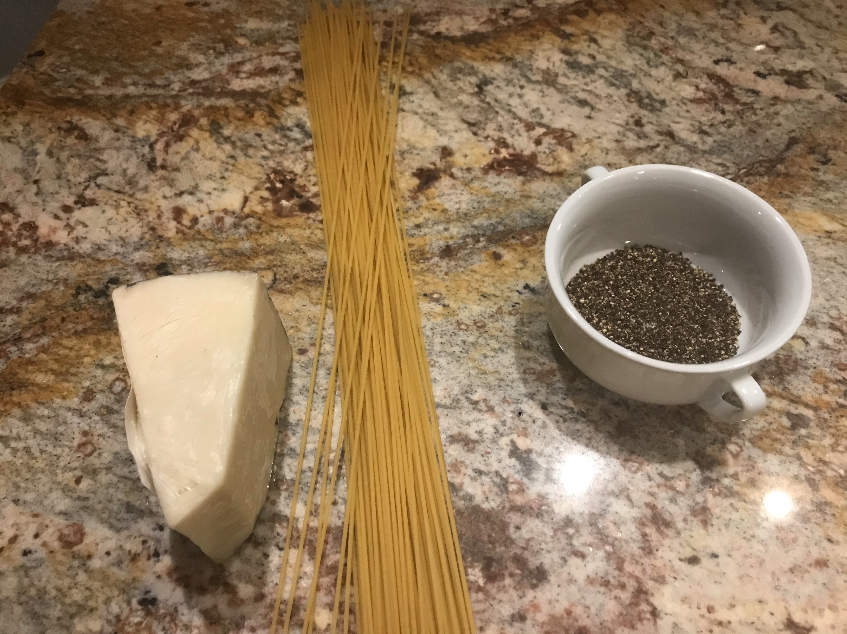
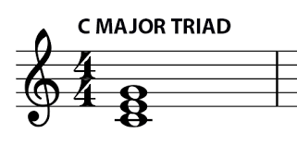
Triads e Pepe?
only 3 ingredients

Slide 7
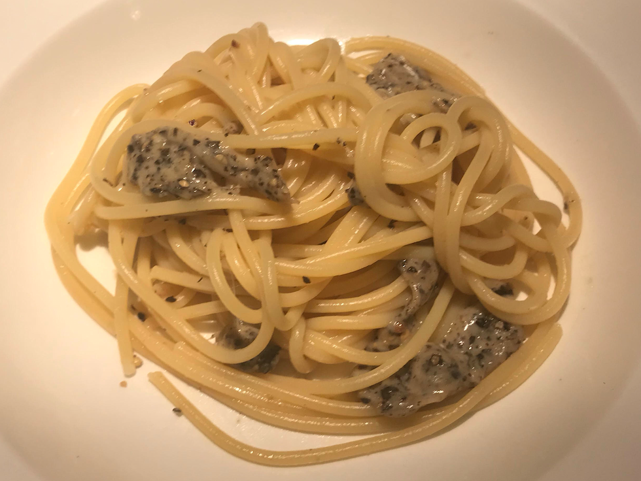
Cacio e Pepe
deceptively difficult to get just right

Slide 8
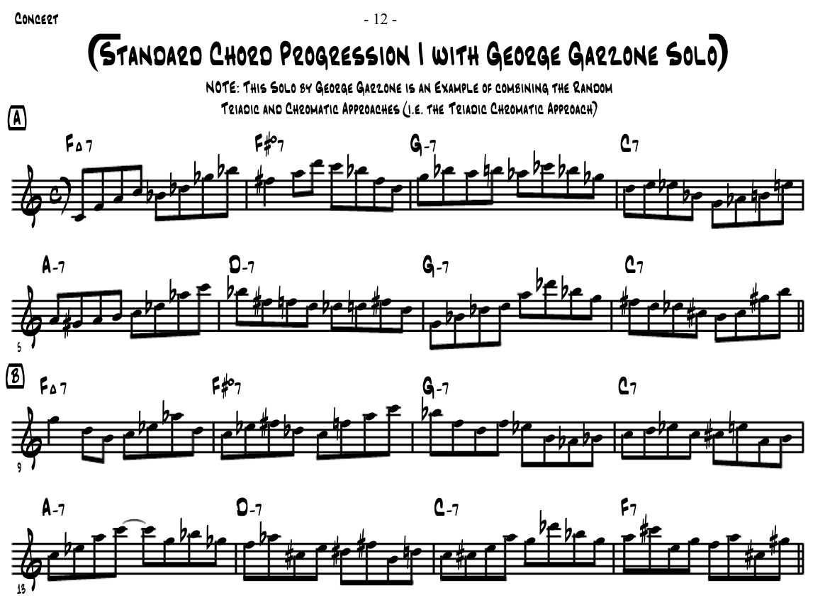
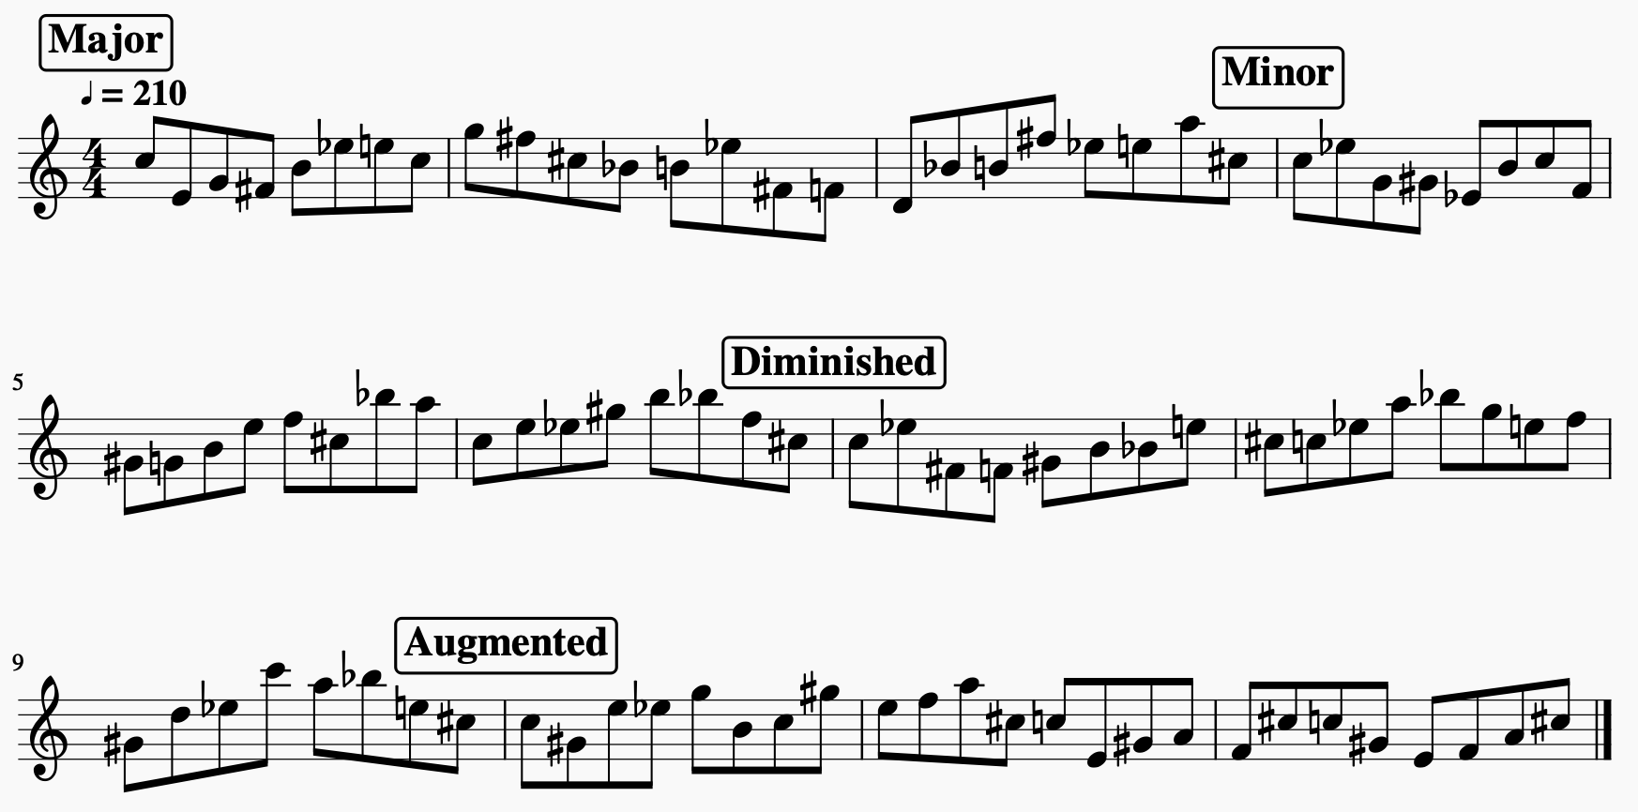
The “Sound”
*play both examples now

Slide 9
Towards an Algorithm
George developed this approach
  Over time starting in 1990s
  Listening to Coltrane
  Spark happened at an ear training class at NEC
Triadic Chromatic Approach
  Connect random triads of same quality
  Starting note offset by ½ step from previous note
  Avoid patterns
    don’t repeat inversions

Slide 10

Music Theory for Computer People
-octave is a scientific term
same note just “higher” sounding
  each octave is 2 * frequency of the next below
    C3 130.81Hz
    C2 65.41Hz
    C1 32.70Hz
    C0 16.35Hz

Slide 11

Music Theory for Computer People
Musical Instrument Digital Interface (midi)
  semitone (half step) is the atomic unit
  an octave has 12 semitones, music is base 12
  notes are integers between the audible lowest and highest notes

Slide 12
Music Theory for Computer People
Musical Instrument Digital Interface (midi)
  C is the name of the lowest note
    1 octave ((#)sharp (b)flat – ebony keys)
0 1 2 3 4 5 6 7 8 9 10 11 12
C (C# Db) D (D# Eb) E F (F# Gb) G (G# Ab) A (A# Bb) B C

Slide 13

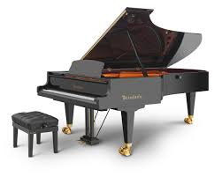
Music Theory for Computer People
A Quick note about range
  bosendofer imperial piano has 8.5 octaves 0 - 102
  midi accommodates 0 - 128
  western music, a practical range is 60 – 84 (0-24)
    2 octaves easy to read in sheet music, easy to play on saxophone

Slide 14
Music Theory for Computer People
an interval is a number of semitones (a distance) between 2 notes
a triad is a cluster of 3 notes - root, middle, top (2 stacked intervals)
4 basic triad “Qualities”

Slide 15
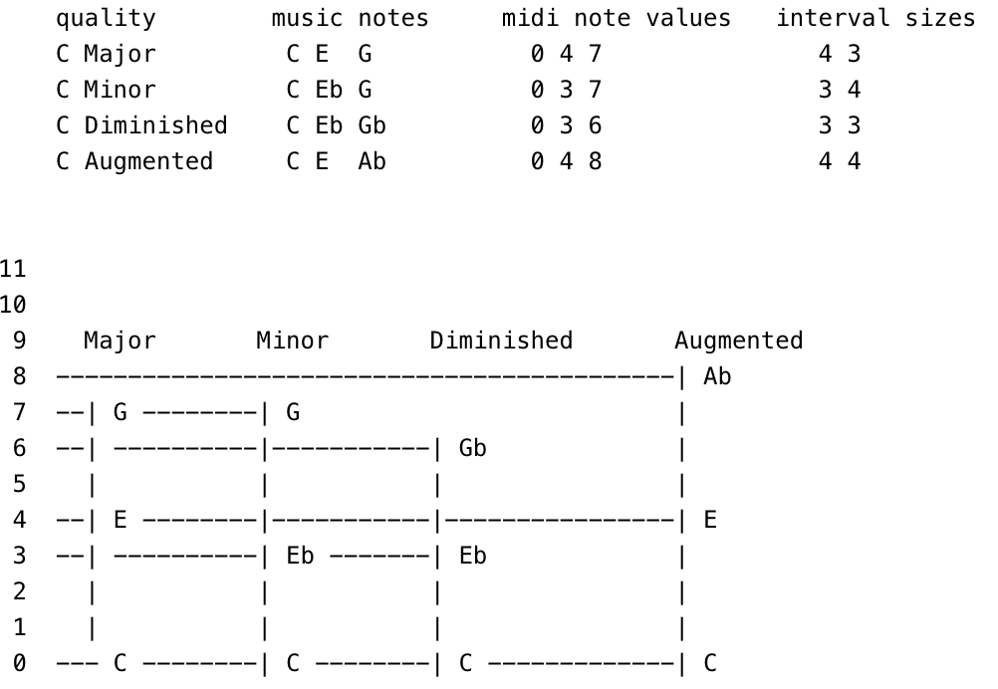
Music Theory Triads

Slide 16
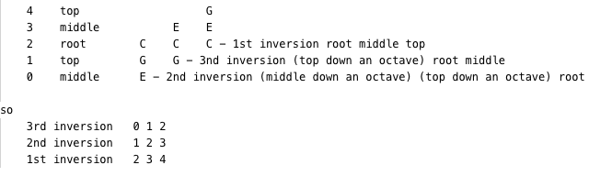
Music Theory – the Inversion
an inversion is when the notes of a triad are rearranged with respect to which one is on bottom
a triad has 3 notes so it has 3 possible inversions
three stacked inversions with the root as the middle note is called an INVERSION LADDER
  there are 5 notes in an inversion ladder
Critical to the epiphany

Slide 17
Computer Theory for Music People
computer people count things starting from 0

Slide 18
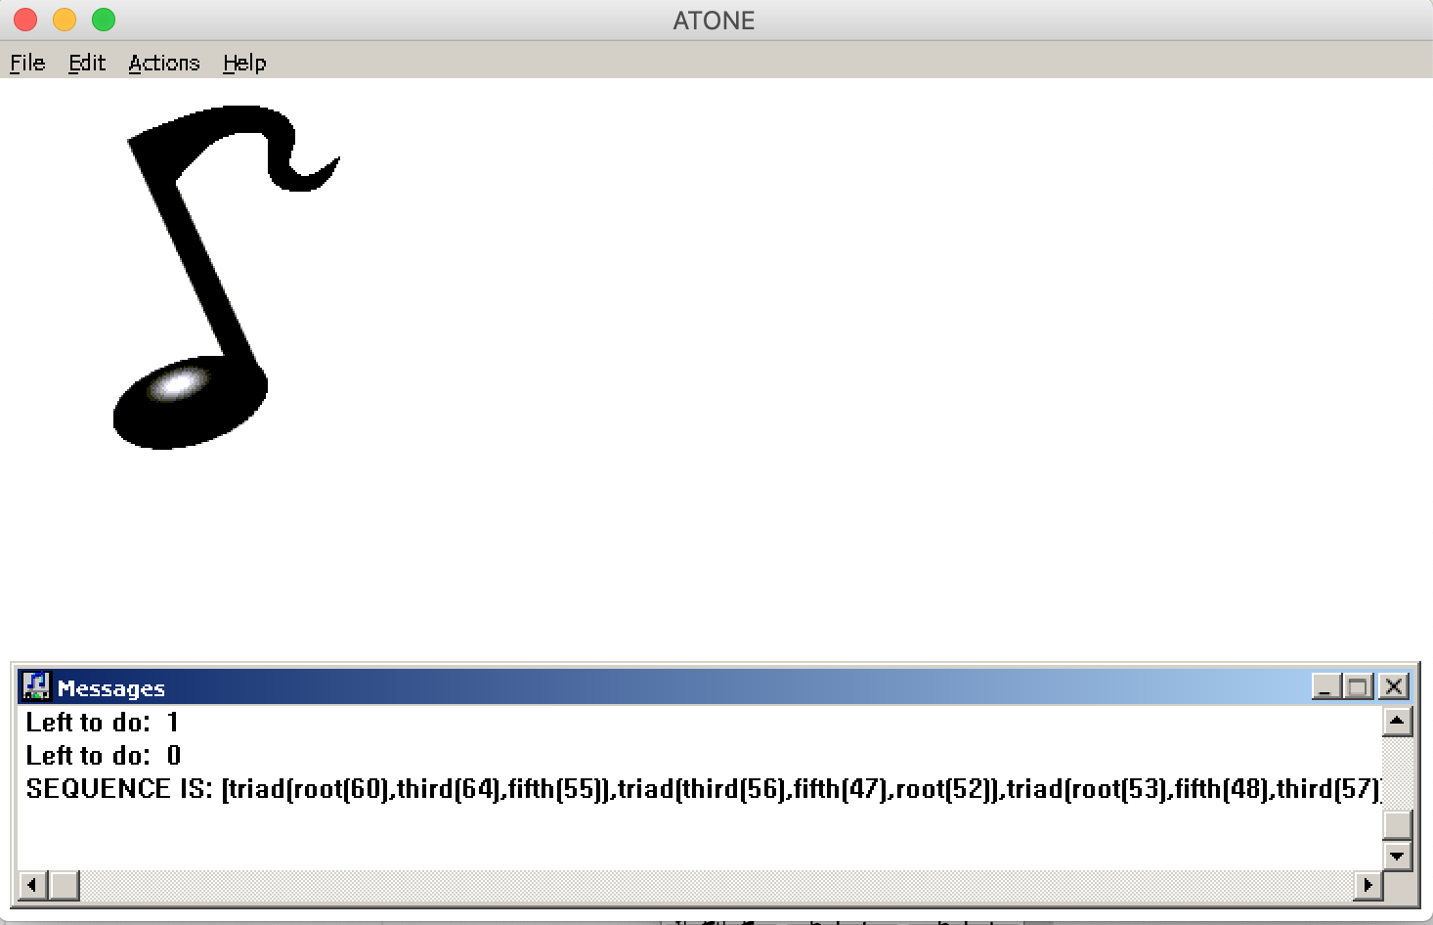
Try and Fail over the Years
England prolog version – late 1990’s
Java version early 2000’s
Finally got the algorithm right do it in KDB+/Q
  Q God Steve Apter: “get to the tiniest version of the algorithm that you can – you have to think really hard for awhile ”

Slide 19
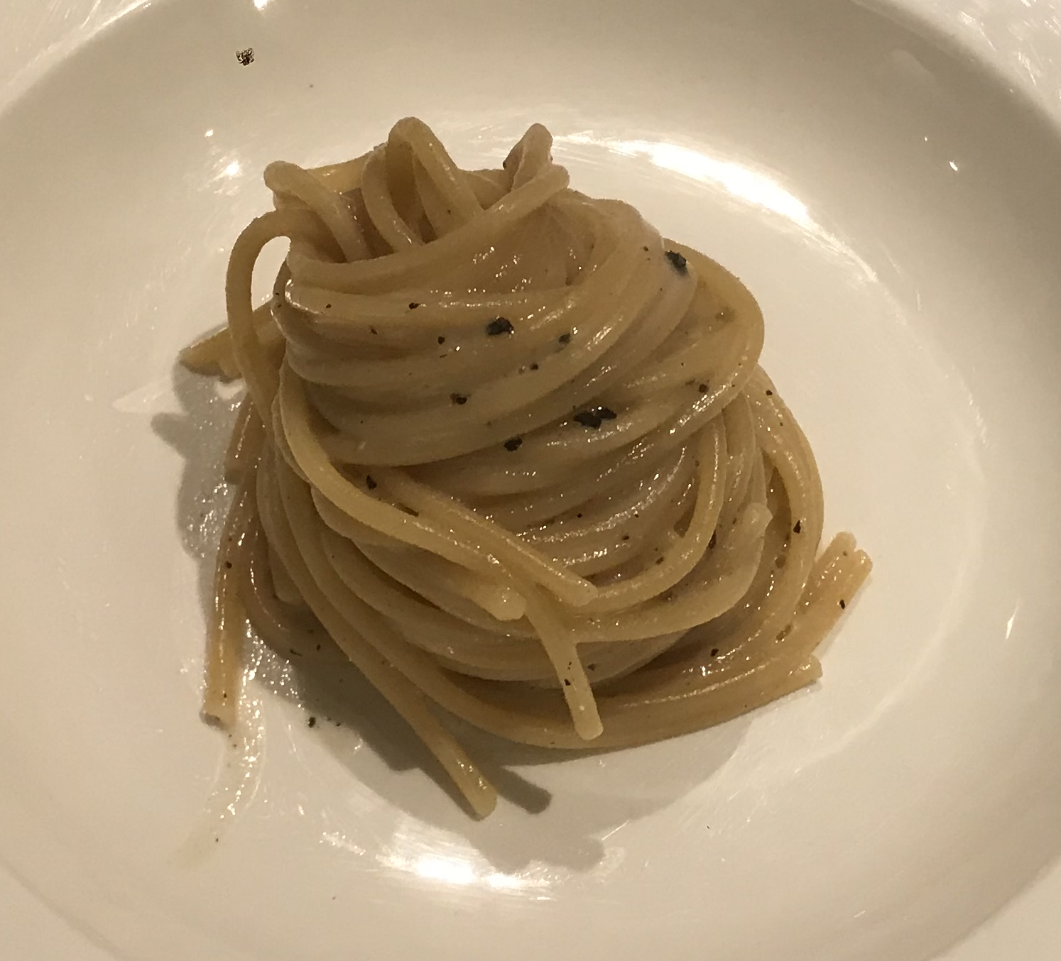

The Epiphany
YOU CAN REPEAT INVERSIONS!
there are 2 keys to avoiding hearing repetition, inversion and order of the notes played within
  anything is trivial once it becomes obvious

Slide 20
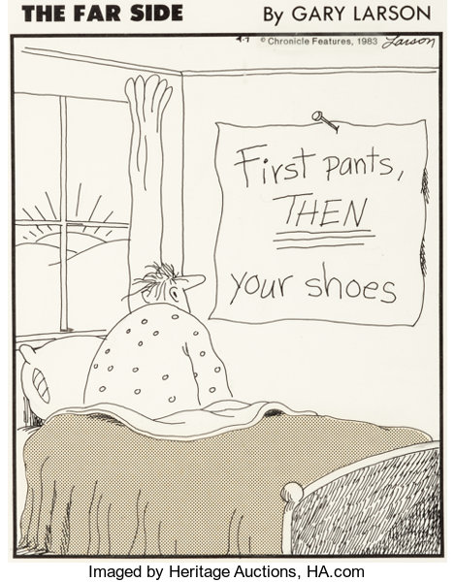
The Algorithm

Slide 21
The Algorithm
construct music "lines" by connecting random triads of the same quality
random means to select at random an inversion and a note sequence
* you can repeat an inversion but note ordering within the inversion must be different from the previous triad
consecutive triads start on a note that is up or down 1 semitone from last note of the previous triad
if the last note of a triad is G, the next triad must start on a Gb(F#) or a Ab(G#)
these notes (Gb or Ab) can be the root middle or top of the next triad

Slide 22
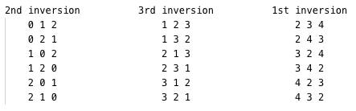
The Algorithm
there are 18 possible note sequences for 1 triad of any quality, these are called
INVERSION LADDER SEQUENCE INDEXES
Permutation of 3

Slide 23
The Algorithm - example
TCA algorithm inputs (reasonable defaults in parens)
  1) starting note (72) middle c
  2) a triad (4 3)
      major "happy" sounding triad expressed as 2 stacked interval sizes
  3) count of repeating triads per output line (8)
  4) the (step) size (1 semitone) between successive triads
      up or down at random
  5) high low bounds (60 84)
      any line that goes above or below this range is disqualified

Slide 24
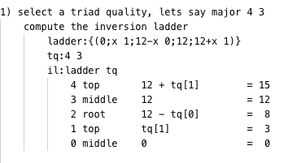
The Algorithm – example (1)

Slide 25
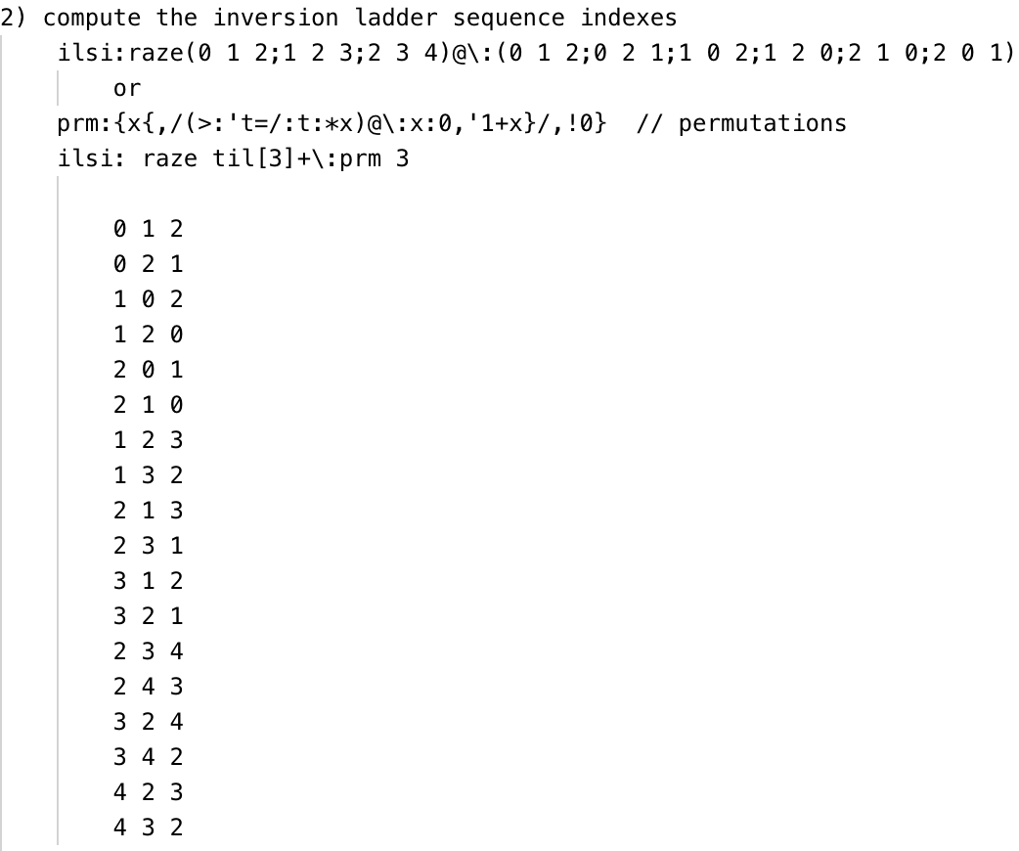
The Algorithm – example (2)

Slide 26
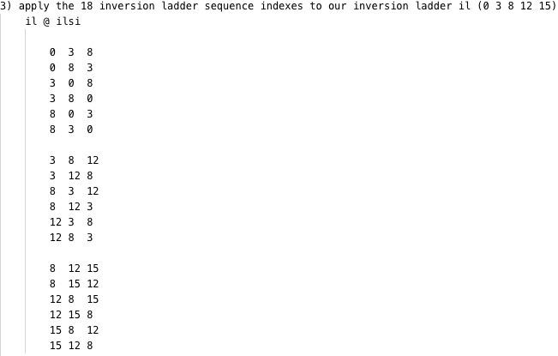
The Algorithm – example (3)

Slide 27
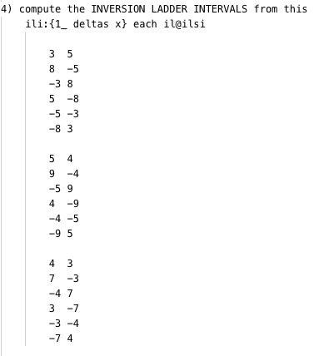
The Algorithm – example (4)

Slide 28

The Algorithm – example (5)

Slide 29
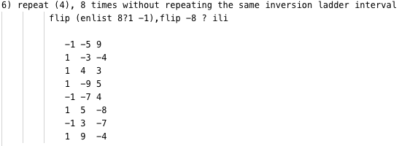
The Algorithm – example (6)

Slide 30
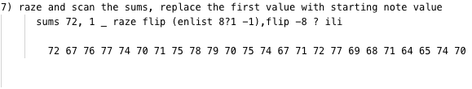
The Algorithm – example (7)

Slide 31
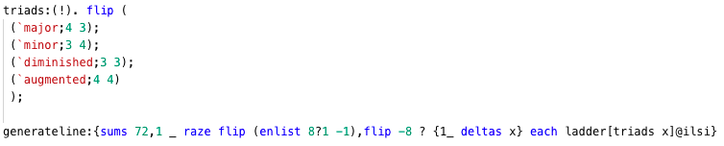
The Algorithm - solution

Slide 32

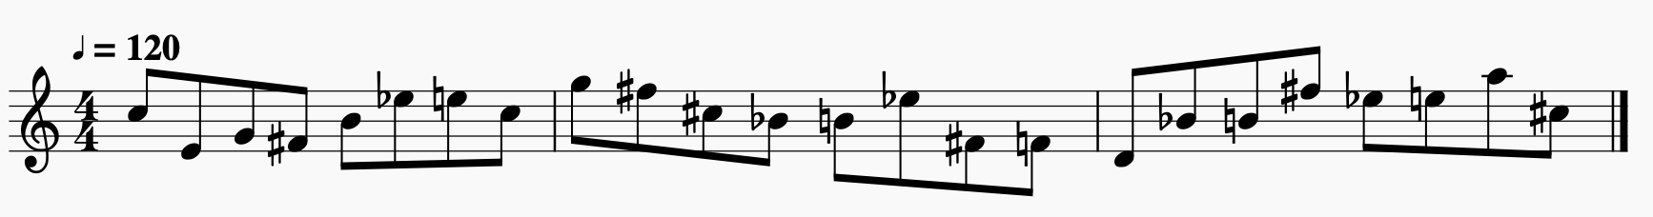
The Algorithm – wrap up

Slide 33
The Algorithm – wrap up
Q is a general purpose language
Try doing small/odd things with it in your free time
  Its fun!!
You can do more things with it than you think
Links
  https://github.com/stevewirts/kdb-midi-generation
  https://github.com/stevewirts/kdb-tca-talk

Slide 34
Fun Time!!!
Lets try some generated lines with George now!

