Slide 1
Yet another unusual Q program(s)
another talk about an unusual usage of kdb :)

Slide 2

A VNC/RFB implementation in Q
open remote desktop client/server software
https://en.wikipedia.org/wiki/Virtual_Network_Computing

Slide 3
Why a VNC UI for KDB?
Something new/different
squeak smalltalk had it (it was possible)
the path was consistent with my background

Slide 4
My Background… (ugh)
I was buried in various libraries for rendering UI
I had a lot of exposure to OO ways of doing UI

Slide 5
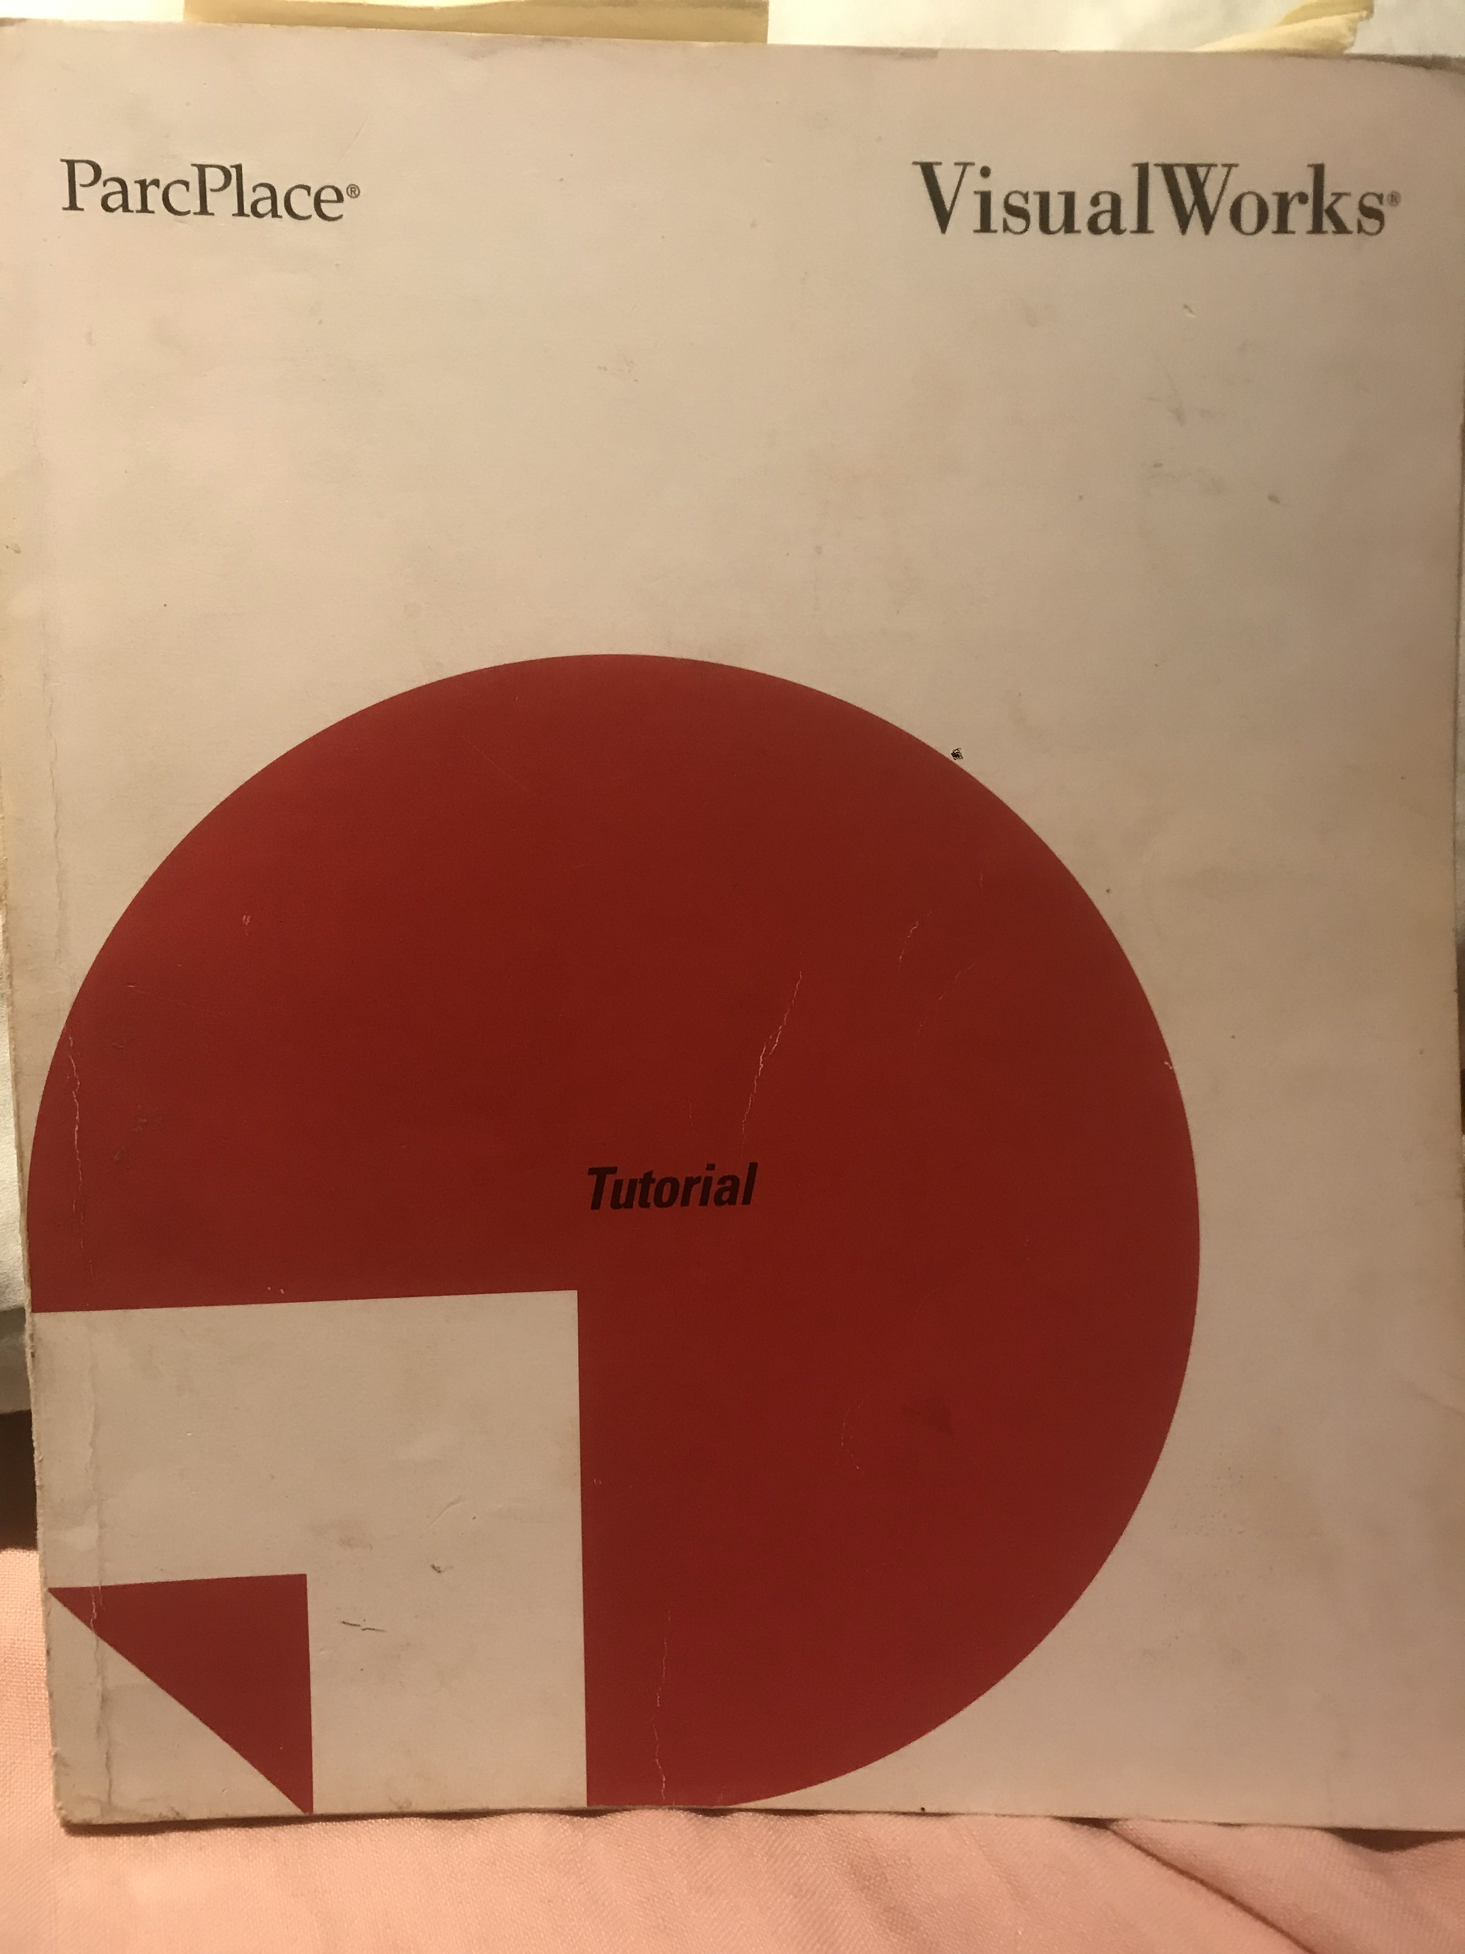
My Background… (ugh)
Visual Works Smalltalk (1993)
earliest form of 2 way binding
** value models
gui and the data are the same

Slide 6
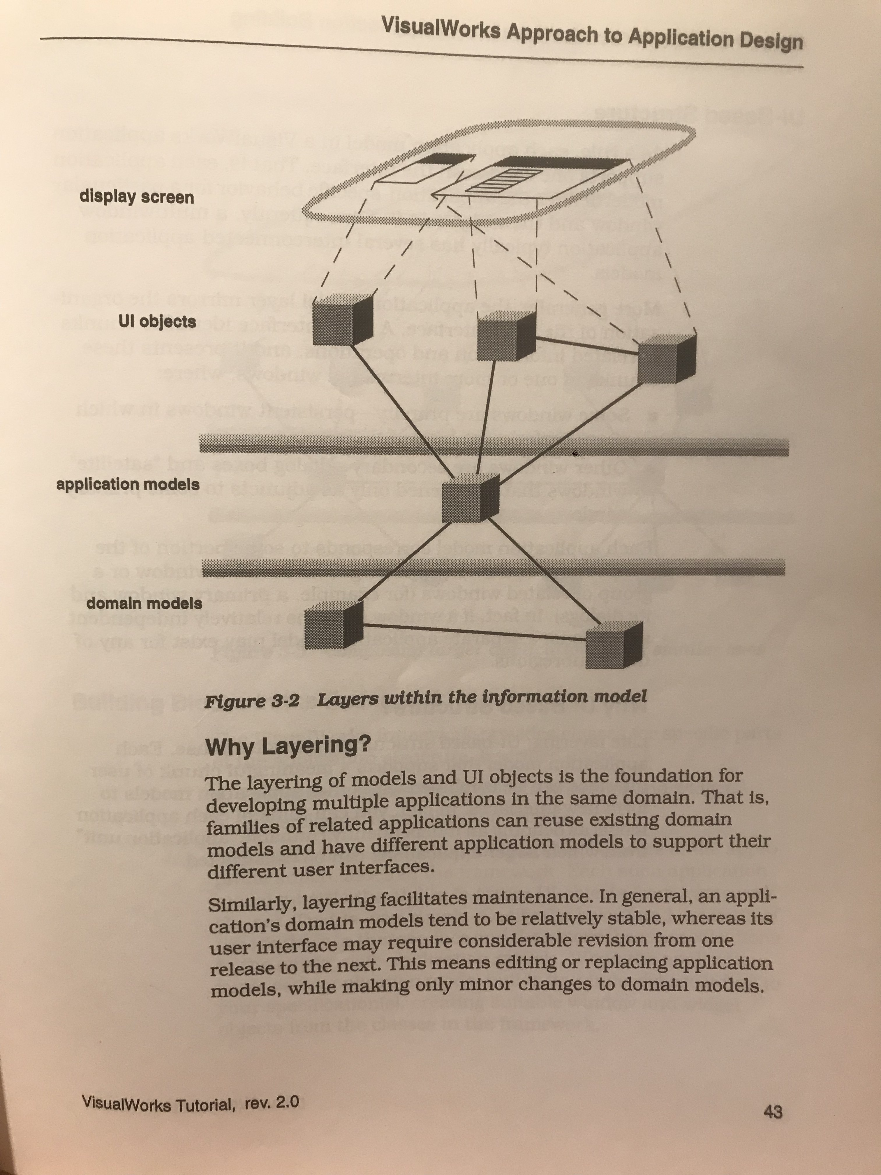
My Background… (ugh)
Visual Works
Value Models
early 90’s

Slide 7
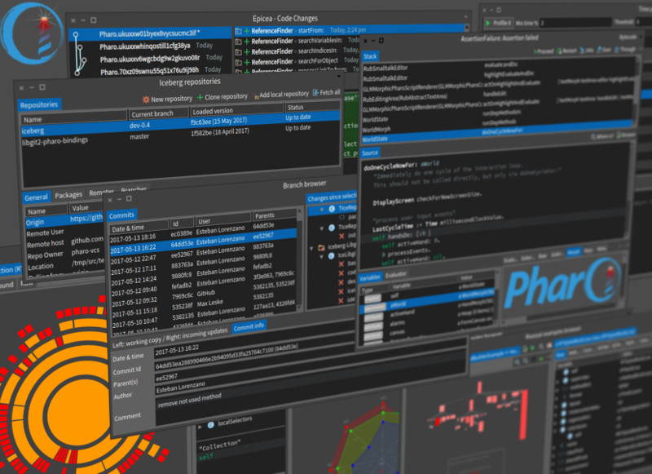
My Background… (ugh)
active in the opensource pharo smalltalk community
I built the windows 2000 look and feel

Slide 8
My Background… (ugh)
IBM
built a library to replace AWT controls
large UI used up all os handles (labels)
write lightweight Swing style components

Slide 9
My Background… (ugh)
2 years at Unilever in Leeds/UK
built a large category management system
complex UI
early days of java and UI
ported visual works smalltalk value models

Slide 10
My Background… (ugh)
Hired by Allaire ( Boston )
courseware for their jsp/ejb engine
Small successful product webtier
landed a major UI role at MLP
UI architecture patent
https://patents.google.com/patent/US7076766B2/en

Slide 11
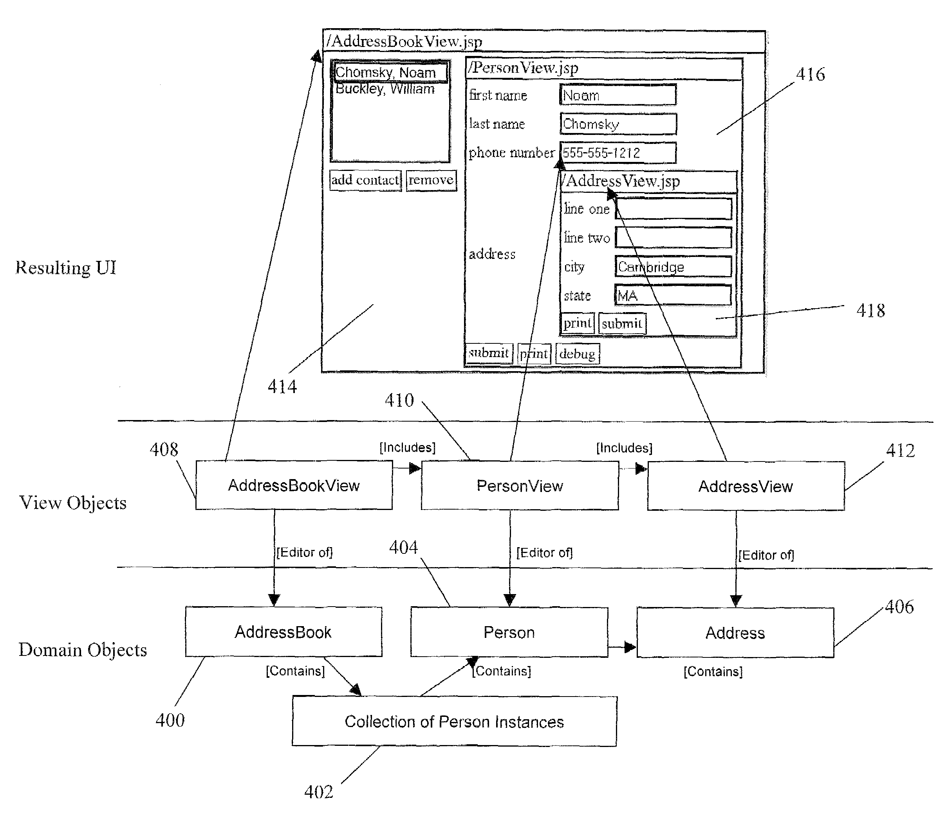
My Background… (ugh)
Patent…..

Slide 12
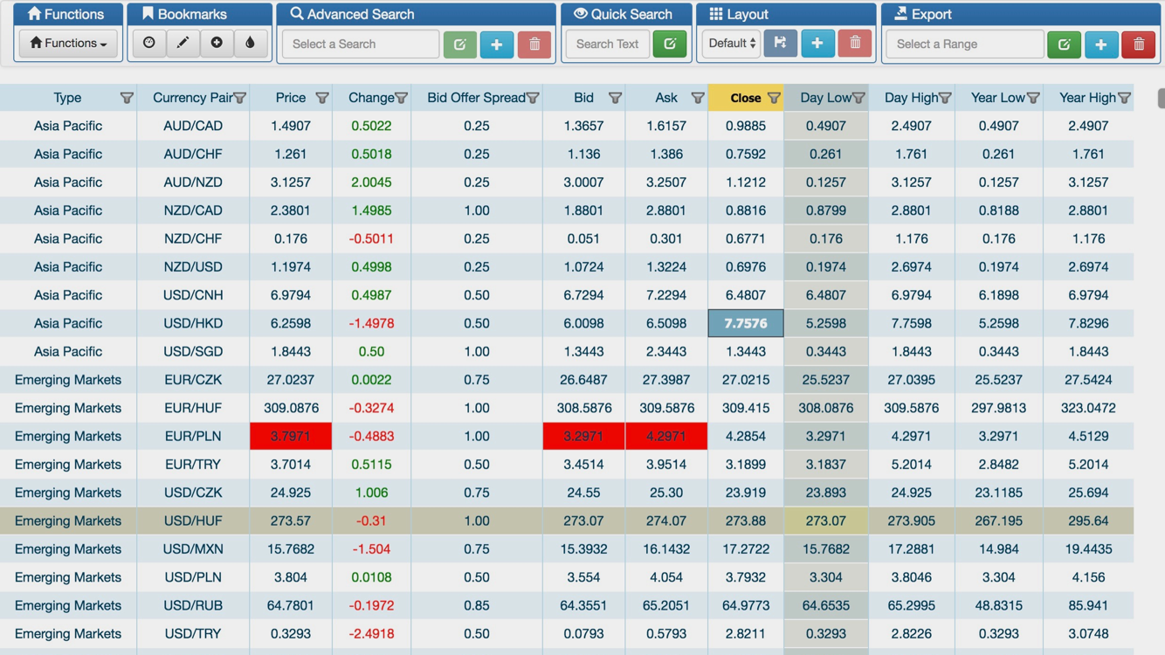
My Background… (ugh)
don’t forget the recent (post) few years….
hypergrid
canvas based high performance grid

Slide 13
Origin Story
Millenium Partners - 2000
Jsp - Webtier based applications
4.5 versions of a firmwide general pnl system
Ed Bierly, Mike Rosenberg, Steve Apter, Ye Tian
Attila Vrabecz, Tom Fergeson
many web applications
blackberry/mobile apps
early spa using some innovative tricks

Slide 14
Origin Story
Millenium Partners – Ed Bierly
”Something completely different”
everything in kdb ?
squeak smalltalk had this
why not for kdb?

Slide 15
Enter the VNC path
my experience
OO languages and libraries
what I needed
OO system for the widgetry
lib for rendering
graphics primitives
simple geometry
font rendering support
simple windowing system

Slide 16
The Code - o.q
OO was how I knew how to build things
simple object system
inheritance
inst vars
methods
could replace it now with a vector based solution

Slide 17
The Code - fonts.q
need to render text onto a bitmap
ascii character matrix
bitmaps
bitmap
computed width/height from bitmap,
chopped up the provided image(s)

Slide 18
The Code – graphics.q
simple drawing function to render into a 2d array
draw3DRect
drawArc
drawChar
drawCircle
drawHorizontalArc
drawHorizontalOval
drawImage
drawLine
drawOval
drawPolygon
drawPolyline
drawRect
drawString
drawVerticalArc
drawVerticalOval

Slide 19
The Code - rect.q
Rect is an array of 4 ints
area
centered
contains
indexes
intersect
intersects
toString
union

Slide 20
The Code – vnc_colors.q
simple map of color data
.vnc.colors:();
.vnc.colors,:enlist (`White;0xffffffffffff);
.vnc.colors,:enlist (`Gray10Percent;0xe3e3e3e3e3e3);
.vnc.colors,:enlist (`LemonChiffon;0xffffffffcdcd);
.vnc.colors,:enlist (`PaleGoldenrod;0xffffffffb1b1);
.vnc.colors,:enlist (`LightYellow;0xffffffff9a9a);
.vnc.colors,:enlist (`NapoleanYellow;0xffffffff8181);
.vnc.colors,:enlist (`Yellow;0xffffffff0000);
.vnc.colors,:enlist (`Thistle;0xffffcdcdffff);
… ETC ...

Slide 21
The Code - vnc_event.q
handles the events coming from the vnc client
.vnc.events.handleEvent:{[x]
l:count x;
if[l<1;return 0N];
mtype:x 0;
//-1 string mtype;
if[mtype~0x03;:.vnc.events.screenRefresh[x]];
if[mtype~0x04;:.vnc.events.key[x]];
if[mtype~0x05;:.vnc.events.mouse[x]];
};

Slide 22
The Code - vnc.q
Tie it all together and implement the RFB protocol
https://www.hep.phy.cam.ac.uk/vnc_docs/rfbproto.pdf
…. show working system here …….

Slide 23
Lessons Learned and Whats Next
modernize things
get rid of the object system
vectorize everything
revisit performance
maybe too much low level stuff done in q?
use cairo and a real vnc server
implementation
john d'ausilio had been working on this

Slide 24
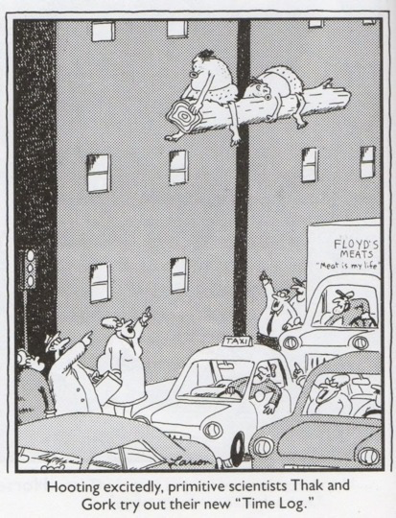
Lessons Learned and Whats Next
Old is new is old is new is...

