Slide 1
GAME AGENTS • UCSC
How to Strengthen a Game-Playing Agent
1) Small games — Exact solving: enumerate states and compute perfect play.
2) Medium-size games — Search + evaluation, chess style: alpha-beta, move ordering, and heuristics.
3) Large games — Learning + search: self-play, policy/value networks, MCTS.

Slide 2
GAME AGENTS • UCSC
Chess history: from heuristics to perfect play
• Sargon: compact evaluation and search on limited hardware.
• Thompson and Belle: endgame tables demonstrate perfect defense.
• AlphaZero: self-play learning coupled with Monte Carlo tree search.
Sources: [1]–[5], [11]

Slide 3
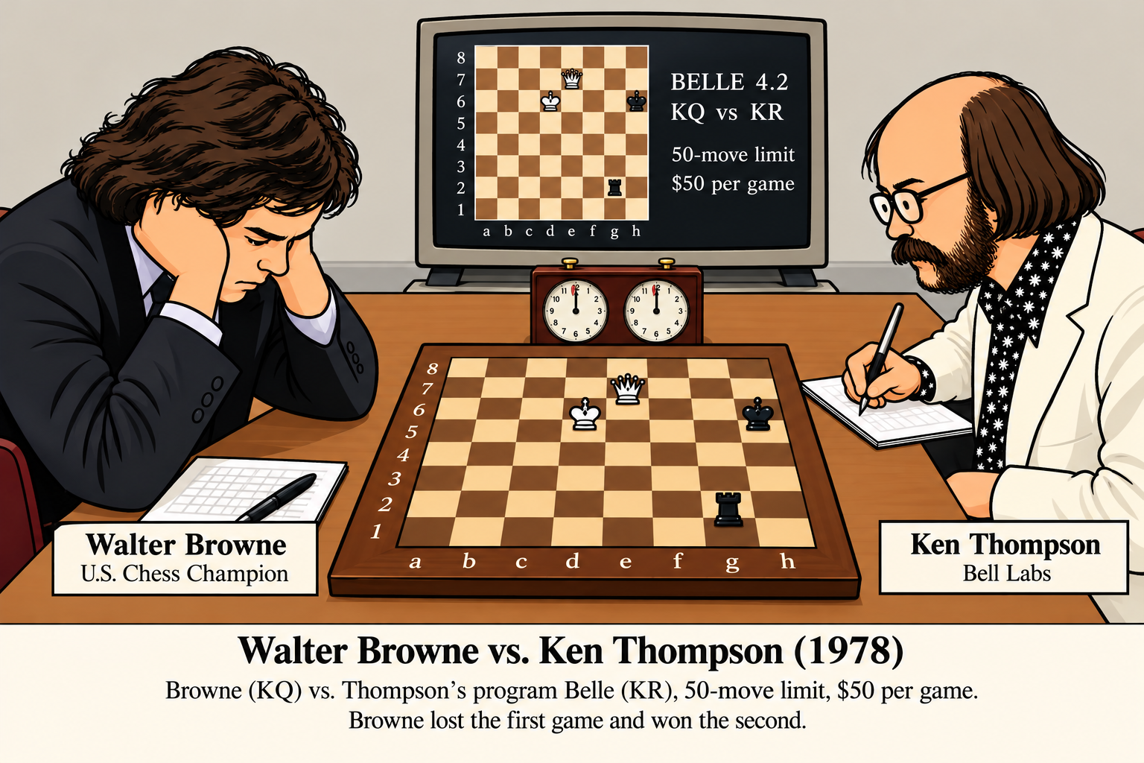
The Thompson vs Browne Bet

Slide 4
GAME AGENTS • UCSC
What a tablebase actually proves
• Enumerate legal states and moves; identify checkmates and draws.
• Work backward: win if some move reaches a loss; loss if all moves reach wins.
• Unresolved cycles are draws under the specified infinite-play rules.
• Distance-to-mate selects a fastest win against longest resistance.

Slide 5
CHESS TABLEBASES | AN EXPONENTIAL RACE
Conjecture: exponentially growing state spaces meet exponentially growing computing capacity
Number of pieces solved vs. completion year
8
THE SCALING ARGUMENT
2018
Placements ≈ 64ⁿ (not 64n)
Effective growth per added piece: ~90–340×
7
6
2005
If capacity doubles every 2 years:
100× capacity ≈ 13.3 years
5
1990
6-piece complete: ~2005
7-piece complete: ~2018
8-piece complete: NOT YET
4
1985
3
1970
1970
1980
1990
2000
2010
2020
2030
Extrapolation: 8-piece completion ~2030–33 (speculative)
Gold = approximate early chronology • Teal = later complete milestones
Caveat: early dates are approximate; algorithms, storage, position legality and project scope matter. Sources: [6].

Slide 6
GAME AGENTS • UCSC
Our first complete example: KRK
• King + rook versus lone king on an 8×8 board.
• 399,112 legal states in our enumeration.
• Exact WDL and minimax distance-to-mate validated.
• Maximum forced mate: 32 plies.
LIVE DEMO: run the 30-second KRK animation.

Slide 7
GAME AGENTS • UCSC
A spectacular contrast: 262 moves
• Six-piece, pawnless KRN versus KNN tablebase line.
• Published historical line, not generated by our KRK solver.
• The 60-second animation begins slowly, then accelerates.
• This theoretical line exceeds the chess fifty-move draw rule.
LIVE DEMO: long_endgame_demo/long_endgame_262.html
Historical game record: [7]

Slide 8


GAME AGENTS • UCSC
Inventing two new chess pieces
ARCHBISHOP = bishop + knight
CHANCELLOR = rook + knight

Slide 9
GAME AGENTS • UCSC
The same solver; different movement rules
• Sliding rays: rook or bishop directions.
• Leaps: knight jumps, or any custom set of offsets.
• Define a piece in JSON; enumerate legal states automatically.
• Compute exact outcomes and an optimal example line.
LIVE DEMO: variant_demo.html

Slide 10
GAME AGENTS • UCSC
Exact 8×8 results: surprising differences
Piece Winning states Max mate
Rook 175,168 32 plies
Chancellor 156,720 22 plies
Archbishop 174,836 34 plies
Exact 8×8 results; counts depend on side to move and legal-state conventions.
Exact results from this project: [10]

Slide 11
GAME AGENTS • UCSC
Gauss and the eight queens: early backtracking
• 1848–1850: The eight-queens problem circulated before Gauss.
• In an 1850 letter, Gauss described systematic trial and error (Tatonniren).
• Place one queen per column; reject attacks; back up when no legal continuation remains.
• Enumerating the branches yields 92 solutions (12 up to symmetry).
• Live demo: switch to the eight-queens animation tab.
Gauss’s 1850 letter and backtracking: [11] (Knuth, Vol. 4B, §7.2.2, p. 53)

Slide 12
GAME AGENTS • UCSC
Next: a game-independent solver
• Adapter: states, legal actions, transitions, terminal outcomes.
• Retrograde core: exact win/loss/draw and optimal strategies.
• Already have two contrasting test cases: KRK and 3×3 NoGo.
• Important: an endgame subset must be closed under legal moves, or have solved exits.
Project implementation: [10]

Slide 13
GAME AGENTS • UCSC
Longer-term goal: solve small Ludii games
• Input: a .lud definition and selected starting configuration.
• Use Ludii’s rule interpreter to generate successor states.
• Solve full games or rigorously bounded subgames when feasible.
• Export proof statistics, optimal lines, and animations.
2–3 week prototype target for a restricted class; not arbitrary Ludii games.
Ludii system: [8]

Slide 14
GAME AGENTS • UCSC
Open research question
• Can Monte Carlo simulation help design stronger static evaluations?
• Measure improvement in Elo against fixed alpha-beta baselines.
• Compare search cost, evaluation complexity, and generality.
• Small exact games provide ground truth for checking the agents.
Related methods and background: [1], [2], [8], [9].

Slide 15

GAME AGENTS • UCSC
Monopoly: early simulation-based evaluation
Early use of Monte Carlo Simulation to adjust property values.
[9] Maxine Brady, The Monopoly Book, D. McKay, 1974.

Slide 16
GAME AGENTS • UCSC
Future Work
1 Generalize retrograde analysis from chess pieces to small games.
2 Read supported Ludii .lud definitions and solve reachable states or closed subgames.
3 Tune static evaluation function with MCTS and measure Elo rating increase.

Slide 17
GAME AGENTS • UCSC
References
[1] D. Levy and M. Newborn, How Computers Play Chess, Computer Science Press, 1991, pp. 141–151 (endgame databases; Thompson’s terminology).
[2] D. Silver et al., “A General Reinforcement Learning Algorithm That Masters Chess, Shogi, and Go Through Self-Play,” Science (2018).
[3] Browne–Belle endgame game records (historical match).
[4] stamma1, “Computer Chess History 1978–1993: Sargon II and Spinoffs,” Chess.com.
[5] stamma1, “The Generic Chess Engine, or Chess Genie,” Chess.com.
[6] Chessprogramming Wiki, “Endgame Tablebases”; Syzygy and Lomonosov project milestones.
[7] ChessBase / Helmut Conrady, published 262-move KRN vs KNN line.
[8] E. Piette et al., “Ludii: The Ludemic General Game System” (2020).
[9] M. Brady, The Monopoly Book: Strategy and Tactics of the World’s Most Popular Game, D. McKay, 1974.
[10] Project code, tablebases and animations: github.com/stevex24/ludii-research.
[11] D. E. Knuth, The Art of Computer Programming, vol. 4B, 1st ed., Addison-Wesley, 2022, §7.2.2, pp. 31, 53 (eight queens; Gauss and backtracking).

