Slide 1
Can an LLM understand a game tileset?
Benchmarking LLM Tile Understanding and Tile Use • UCSC Augmented Design Lab • October 27, 2026
From recognizing tile relationships
to generating coherent levels
Research proposal • Existing WFC/SAT experience • Invitation to collaborate
1 / 8

Slide 2
Three research questions
Framing proposed by Jim Whitehead
01 GENERATE
02 RELATE
03 LEARN
Given a tileset, can an LLM construct a coherent game level?
Can it infer possible relationships among individual tiles and groups?
How much does seeing example levels improve its performance?
2 / 8

Slide 3
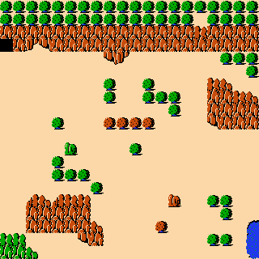
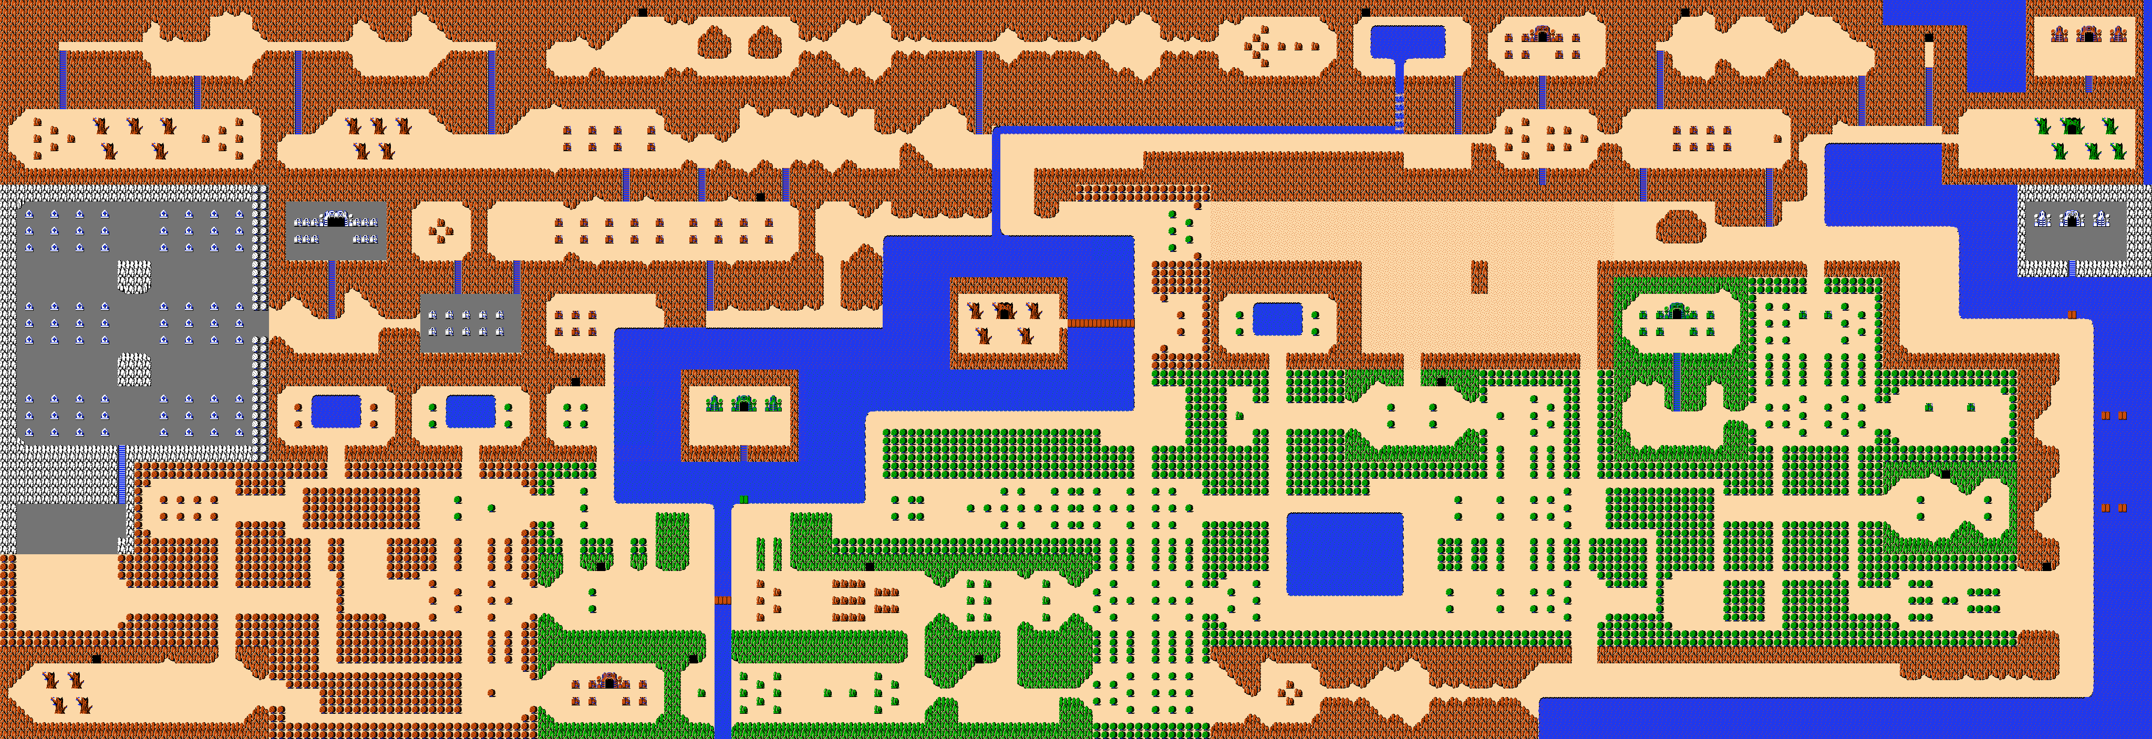
Zelda: original and generated levels
Existing WFC / SAT examples — motivation for testing higher-level tile understanding
Original Zelda map
Context-sensitive WFC
Context-sensitive WFC-as-SAT
Reference example: complete map structures
Generated output, seed 0
Generated output, seed 0
Tiny Town: explicit house constraints also motivated the proposed relationship-inference tasks.
3 / 8

Slide 4
A tileset is not just a bag of images
Candidate relationships to ask a multimodal model to identify
ROLE
LOCAL
STRUCTURE
roof • wall • floor • door
which tiles connect at edges?
which groups form a house or room?
Predictions are hypotheses; evaluate them against annotated examples and explicit rules.
4 / 8

Slide 5
The central experiment: examples or no examples?
Hold model, task, tile IDs, and scoring constant
A — TILESET ONLY
B — TILESET + LEVELS
Atlas + tile IDs + identical question or construction task.
Same atlas and task, plus one or more example levels.
Initial candidates: Kenney Tiny Town, Tiny Dungeon, Tiny Farm; Zelda as another source.
5 / 8

Slide 6
Tasks and measurements
A small, reproducible benchmark before expanding coverage
MODEL TASKS
EVALUATION
Identify tile roles
Predict adjacency or assemblies
Generate a tile-ID grid
Repair a broken arrangement
Valid IDs and grid dimensions
Constraint satisfaction
Precision / recall / F1 where labeled
Blind human coherence rubric
Record prompts, inputs, model versions, outputs, and scoring for repeatable comparisons.
6 / 8

Slide 7
A small project that others can join
First milestone: one tileset, a few annotated tasks, and two input conditions
CONTRIBUTIONS
LATER POSSIBILITIES
Choose examples and annotate relationships
Test prompts and models
Develop simple baselines
Review relevant papers
Identify objects, shapes, and textures
Confirm inferred structure with a user
Pass structural rules to WFC or SAT
Collaboration welcome; scope and responsibilities remain open for discussion.
7 / 8

Slide 8
Resources and next steps
Proposed resources and selected reading — not a completed literature review
Tilesets: Kenney Tiny Town · Tiny Dungeon · Tiny Farm
Zelda map data: inventwithpython.com
Related work: Video Game Level Corpus · Tile Embedding
Patterns and PCG · GameTileNet · Learned Level Representations
github.com/stevex24/tile-understanding-benchmark
Next: select a first tileset, freeze tasks, annotate ground truth, and run baseline trials.
8 / 8

