Slide 1
RESEARCH PROPOSAL
Can an LLM understand a game tileset?
Benchmarking LLM Tile Understanding and Tile Use
Recognize tile relationships.
Reconstruct tilesets. Generate coherent levels.
Existing WFC/SAT research • A reproducible benchmark • Collaboration
UCSC • Augmented Design Lab | October 27, 2026
1

Slide 2
RESEARCH QUESTIONS
Three questions for multimodal models
01 GENERATE
02 RELATE
03 LEARN
Given a tileset, can a model build a coherent level?
Can it infer relationships among tiles and groups?
How much do example levels improve performance?
UCSC • Augmented Design Lab | October 27, 2026
2

Slide 3
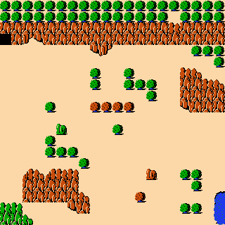
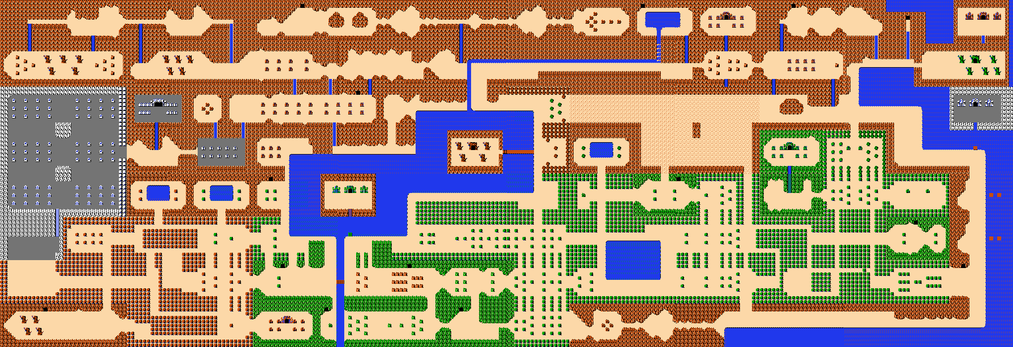
PREVIOUS WORK
Zelda: original and generated levels
WFC and SAT motivate tests of higher-level structural understanding
Original Zelda map
Context-sensitive WFC
Context-sensitive WFC-as-SAT
Existing algorithms can reproduce local patterns without recovering every semantic object.
UCSC • Augmented Design Lab | October 27, 2026
3

Slide 4
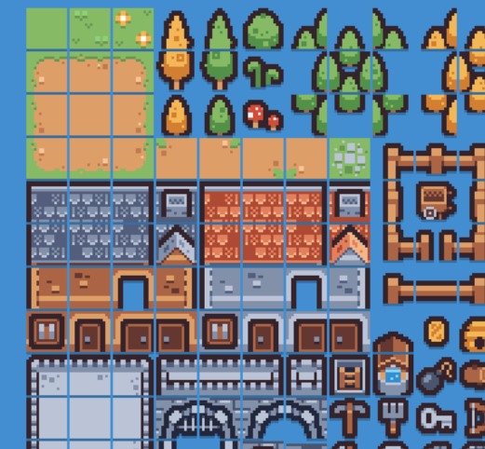
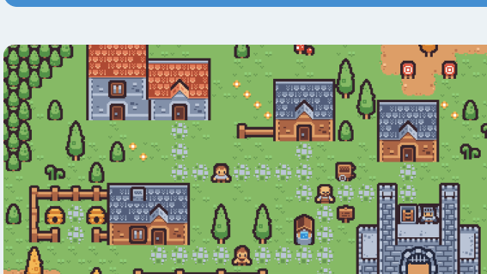
PROPOSED BENCHMARK EXAMPLE
Tiny Town: level image ⇄ tileset
Two inverse tasks using the same source images • Kenney Tiny Town (CC0)
TILESET / PALETTE
EXAMPLE TOWN IMAGE
Tileset → construct a coherent town
Town image → recover its tileset
UCSC • Augmented Design Lab | October 27, 2026
4

Slide 5
TILE UNDERSTANDING
A tileset is more than a bag of images
What relationships should a multimodal model discover?
ROLE
LOCAL
STRUCTURE
Roof • wall • floor • door
Which tile edges can meet?
Which groups form a house or room?
Treat predictions as hypotheses; validate them against annotations and explicit rules.
UCSC • Augmented Design Lab | October 27, 2026
5

Slide 6
EXPERIMENTAL DESIGN
Examples or no examples?
Hold the model, task, tile IDs, and scoring constant
A TILESET ONLY
B TILESET + LEVELS
Atlas + tile IDs + the same question or construction task.
Same atlas and task, plus one or more example levels.
Candidates: Kenney Tiny Town, Tiny Dungeon, Tiny Farm, and Zelda.
UCSC • Augmented Design Lab | October 27, 2026
6

Slide 7
MODEL TASKS
Recognize, generate, and repair
Example: repair an invalid Tiny Town house arrangement
Four benchmark tasks
BROKEN
REPAIRED
1. Identify tile roles
2. Predict adjacency and assemblies
3. Generate a tile-ID grid
4. Repair a broken arrangement
MISPLACED WINDOW
WINDOW IN WALL
Repair test: give the model the damaged arrangement and the available tiles; ask it to identify and replace the invalid tile.
UCSC • Augmented Design Lab | October 27, 2026
7

Slide 8
EVALUATION
How do we measure success?
Objective scores for labeled tasks; blind human judgments for complete levels
Precision, recall, and F1
Blind human coherence rubric
Precision: of predicted roof tiles, how many are correct?
Recall: of all true roof tiles, how many were found?
Independent evaluators score generated levels without knowing which model or condition produced them.
F1 = 2 × (precision × recall) / (precision + recall)
Score each 1–5:
• Local tile connections
• Recognizable buildings and roads
• Overall level plausibility
Example: precision 75%, recall 60% → F1 = 66.7%
UCSC • Augmented Design Lab | October 27, 2026
8

Slide 9
COLLABORATION
A small project others can join
First milestone: one tileset, annotated tasks, and two input conditions
CONTRIBUTIONS
LATER POSSIBILITIES
Choose and annotate examples
Test prompts and models
Develop simple baselines
Review relevant papers
Identify objects, shapes, textures
Confirm inferred structures
Pass structural rules to WFC or SAT
UCSC • Augmented Design Lab | October 27, 2026
9

Slide 10
RESOURCES
Resources and next steps
A research proposal, not a completed literature review
Tilesets: Kenney Tiny Town • Tiny Dungeon • Tiny Farm
Zelda map data: inventwithpython.com
Related work: Video Game Level Corpus • Tile Embedding
Patterns and PCG • GameTileNet • Learned Level Representations
github.com/stevex24/tile-understanding-benchmark
Next: select a tileset, annotate ground truth, and run baseline trials.
UCSC • Augmented Design Lab | October 27, 2026
10

