Slide 1
HW05:LianLianKan

Slide 2
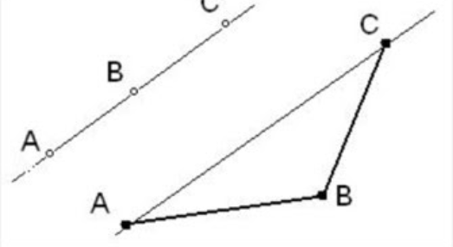

Assignment Requirement:
Your program will take a set that consists of two-dimensional points as input. Please determine whether the given set containing three points lie in a line
C
Example:
Abstract class:

