Slide 1
An Updated R Package for Evaluation of CAGI Challenge Results
Changhua Yu (with Dr.Zhiqiang Hu)

Slide 2
Background: Summary on Past Evaluation
Walkthrough of Package with GAA example
Lessons learned through comparison of evaluation methods
TO-DOs

Slide 3
Background: Summary of Past Evaluation
Challenge | Bootstrap | Use of SD | Normalization Method | Correlation | General Methods | Other measurement
Working towards precision medicine [1] | > multiple samples with replacement > Cross-validated logistic regression meta-classifier using lasso regularization is trained | > Each prediction modified based on original prediction sd during resampling | > Difference in terms of SD: z-score transformation based on participant provided SD > Range with SD: mean of the standard deviation for each prediction divided by the predicted dose | > spearman rank correlation | > ROC and average AUC along with confidence interval of AUC to assess robustness of prediction | > RMSD
SUMO [2] | > Resampling with real data modified based on experimental value and SD as a Gaussian | > Quantile transformation | > Rank based transformation | > Kendall > Spearman’s > Pearson’s | > The average Z scores of the rank-based, original value-based, and transformed value based measurement combined to a growth score | > RMSD
Pyruvate kinase [3] | > Resampling with real data modified based on experimental value and SD as a Gaussian | / | > Rank based transformation | > Kendall > Spearman’s > Pearson’s | / | > RMSD
P16 [4] | > Resampling with real data modified based on experimental value and SD as a Gaussian | / | > z-score transformation | > Pearson’s | / | > RMSD
[1] Working toward precision medicine: Predicting phenotypes from exomes in the Critical Assessment of Genome Interpretation (CAGI) challenges.
[2] Benchmarking predictions of allostery in liver pyruvate kinase in CAGI4
[3] Assessing predictions of fitness effects of missense mutations in SUMO-conjugating enzyme UBE2I
[4] Performance of in silico tools for the evaluation of p16INK4a (CDKN2A) variants in CAGI.

Slide 4
Motivation:
Past Problems | Improvement in our package
No user-side automation with customized options | > Compatible with most of the numeric prediction in CAGI challenges > consistent plotting as ggplot objects
Heavy reliance on Rank based methods limited usage of prediction and experimental SD | > density function based RMSD > z-score transformation to unify scale for visualization > variance-based normalization for RMSD > sd cutoff
ROC analysis is not flexible on user-side | > Customized ROC/AUC generation
Not using the submission group information effectively | > Grouped Uniqueness and Correlation Analysis
Lack of standard method to analyze unique contribution of each submission | > Adjusted R^2 based uniqueness analysis
Lack of a measurement of statistical meaning with resampling | > A bootstrap module that can be applied to all numeric evaluation with confidence interval and plot automatically rendered
Notes:
ROC: cutoff based, customized

Slide 5
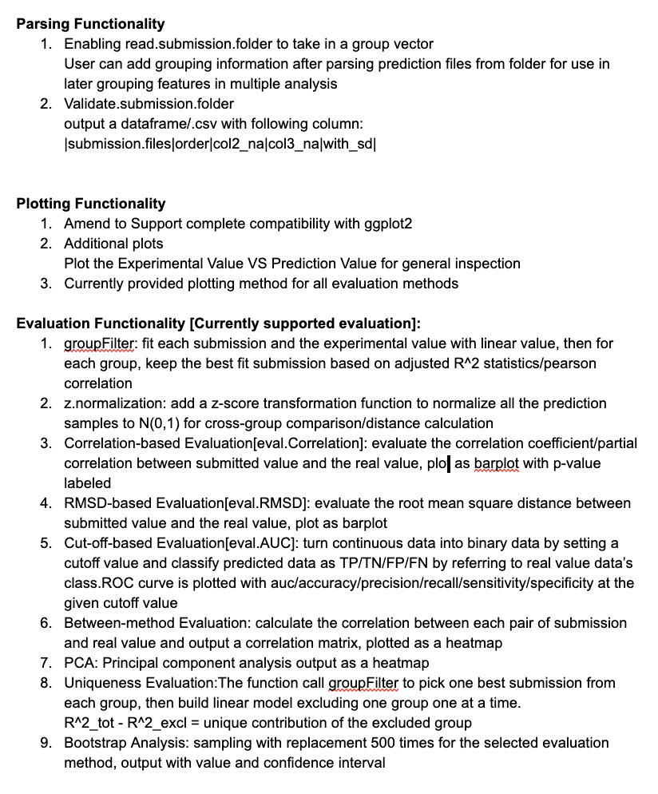
Documentation on Package Pipeline
Demonstration also exported as R Markdown document
Documentation on Parsing, Plotting, and Evaluation methods provided as roxygen comment in the package

Slide 6
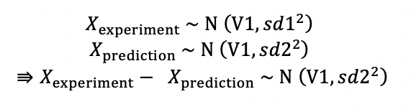
New Features - Exploiting Variance
Integrating experimental SD into RMSD:
Z-score normalization to N(0,1)each submission scatter plots plotting for unified visualization
Applying normalization to RMSD by variance:
Notes:
Add a figure to demo

Slide 7
New Features - Uniqueness
Create one linear models for each of the submission with the experimental value
Pick one best submission from each group
Build a linear model with all submissions combined
Build linear models excluding one group one at a time

Slide 8
New Features - Resampling Method
Sampling with replacement 500 times for the selected evaluation method
Resampling strategy:
1. Resampling rows with replacement
2. Modeling experimental values based on mean and sd
output with value and confidence interval/standard deviation for the given analysis
Can take in any type of numeric evaluation in the package

Slide 9
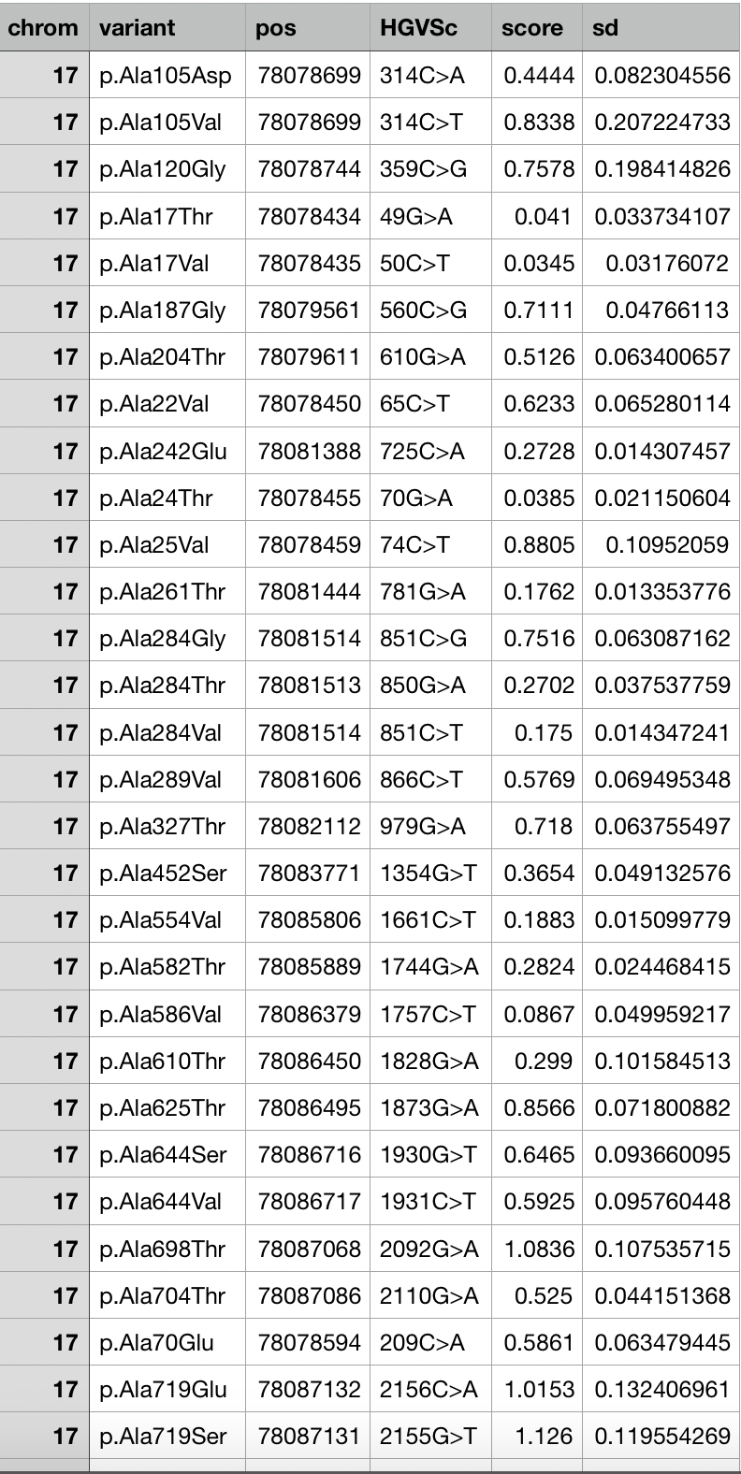
Package Walkthrough with GAA Challenge
Acid alpha-glucosidase (GAA): predict the effect of naturally occurring missense mutations on enzymatic activity
7 Groups with 26 Submissions

Slide 10
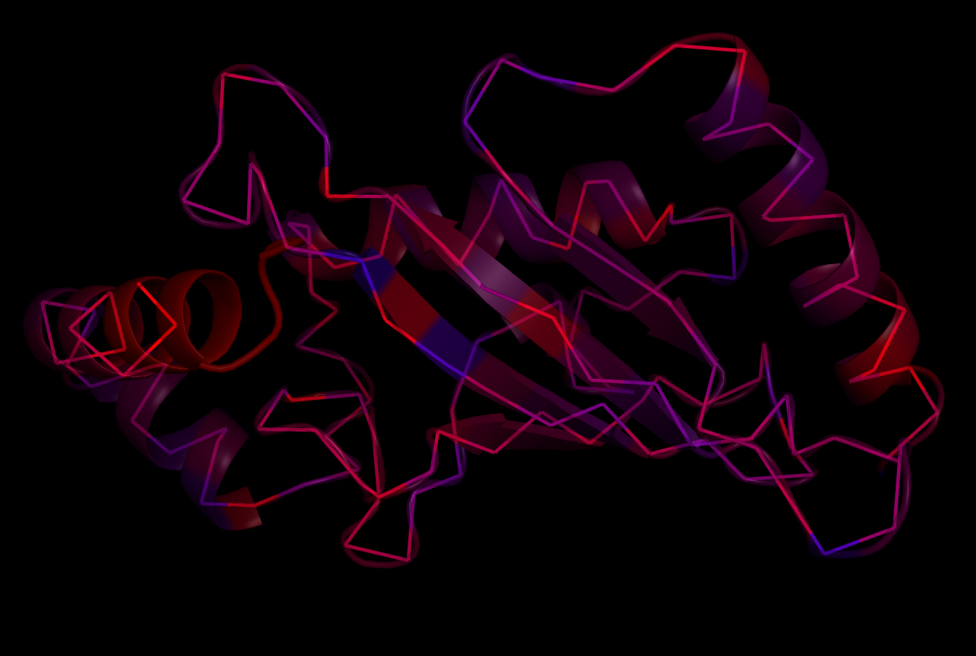
Lessons Learned
SUMO Ligase

Slide 11
Bootstrap: Resampling VS Simulation
Variance-Based Simulation has smaller standard error/confidence interval
Numerical methods are generally less robust than rank-based method in our case
The numerical sd of submission is usually not used effectively

Slide 12
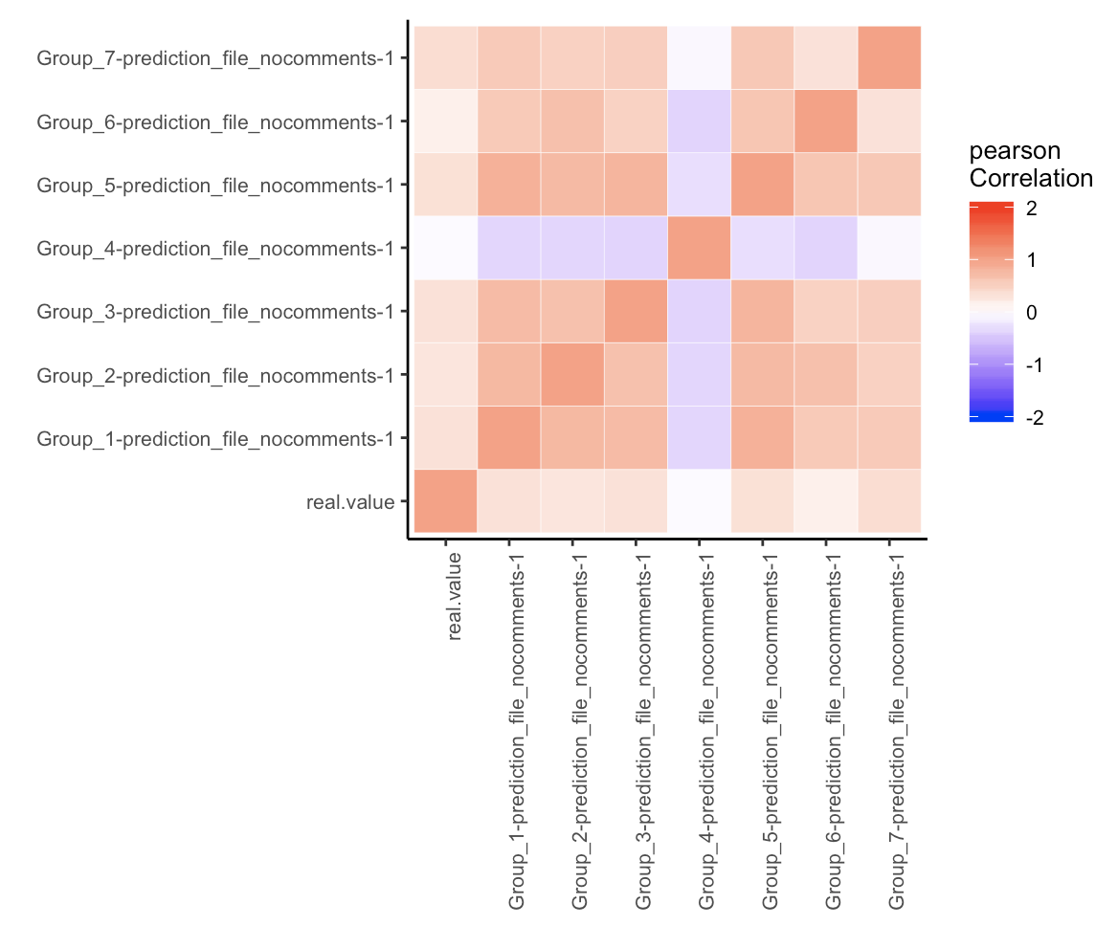
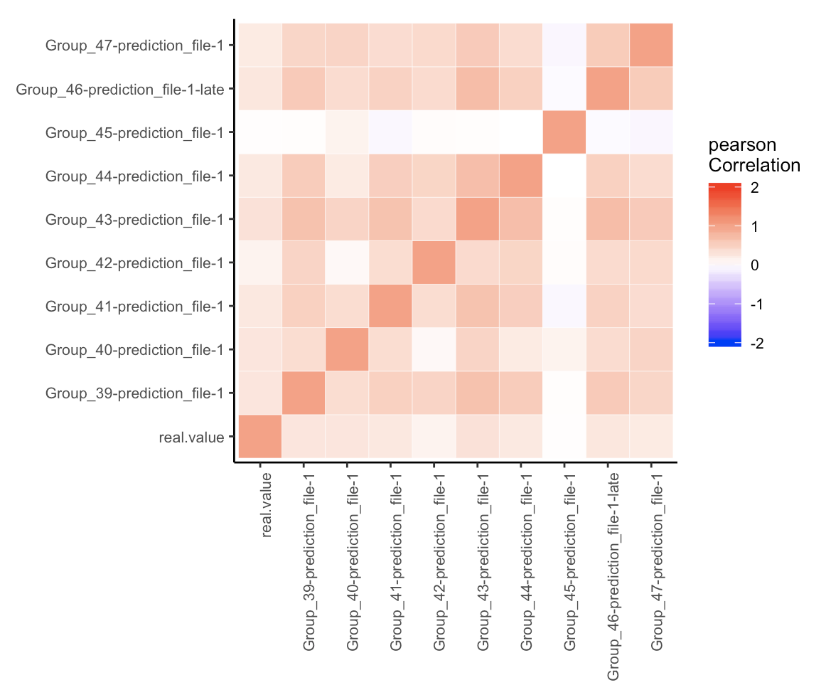
Between Method reveals that submission resembles themselves more than the real value
GAA Challenge
CALM1 Challenge

Slide 13
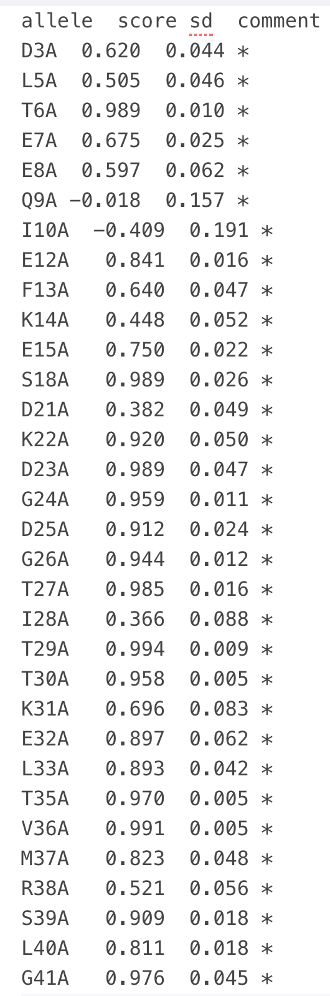
Uniqueness VS Correlation [CALM1]
Effects of missense mutations on calmodulin function as measured by a high-throughput yeast complementation assay
Group 1: Sequence Based
Group 2: Integration of multiple methods
Group 3: Machine Learning for stability
Group 4: Molecular Dynamics

Slide 14
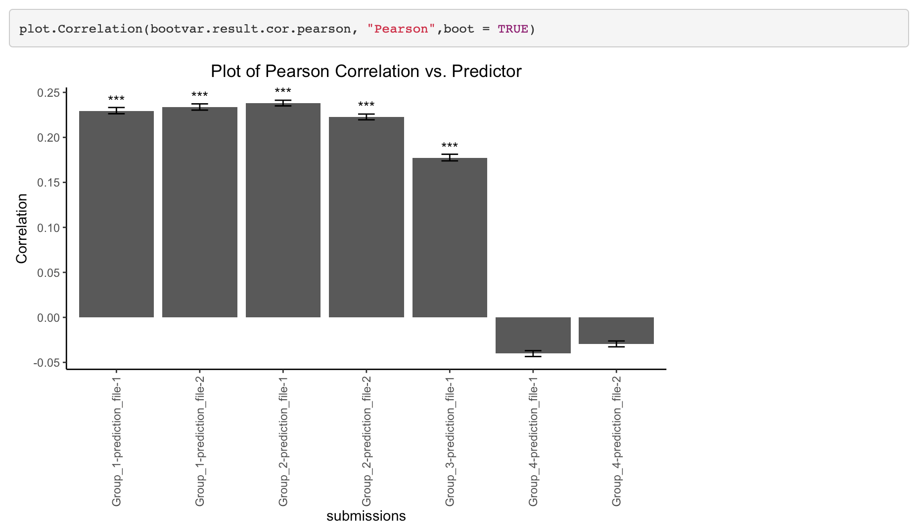
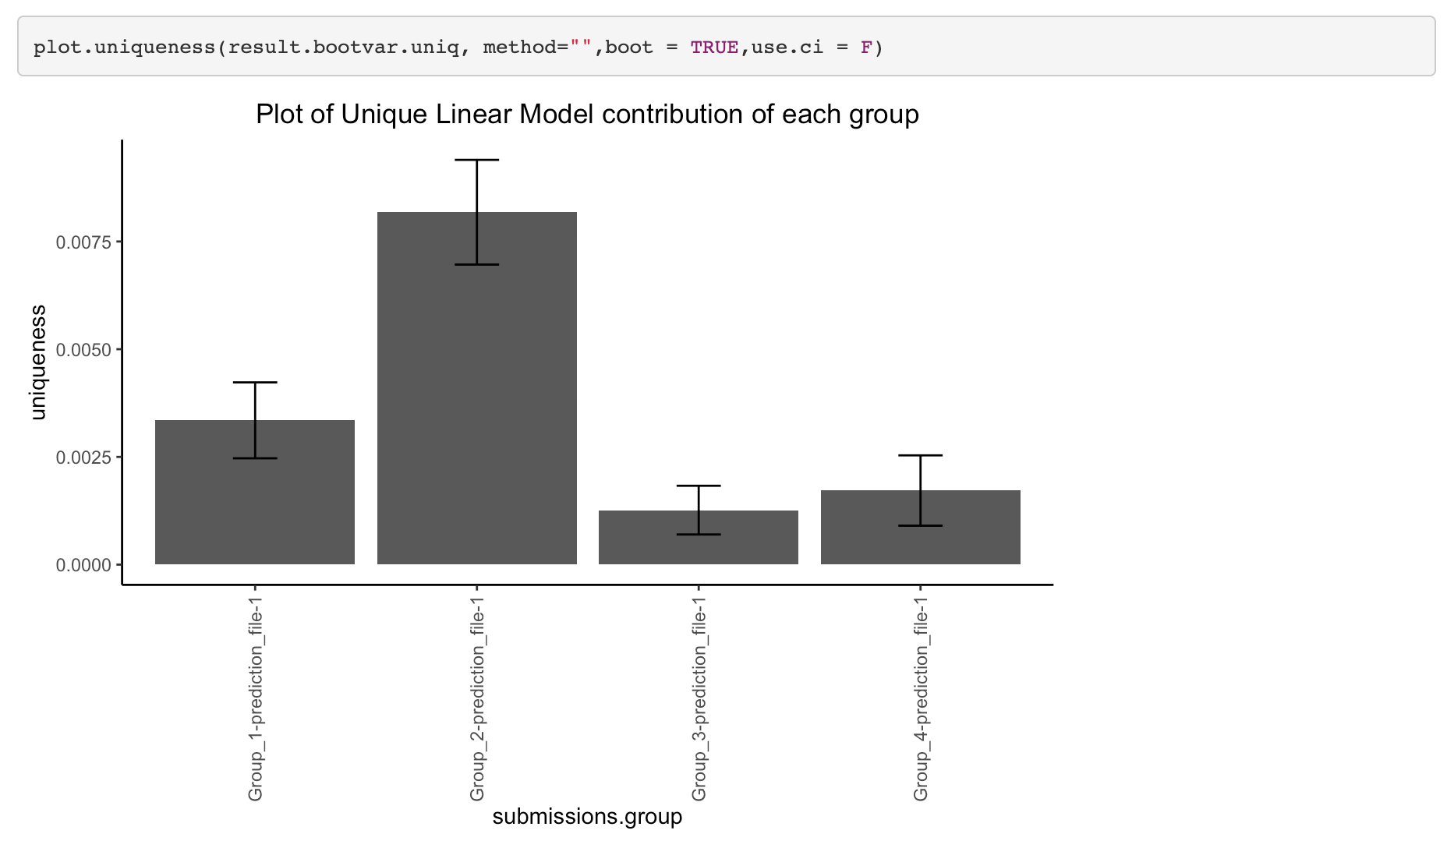
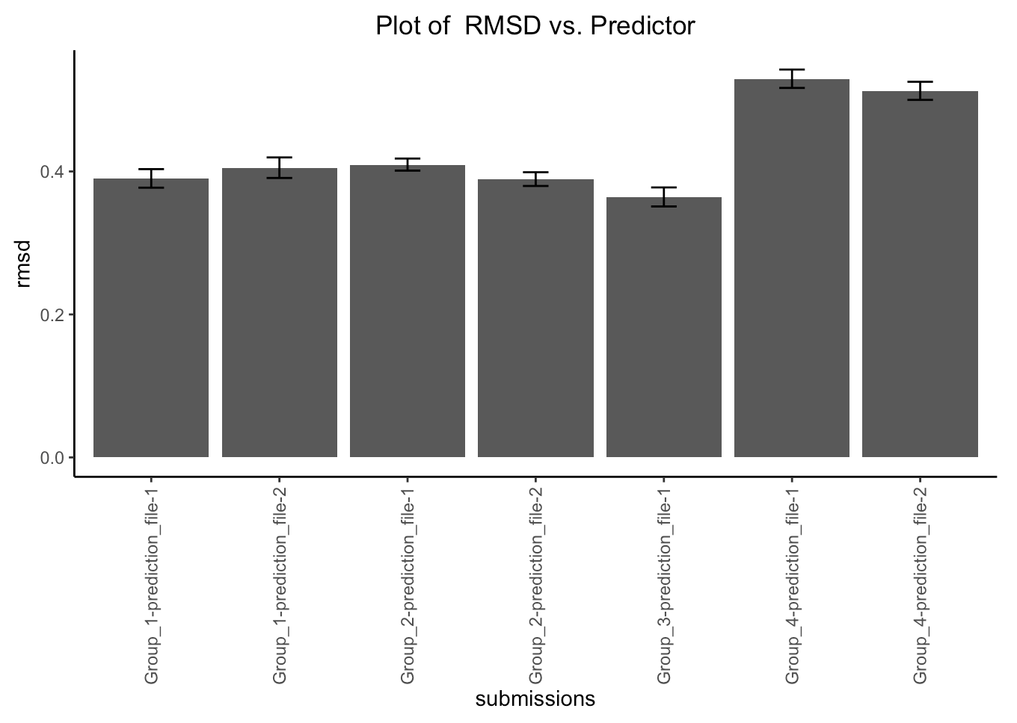
Uniqueness VS Correlation [CALM1]
Group 3 has high correlation, and low RMSD but low contribution for contributing towards the linear model
Uniqueness analysis emphasizes on the contribution and the unique knowledge they apply, that can be put into further research
Notes:
Several methods may do both quite good and resembles each other
In that case the uniqueness analysis
Based on the baseline tools see how much variance can be further explained

Slide 15
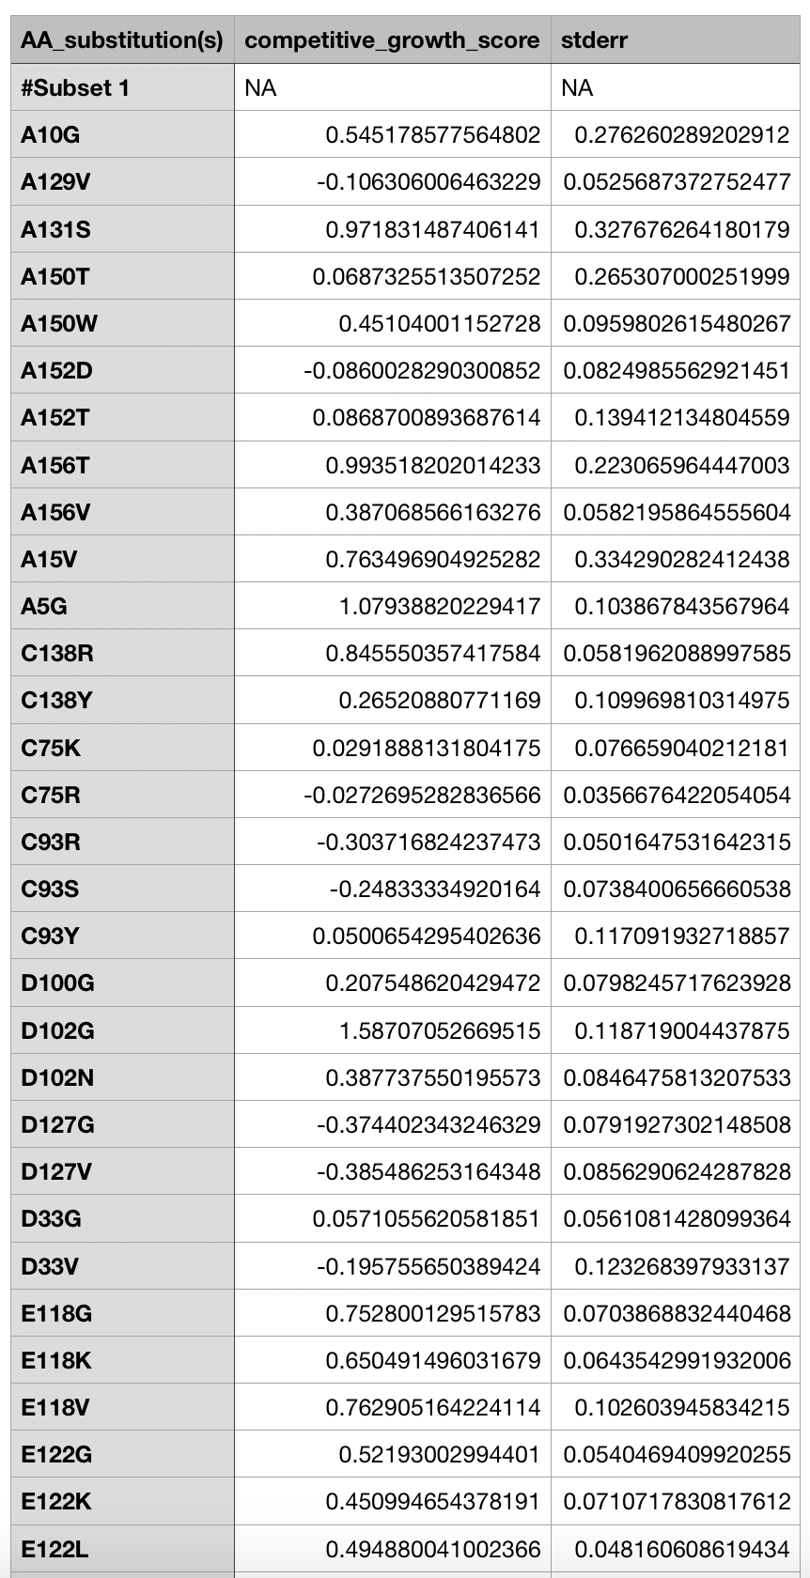
Rank VS Numeric [SUMO]
Human SUMO ligase (UBE2l): predict the effects of missense mutations on competitive growth in a high-throughput yeast complementation assay
16 submissions from 9 groups

Slide 16
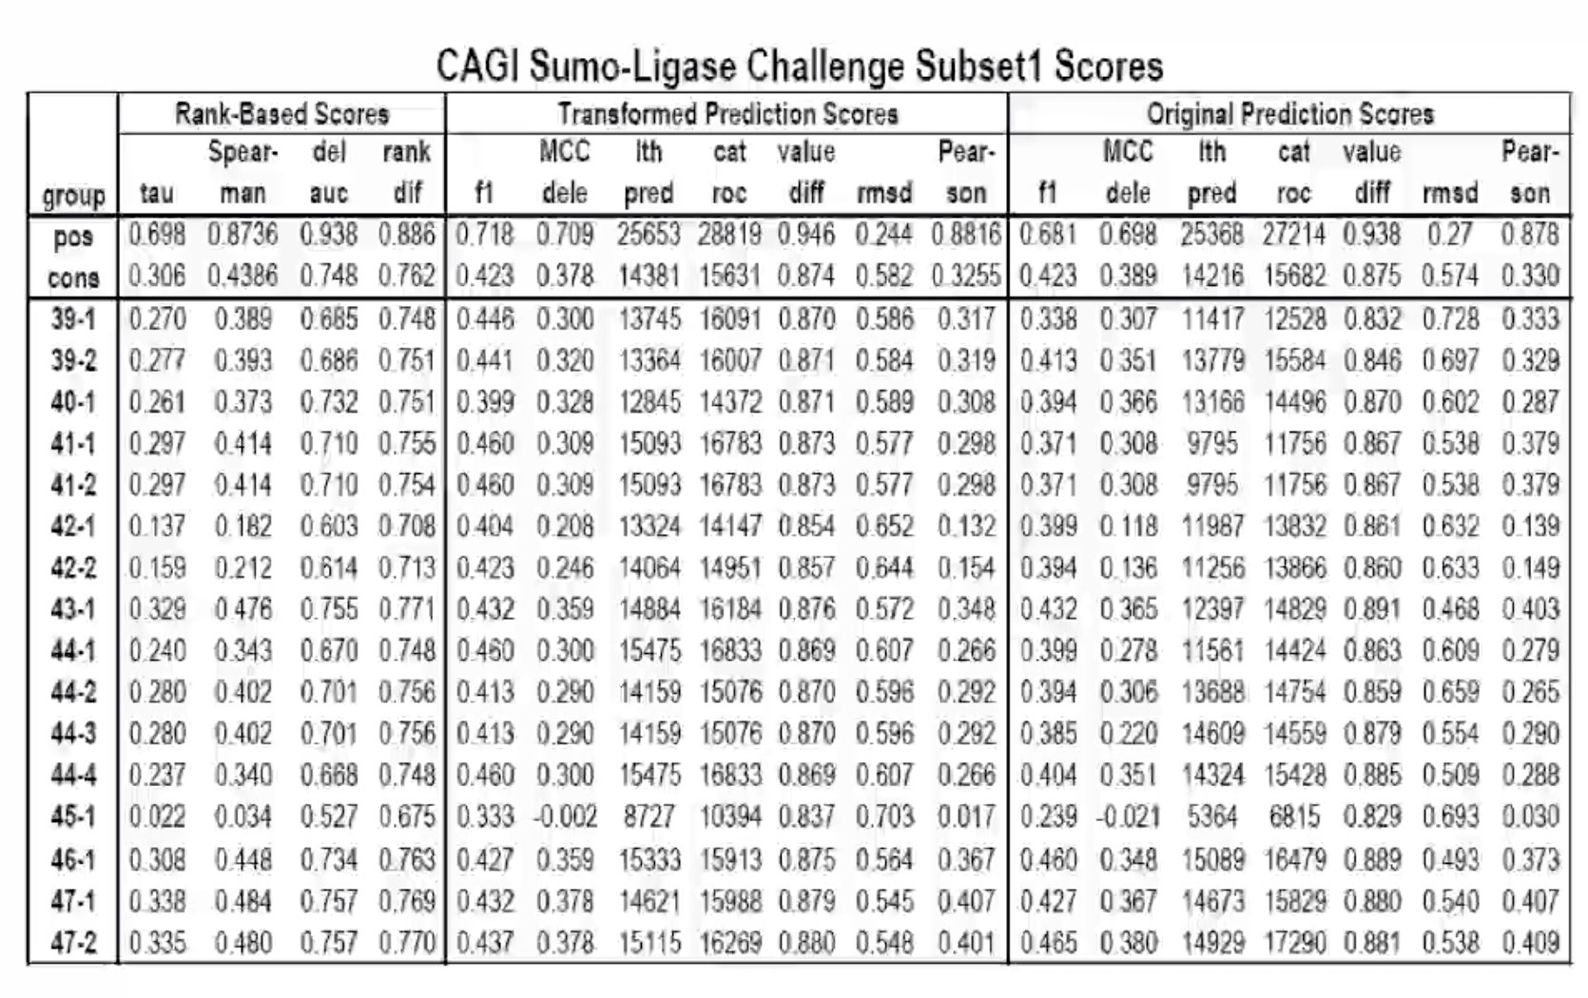
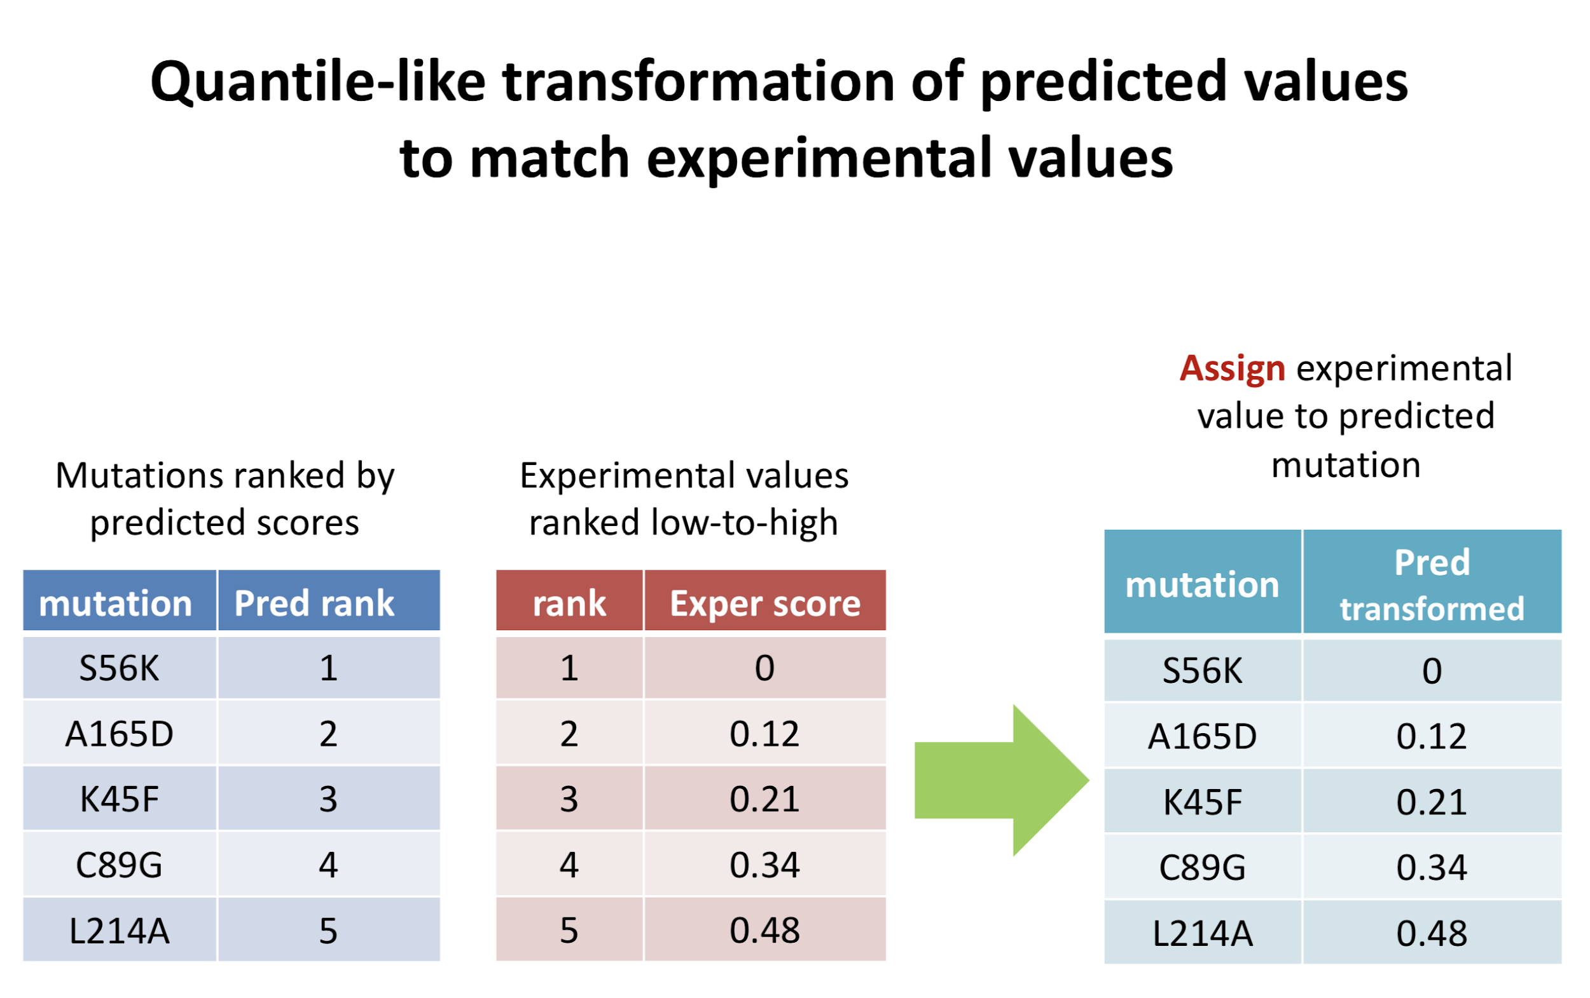
Rank VS Numeric [SUMO]

Slide 17
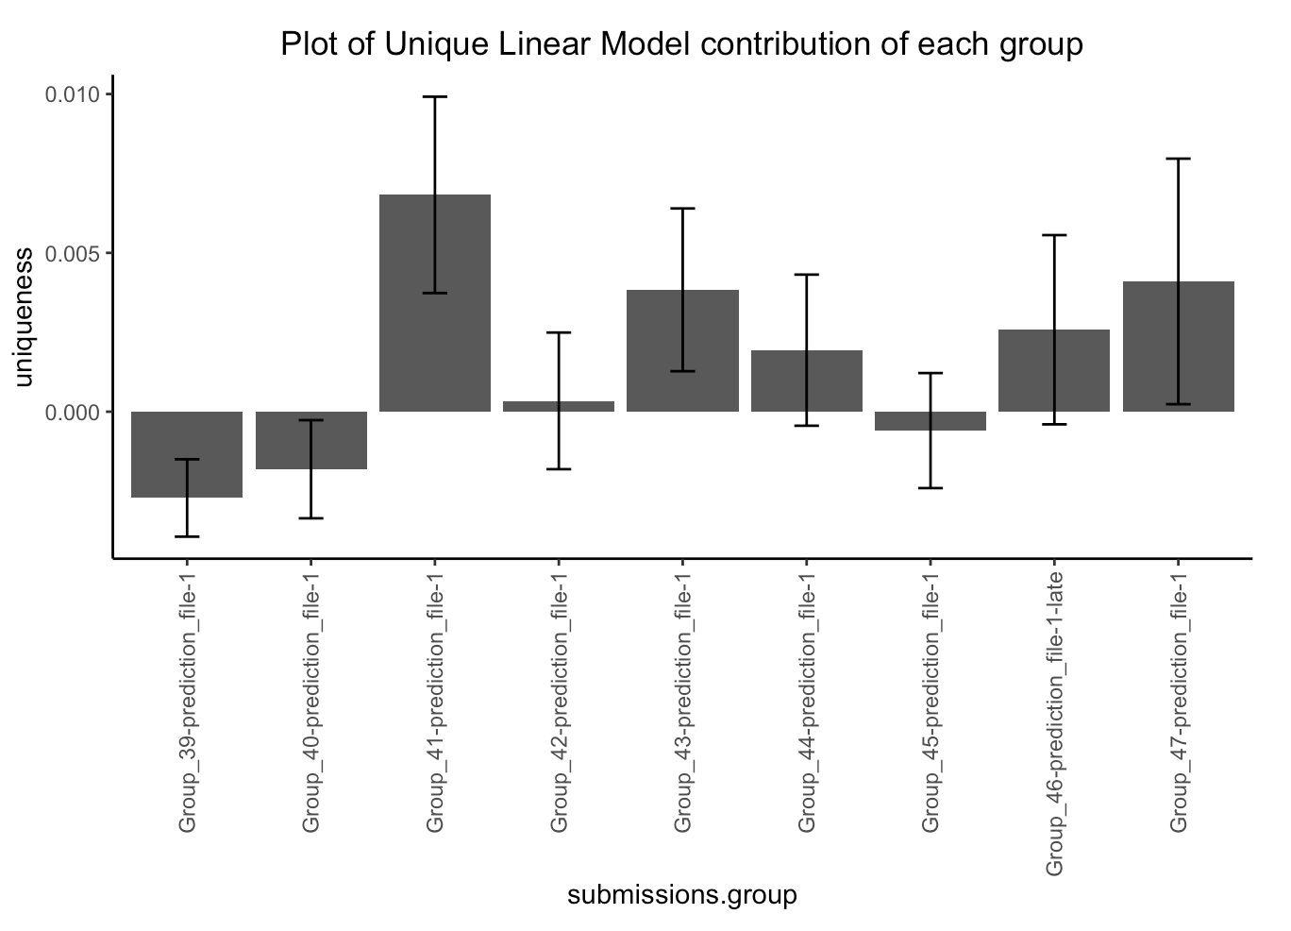
Rank VS Numeric [SUMO]

Slide 18
Rank VS Numeric [SUMO]
Group 41,43,44,47 has the highest unique contribution after bootstrap
43,44,47,46 ranks highest with the composite Z-score
41 performs better on original prediction score rmsd and pearson
46 performs better after rank transformation and Rank-based Eval
41 VS 46: rank and transformed evaluation VS numeric evaluation
Uniqueness analysis use numeric values and compensate rank
Rank based method emphasizes on providing a relatively robust way for compare
Notes:
vUniqueness analysis emphasize on the contribution and the unique knowledge they apply, that can be put into further research
R squre based analysis: will combination of the best methods in each group do better than a single method

Slide 19
Conclusion
Application Side:
A package with consistent ggplot plotting and customized option for evaluation
ROC plot generated with statistics and cutoff selection
PCA
“Between methods” for comparison across submission
Integration of structural genomics: Automated Generation of pymol model
Evaluation Parameter
Incorporate submission grouping feature
Uniqueness Analysis
Exploring more diverse usage of SD

Slide 20
Things may be work on
> Realizing that still a lot of group does not provide SD value …
> R-square significance on likelihood ratio with two linear model
> Rank based Analysis
> Binary/Classification data with comparable logistic regression/DCA modelling

