Slide 1
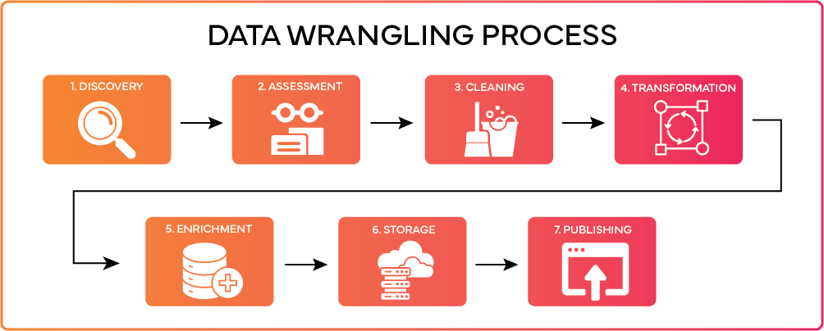
Data Wrangling
In this section, we will learn to ‘wrangle’ raw data. Why do we need to do this?
To transform the data into a format that is more usable and easier to analyse
To clean and remove errors, e.g. entries which are just plain wrong and/or can cause a crash
To allow the combination with other data
To visualize the data
Notes:
SHOW VIDEO OF SWEETIE ESTIMATES

Slide 2
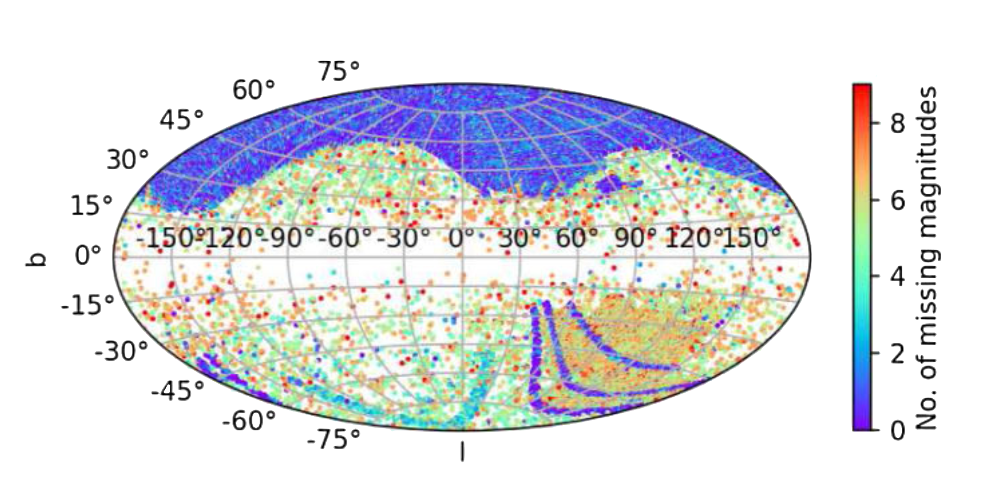
The Tools
• import pandas as pd
For manipulation of the data. Much more flexible than dealing with arrays directly (and output resembles Excel), although arrays are much faster with very large datasets https://www.w3schools.com/python/pandas/
import numpy as np
The alternative if working with arrays. Also numerical python contains a lot of useful stats functions (e.g. mean, max, min) https://numpy.org/doc/stable/user/absolute_beginners.html
import matplotlib.pyplot as plt
For plotting and visualisation
https://matplotlib.org
https://matplotlib.org/cheatsheets/handout-beginner.pdf
Notes:
SHOW VIDEO OF SWEETIE ESTIMATES

Slide 3
Pandas
First thing we have to do is read the data into a dataframe (df, but name it whatever you want):
file.csv - df = pd.read_csv(‘file.csv’)
The most favoured format, as the commas allow empty fields (which can play havoc otherwise)
file.dat - df = pd.read_csv(‘file.dat’, delim_whitespace=True) or sep='\s+',
For space/tab separated ascii/txt files
file.xlsx - df1 = pd.read_excel(‘file.xlsx’, sheet_name = 0)
Have to do each Excel sheet separately – you can loop this if a large number. I just export the ones I need to CSVs, as I find read_excel a bit temperamental
There’s also a couple I’ve never tried:
pd.read_table() - reads general delimited files with any delimiter
pd.read_fwf() - reads fixed width files. You can specify fields either by their widths or their position
Notes:
Remember weight in pounds

Slide 4
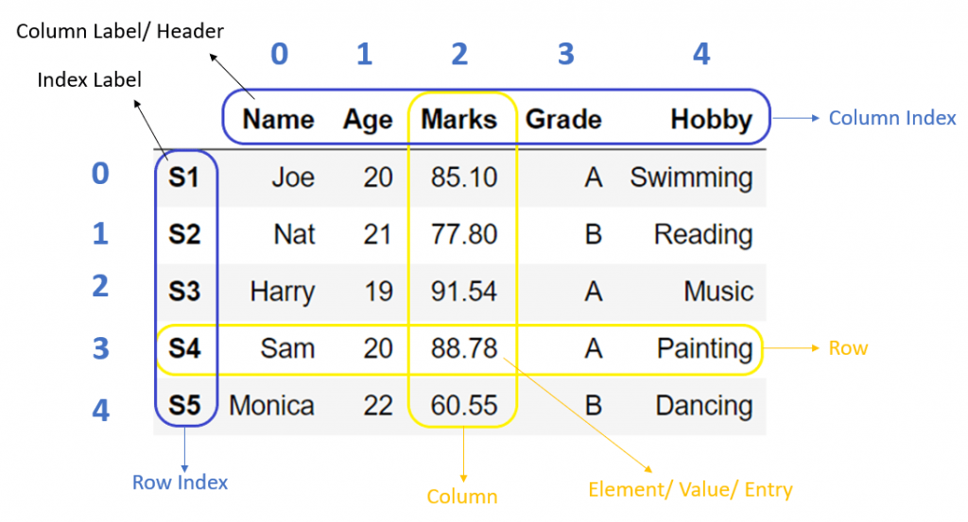
Useful options
infile = ‘file.csv’
pd.read_csv(infile,sep=’|’) - if the separator is a pipe, or some other character (can also be spaces, e.g. sep = ‘ ’, sep='\s+’ )
pd.read_csv(infile, usecols=['column_name1', 'column_name2’]) – if your infile has lots of columns which are not of interest, you can select the ones you want by name
pd.read_csv(infile', usecols=[0, 2, 4]) - as above but selecting columns by the index number
pd.read_csv(infile, comment=‘#’) – if you want to ignore certain lines in your input file you can add a symbol (e.g. #) at the start of the line to specify this

Slide 5
Useful options
pd.read_csv(infile,header=None) – by default the first line of the data are treated as the header, so use this if the header is missing
The header can be added when reading in the data or later on, e.g.
pd.read_csv(infile header=None, names=['col1', 'col2', 'col3’])
df.columns = ['col1', 'col2', 'col3’]
pd.read_csv(infile,skiprows=5) – when you have
rows (e.g. 5 rows in this case) at the top of the
file you don’t want confused for the header
Note the options can be used in conjunction, e.g.
pd.read_csv(infile,header=None,comment='#’)

Slide 6
The dataframe
This presents the data in a clear format and is open to serious manipulation, e.g. performing maths on the entries, vectorised operations, transposing and pivoting the data, filtering, matching and grouping (cf. SQL)…
In a good dataframe:
Each variable must have its own column
Each observation must have its own row
Each value must have its own cell
Have a look at https://pandas.pydata.org/docs/getting_started/intro_tutorials

Slide 7
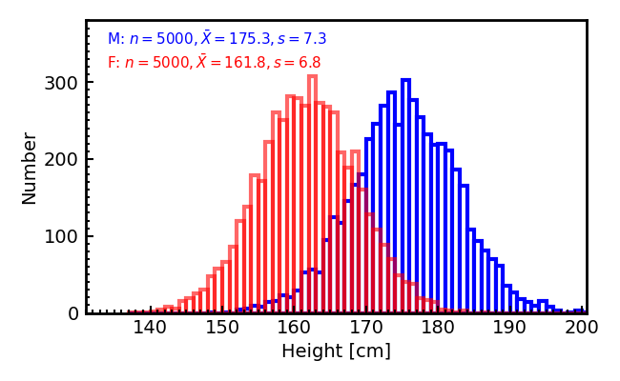
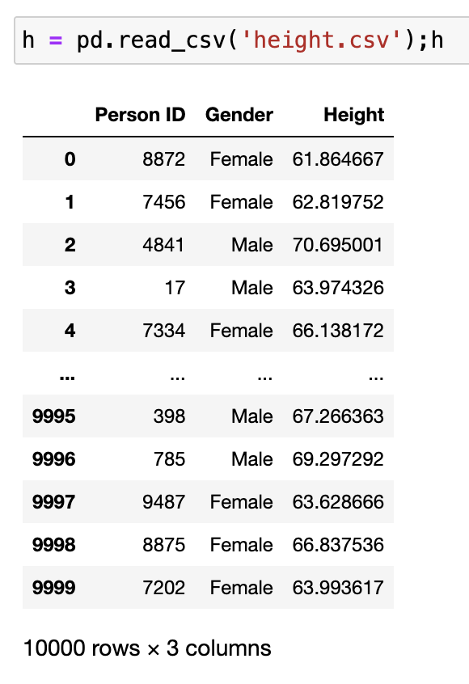
Example, remember this from PHYS/SPCE245?
Let’s look at height.csv
Ex1.ipynb
Default is to show the first and last 5 lines of data, but this can easily be changed
Notes:
Weight data – describe, etc – combine with height teaching/VUW/345_Experiments_In_Space/data/weight_height.py

Slide 8
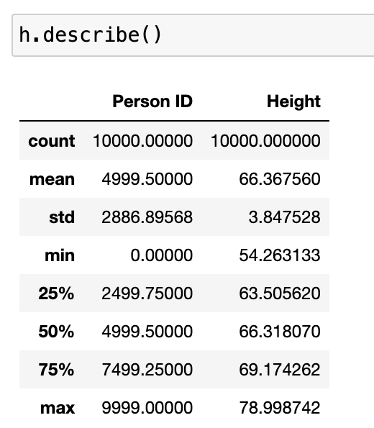
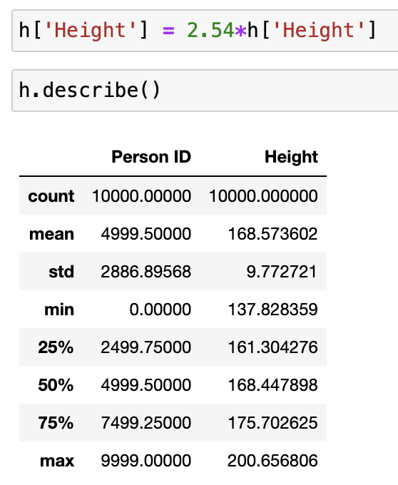
First – inspect the data
Describes the numerical values in the data – note that, although numerical, Person ID is a categorical value (like your student number)
Number of entries (none appear to be missing here)
Mean value
Standard deviation
Minimum value
1st quartile
2nd quartile (the median)
3rd quartile
Maximum value
Data good – nothing missing, no zero nor negative heights and no obvious outliers (mean ≈ median).
However, look the units! Remember from 245 this was American data, so not in sensible units. Probably inches (can’t be feet!). Let’s see – 2.54 cm in an inch
Notes:
Conver to SI

Slide 9
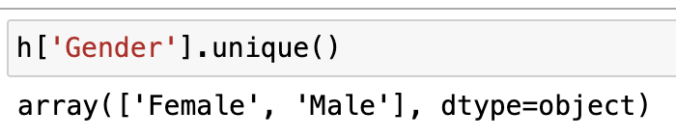

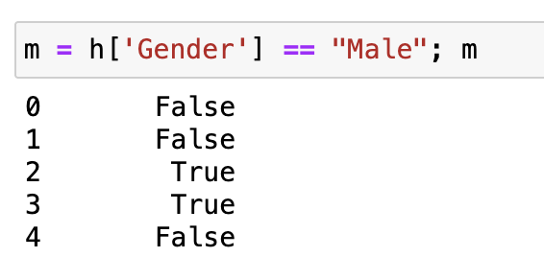
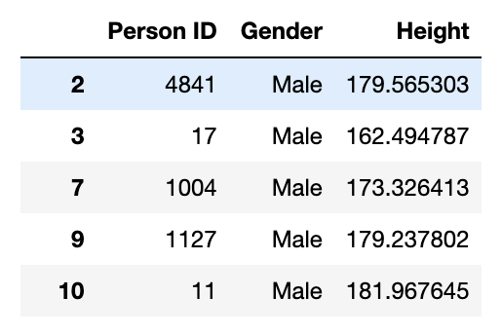
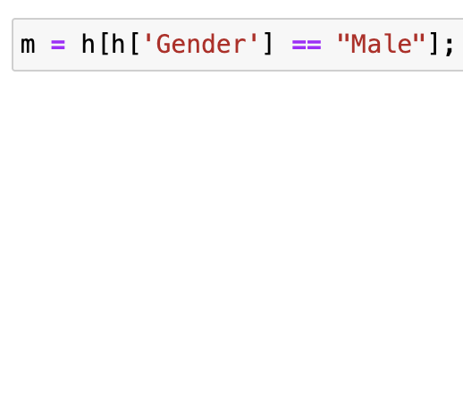
Note we have a mix of genders, but this may not always be obvious (e.g. if the first and last 5 rows all male)
Just the two (data is American and old)
How do we filter this? By selecting a column of the dataframe we select a series, not a single value, so
To filter use the syntax

Slide 10
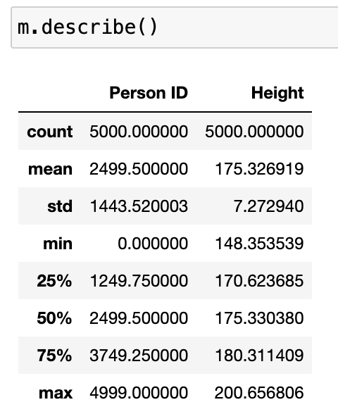
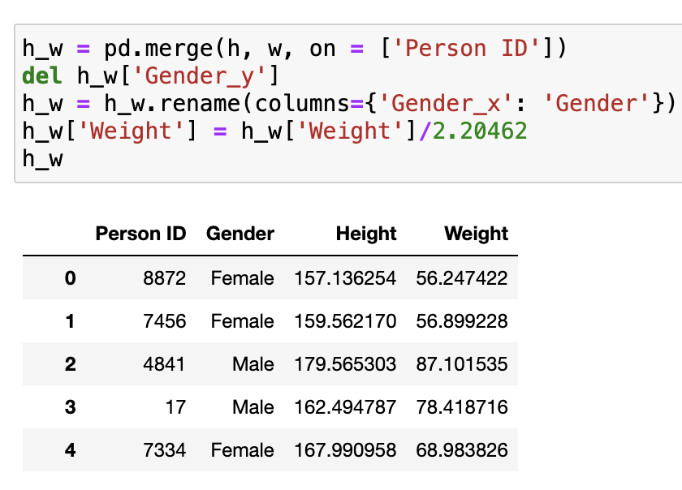
And we can, of course, examine the new dataframes
We can also work with more than one dataframe at a time and combine these,
say after w = pd.read_csv('weight.csv')
Check what you have makes sense!
h_w = pd.merge(h, w, on = ['Person ID’]) will merge the data, but because each dataframe has a column with the h_w['Gender_y’] same name, we can remove one of these and rename the remaining
h_w = h_w.rename(columns={'Gender_x': 'Gender’}) this is not necessary, but is tidier
h_w['Weight'] = h_w['Weight']/2.20462 you’ll note the weights appear high, but, again, these are in imperial
units (so convert from lb to kg)

Slide 11
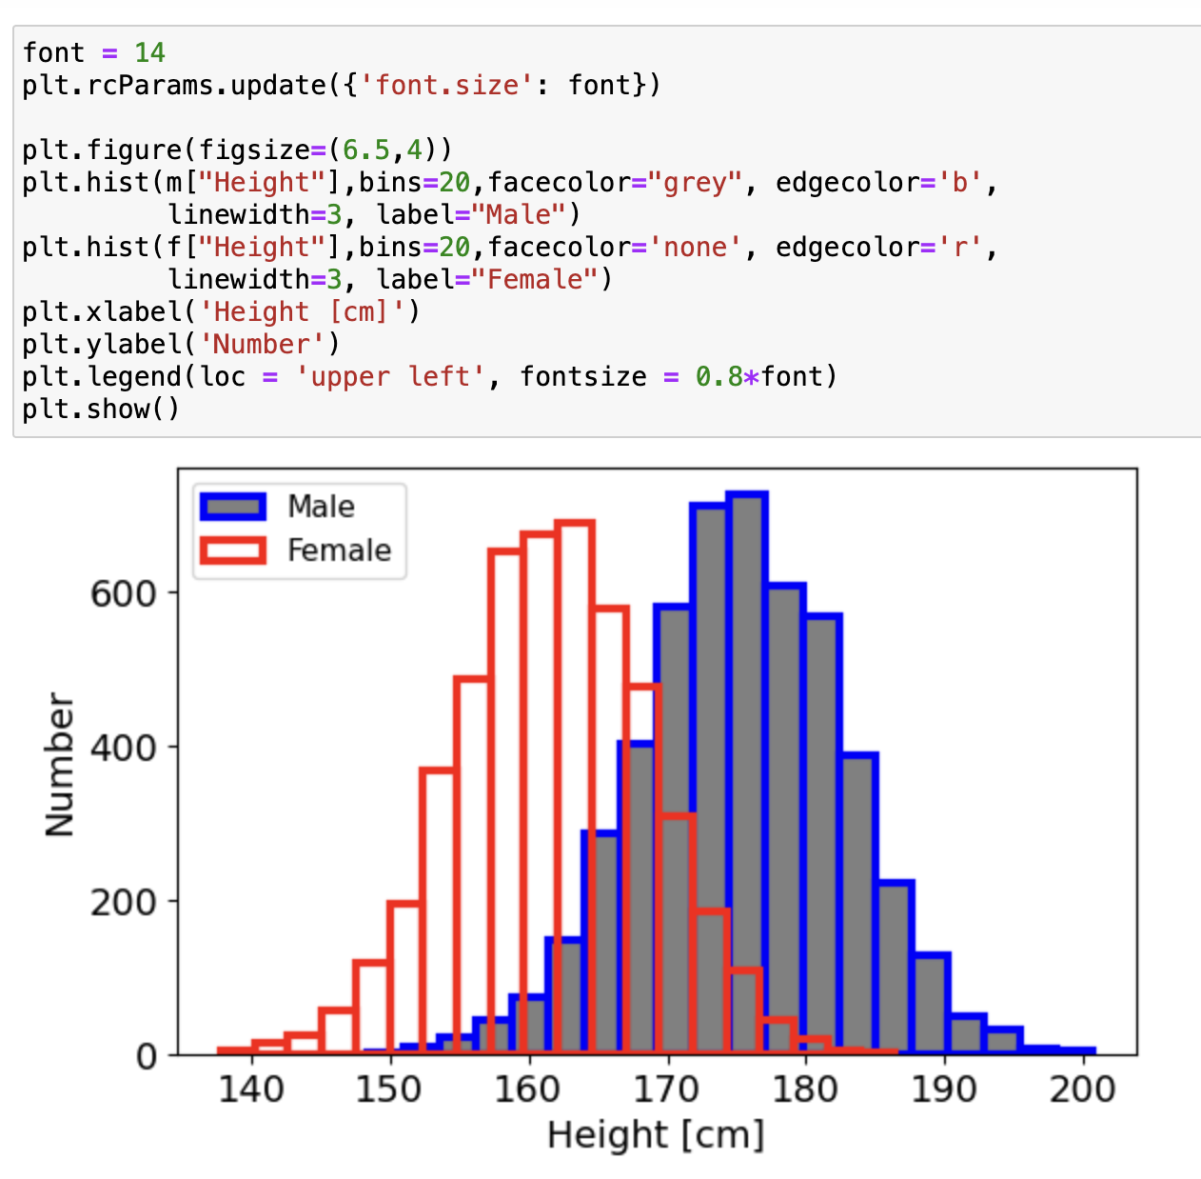
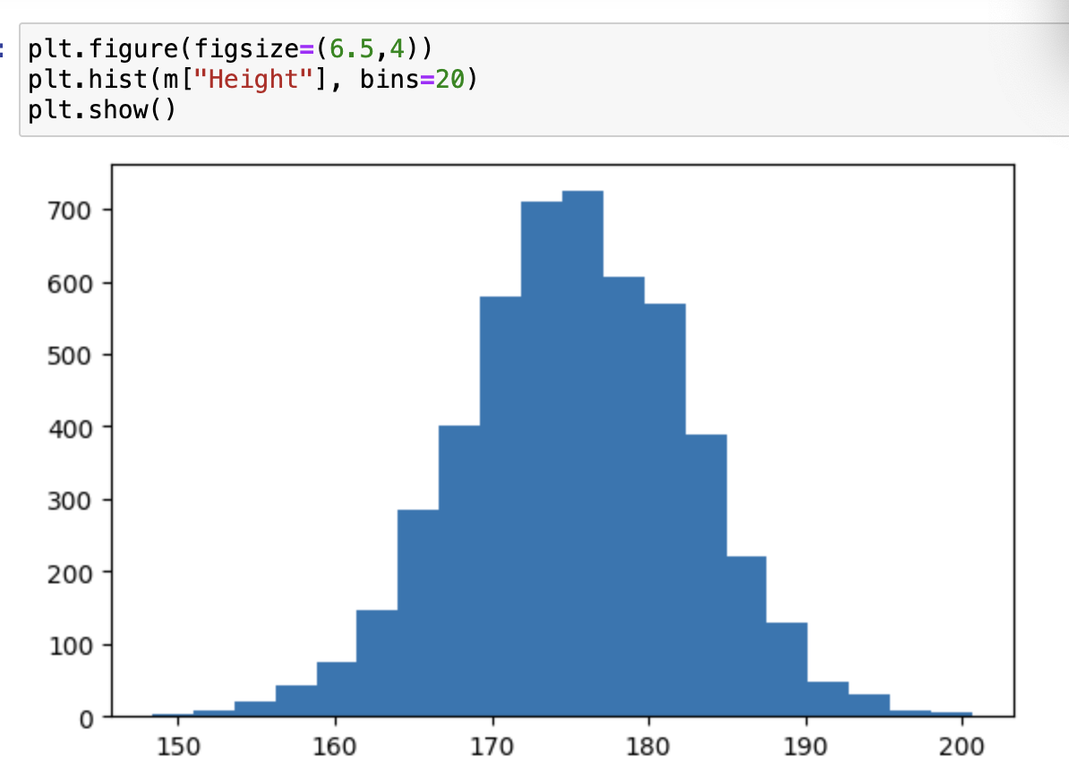
Matplotlib
For plotting the data – by no means are you limited to this package (I’ve heard of pgplot being used and this is way older than most you. I’m guilty of using this up to 2023, but with C).
As you might have seen in 245, the default settings give pretty basic plots, but these can easily be snazzed up

Slide 12
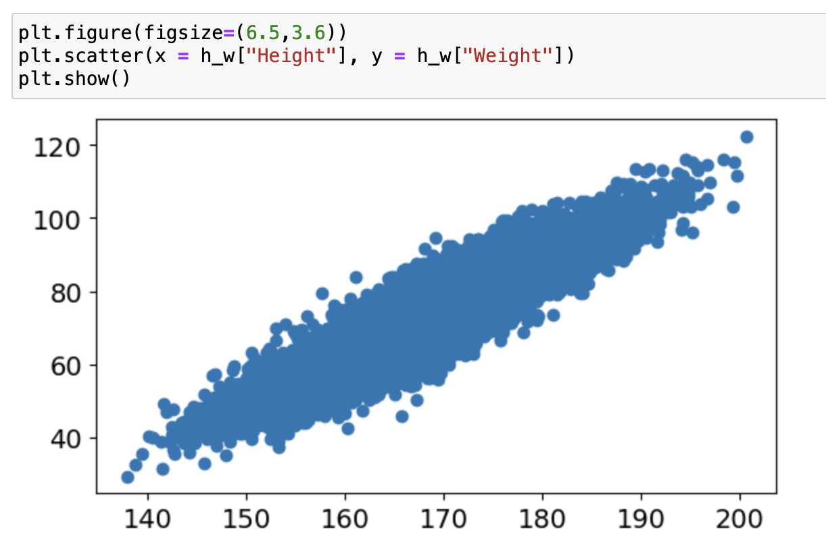
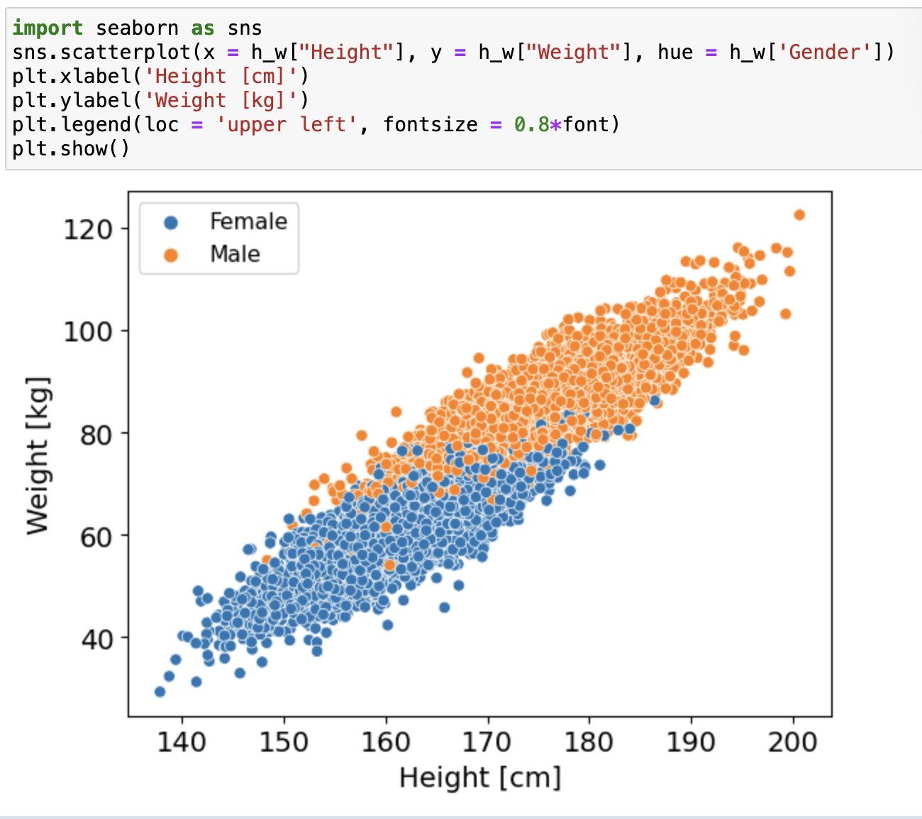
Have a play and try different things
With the data combined we can plot the different parameters against each other
Note that seaborn will plot the labels and legend without being asked, but the former are based on the column names (so don’t have the units), plus I don’t like the legend at full size

Slide 13
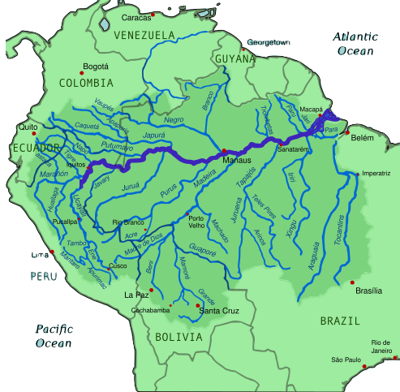
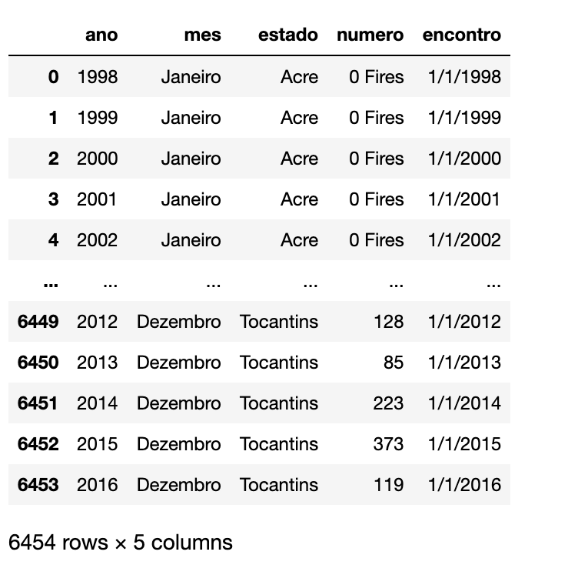
Data Cleaning
ISO/IEC 8859-1 encodes what it refers to as "Latin alphabet no. 1", consisting of 191 characters from the Latin script. This character-encoding scheme is used throughout the Americas, Western Europe, Oceania, and much of Africa.
Doing in Ex2.ipynb
Load a new dataset on the number of fires in the Amazon rainforest
df = pd.read_csv(url, encoding = "ISO-8859-1")
Looks like names are in Spanish or Portuguese, which we could of course work with but let’s change the column names to see how this is done. The syntax is
df = df.rename(columns={'old1': 'new1', 'old2': 'new2’})
but we can do this directly by using a dictionary
A dictionary is a built-in data structure used to store collections of data in key-value pairs. It is mutable, meaning its contents can be changed after creation.
Notes:
courses/Deep_Learning_for_Business-Udemy/notes.pdf. P15

Slide 14
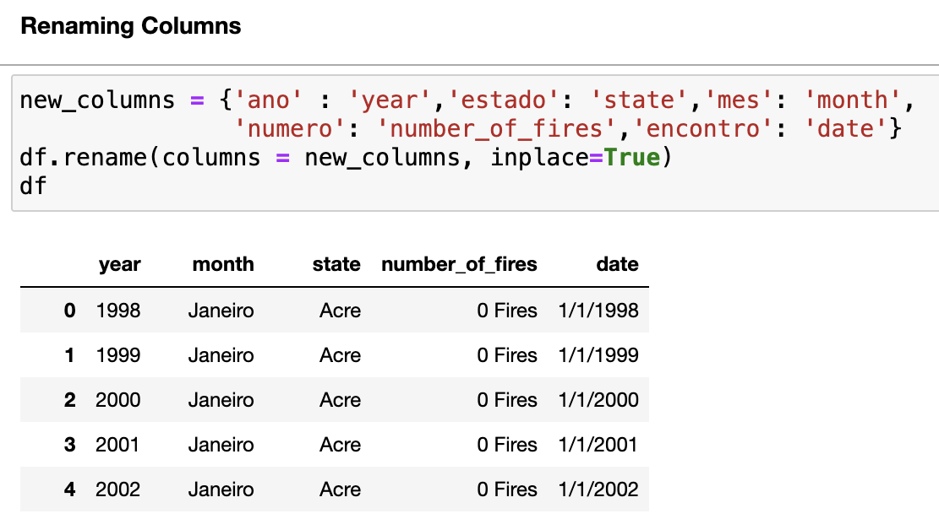


dictionary – {key:value}
note the inplace = True, which is just the same as df = df.rename…
Next, we’ll rearrange the columns so the date is in the first field, followed by month and then year
df.columns
df = df[['date','month','year','state', 'number_of_fires']]
list the columns (as a series)
in the order you want them

Slide 15
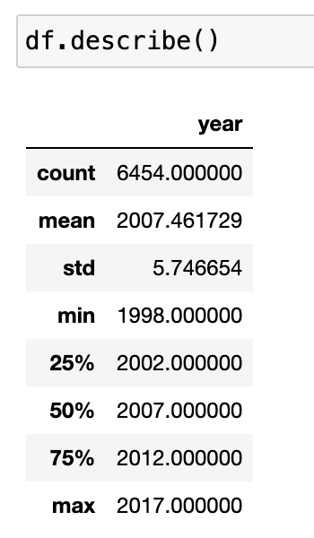
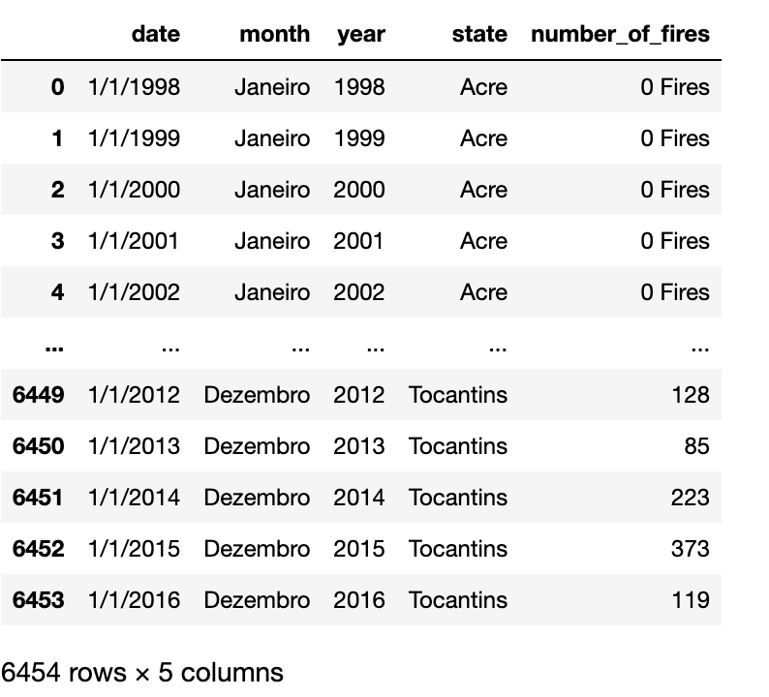
number_of_fires is not included under describe – so it’s not numerical.
The fact that some of these include Fires means this parameter is treated as a string.
To remove unnecessary text from use str.strip
df['number_of_fires'] = df['number_of_fires'].str.strip(" Fires")
But we also have to tell pandas that this is not a string anymore
df['number_of_fires'] = df['number_of_fires'].astype(int) but crashes – still have some non-numeric values in column?

Slide 16
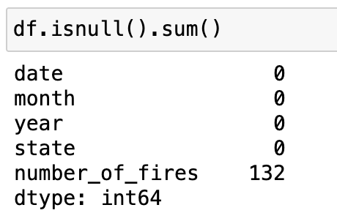

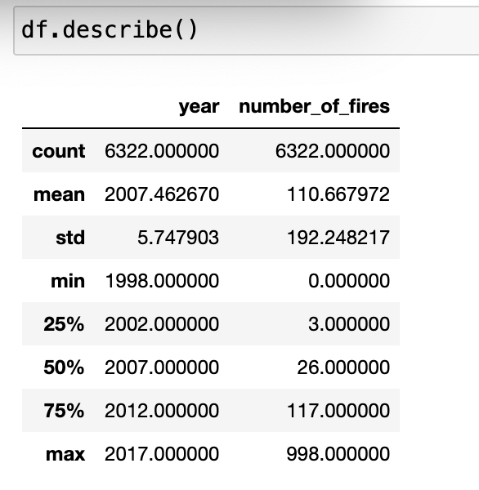
Missing Data
We can remove Null or NaN (not a number) values by dropping rows with NaN values
df = df.dropna()
df = df.reset_index() resets row indices in case any rows were dropped
Note that the count has dropped from 6454

Slide 17
What do we do with missing data?
Remove the rows, as above
Replace them (impute) with some arbitrary number (e.g. 0 or the average)
df= df.fillna(0)
df = df.fillna(df.mean())
But bear in mind that the values are probably wrong. These are handy if the other columns contain useful data and you don’t want to discard the whole row – each of these methods will leave us with all 6454 entries
Forward Fill (ffill) or Back Fill (bfill).
ffill propagates the last observed non-null value forward until…
bfill propagates the first observed non-null value backward until...
another non-null value is met.
Impute the missing data using machine learning to estimate what these should be

Slide 18
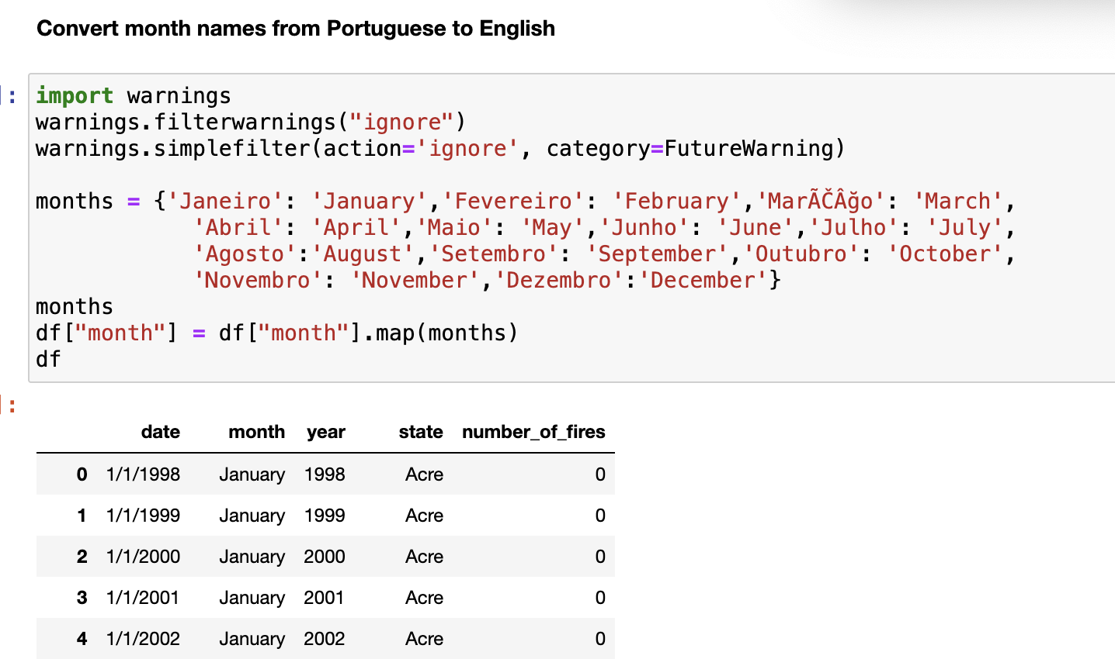
Modifying the contents of the dataframe
As well as mathematical operations and converting strings to numbers, we can, for example…
If you don’t want the annoying, and not very helpful, warnings
Defining a dictionary
Changing the values in the column by mapping the dictionary
This can be very useful for other tasks, such as conditional statements – instead of
if something == the_other:

Slide 19
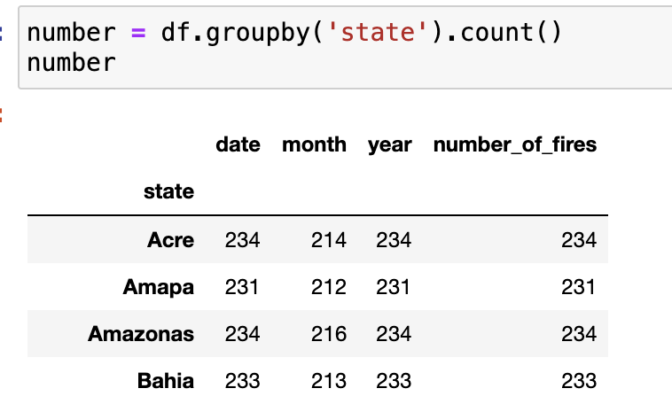
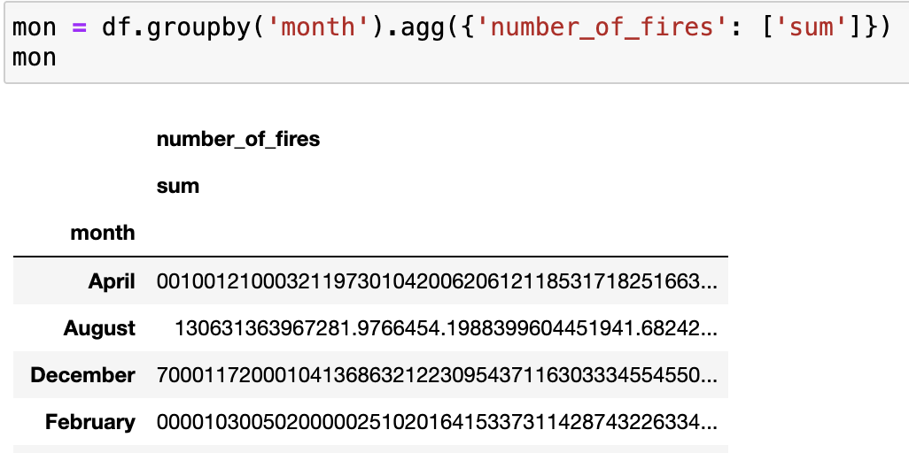
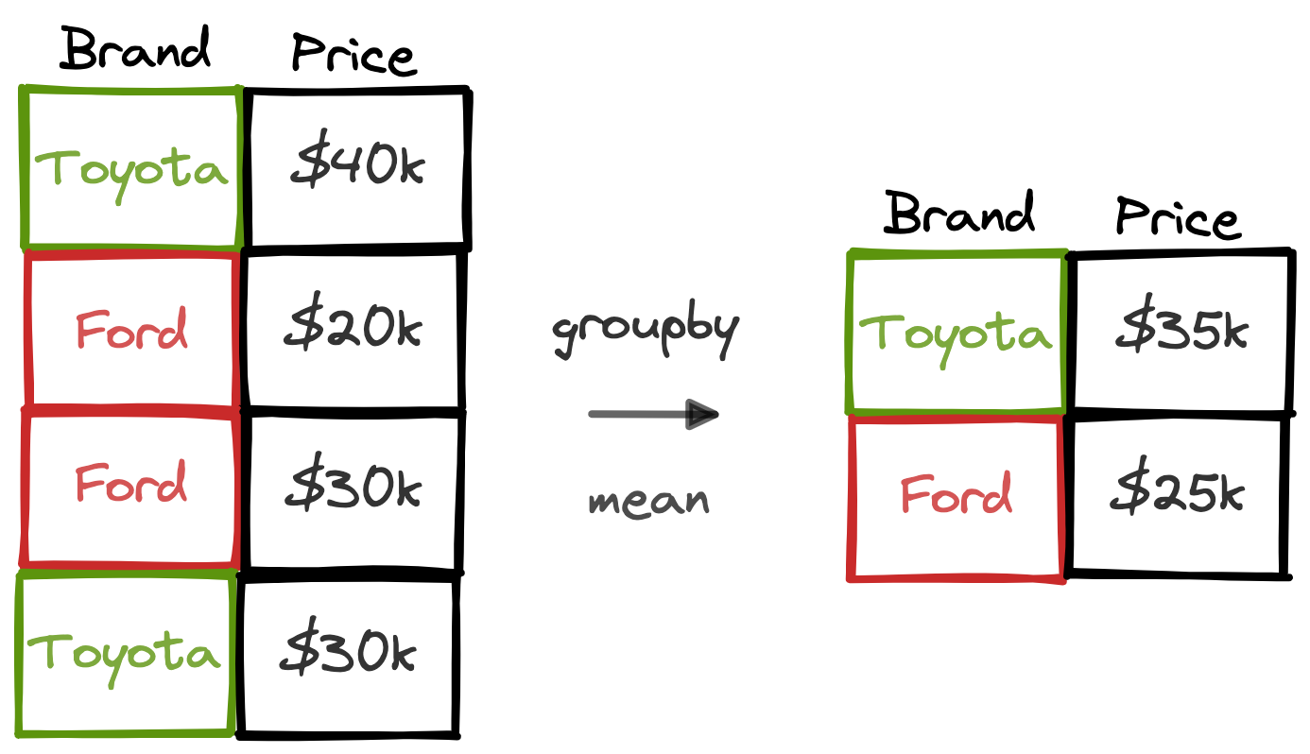
Grouping Data
Using groupby – note that this is counting the number of entries (rows for each state), not the number of times a fire has been recorded, which we can do with..
Summing the number of fires per month highlights a problem – the number_of_fires column is considered to comprise strings (a hangover from 0 Fires) and so pandas is summing them accordingly.
Other aggregation functions are min ,max , mean, std

Slide 20
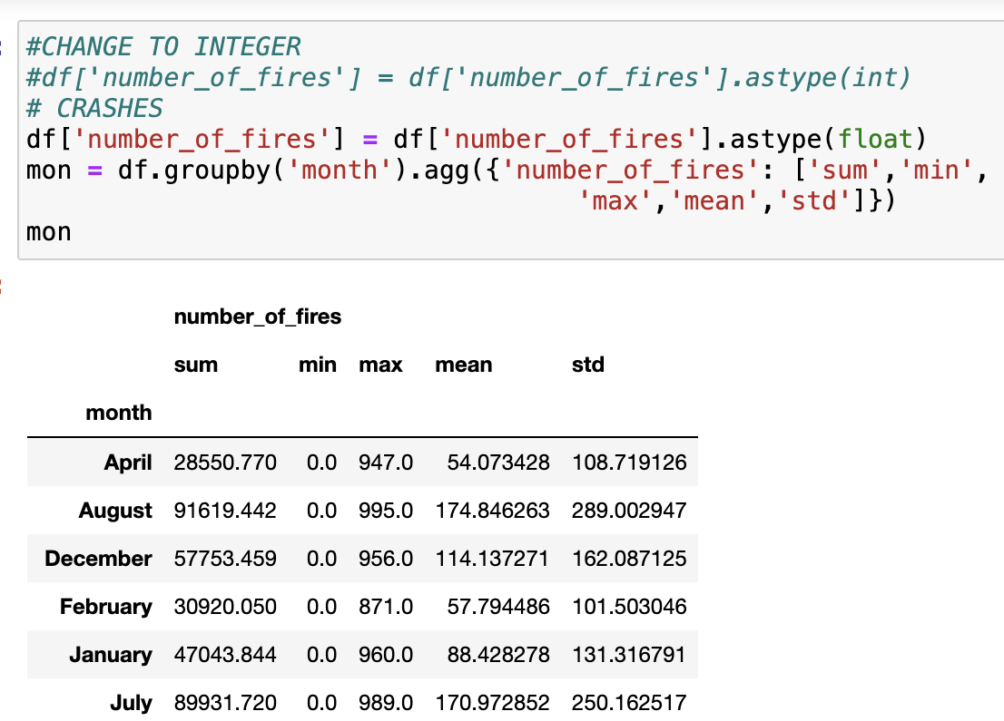
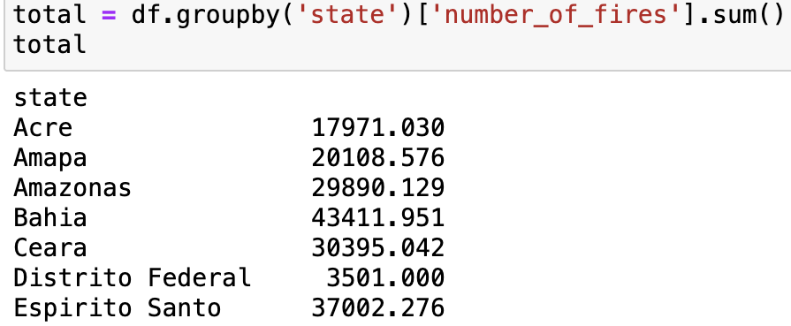
However, this crashes when using astype(int) - I found that the number_of_fires is not an integer, but a float.
Note also that the months are in alphabetical order, which we’ll change next

Slide 21
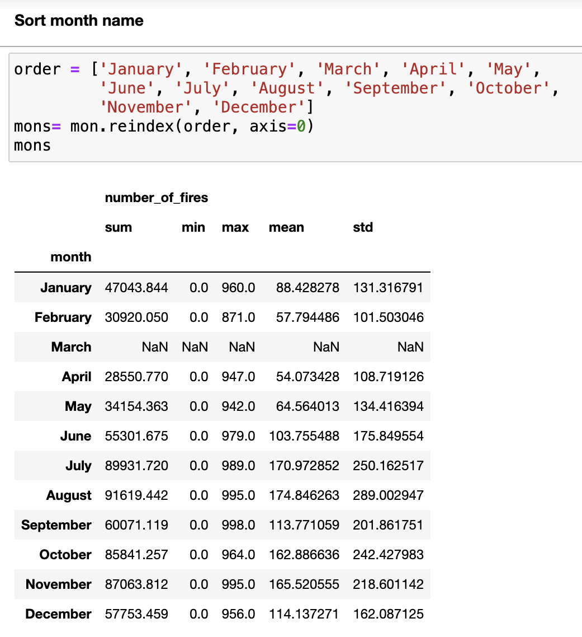
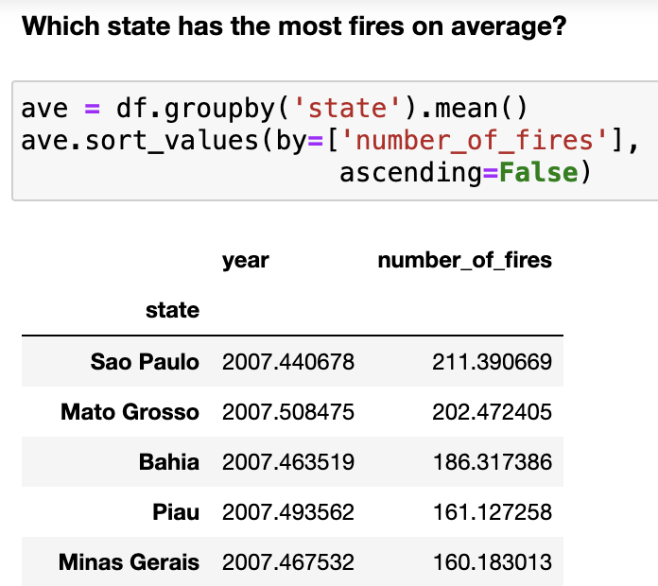
This wasn’t obvious in the unsorted version
See what this does
df.groupby(['state','month']).agg({'number_of_fires': ['sum','min', 'max','mean','std']})

Slide 22
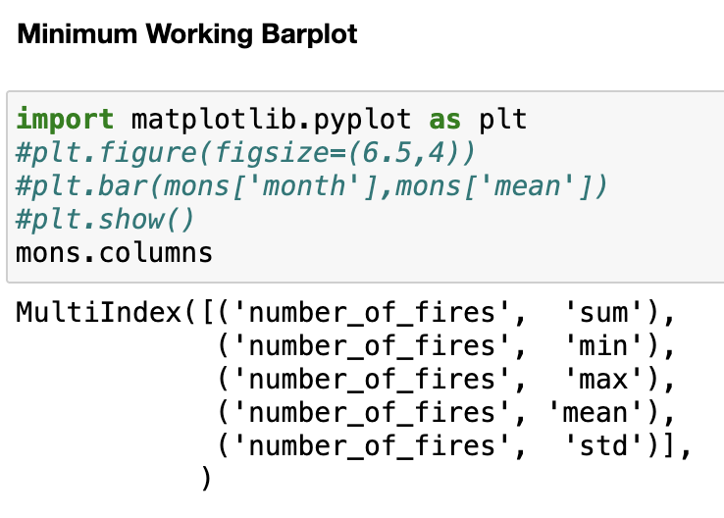
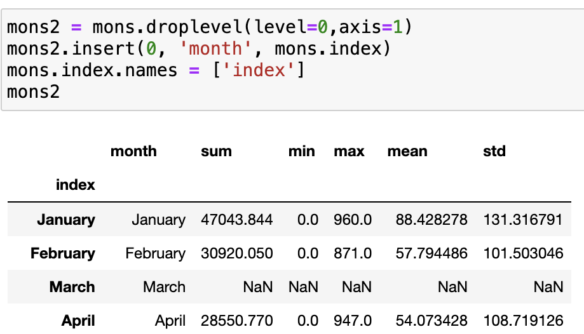
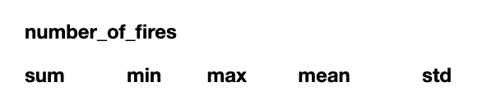
Look at the distributions
Bar plot crashes because of the MultiIndex format generated by groupby means it can’t find month or mean
mons2 = mons.droplevel(level=0,axis=1) drops the first level heading (axis = 1, horizontally along the columns)
mons2.insert(0, 'month', mons.index) uses the index column from the DF as the first column ‘month’
mons.index.names = ['index’] renames the index – although not recognised, it’ll still complain
Notes:
Note that groupby doesn’t really know what to do with the column names,
but we can fix that (there’s many other suggestions online, but they can be complicated or unreliable)

Slide 23
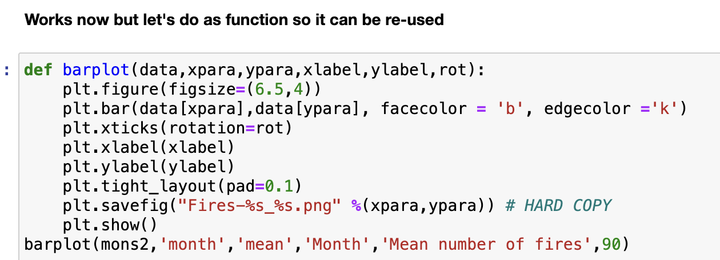
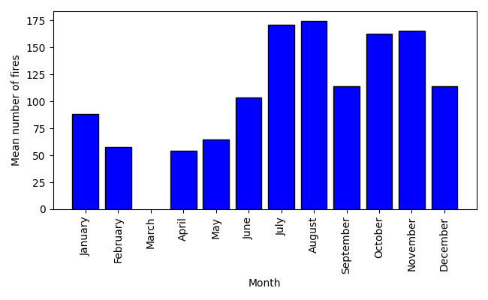
E.g. for total number of fires binned by month
barplot(mons2,'month','sum','Month','Total number of fires',90)
for total number of fires binned by state, year, etc
barplot(state,'month','sum','Month','Total number of fires',90)
But will have to fix the columns as on previous slide – could put the whole thing in a function

Slide 24
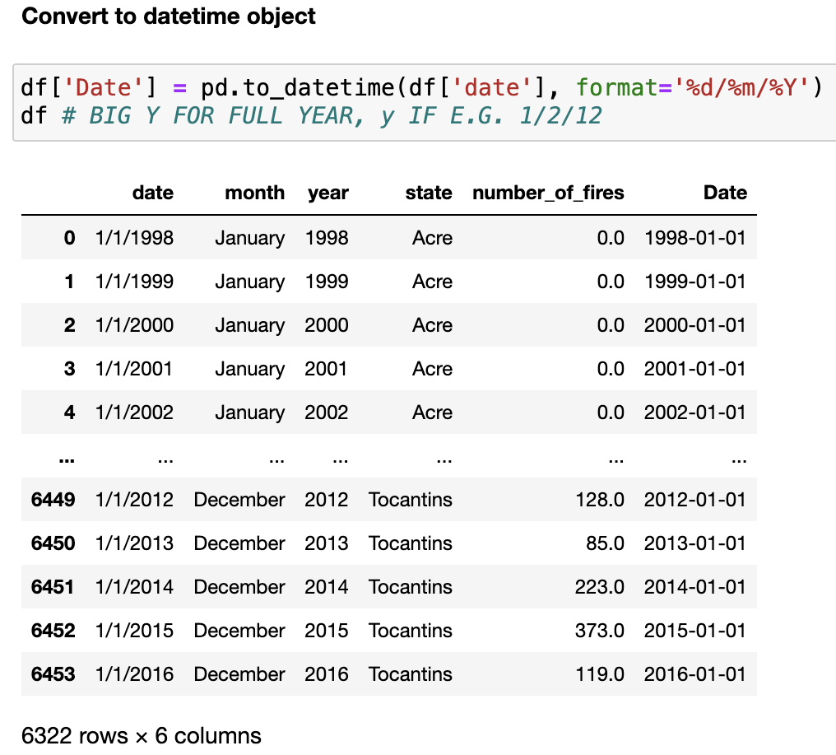
Time Series
Also in the datetime module.
date: date (year, month, and day).
time: time (hour, minute, second, microsecond).
datetime: a specific moment in time, combining date and time.
timedelta: the difference between two dates, time or datetime instances.
timezone: time zone with a fixed offset from UTC.

Slide 25
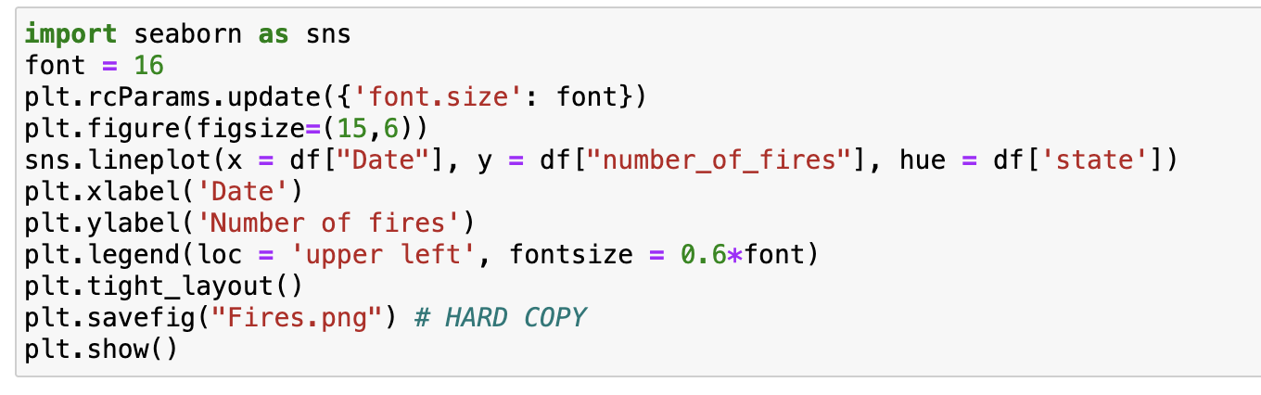
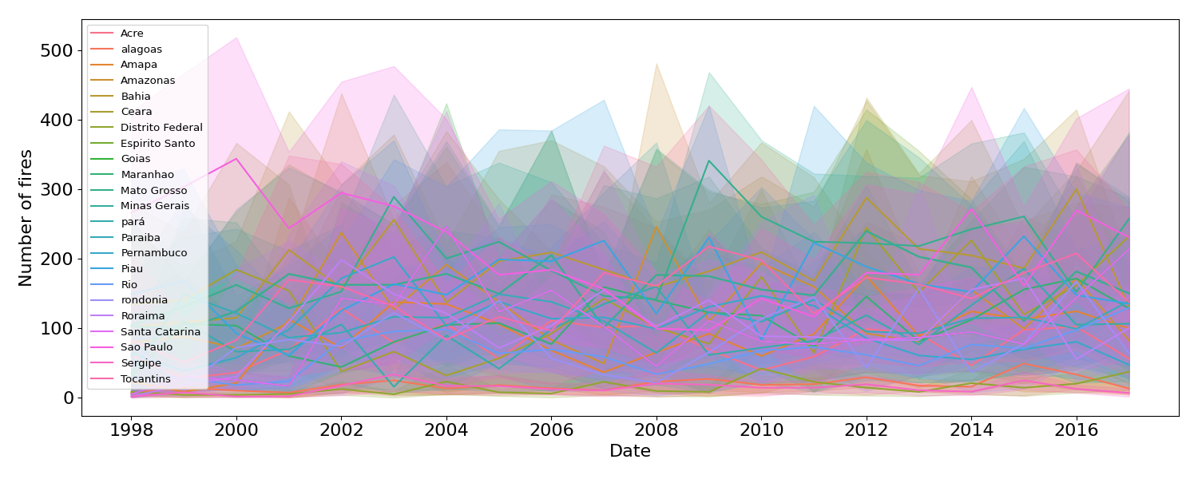
A bit busy, but you get the idea

Slide 26
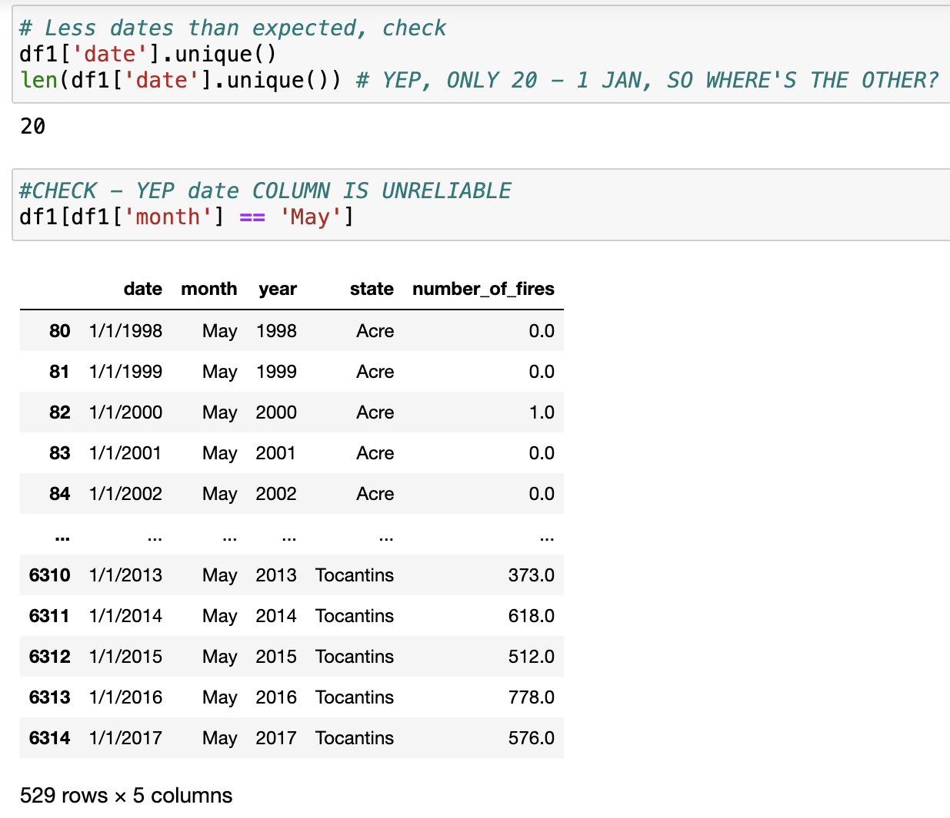
But, from summing all of the data it appears that the date column doesn’t match the month
According to date all of the months under the date column are January!
I’m beginning to suspect that this dataset was set up to test us

Slide 27
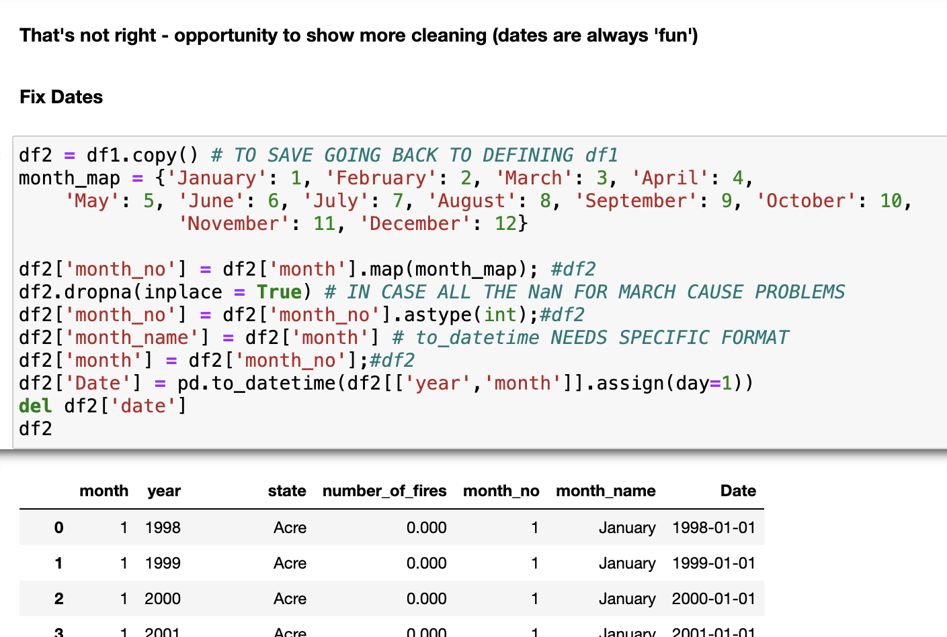
Mapping month names to month number
Became a float, convert to int
Renaming columns as datetime is fussy
Make the first date day 1

Slide 28
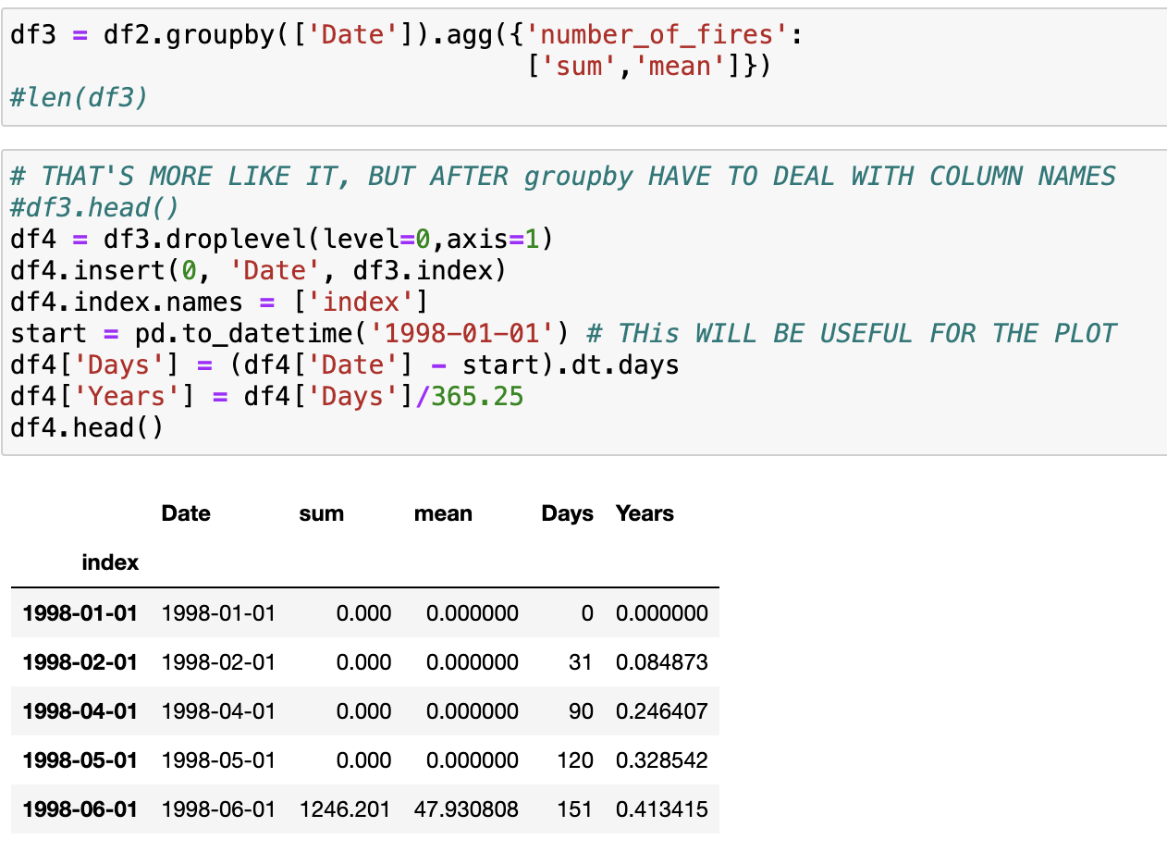
Fix the mess left by groupby
dt giving time difference
dt doesn’t work with years (or months)

Slide 29
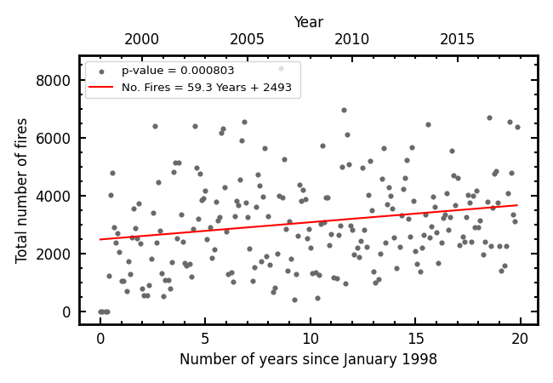
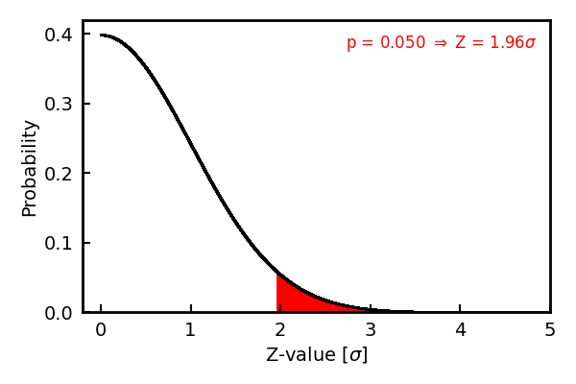

An increase of 59 fires per year, on average (starting from 2493 in 1998)
This is statistical evidence, not opinion, that fires are becoming more frequent. What could be causing that?
The distribution has a probability of p = 8.0 x 10⁻⁴ of arising by chance (Z = 3.35) – remember for the ‘softer sciences’ p < 0.05 (Z > 1.96) is considered significant!

