Slide 1
On the Robustness of Natural Language Explainers
Steven George, Da Wei Wong, Olivier Kraft, Kirill Rodriguez-Blanter

Slide 2
Background

Slide 3
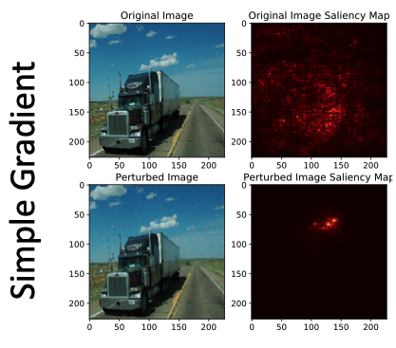
Background
Growing role of explainers in NLP context
Research on sensitivity of explainers in the context of machine vision (Ghorbani et al. 2019)
Image: Interpretation of Neural Networks is Fragile (Ghorbani et al 2019)

Slide 4
Research objective
Is it possible for two natural language inputs that look identical to humans to produce significantly different explanations?

Slide 5
Experimental Set-up

Slide 6
Experimental set-up
Model | Explainer
BERT | LIME
BERT | SHAP
BCN | LIME
BCN | Gradient
Data sets: SST and AG News
10 perturbations
Two metrics:
Top-k intersection
Spearman’s rank correlation coefficient

Slide 7
Results

Slide 8
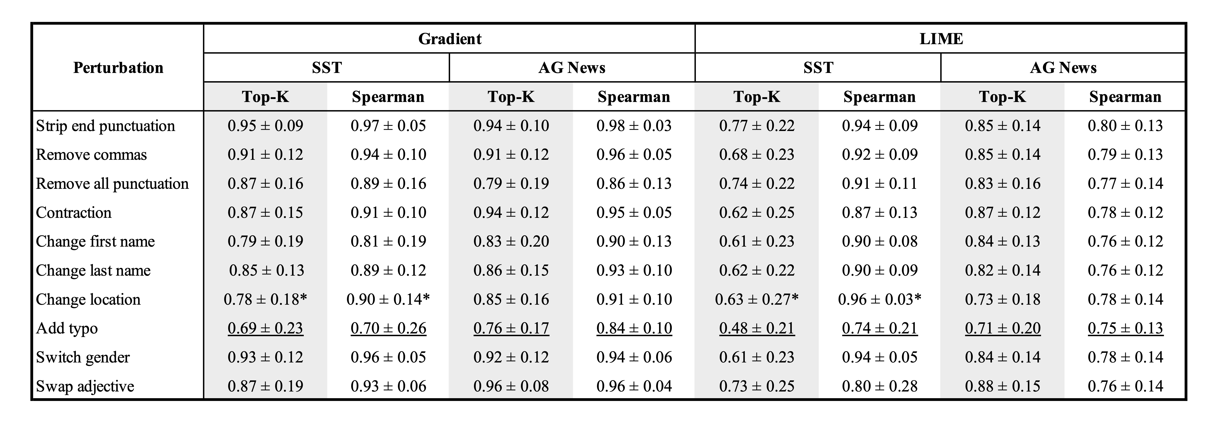
BCN results
Explainers most affected by typos
* Fewer than 20 examples

Slide 9
BCN results
Explainers most affected by typos
* Fewer than 20 examples

Slide 10
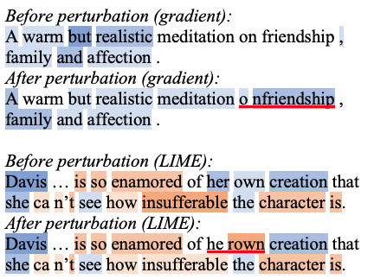
Sentence-level analysis

Slide 11
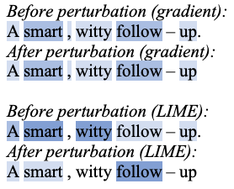
Sentence-level analysis

Slide 12
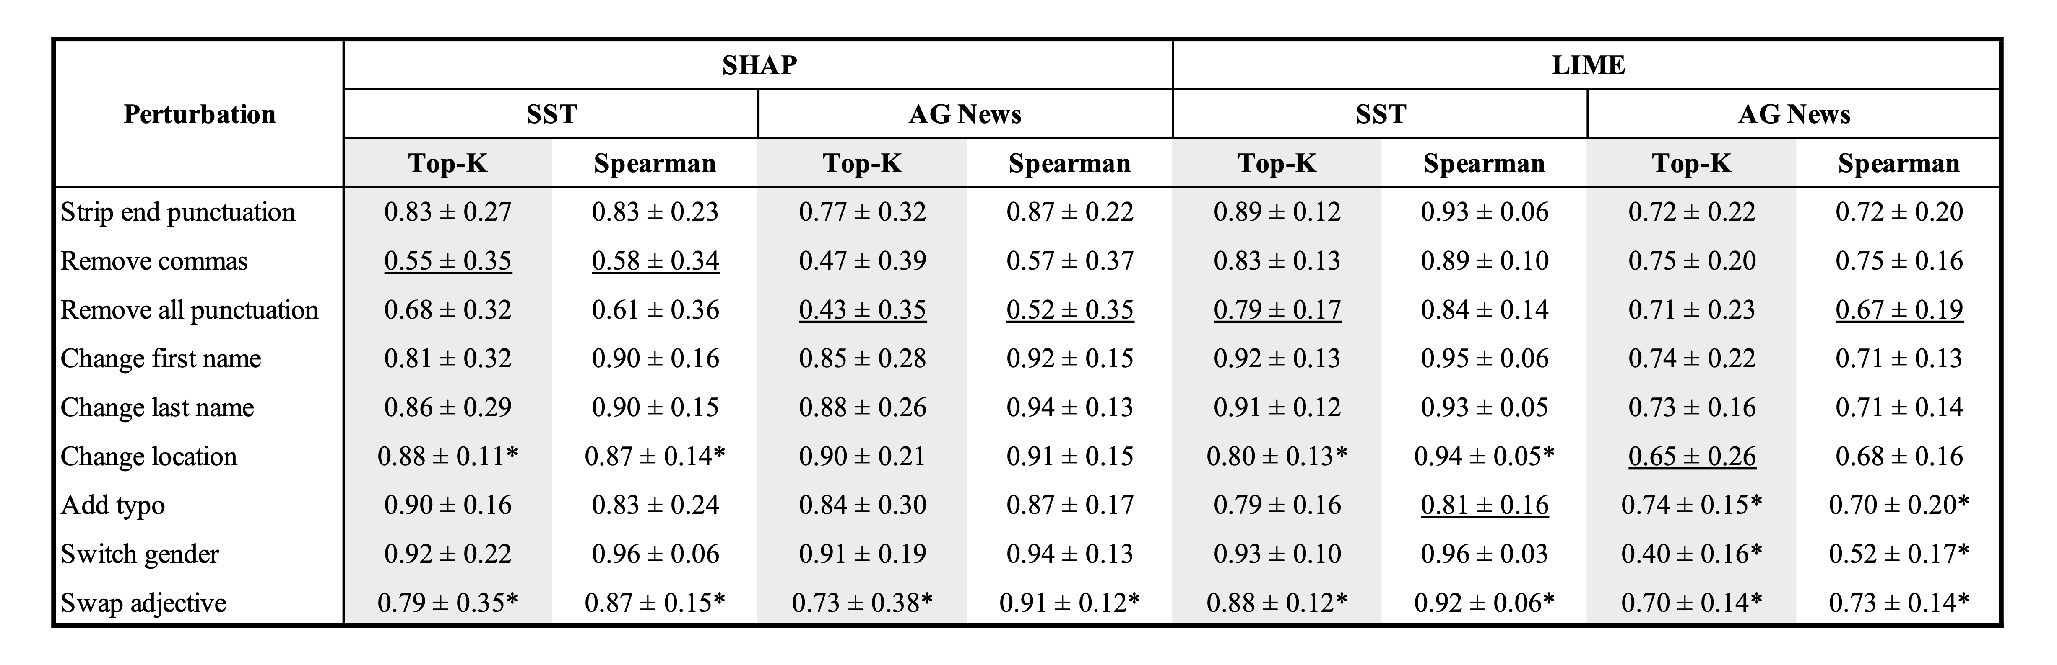
BERT results
Explainers most affected by removal of commas and all punctuation
* Fewer than 20 examples

Slide 13
BERT results
Explainers most affected by removal of commas and all punctuation
* Fewer than 20 examples

Slide 14
Have we fooled the explainer?
SHAP and LIME produce inconsistent explanations both before and after perturbation

Slide 15
Have we fooled the explainer?
SHAP and LIME produce inconsistent explanations both before and after perturbation
Top-5 intersection between explainers for AG News 0.33 (± 0.21)

Slide 16
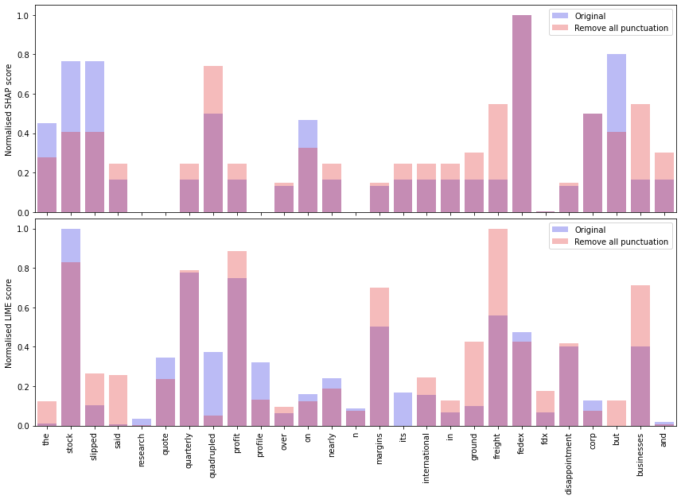
Have we fooled the explainer?
SHAP and LIME produce inconsistent explanations both before and after perturbation
Top-5 intersection between explainers for AG News 0.33 (± 0.21)

Slide 17
Have we fooled the explainer?
SHAP and LIME produce inconsistent explanations both before and after perturbation
Top-5 intersection between explainers for AG News 0.33 (± 0.21)

Slide 18
Have we fooled the explainer?
SHAP and LIME produce inconsistent explanations both before and after perturbation
Top-5 intersection between explainers for AG News 0.33 (± 0.21)

Slide 19
Conclusions

Slide 20
Findings
Demonstrated that simple non-targeted perturbations can lead to significantly different explanations
SHAP and LIME shown to produce inconsistent explanations for the same sentence

