Slide 1
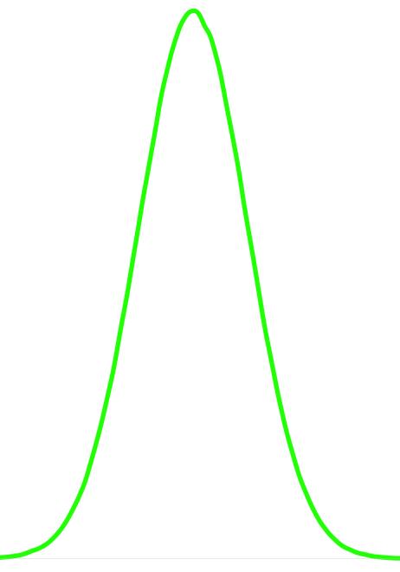
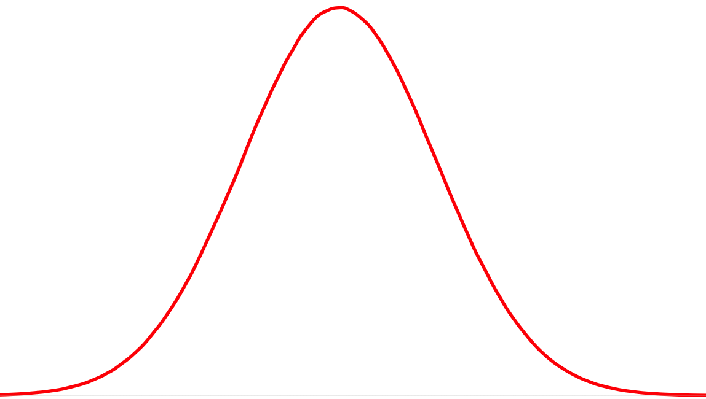
True
Negative
True
Positive
0
0.5
1
False
Negatives

Slide 2
True
Negative
True
Positive
0
0.5
1
False
Positives

Slide 3
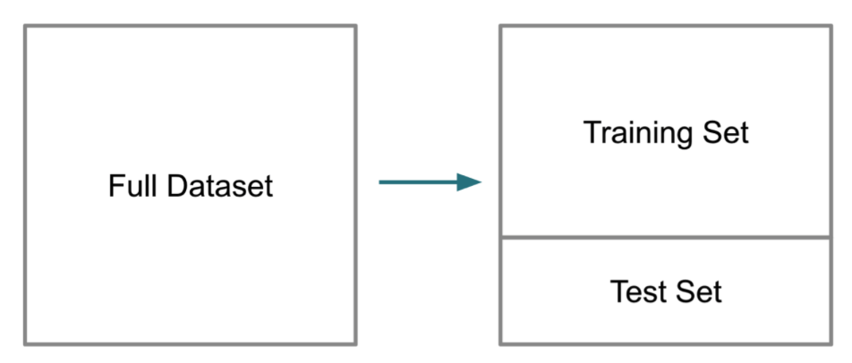
X_{1,} X_{2, ………,} X_{n} y
X_{1,} X_{2, ………,} X_{n} y

