Slide 1
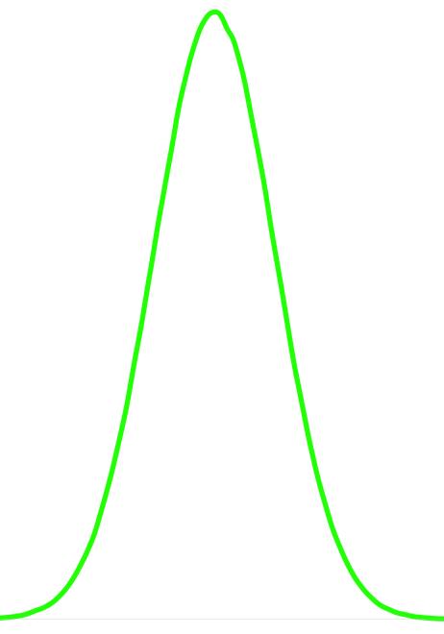
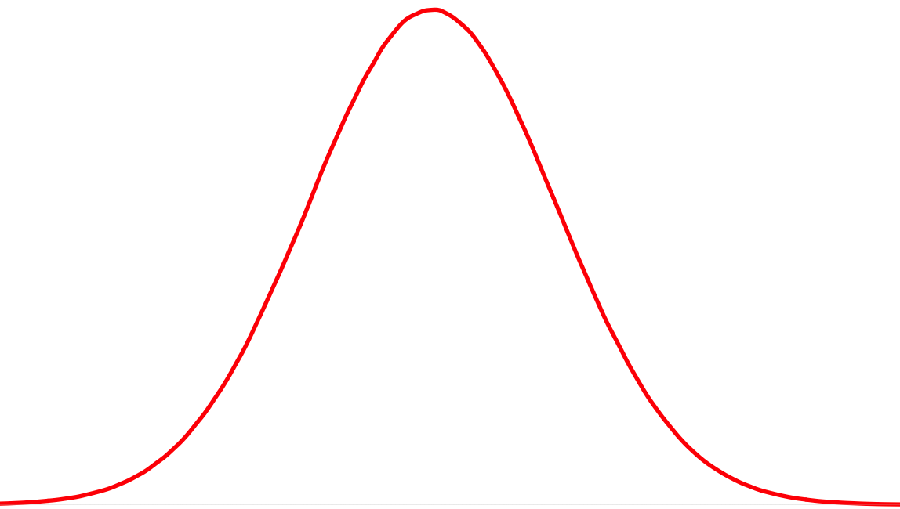
True
Negative
True
Positive
0
0.5
1
False
Negatives

Slide 2
True
Negative
True
Positive
0
0.5
1
False
Positives

Slide 3
X_{1,} X_{2, ………,} X_{n} y
X_{1,} X_{2, ………,} X_{n} y
Training Set
Full Dataset
Test Set
K-Fold Cross Validation For K = 3
X_{1,} X_{2, ………,} X_{n} y
X_{1,} X_{2, ………,} X_{n} y
X_{1,} X_{2, ………,} X_{n} y
X_{1,} X_{2, ………,} X_{n} y
Test
Training
Training
Training Set
Training
Test
Training
Training
Training
Test

Slide 4
K-Fold Cross Validation For K = 3
X_{1,} X_{2, ………,} X_{n} y
X_{1,} X_{2, ………,} X_{n} y
X_{1,} X_{2, ………,} X_{n} y
X_{1,} X_{2, ………,} X_{n} y
Test
Training
Training
Training Set
Training
Test
Training
Training
Training
Test
For 1 to K:
Build A Model on Combined Training Folds
Make Predictions on Test Fold
Record Performance Metric (e.g AUC, Accuracy)
Present an average of the performance metric across all K iterations

Slide 5
E-CARE Meeting 12/17/20
Math / CS student – currently 20 hours per week
Status of the Model (Github ) - ETA end of year
Resume Review – in progress
iCIMS parsed resumes vs Rchili – look for job id numbers of existing resume batch – for now, focus on existing parsing strategy, if iCIMS comes through then great but still need to move ahead with what we have.
February GRA Report – can address accuracy claims via citation of various metrics and by pointing out that the method is still better and much quicker than human accomplished review. Jinho is working on a paper with a due date of early February.
Project Name and Identity - Resu-Match, CliniMatch,
Web Site
John Yates Meeting – Nurse Match, Create executive summary, refine clinical and nursing focus, Talk with OTT about “emory’s slice”.

