Slide 1
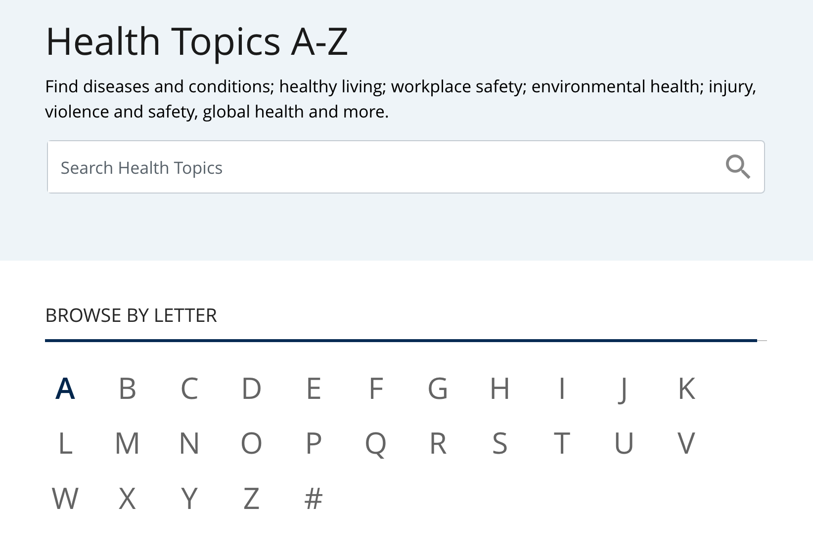
https://www.cdc.gov/health-topics.html#a

Slide 2

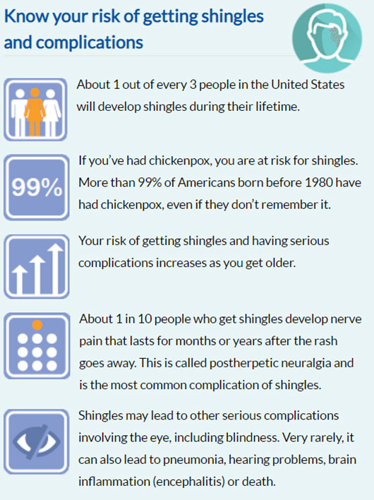
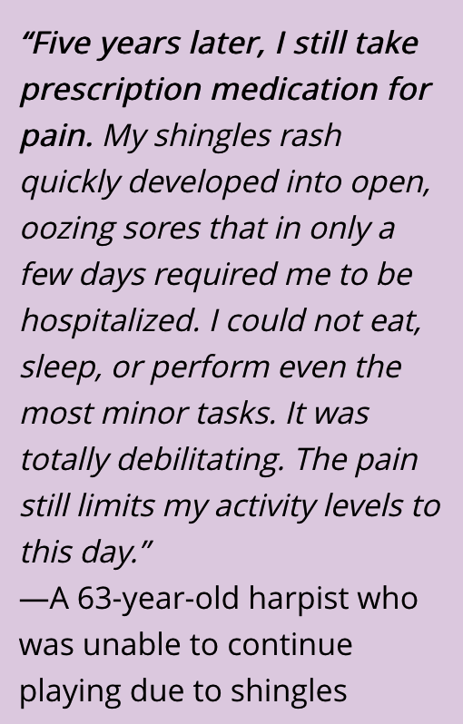
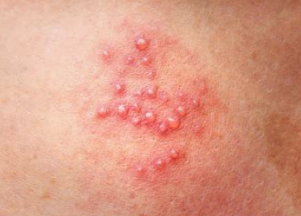
Image from http://healtchcentral.com
Info from www.cdc.gov/shingles/

Slide 3
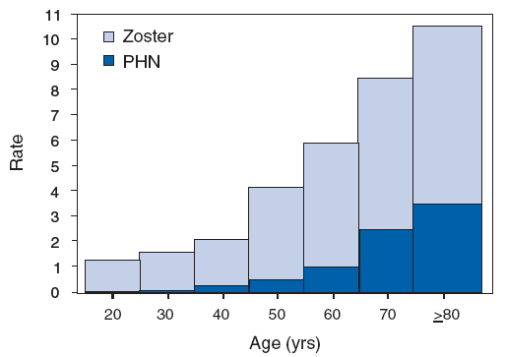
Shingles and Postherpatic Neuralgia Rates by Age, United States
https://www.cdc.gov/shingles/surveillance.html

Slide 4
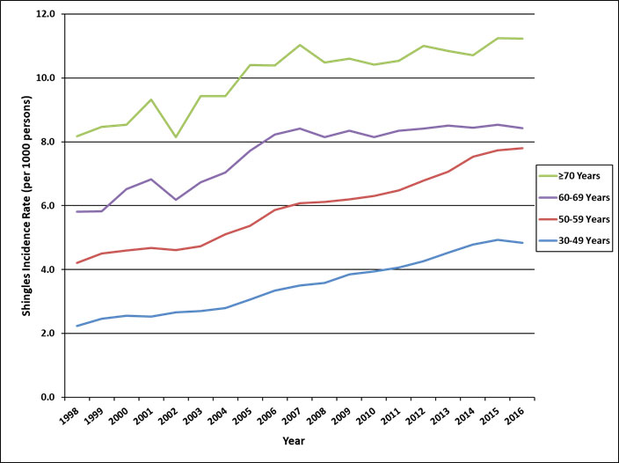
Shingles Rates in Adults 30 and Older, 1998-2016
https://www.cdc.gov/shingles/surveillance.html

Slide 5
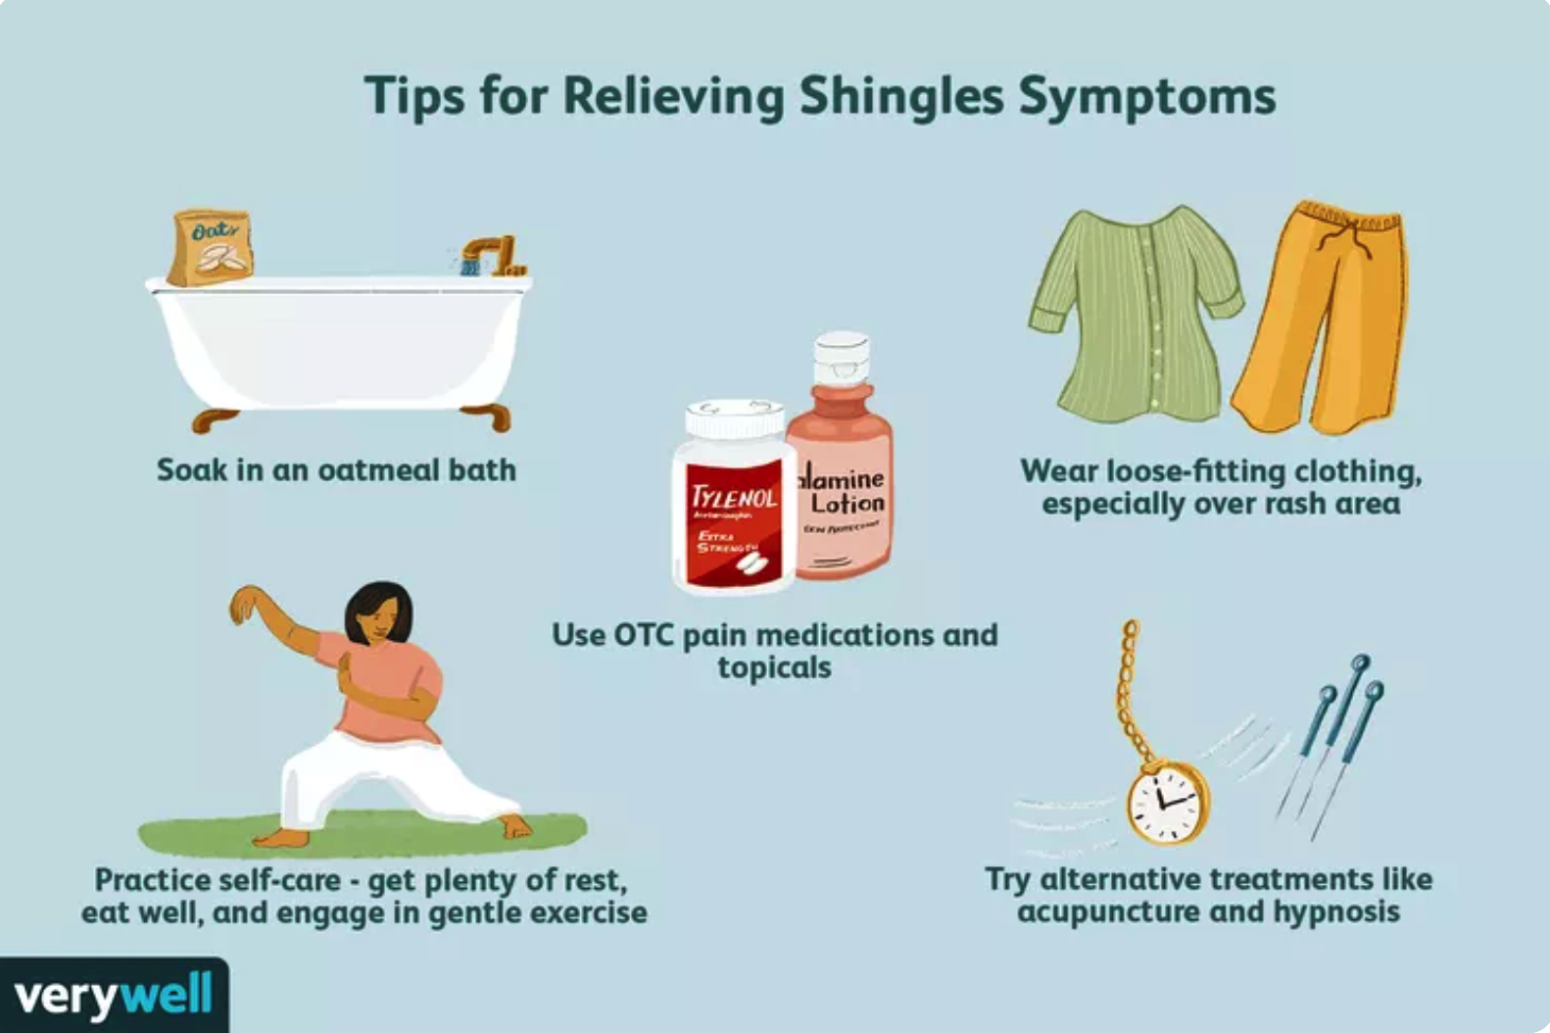
https://www.verywellhealth.com/shingles-coping-support-and-living-well-4163772

Slide 6
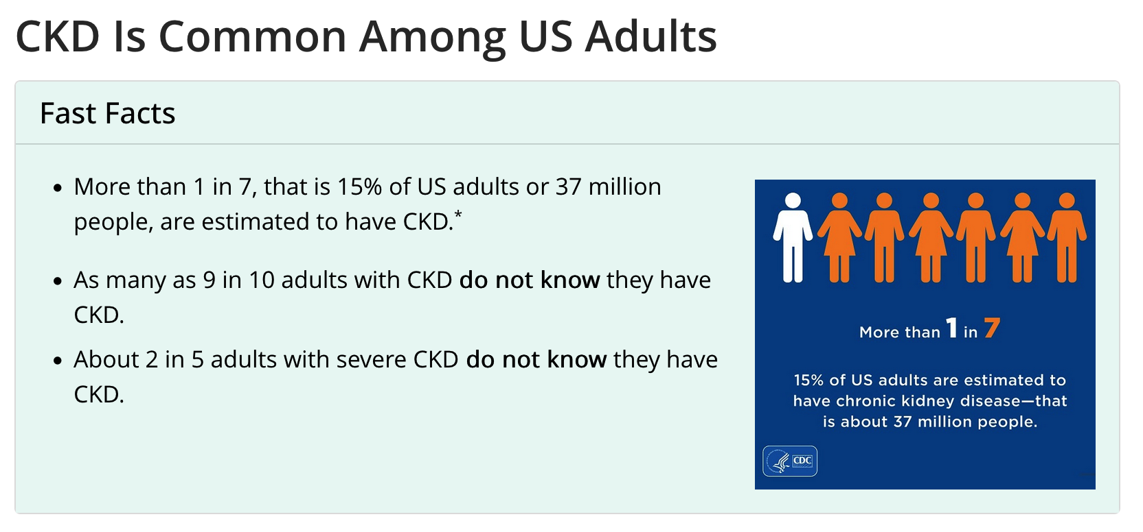
When people develop chronic kidney disease (CKD), their kidneys become damaged and over time may
not clean the blood as well as healthy kidneys.
https://www.cdc.gov/kidneydisease/publications-resources/ckd-national-facts.html

Slide 7
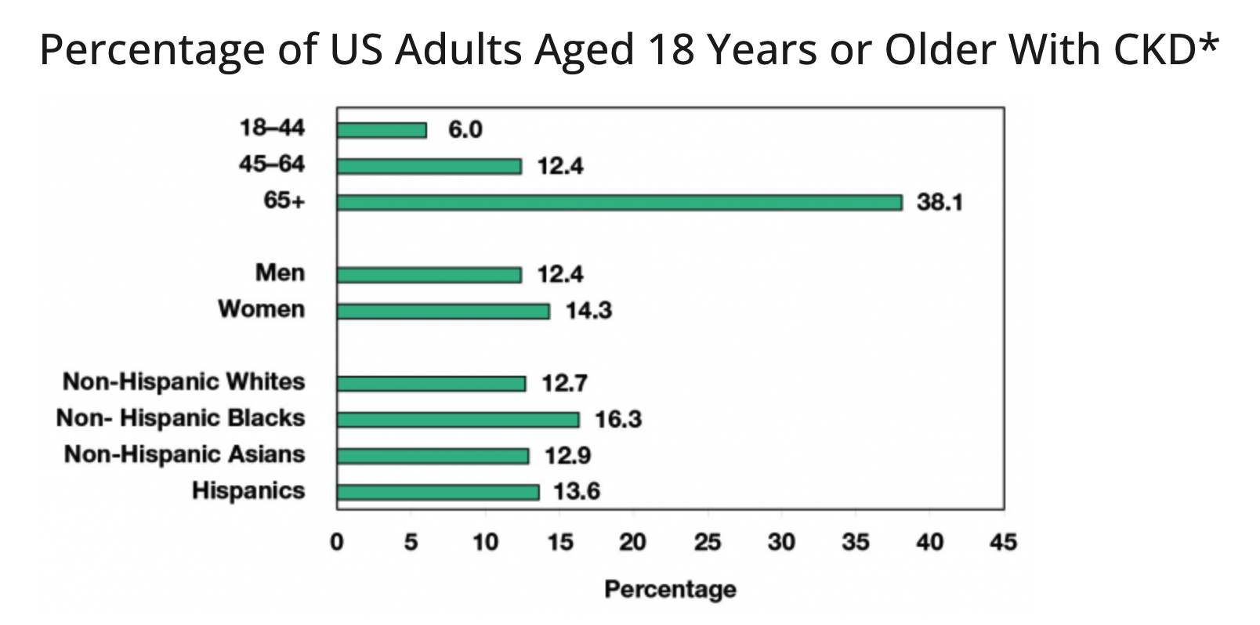
When people develop chronic kidney disease (CKD), their kidneys become damaged and over time may
not clean the blood as well as healthy kidneys.
https://www.cdc.gov/kidneydisease/publications-resources/ckd-national-facts.html

