Slide 1

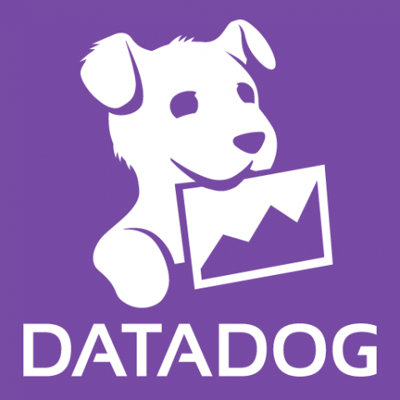

NodeJS: Services and Traces

Slide 2
How to monitor NodeJS Transactions/Traces in Datadog
We need to follow those steps below:
1. Open Terminal and navigate to application folder
2. Install “dd-trace” package using the command below:
npm install dd-trace
3. Add the Datadog Tracing Library to your code (put this at top of app.js)
const tracer = require('dd-trace').init();
4. Perform actions on your application and then navigate to Datadog APM-> Service Catalog page
It will display two services:
- Nodejs
- MongoDB

