Slide 1

How to Log data using NLog

Slide 2
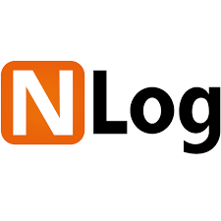

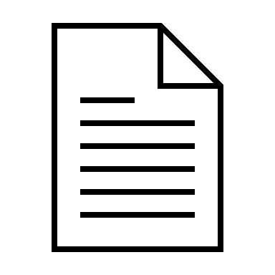
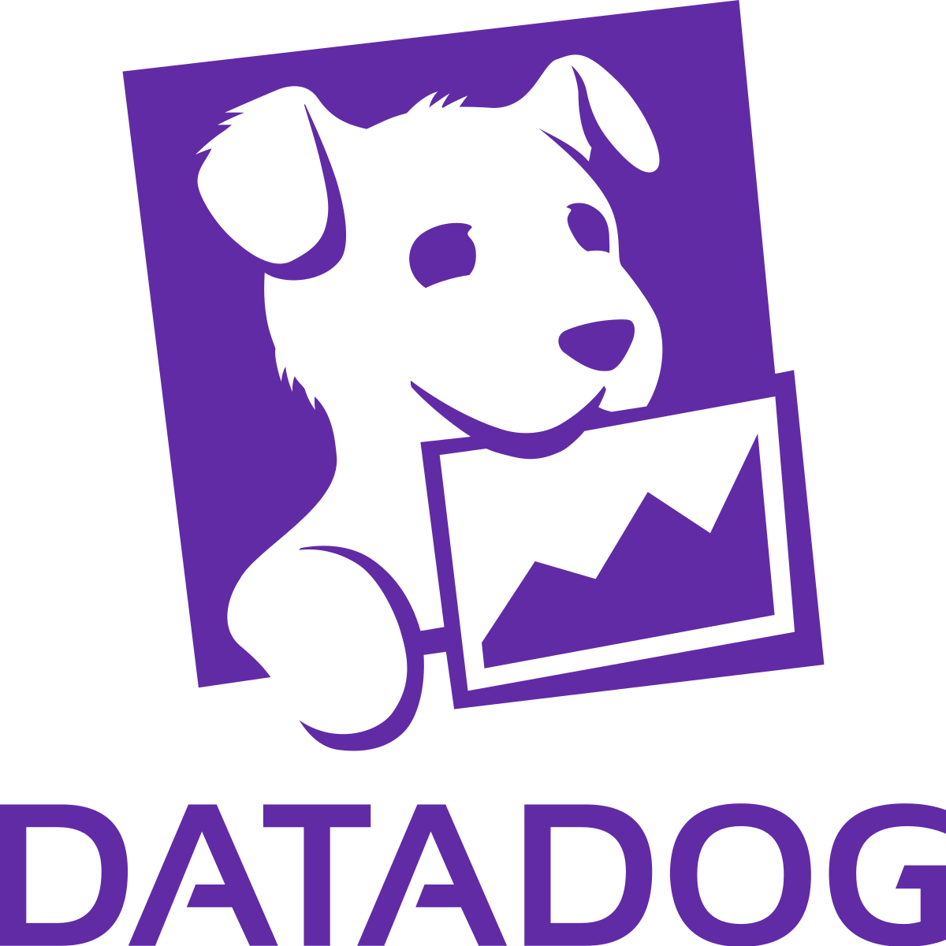
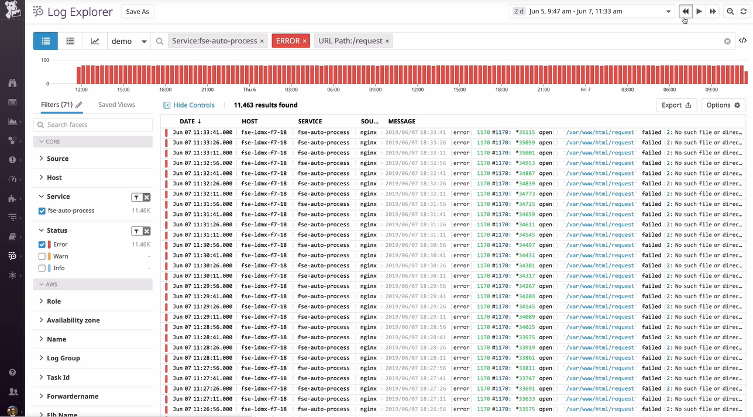
How to log data using NLog in .NET?
NLog is a logging platform for .NET with rich log routing and management capabilities.
Application
Log File
Datadog Website

Slide 3
Steps
1. Datadog Agent - we need to enable logs in datadog.yaml file (logs_enabled: true)
2. Create "csharp.d" folder in Datadog\conf.d with a conf.yaml file inside
3. Create the empty Datadog.log file
4. Application changes - install Nuget Package for NLog
5. Configure NLog (using NLog.config) to save logs to a file and this file will be accessed from Datadog later
6. Go in Datadog Log Explorer and analyze your data

