Slide 1
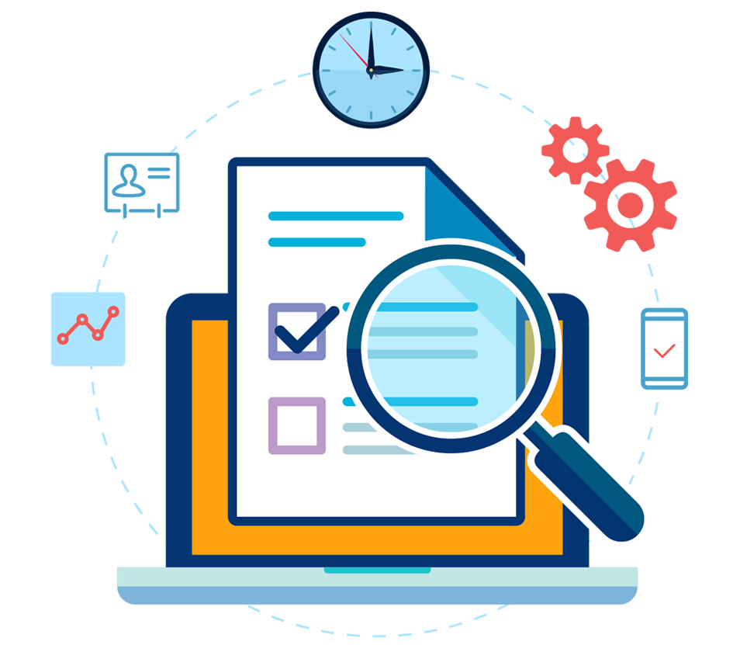

Monitoring: SLA, SLO, SLI and Error Budget

Slide 2



What are SLA, SLOs and SLIs in general?
Pay
Users
Provider
Application
Client | Provider
How often will your systems be available?
24 hours
How fast is your application?
Every request took under 30ms
What will be the success rate when we use your API?
Success rate should be 99%
The goals of three things (SLA, SLOs and SLIs) is to have an Agreement between us (provider) and the client.
So, both parts can be on the same page regarding application performance.

Slide 3
What are SLA, SLOs and SLIs in general?
SLA: Service Level Agreements | This is the agreement (contract) which you make with your users or clients
SLO: Service Level Objectives | Those are the objectives (promises, goals) which your team must hit to meet that agreement (SLA).
SLI: Service Level Indicator | The real numbers of the performance who determines is SLO successful.

Slide 4
What is SLA in details?
SLA (service level agreement) is an agreement between provider and client.
This agreement represents promises and consequences if you fail to keep them.
Agreement is about measurable metrics like uptime, responsiveness, and responsibilities.
Contract
Promise
Promise
Promise
Success Rate to be 99.50%
Promise
Promise
Promise
System should be available 24 hours per day
Important Note:
SLAs are difficult to measure, report on, and meet. IT and DevOps team should collaborate together to develop SLAs that address real-world scenarios.

Slide 5
What is SLO?
If the SLA is the formal agreement between you and your customer,
SLOs are the individual promises you’re making to that customer.
SLA Contract
Promise (SLO)
Success Rate to be 99.50%
Promise (SLO)
Promise (SLO)
Success Rate to be 99%
SLO defines the promise:
- what kind of metrics we will use to measure this
- what is the customer expectation
- what IT/DevOps should hit to cover this promise
Promise (SLO)
Promise (SLO)
Important Note:
The most important thing about SLO is to be simple and easy measurable and should use the most important metric always.

Slide 6
What is SLI?
SLI (service level indicator) measures compliance with an SLO (service level objective).
SLI is the real numbers of the performance.
SLA Contract
Promise (SLO)
Success Rate to be 99.50%
Promise (SLO)
Promise (SLO)
SLO defines the promise:
- what kind of metrics we will use to measure this
- what is the customer expectation
- what IT/DevOps should hit to cover this promise
Success Rate to be 99%
Promise (SLO)
Promise (SLO)
SLI
SLI is the actual measured value using the SLO metrics and the real value for example is 99.90%

Slide 7

What is an Error Budget
This is the allowance value before the SLO violations.
An error budget is 1 minus the SLO of the service.
Example:
We define SLO for success rate to be 99.90%
This means that our Error Budget is 100% - 99.90% = 0.10%.
If our service receives 1,000,000 requests in a month.
Error Budget requests is 0.10% x 1,000,000 requests = 1,000 allowed error requests
This means that you can have 1,000 errors requests - and it is good, this is your error budget.
What is 6O% from the Error Budget?
60% from my Error Budget means 60% from 1,000 allowed error request which is 600 requests.

