Slide 1

Notebook in Datadog

Slide 2
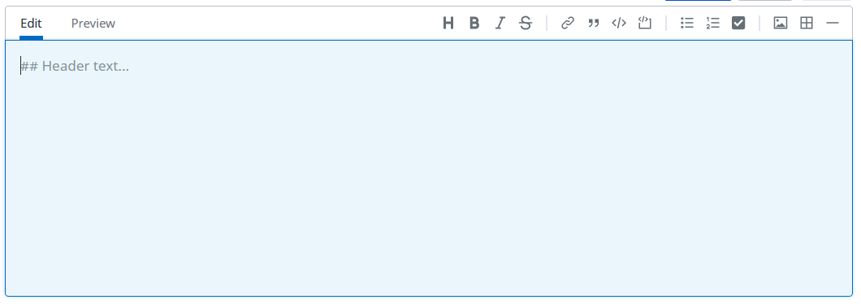
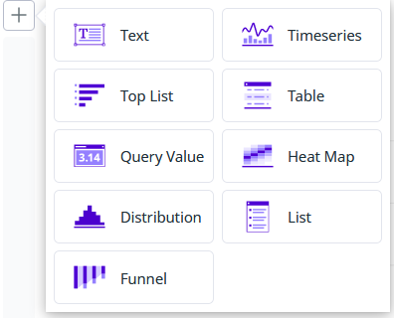
What is a Notebook in Datadog?
Notebook is a place/page where you can add Text elements and Graphs.
Text element includes:
free text, headings, subheadings, links, images, lists, code blocks
Graph includes:
- timeseries, top lists, heat map, query value and etc.

Slide 3
What is the Notebook usage (types)?
It could be used for:
- Runbook creation - where we can describe how specific dashboard/monitor could be used for your team members
- Investigation - there is an exception in my application, and I am gathering graphs and notes and adding them in my notebook. So, everyone can see how investigation is going on and maybe someone can help me in my team.
- Documentation - you can add any kind of notes
- Report - to analyze data after specific time
- Postmortem - to document an incident root causes after it happened
Note: The most powerful thing for Datadog Notebook is the collaboration.
Your notebook is available for other members in your team so they can view it and add comments.
When someone adds a comment, you can receive an email notification.

