Slide 1

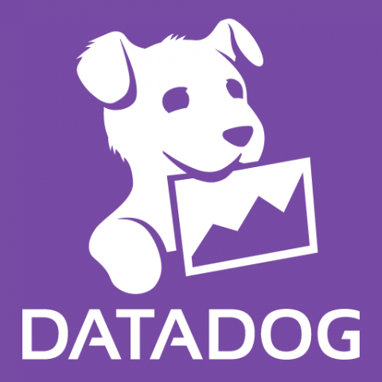
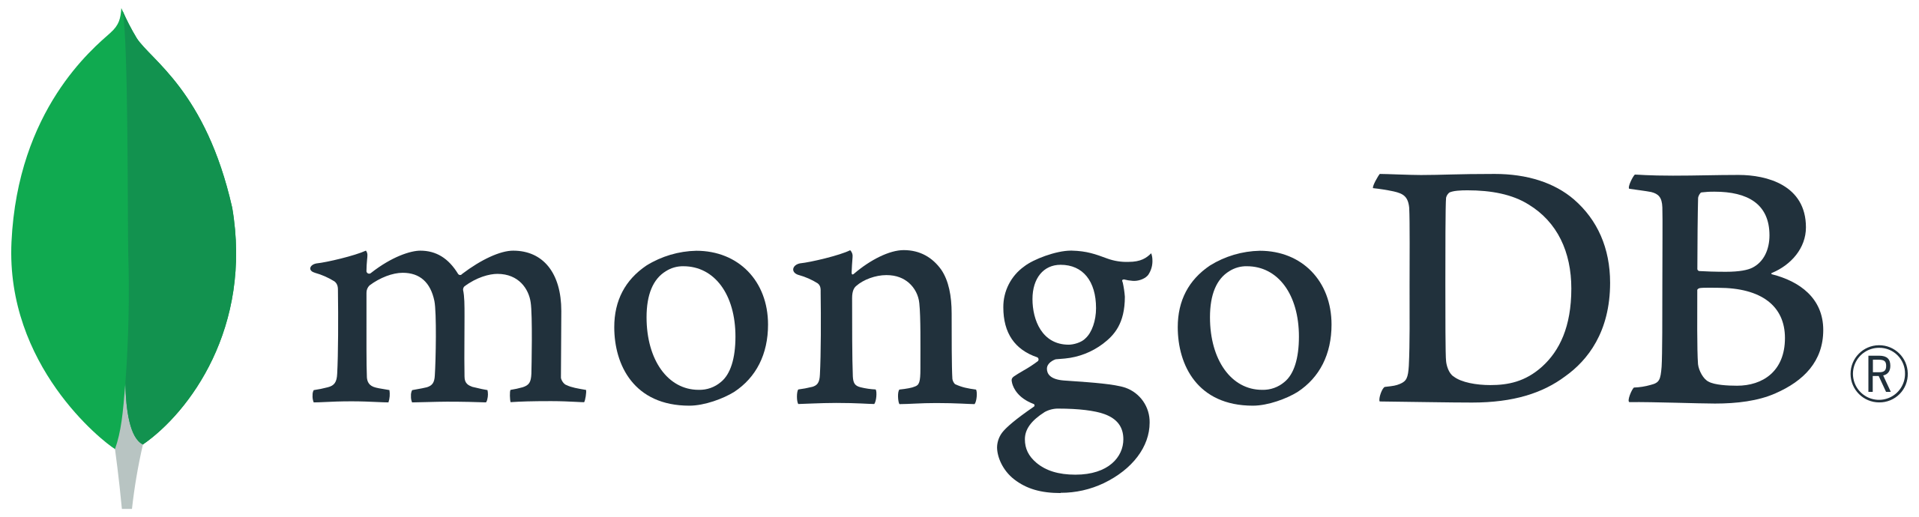
NodeJS monitoring in Datadog

Slide 2
NodeJS with MongoDB Application Setup – Page 1
Prerequisites
1. Command line tool Terminal: https://learn.microsoft.com/en-us/windows/terminal/install Windows PowerShell: https://learn.microsoft.com/en-us/powershell/scripting/install/installing-powershell-on-windows?view=powershell-7.2 Command Prompt
2. Git installation 2.1 Download and install from this link: https://git-scm.com/download/win 2.2 Check the installation - open Terminal/Command Prompt and type "git --version" If you see a version, then all is good.
3. NodeJS installation 3.1 Download and install from this link: https://nodejs.org/en/download Please download LTS version. It also installs NPM (node package manager). 3.2 Check the installation - open Terminal/Command Prompt and type "node --version" If you see a version, then all is good.

Slide 3
NodeJS with MongoDB Application Setup – Page 2
Prerequisites
4. MongoDB installation 4.1 Download and install from this link: https://www.mongodb.com/try/download/community It also installs MongoDB Compass which we can launch after installation. This is the UI which we use to interact with MongoDB. Compass is like MS SQL Management Studio for the SQL Server. 4.2 Additional Configuration - for adding MongoDB as Environment variable - Copy the MongoDB installation path which is in "C:\Program Files\MongoDB\Server\6.0\bin" (Please have on mind that this path could be differ depends on the version - for me it is 6.0) - Then type in Windows search -> "Edit system variables" and launch the pop-up window. - Then click on "Environment Variables" button and it will bring a new pop-up with variables. - Then in "System variables" section select "Path" variable and click on "Edit" button and it will list all values associated with the Path variable. - Then please click "New" button and add the MongoDB path copied earlier as a last option. - Then just click "OK“ We do all this so mongodb could become a recognizable command. 4.3 Check the installation - open Terminal/Command Prompt and type: "mongod --version" This is for the mongo database. If you see a version, then all is good :)

Slide 4
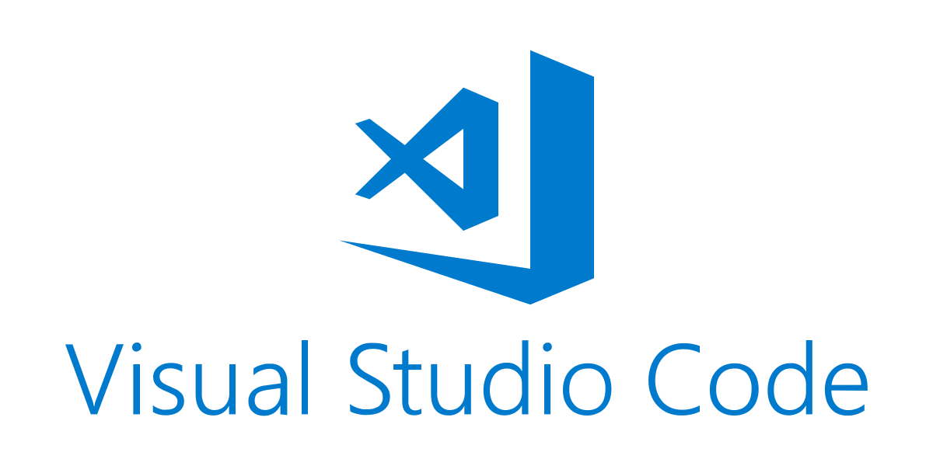
NodeJS with MongoDB Application Setup – Page 3
Prerequisites
5. Visual Studio Code installation 5.1 Download and install from this link: https://code.visualstudio.com/docs/setup/windows

Slide 5
NodeJS with MongoDB Application Setup – Page 4
Setup BirdsWorld application locally
6. NodeJS Project Setup 6.1 Open Terminal or Command Prompt Navigate to the folder where you want your project to be cloned. 6.2 Clone Git Repository using the command below: "git clone https://github.com/em4o/BirdsWorld.git“ Navigate to the folder where you clone the repository /BirdsWorld. 6.3 Open project folder using Visual Studio Code 6.4 Install Packages using the command: "npm install“ 6.5 Run the application using the command: "npm start“ 6.6 Navigate to localhost and open your application: http://localhost:3001/swagger/

