Slide 1

Datadog - Browser Tests

Slide 2



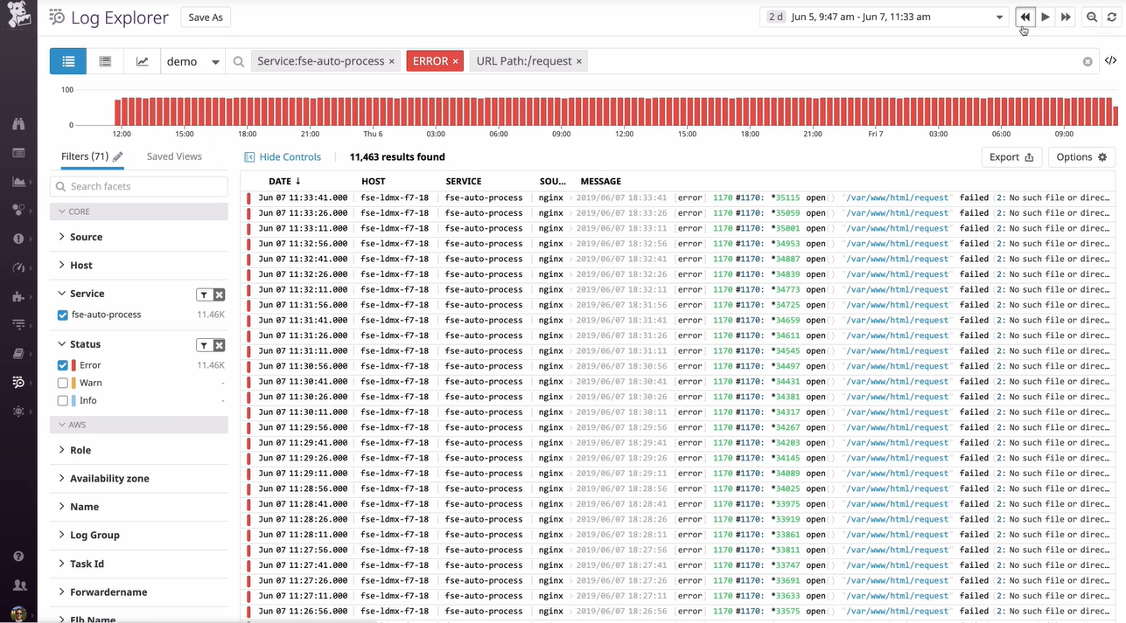

What is a Browser Test?
Browser test is a scenario (set of actions) that Datadog executes on your web application using a Browser.
Assertions
(verify our action result)
Login
Get Product
Add Product to Card
Launch
Recorded
Chrome
Chrome Extension
Browser Test
Application
Browser Test
* You can configure periodic intervals to run tests from multiple locations, devices, and browsers as well as execute them from your CI/CD pipelines.

