Slide 1

Synthetic Monitoring

Slide 2
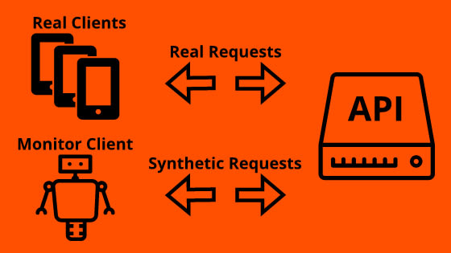
What is a Synthetic Monitoring?
Synthetic monitoring or synthetic testing is an application performance monitoring practice
where we perform the actions which we think users/clients will do with our application.
This could be achieved using automated series of request on our business transactions and API endpoints.
Which metrics we track?
1. Response Time (from server to the client)
2. Latency (from request to response end)
3. Load Time (whole page load time with all files)
4. System and Network Resources (CPU, Memory, HD)
Use cases
1. To see is our Application still running and alive? (Reachability and Availability)
2. Test new features before launching
3. To monitor web page speed and load times (application performance and availability)
4. Monitor third-party services and APIs
5. Identify browser or device-specific issues
6. Ensure SLA compliance
7. Reduce mean time to resolution (MTTR)

