Slide 1
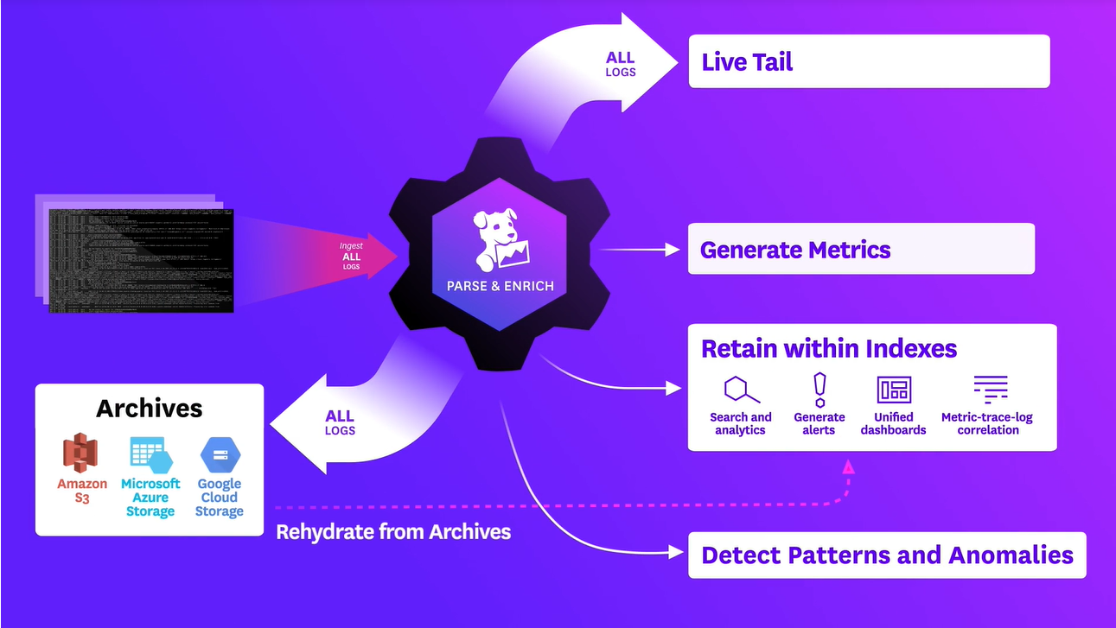
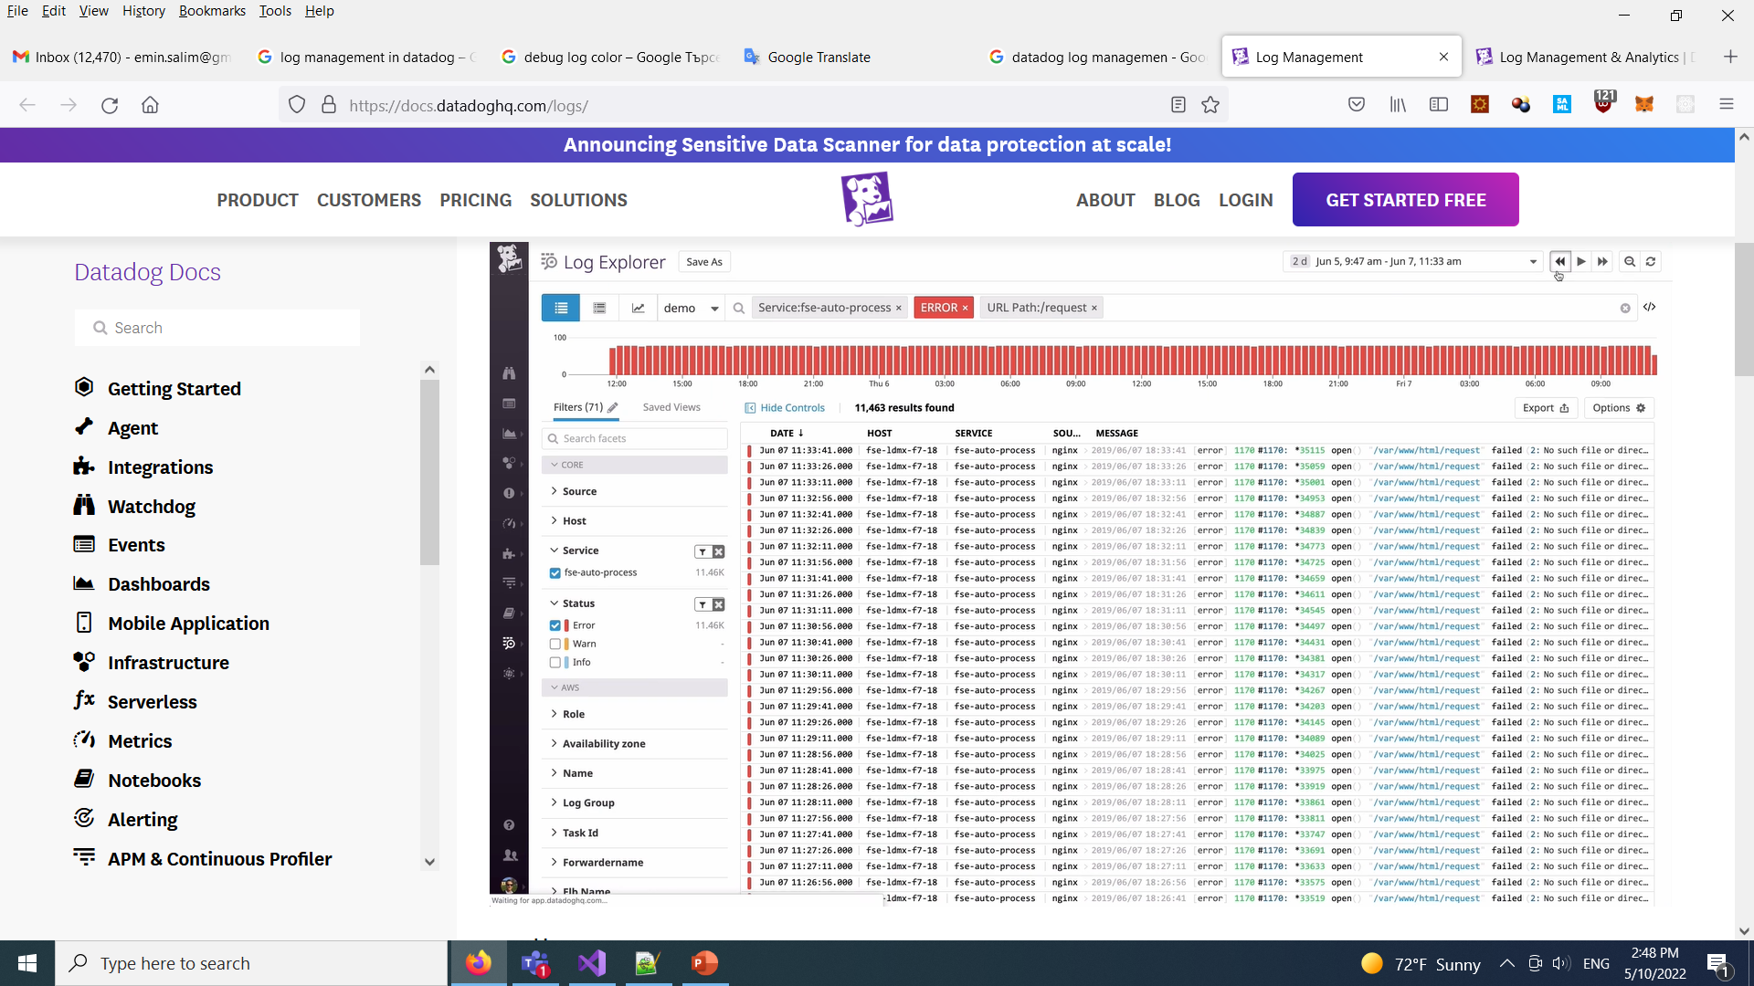
What is a Log Management System

Slide 2
What is a Log Entry?
Log entry is the simplest data structure. This is a Data which structure you define, and you want to store somewhere.
It is like a time-stamped documentation of event relevant to a particular system.
All software applications and systems produce logs.
Log File
Log Entry
1. Time stamp
2. Type of Log
- Error, Warn, Info and Debug
3. Additional Information
- user information
- api information

Slide 3
What is a Log Management System?
LMS is a software solution that involves gathering, processing, storing and analyzing log data from our applications.
This answer the question how to analyze Log files.
LMS helps us:
- Pinpointing areas of poor performance.
- Assessing application health and troubleshooting.
- Diagnosing and identifying the root cause of application installation and run-time errors.
How to save logs in Datadog?
We use a logger object which is used to log messages for a specific system or application component
Data logging is the process of collecting and storing data over a period in order to analyze specific trends or record the data-based events/actions of a system, network or IT environment.
For different languages Datadog offers different logger solutions.
.NET: Serilog, log4net, NLog and Microsoft.Extensions.Logging
Java: Log4j,Log4j 2, Logback.

