Slide 1
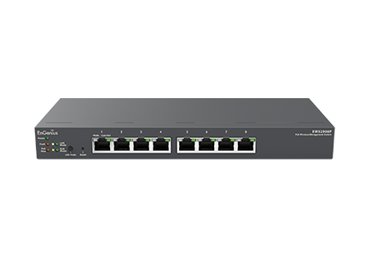

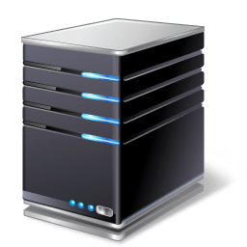





okd4-services.okd.local
192.168.10.210
okd4-control-plane-1.lab.okd.local
192.168.10.201
okd4-bootstrap.lab.okd.local
192.168.10.200

