Slide 1
Classification modeling of flu vaccination status for Michigan residents
By: stewarjr
December 1, 2014

Slide 2
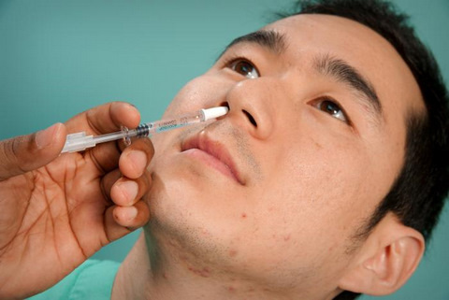
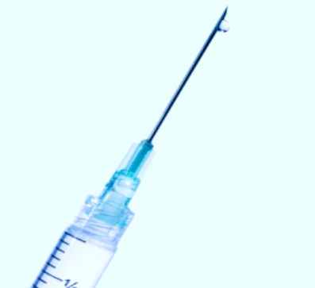
Introduction
Why get an influenza vaccination?
In U.S. for past 31 flu seasons, deaths ranged from 3,000 – 49,000 people
90% of people were age 65 or older
More people vaccinated reduces the spread of influenza

Slide 3


Goal: Predict if an individual will vaccinate
Using BRFSS data from CDC, predict FLUSHOT6*
Observational study: lack of imposed treatment
FLUSHOT6 is dichotomous → categorical response
Data will be subset on Michigan residents (n ≈ 26,000)

Slide 4
Methods
Variable selection
Match between years for consistency
Remove if: too many factors & missing values
Training and test set creation
years 2011 & 2012 = training; year 2013 = test
Impute missing data
Multivariate imputation by chained equations
Apply classification models
Want low test errors (high accuracy)

Slide 5
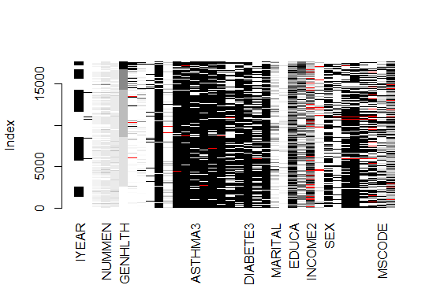
Valid imputation?
CMAR, MAR, NMAR (MAR = missing at random)
After sorting by several variables, assume it’s MAR
Correlations of missing data:
EXERANY2 and
(FLUSHOT6, QLACTLM2, USEEQUIP) [0.7001, 0.7149, 0.7503]
FLUSHOT6 and USEEQUIP 0.9032

Slide 6
Results
Flu vaccination status prediction (33 predictors)
Classification Model | Logistic Regression | Linear Discriminant Analysis | k Nearest Neighbors (k = 5) | Decision Tree
Accuracy | 65.03% | 65.06% | 58.51% | 64.66%
PNEUVAC3 determined the split
Used random forests to determine “important” predictors
Important predictors
PNEUVAC3
INCOME2
EMPLOY1
Logistic regression with just important predictors; 64.68% accuracy

Slide 7

Conclusion (Why vs. Who)
High risk factors for developing influenza (from CDC)
Adults age 65 or older
Pregnant women
Heart disease
Morbidly Obese
Important factors for prediction
Pneumonia vaccination status
Annual household income
Employment status

