Slide 1
Comp Photography (Spring 2016)
HW 4
Stewart Boyd
CS 6475

Slide 2
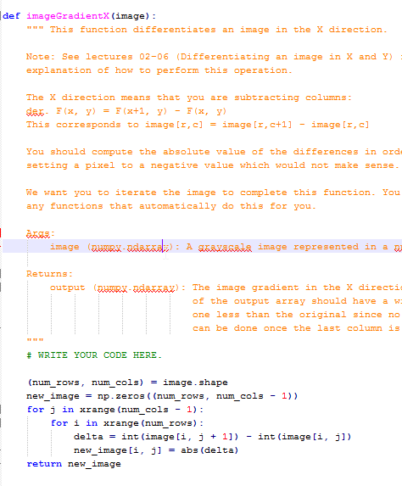
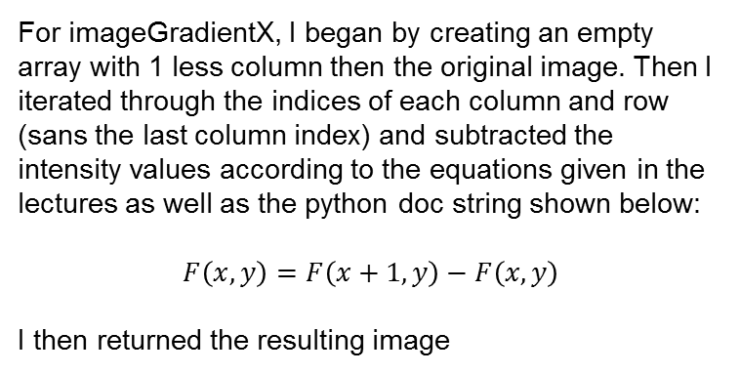
imageGradientX
For imageGradientX, I began by creating an empty array with 1 less column then the original image. Then I iterated through the indices of each column and row (sans the last column index) and subtracted the intensity values according to the equations given in the lectures as well as the python doc string shown below:
$$F\left(x,y\right)=F\left(x+1, y\right)−F\left(x,y\right)$$
I then returned the resulting image
CS 6475

Slide 3
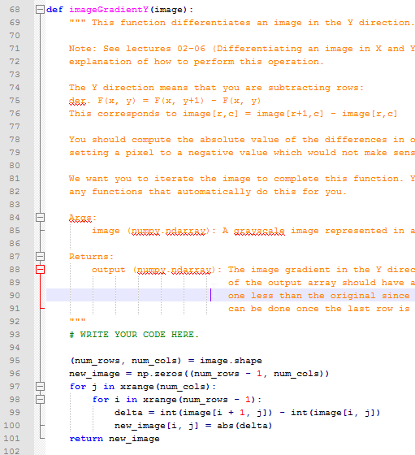
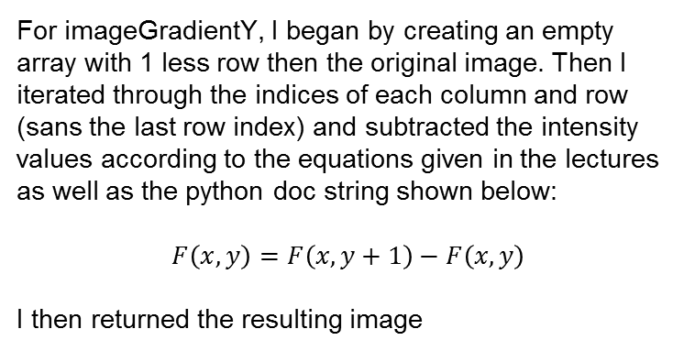
imageGradientY
For imageGradientY, I began by creating an empty array with 1 less row then the original image. Then I iterated through the indices of each column and row (sans the last row index) and subtracted the intensity values according to the equations given in the lectures as well as the python doc string shown below:
$$F\left(x,y\right)=F\left(x, y+1\right)−F\left(x,y\right)$$
I then returned the resulting image
CS 6475

Slide 4
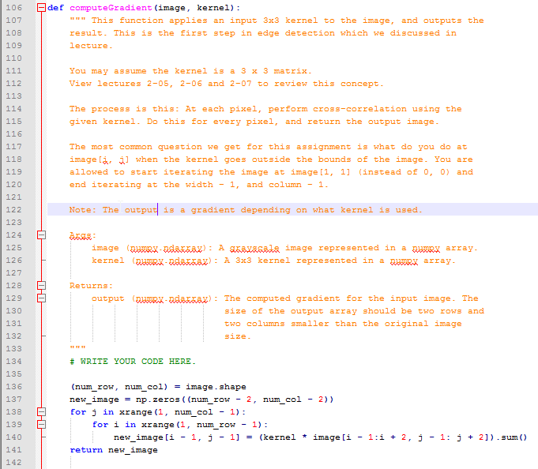
computeGradient
… | … | … | … | … | …
… | i-1,j -1 | i-1,j | i-1,j +1 | … | …
… | i,j -1 | i,j | i,j +1 | … | …
… | i+1,j -1 | i+1,j | i+1,j +1 | … | …
… | … | … | … | … | …
For computeGradient, I began by creating an empty array with 2 less columns and 2 less rows then the original image. Then I iterated through the indices of each column and row (sans the first and last column and row index) . In line 140 of code I do the following things:
Use array slicing to get a 3X3 subset image array of the ndarray passed as image argument surroudning the current index i, j (see image graphic above for illustration)
Use element by element multipication (* operator) to calculate 3 X 3 matrix of kernel * subimage
Use sum method to sum up individual elements of kernel * subimage and place at the index I – 1, j -1 (because looping started at 1 index instead of 0).
After looping finishes the new_image is returned
CS 6475

Slide 5
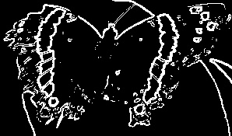
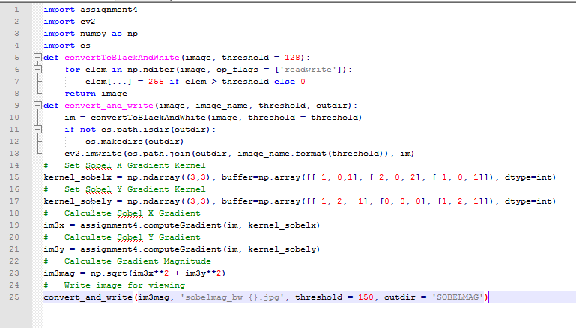
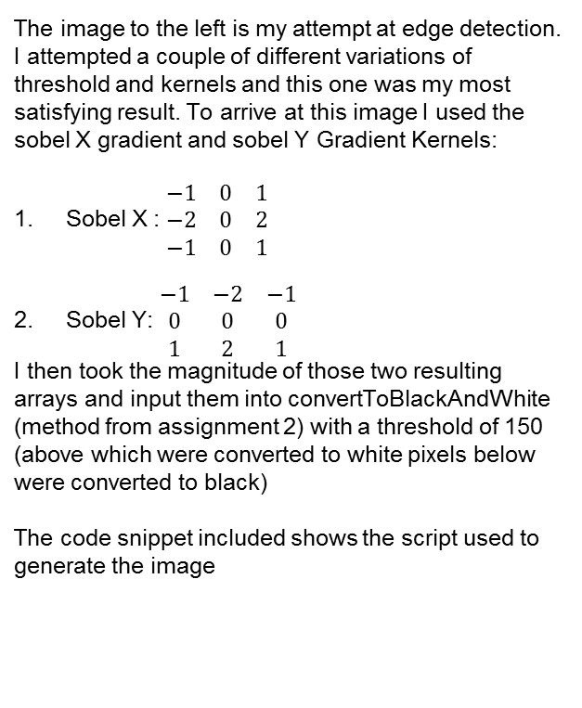
Edge Detection using a Sobel Kernel and a threshold of 150
The image to the left is my attempt at edge detection. I attempted a couple of different variations of threshold and kernels and this one was my most satisfying result. To arrive at this image I used the sobel X gradient and sobel Y Gradient Kernels:
Sobel X : $\begin{matrix}−1 & 0 & 1 \\ −2 & 0 & 2 \\ −1 & 0 & 1\end{matrix}$
Sobel Y: $\begin{matrix}−1 & −2 & −1 \\ 0 & 0 & 0 \\ 1 & 2 & 1\end{matrix}$
I then took the magnitude of those two resulting arrays and input them into convertToBlackAndWhite (method from assignment 2) with a threshold of 150 (above which were converted to white pixels below were converted to black)
The code snippet included shows the script used to generate the image
CS 6475

Slide 6
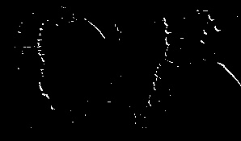
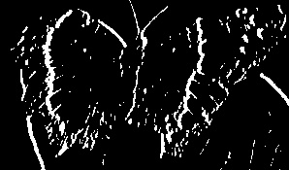




Edge Detection Continued
I tried other kernels (Prewitt, Roberts) with varying thresholds (50, 100, 128, 150 and 200) as the cutoffs. I’ve included the script on the next page as well a couple of the outputted images here
$$\begin{matrix}0 & 0 & 0 \\ 0 & 0 & 1 \\ 0 & −1 & 0\end{matrix}$$
$$\begin{matrix}−1 & 0 & 1 \\ −1 & 0 & 1 \\ −1 & 0 & 1\end{matrix}$$
$$\begin{matrix}−1 & 0 & 1 \\ −1 & 0 & 1 \\ −1 & 0 & 1\end{matrix}$$
Kernel =
Kernel =
Kernel =
Threshold = 200
Threshold = 50
Threshold = 50

Slide 7
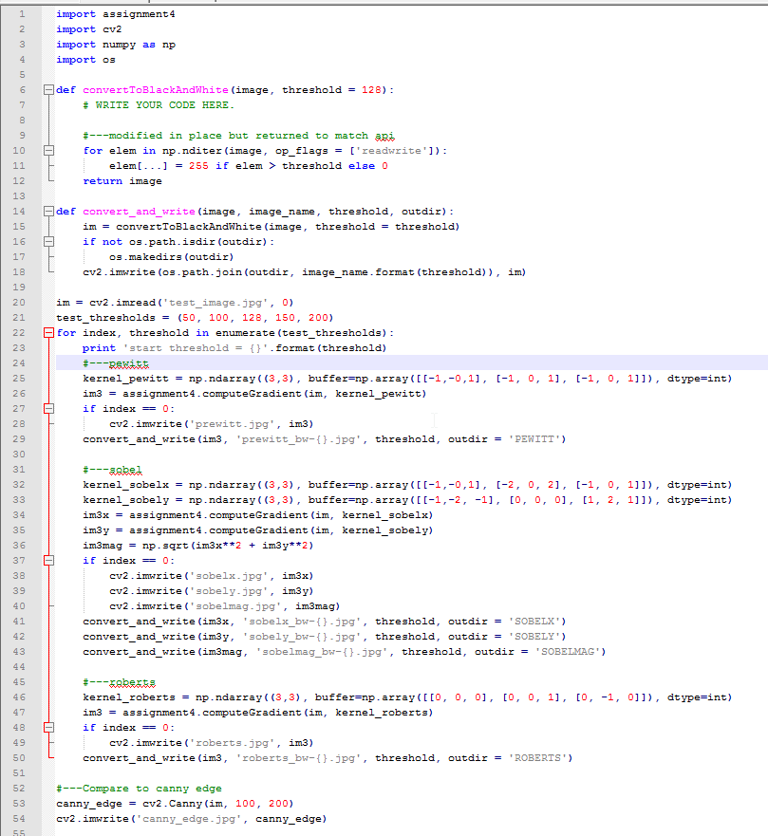
Edge Detection Script

Slide 8
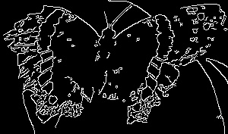
Canny Edge Vs Assignment 4 Algorithm
I also included, for comparison, the output of the Canny Edge algorithm (shown on the left). As can be seen the Canny Edge algorithm has resulted in thinner lines and more distinct edges. I think a key difference in the two algorithms is the hysteresis thresholding used by the Canny Edge algorithm. The thresholding implemented in my algorithm was simple a binary cutoff, however the Canny Edge Algorithm has a mimumn and maximum threshold input and then makes decisions in the middle of those thresholds based on connectivity.
The other difference, a Gaussian kernel, run over the image before hand, I don’t think makes a huge difference in this particular image as there wasn’t a great deal of noise in the moth test image.

