Slide 1
Comp Photography (Spring 2016)
HW 8
Stewart Boyd
CS 6475

Slide 2
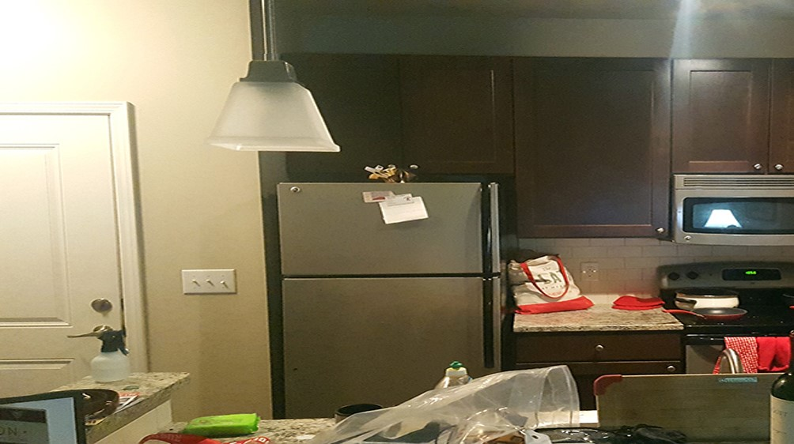
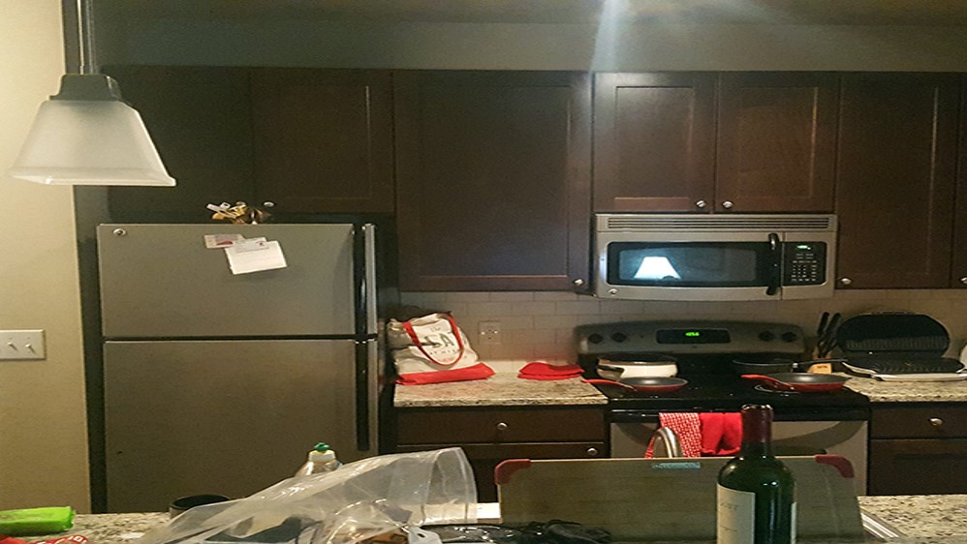
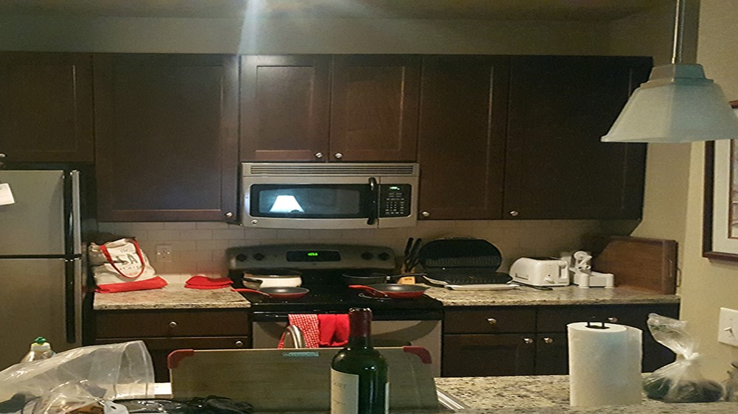
Images for assignment 8
Image 1
Image 2
Image 3
CS 6475

Slide 3
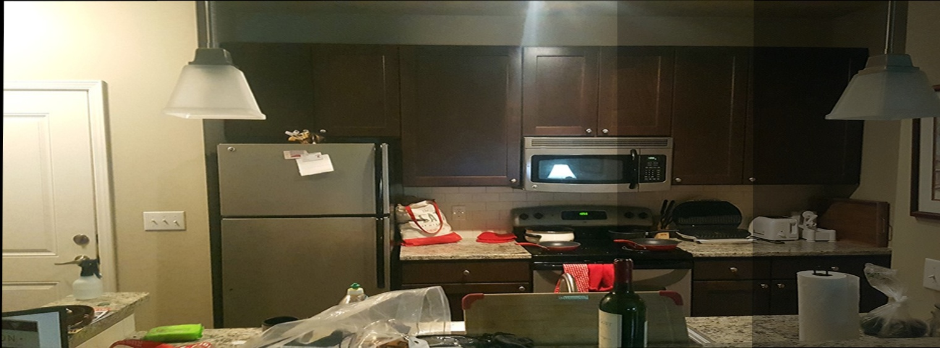
Panaroma Result
CS 6475

Slide 4
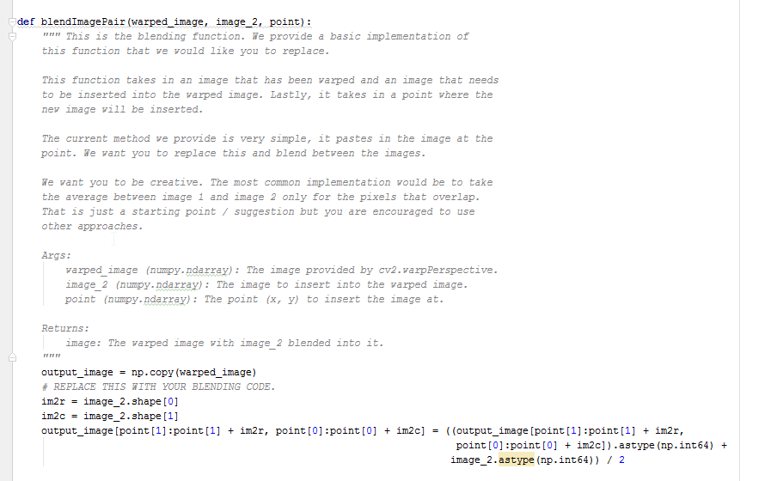
blendImagePair
My implementation of blendImagePair was simply an average of the warped_image and image_2 at the point given by argument point.
Because of overflow issues with int8 I cast the Ndarray’s to int64s before the average operation.
The code may be seen in the adjacent image

Slide 5
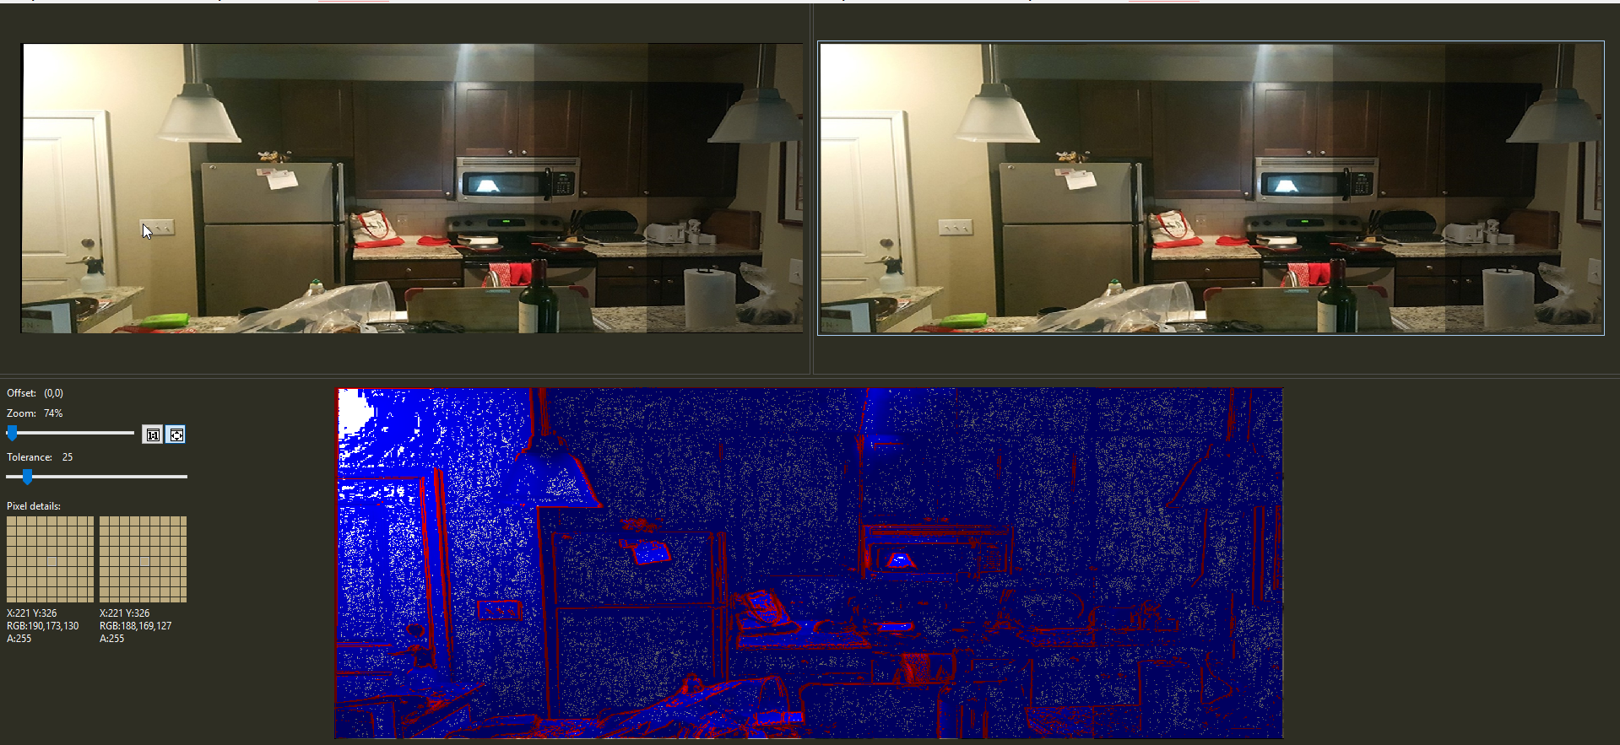
Sensitivity to Number of Matches
The images I ultimately used for the panorama were not sensititive to increasing the number of matching features used (increased from 10). The image on the left is the stitched together image using three features whilst that on the right is using 1000.
The blue and red image is the diffed result. Red indicates larger deltas between the intensity of a pixel in the left image versus the right. This image makes it clear that the result was a just a slight translational shift.

Slide 6
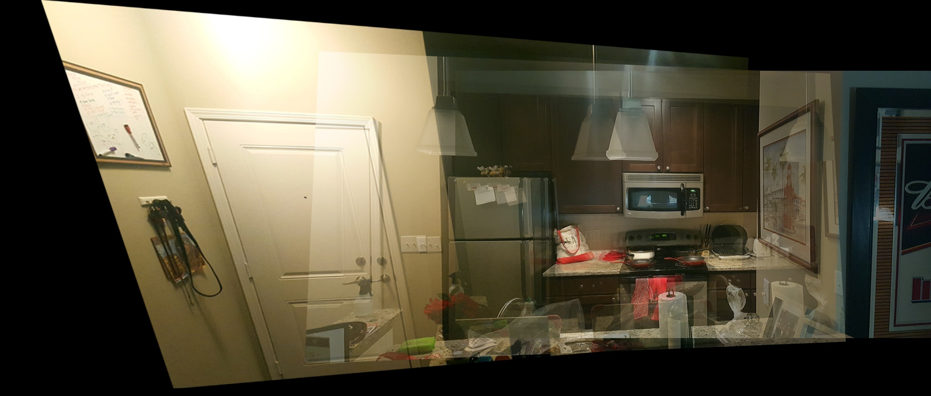

Sensitivity to Number of Matches (Cont)
However, that’s not to say the overall algorithm is not sensitive to the number of matches required for stitching. I’ve included here, another outputted panaroma using a different set of pictures than that shown on slide 2. The top image is with 20 features requested, and the bottom is a 1000. The quality of matches diminishes as the request grows and has lead to significantly distorted panaroma output images

Slide 7
What type of Panorama?
I took a planar panorama image. The reason being, simply, that the stitched together image would maintain its rectangular shape and thus wouldn’t lead to introduced blank space in the final stitched image.

Slide 8
Happy with Result?
I was happy with the overall result. The image isn’t perfect, by any means. The outputted image has been warped enough that the aspect ratio of objects has definitely been skewed. Other than that, however, the final stitched together image accurately blends that of its 3 image constituents.

Slide 9

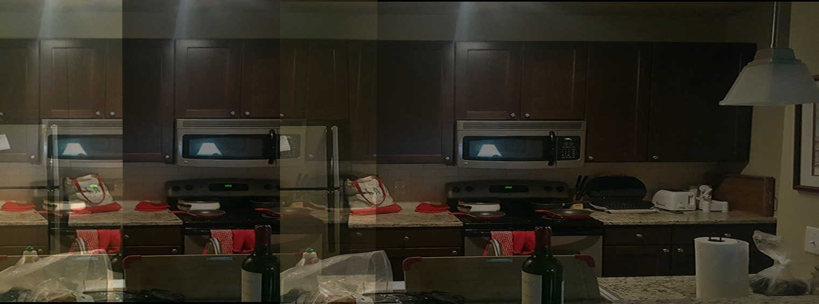
multiplying by -x_min and -y_min
In the warpImagePair method the homograph is multiplied by the translation matrix as seen to the right. This affine transformation acts to translate image 1 by xmin and ymin. Without the transformation the stitched together images are offset considerably (as evidenced in image to right where no transformation factor is used).

