Slide 1
FITNESS BUDDY
CAPSTONE PROJECT
Presented By:
Student name : STEWART LALU
College Name & Department : TOC H INSTITUTE OF SCIENCE AND TECHNOLOGY- COMPUTER SCIENCE

Slide 2
OUTLINE
Problem Statement
Technology used
Wow factor
End users
Result
Conclusion
Git-hub Link
Future scope
IBM Certifications

Slide 3
Problem Statement
Health-conscious individuals and fitness enthusiasts often face challenges in maintaining consistent routines due to lack of personalized guidance, time limitations, and information overload. Sifting through countless workout plans, nutrition tips, and motivation strategies across various sources is inefficient and overwhelming. The absence of a centralized, intelligent solution makes it difficult to stay on track with long-term fitness goals. Proposed Solution: An AI Fitness Agent that leverages Natural Language Processing (NLP) and user-centric design to deliver personalized workout plans, healthy recipes, motivational support, and habit-tracking tools—all through an accessible, conversational interface.

Slide 4
Technology used
IBM cloud lite services
Natural Language Processing (NLP)
Retrieval Augmented Generation (RAG)
IBM Granite model

Slide 5
IBM cloud services used
IBM Cloud Watsonx AI Studio
IBM Cloud Watsonx AI runtime
IBM Cloud Agent Lab
IBM Granite foundation model

Slide 6
Wow factors
This agent will empower users to achieve their health goals faster, eliminate the need for expensive coaching or rigid plans, and boost long-term consistency through personalized, real-time support. Whether you're just starting or optimizing your routine, the AI acts as a 24/7 fitness companion tailored to your lifestyle. Unique features:
Dynamic workout generation based on fitness level and time availability
Smart meal suggestions aligned with dietary preferences and goals
Daily motivational nudges and habit-building support
Progress tracking and personalized fitness insights
Adaptive plans that evolve with user feedback
Voice/chat-based interaction for on-the-go support

Slide 7
End users
Busy Professionals
Fitness Beginners
College Students
Home-Based Individuals

Slide 8
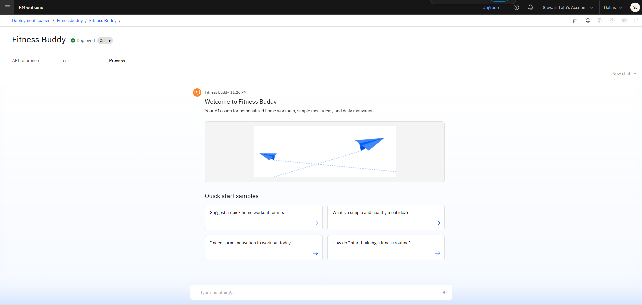
Results

Slide 9
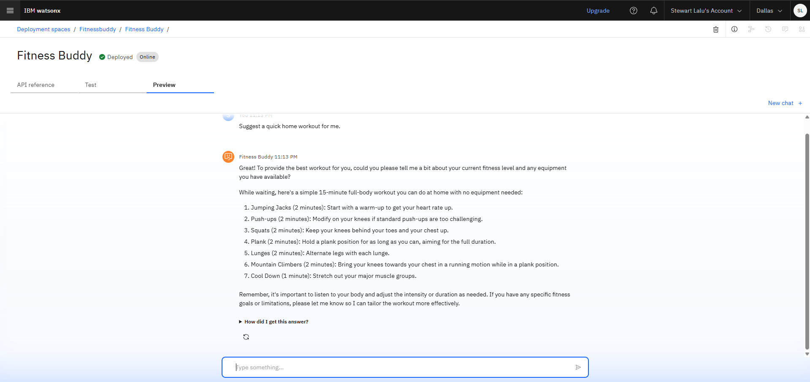
Results

Slide 10
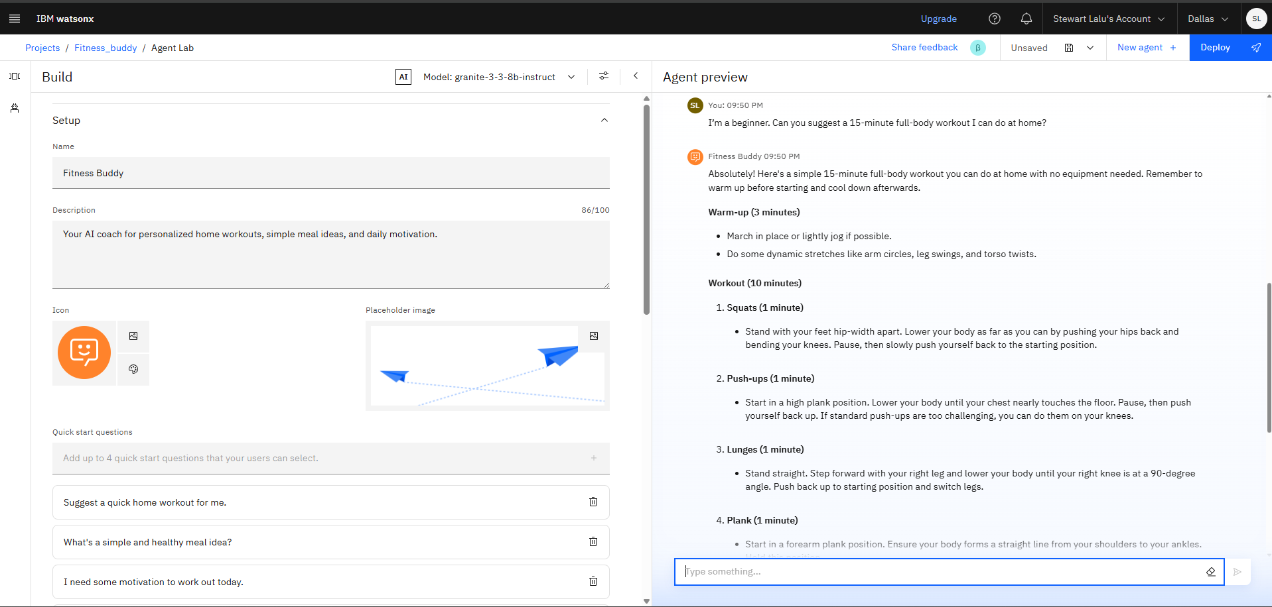
Results

Slide 11
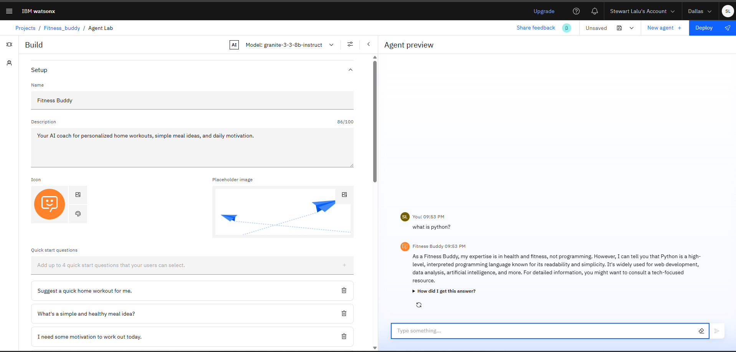
Results

Slide 12
Conclusion
The agent delivers personalized fitness and nutrition guidance tailored to individual goals.
It saves time by automating workout planning, meal suggestions, and daily motivation.
Fitness Agents boost consistency, engagement, and long-term health outcomes for users across all lifestyles.

Slide 13
Future scope
Multilingual Fitness Coaching
Voice-Activated Workout and Meal Planning
Integration with Wearable Devices (e.g., Fitbit, Apple Watch)
AI-Driven Habit and Progress Analytics
Smart Integration with Calendar and Reminder Apps
Personalized Wellness Challenges and Goal Setting

Slide 14
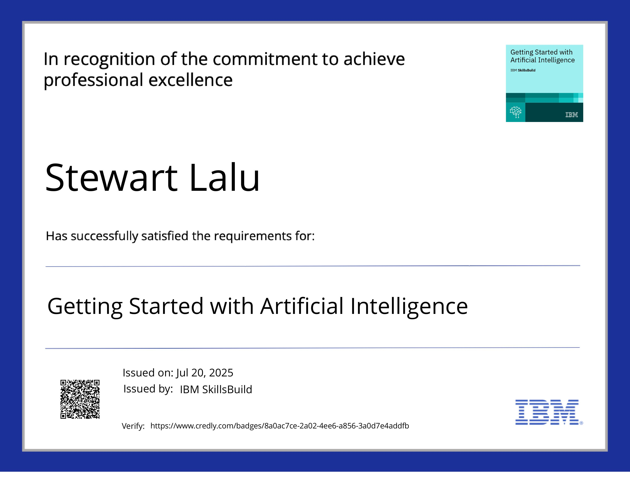
IBM Certifications

Slide 15
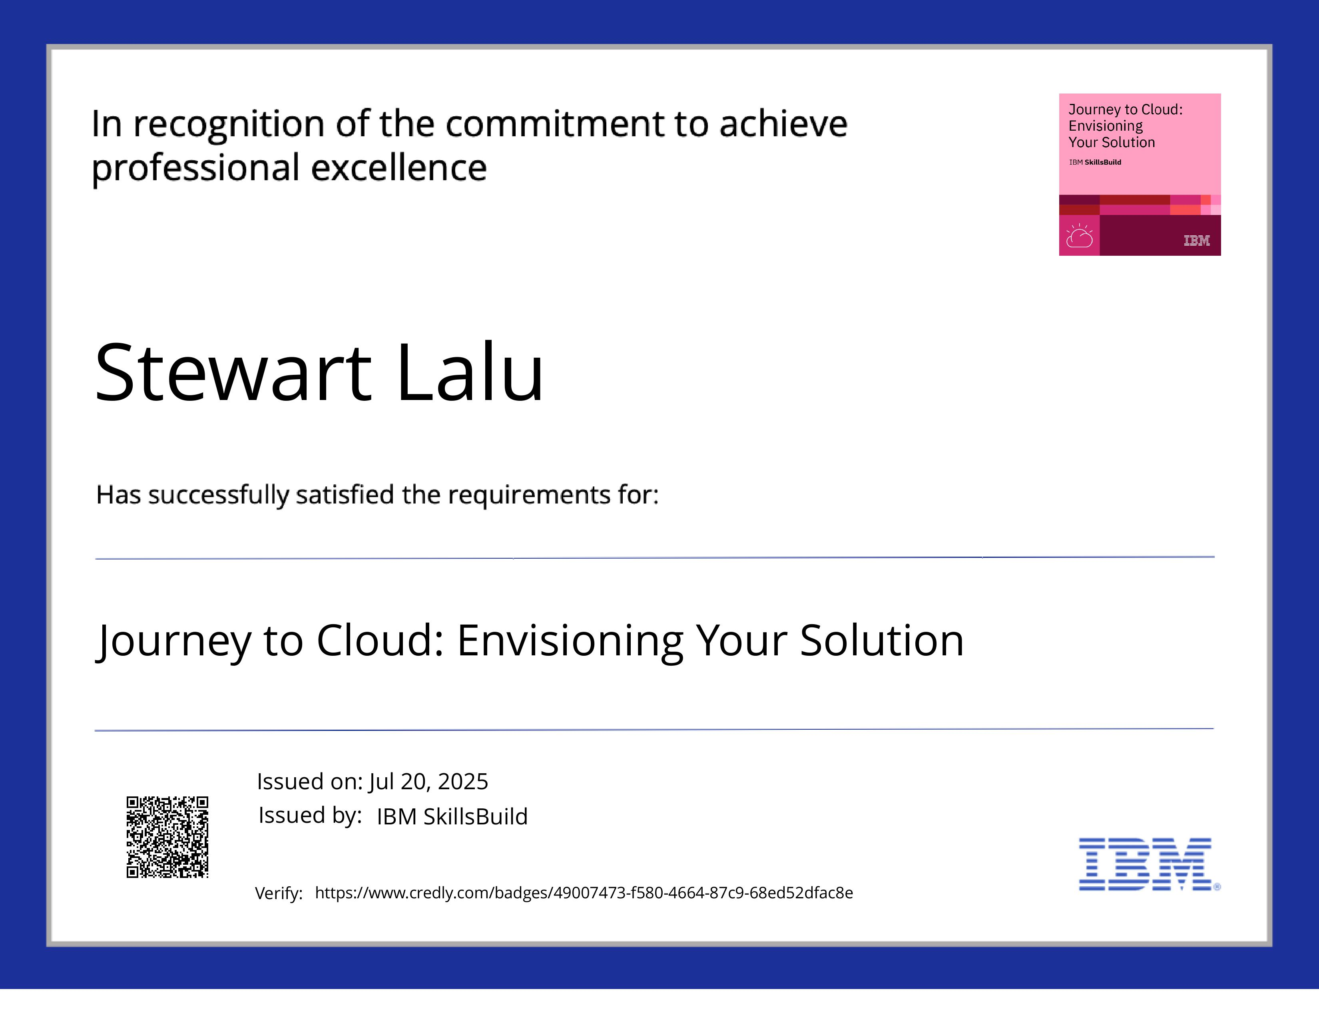
IBM Certifications

Slide 16
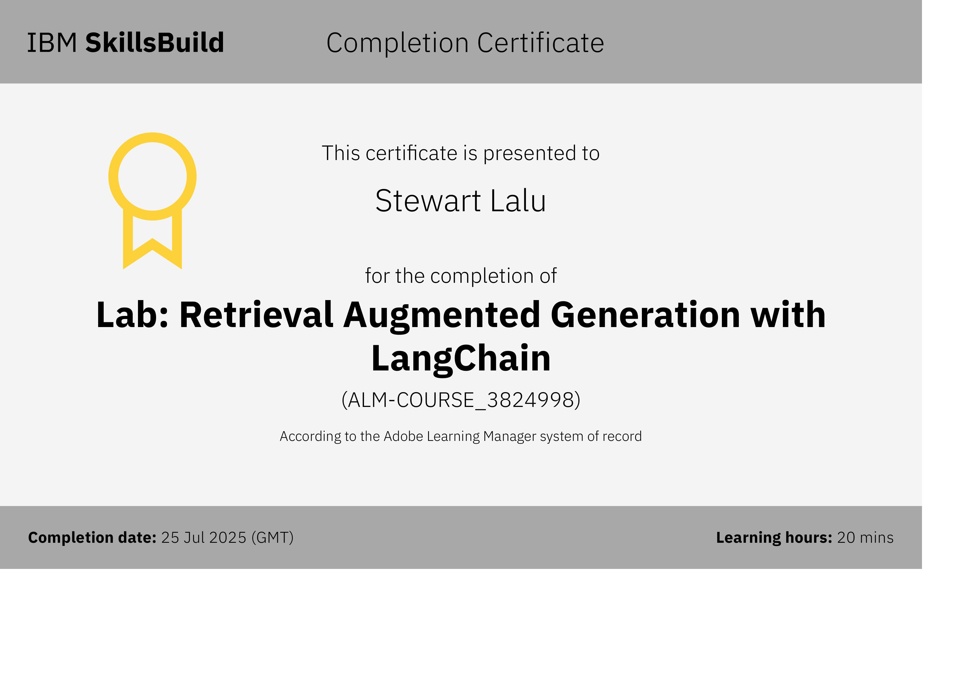
IBM Certifications

Slide 17
Github link
https://github.com/stewartlalu/Fitness_Buddy

Slide 18
THANK YOU

