Slide 1

Root Cause Analysis of P4V Release 2008.2

Slide 2
What’s our objective?
Figure out what QA can do better to find bugs before customers.
Figure out root cause of bugs being found by customers before QA.

Slide 3
What occurs after P4V has been released?
Release 2008.2 Beta.
Customer Reports Bugs.
Release 2008.2 GA.
Customer Reports Bugs.

Slide 4
How does QA determine which bugs customers have reported?
Defect Removal Efficiency Report

Slide 5
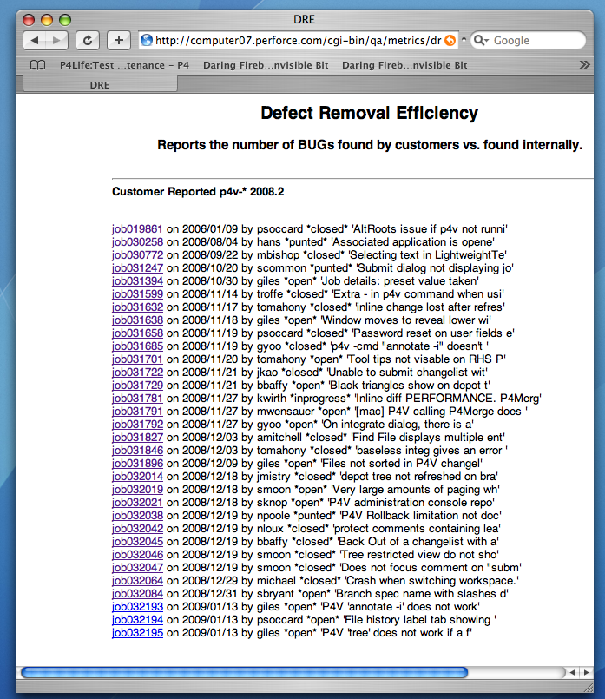

Slide 6
How does QA find bugs in P4V?
By running test cases of test plans.
Verifying jobs.
Accidentally.

Slide 7
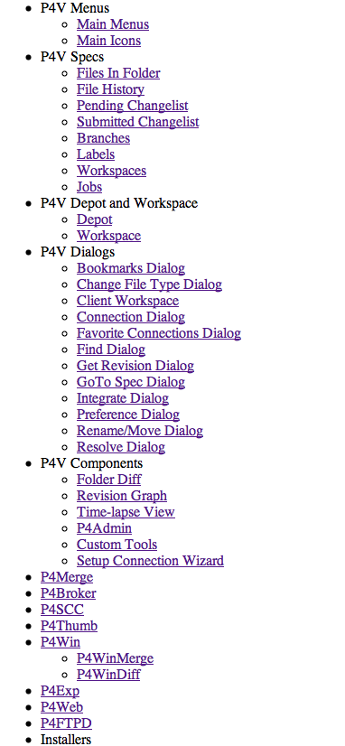
P4V has been broken into categories ?

Slide 8
Categories for jobs from DRE report.
ALT-Root SQL-Server Text-Editor
Submit Jobs Integrate
Merge-Diff UI PassWD
Command-Line Tool-Tip Inline-Diff
Find File Changelist Rollback
Depot Tree Performance Backout
Workspace Tree Branch Spec Crash

Slide 9
Categories not listed under P4V test plans.
SQL-Server Text-Editor
UI Performance
ALT-Root PassWD
Command Line

Slide 10
Categories that are new functionality in P4V 2008.2.
InLine-Diff RollBack
BackOut Integration

Slide 11
The remaining Categories that have Test Plans in P4V.
Submit Find File Depot Tree
Jobs Tool-Tips Changelist
Crash Workspace Tree
Branch Spec Merge-Diff

