Slide 1
Chapter 1: Introduction

Slide 2
Introduction
What Operating Systems Do
Computer-System Organization
Computer-System Architecture
Operating-System Operations
Resource Management
Security and Protection
Virtualization
Computing Environments
Free/Libre and Open-Source Operating Systems

Slide 3
Objectives
Describe the general organization of a computer system and the role of interrupts
Describe the components in a modern, multiprocessor computer system
Illustrate the transition from user mode to kernel mode
Discuss how operating systems are used in various computing environments
Provide examples of free and open-source operating systems

Slide 4
Computer System Structure
Computer system can be divided into four components:
  Hardware – provides basic computing resources
    CPU, memory, I/O devices
  Operating system
    Controls and coordinates use of hardware among various applications and users
  Application programs – define the ways in which the system resources are used to solve the computing problems of the users
    Word processors, compilers, web browsers, database systems, video games
  Users
    People, machines, other computers

Slide 5
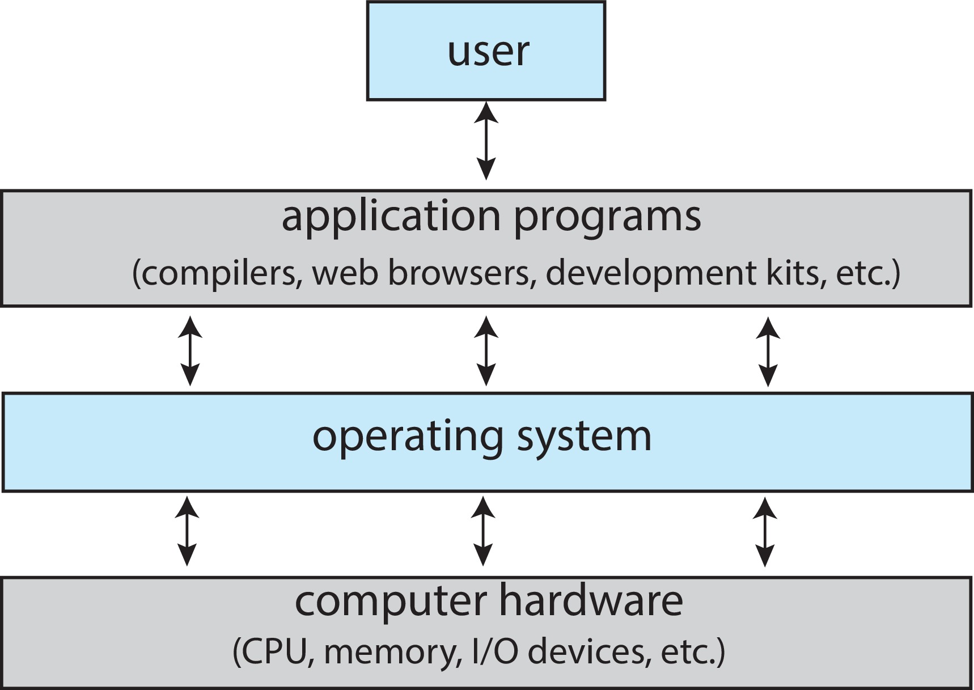
Abstract View of Components of Computer

Slide 6
What Operating Systems Do
Depends on the point of view
Users want convenience, ease of use and good performance
  Don’t care about resource utilization
But shared computer such as mainframe or minicomputer must keep all users happy
  Operating system is a resource allocator and control program making efficient use of HW and managing execution of user programs
Users of dedicated systems such as workstations have dedicated resources but frequently use shared resources from servers
Mobile devices like smartphones and tables are resource poor, optimized for usability and battery life
  Mobile user interfaces such as touch screens, voice recognition
Some computers have little or no user interface, such as embedded computers in devices and automobiles
  Run primarily without user intervention

Slide 7
Defining Operating Systems
Term OS covers many roles
  Because of myriad designs and uses of OSes
  Present in toasters through ships, spacecraft, game machines, TVs and industrial control systems
  Born when fixed use computers for military became more general purpose and needed resource management and program control

Slide 8
Operating System Definition (Cont.)
No universally accepted definition
“Everything a vendor ships when you order an operating system” is a good approximation
  But varies wildly
“The one program running at all times on the computer” is the kernel, part of the operating system
Everything else is either
  a system program (ships with the operating system, but not part of the kernel) , or
  an application program, all programs not associated with the operating system
Today’s OSes for general purpose and mobile computing also include middleware – a set of software frameworks that provide addition services to application developers such as databases, multimedia, graphics

Slide 9
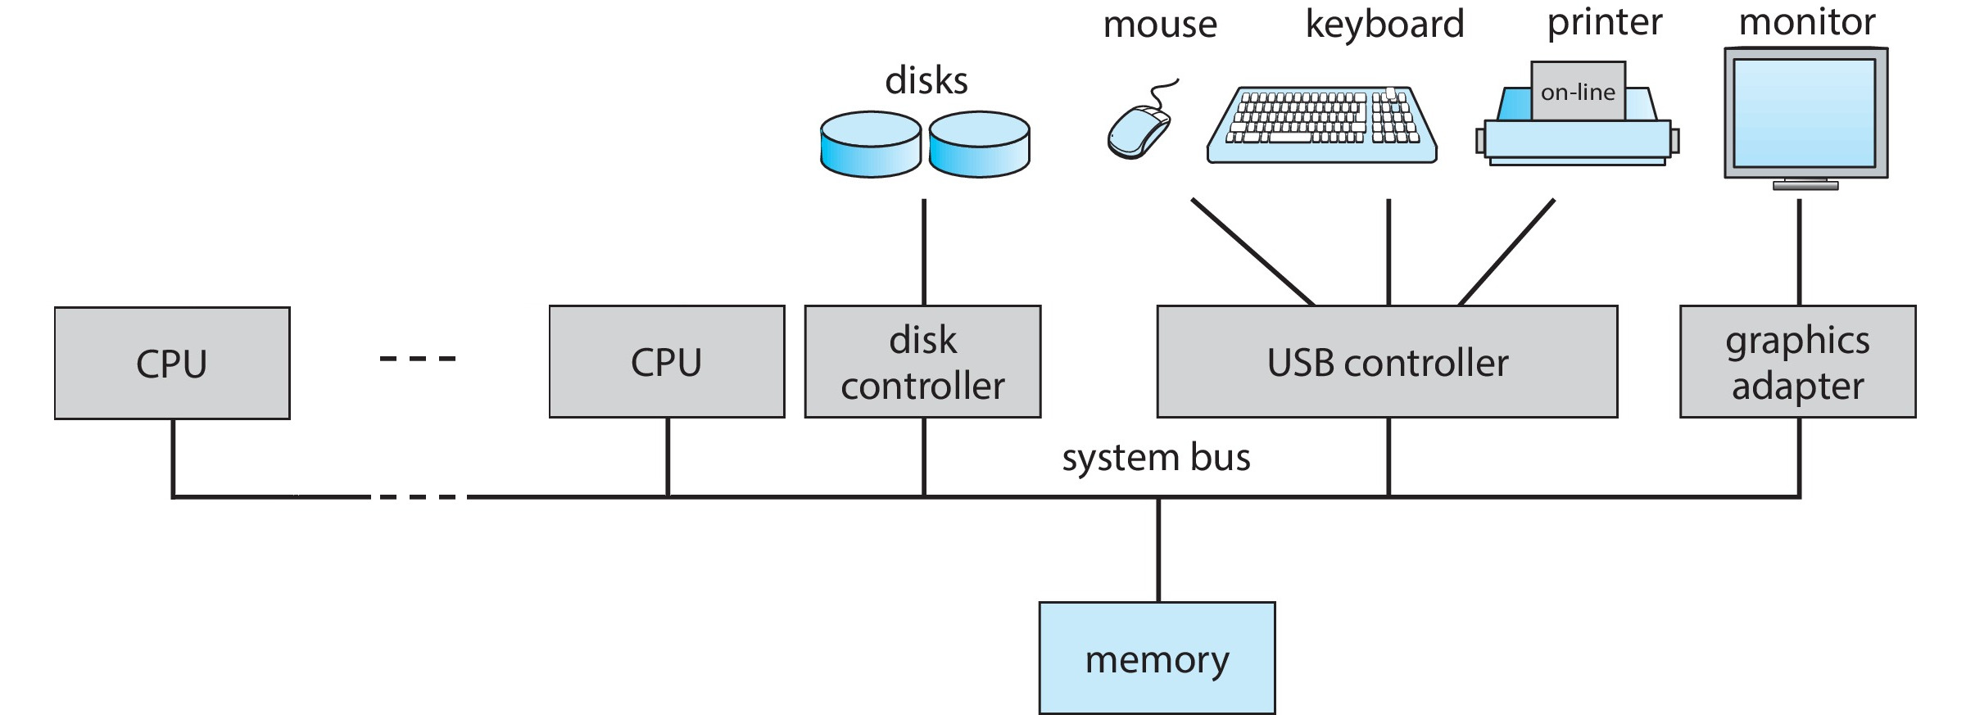
Computer System Organization
Computer-system operation
  One or more CPUs, device controllers connect through common bus providing access to shared memory
  Concurrent execution of CPUs and devices competing for memory cycles

Slide 10
Computer-System Operation
I/O devices and the CPU can execute concurrently.
Each device controller is in charge of a particular device type.
Each device controller has a local buffer.
Each device controller type has an operating system device driver to manage it.
CPU moves data from/to main memory to/from local buffers.
I/O is from the device to local buffer of controller
Device controller informs CPU that it has finished its operation by causing an interrupt

Slide 11
Common Functions of Interrupts
Interrupt transfers control to the interrupt service routine generally, through the interrupt vector, which contains the addresses of all the service routines
Interrupt architecture must save the address of the interrupted instruction and in general the state of the CPU and be able to restore that state later.
A trap or exception is a software-generated interrupt caused either by an error or a user request
An operating system is interrupt driven – it only runs as a result of interrupts (including exceptions).
Usually two interrupt lines, one non-maskable, for events that must be handled immediately, and one for maskable interrupts, which can be turned off (deferred usually) by the CPU.

Slide 12
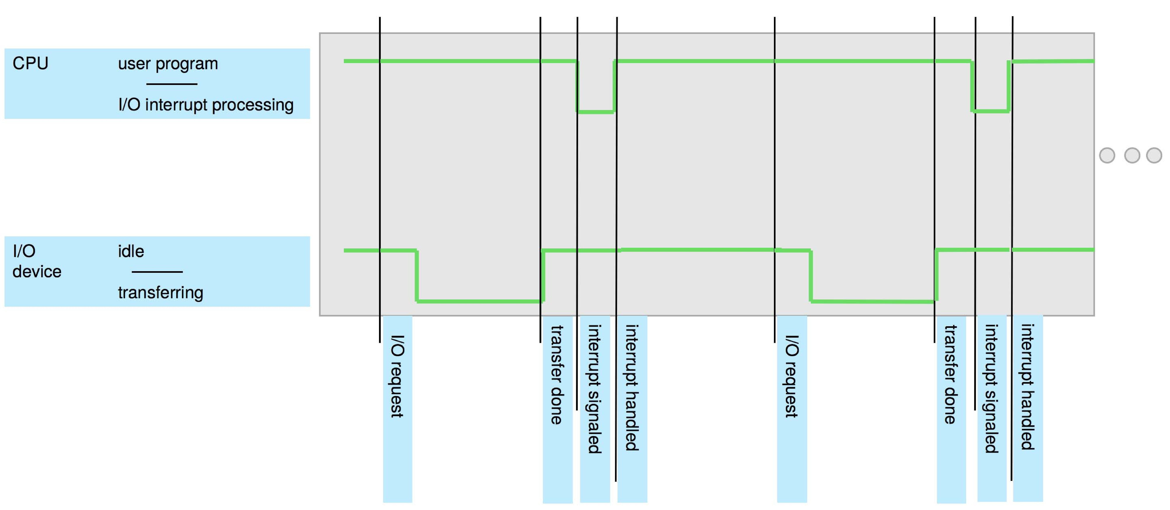
Interrupt Timeline

Slide 13
Computer Startup
Bootstrap program is loaded at power-up or reboot
  Typically stored in ROM or EPROM, generally known as firmware
  Initializes all aspects of system
  Loads operating system kernel and starts execution

Slide 14
Interrupt Handling
The operating system preserves the state of the CPU by storing registers and the program counter
Determines which type of interrupt has occurred:
  vectored interrupt system
  polling to determine which device
  hybrid – interrupt vector with linked list of devices (when number of devices exceeds table size)
Separate segments of code determine what action should be taken for each type of interrupt – interrupt service routines, also called interrupt handlers

Slide 15
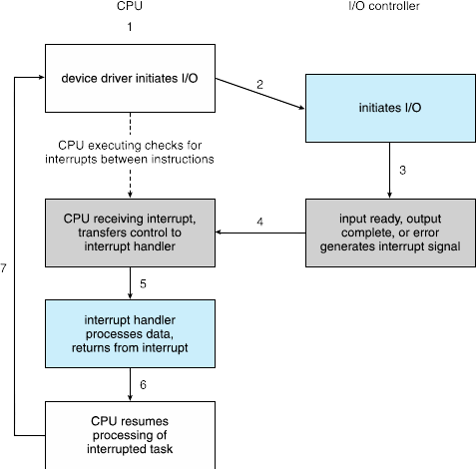
Interrupt-driven I/O Cycle

Slide 16
Synchronous vs Asynchronous I/O
Synchronous: After I/O starts, control returns to user program only upon I/O completion
  Wait instruction idles the CPU until the next interrupt
  Wait loop (contention for memory access)
  At most one I/O request is outstanding at a time, no simultaneous I/O processing
Asynchronous: After I/O starts, control returns to user program without waiting for I/O completion
  System call – request to the OS to allow user to wait for I/O completion
  Device-status table contains entry for each I/O device indicating its type, address, and state
  OS indexes into I/O device table to determine device status and to modify table entry to include interrupt

Slide 17
Storage Structure
Main memory – only large storage medium that the CPU can access directly
  Random access
  Typically volatile
  Typically random-access memory in the form of Dynamic Random-access Memory (DRAM)
Secondary storage – extension of main memory that provides large nonvolatile storage capacity
Hard Disk Drives (HDD) – rigid metal or glass platters covered with magnetic recording material
  Disk surface is logically divided into tracks, which are subdivided into sectors
  The disk controller determines the logical interaction between the device and the computer
Non-volatile memory (NVM) devices– faster than hard disks, nonvolatile
  Various technologies
  Becoming more popular as capacity and performance increases, price drops

Slide 18
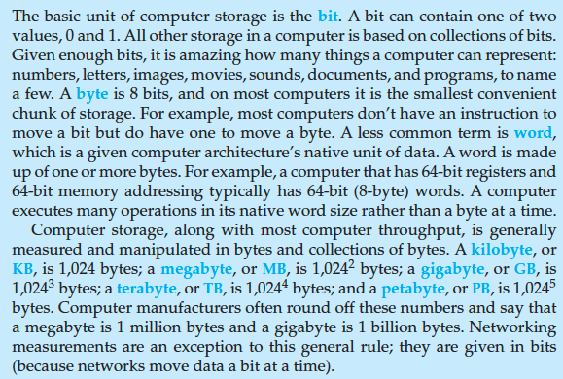
Storage Definitions and Notation Review
The basic unit of computer storage is the bit . A bit can contain one of two
values, 0 and 1. All other storage in a computer is based on collections of bits.
Given enough bits, it is amazing how many things a computer can represent:
numbers, letters, images, movies, sounds, documents, and programs, to name
a few. A byte is 8 bits, and on most computers it is the smallest convenient
chunk of storage. For example, most computers don’t have an instruction to
move a bit but do have one to move a byte. A less common term is word,
which is a given computer architecture’s native unit of data. A word is made
up of one or more bytes. For example, a computer that has 64-bit registers and
64-bit memory addressing typically has 64-bit (8-byte) words. A computer
executes many operations in its native word size rather than a byte at a time.
Computer storage, along with most computer throughput, is generally
measured and manipulated in bytes and collections of bytes. A kilobyte , or
KB , is 1,024 bytes; a megabyte , or MB , is 1,024² bytes; a gigabyte , or GB , is
1,024³ bytes; a terabyte , or TB , is 1,024⁴ bytes; and a petabyte , or PB , is 1,024⁵
bytes. Computer manufacturers often round off these numbers and say that
a megabyte is 1 million bytes and a gigabyte is 1 billion bytes. Networking
measurements are an exception to this general rule; they are given in bits
(because networks move data a bit at a time).

Slide 19
Storage Hierarchy
Storage systems organized in hierarchy
  Speed
  Cost
  Volatility
Caching – copying information into faster storage system; main memory can be viewed as a cache for secondary storage
Device Driver for each device controller to manage I/O
  Provides uniform interface between controller and kernel

Slide 20
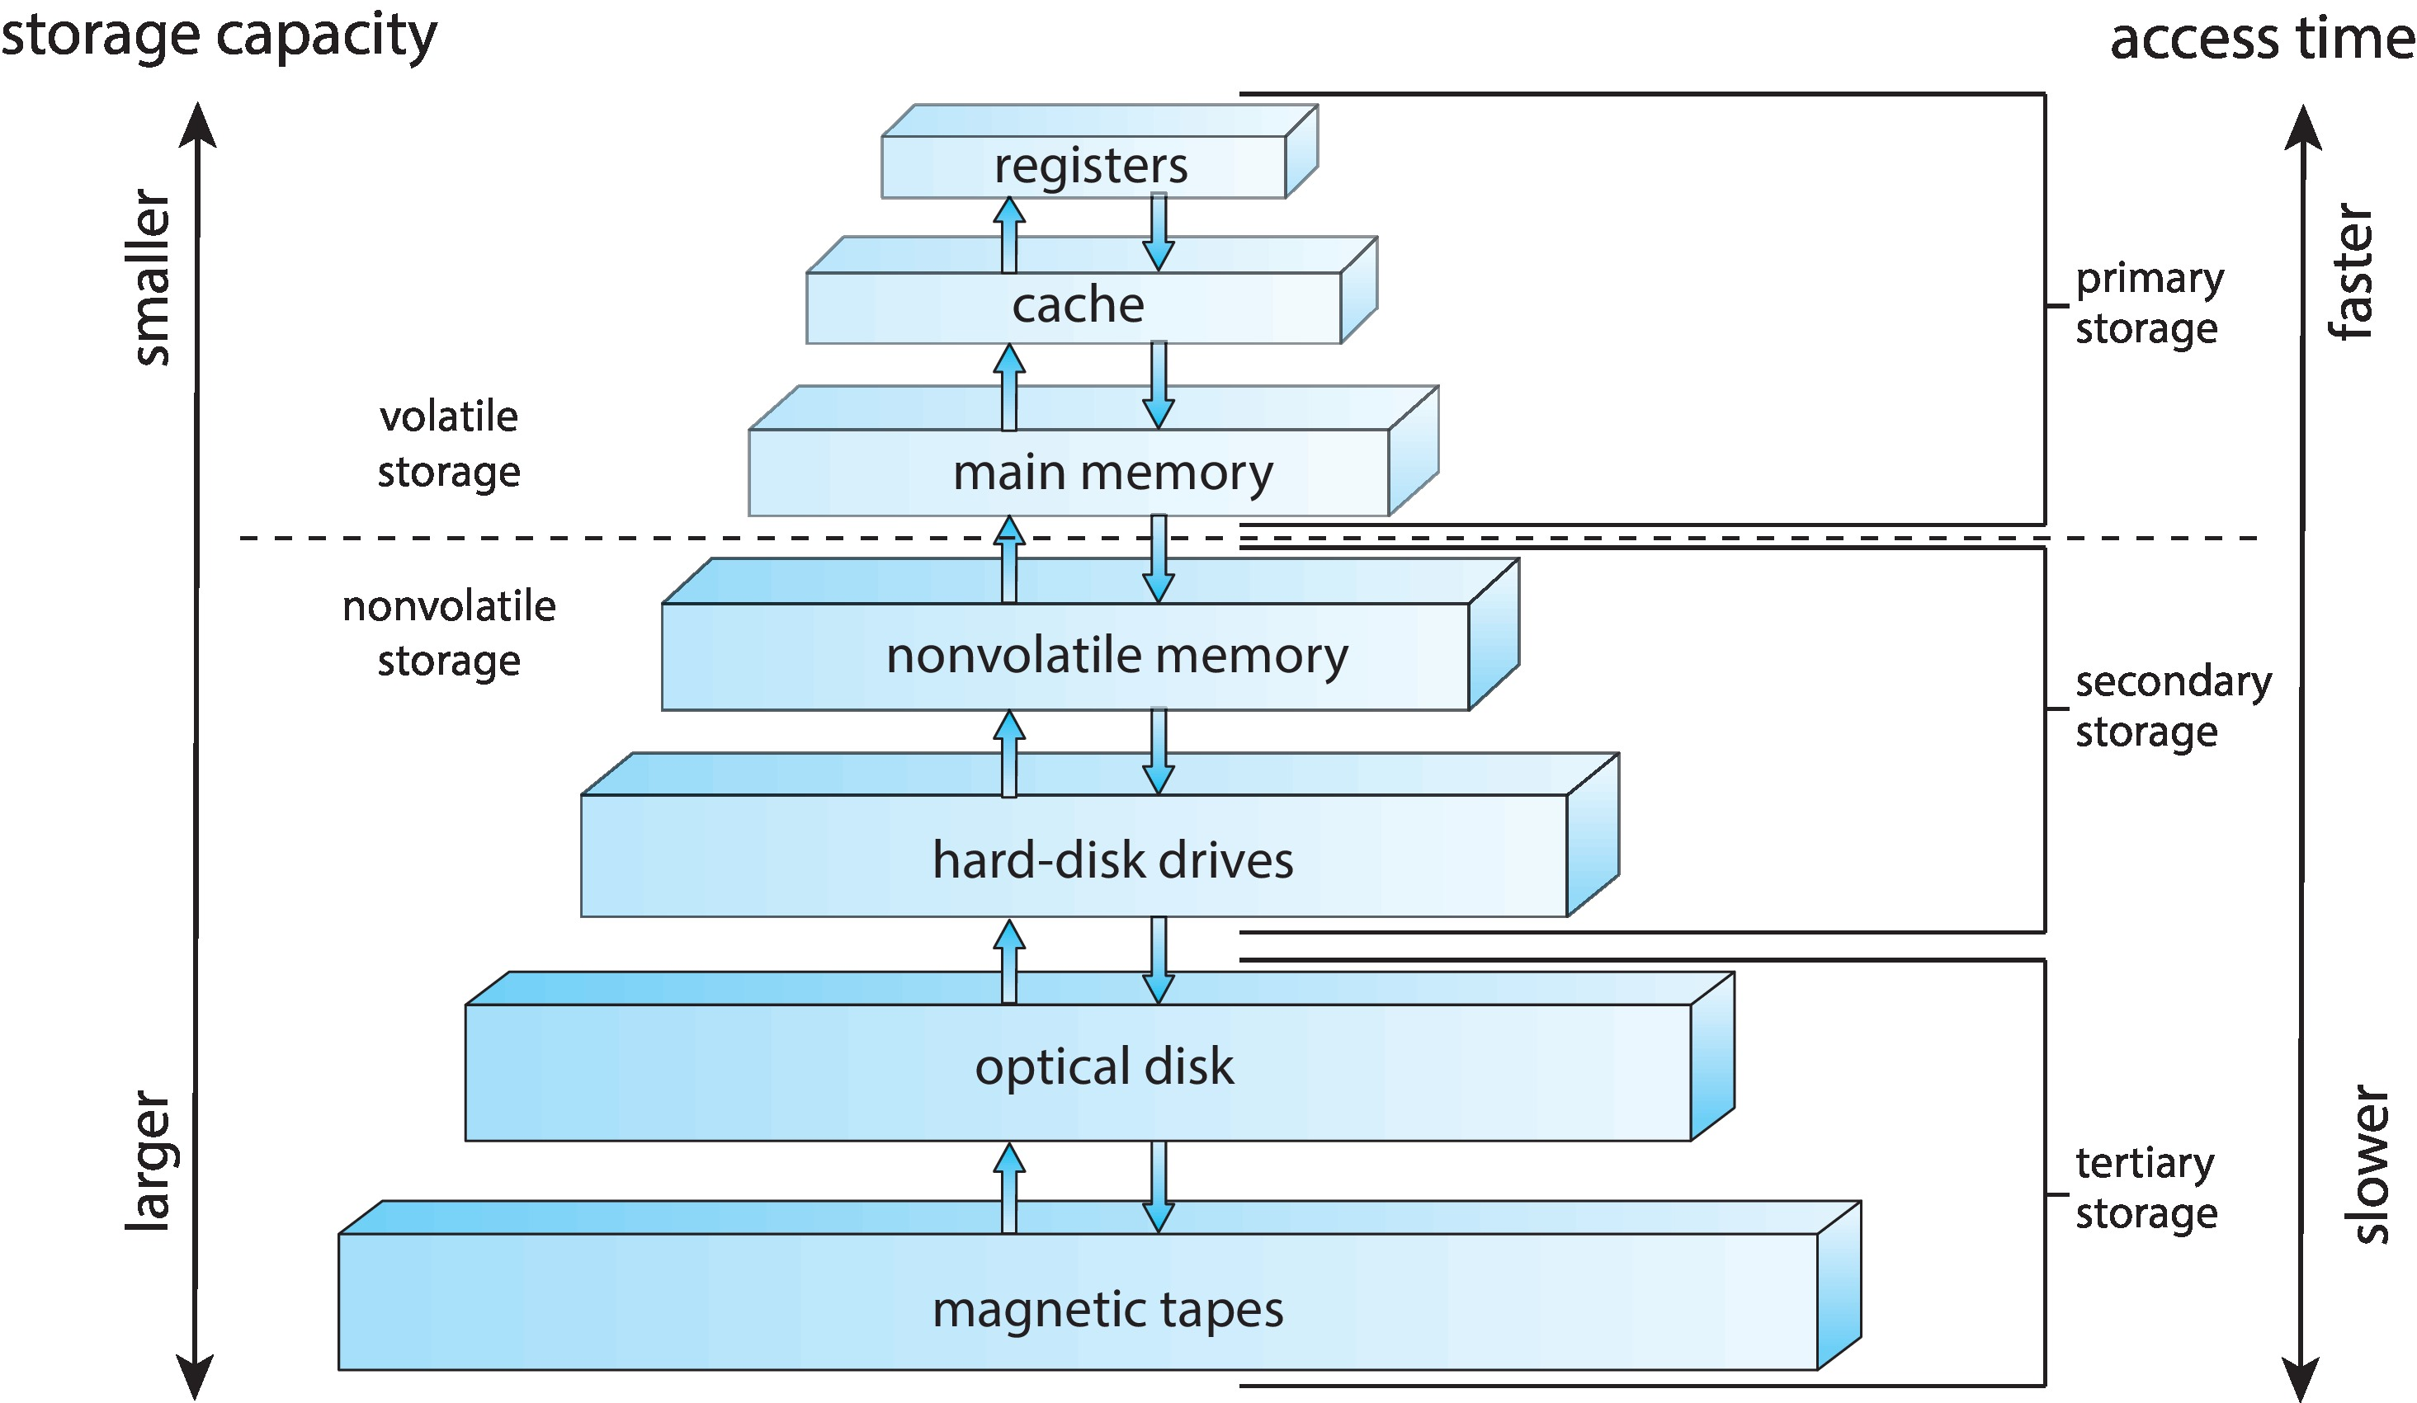
Storage-Device Hierarchy

Slide 21
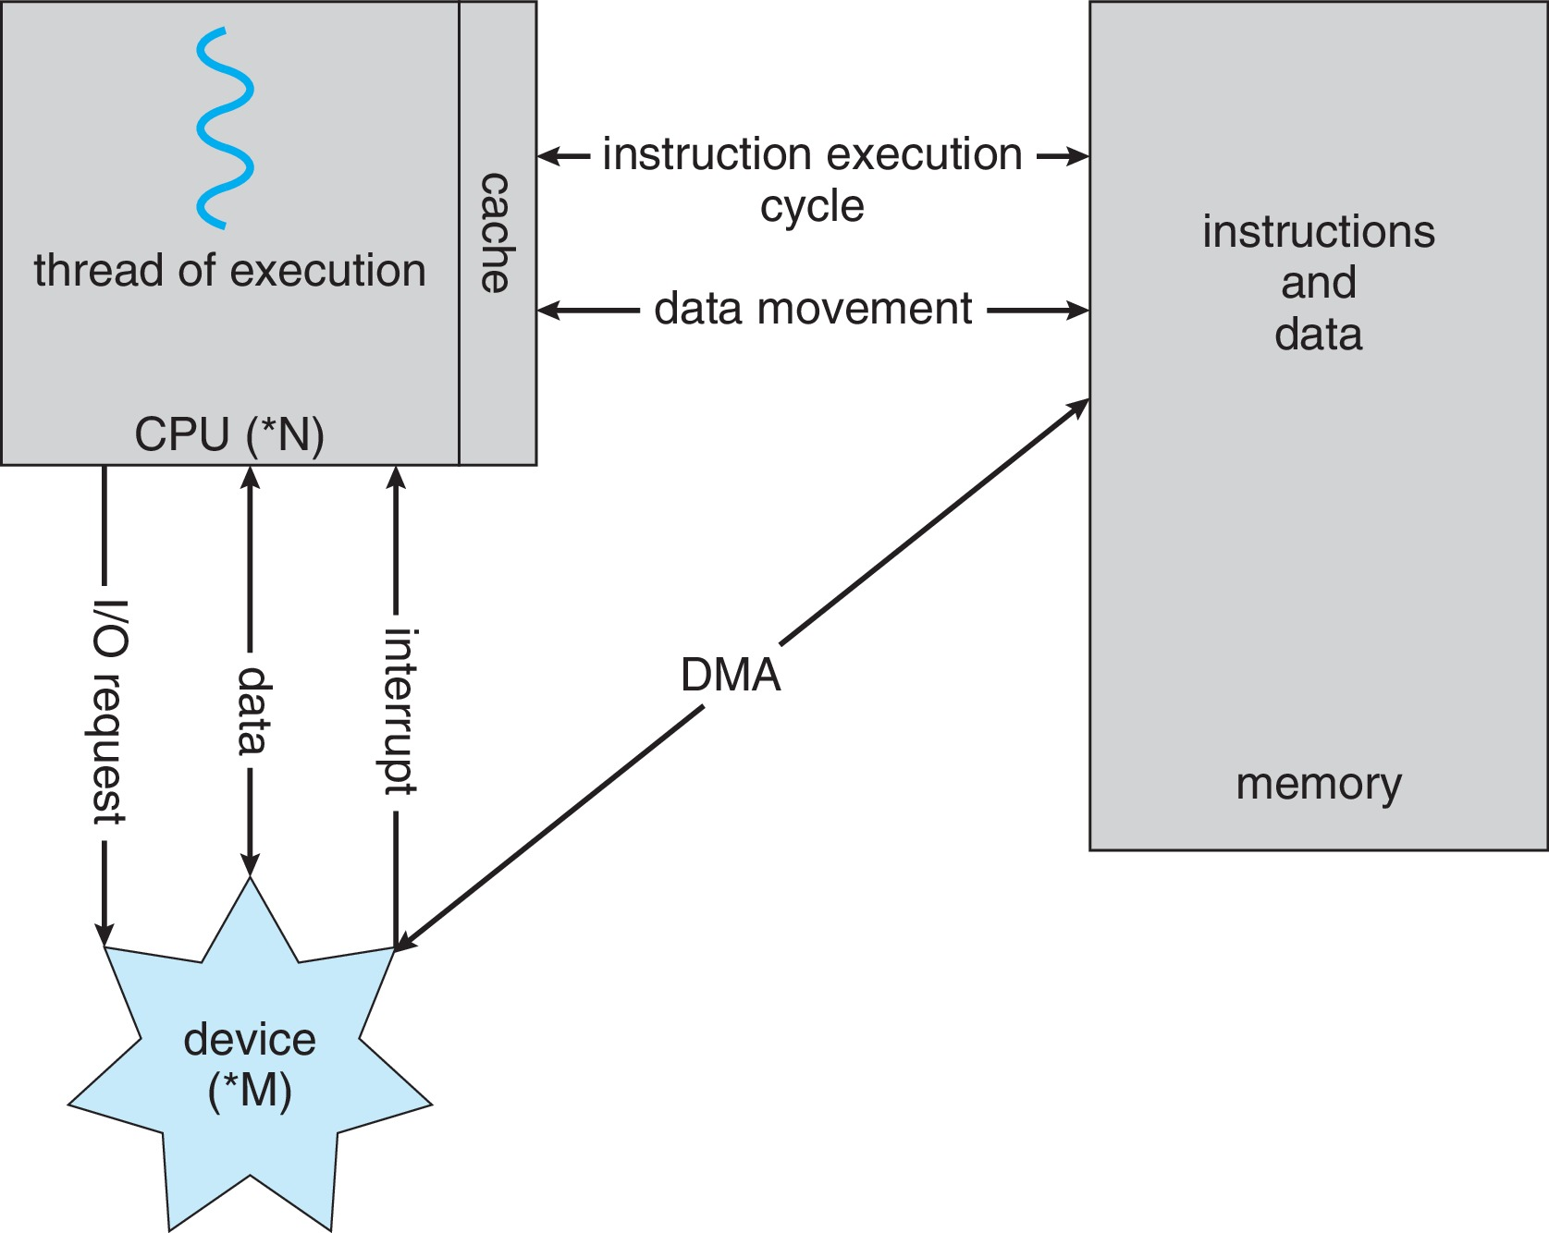
How a Modern Computer Works
A von Neumann architecture

Slide 22
Direct Memory Access Structure
Used for high-speed I/O devices able to transmit information at close to memory speeds
Device controller transfers blocks of data from buffer storage directly to main memory without CPU intervention. (CPU needs to set up transfer first.)
Only one interrupt is generated per block, rather than the one interrupt per byte

Slide 23
Computer-System Architecture
Most systems used to use a single general-purpose processor. Now most use more than one.
  Most systems have special-purpose processors as well
Multiprocessors systems growing in use and importance
  Also known as parallel systems, tightly-coupled systems
  Advantages include:
    Increased throughput
    Economy of scale
    Increased reliability – graceful degradation or fault tolerance
  Two types:
    Asymmetric Multiprocessing – each processor is assigned a specie task.
    Symmetric Multiprocessing – each processor performs all tasks

Slide 24
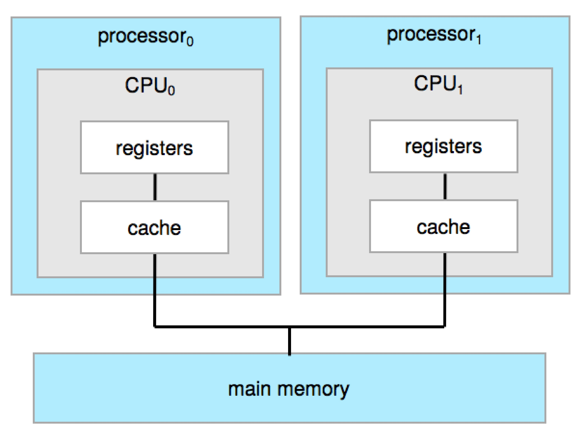
2-Processor Symmetric Multiprocessing Architecture

Slide 25
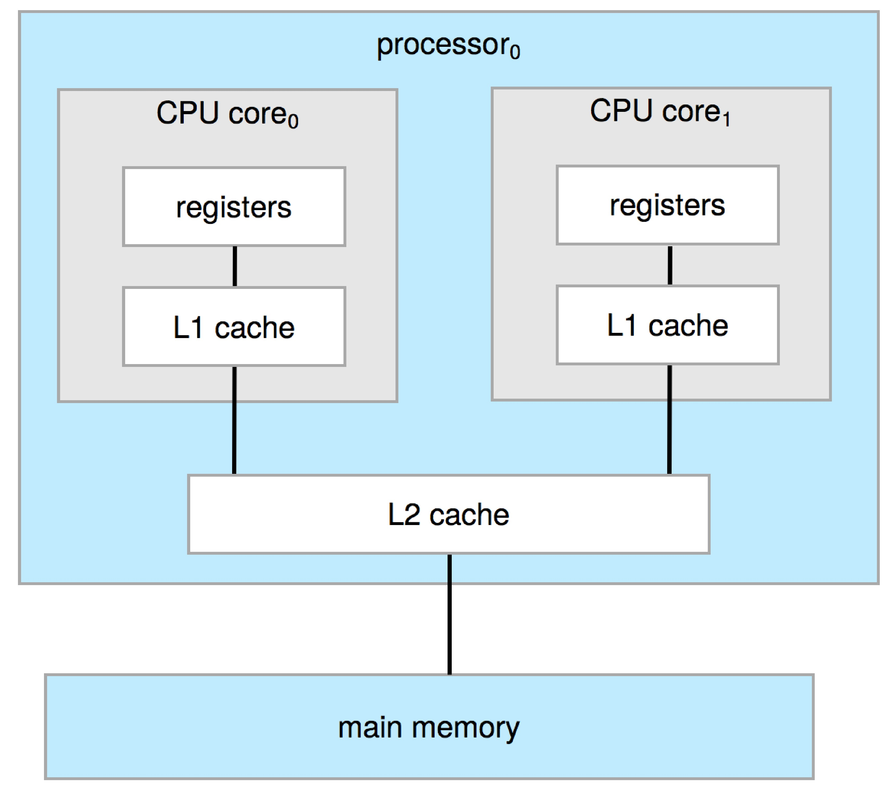
A Dual-Core Design
Multi-chip and multicore
Systems containing all chips
  Chassis containing multiple separate systems
Might be L3 cache here

Slide 26
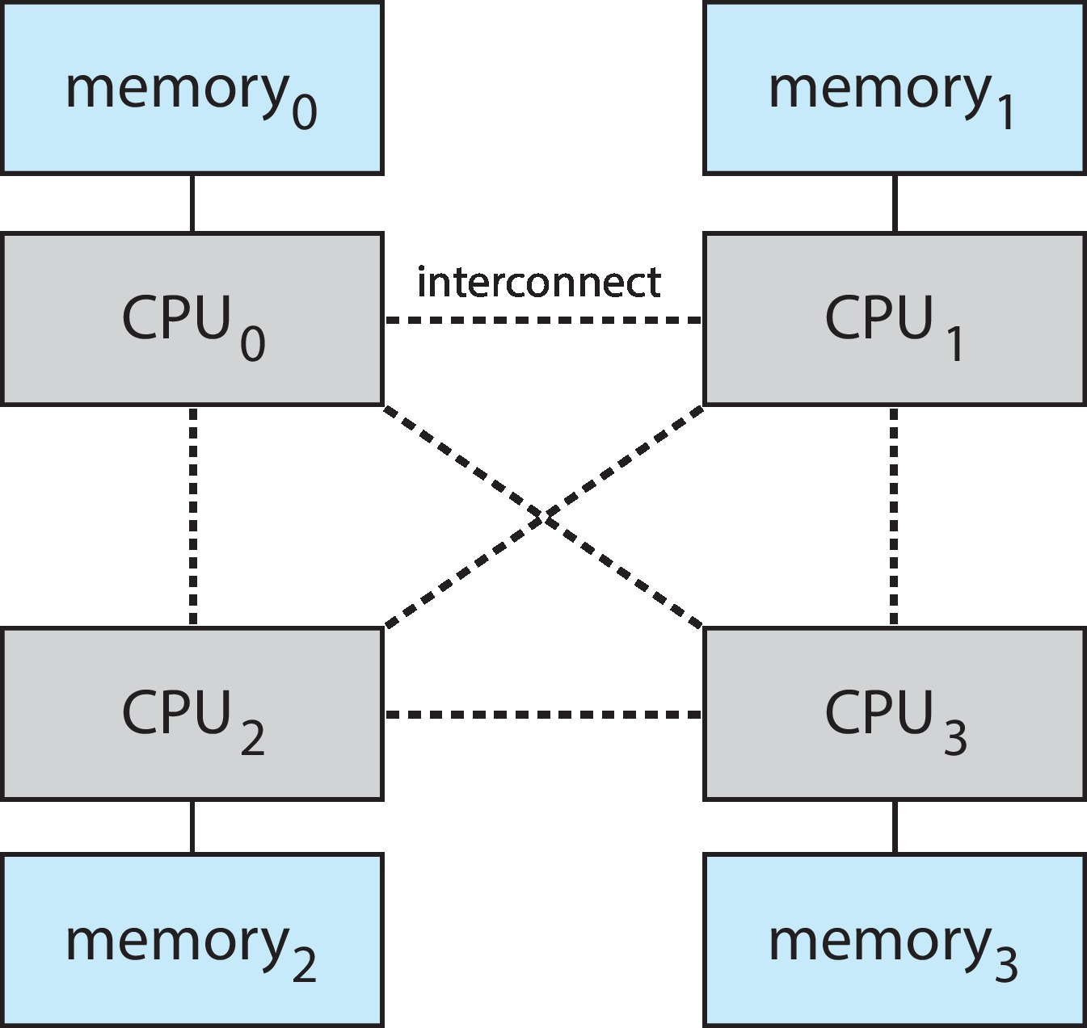
Non-Uniform Memory (NUMA) Access System

Slide 27
Clustered Systems
Like multiprocessor systems, but multiple systems working together
  Usually sharing storage via a storage-area network (SAN)
  Provides a high-availability service which survives failures
    Asymmetric clustering has one machine in hot-standby mode
    Symmetric clustering has multiple nodes running applications, monitoring each other
  Some clusters are for high-performance computing (HPC)
    Applications must be written to use parallelization
  Some have distributed lock manager (DLM) to avoid conflicting operations

Slide 28
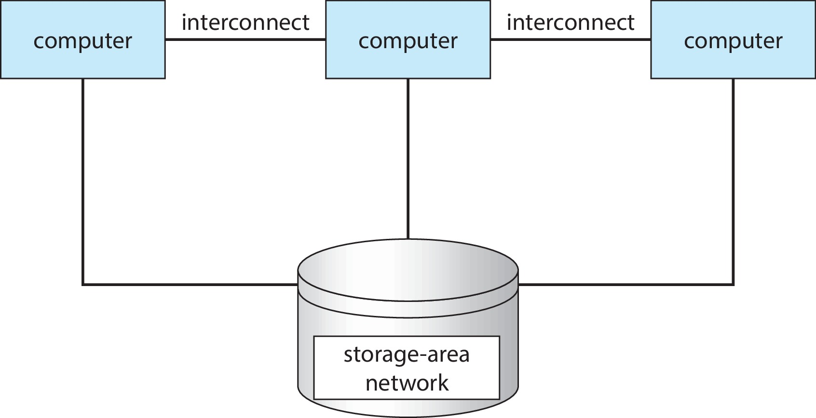
A Clustered System

Slide 29
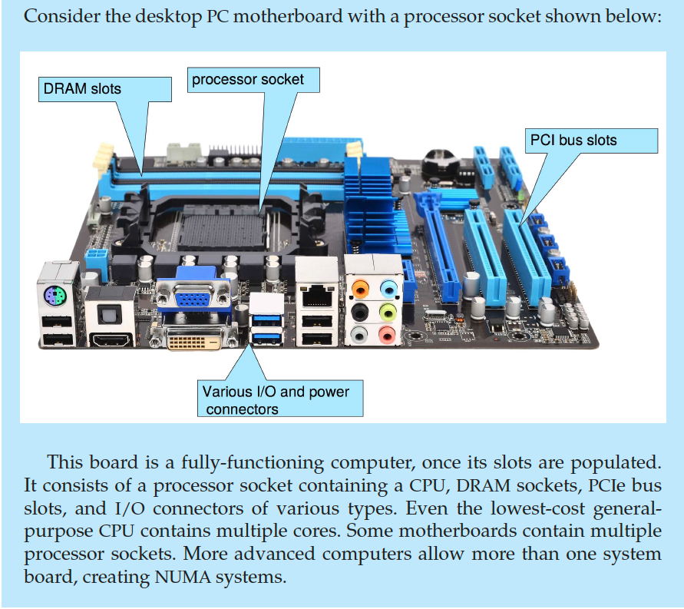
PC Motherboard

Slide 30
Operating-System Operations
Bootstrap program – simple code to initialize the system, load the kernel
Kernel loads
Starts system daemons (services provided outside of the kernel)
Kernel interrupt driven (hardware and software)
  Hardware interrupt by one of the devices
  Software interrupt (exception or trap):
    Software error (e.g., division by zero)
    Request for operating system service – system call
    Other process problems include infinite loop, processes modifying each other or the operating system

Slide 31
Multiprogramming
Multiprogramming means keeping more than one program in memory at a time.
  A single program cannot keep CPU and I/O devices busy at all times.
  Allows several programs to be run simultaneously.
  Multiprogramming allows OS to switch programs so that CPU always has one to execute.
  When running process requests I/O, CPU is given to a process that can make progress.
  Increases CPU utilization (fraction of time CPU is doing useful work).

Slide 32
Batch Processing and Multitasking
Batch processing is one kind of multiprogramming system:
  Processes jobs in bulk, with predetermined input from files or other data sources.
  A subset of total jobs in system is kept in memory
  One job selected and run via job scheduling
  Each job is run to completion.
Multitasking is a kind of multiprogramming system in which processes get small time slices.
  It is a form of timesharing system.
  CPU switches jobs so frequently that users can interact with each job while it is running, creating interactive computing.
  Response time should be fast
  If several jobs ready to run at the same time CPU scheduling is used
  If processes don’t fit in memory, swapping moves them in and out to run
  Virtual memory allows execution of processes not completely in memory

Slide 33
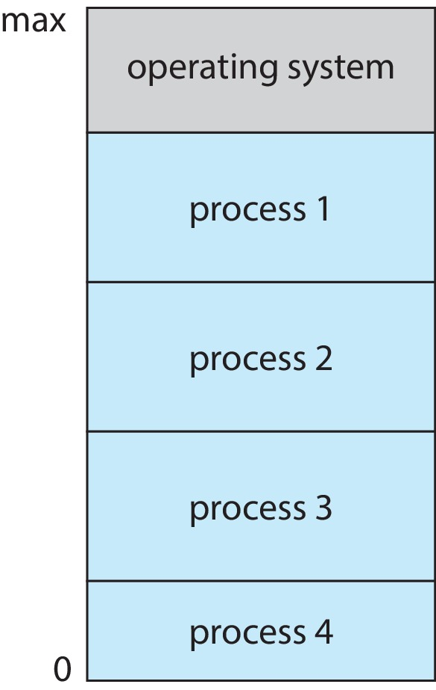
Memory Layout for Multiprogrammed System

Slide 34
Dual-mode and Multimode Operation
Dual-mode operation allows OS to protect itself and other system components. Two modes:
  User mode and kernel mode (aka privileged mode, supervisor mode)
  Mode bit provided by hardware
    Provides ability to distinguish when system is running user code or kernel code
    Some instructions designated as privileged, only executable in kernel mode
    System call changes mode to kernel, return from call resets it to user
Increasingly CPUs support multi-mode operations
  i.e. virtual machine manager (VMM) mode for guest VMs

Slide 35
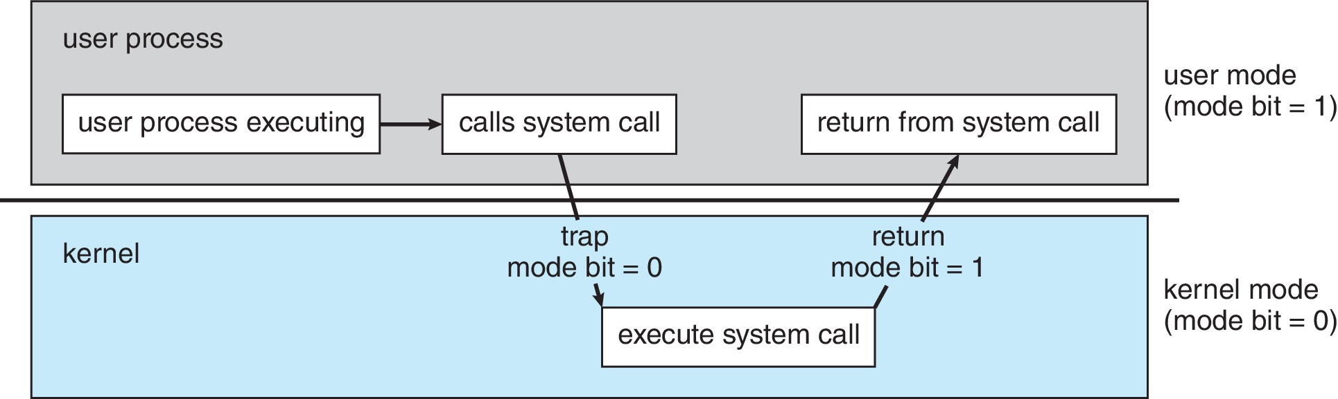
Transition from User to Kernel Mode
Timer to prevent infinite loop / process hogging resources
  Timer is set to interrupt the computer after some time period
    Keep a counter that is decremented by the physical clock
    Operating system set the counter (privileged instruction)
    When counter is zero, generate an interrupt
  Set up before scheduling process to regain control or terminate program that exceeds allotted time

Slide 36
Process Management
A process is a program in execution. It is a unit of work within the system. Program is a passive entity, process is an active entity.
Process needs resources to accomplish its task
  CPU, memory, I/O, files
  Initialization data
Process termination requires reclaiming any reusable resources
Single-threaded process has one program counter specifying location of next instruction to execute
  Process executes instructions sequentially, one at a time, until completion
Multi-threaded process has one program counter per thread
Typically system has many processes, some user, some operating system running concurrently on one or more CPUs
  Concurrency by multiplexing the CPUs among the processes / threads

Slide 37
Process Management Activities
The operating system is responsible for the following activities in connection with process management:
Creating and deleting both user and system processes
Suspending and resuming processes
Providing mechanisms for process synchronization
Providing mechanisms for process communication
Providing mechanisms for deadlock handling

Slide 38
Memory Management
To execute a program all (or part) of the instructions must be in memory
All (or part) of the data that is needed by the program must be in memory
Memory management determines what is in memory and when
  Optimizing CPU utilization and computer response to users
Memory management activities
  Keeping track of which parts of memory are currently being used and by whom
  Deciding which processes (or parts thereof) and data to move into and out of memory
  Allocating and deallocating memory space as needed

Slide 39
File-system Management
OS provides uniform, logical view of information storage
  Abstracts physical properties to logical storage unit - file
  Each medium is controlled by device (i.e., disk drive, tape drive)
    Varying properties include access speed, capacity, data-transfer rate, access method (sequential or random)
File-System management
  Files usually organized into directories
  Access control on most systems to determine who can access what
  OS activities include
    Creating and deleting files and directories
    Primitives to manipulate files and directories
    Mapping files onto secondary storage
    Backup files onto stable (non-volatile) storage media

Slide 40
Mass-Storage Management
Usually disks used to store data that does not fit in main memory or data that must be kept for a “long” period of time
Proper management is of central importance
Entire speed of computer operation hinges on disk subsystem and its algorithms
OS activities
  Mounting and unmounting filesystems to file hierarchy
  Free-space management
  Storage allocation
  Disk scheduling
  Partitioning disks
  Protection
Some storage need not be fast
  Tertiary storage includes optical storage, magnetic tape
  Still must be managed – by OS or applications

Slide 41
Caching
Important principle, performed at many levels in a computer (in hardware, operating system, software)
Information in use copied from slower to faster storage temporarily
Faster storage (cache) checked first to determine if information is there
  If it is, information used directly from the cache (fast)
  If not, data from slower storage copied to cache and then used there
Cache smaller than storage being cached
  Cache management important design problem
  Cache size and replacement policy

Slide 42
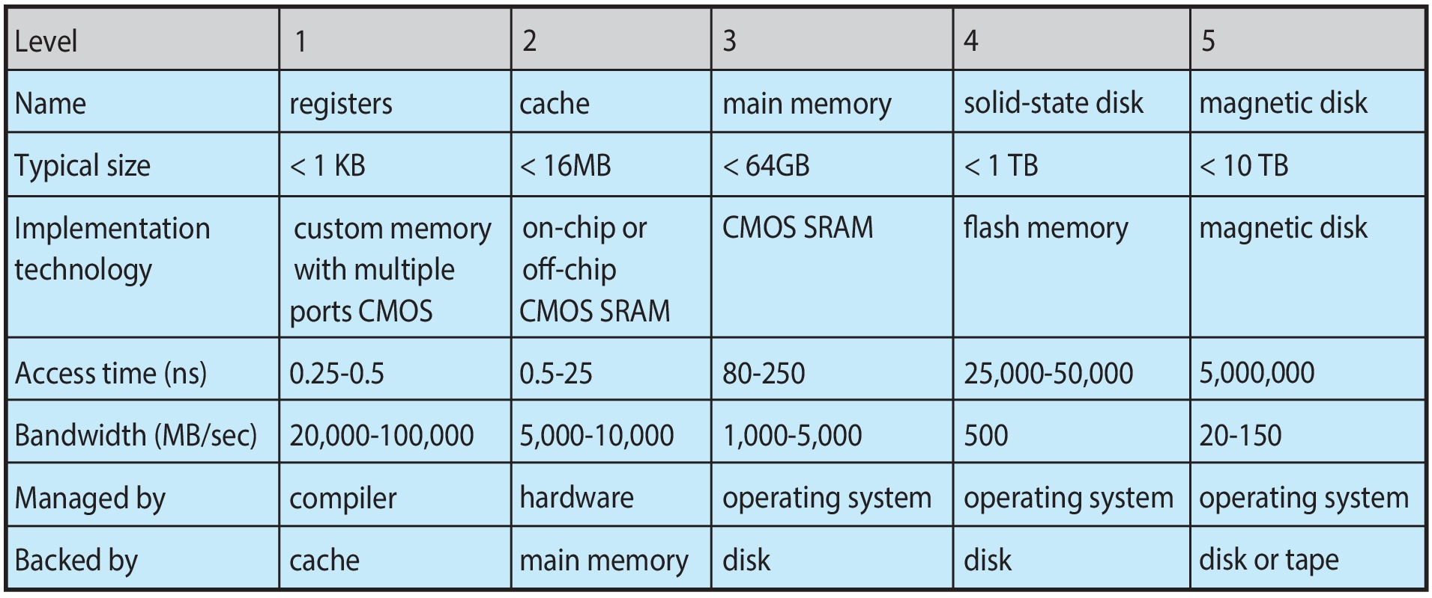
Characteristics of Various Types of Storage
Movement between levels of storage hierarchy can be explicit or implicit.
Values based on data from around 2017

Slide 43
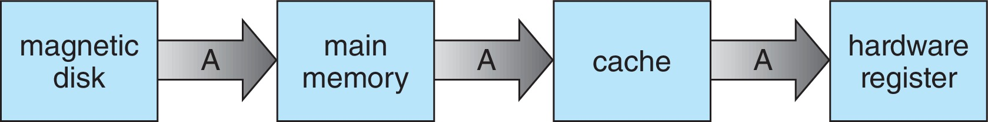
Migration of data “A” from Disk to Register
Multitasking environments must be careful to use most recent value, no matter where it is stored in the storage hierarchy
Multiprocessor environment must provide cache coherency in hardware such that all CPUs have the most recent value in their cache
Distributed environment situation even more complex
  Several copies of a datum can exist
  Various solutions covered in Chapter 19

Slide 44
I/O Subsystem
One purpose of OS is to hide peculiarities of hardware devices from the user
I/O subsystem responsible for
  Memory management of I/O including buffering (storing data temporarily while it is being transferred), caching (storing parts of data in faster storage for performance), spooling (the overlapping of output of one job with input of other jobs)
  General device-driver interface
  Drivers for specific hardware devices

Slide 45
Protection and Security
Protection – any mechanism for controlling access of processes or users to resources defined by the OS
Security – defense of the system against internal and external attacks
  Huge range, including denial-of-service, worms, viruses, identity theft, theft of service
Systems generally first distinguish among users, to determine who can do what
  User identities (user IDs, security IDs) include name and associated number, one per user
  User ID then associated with all files, processes of that user to determine access control
  Group identifier (group ID) allows set of users to be defined and controls managed, then also associated with each process, file
  Privilege escalation allows user to change to effective ID with more rights

Slide 46
Computing Environments - Traditional
Stand-alone general purpose machines
But blurred as most systems interconnect with others (i.e., the Internet)
Portals provide web access to internal systems
Network computers (thin clients) are like Web terminals
Mobile computers interconnect via wireless networks
Networking becoming ubiquitous – even home systems use firewalls to protect home computers from Internet attacks

Slide 47
Computing Environments - Mobile
Handheld smartphones, tablets, etc
What is the functional difference between them and a “traditional” laptop?
Extra feature – more OS features (GPS, gyroscope)
Allows new types of apps like augmented reality
Use IEEE 802.11 wireless, or cellular data networks for connectivity
Most common are Apple iOS and Google Android

Slide 48
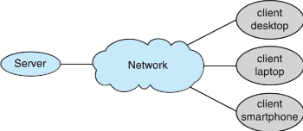
Computing Environments – Client-Server
Client-Server Computing
  Dumb terminals supplanted by smart PCs
  Many systems now servers, responding to requests generated by clients
    Compute-server system provides an interface to client to request services (i.e., database)
    File-server system provides interface for clients to store and retrieve files

Slide 49
Free and Open-Source Operating Systems
Operating systems made available in source-code format rather than just binary and free to modify, as opposed to closed-source and proprietary
Counter to the copy protection and Digital Rights Management (DRM) movement
UNIX was the first one.
Promoted by Free Software Foundation (FSF), which invented the first “copyleft” GNU Public License (GPL)
  Free software and open-source software are two different ideas championed by different groups of peopl
Examples include GNU/Linux and BSD UNIX (including core of Mac OS X), and many more
Can use VMM like VMware Player (Free on Windows), Virtualbox (open source on many platforms - http://www.virtualbox.com)
  Use to run guest operating systems for exploration

Slide 50
The Study of Operating Systems
There has never been a more interesting time to study operating systems, and it has never been
easier. The open-source movement has overtaken operating systems, causing many of them to be
made available in both source and binary (executable) format. The list of operating
systems available in both formats includes Linux, BUSD UNIX, Solaris, and part of macOS.
The availability of source code allows us to study operating systems from the inside out.
Questions that we could once answer only by looking at documentation or the behavior of an
operating system we can now answer by examining the code itself.
Operating systems that are no longer commercially viable have been open-sourced as well, enabling
us to study how systems operated in a time of fewer CPU, memory, and storage resources.
An extensive but incomplete list of open-source operating-system projects is available
from https://curlie.org/Computers/Software/Operating_Systems/Open_Source/
In addition, the rise of virtualization as a mainstream (and frequently free) computer function
makes it possible to run many operating systems on top of one core system. For example, VMware
(http://www.vmware.com) providesa free “player” for Windows on which hundreds of free
“virtual appliances” can run. Virtualbox (http://www.virtualbox.com) provides a free, open-source
virtual machine manager on many operating systems. Using such tools, students can try out
hundreds of operating systems without dedicated hardware.
The advent of open-source operating systems has also made it easier to make the move from
student to operating-system developer. With some knowledge, some effort, and an Internet
connection, a student can even create a new operating-system distribution. Just a few years ago,
it was difficult or impossible to get access to source code. Now, such access is limited only by
how much interest, time, and disk space a student has.

