Slide 1
Chapter 2: Operating-System Structures

Slide 2
Operating-System Structures
Operating System Services
User and Operating System-Interface
System Calls
System Services
Linkers and Loaders
Why Applications are Operating System Specific
Operating-System Design and Implementation
Operating System Structure

Slide 3
Chapter Objectives
Identify services provided by an operating system
Illustrate how system calls are used to provide operating system services
Compare and contrast monolithic, layered, microkernel, modular, and hybrid strategies for designing operating systems
Apply tools for monitoring operating system performance

Slide 4
Operating System Services 1
Operating systems provide an environment for execution of programs and services to programs and users
One set of operating-system services provides functions that are helpful to the user:
  User interface - Almost all operating systems have a user interface (UI).
    Varies between Command-Line (CLI), Graphical User Interface (GUI), touch-screen, Batch
  Program execution - The system must be able to load a program into memory and to run that program, terminate execution, either normally or abnormally (indicating error).
  I/O operations - A running program may require I/O, which may involve a file or an I/O device; OS must provide interface to I/O subsystems.

Slide 5
Operating System Services 2
More operating-system services that are helpful to the user :
  File-system manipulation - The file system is of particular interest. Programs need to read and write files and directories, create and delete them, search them, list file Information, permission management.
  Communications – Processes may exchange information, on the same computer or between computers over a network
    Communications may be via shared memory or through message passing (packets moved by the OS)
  Error detection – OS needs to be constantly aware of possible errors
    May occur in the CPU and memory hardware, in I/O devices, in user program
    For each type of error, OS should take the appropriate action to ensure correct and consistent computing
    Debugging facilities can greatly enhance the user’s and programmer’s abilities to efficiently use the system

Slide 6
Operating System Services 3
Another set of OS functions exists for ensuring the efficient operation of the system itself via resource sharing
  Resource allocation - When multiple users or multiple jobs running concurrently, resources must be allocated to each of them
    Many types of resources - CPU cycles, main memory, file storage, I/O devices.
  Logging - To keep track of which users use how much and what kinds of computer resources
  Protection and security - The owners of information stored in a multiuser or networked computer system may want to control use of that information, concurrent processes should not interfere with each other
    Protection involves ensuring that all access to system resources is controlled
    Security of the system from outsiders requires user authentication, extends to defending external I/O devices from invalid access attempts

Slide 7
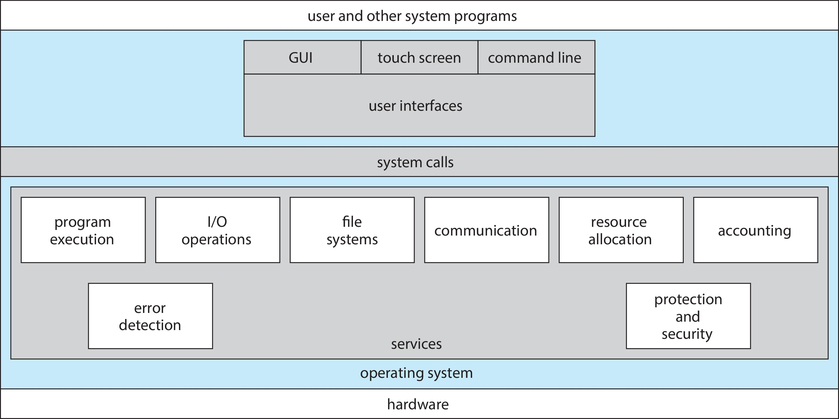
A View of Operating System Services

Slide 8
User Operating System Interface - CLI
CLI or command line interpreter allows direct command entry
  Sometimes implemented in kernel, sometimes by systems program
  Sometimes multiple programs implemented – shells (sh, bash,csh, tcsh, zsh)
  Primarily reads a command entered by user and executes it
  Sometimes commands are built-in, sometimes just names of programs
    If the latter, adding new features doesn’t require shell modification

Slide 9
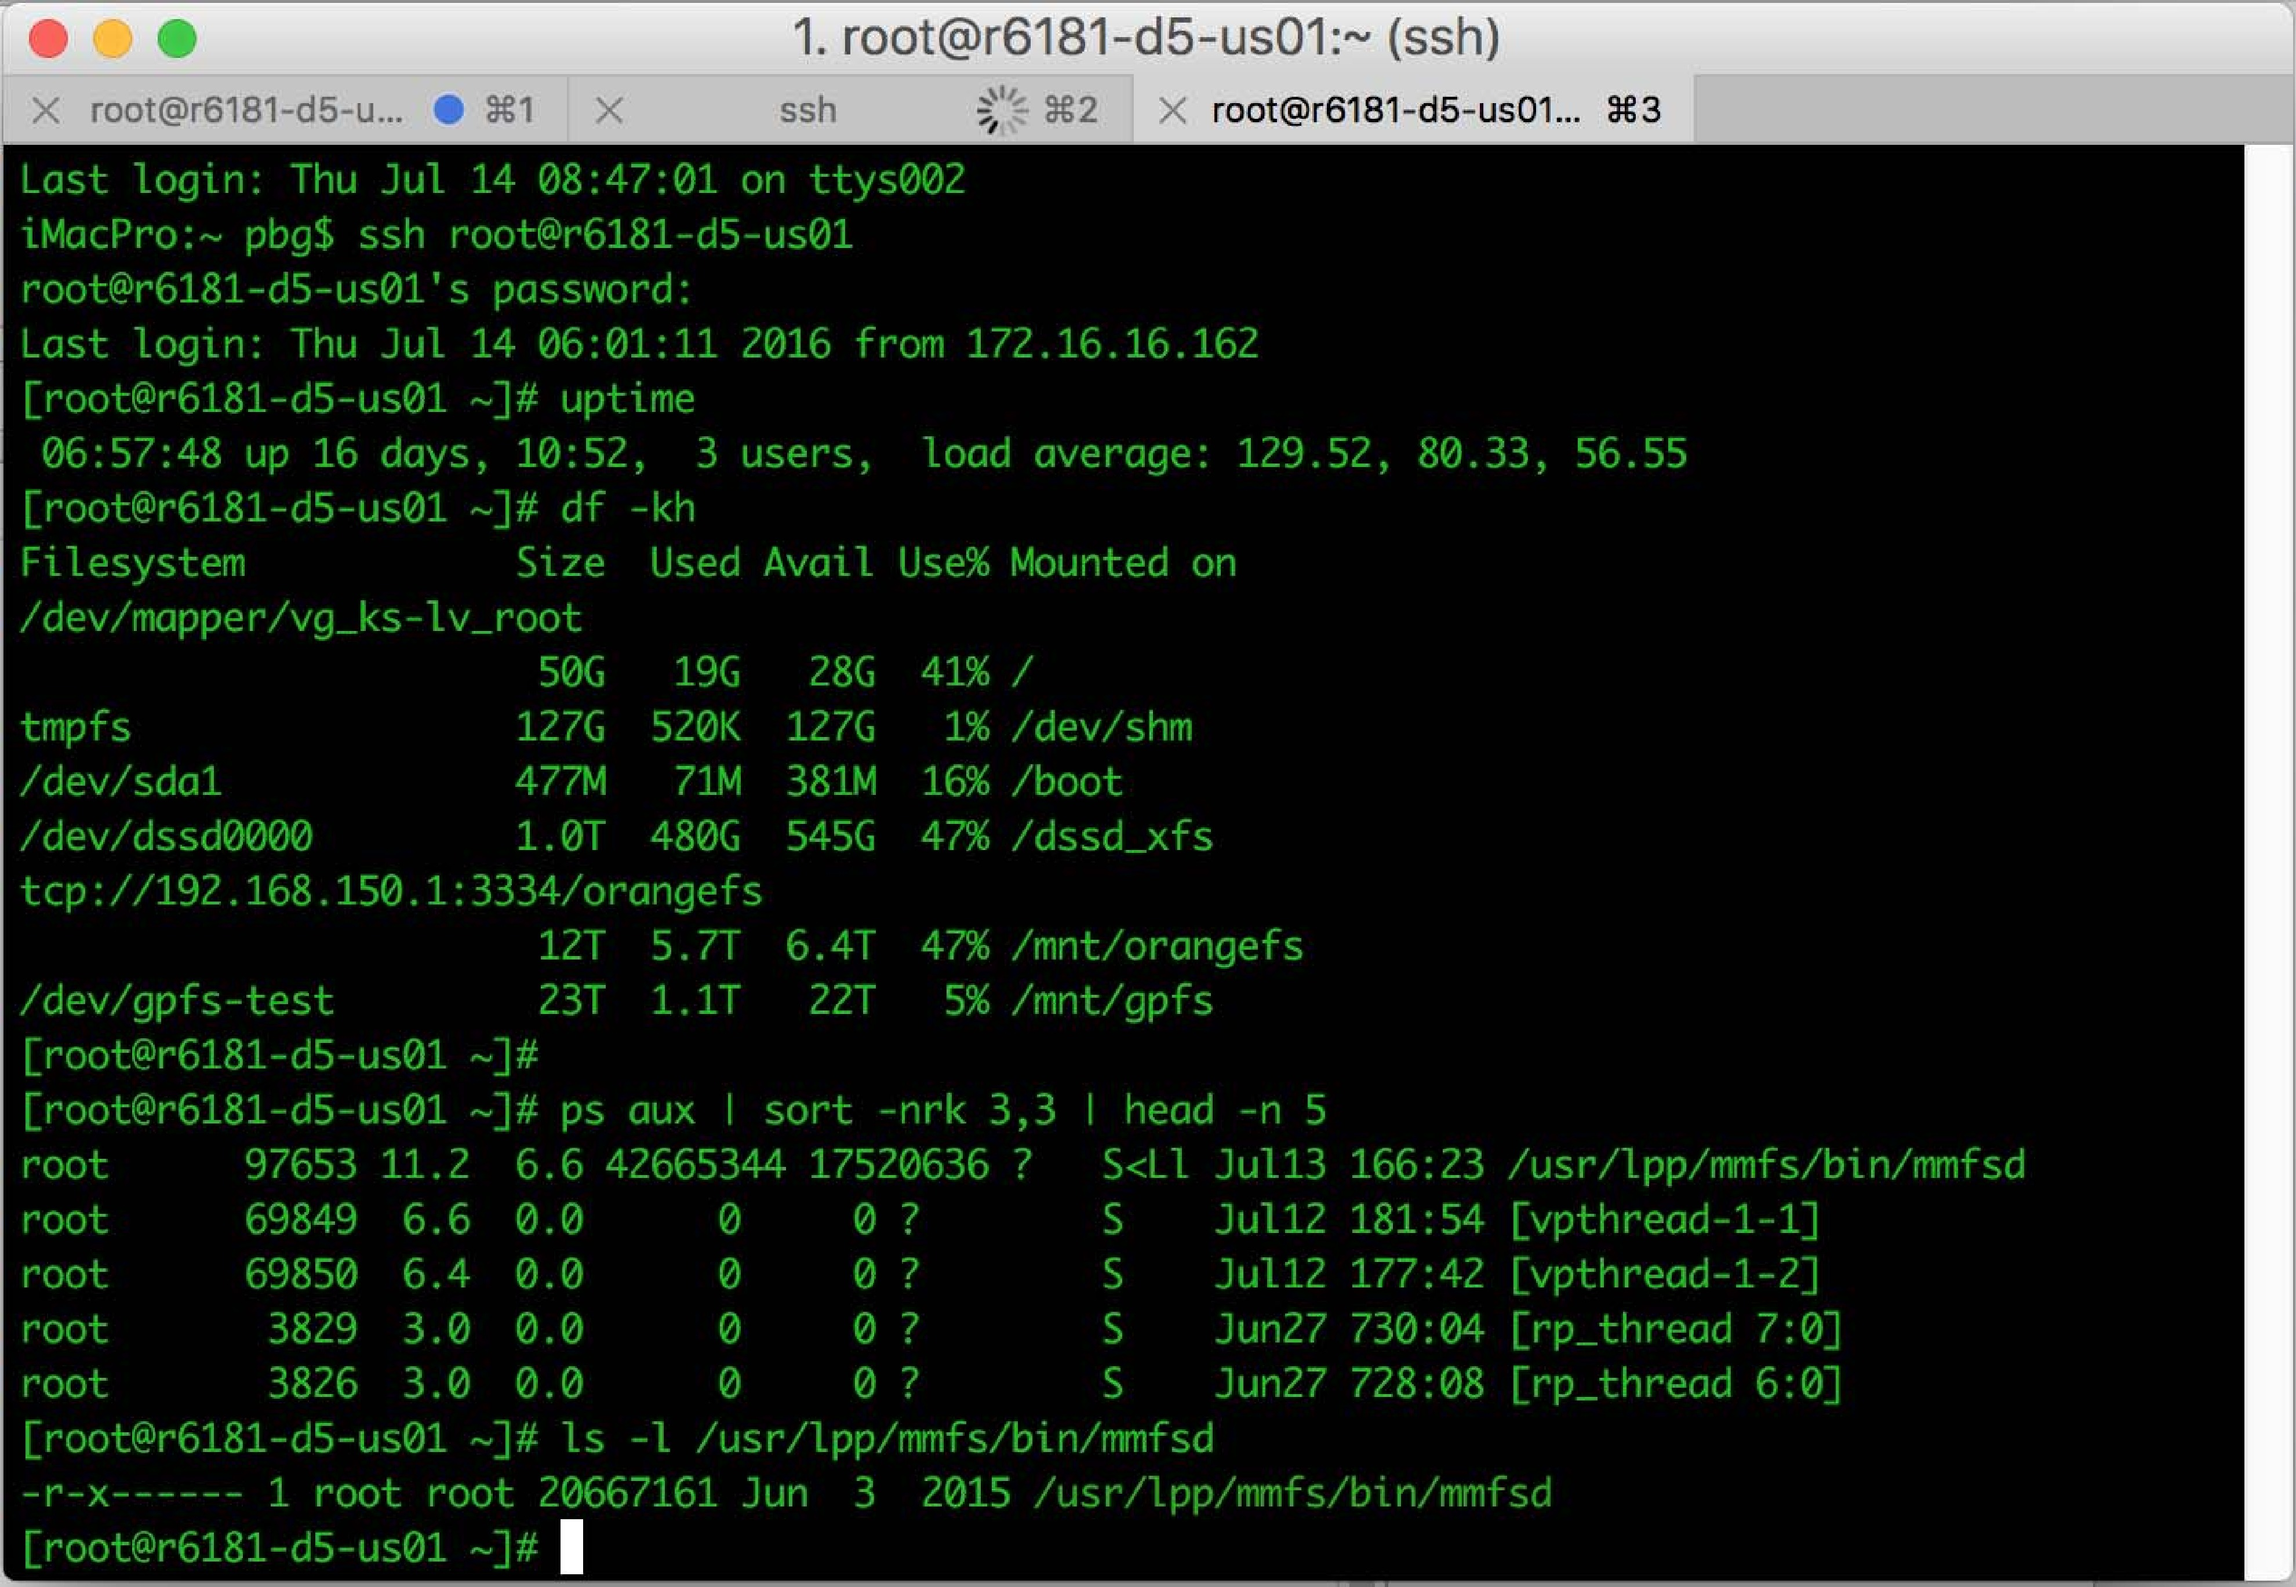
Bourne Shell Command Interpreter

Slide 10
User Operating System Interface - GUI
User-friendly desktop metaphor interface
  Usually mouse (or touchpad), keyboard, and monitor
  Icons represent files, programs, actions, etc
  Various mouse buttons over objects in the interface cause various actions (provide information, options, execute function, open directory (also known as a folder)
  Invented at Xerox PARC
Many systems now include both CLI and GUI interfaces
  Microsoft Windows is GUI with CLI “command” shell
  Apple Mac OS X is “Aqua” GUI interface with UNIX kernel underneath and shells available
  Unix and Linux have CLI with optional GUI interfaces (CDE, KDE, GNOME)

Slide 11
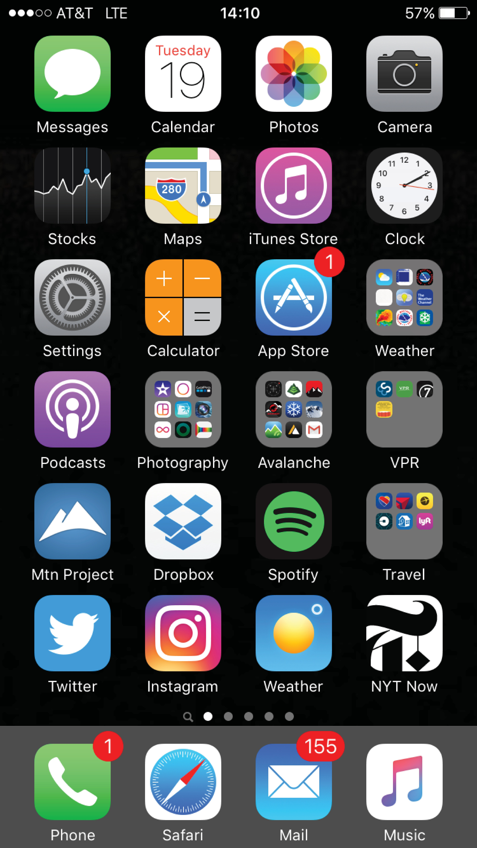
Touchscreen Interfaces
Touchscreen devices require new interfaces
  Mouse not possible or not desired
  Actions and selection based on gestures
  Virtual keyboard for text entry
Voice commands

Slide 12
The Mac OS X GUI

Slide 13
System Calls
Programming interface to the services provided by the OS
Typically written in a high-level language (C or C++)
Mostly accessed by programs via a high-level Application Programming Interface (API) rather than direct system call use
Three most common APIs are Win32 API for Windows, POSIX API for POSIX-based systems (including virtually all versions of UNIX, Linux, and Mac OS X), and Java API for the Java virtual machine (JVM)
Note that the system-call names used throughout this text are generic

Slide 14
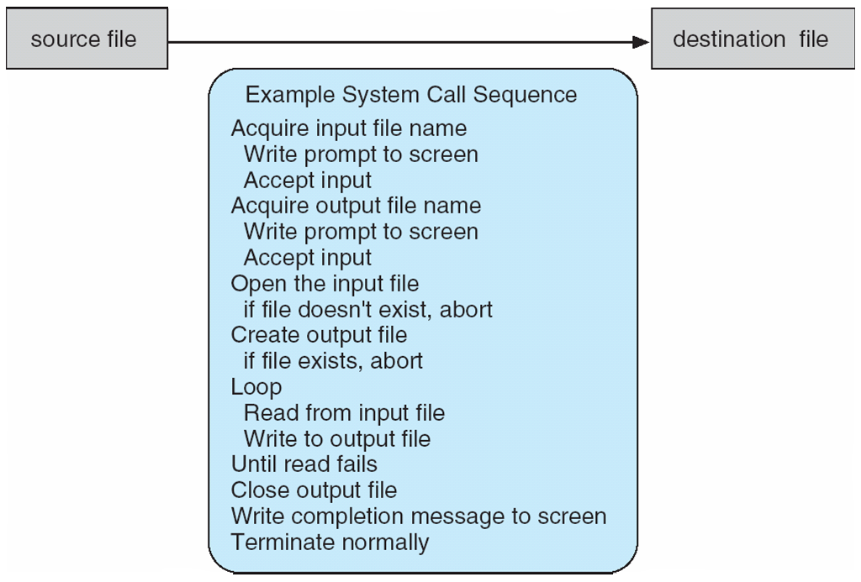
Example of System Calls
System call sequence to copy the contents of one file to another file

Slide 15
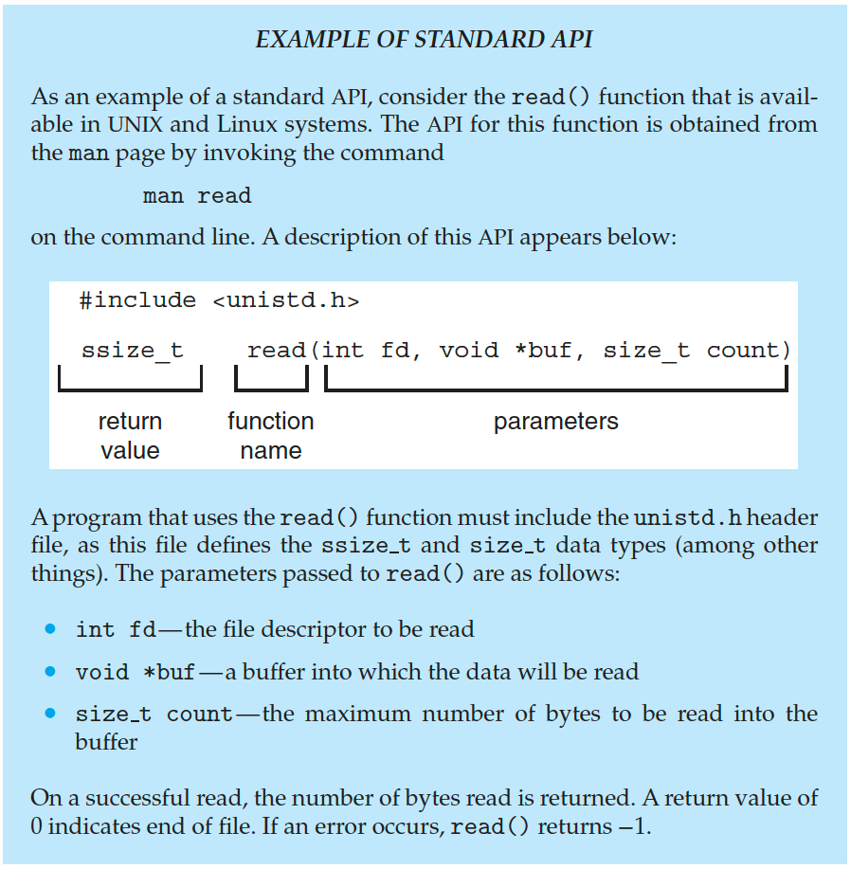
Example of Standard API

Slide 16
System Call Implementation
Typically, a number associated with each system call
  System-call interface maintains a table indexed according to these numbers
The system call interface invokes the intended system call in OS kernel and returns status of the system call and any return values
The caller need know nothing about how the system call is implemented
  Just needs to obey API and understand what OS will do as a result call
  Most details of OS interface hidden from programmer by API
    Managed by run-time support library (set of functions built into libraries included with compiler)

Slide 17
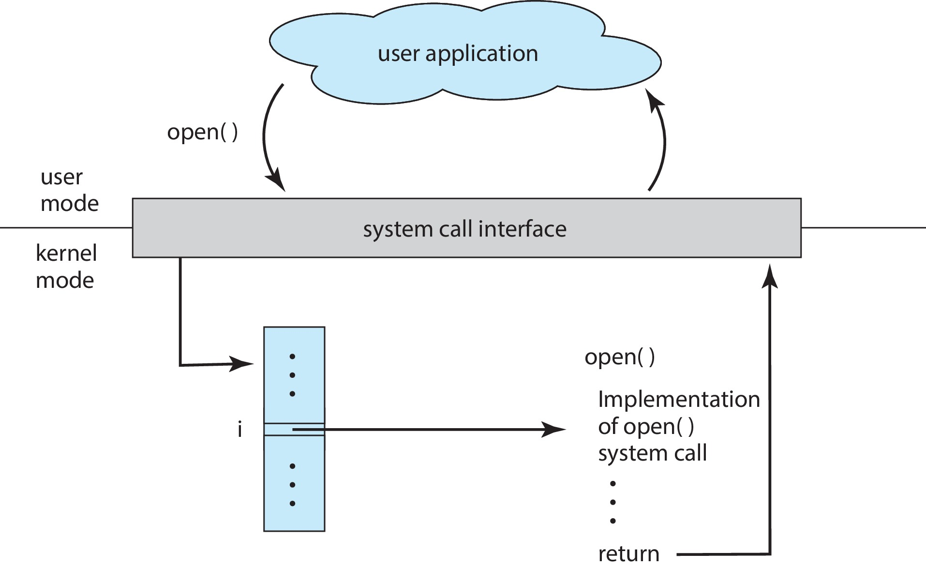
API – System Call – OS Relationship

Slide 18
System Call Parameter Passing
Often, more information is required than simply identity of desired system call
  Exact type and amount of information vary according to OS and call
Three general methods used to pass parameters to the OS
  Simplest: pass the parameters in registers
    In some cases, may be more parameters than registers
  Parameters stored in a block, or table, in memory, and address of block passed as a parameter in a register
    This approach taken by Linux and Solaris
  Parameters placed, or pushed, onto the stack by the program and popped off the stack by the operating system
  Block and stack methods do not limit the number or length of parameters being passed

Slide 19
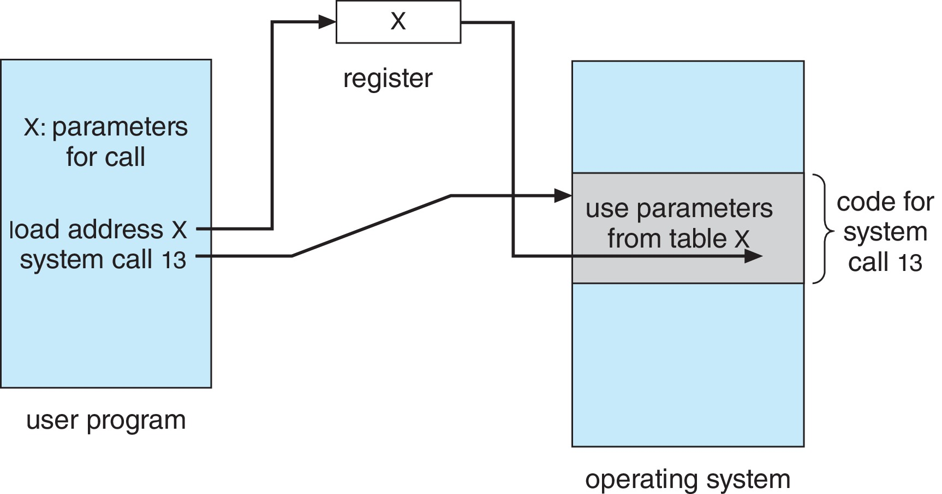
Parameter Passing via Table

Slide 20
Types of System Calls
Process control
  create process, terminate process
  end, abort
  load, execute
  get process attributes, set process attributes
  wait for time
  wait event, signal event
  allocate and free memory
  Dump memory if error
  Debugger for determining bugs, single step execution
  Locks for managing access to shared data between processes

Slide 21
Types of System Calls (cont.)
File management
  create file, delete file
  open, close file
  read, write, reposition
  get and set file attributes
Device management
  request device, release device
  read, write, reposition
  get device attributes, set device attributes
  logically attach or detach devices

Slide 22
Types of System Calls (Cont.)
Information maintenance
  get time or date, set time or date
  get system data, set system data
  get and set process, file, or device attributes
Communications
  create, delete communication connection
  send, receive messages if message passing model to host name or process name
    From client to server
  Shared-memory model create and gain access to memory regions
  transfer status information
  attach and detach remote devices

Slide 23
Types of System Calls (Cont.)
Protection
  Control access to resources
  Get and set permissions
  Allow and deny user access

Slide 24
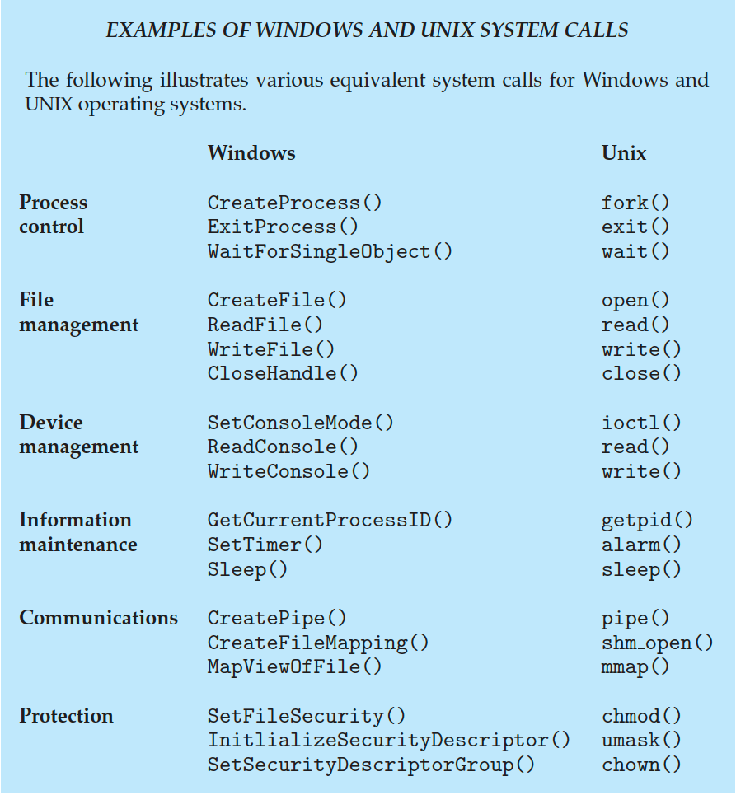
Examples of Windows and Unix System Calls

Slide 25
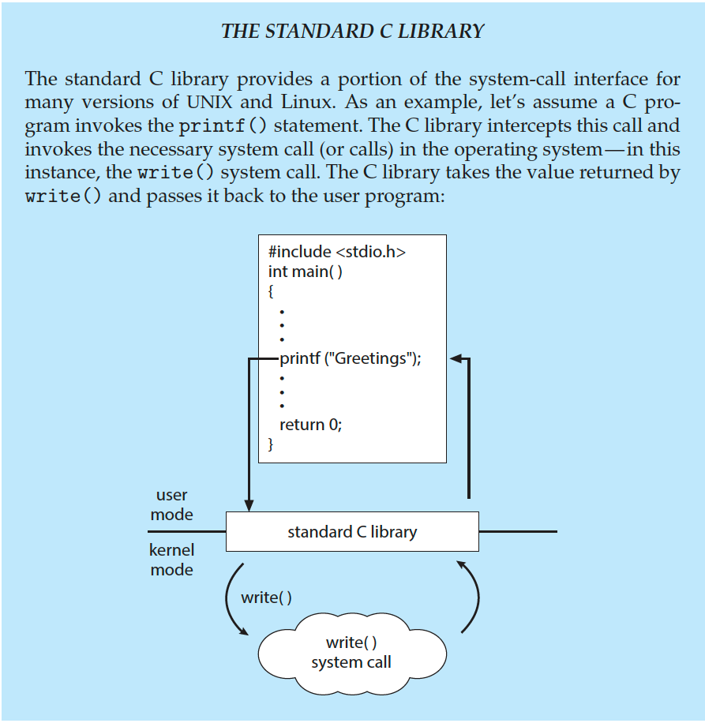
Standard C Library Example
C program invoking printf() library call, which calls write() system call

Slide 26
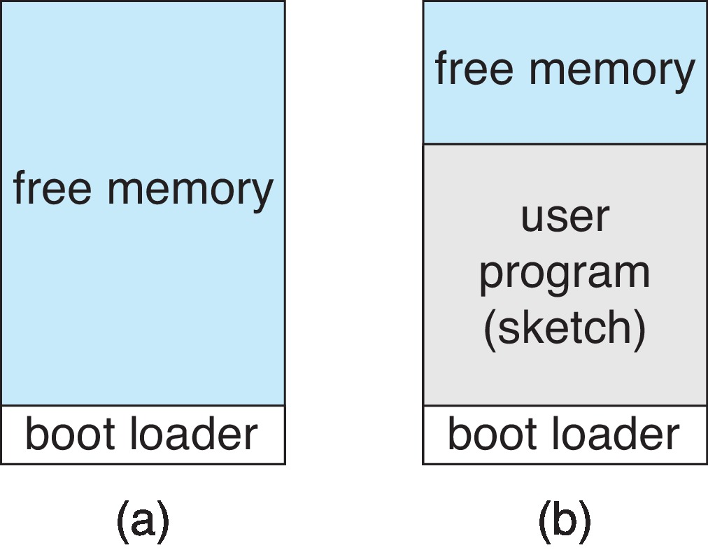
Example: Arduino
Single-tasking
No operating system
Programs (sketch) loaded via USB into flash memory
Single memory space
Boot loader loads program
Program exit -> shell reloaded
At system startup running a program

Slide 27
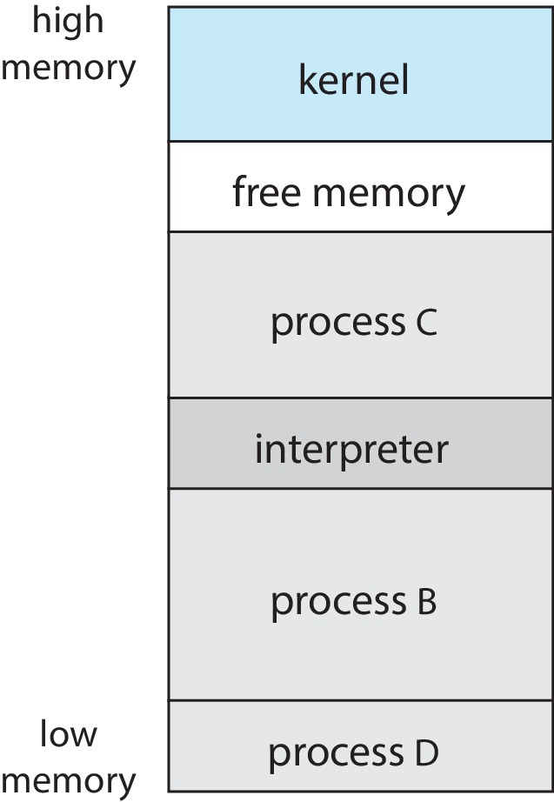
Example: FreeBSD
Unix variant
Multitasking
User login -> invoke user’s choice of shell
Shell executes fork() system call to create process
  Executes exec() to load program into process
  Shell waits for process to terminate or continues with user commands
Process exits with:
  code = 0 – no error
  code > 0 – error code

Slide 28
System Services
System programs provide a convenient environment for program development and execution. They can be divided into categories:
  File manipulation
  Status information sometimes stored in a file
  Programming language support
  Program loading and execution
  Communications
  Background services
  Application programs
Most users’ view of the operation system is defined by system programs, not the actual system calls

Slide 29
System Services (cont.)
Provide a convenient environment for program development and execution
  Some of them are simply user interfaces to system calls; others are considerably more complex
File management - Create, delete, copy, rename, print, dump, list, and generally manipulate files and directories
Status information
  Some ask the system for info - date, time, amount of available memory, disk space, number of users
  Others provide detailed performance, logging, and debugging information
  Typically, these programs format and print the output to the terminal or other output devices
  Some systems implement a registry - used to store and retrieve configuration information

Slide 30
System Services (Cont.)
File modification
  Text editors to create and modify files
  Special commands to search contents of files or perform transformations of the text
Programming-language support - Compilers, assemblers, debuggers and interpreters sometimes provided
Program loading and execution- Absolute loaders, relocatable loaders, linkage editors, and overlay-loaders, debugging systems for higher-level and machine language
Communications - Provide the mechanism for creating virtual connections among processes, users, and computer systems
  Allow users to send messages to one another’s screens, browse web pages, send electronic-mail messages, log in remotely, transfer files from one machine to another

Slide 31
System Services (Cont.)
Background Services
  Launch at boot time
    Some for system startup, then terminate
    Some from system boot to shutdown
  Provide facilities like disk checking, process scheduling, error logging, printing
  Run in user context not kernel context
  Known as services, subsystems, daemons
Application programs
  Don’t pertain to system
  Run by users
  Not typically considered part of OS
  Launched by command line, mouse click, finger poke

Slide 32
Linkers and Loaders
Source code compiled into object files designed to be loaded into any physical memory location – relocatable object file
Linker combines these into single binary executable file
  Also brings in libraries
Program resides on secondary storage as binary executable
Must be brought into memory by loader to be executed
  Relocation assigns final addresses to program parts and adjusts code and data in program to match those addresses
Modern general purpose systems don’t link libraries into executables
  Rather, dynamically linked libraries (in Windows, DLLs) are loaded as needed, shared by all that use the same version of that same library (loaded once)
Object, executable files have standard formats, so operating system knows how to load and start them

Slide 33
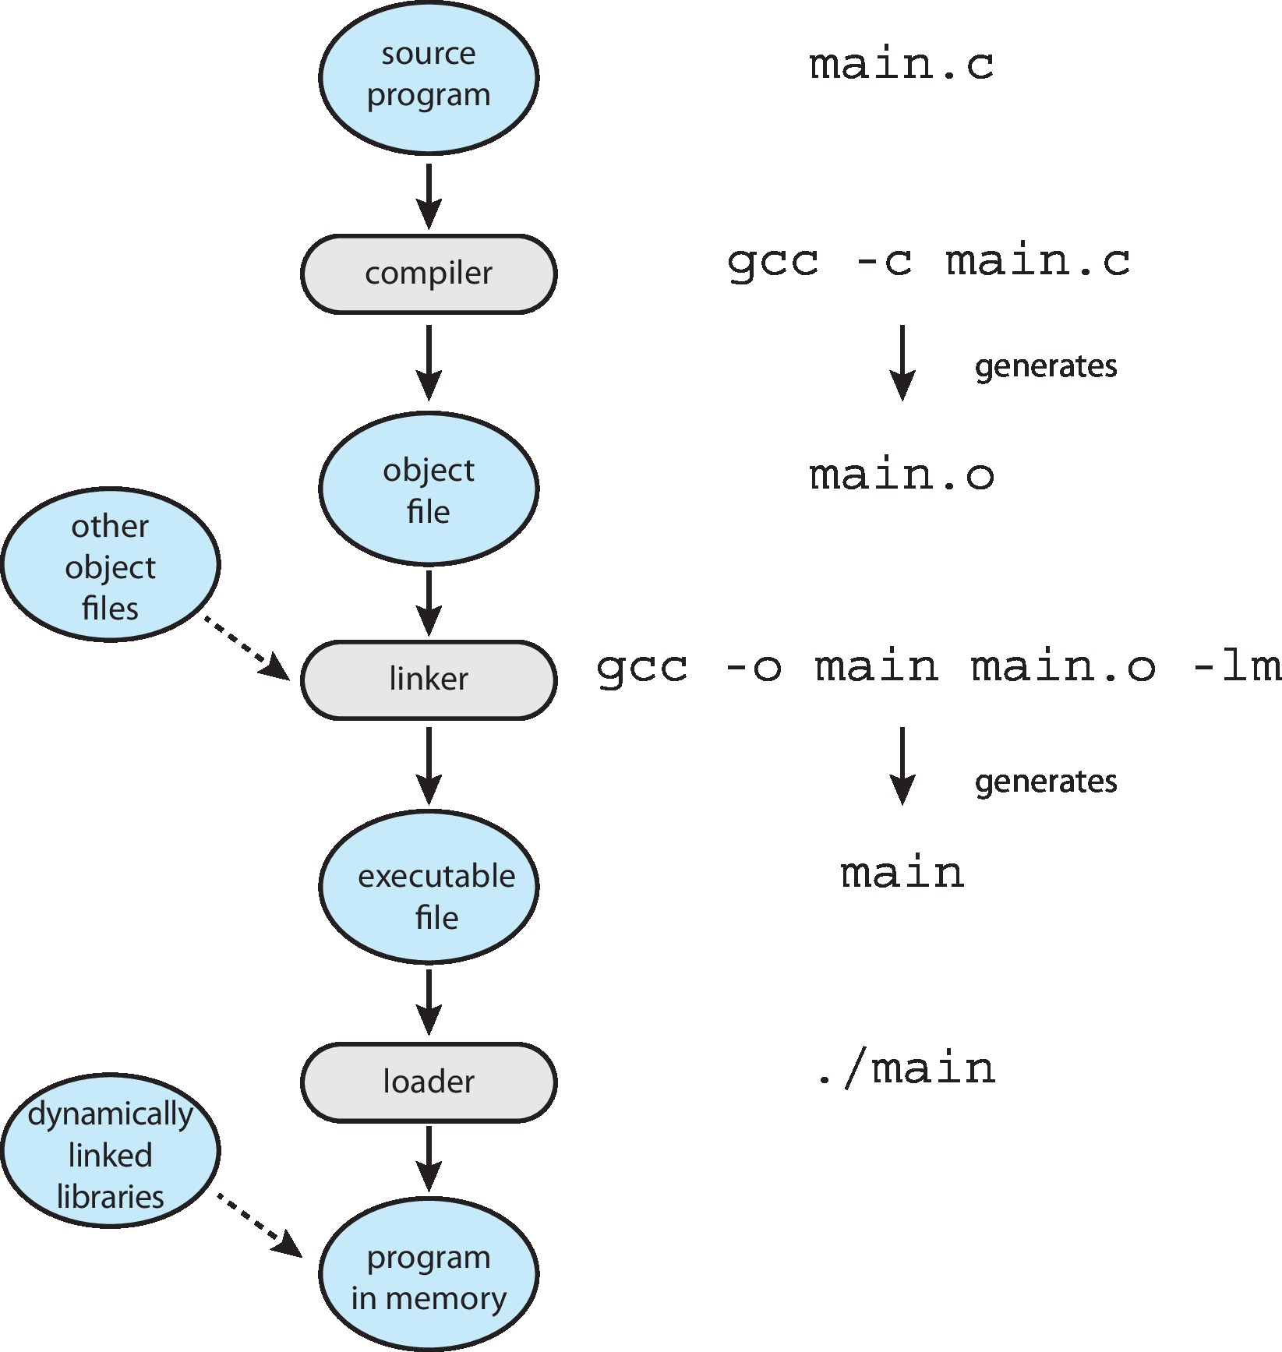
The Role of the Linker and Loader

Slide 34
Why Applications are Operating System Specific
Apps compiled on one system usually not executable on other operating systems
Each operating system provides its own unique system calls
  Own file formats, etc
Apps can be multi-operating system
  Written in interpreted language like Python, Ruby, and interpreter available on multiple operating systems
  App written in language that includes a VM containing the running app (like Java)
  Use standard language (like C), compile separately on each operating system to run on each
Application Binary Interface (ABI) is architecture equivalent of API, defines how different components of binary code can interface for a given operating system on a given architecture, CPU, etc

Slide 35
Operating System Design and Implementation
Design and Implementation of OS not “solvable”, but some approaches have proven successful
Internal structure of different Operating Systems can vary widely
Start the design by defining goals and specifications
Affected by choice of hardware, type of system
User goals and System goals
  User goals – operating system should be convenient to use, easy to learn, reliable, safe, and fast
  System goals – operating system should be easy to design, implement, and maintain, as well as flexible, reliable, error-free, and efficient

Slide 36
Operating System Design and Implementation (Cont.)
Important principle to separate
Policy: What will be done?
Mechanism: How to do it?
Mechanisms determine how to do something, policies decide what will be done
The separation of policy from mechanism is a very important principle, it allows maximum flexibility if policy decisions are to be changed later (example – timer)
Specifying and designing an OS is highly creative task of software engineering

Slide 37
Implementation
Much variation
  Early OSes in assembly language
  Then system programming languages like Algol, PL/1
  Now C, C++
Actually usually a mix of languages
  Lowest levels in assembly
  Main body in C
  Systems programs in C, C++, scripting languages like PERL, Python, shell scripts
More high-level language easier to port to other hardware
  But slower
Emulation can allow an OS to run on non-native hardware

Slide 38
Operating System Structure
General-purpose OS is very large program
Various ways to structure ones
  Simple structure – MS-DOS
  More complex -- UNIX
  Layered – an abstrcation
  Microkernel -Mach

Slide 39
Monolithic Structure – Original UNIX
UNIX – limited by hardware functionality, the original UNIX operating system had limited structuring. The UNIX OS consists of two separable parts
  Systems programs
  The kernel
    Consists of everything below the system-call interface and above the physical hardware
    Provides the file system, CPU scheduling, memory management, and other operating-system functions; a large number of functions for one level

Slide 40
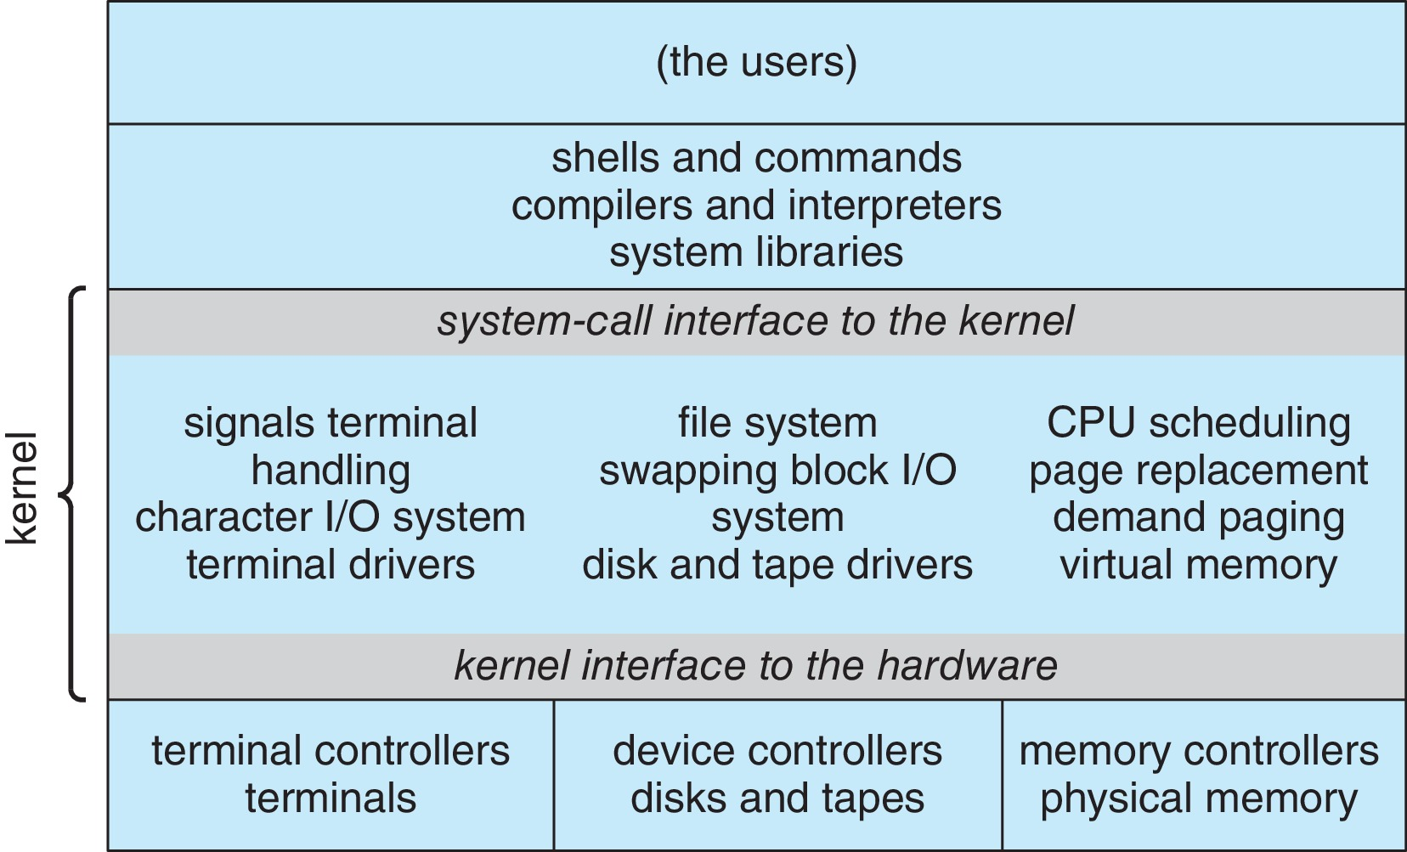
Traditional UNIX System Structure
Beyond simple but not fully layered

Slide 41
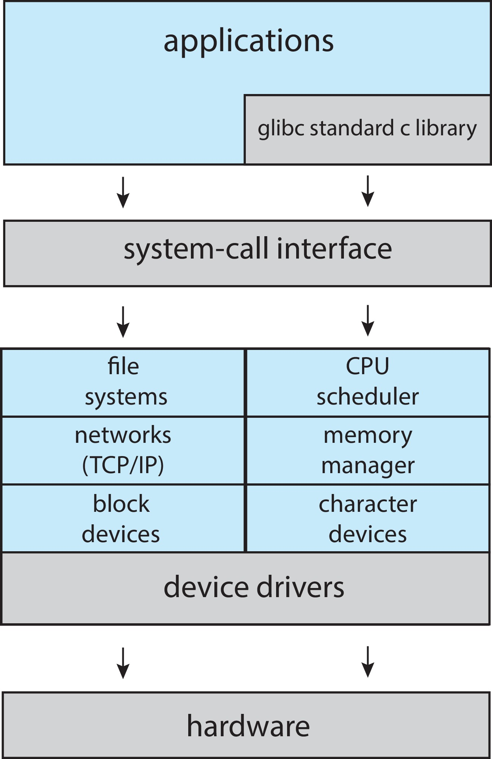
Linux System Structure
Monolithic plus modular design

Slide 42
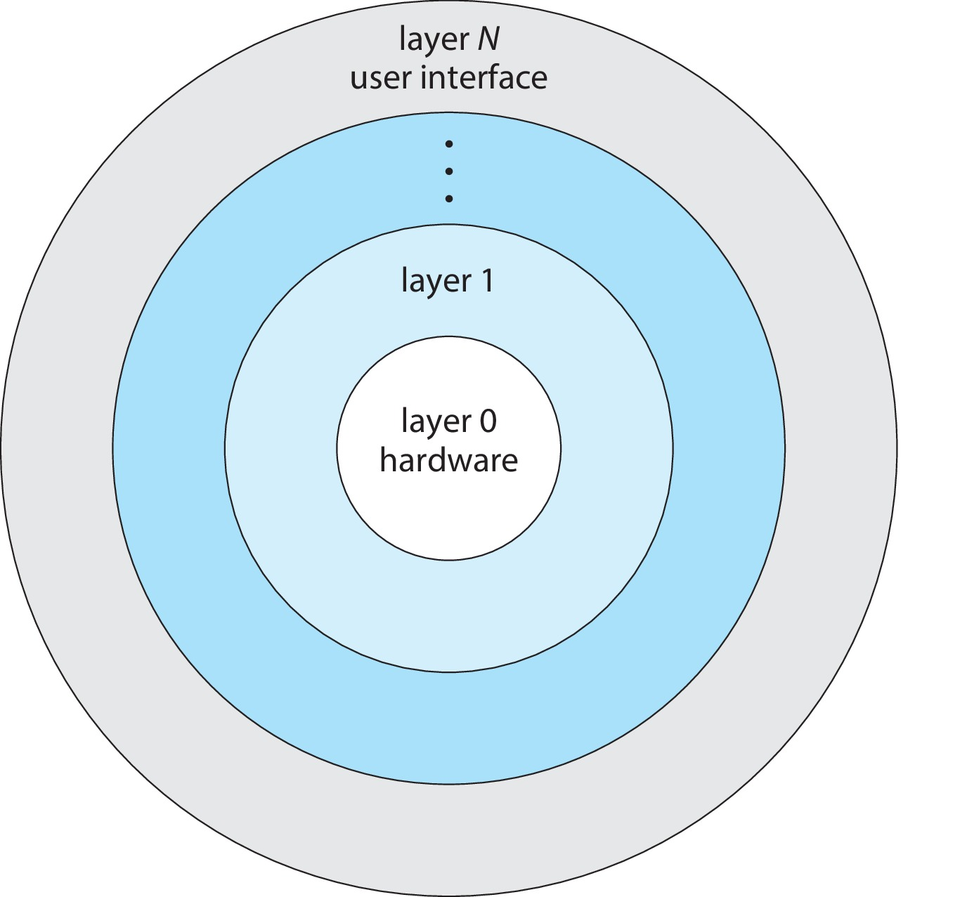
Layered Approach
The operating system is divided into a number of layers (levels), each built on top of lower layers. The bottom layer (layer 0), is the hardware; the highest (layer N) is the user interface.
With modularity, layers are selected such that each uses functions (operations) and services of only lower-level layers

Slide 43
Microkernels
Moves as much from the kernel into user space
Mach example of microkernel
  Mac OS X kernel (Darwin) partly based on Mach
Communication takes place between user modules using message passing
Benefits:
  Easier to extend a microkernel
  Easier to port the operating system to new architectures
  More reliable (less code is running in kernel mode)
  More secure
Detriments:
  Performance overhead of user space to kernel space communication

Slide 44
Microkernel System Structure

Slide 45
Modules
Many modern operating systems implement loadable kernel modules (LKMs)
  Uses object-oriented approach
  Each core component is separate
  Each talks to the others over known interfaces
  Each is loadable as needed within the kernel
Overall, similar to layers but with more flexible
  Linux, Solaris, etc

Slide 46
Hybrid Systems
Most modern operating systems are actually not one pure model
  Hybrid combines multiple approaches to address performance, security, usability needs
  Linux and Solaris kernels in kernel address space, so monolithic, plus modular for dynamic loading of functionality
  Windows mostly monolithic, plus microkernel for different subsystem personalities
Apple Mac OS X hybrid, layered, Aqua UI plus Cocoa programming environment
  Below is kernel consisting of Mach microkernel and BSD Unix parts, plus I/O kit and dynamically loadable modules (called kernel extensions)

Slide 47
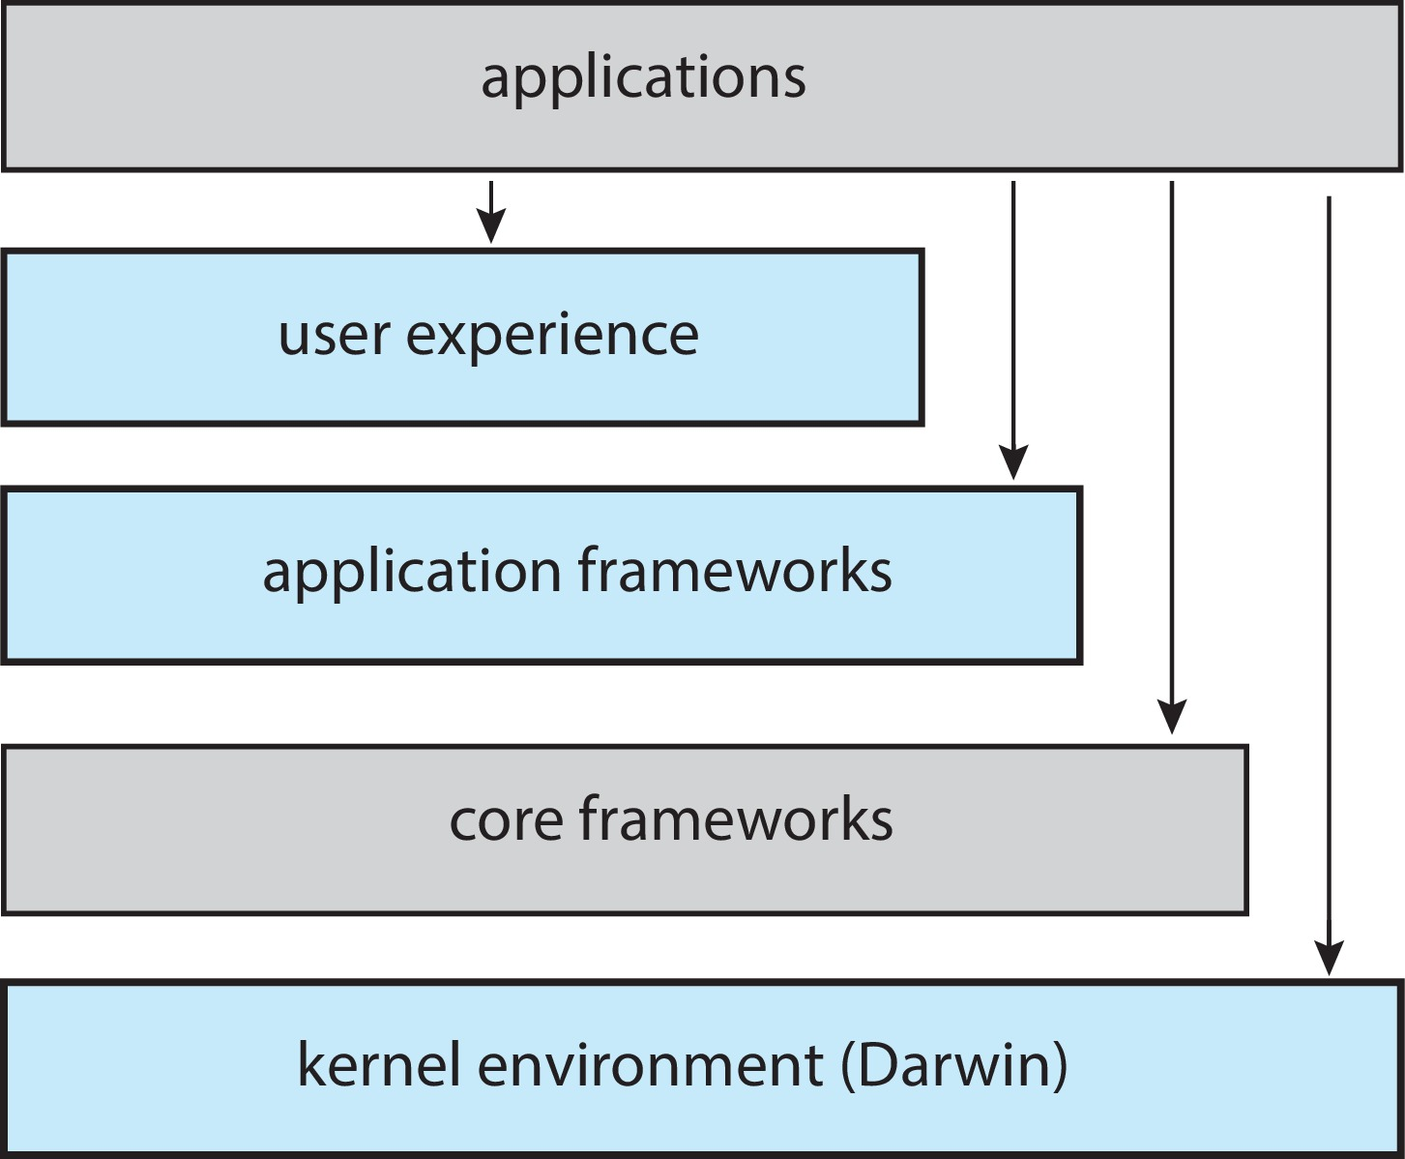
macOS and iOS Structure

Slide 48
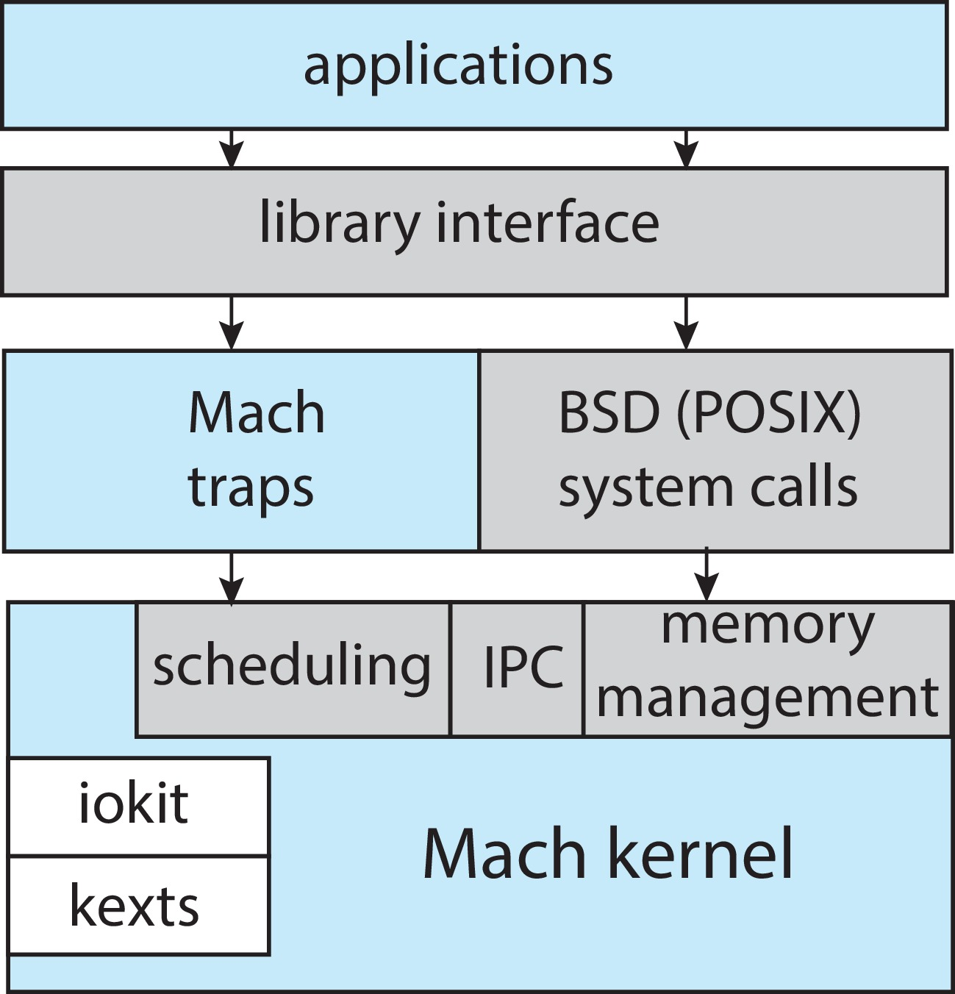
Darwin

Slide 49
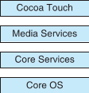
iOS
Apple mobile OS for iPhone, iPad
  Structured on Mac OS X, added functionality
  Does not run OS X applications natively
    Also runs on different CPU architecture (ARM vs. Intel)
  Cocoa Touch Objective-C API for developing apps
  Media services layer for graphics, audio, video
  Core services provides cloud computing, databases
  Core operating system, based on Mac OS X kernel

Slide 50
Android
Developed by Open Handset Alliance (mostly Google)
  Open Source
Similar stack to IOS
Based on Linux kernel but modified
  Provides process, memory, device-driver management
  Adds power management
Runtime environment includes core set of libraries and Dalvik virtual machine
  Apps developed in Java plus Android API
    Java class files compiled to Java bytecode then translated to executable than runs in Dalvik VM
Libraries include frameworks for web browser (webkit), database (SQLite), multimedia, smaller libc

Slide 51
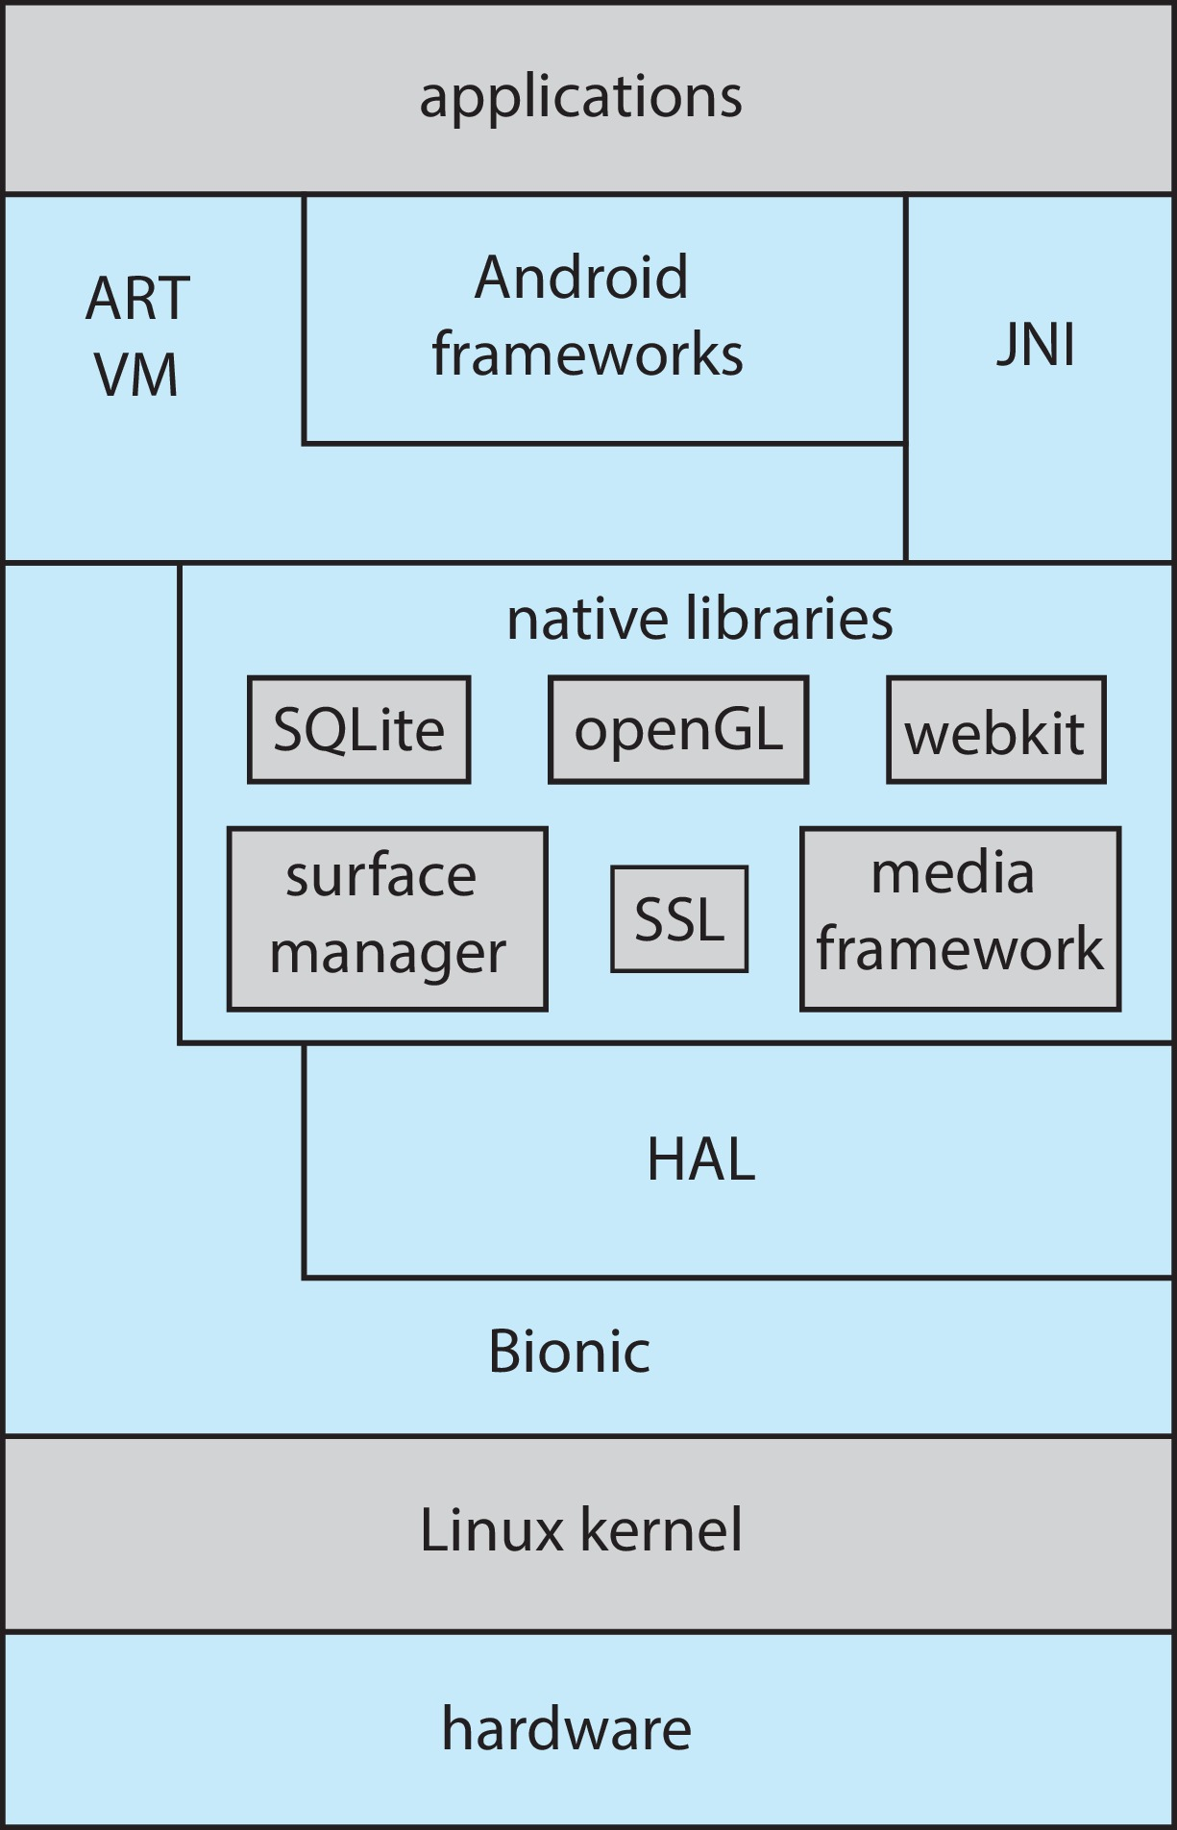
Android Architecture

Slide 52
System Boot
When power initialized on system, execution starts at a fixed memory location
Operating system must be made available to hardware so hardware can start it
  Small piece of code – bootstrap loader, BIOS, stored in ROM or EEPROM locates the kernel, loads it into memory, and starts it
  Sometimes two-step process where boot block at fixed location loaded by ROM code, which loads bootstrap loader from disk
  Modern systems replace BIOS with Unified Extensible Firmware Interface (UEFI)
Common bootstrap loader, GRUB, allows selection of kernel from multiple disks, versions, kernel options
Kernel loads and system is then running
Boot loaders frequently allow various boot states, such as single user mode

Slide 53
Operating-System Debugging
Debugging is finding and fixing errors, or bugs
Also performance tuning
OS generate log files containing error information
Failure of an application can generate core dump file capturing memory of the process
Operating system failure can generate crash dump file containing kernel memory
Beyond crashes, performance tuning can optimize system performance
  Sometimes using trace listings of activities, recorded for analysis
  Profiling is periodic sampling of instruction pointer to look for statistical trends
Kernighan’s Law: “Debugging is twice as hard as writing the code in the first place. Therefore, if you write the code as cleverly as possible, you are, by definition, not smart enough to debug it.”

Slide 54
Performance Tuning
Improve performance by removing bottlenecks
OS must provide means of computing and displaying measures of system behavior
For example, “top” program or Windows Task Manager

Slide 55
Tracing
Collects data for a specific event, such as steps involved in a system call invocation
Tools include
    strace – trace system calls invoked by a process
    gdb – source-level debugger
    perf – collection of Linux performance tools
    tcpdump – collects network packets

Slide 56
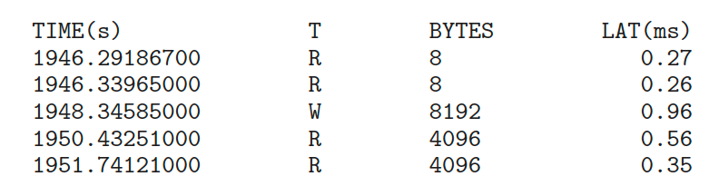
BCC
Debugging interactions between user-level and kernel code nearly impossible without toolset that understands both and an instrument their actions
BCC (BPF Compiler Collection) is a rich toolkit providing tracing features for Linux
  See also the original DTrace
For example, disksnoop.py traces disk I/O activity
Many other tools (next slide)

Slide 57
Linux bcc/BPF Tracing Tools

Slide 58
End of Chapter 2

