Slide 1
Chapter 3: Processes

Slide 2
Chapter 3: Processes
Process Concept
Process Scheduling
Operations on Processes
Interprocess Communication
IPC in Shared-Memory Systems
IPC in Message-Passing Systems
Examples of IPC Systems

Slide 3
Objectives
Identify the separate components of a process and illustrate how they are represented and scheduled in an operating system.
Describe how processes are created and terminated in an operating system, including developing programs using the appropriate system calls that perform these operations.
Describe and contrast inter-process communication using shared memory and message passing.
Understand kernel modules that interact with the Linux operating system.

Slide 4
Process Concept
An operating system executes a variety of programs that run as a process.
A process is a program in execution.
Multiple parts in a process image:
  The program code, also called text section
  Current processor state, including program counter, processor registers, including stack pointer, etc.
  Stack contents, containing temporary data
    Function parameters, return addresses, local variables
  Data section containing global variables
  Heap containing memory dynamically allocated during run time
  Other resources such as open files, command-line arguments, environment values, ...

Slide 5
Process Concept (Cont.)
Program is passive entity stored on disk (executable file); process is active -
  Program becomes process when executable file loaded into memory
Execution of program started via GUI mouse clicks, command line entry of its name, etc
One program can be executed by several processes
  e.g.: compiler, shell (bash), browser, etc.

Slide 6
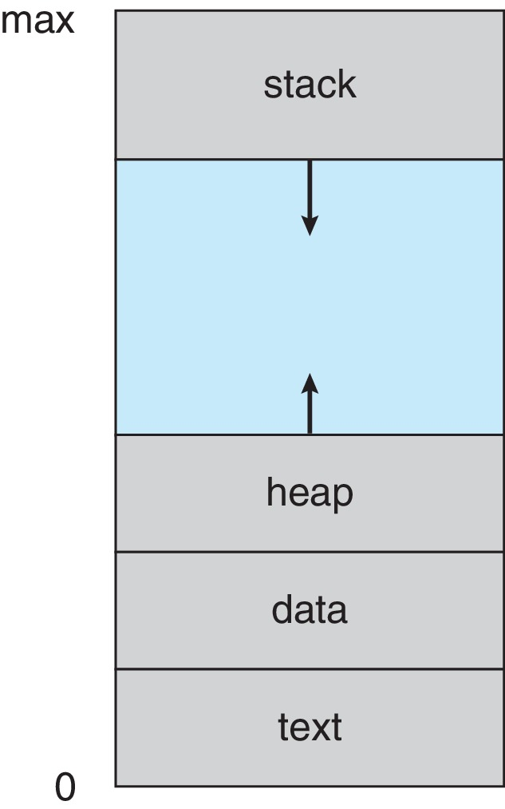
Process in Memory (simplified)

Slide 7
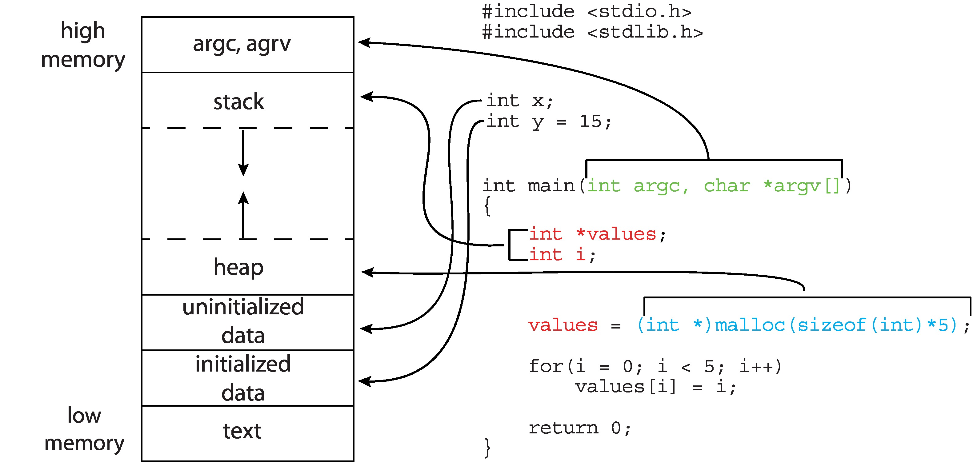
Memory Layout of a C Program

Slide 8
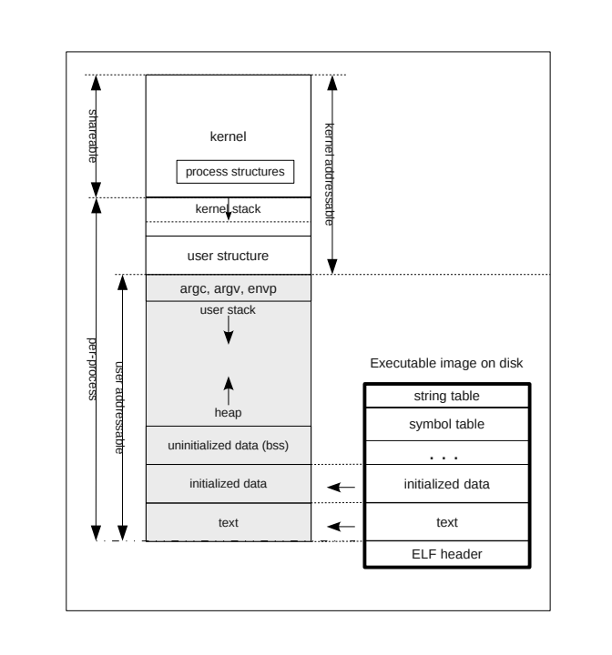
Detailed ELF Memory Layout

Slide 9
Process State
As a process executes, it changes state
  New: The process was just created
  Ready: The process is ready to run but is waiting to be assigned to a processor
  Running: Instructions are being executed
  Waiting: The process is waiting for some event to occur and is not able to use the processor
  Terminated: The process has finished execution

Slide 10
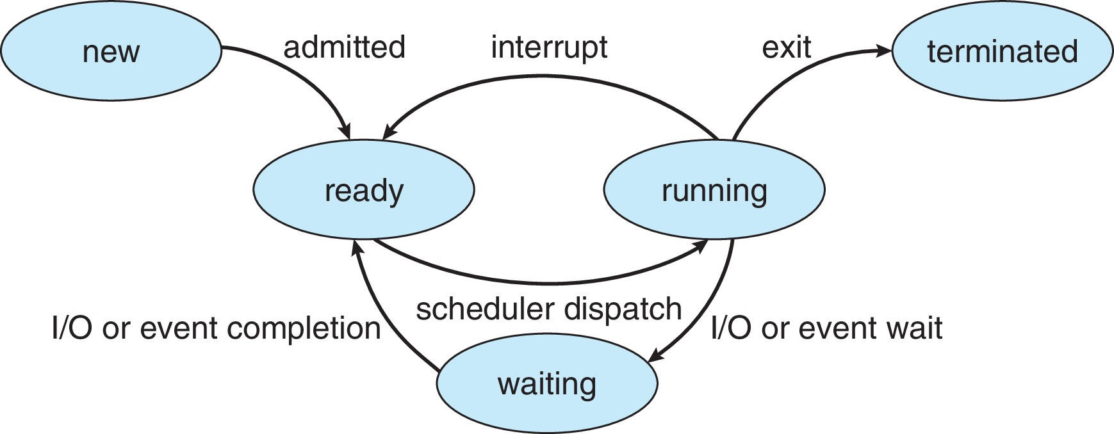
Process State Transition Diagram
Edges are transitions.
Their labels are the actions or events that cause these transitions.

Slide 11
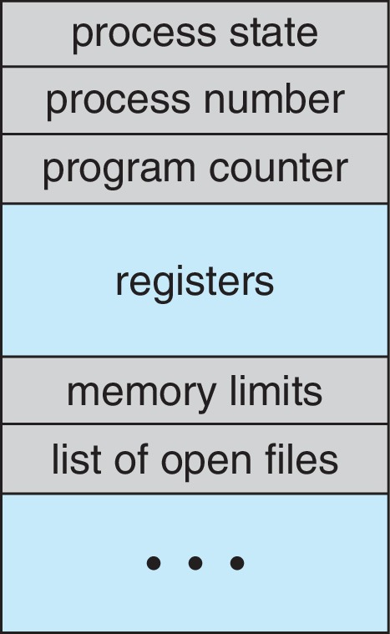
Process Control Block (PCB)
Information associated with each process (also called task control block)
Process state – running, waiting, etc
Program counter – location of instruction to next execute
CPU registers – contents of all process-centric registers
CPU scheduling information- priorities, scheduling queue pointers
Memory-management information – memory allocated to the process
Accounting information – CPU used, clock time elapsed since start, time limits
I/O status information – I/O devices allocated to process, list of open files

Slide 12
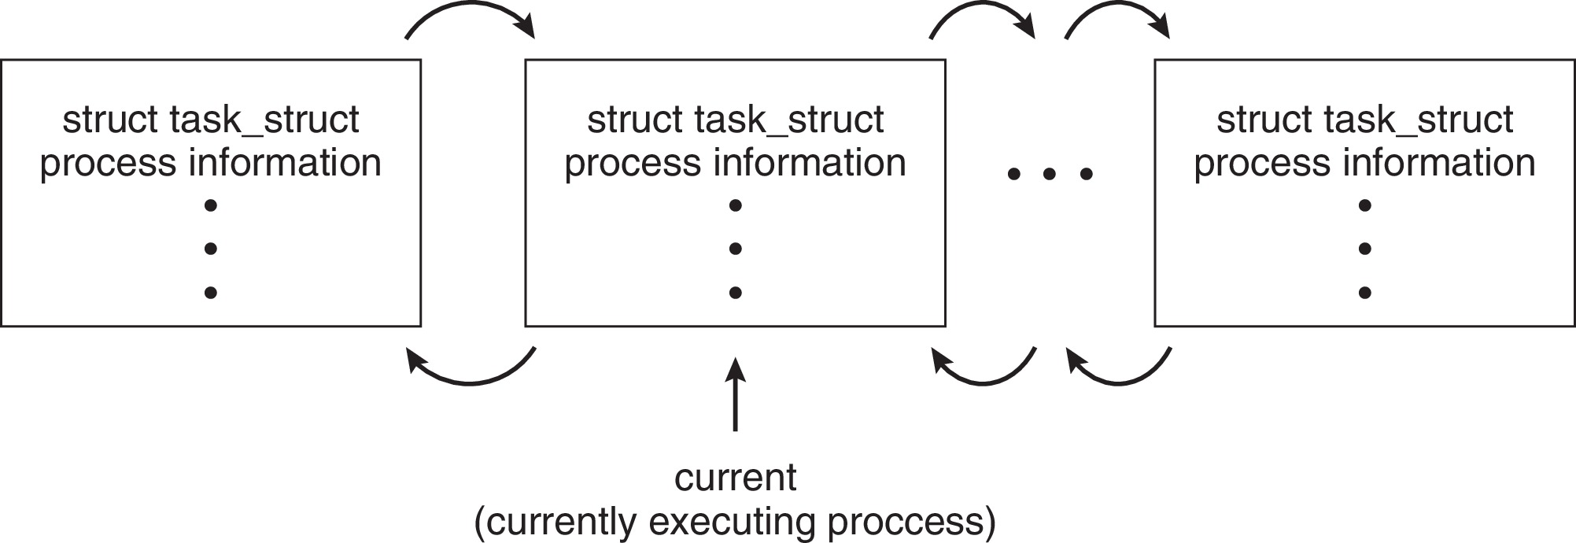
PCB Representation in Linux
Represented by the C structure task_struct, part of which is
pid t_pid; /* process identifier */
long state; /* state of the process */
unsigned int time_slice /* scheduling information */
struct task_struct *parent;/* this process’s parent */
struct list_head children; /* this process’s children */
struct files_struct *files;/* list of open files */
struct mm_struct *mm; /* address space of this process */

Slide 13
Scheduling
There are three levels of scheduling:
  long-term scheduling: decision about which processes are admitted into system (usually just in batch systems)
  medium-term scheduling: decision about which processes are memory resident
  short-term scheduling: decision about which memory resident process gets the CPU next
Short-term scheduler is also called process scheduler

Slide 14
Process Scheduler
Objective: Maximize CPU utilization, quickly switch processes onto CPU core
Maintains scheduling queues of processes
  Ready queue – set of all processes residing in main memory, ready and waiting to execute
  Wait queues – set of processes waiting for an event (i.e. I/O)
  Processes migrate among the various queues
Scheduler runs most frequently, so it must be very fast

Slide 15
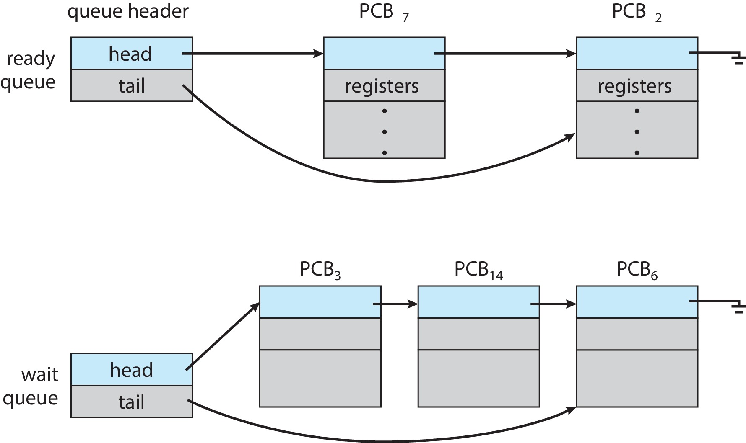
Ready and Wait Queues
One ready queue for each processor
One wait queue for each device

Slide 16
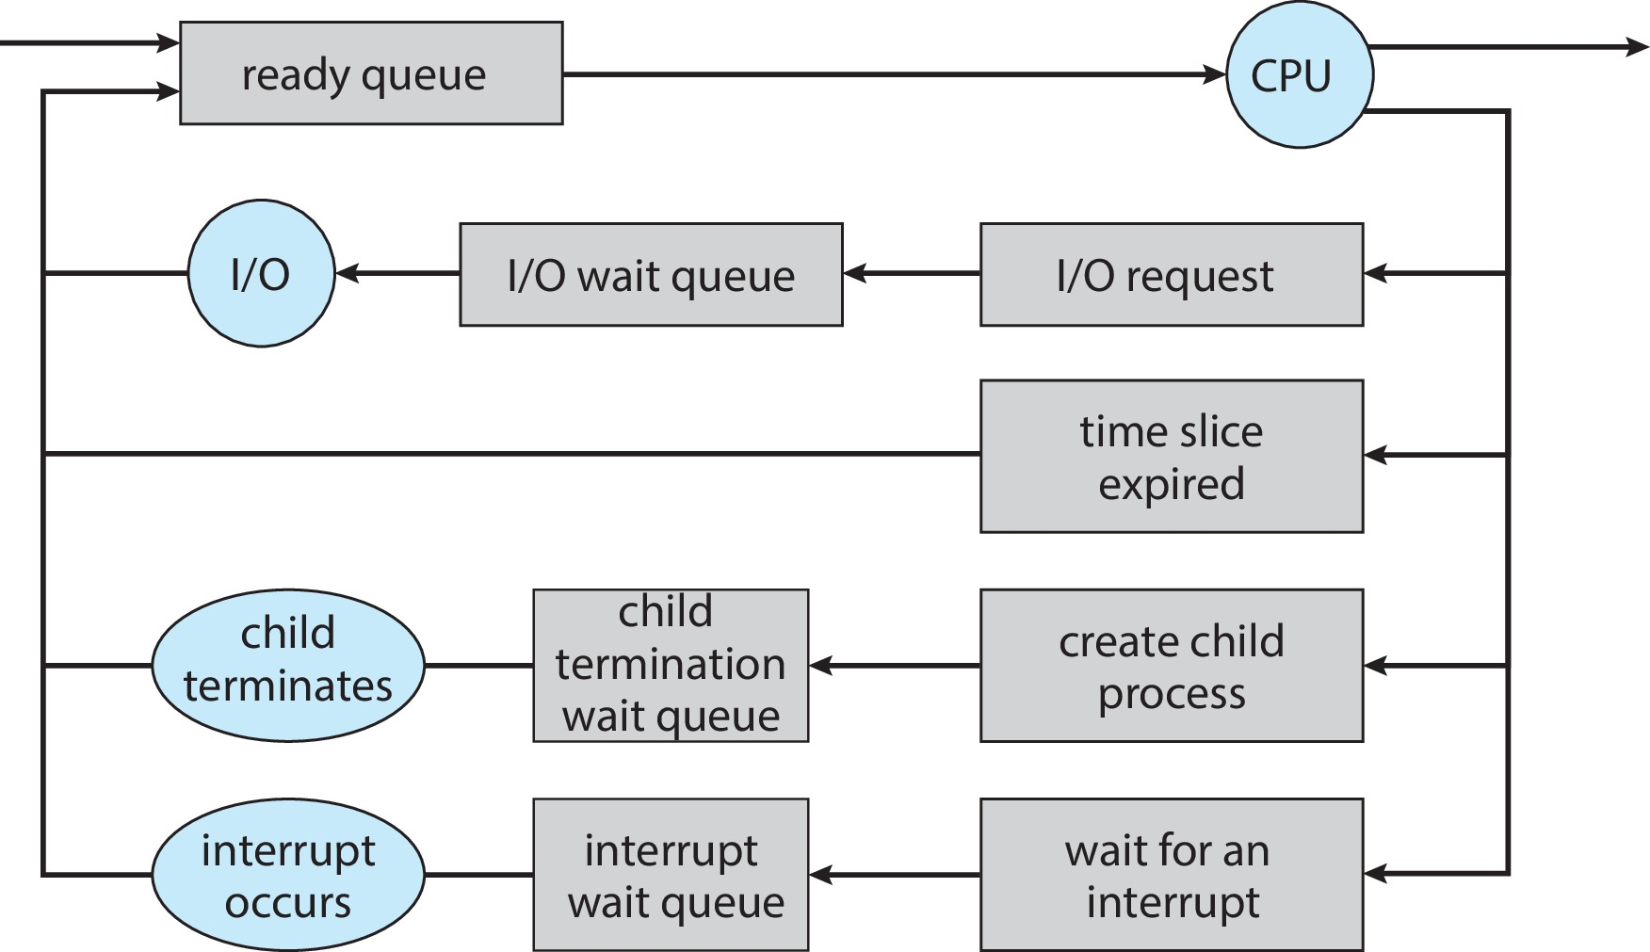
Transitions in Process Scheduling

Slide 17
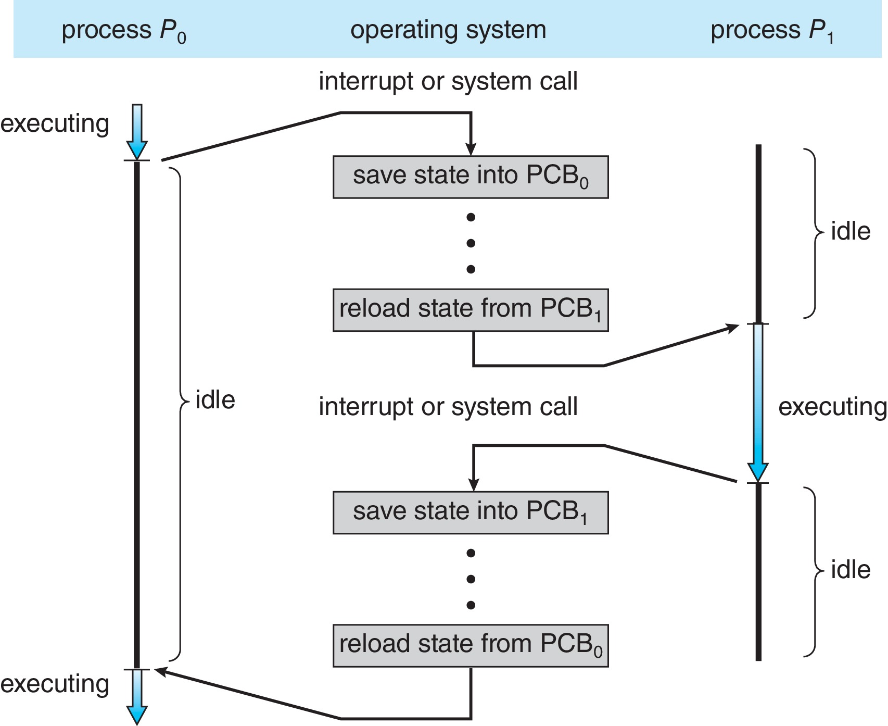
CPU Switch From Process to Process
A context switch occurs when the CPU
switches from one process to another.

Slide 18
Context Switch
When CPU switches to another process, the system must save the state of the old process and load the saved state for the new process via a context switch
Context of a process represented in the PCB
Context-switch time is overhead; the system does no useful work while switching
  The more complex the OS and the PCB ➔ the longer the context switch
Time dependent on hardware support
  Some hardware provides multiple sets of registers per CPU ➔ multiple contexts loaded at once

Slide 19
Operations on Processes
System must provide mechanisms for:
  process creation
  process termination

Slide 20
Process Creation
Parent process create children processes, which, in turn create other processes, forming a tree of processes
Generally, process identified and managed via a process identifier (pid)
Resource sharing options
  Parent and children share all resources
  Children share subset of parent’s resources
  Parent and child share no resources
Execution options
  Parent and children execute concurrently
  Parent waits until children terminate

Slide 21
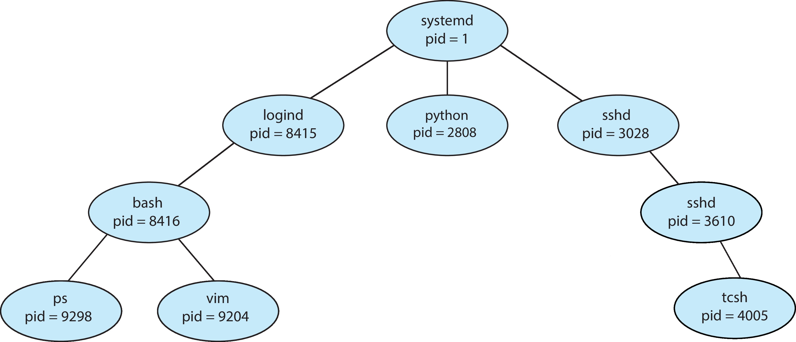
A Tree of Processes in Linux

Slide 22
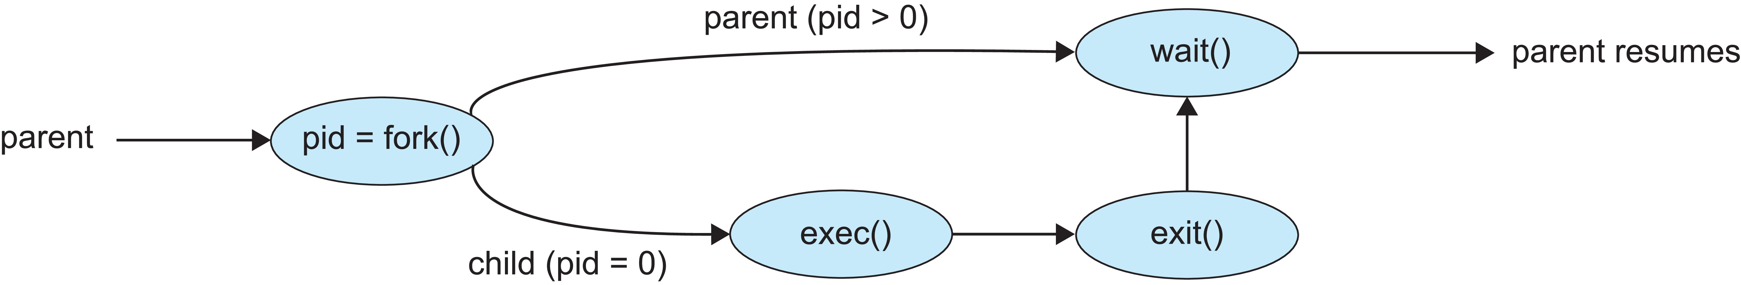
Process Creation (Cont.)
Address space
  Child duplicate of parent
  Child has a program loaded into it
UNIX examples
  fork() system call creates new process
  exec() system call used after a fork() to replace the process’ memory space with a new program
  Parent process calls wait() for the child to terminate

Slide 23
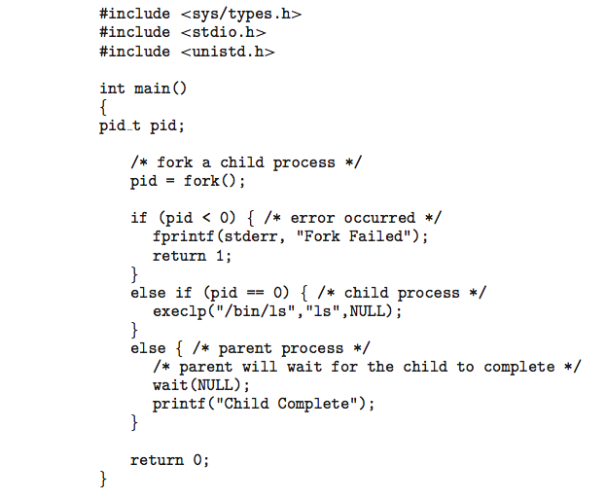
C Program Forking Separate Process

Slide 24
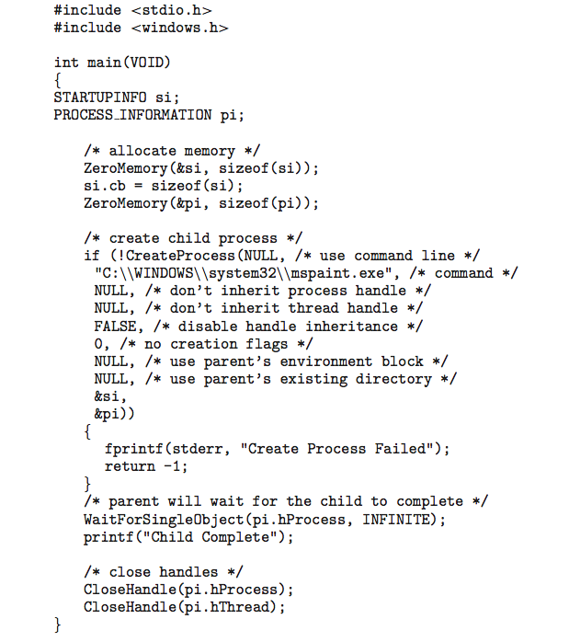
Creating a Separate Process via Windows API

Slide 25
Process Termination
Process executes last statement and then asks the operating system to delete it using the exit() system call.
  Returns status data from child to parent (via wait())
  Process’ resources are deallocated by operating system
Parent may terminate the execution of children processes using signals. Some reasons for doing so:
  Child has exceeded allocated resources
  Task assigned to child is no longer required
  The parent is exiting and the operating systems does not allow a child to continue if its parent terminates

Slide 26
Process Termination 2
Some operating systems do not allow child to exists if its parent has terminated. If a process terminates, then all its children must also be terminated.
  cascading termination. All children, grandchildren, etc. are terminated.
  The termination is initiated by the operating system.
The parent process may wait for termination of a child process by using the wait()system call. The call returns status information and the pid of the terminated process
pid = wait(&status);
If no parent waiting (did not invoke wait()) process is a zombie
If parent terminated without invoking wait , process is an orphan

Slide 27
Android Process Importance Hierarchy
Mobile operating systems often have to terminate processes to reclaim system resources such as memory. From most to least important:
Foreground process
Visible process
Service process
Background process
Empty process
Android will begin terminating processes that are least important.

Slide 28
Cooperating Processes
Two processes can be either independent or cooperating with respect to each other.
They are independent if neither can affect or be affected by the execution of the other process
They are cooperating if either can affect or be affected by the execution of the other process.
Various reasons for processes to cooperate:
  To share information sharing
  To speed up a computation
  To increase modularity of an application

Slide 29

Example: Chrome Browser
Many web browsers ran as single process (some still do)
  If one web site causes trouble, entire browser can hang or crash
Google Chrome Browser is multiprocess with 3 different types of processes:
  Browser process manages user interface, disk and network I/O
  Renderer process renders web pages, deals with HTML, Javascript. A new renderer created for each website opened
    Runs in sandbox restricting disk and network I/O, minimizing effect of security exploits
  Plug-in process for each type of plug-in

Slide 30
Interprocess Communication
Cooperating processes need interprocess communication (IPC), a mechanism that allows them to exchange data.
Two models of IPC:
  Shared memory
  Message passing

Slide 31
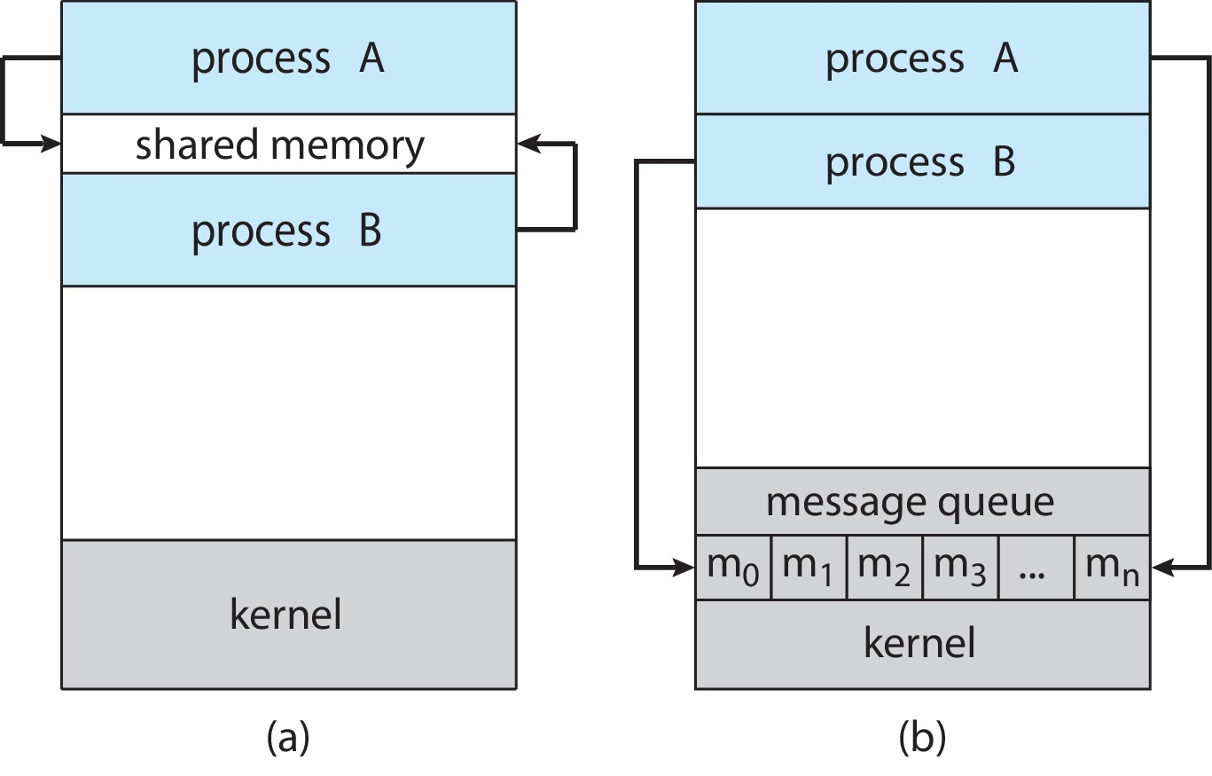
Communications Models
(a) Shared memory. (b) Message passing.

Slide 32
Interprocess Communication – Shared Memory
An area of memory shared among the processes that wish to communicate
With threads (discussed later) sharing memory is easy.
The communication is under the control of the user processes, not the operating system.
Processes do not have access to same memory, so operating system must provide mechanism to allow them to create a shared memory region.
When processes share memory to communicate – grave danger! They must synchronize otherwise they risk lots of bad problems (addressed in Chapters 6 and 7).

Slide 33
Producer-Consumer Problem
Paradigm for cooperating processes, producer process produces information that is consumed by a consumer process
  unbounded-buffer places no practical limit on the size of the buffer
  bounded-buffer assumes that there is a fixed buffer size
No buffer means they run in lockstep; as buffer size increases, less need for synchronizing.
Examples:
  printer is consumer; word processor is producer
  compiler produces assembler code; assembler consumes it, producing machine code.
  pipeline:
    grep expr file | sort | uniq
    command to left is producer for command to right of pipe

Slide 34
Bounded-Buffer – Shared-Memory Solution
Shared data
      #define BUFFER_SIZE 10
      typedef struct {
      . . .
      } item;
      item buffer[BUFFER_SIZE];
      /* Initialization */
      int in = 0;
      int out = 0;
Assumes processes somehow access shared buffer and shared variables in and out
This solution uses BUFFER_SIZE-1 elements: treats buffer as a circular queue.
in == out iff buffer is empty
(in +1) % BUFFER_SIZE == out iff buffer is full

Slide 35
Producer Process – Shared Memory
item next_produced; /* local var in producer */
while (true) {
/* produce an item in next_produced */
while (((in + 1) % BUFFER_SIZE) == out)
; /* do nothing (full condition) */
buffer[in] = next_produced;
in = (in + 1) % BUFFER_SIZE; /* advance in */
}

Slide 36
Consumer Process – Shared Memory
item next_consumed; /* local var in consumer */
while (true) {
while (in == out)
; /* do nothing (empty condition) */
next_consumed = buffer[out];
out = (out + 1) % BUFFER_SIZE;
/* consume the item in next_consumed */
}
Why is this correct?
What does “correct” mean?
  No data produced is lost before consumed
  No data produced is consumed more than once
  What else?

Slide 37
Interprocess Communication – Message Passing
Mechanism for processes to communicate and to synchronize their actions
Message system – processes communicate with each other without resorting to shared variables
IPC facility provides two operations:
  send([destination,] message)
  receive([source,] message)
The message size is either fixed or variable
Usually a destination is required by send and usually a source is required by receive.
Can be used by processes on remote hosts or on same host, so is very general.

Slide 38
Message Passing (Cont.)
If processes P and Q wish to communicate, they need to:
  Establish a communication link between them
  Exchange messages via send/receive
Implementation issues:
  How are links established?
  Can a link be associated with more than two processes?
  How many links can there be between every pair of communicating processes?
  What is the capacity of a link?
  Do links have buffering?
  Is the size of a message that the link can accommodate fixed or variable?
  Is a link unidirectional or bi-directional? (Do we need two separate links for messages from P to Q and from Q to P?)

Slide 39
Message Passing (Cont.)
Implementation of communication link
  Physical:
    Shared memory
    Hardware bus
    Network
  Logical:
    Direct or indirect naming of links
    Blocking or non-blocking transmission (defined soon)
    Symmetric or asymmetric communication (e.g., send is non-blocking but receive is blocking)
    Automatic or explicit buffering of link

Slide 40
Direct Communication
Processes must name each other explicitly:
  send (P, message) – send a message to process P
  receive(Q, message) – receive a message from process Q
Names are bound at compile time
Properties of communication link
  Links are established automatically
  A link is associated with exactly one pair of communicating processes
  Between each pair there exists exactly one link
  The link may be unidirectional, but is usually bi-directional
  Easy to implement
  Cannot be used for client/server architectures
  Compile-time binding is very limiting

Slide 41
Indirect Communication
Messages are directed and received from mailboxes (also referred to as ports)
  Each mailbox has a unique id
  Processes can communicate only if they share a mailbox
  send (A, message) – send a message to mailbox A
  receive(A, message) – receive a message from mailbox A
Mailboxes might be owned and managed by OS, or by processes.
Properties of communication link
  Link established only if processes share a common mailbox
  A link may be associated with many processes
  Each pair of processes may share several communication links
  Link may be unidirectional or bi-directional

Slide 42
Indirect Communication
Operations
  create a new mailbox (port)
  send and receive messages through mailbox
  destroy a mailbox
Primitives are defined as:
send(A, message) – send a message to mailbox A
receive(A, message) – receive a message from mailbox A
If process creates mailbox, it owns it.
If process creates child processes they can access sometimes:
  P creates A
  P creates child Q
  Q can receive from or send to A

Slide 43
Indirect Communication
Mailbox sharing
  P₁, P₂, and P₃ share mailbox A
  P₁, sends; P₂ and P₃ receive
  Who gets the message?
Solutions
  Allow a link to be associated with at most two processes
  Allow only one process at a time to execute a receive operation
  Allow the system to select arbitrarily the receiver. Sender is notified who the receiver was.
Many unanswered questions, such as lost messages, faulty communications, process terminations, scrambled messages, etc

Slide 44
Synchronization
Message passing may be either blocking or non-blocking
Blocking is considered synchronous
  Blocking send -- the sender is blocked until the message is received
  Blocking receive -- the receiver is blocked until a message is available
Non-blocking is considered asynchronous
  Non-blocking send -- the sender sends the message and continues without waiting
  Non-blocking receive -- the receiver receives:
    A valid message, or
    Null message
Different combinations possible
  If both send and receive are blocking, we have a rendezvous

Slide 45
Producer – Message Passing
message next_produced;
while (true) {
/* produce an item in next_produced */
send(next_produced);
}

Slide 46
Consumer– Message Passing
message next_consumed;
while (true) {
receive(next_consumed)
/* consume the item in next_consumed */
}

Slide 47
Buffering
Queue of messages attached to the link.
Implemented in one of three ways
  1. Zero capacity – no messages are queued on a link.
  Sender must wait for receiver (rendezvous)
  2. Bounded capacity – finite length of n messages
  Sender must wait if link full
  3. Unbounded capacity – infinite length
  Sender never waits

Slide 48
Examples of IPC Systems - POSIX
POSIX Shared Memory
  Process first creates shared memory segment
  shm_fd = shm_open(name, O_CREAT | O_RDWR, 0666);
  Also used to open an existing segment
  Set the size of the object
ftruncate(shm_fd, 4096);
  Use mmap() to memory-map a file pointer to the shared memory object
  Reading and writing to shared memory is done by using the pointer returned by mmap().

Slide 49
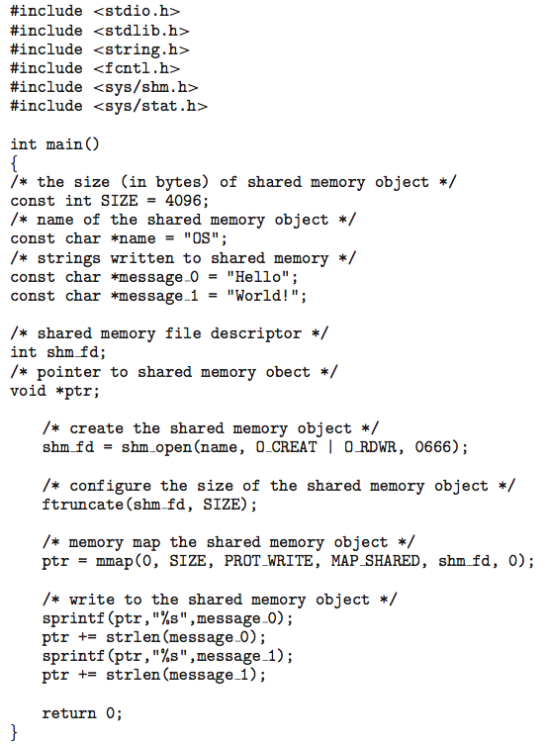
IPC POSIX Producer

Slide 50
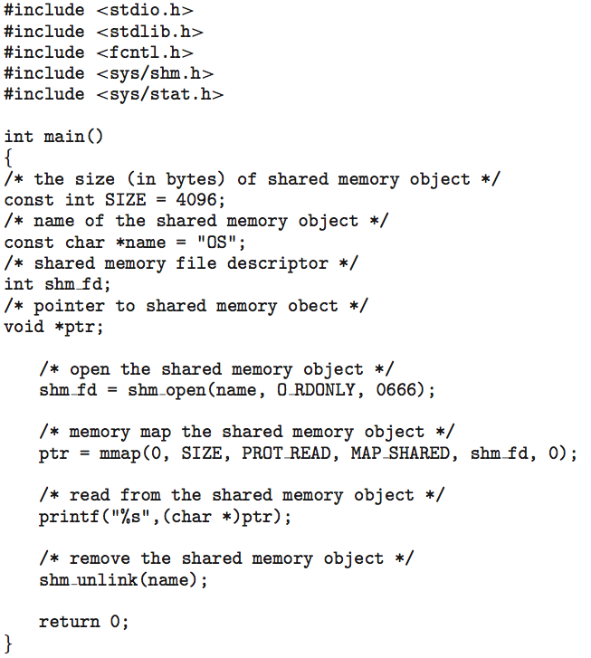
IPC POSIX Consumer

Slide 51
Examples of IPC Systems - Mach
Mach communication is message based
  Even system calls are messages
  Each task gets two ports at creation- Kernel and Notify
  Messages are sent and received using the mach_msg() function
  Ports needed for communication, created via
  mach_port_allocate()
  Send and receive are flexible, for example four options if mailbox full:
    Wait indefinitely
    Wait at most n milliseconds
    Return immediately
    Temporarily cache a message

Slide 52
Mach Messages
#include<mach/mach.h>
struct message {
mach_msg_header_t header;
int data;
};
mach port t client;
mach port t server;

Slide 53
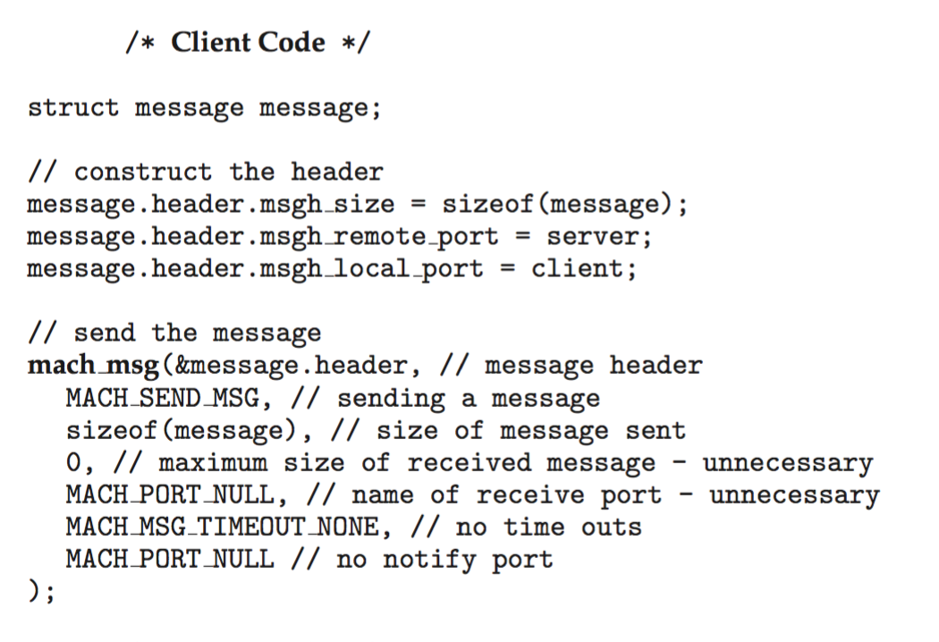
Mach Message Passing - Client

Slide 54
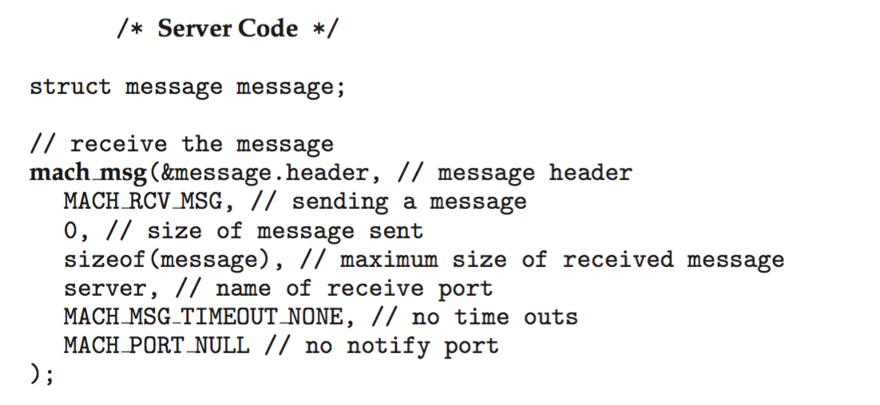
Mach Message Passing - Server

Slide 55
Pipes
A pipe acts as a conduit allowing two processes to communicate
Issues:
  Is communication unidirectional or bidirectional?
  In the case of two-way communication, is it half or full-duplex?
  Must there exist a relationship (i.e., parent-child) between the communicating processes?
  Can the pipes be used over a network?
Ordinary pipes – cannot be accessed from outside the process that created it. Typically, a parent process creates a pipe and uses it to communicate with a child process that it created.
Named pipes – can be accessed without a parent-child relationship.

Slide 56
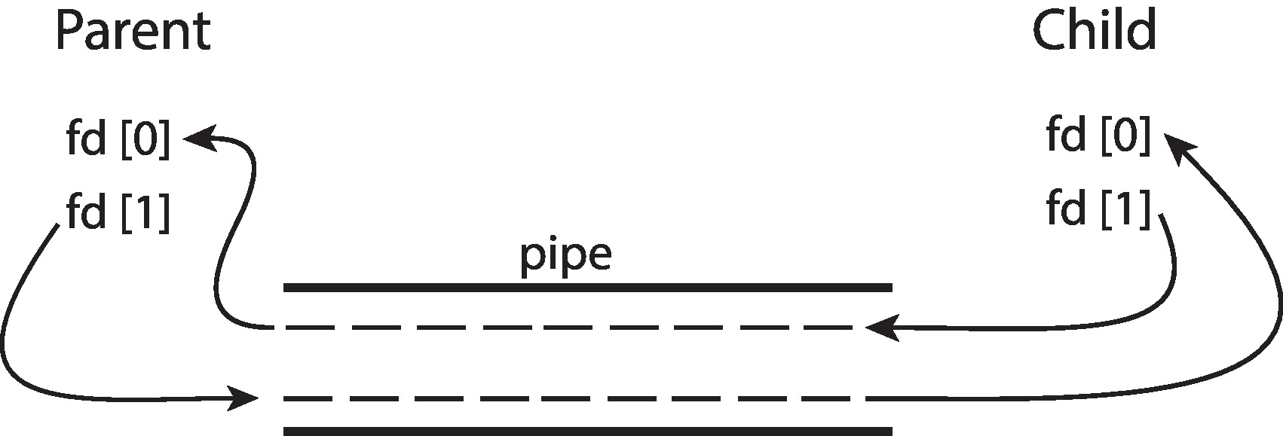
Ordinary Pipes
Ordinary Pipes allow communication in standard producer-consumer style
Producer writes to one end (the write-end of the pipe)
Consumer reads from the other end (the read-end of the pipe)
Ordinary pipes are therefore unidirectional
Require parent-child relationship between communicating processes
Windows calls these anonymous pipes

Slide 57
Named Pipes
Named Pipes are more powerful than ordinary pipes
Communication is bidirectional
No parent-child relationship is necessary between the communicating processes
Several processes can use the named pipe for communication
Provided on both UNIX and Windows systems

Slide 58
Communications in Client-Server Systems
Sockets
Remote Procedure Calls

Slide 59
Sockets
A socket is defined as an endpoint for communication
Concatenation of IP address and port – a number included at start of message packet to differentiate network services on a host
The socket 161.25.19.8:1625 refers to port 1625 on host 161.25.19.8
Communication consists between a pair of sockets
All ports below 1024 are well known, used for standard services
Special IP address 127.0.0.1 (loopback) to refer to system on which process is running

Slide 60
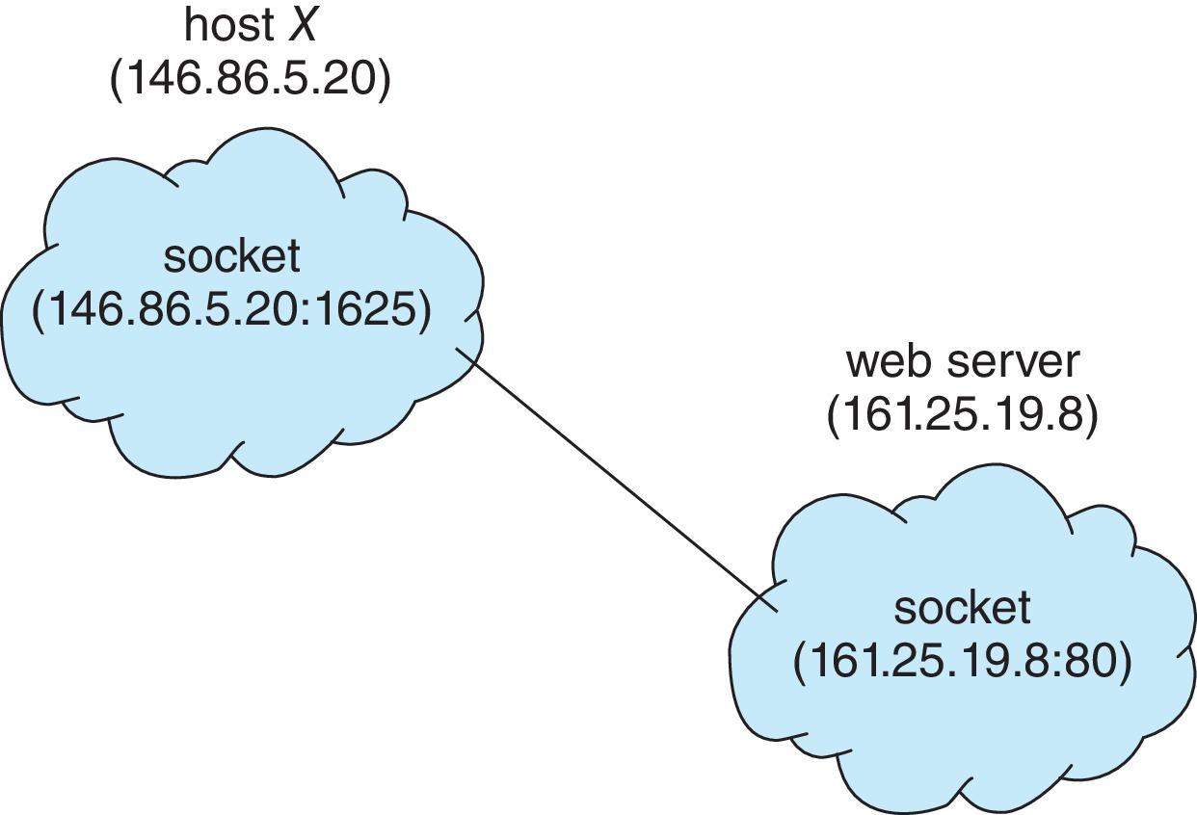
Socket Communication

Slide 61
End of Chapter 3

