Slide 1
Chapter 4: Threads & Concurrency

Slide 2
Chapter 4: Threads
Overview
Multi-core Programming
Multi-threading Models
Thread Libraries
Implicit Threading
Threading Issues
Operating System Examples

Slide 3
Objectives
Identify the basic components of a thread, and contrast threads and processes
Describe the benefits and challenges of designing multi-threaded applications
Illustrate different approaches to implicit threading, including thread pools and fork-join
Describe how the Linux operating system represents threads
Explore multi-threaded applications using the Pthreads, Java, and Windows threading APIs

Slide 4
Motivation
Kernels are generally multi-threaded
Most modern applications are multi-threaded
Whereas cooperating processes are independent, cooperating threads run within the same process (think application)
Multiple functions or tasks within an application can be implemented by separate threads. Example decomposition:
  A thread to update display
  A thread to fetch data from a database
  A thread to run a tool such as a spell-checker
  A thread to respond to a network request
Process creation is costly and slow, whereas thread creation is light-weight
Proper threading can simplify code, increase efficiency

Slide 5
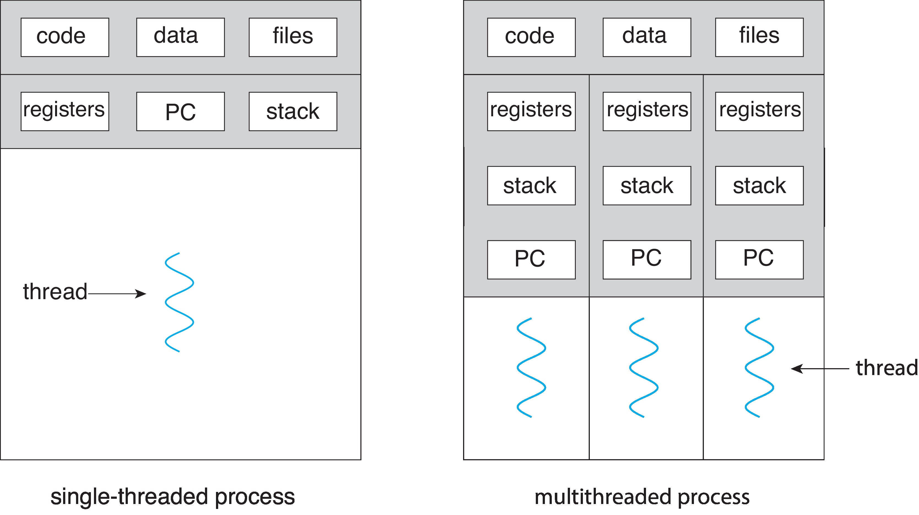
Single versus Multi-threaded Processes
Each thread has its own register set, stack, and PC.

Slide 6
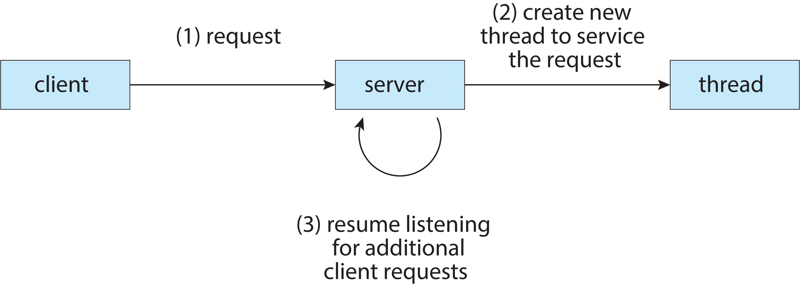
Multi-threaded Server Architecture
client sends request to server;
server creates a thread to process the request, and
immediately returns to listening for the next request from a client in the same main thread.

Slide 7
Benefits of Threads
Responsiveness – may allow continued execution if part of process is blocked, or some slow operation in a different thread - especially important for user interfaces
Resource Sharing – threads share same address space in single process, easier than processes using shared memory or message passing
Cost – cheaper than process creation, thread switching lower overhead than context switching
Scalability – process can take advantage of multi-core architectures

Slide 8
Concurrency vs. Parallelism
Two or more sequences of instructions are said to be concurrent if no matter what order they are executed in relation to each other, the final result of their combined computation is the same.
This means that they can be executed simultaneously on different processors, or interleaved on a single processor in any order, and whatever outputs they produce will be the same.
A system with two ore more concurrent processes is called a concurrent program or a concurrent system.
Two processes or threads execute in parallel if they execute at the same time on different processors.
Parallel programs are those containing instruction sequences that can be executed in parallel. A parallel program is always a concurrent program, but a system can have concurrency even though it is not a parallel program.

Slide 9
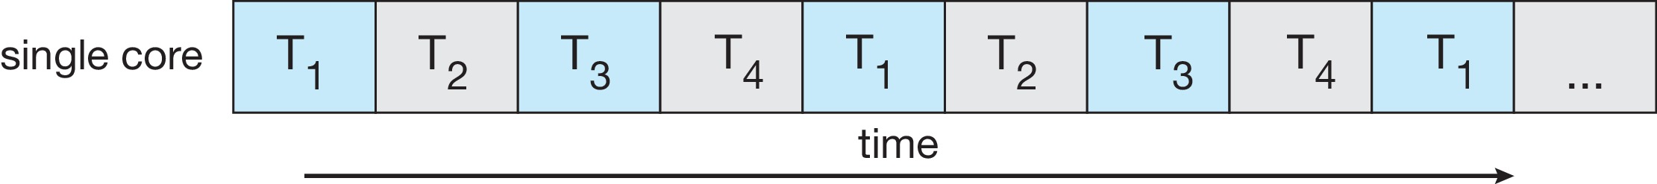
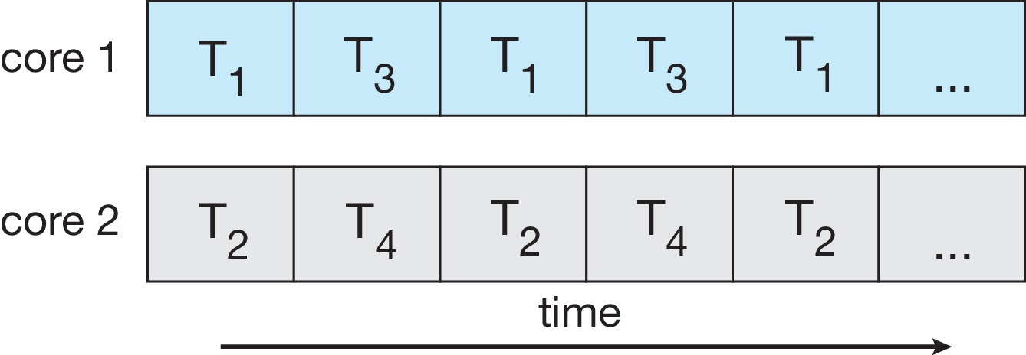
Concurrency vs. Parallelism
Concurrent execution on single-core system:
Parallelism on a multi-core system:

Slide 10
Multi-core Programming
Multi-core or multi-processor systems challenge programmers to take advantage of hardware, but it is not easy:
  How to decompose a single task into many independent parallel tasks
  How to load-balance the tasks
  How to split data onto separate cores/processors
  How to identify data dependency and handle synchronization
  How to test and debug parallel programs

Slide 11
Multi-core Programming (cont.)
Types of inherent parallelism:
  Data parallelism – distributes subsets of the same data across multiple cores, same operation on each
    an image on which the same operation is applied to all pixels
    a payroll with taxes to be calculated for all individuals
    a set of points to be rotated through same angle in space
  Task parallelism – distributing threads across cores, each thread performing unique operation
    same data set evaluated by multiple algorithms for some property (census data analyzed for demographics, financials, geographic, etc)

Slide 12
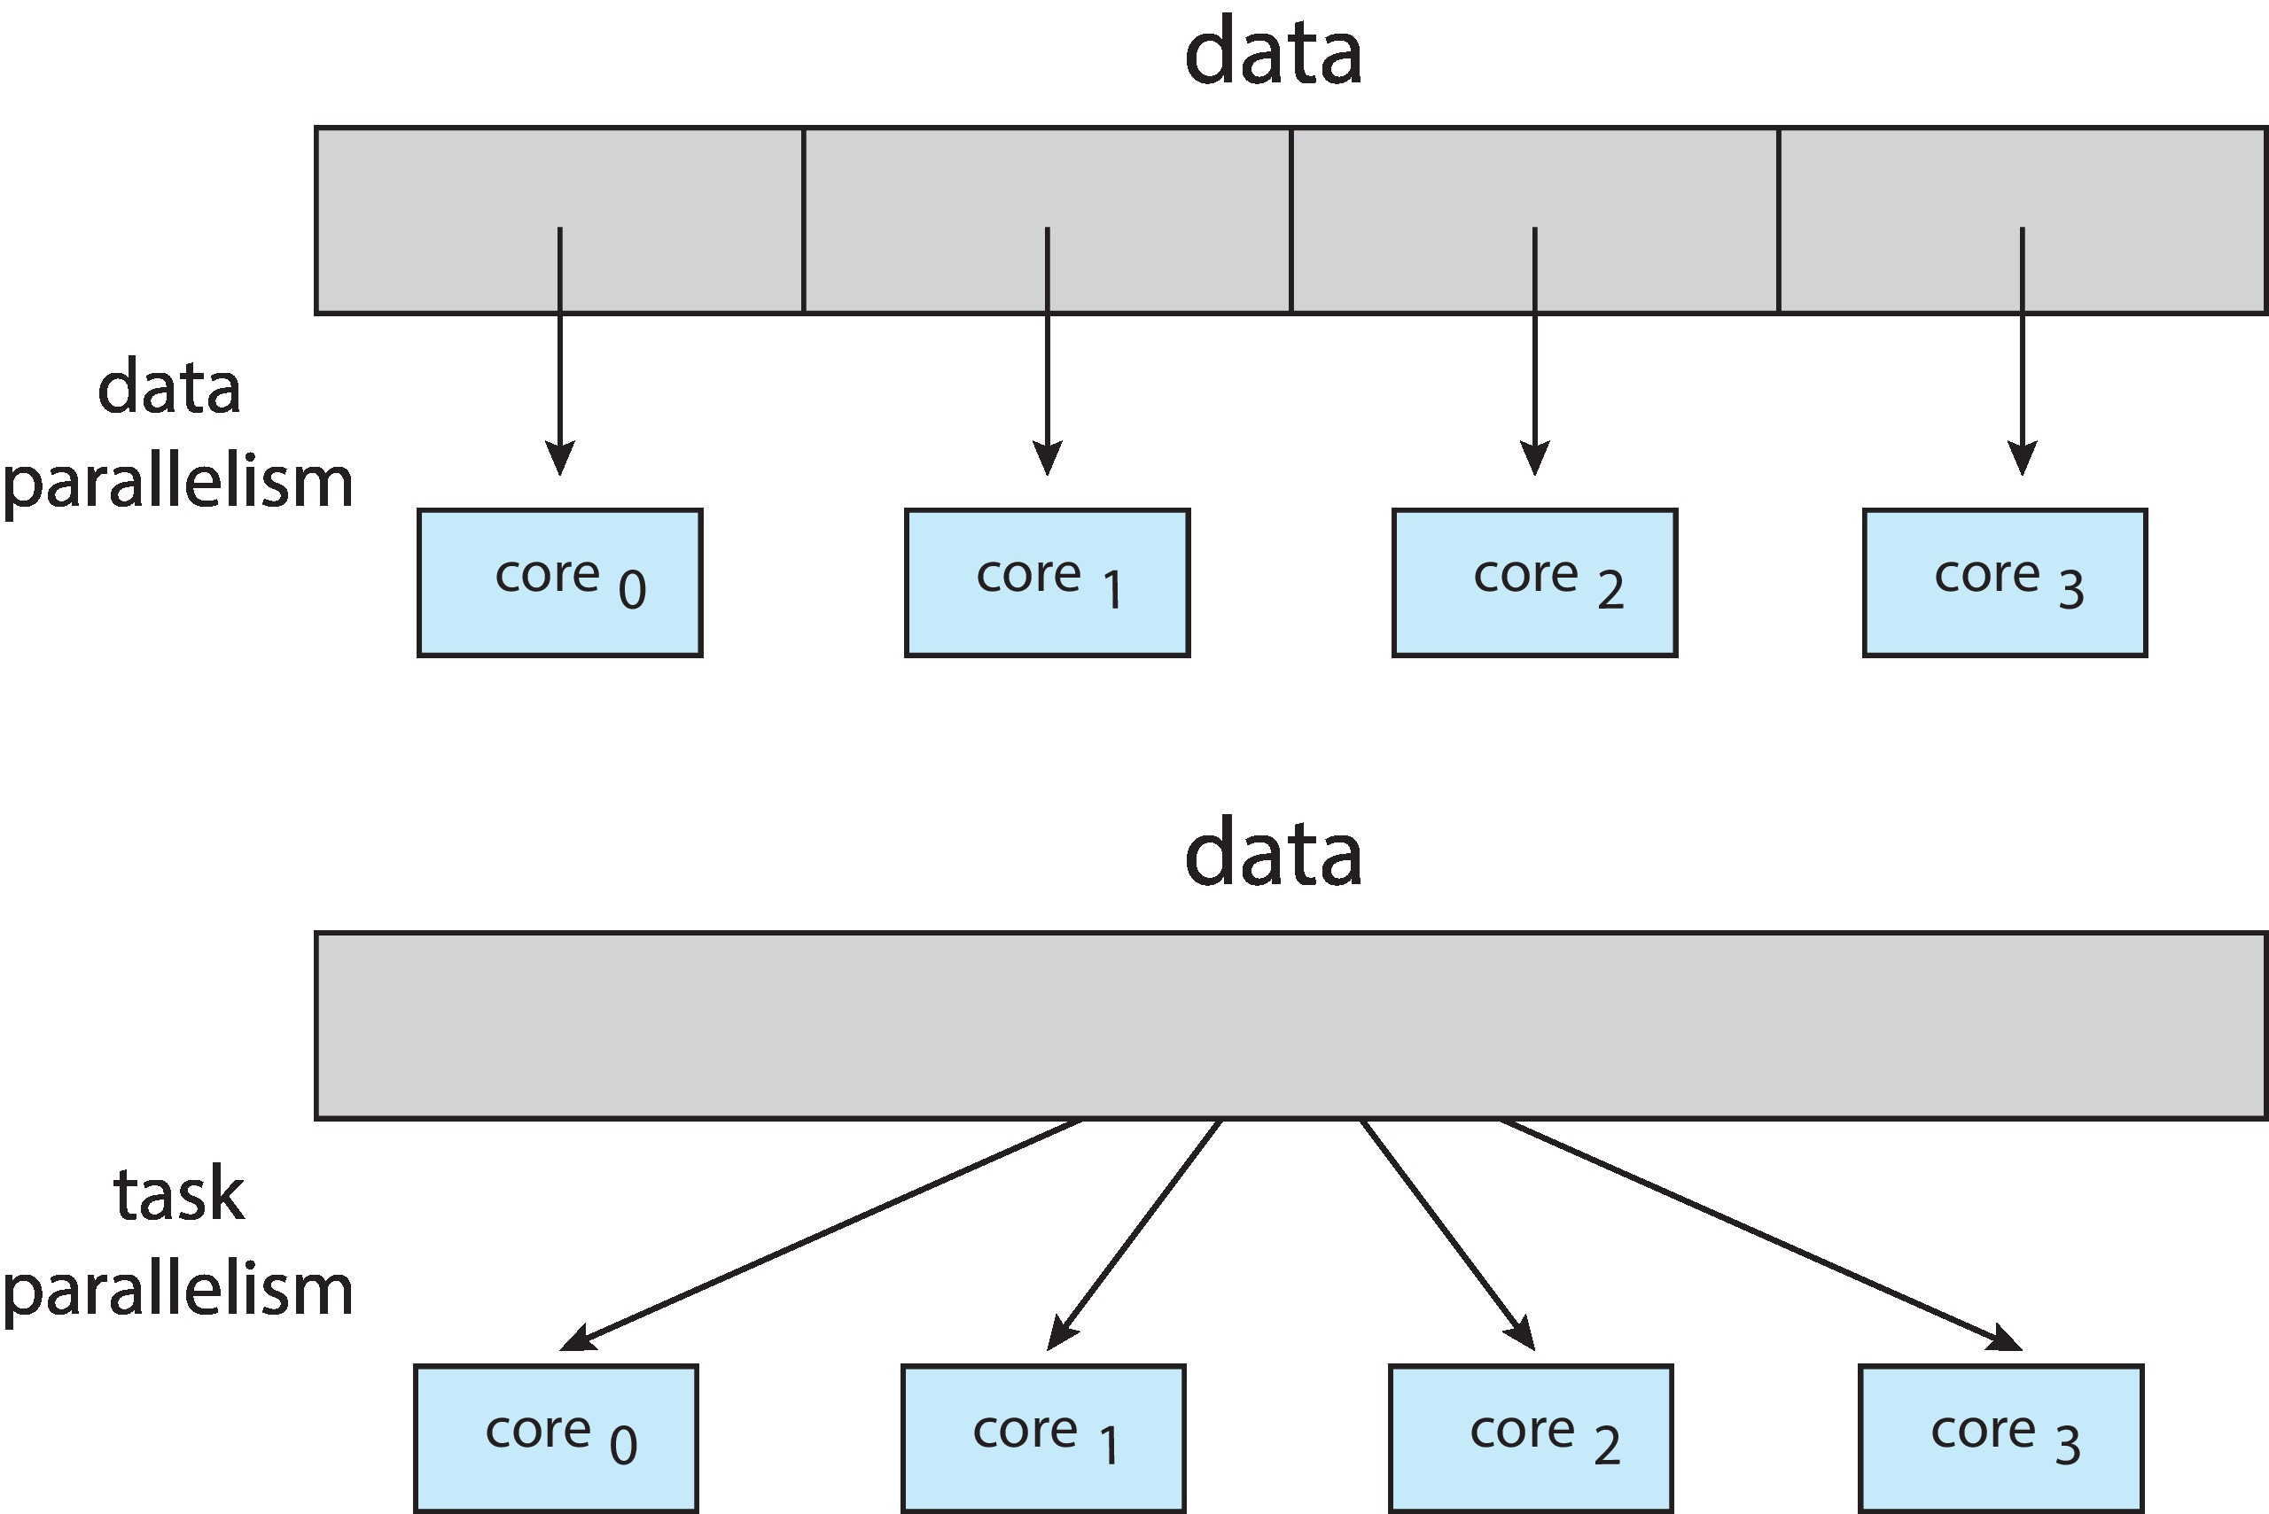
Data and Task Parallelism

Slide 13
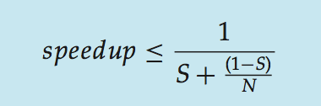
Amdahl’s Law
In 1967, Gene Amdahl argued that there was an inherent limitation to the amount of speedup that could be obtained by performing a computation using more processors. His argument is known as “Amdahl’s Law”. If
  S, 0 <= S <= 1, is the fraction of operations that must be executed serially (in sequence), and
  N is the number of processing cores, then the speed-up is bounded above:
Example: if program is 75% parallel / 25% serial, (S=0.25) moving from 1 to 2 cores (N=2) results in speedup of 1/((1/4) + (3/4)/2)) = 1.6
As N approaches infinity, speedup approaches 1 / S
Serial portion of an application limits maximum performance gained by adding additional cores

Slide 14
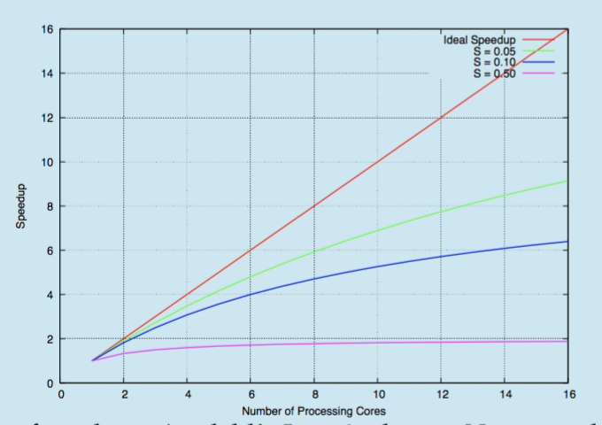
Amdahl’s Law Graphically

Slide 15
User Threads and Kernel Threads
User threads are supported by user-level libraries
Three primary user thread libraries:
  POSIX Pthreads
  Windows threads
  Java threads
Kernel threads are supported directly by the kernel
  Examples – virtually all modern operating systems, including:
    Windows
    Linux
    Mac OS X
    iOS
    Android

Slide 16
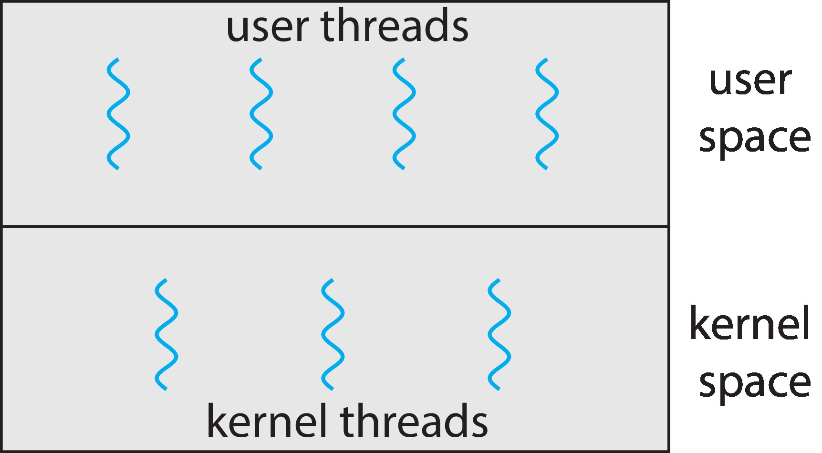
User and Kernel Threads
When threads are provided as user threads, they still must be mapped onto kernel threads.
There is not necessarily an equal number of user and kernel threads.

Slide 17
Multi-threading Models
How to map user threads to kernel threads?
Three different models:
  Many-to-One: many user-level threads map to single kernel thread
  One-to-One: one user-level thread maps to one kernel thread
  Many-to-Many: many user-level threads map to many kernel threads

Slide 18
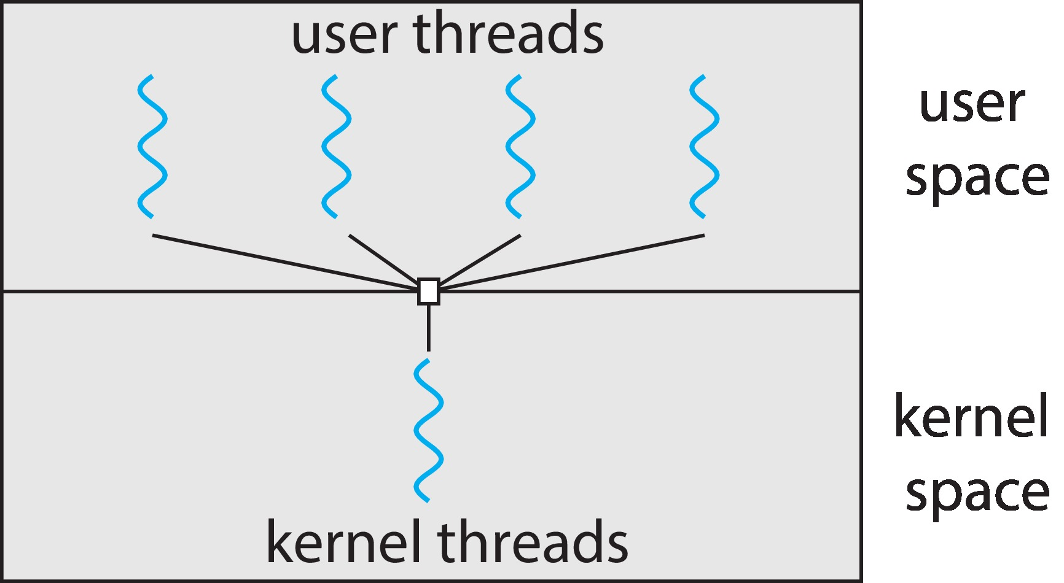
Many-to-One
Many user-level threads mapped to single kernel thread.
Weaknesses:
  One thread blocking causes all to block
  Multiple threads may not run in parallel on multi-core system because only one may be in kernel at a time
Few systems currently use this model because modern systems have many cores which are not utilized well.
Examples:
  Solaris Green Threads
  GNU Portable Threads

Slide 19
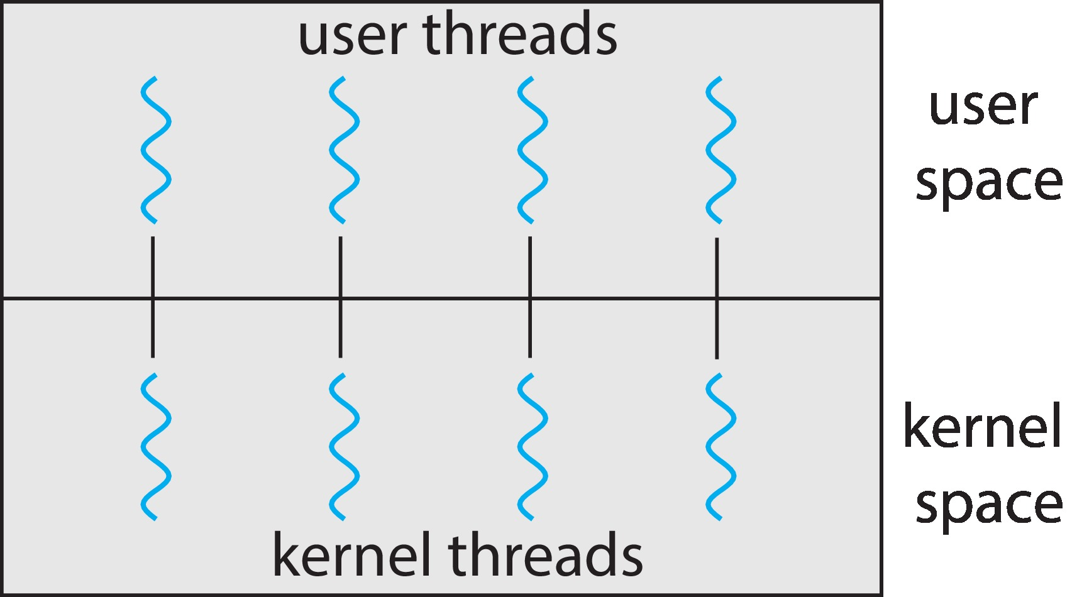
One-to-One
Each user-level thread maps to one kernel thread
Creating a user-level thread creates a kernel thread
More concurrency than many-to-one
Number of threads per process sometimes restricted due to overhead:
  Creating a user thread requires creating a kernel thread, and too many kernel threads can degrade performance of system.
Examples
  Windows
  Linux

Slide 20
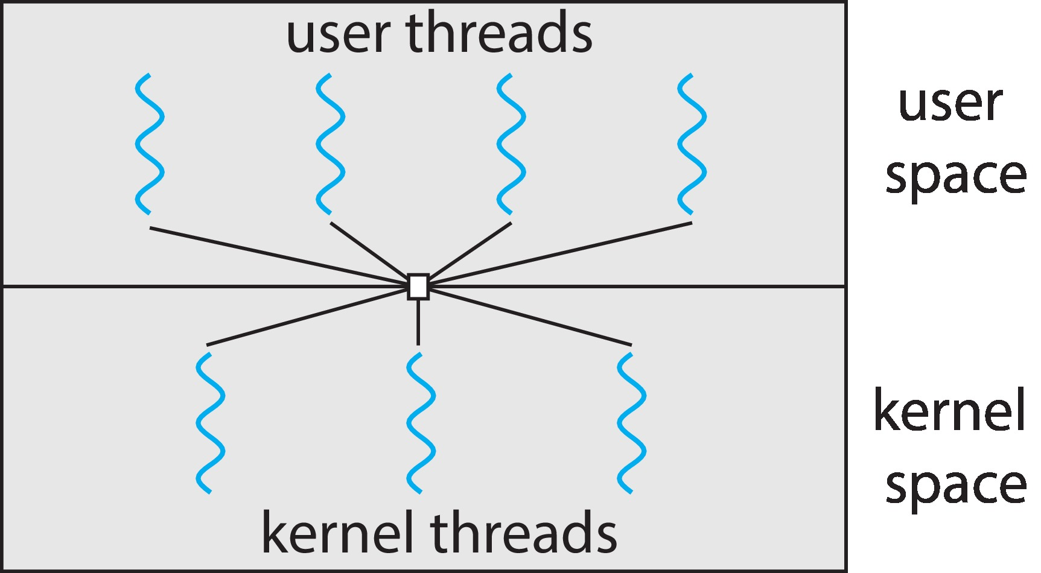
Many-to-Many Model
Allows many user level threads to be multiplexed onto an equal or smaller number of kernel threads
Allows the operating system to create a sufficient number of kernel threads
Program can have as many user threads as necessary, and the corresponding kernel threads can run in parallel on a multiprocessor. If thread blocks, kernel can schedule a different thread.
Windows with the ThreadFiber package
Otherwise not very common

Slide 21
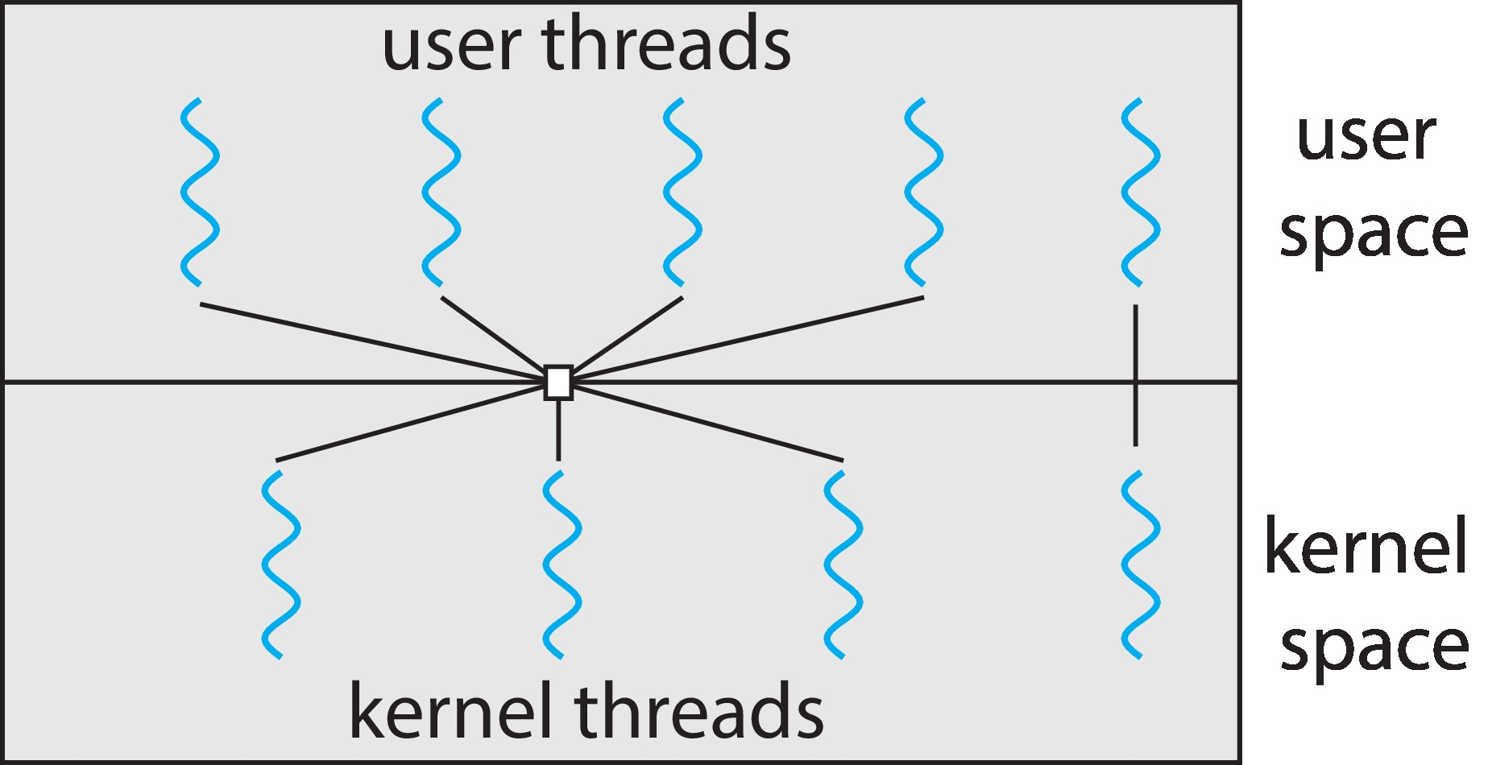
Two-level Model
Similar to the many-to-many, except that it allows a user thread to be bound to a kernel thread.

Slide 22
Thread Libraries
Thread library provides programmer with API for creating and managing threads
Two primary ways of implementing
  Library entirely in user space
  Kernel-level library supported by the OS
Three prevalent libraries: POSIX threads (Pthreads), Windows, and Java threads.

Slide 23
Pthreads
May be provided either as user-level or kernel-level
A POSIX standard (IEEE 1003.1c) API for thread creation and synchronization
Specification, not implementation
API specifies behavior of the thread library, implementation is up to development of the library
Common in UNIX operating systems (Linux & Mac OS X)

Slide 24
Pthreads Example 1
#include <unistd.h>
#include <stdio.h>
#include <stdlib.h>
#include <pthread.h>
void* hello_world( void* unused)
{
printf("The child says, \"Hello world!\"\n");
pthread_exit(NULL) ;
}
int main( int argc, char *argv[])
{
pthread_t child_thread;
/* Create the thread and launch it. */
if ( 0 != pthread_create(&child_thread, NULL,
hello_world, NULL ) ){
printf("pthread_create failed.\n");
exit(1);
}
printf("This is the parent thread.\n");
/* Wait for the child thread to terminate. */
pthread_join(child_thread, NULL);
return 0;
}

Slide 25
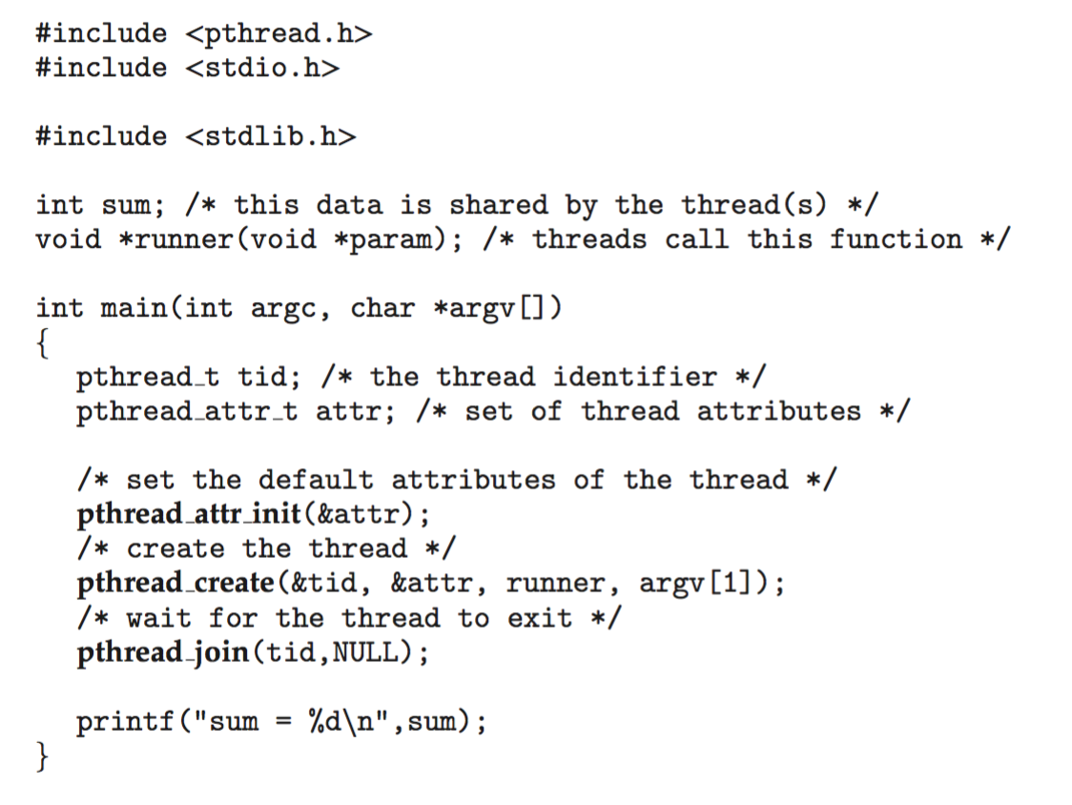
Pthreads Example 2

Slide 26
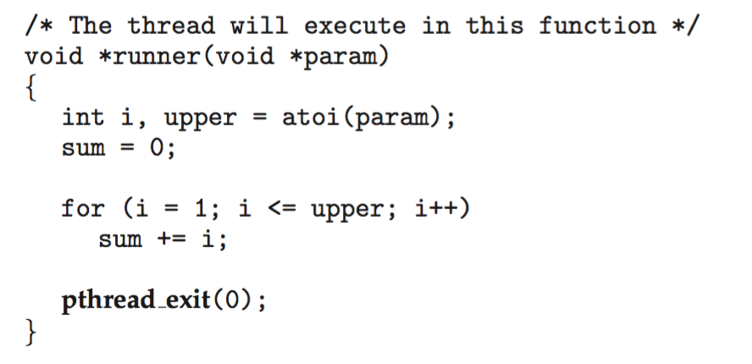
Pthreads Example 2 (cont)

Slide 27
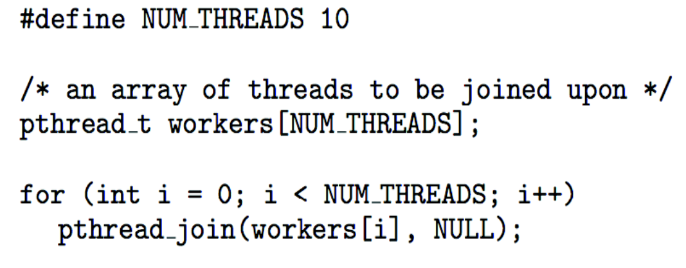
Pthreads Code for Joining 10 Threads

Slide 28
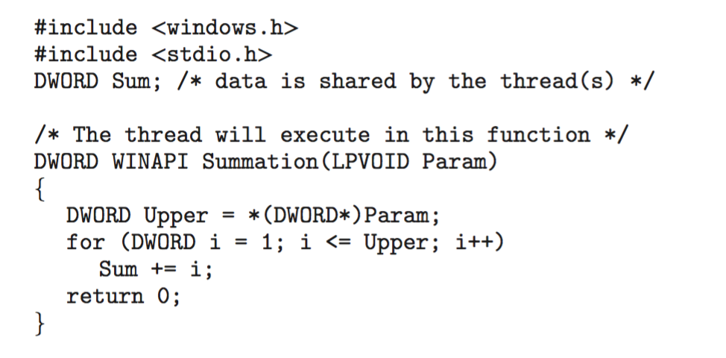
Windows Multi-threaded C Program

Slide 29
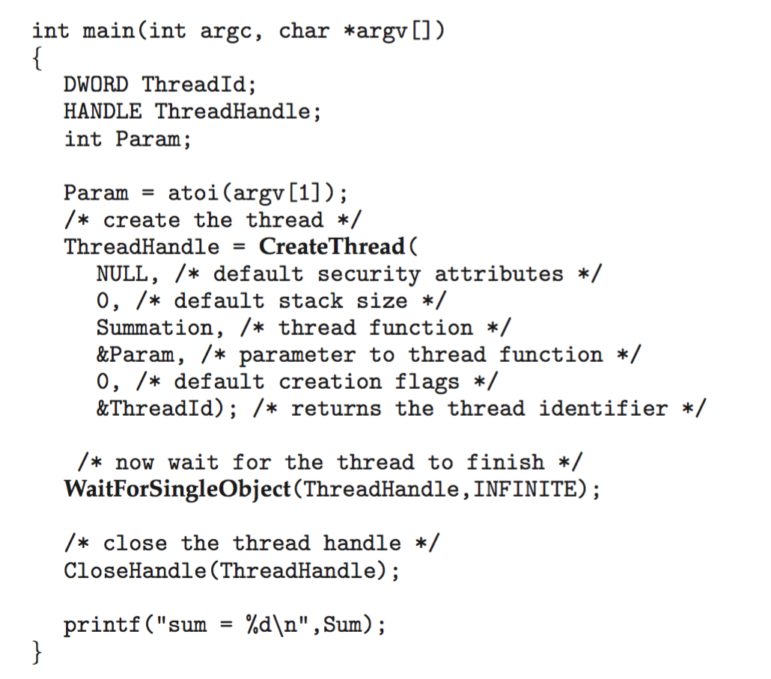
Windows Multi-threaded C Program (Cont.)

Slide 30
Implicit Threading
Growing in popularity as numbers of threads increase, program correctness more difficult with explicit threads
Creation and management of threads done by compilers and run-time libraries rather than programmers
Five methods explored
  Thread Pools
  Fork-Join
  OpenMP
  Grand Central Dispatch
  Intel Threading Building Blocks

Slide 31
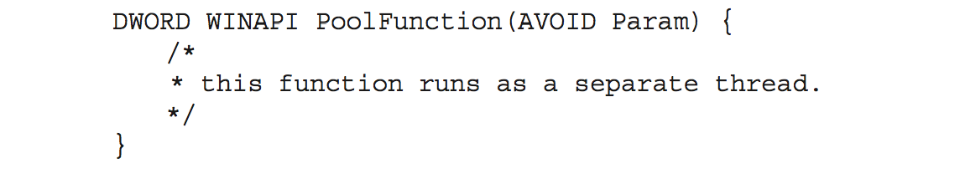
Thread Pools
Create a number of threads in a pool where they await work
Advantages:
  Usually slightly faster to service a request with an existing thread than create a new thread
  Allows the number of threads in the application(s) to be bound to the size of the pool
  Separating task to be performed from mechanics of creating task allows different strategies for running task
    i.e.Tasks could be scheduled to run periodically
Windows API supports thread pools:

Slide 32
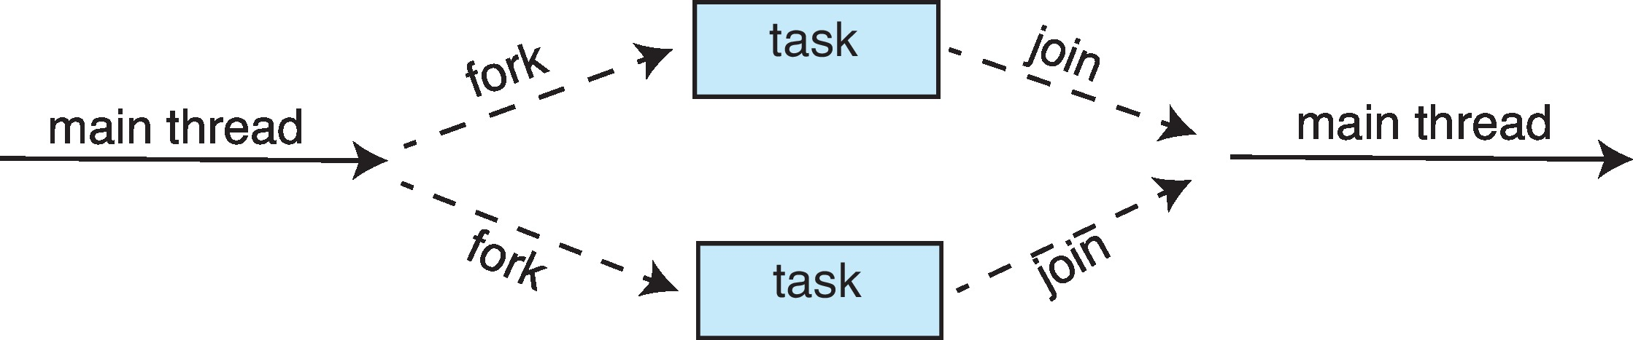
Fork-Join Parallelism
Multiple threads (tasks) are forked, and then joined.

Slide 33
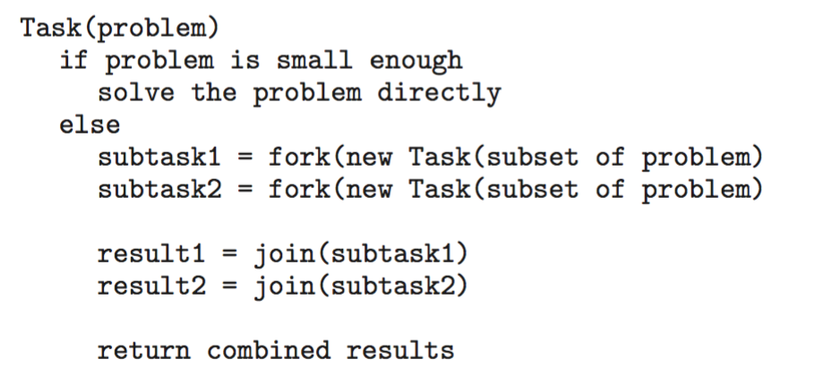
Fork-Join Parallelism
General algorithm for fork-join strategy:

Slide 34
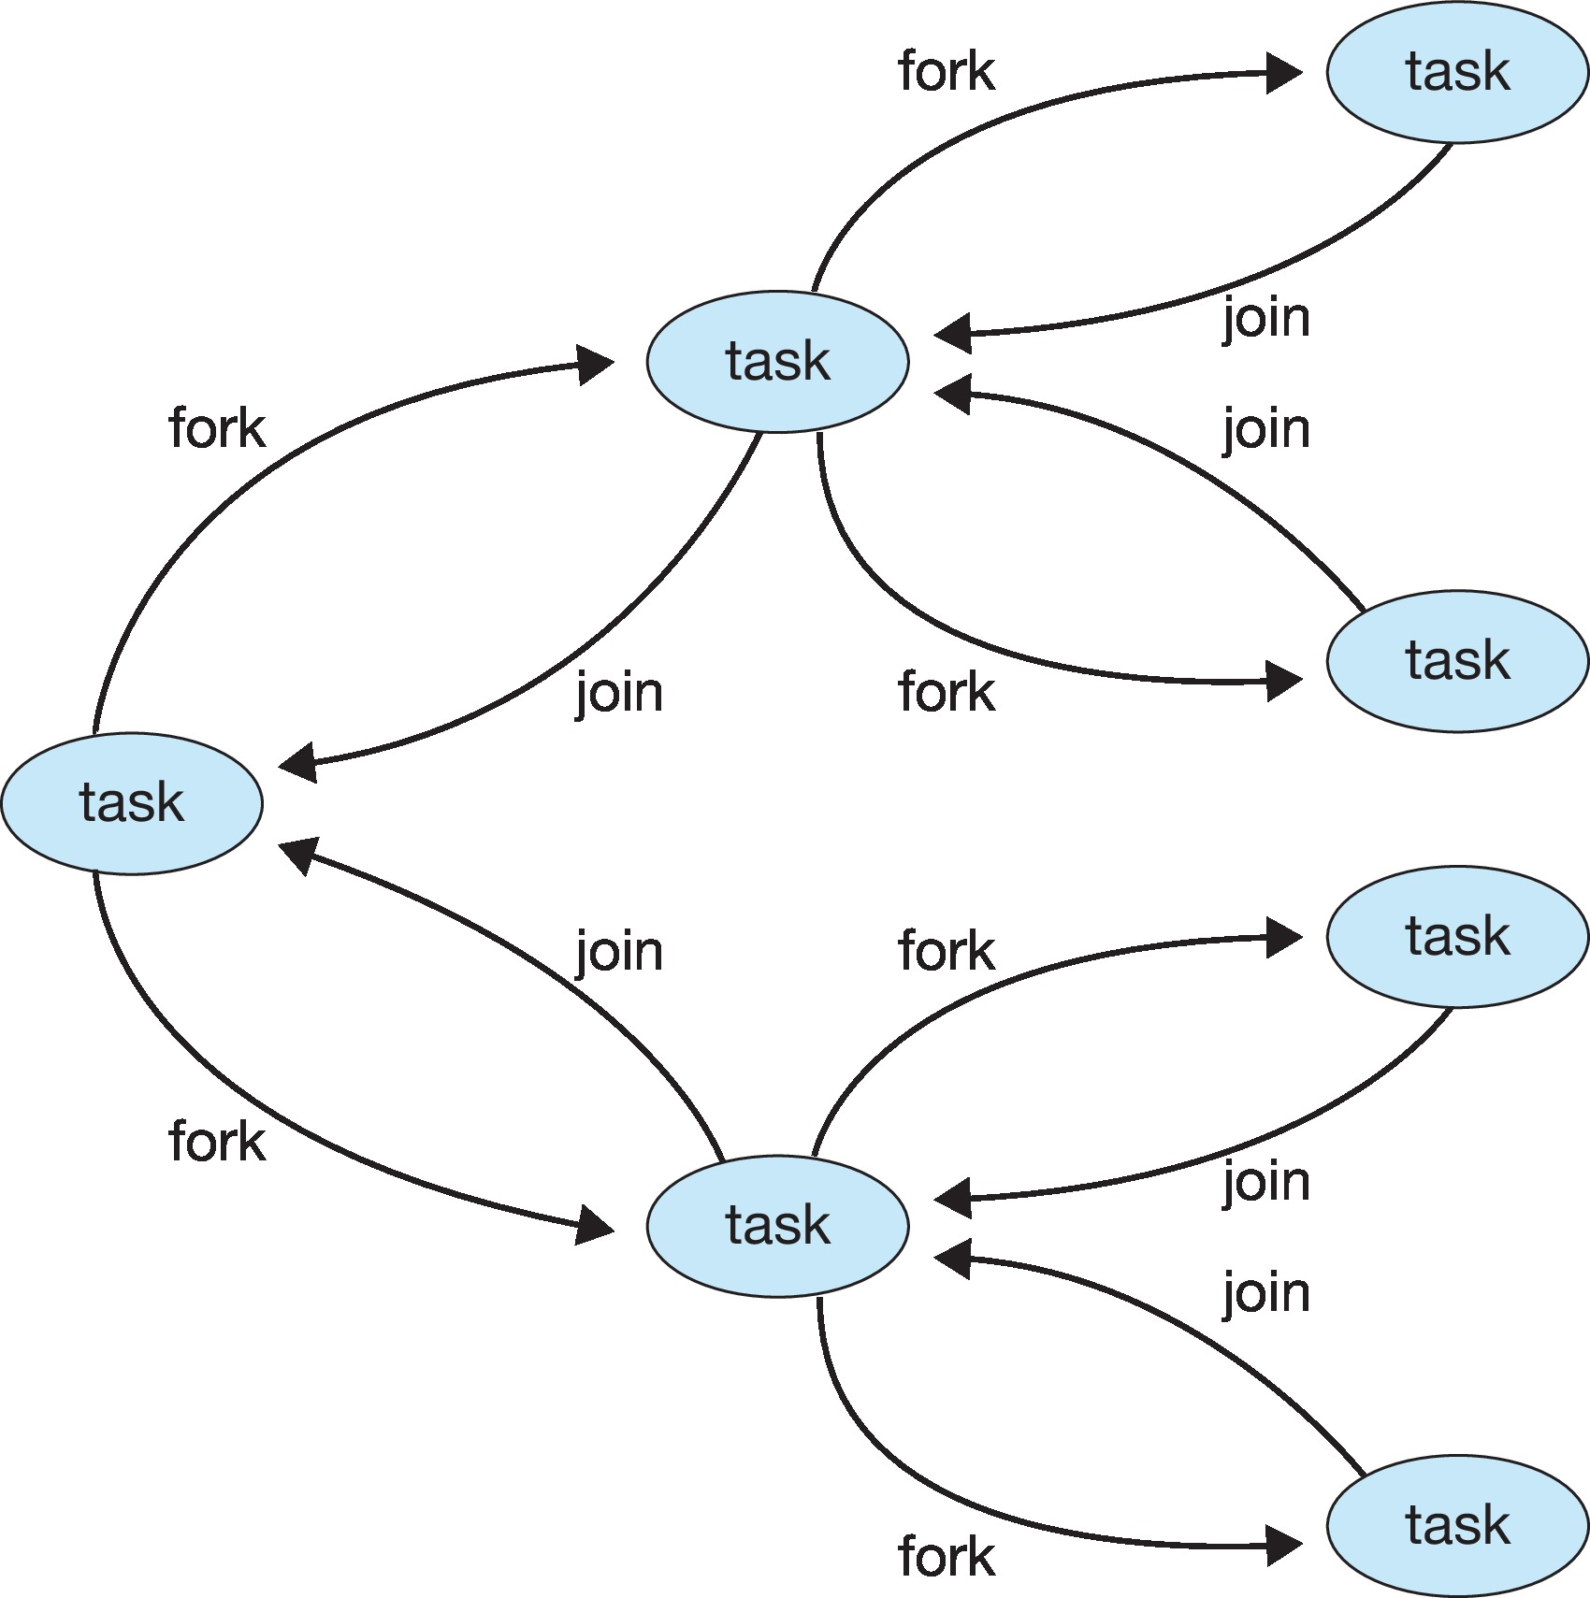
Fork-Join Parallelism

Slide 35
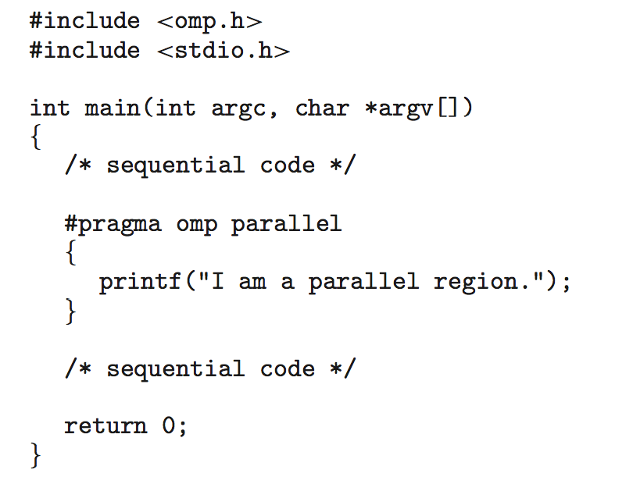
OpenMP
Set of compiler directives and an API for C, C++, FORTRAN
Provides support for parallel programming in shared-memory environments
Identifies parallel regions – blocks of code that can run in parallel
#pragma omp parallel
Create as many threads as there are cores

Slide 36
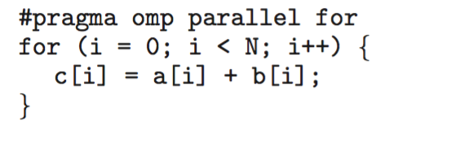
OpenMP Example
Run the for loop in parallel

Slide 37
Grand Central Dispatch
Apple technology for macOS and iOS operating systems
Extensions to C, C++ and Objective-C languages, API, and run-time library
Allows identification of parallel sections
Manages most of the details of threading
Block is in “^{ }” :
ˆ{ printf("I am a block"); }
Blocks placed in dispatch queue
  Assigned to available thread in thread pool when removed from queue

Slide 38
Grand Central Dispatch (cont)
Two types of dispatch queues:
  serial – blocks removed in FIFO order, queue is per process, called main queue
    Programmers can create additional serial queues within program
  concurrent – removed in FIFO order but several may be removed at a time
    Four system wide queues divided by quality of service:
    QOS_CLASS_USER_INTERACTIVE
    QOS_CLASS_USER_INITIATED
    QOS_CLASS_USER_UTILITY
    QOS_CLASS_USER_BACKGROUND

Slide 39
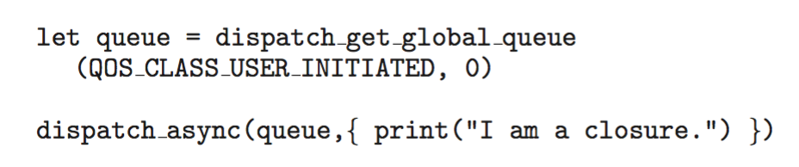
Grand Central Dispatch (3)
For the Swift language a task is defined as a closure – similar to a block, minus the caret
Closures are submitted to the queue using the dispatch_async() function:

Slide 40
Threading Issues
Semantics of fork() and exec() system calls
Signal handling
  Synchronous and asynchronous
Thread cancellation of target thread
  Asynchronous or deferred
Thread-local storage
Scheduler Activations

Slide 41
Semantics of fork() and exec()
Does fork()duplicate only the calling thread or all threads?
  Some UNIXes have two versions of fork
exec() usually works as normal – replace the running process including all threads

Slide 42
Signal Handling
Signals are used in UNIX systems to notify a process that a particular event has occurred.
A signal handler is used to process signals
  Signal is generated by particular event
  Signal is delivered to a process
  Signal is handled by one of two signal handlers:
    default
    user-defined
Every signal has default handler that kernel runs when handling signal
  User-defined signal handler can override default
  For single-threaded, signal delivered to process

Slide 43
Signal Handling (Cont.)
Where should a signal be delivered for multi-threaded?
  Deliver the signal to the thread to which the signal applies
  Deliver the signal to every thread in the process
  Deliver the signal to certain threads in the process
  Assign a specific thread to receive all signals for the process

Slide 44
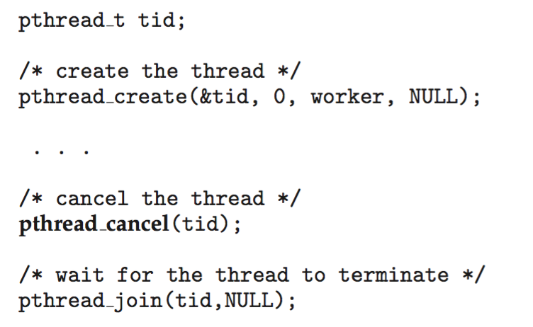
Thread Cancellation
Terminating a thread before it has finished
Thread to be canceled is target thread
Two general approaches:
  Asynchronous cancellation terminates the target thread immediately
  Deferred cancellation allows the target thread to periodically check if it should be cancelled
Pthread code to create and cancel a thread:

Slide 45
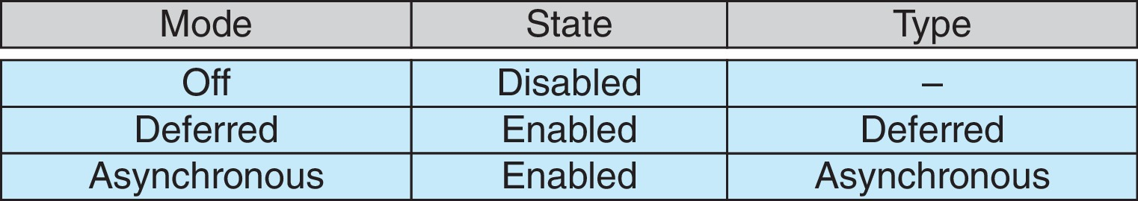
Thread Cancellation (Cont.)
Invoking thread cancellation requests cancellation, but actual cancellation depends on thread state
If thread has cancellation disabled, cancellation remains pending until thread enables it
Default type is deferred
  Cancellation only occurs when thread reaches cancellation point
    I.e. pthread_testcancel()
    Then cleanup handler is invoked
On Linux systems, thread cancellation is handled through signals

Slide 46
Thread-Local Storage
Thread-local storage (TLS) allows each thread to have its own copy of data
Useful when you do not have control over the thread creation process (i.e., when using a thread pool)
Different from local variables
  Local variables visible only during single function invocation
  TLS visible across function invocations
Similar to static data
  TLS is unique to each thread

Slide 47
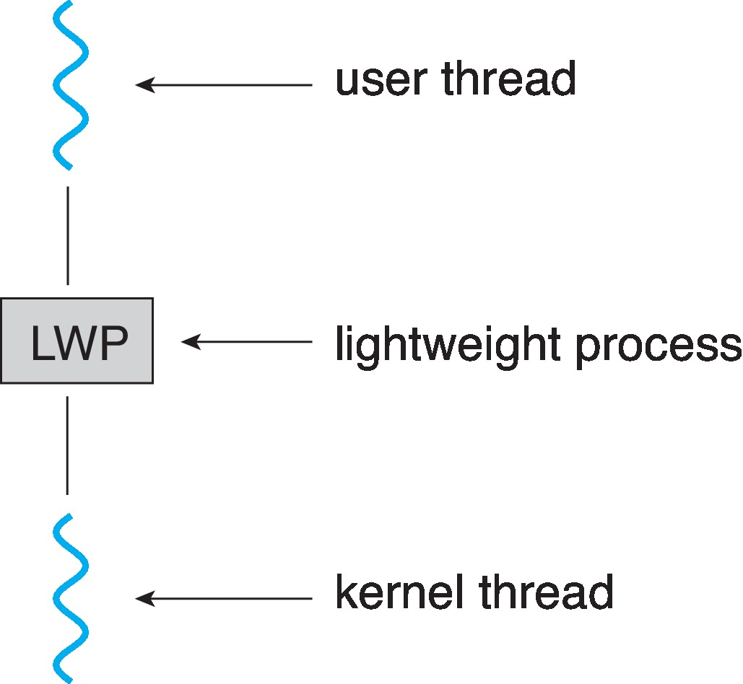
Scheduler Activations
Both M:M and Two-level models require communication to maintain the appropriate number of kernel threads allocated to the application
Typically use an intermediate data structure between user and kernel threads – lightweight process (LWP)
  Appears to be a virtual processor on which process can schedule user thread to run
  Each LWP attached to kernel thread
  How many LWPs to create?
Scheduler activations provide upcalls - a communication mechanism from the kernel to the upcall handler in the thread library
This communication allows an application to maintain the correct number kernel threads

Slide 48
Operating System Examples
Windows Threads
Linux Threads

Slide 49
Windows Threads
Windows API – primary API for Windows applications
Implements the one-to-one mapping, kernel-level
Each thread contains
  A thread id
  Register set representing state of processor
  Separate user and kernel stacks for when thread runs in user mode or kernel mode
  Private data storage area used by run-time libraries and dynamic link libraries (DLLs)
The register set, stacks, and private storage area are known as the context of the thread

Slide 50
Windows Threads (Cont.)
The primary data structures of a thread include:
  ETHREAD (executive thread block) – includes pointer to process to which thread belongs and to KTHREAD, in kernel space
  KTHREAD (kernel thread block) – scheduling and synchronization info, kernel-mode stack, pointer to TEB, in kernel space
  TEB (thread environment block) – thread id, user-mode stack, thread-local storage, in user space

Slide 51
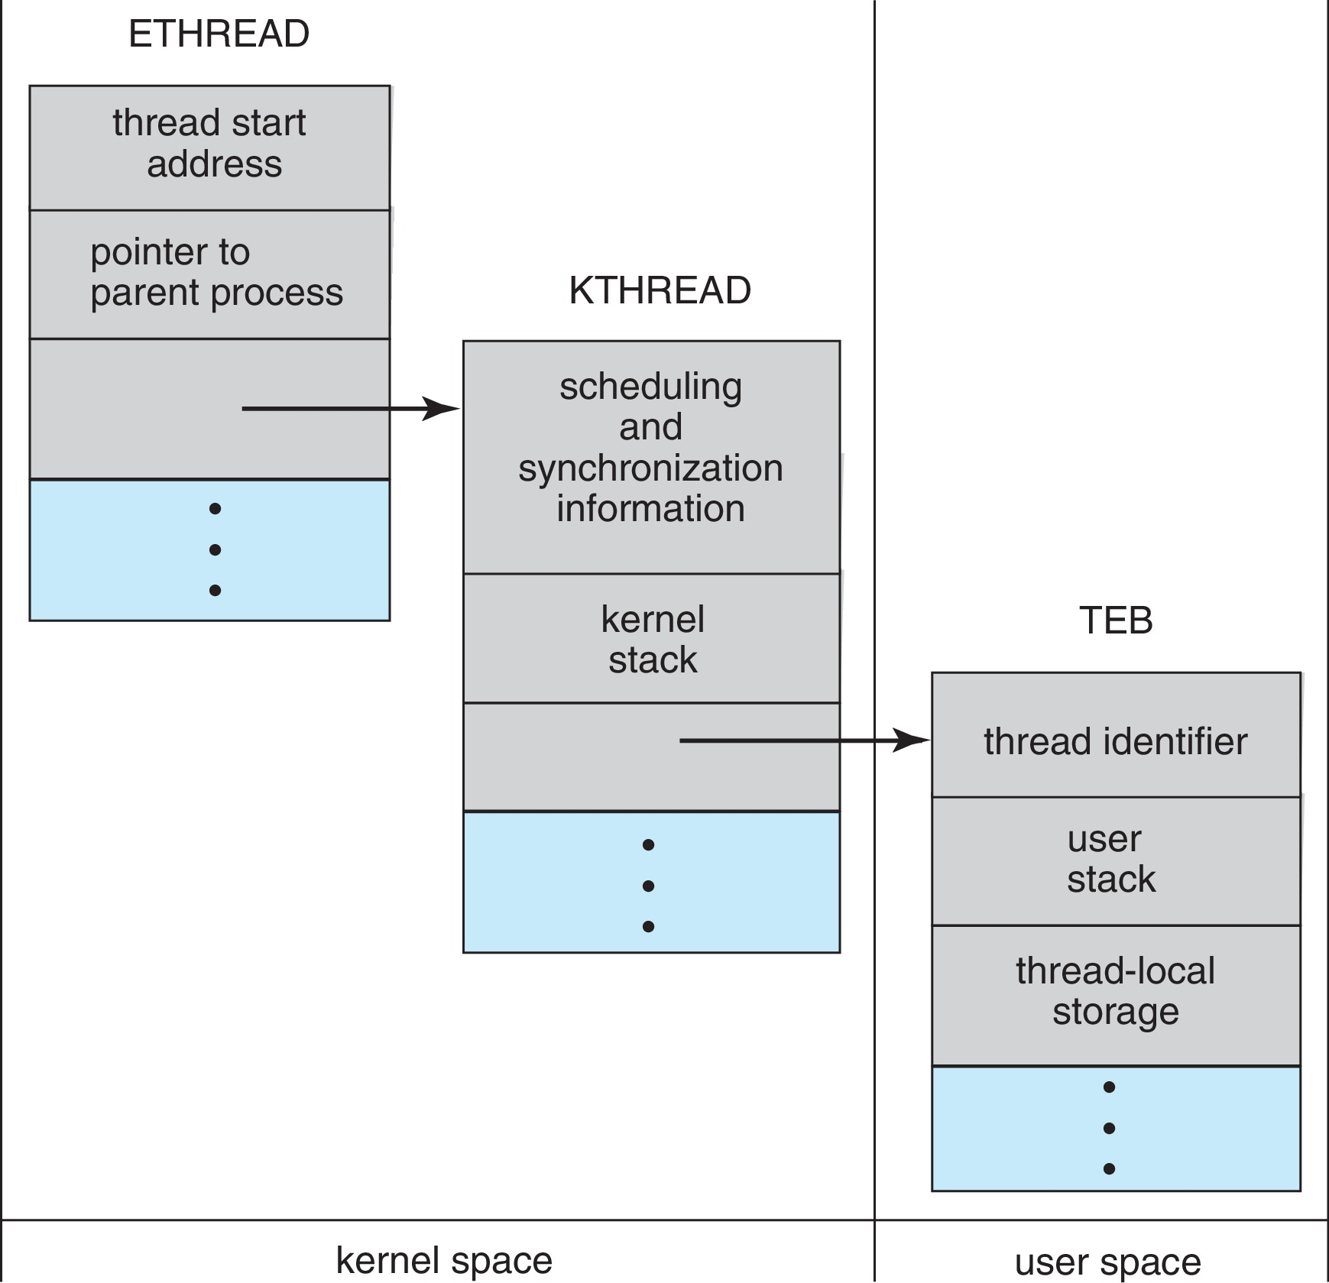
Windows Threads Data Structures

Slide 52
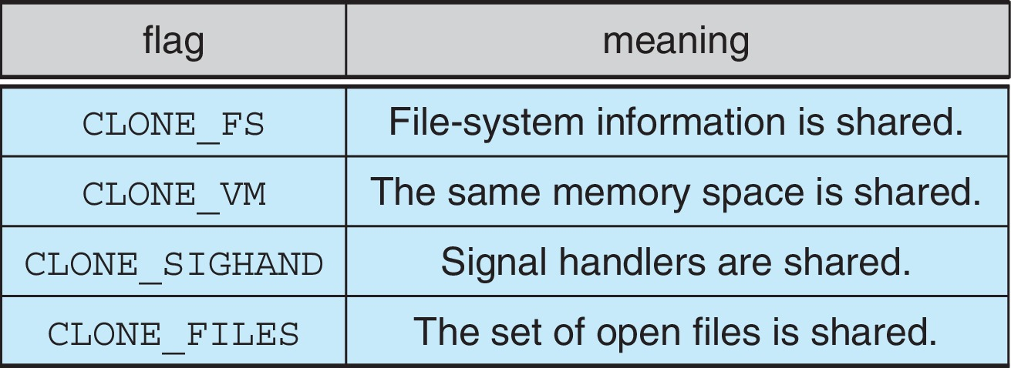
Linux Threads
Linux refers to them as tasks rather than threads
Thread creation is done through clone() system call
clone() allows a child task to share the address space of the parent task (process)
  Flags control behavior
struct task_struct points to process data structures (shared or unique)

Slide 53
End of Chapter 4

