Slide 1
Chapter 5: CPU Scheduling

Slide 2
Chapter 5: CPU Scheduling
Basic Concepts
Scheduling Criteria
Scheduling Algorithms
Thread Scheduling
Multi-Processor Scheduling
Real-Time CPU Scheduling
Operating Systems Examples
Algorithm Evaluation

Slide 3
Objectives
Understand difference between different types of scheduling
Describe various CPU scheduling algorithms
Assess CPU scheduling algorithms based on scheduling criteria
Explain the issues related to multiprocessor and multicore scheduling
Describe various real-time scheduling algorithms
Describe the scheduling algorithms used in the Linux operating system

Slide 4
Medium Term Scheduling
The medium term scheduler controls the degree of multi-programming.
It admits processes into memory to compete for the CPU
Also called a swapper when it is used to control the process mix by removing and restoring processes
Goal of medium term scheduler is to keep a good mix of processes in memory so that the CPU is always kept busy.

Slide 5
Basic Problem
Objective of multi-programming is to have some process running at all times, to maximize CPU utilization.
Need to keep many programs in memory
Process executes on CPU until it executes some instruction for which it has to wait (e.g. I/O)
Process is removed from CPU and another must be chosen to run
This is purpose of CPU scheduler: which process should run?

Slide 6
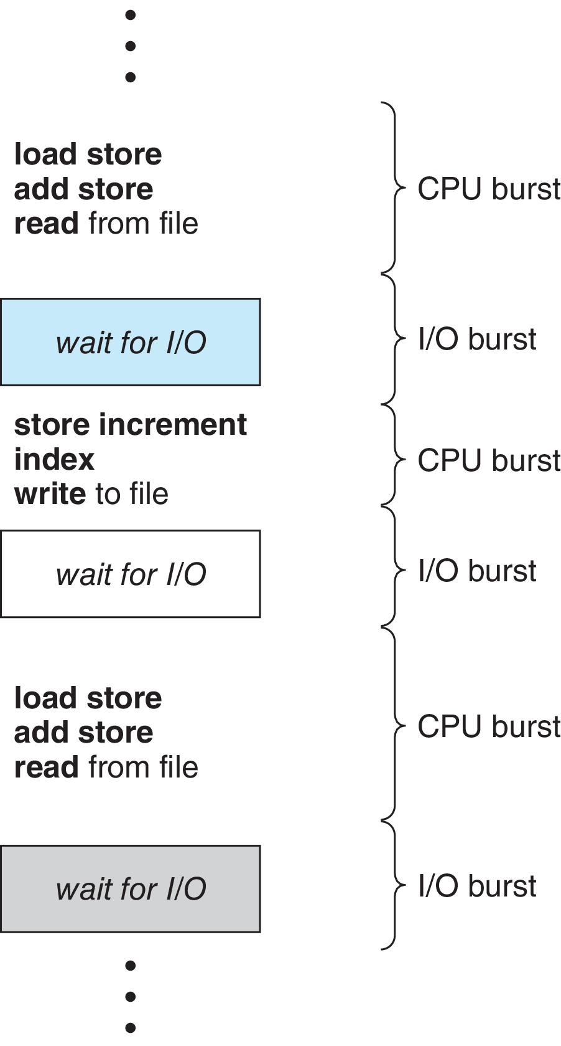
Core Concept
Every process has the same cycle of execution, called the CPU–I/O Burst Cycle
  Process executes on CPU until it issues I/O, then waits for I/O to complete
  The time on CPU is called a CPU burst
  When it issues I/O request it is called an I/O burst
It repeats this cycle over and over until it terminates.
Lengths of CPU bursts affect decisions about scheduling.

Slide 7
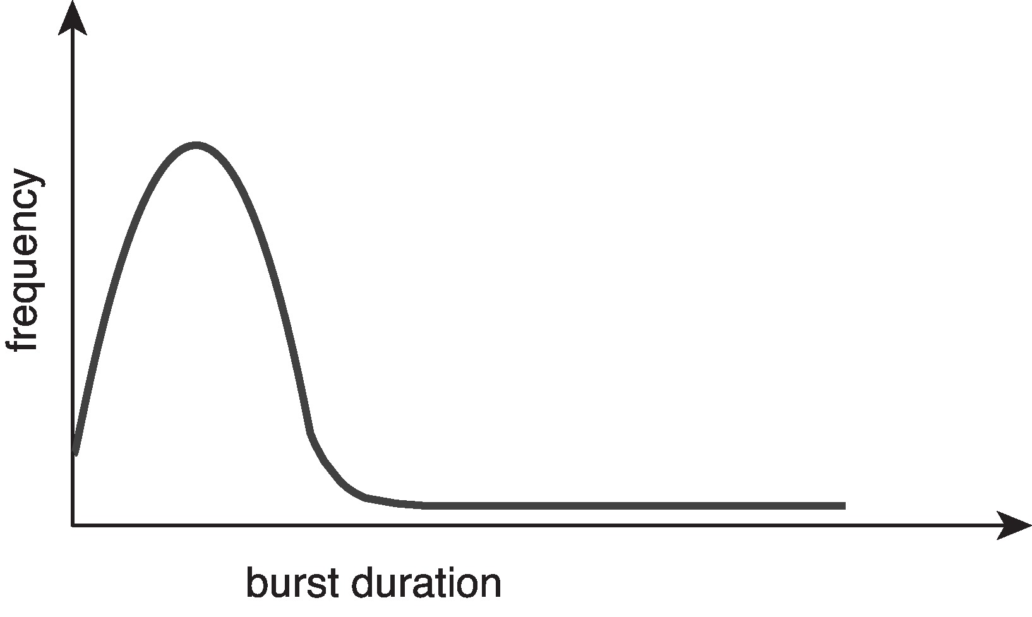
Distribution of CPU Burst Times
The duration of CPU bursts has been measured extensively.
  Many burst times are short; few are long
  Distribution is generally exponential or hyperexponential,
  An I/O-bound program has many short CPU bursts.
  A CPU-bound program has a few long CPU bursts.

Slide 8
CPU Scheduler
When the running process is removed from CPU, the OS must choose a process to run. This is the role of the CPU scheduler.
One or more queues of ready-to-run processes are kept in memory. These are called ready queues.
The CPU scheduler selects from among the processes in ready queue, and allocates the a CPU core to one of them
  Queue may be ordered in various ways – FIFO, priority queue, unordered, etc
  Usually process control blocks or pointers to PCBs are kept in queues.

Slide 9
Scheduling Decisions
CPU scheduling decisions may take place when a process:
  1. Switches from running to waiting state (e.g. by issuing an I/O request)
  2. Switches from running to ready state (e.g., an interrupt occurs)
  3. Switches from waiting to ready (e.g., I/O completes)
  Terminates
Condition 3 is called a signal or release event.
If scheduling only occurs under conditions 1 and 4 it is called nonpreemptive scheduling
If it occurs under any of the conditions it is called preemptive scheduling

Slide 10
Preemption
Without preemption, process runs until it terminates or issues some request that causes it to wait such as I/O or other system call.
Results in poor response time for other processes.
Preemptive scheduling is the norm for modern operating systems.
But preemptive scheduling causes other problems:
  Consider two processes that access shared data
  Consider preemption while in kernel mode – kernel data structures can become corrupted if kernel is not designed carefully
  Consider interrupts occurring during crucial OS activities

Slide 11
Non-Preemptive Kernel
During the processing of a system call, the kernel may be busy with an activity on behalf of a process.
This can involve changing a kernel data structure.
If it is interrupted or preempted, the data structure can become corrupted.
A non-preemptive kernel waits for a system call to complete or for a process to block while waiting for I/O to complete to take place before doing a context switch.
Makes the kernel structure simple, since the kernel will not preempt a process while the kernel data structures are in an inconsistent state.
But very inefficient and does not work for real-time operating systems.

Slide 12
Preemptive Kernels
Kernel is allowed to be interrupted almost any time because they might be important and cannot be ignored by the kernel.
The kernel needs to handle these interrupts otherwise, input might be lost or output overwritten.
Solution: disable interrupts at entry and re-enable interrupts at exit of sections of code that handle them.
Code sections must be very short.

Slide 13
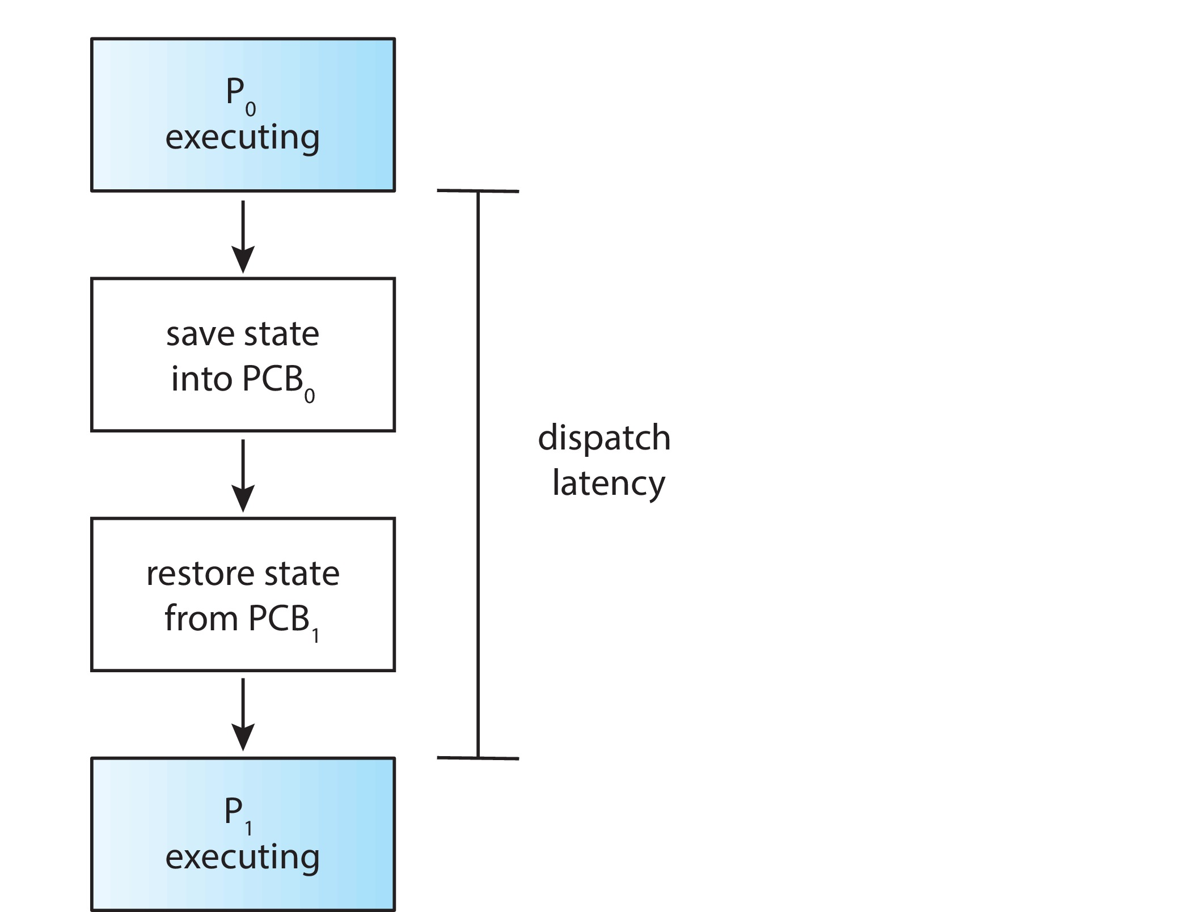
Dispatcher
Dispatcher is the component of the kernel that gives control of the CPU to the process selected by the short-term scheduler
This involves:
  switching context
  switching to user mode
  jumping to the proper location in the user program to restart that program (loading its PC)
Dispatch latency – time it takes for the dispatcher to stop one process and start another running
Need dispatcher to be very fast to minimize latency.

Slide 14
CPU Scheduling Criteria
CPU utilization – keep the CPU as busy as possible
Throughput – # of processes that complete their execution per time unit
Turnaround time – amount of time to execute a particular process, including wait time
Waiting time – amount of time a process has been waiting in the ready queue
Response time – amount of time it takes from when a request was submitted until the first response is produced, not output (for time-sharing environment)

Slide 15
Scheduling Algorithm Objectives
Maximize CPU utilization
Maximize throughput
Minimize turnaround time
Minimize waiting time
Minimize response time
Cannot accomplish all, so it is an optimization problem.

Slide 16
Nuances of Optimization
Do we optimize the maximum, minimum, or average measure of the property. For example,
  do we optimize design so that maximum response time is minimal or average response time is minimal?
  do we minimize maximum waiting time or average waiting time?
In time-sharing systems, reliability is important, so minimizing variance in response time is often the objective rather than mean response time.
For simple analysis, to assess scheduling algorithms, we can model processes by the lengths of CPU bursts and their average wait times.

Slide 17
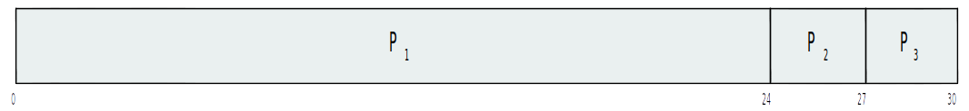
Scheduling Algorithms
We look at a few common scheduling algorithms.
Each is classified as preemptive or non-preemptive.
An algorithm that is non-preemptive is only used for non-preemptive scheduling; a preemptive algorithm is used for preemptive scheduling.
We will use Gantt charts to analyze the algorithms.
A Gantt chart is a horizontal bar chart in which the x-axis is time. A Gantt chart represents the order in which processes are scheduled and how much time each spends in the CPU.
Example:
  The chart below represents 3 processes, P1, P2, P3, scheduled at times 0, 26, and 27 respectively. P1 ran 26 units, P2, 1 unit, P3, 3 units.

Slide 18
First-Come-First-Served Scheduling
The first is first-come-first-served (FCFS) which is a non-preemptive algorithm.
In first-come-first-served scheduling, processes arrive and are placed at the rear of a FIFO queue.
The process at the front of the queue is scheduled next.
If a process issues a wait, it is placed at the rear of the queue again.

Slide 19
FCFS Example
Process Burst Time
P₁ 24
P₂ 3
P₃ 3
Suppose that the processes arrive in the order: P₁ , P₂ , P₃
The Gantt Chart for the schedule is:
Waiting time for P₁ = 0; P₂ = 24; P₃ = 27
Average waiting time: (0 + 24 + 27)/3 = 17

Slide 20
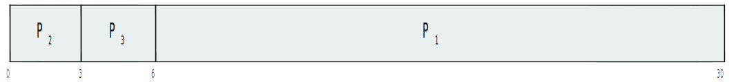
FCFS Example (Cont.)
Suppose that the processes arrive in the order:
P₂ , P₃ , P₁
The Gantt chart for the schedule is:
Waiting time for P₁ = 6; P₂ = 0; P₃ = 3
Average waiting time: (6 + 0 + 3)/3 = 3
Much better than previous case
Performance is affected by order of arrivals

Slide 21
Convoy Effect
Convoy effect - short process behind long process
  Consider one CPU-bound and many I/O-bound processes
  CPU bound process runs, takes long time and short I/O bound processes wait.
  They all run quickly, issue I/O requests and wait again for long CPU bound process. Their I/O is satisfied and they all move to ready queue, but they have to wait and wait and wait...
I/O devices are poorly utilized and response times are poor.

Slide 22
Shortest-Job-First (SJF) Scheduling
Associate with each process the length of its next CPU burst
  Use these lengths to schedule the process with the shortest time
SJF is optimal – gives minimum average waiting time for a given set of processes
  The difficulty is knowing the length of the next CPU request
  Could ask the user

Slide 23
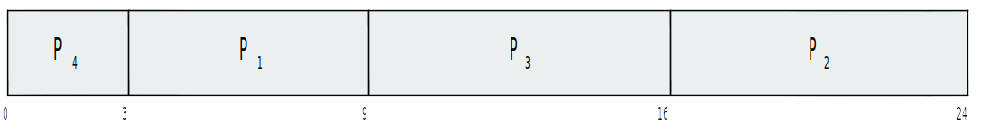
Example of SJF
Assume all processes arrive at time 0 and that CPU burst times are known and as shown below.
ProcessArriva l Time Burst Time
P₁ 0.0 6
P₂ 2.0 8
P₃ 4.0 7
P₄ 5.0 3
SJF scheduling chart
Average waiting time = (3 + 16 + 9 + 0) / 4 = 7

Slide 24
Predicting Length of Next CPU Burst
Can only estimate the length of next burst – should be similar to the previous one, or the the most recent ones.
  Then pick process with shortest predicted next CPU burst
Can be done by using the length of previous CPU bursts, using exponential averaging:
Initally, first guess τ0 is any value.
When α=0, guess never changes. When α = 1, guess is always last burst length. (upcoming slides illustrate ) Typically α is set to ½
Preemptive version called shortest-remaining-time-first

Slide 25
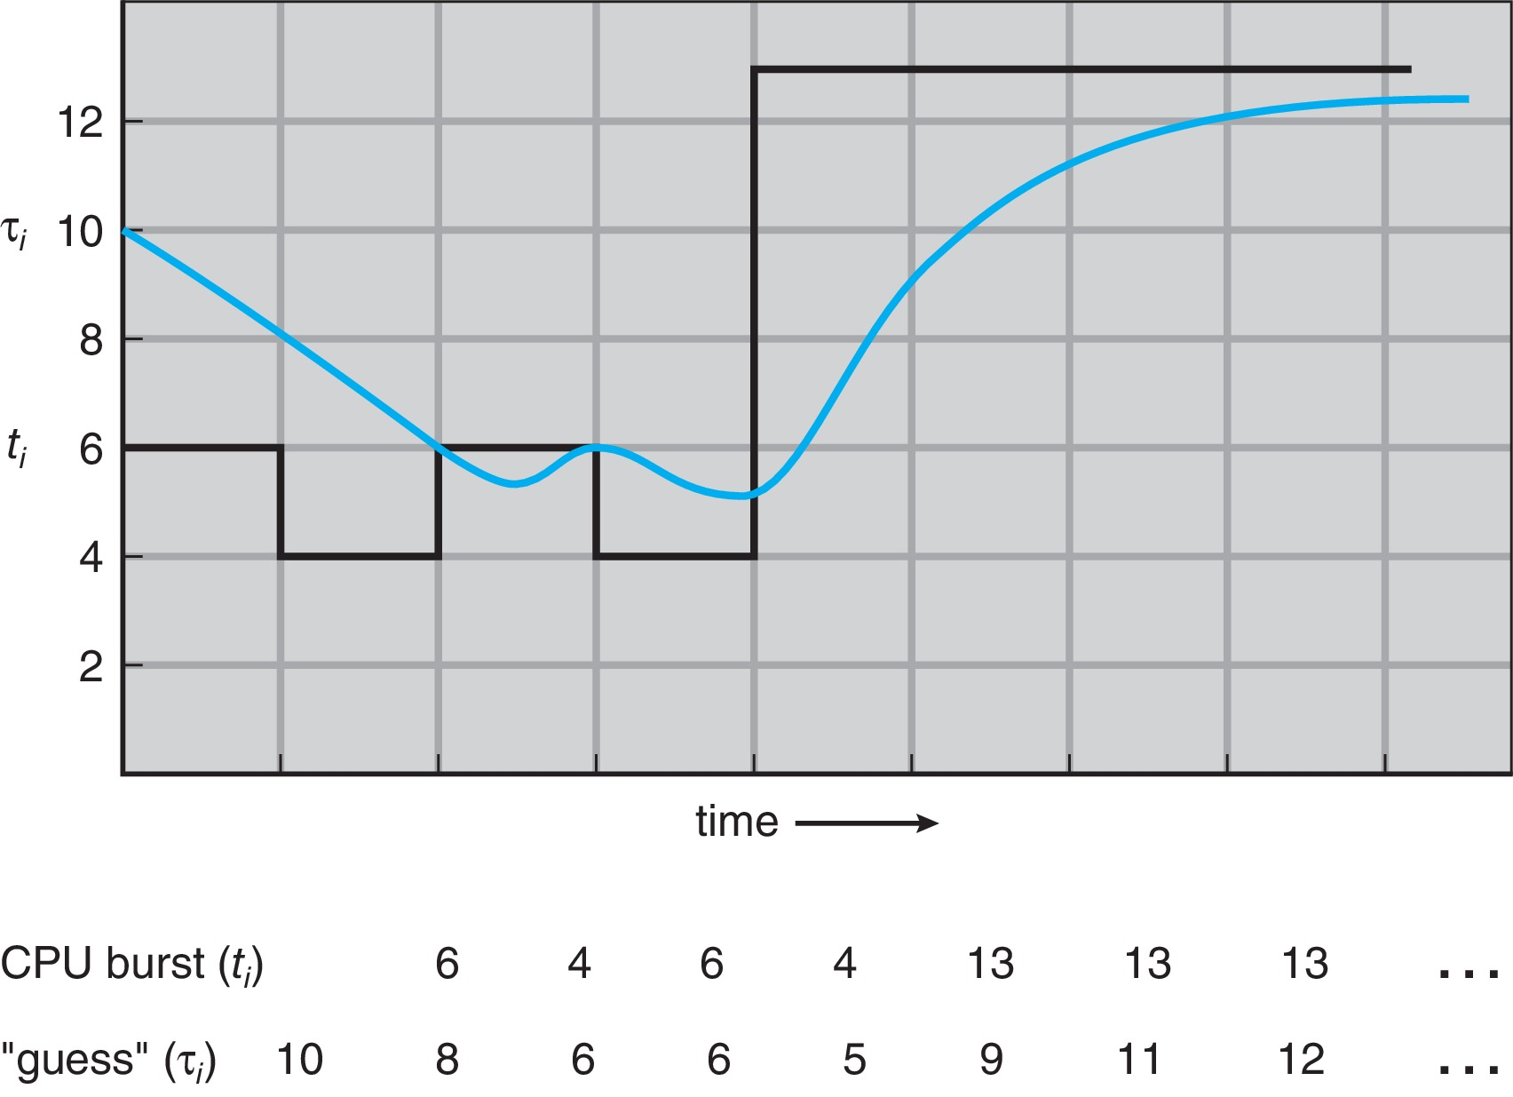
Prediction of the Length of the Next CPU Burst
(This graph is for α=0.5.)

Slide 26
Examples of Exponential Averaging
α =0
  τ_{n+1} = τ_{n}
  Recent history does not count
α =1
  τ_{n+1} = α t_{n}
  Only the actual last CPU burst counts
If we expand the formula, we get:
    τ_{n+1} = α t_{n}+(1 - α)α t_{n} ₋₁ + …
    +(1 - α )^{j} α t_{n} _{-j} + …
    +(1 - α )^{n +1} τ₀
Since both α and (1 - α) are less than or equal to 1, each successive term has less weight than its predecessor

Slide 27
Example of Shortest-Remaining-Time-First
When SJF is preemptive it is called Shortest Remaining Time First, so SRTF = Preemptive SJF
A process runs, gets preempted and is moved to back of ready queue. Its new predicted burst time is the previous one minus the time it just spent on the CPU.
This is why it is shortest remaining time first, because predicted burst is what is remaining.

Slide 28
Example of SRTF
Now we add the concepts of varying arrival times and preemption to the analysis
ProcessA Arrival TimeT Burst Time
P₁ 0 8
P₂ 1 4
P₃ 2 9
P₄ 3 5
To create a Gantt Chart, you need to simulate the scheduler.
Scheduler needs to run when a new process arrives, and it picks shortest burst time remaining process.

Slide 29
SRTF Worked Example
ProcessA Arrival TimeT Burst Time
P₁ 0 8
P₂ 1 4
P₃ 2 9
P₄ 3 5
Time 0: P1 runs for 1 msec. P2 arrives and has shorter time so it is scheduled. P1 has 7 msec remaining time now.
Time 1: P2 runs. P3 and P4 arrive at times 2 and 3, but both have longer times, so P2 stays on CPU until it finishes at time 5 (1+4)
Time 5: P4 has shortest remaining time (5 msec) so it gets CPU and runs to finish at time 10.
Time 10: P1 has shorter time than P3, so P1 runs and finishes at time 17, then P3 runs.

Slide 30
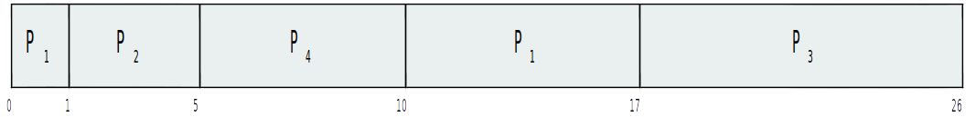
Example of Shortest-Remaining-Time-First
SRTF Gantt Chart for this set of processes:
What is the average waiting time?

Slide 31
Waiting Time for SRTF
Waiting time for each process is
  (time it finishes) – (burst length) – (arrival time)
ProcessA Arrival TimeT Burst Time End Time
P₁ 0 8 17
P₂ 1 4 5
P₃ 2 9 26
P₄ 3 5 10
Average waiting time =
  ((17-8-0) +(5-4-1) + (26-9-2) + (10-5-3))/4 =
  (9+0+15+2)/4 = 6.5

Slide 32
Round Robin (RR)
Each process gets a small unit of CPU time (time quantum q), usually 10-100 milliseconds. After this time has elapsed, the process is preempted and added to the end of the ready queue. This is a scheduled event.
If there are n processes in the ready queue and the time quantum is q, then each process gets 1/n of the CPU time in chunks of at most q time units at once. No process waits more than (n-1)q time units to run again.
Might be less if processes issue I/O requests.
Timer interrupts at end of quantum to schedule next process
Performance
  q large ⇒ FIFO
  q small ⇒ q must be large with respect to context switch, otherwise overhead is too high

Slide 33
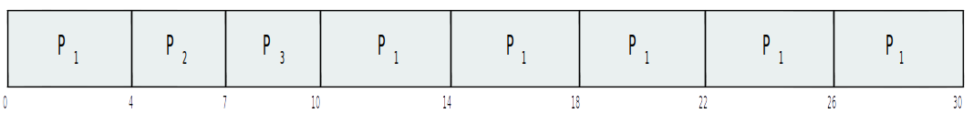
Example of RR with Time Quantum = 4
Process Burst Time
P₁ 24
P₂ 3
P₃ 3
The Gantt chart is:
Turnaround time average here = ( 30 + 10 + 7 )/3 = 15.7
If using SJF, turnaround would be (30 + 6 + 3)/3 = 13
Typically, higher average turnaround than SJF, but better response time
q should be large compared to context switch time; q usually 10ms to 100ms, context switch < 10 usec

Slide 34
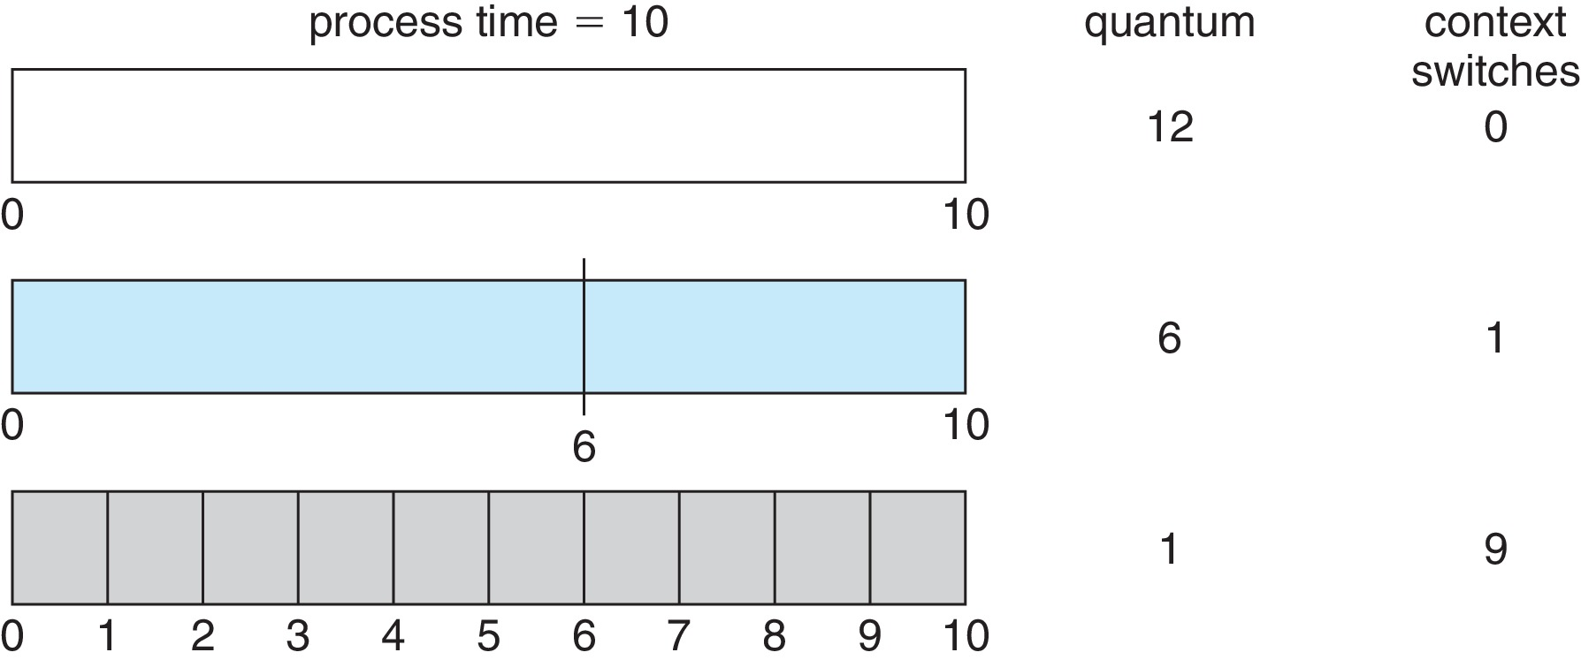
Time Quantum and Context Switch Time

Slide 35
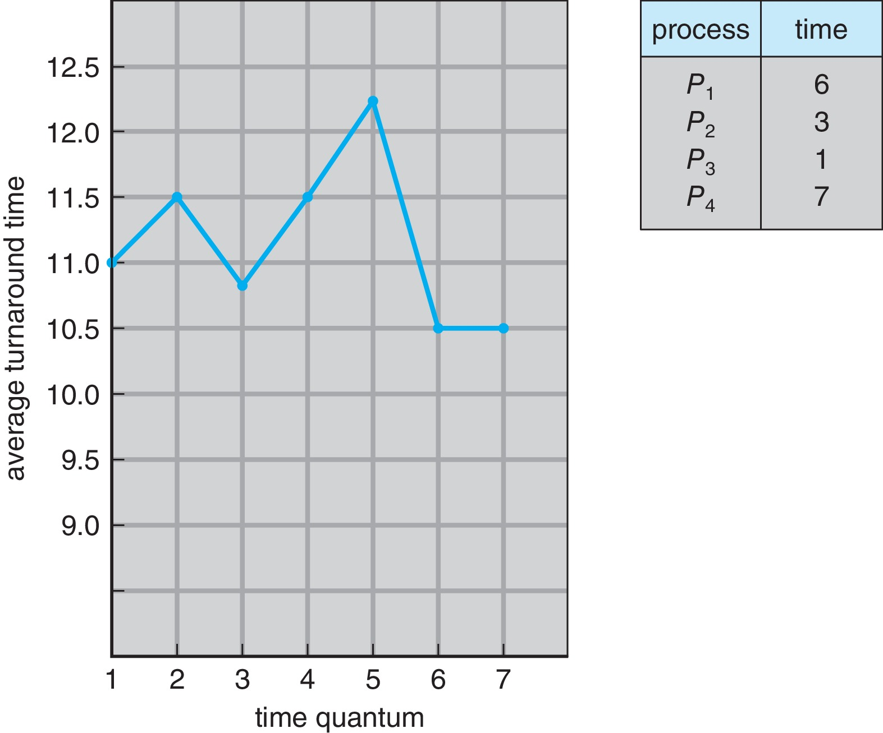
Turnaround Time Varies With The Time Quantum
Rule of thumb for choosing quantum size:
80% of CPU bursts should be shorter than q

Slide 36
Priority Scheduling
A priority number (integer) is associated with each process
The CPU is allocated to the process with the highest priority (smallest integer ≡ highest priority)
Can be either
  Preemptive - high priority arriving process preempts lower one
  Nonpreemptive
SJF is priority scheduling where priority is the inverse of predicted next CPU burst time
Problem ≡ Starvation – (also called indefinite blocking)
  low priority processes may never execute
Solution ≡ Aging – as time progresses increase the priority of the process

Slide 37
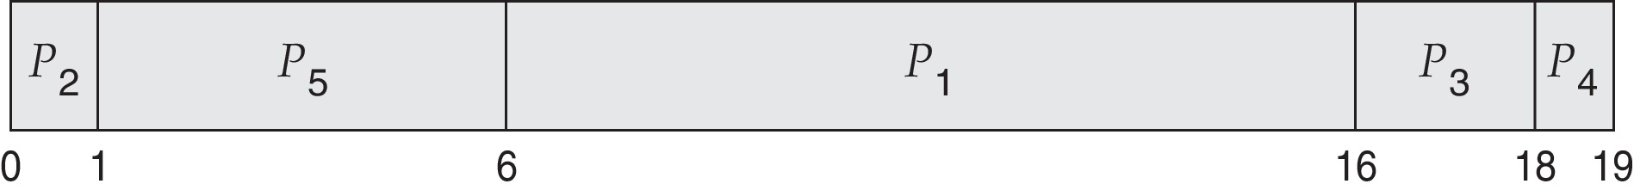
Example of Priority Scheduling
ProcessA arri Burst TimeT Priority
P₁ 10 3
P₂ 1 1
P₃ 2 4
P₄ 1 5
P₅ 5 2
Priority scheduling Gantt Chart
Average waiting time = 8.2 msec

Slide 38
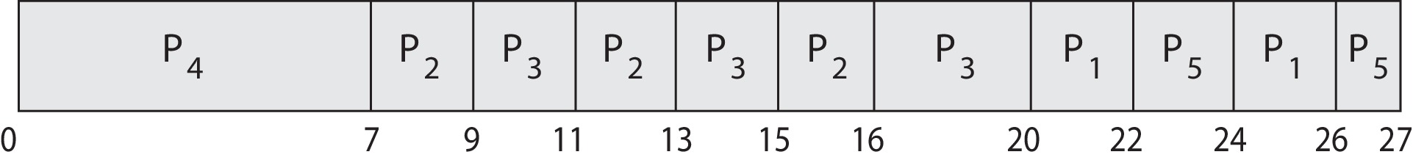
Priority Scheduling w/ Round-Robin
ProcessA arri Burst TimeT Priority
P₁ 4 3
P₂ 5 2
P₃ 8 2
P₄ 7 1
P₅ 3 3
Run the process with the highest priority. Processes with the same priority run round-robin
Gantt Chart with 2 ms time quantum

Slide 39
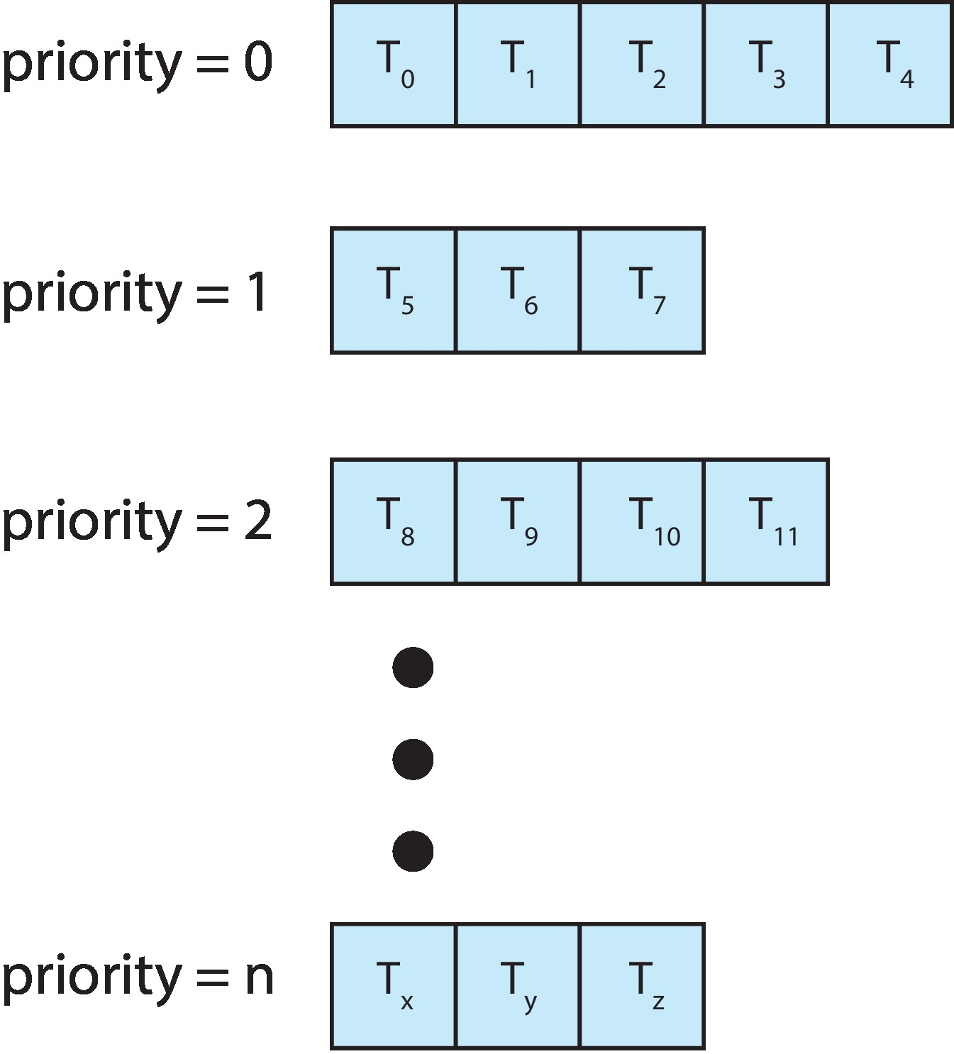
Multilevel Queue
With priority scheduling, have separate queues for each priority.
Schedule the process in the highest-priority queue!

Slide 40
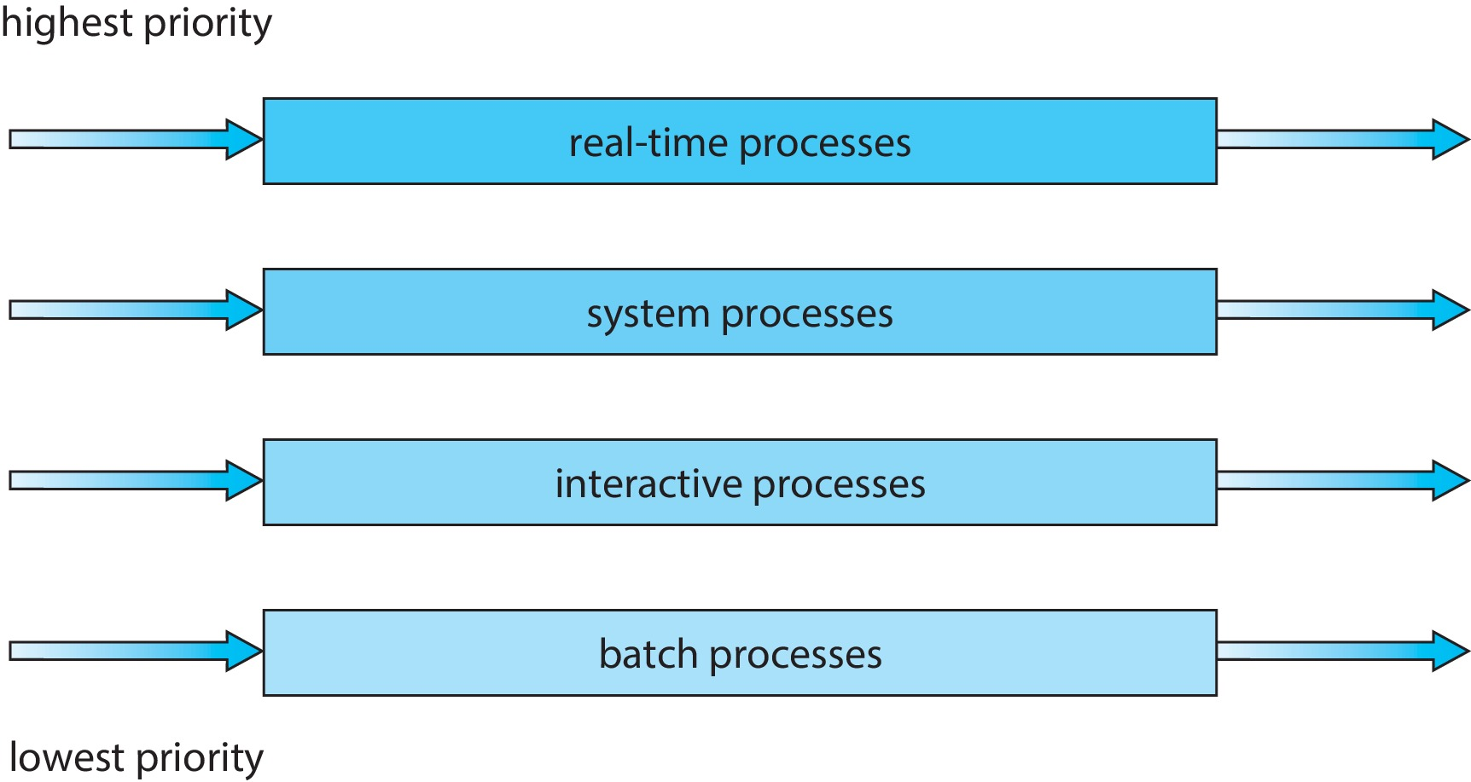
Multilevel Queues
Prioritization based upon process type

Slide 41
Multilevel Feedback Queue
A process can move between the various queues; aging can be implemented this way
Multilevel-feedback-queue scheduler defined by the following parameters:
  number of queues
  scheduling algorithms for each queue
  method used to determine when to upgrade a process
  method used to determine when to demote a process
  method used to determine which queue a process will enter when that process needs service

Slide 42
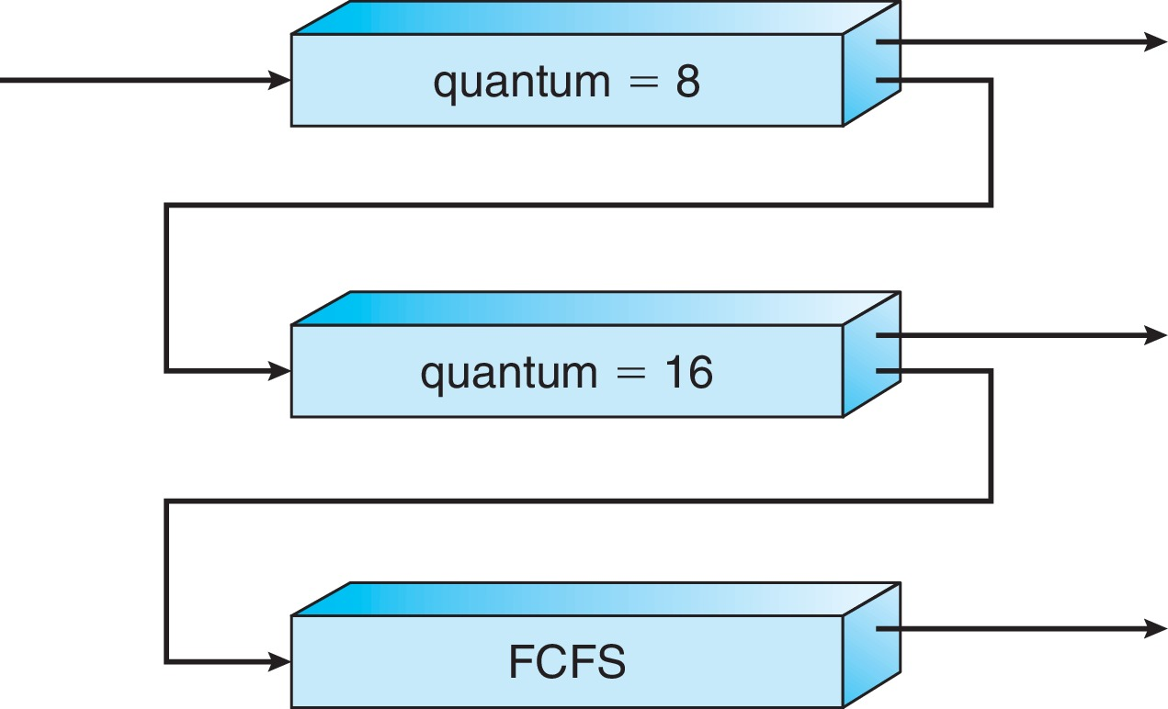
Example of Multilevel Feedback Queue
Three queues:
  Q₀ – RR with time quantum 8 milliseconds
  Q₁ – RR time quantum 16 milliseconds
  Q₂ – FCFS
Scheduling
  A new job enters queue Q₀ which is served RR with q= 8
    When it gains CPU, job receives 8 milliseconds
    If it does not finish in 8 milliseconds, job is moved to queue Q₁
  At Q₁ job is again served RR with q=16 and receives 16 additional milliseconds
    If it still does not complete, it is preempted and moved to queue Q₂

Slide 43
Thread Scheduling: Contention Scope
User-level and kernel-level threads are scheduled differently.
When threads are supported by the kernel, threads are scheduled, not processes.
Remember – user threads are mapped to kernel threads.
Question – do all threads of all processes compete for CPUs equally, or do the threads of each process compete against each other for the CPU, with each process being given a share of CPU time?
  This is the question of thread contention scope – which threads does a thread contend with (i.e., compete against) for the CPU?
  Two types: process-contention and system-contention scopes.

Slide 44
Process Contention Scope
With the many-to-one and many-to-many models, the thread library schedules user-level threads to run on LWPs.
  Implies that all threads in a single process get scheduled onto fixed set of LWPs, which in turn get scheduled onto CPUs.
  So threads within a process compete for LWPs.
  Known as process-contention scope (PCS) since scheduling competition is within the process.
  Typically done via priority set by programmer

Slide 45
System Contention Scope
Kernel threads are scheduled onto available CPUs, so all kernel threads compete with each other across the entire system.
This is called system-contention scope (SCS) – competition among all threads in the system.
The one-to-one thread model (used by Windows and Linux) uses SCS only.

Slide 46
Pthread Scheduling
The Pthread API allows specifying either PCS or SCS during thread creation
  PTHREAD_SCOPE_PROCESS schedules threads using PCS scheduling
  PTHREAD_SCOPE_SYSTEM schedules threads using SCS scheduling
Although the API allows the choice, can be overridden by OS – Linux and macOS only allow PTHREAD_SCOPE_SYSTEM

Slide 47
Pthread Scheduling API Example
#include <pthread.h>
#include <stdio.h>
#define NUM_THREADS 5
int main(int argc, char *argv[]) {
int i, scope;
pthread_t tid[NUM THREADS];
pthread_attr_t attr;
pthread_attr_init(&attr); /* apply default attributes */
/* inquire about the current scope */
if (pthread_attr_getscope(&attr, &scope) != 0)
fprintf(stderr, "Unable to get scheduling scope\n");
else {
if (scope == PTHREAD_SCOPE_PROCESS)
printf("thread has PTHREAD_SCOPE_PROCESS");
else if (scope == PTHREAD_SCOPE_SYSTEM)
printf("thread has PTHREAD_SCOPE_SYSTEM");
else
fprintf(stderr, "Illegal scope value.\n");
}

Slide 48
Pthread Scheduling API
/* set the scheduling algorithm to PCS */
pthread_attr_setscope(&attr, PTHREAD_SCOPE_SYSTEM);
/* create the threads */
for (i = 0; i < NUM_THREADS; i++)
pthread_create(&tid[i],&attr,runner,NULL);
/* now join on each thread */
for (i = 0; i < NUM_THREADS; i++)
pthread_join(tid[i], NULL);
}
/* Each thread will begin control in this function */
void *runner(void *param)
{
/* do some work ... */
pthread_exit(0);
}

Slide 49
Multiple-Processor Scheduling
CPU scheduling more complex when multiple CPUs are available
A multiprocessor may be any one of the following architectures:
  Multi-core processor
  Multi-threaded cores
  A multi-core processor with multi-threaded cores
  NUMA systems
  Heterogeneous multiprocessing

Slide 50
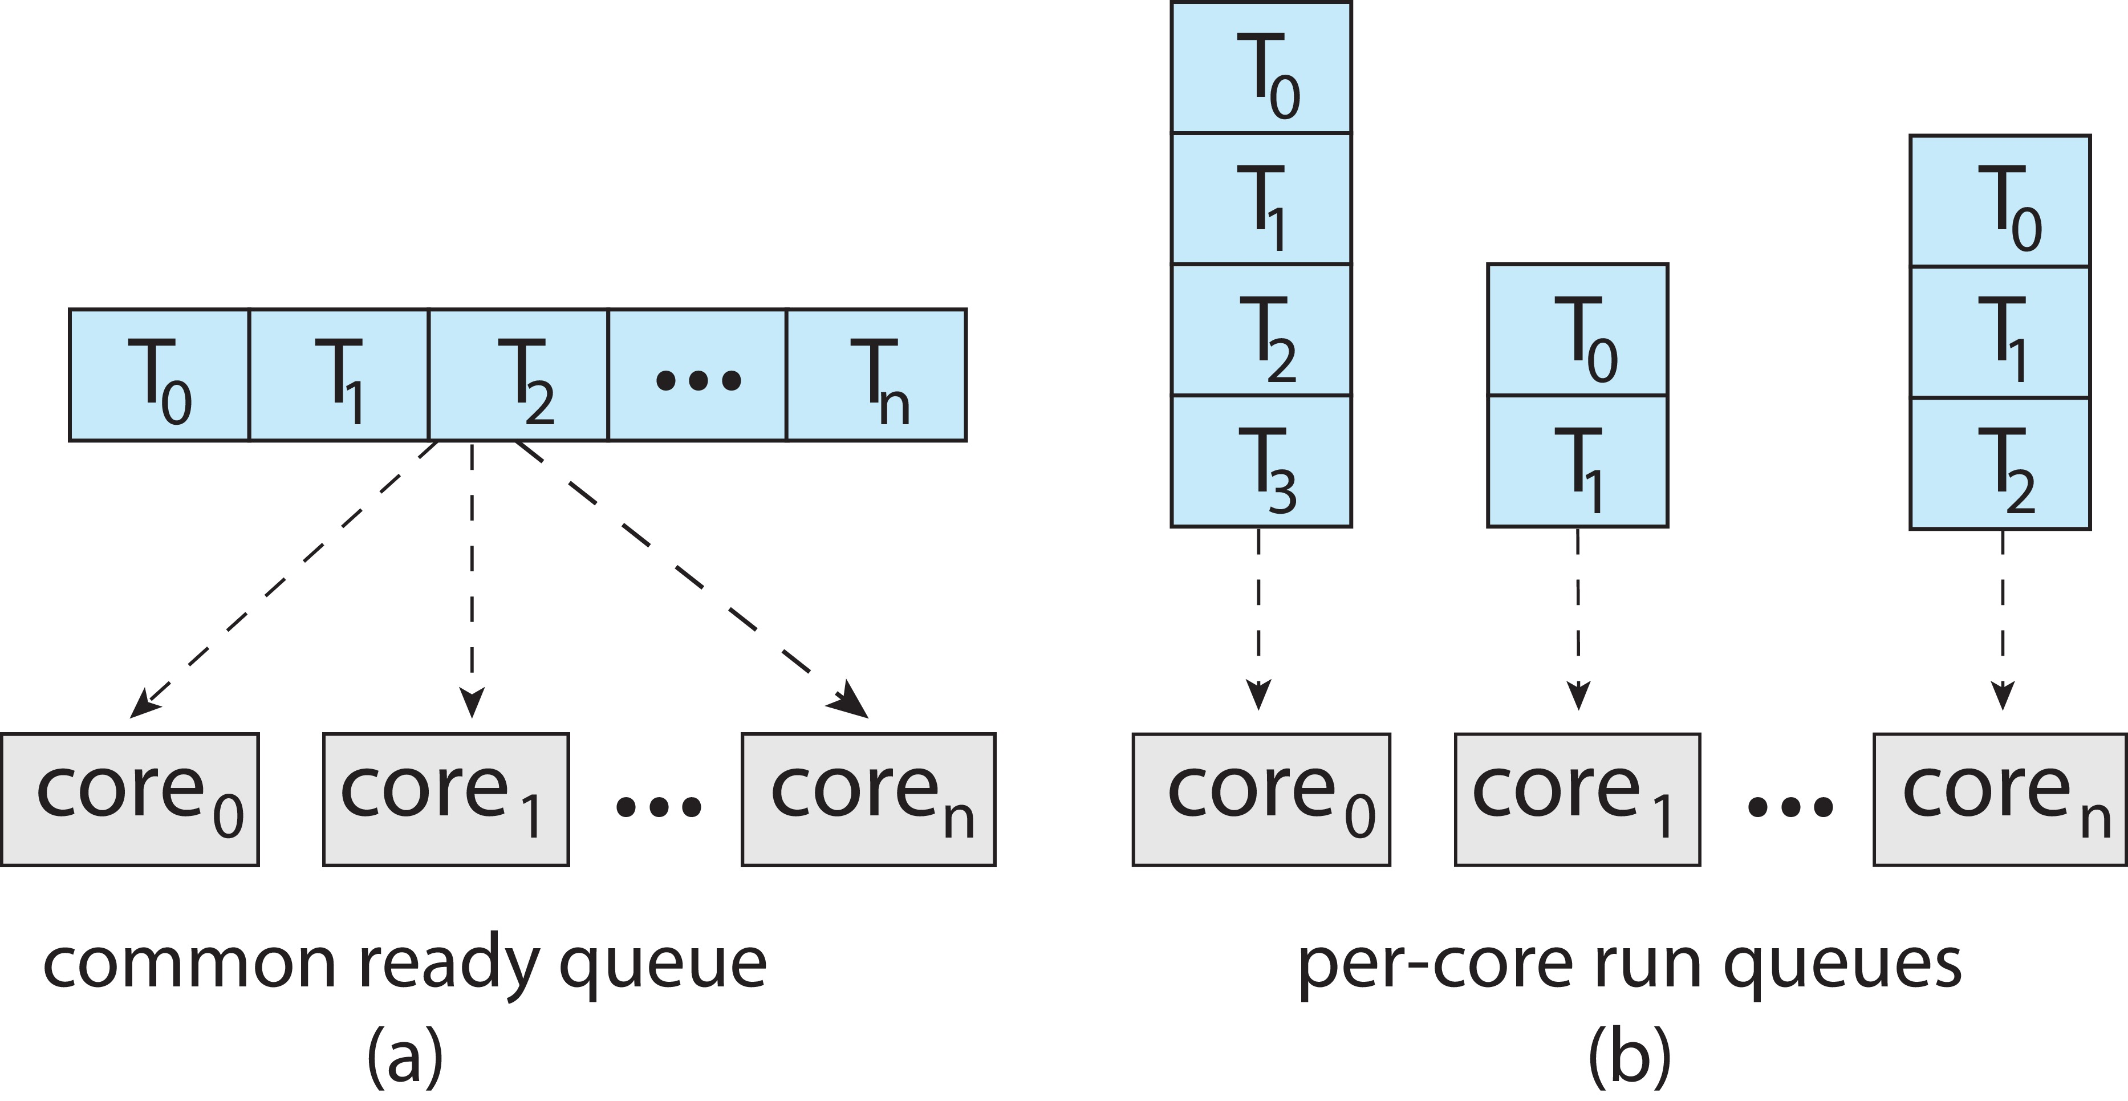
Multiple-Processor Scheduling (2)
Symmetric multiprocessing (SMP) is where each processor is self scheduling. Two scheduling models:
  All threads may be in a shared ready queue (a)
  Each processor may have its own private queue of threads (b)
  Shared queue has race condition and needs synchronization/locking

Slide 51
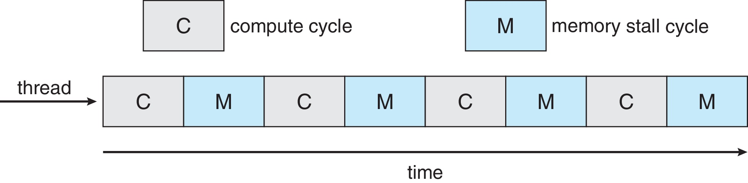
Multi-core Processors
Multiple processor cores on same physical chip
Faster and consumes less power
Multiple threads per core also growing
  Sometimes called hyperthreading
  Takes advantage of memory stall to make progress on another thread while memory retrieve happens

Slide 52
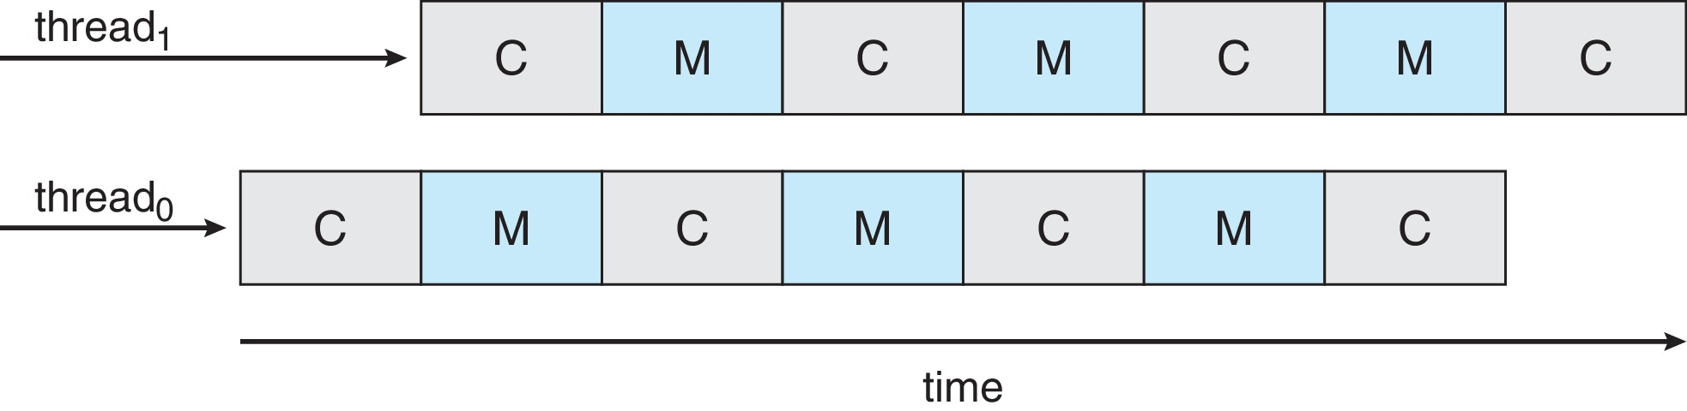
Multi-threaded Multi-core System
Each core has > 1 hardware threads.
If one thread has a memory stall, switch to another thread!

Slide 53
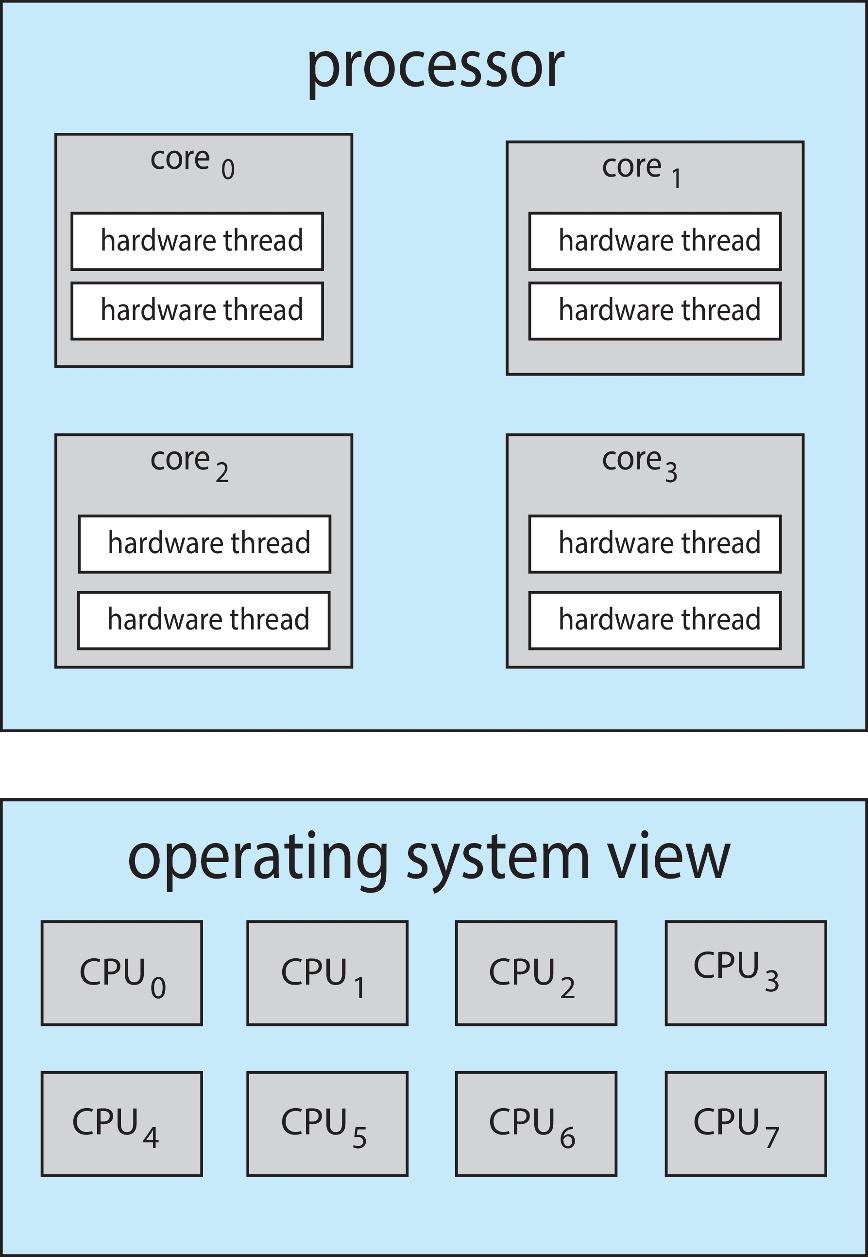
Multi-threaded Multi-core System
Chip-multithreading (CMT) assigns each core multiple hardware threads. (Intel refers to this as hyperthreading.)
On a quad-core system with 2 hardware threads per core, the operating system sees 8 logical processors.

Slide 54
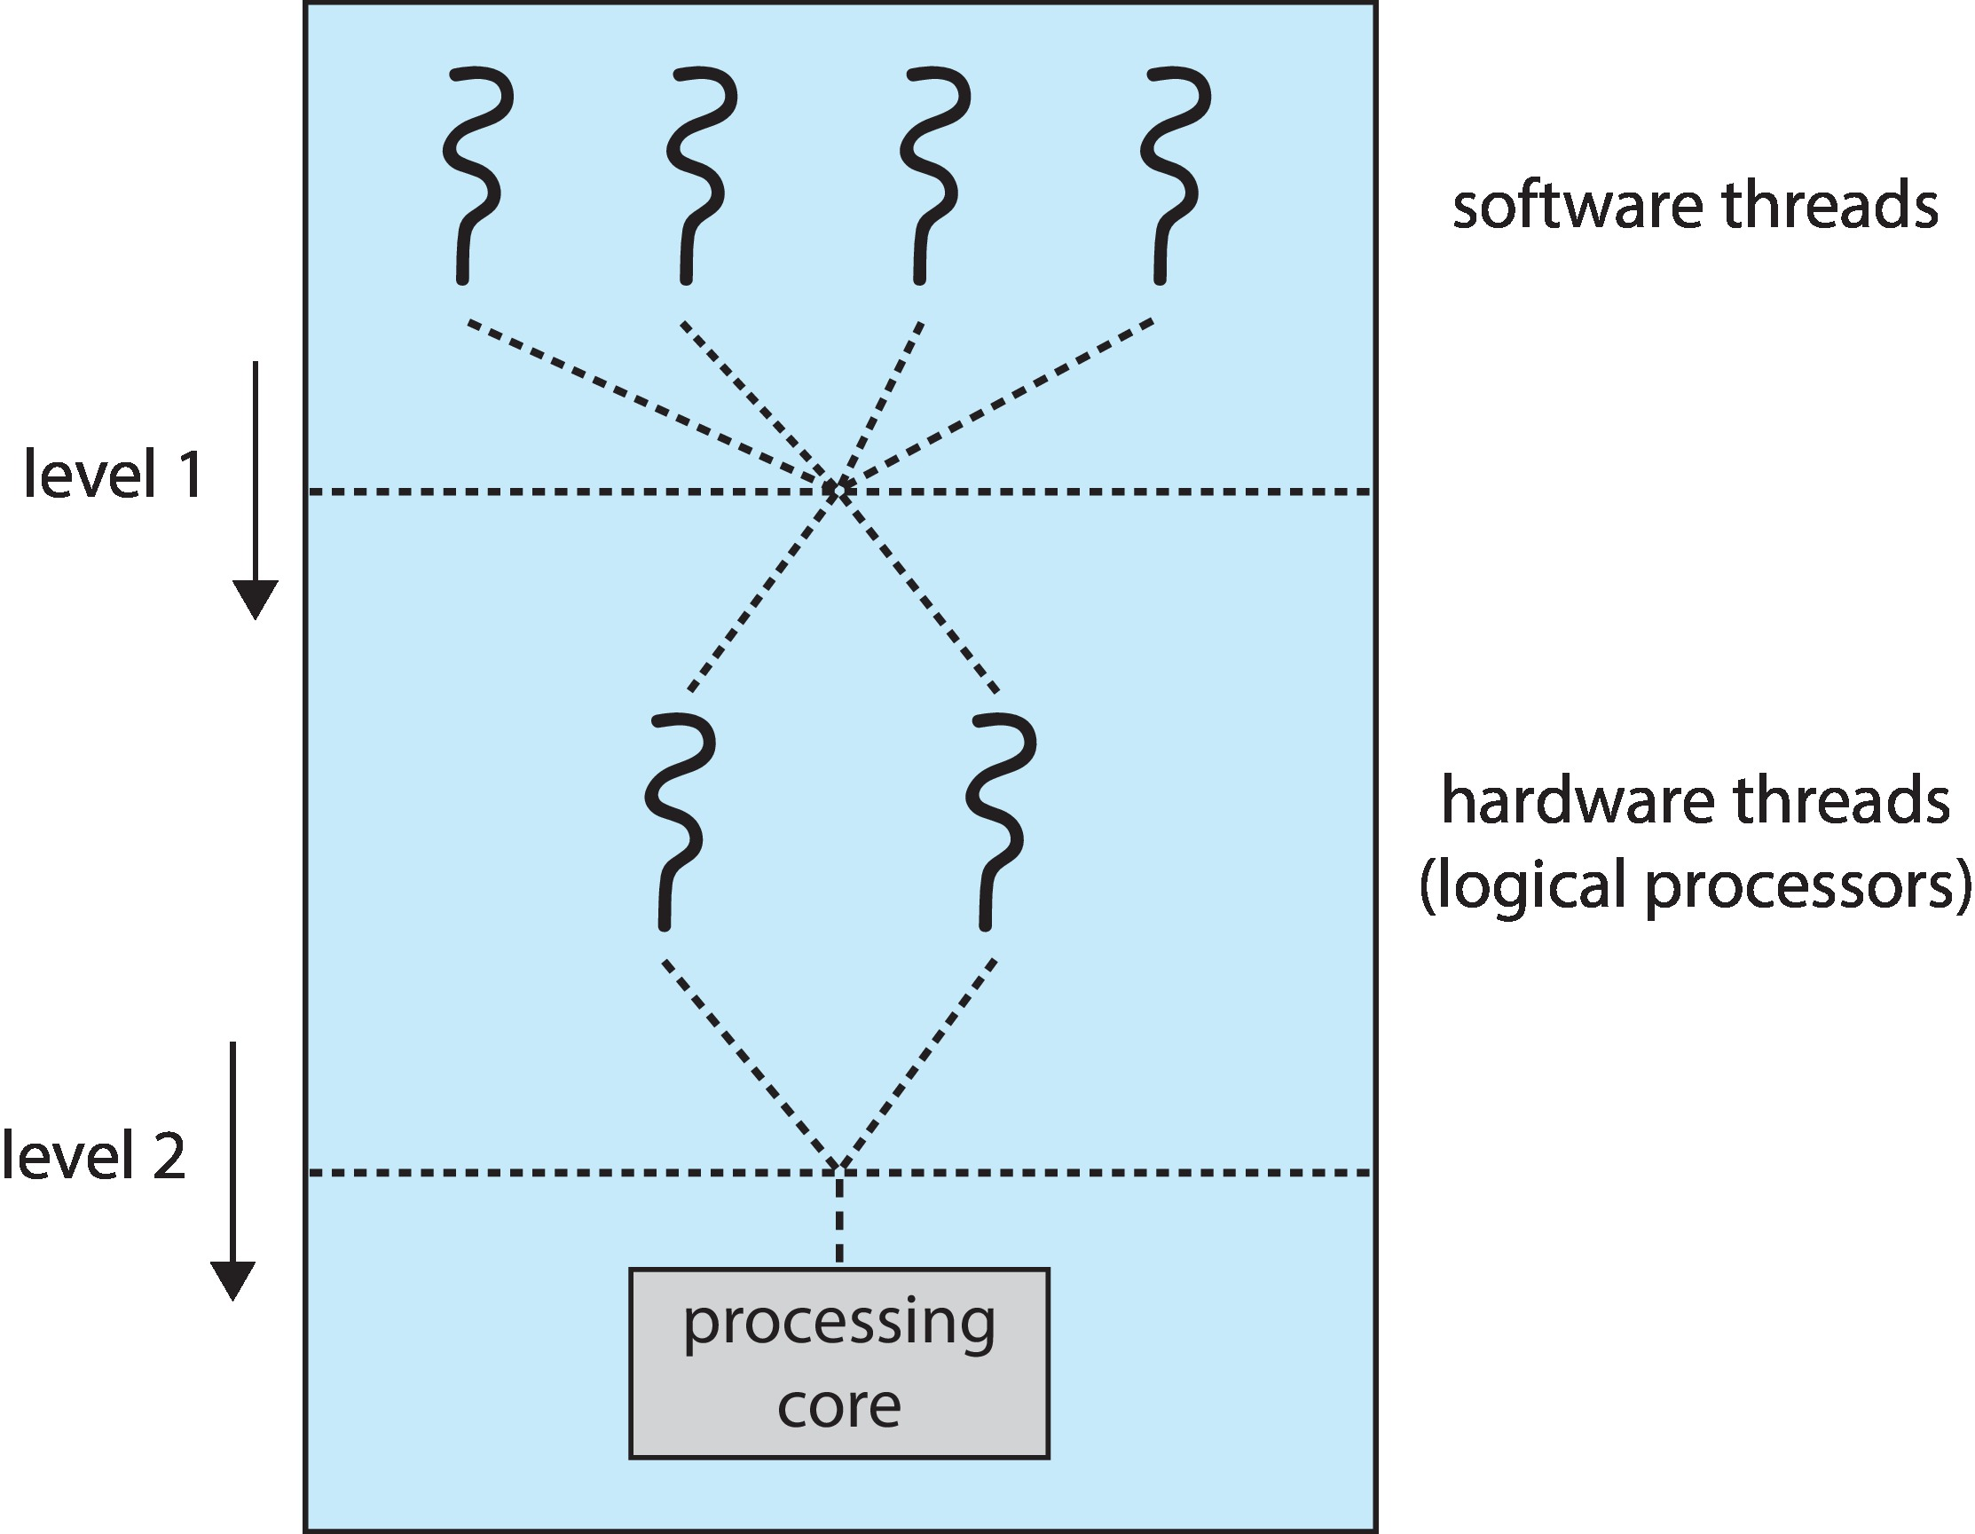
Multi-threaded Multi-core System
Two levels of scheduling:
The operating system deciding which software thread to run on a logical CPU
How each core decides which hardware thread to run on the physical core.

Slide 55
Multiple-Processor Scheduling – Load Balancing
If SMP, need to keep all CPUs loaded for efficiency
Load balancing attempts to keep workload evenly distributed
Two paradigms:
  Push migration – periodic task checks load on each processor, and if found pushes task from overloaded CPU to other CPUs
  Pull migration – idle processors pull waiting task from busy processor
  Both can be used in combination (Linux CFS does)

Slide 56
Multiple-Processor Scheduling – Processor Affinity
When a thread has been running on one processor, the cache contents of that processor stores the memory accesses by that thread.
We refer to this as a thread having affinity for a processor (i.e. “processor affinity”)
Load balancing may affect processor affinity as a thread may be moved from one processor to another to balance loads, yet that thread loses the contents of what it had in the cache of the processor it was moved off of.
Soft affinity – the operating system attempts to keep a thread running on the same processor, but no guarantees.
Hard affinity – allows a thread to specify a set of processors it may run on.

Slide 57
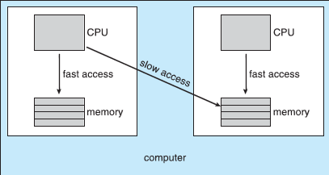
NUMA and CPU Scheduling
If the operating system is NUMA-aware, it will assign
memory closes to the CPU the thread is running on.

Slide 58
Real-Time CPU Scheduling
Can present obvious challenges
Soft real-time systems – Critical real-time tasks have the highest priority, but no guarantee as to when tasks will be scheduled
Hard real-time systems – task must be serviced by its deadline
We will not cover real-time scheduling in this class

Slide 59
Linux Scheduling Through Version 2.5
Prior to kernel version 2.5, ran variation of standard UNIX scheduling algorithm
Version 2.5 moved to constant order O(1) scheduling time
  Preemptive, priority based
  Two priority ranges: time-sharing and real-time
  Real-time range from 0 to 99 and nice value from 100 to 140
  Map into global priority with numerically lower values indicating higher priority
  Higher priority gets larger q
  Task run-able as long as time left in time slice (active)
  If no time left (expired), not run-able until all other tasks use their slices
  All run-able tasks tracked in per-CPU runqueue data structure
    Two priority arrays (active, expired)
    Tasks indexed by priority
    When no more active, arrays are exchanged
  Worked well, but poor response times for interactive processes

Slide 60
Linux Scheduling in Version 2.6.23 +
Completely Fair Scheduler (CFS)
Scheduling classes
  Each has specific priority
  Scheduler picks highest priority task in highest scheduling class
  Rather than quantum based on fixed time allotments, based on proportion of CPU time
  2 scheduling classes included, others can be added
    default
    real-time
Quantum calculated based on nice value from -20 to +19
  Lower value is higher priority
  Calculates target latency – interval of time during which task should run at least once
  Target latency can increase if say number of active tasks increases
CFS scheduler maintains per task virtual run time in variable vruntime
  Associated with decay factor based on priority of task – lower priority is higher decay rate
  Normal default priority yields virtual run time = actual run time
To decide next task to run, scheduler picks task with lowest virtual run time

Slide 61
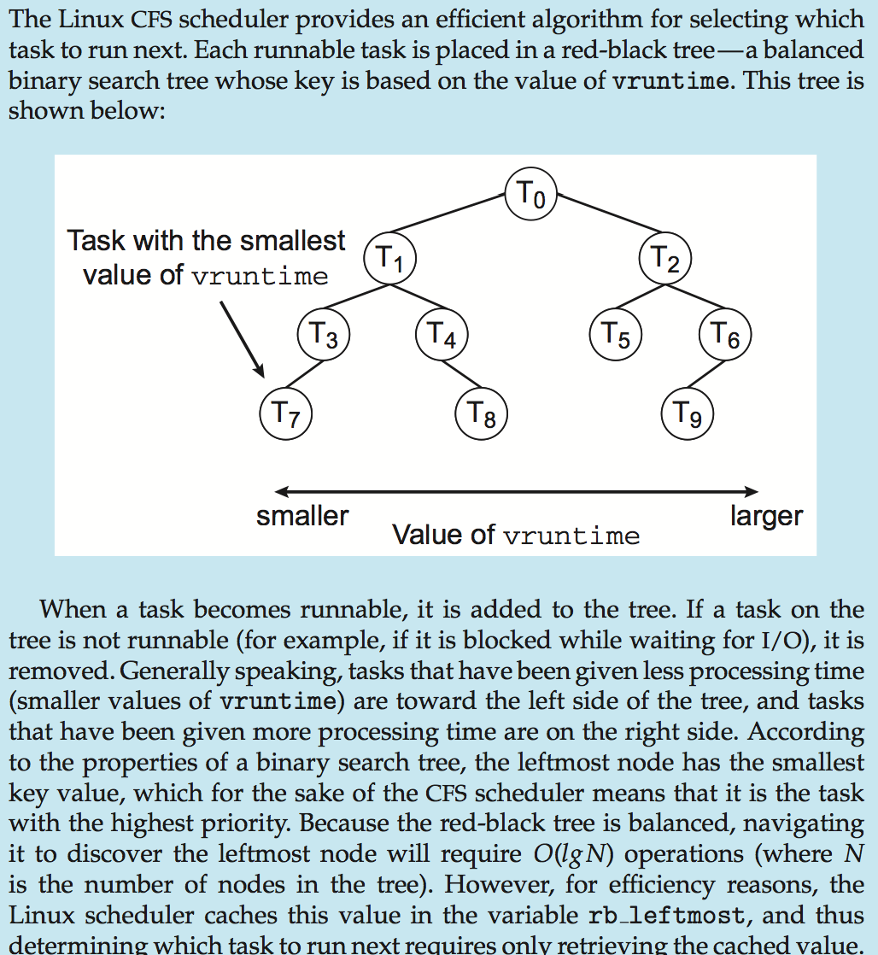
CFS Performance

Slide 62
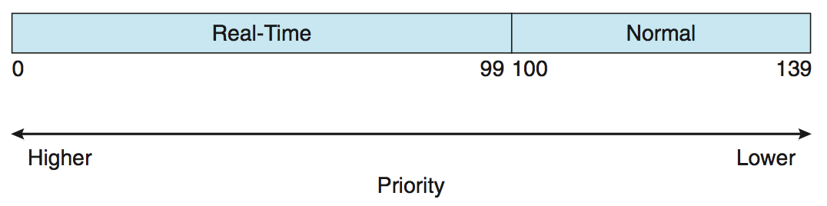
Linux Scheduling (Cont.)
Real-time scheduling according to POSIX.1b
  Real-time tasks have static priorities
Real-time plus normal map into global priority scheme
Nice value of -20 maps to global priority 100
Nice value of +19 maps to priority 139

Slide 63
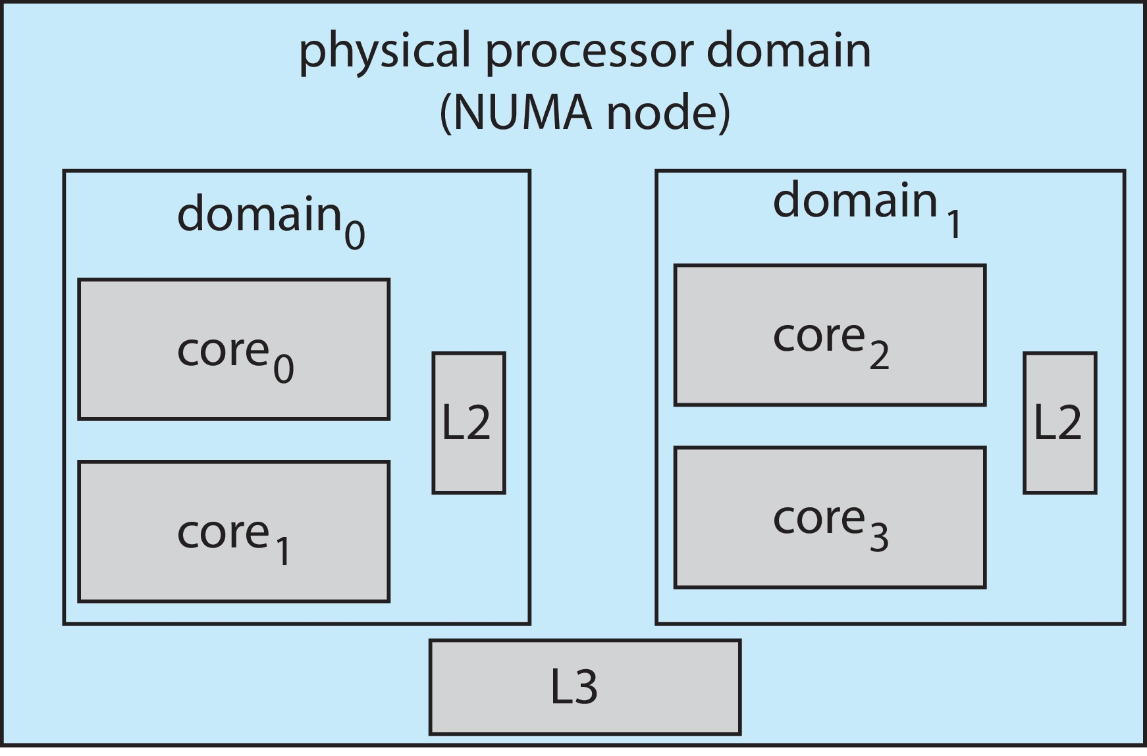
Linux Scheduling (Cont.)
Linux supports load balancing, but is also NUMA-aware.
Scheduling domain is a set of CPU cores that can be balanced against one another.
Domains are organized by what they share (i.e. cache memory.) Goal is to keep threads from migrating between domains.

