Slide 1
Chapter 7: Synchronization Examples

Slide 2
7: Model Synchronization Problems
The bounded-buffer, readers-writers, and dining philosophers synchronization problems.
Tools used by Linux to solve synchronization problems.
POSIX solutions to synchronization problems.

Slide 3
Classical Problems of Synchronization
Classical problems used to test newly-proposed synchronization schemes
  Bounded-Buffer Problem
  Readers and Writers Problem
  Dining-Philosophers Problem

Slide 4
Bounded-Buffer Problem
n buffers, each can hold one item
Semaphore mutex initialized to the value 1
Semaphore full initialized to the value 0
Semaphore empty initialized to the value n

Slide 5
Bounded Buffer Problem (Cont.)
The structure of the producer process
while (true) {
...
/* produce an item in next_produced */
...
wait(empty);
wait(mutex);
...
/* add next produced to the buffer */
...
signal(mutex);
signal(full);
}

Slide 6
Bounded Buffer Problem (Cont.)
The structure of the consumer process
while (true) {
wait(full);
wait(mutex);
...
/* remove an item from buffer to next_consumed */
...
signal(mutex);
signal(empty);
...
/* consume the item in next consumed */
...
}

Slide 7
Readers-Writers Problem
A data set is shared among a number of concurrent processes
  Readers – only read the data set; they do not perform any updates
  Writers – can both read and write
Problem – allow multiple readers to read at the same time
  Only one single writer can access the shared data at the same time
Several variations of how readers and writers are considered – all involve some form of priorities
Shared Data
  Data set
  Semaphore rw_mutex initialized to 1
  Semaphore mutex initialized to 1
  Integer read_count initialized to 0

Slide 8
Readers-Writers Problem (Cont.)
The structure of a writer process
while (true) {
wait(rw_mutex);
...
/* writing is performed */
...
signal(rw_mutex);
}

Slide 9
Readers-Writers Problem (Cont.)
The structure of a reader process
while (true){
wait(mutex);
read_count++;
if (read_count == 1)
wait(rw_mutex);
signal(mutex);
...
/* reading is performed */
...
wait(mutex);
read count--;
if (read_count == 0)
signal(rw_mutex);
signal(mutex);
}

Slide 10
Readers-Writers Problem Variations
First variation – no reader kept waiting unless writer has permission to use shared object
Second variation – once writer is ready, it writes as soon as any existing writer finishes writing
Both may have starvation leading to even more variations

Slide 11

Dining Philosophers Problem
Originally posed by Edsger Dijkstra in 1965 as a tape drive exercise for his students, and later formalized by C.A.R. Hoare.
Five philosophers sit at a round table, and spend their lives alternating thinking and eating.
They each have a bowl of spaghetti in front of them, and five forks are between the five bowls.
They need two forks to eat. They cannot eat with just one.
Problem has morphed over the years to bowls of rice and chopsticks.

Slide 12
Dining Philosophers Problem
Philosophers are independent – they do not interact with their neighbors. They try to pick up 2 chopsticks one after the other to eat from bowl
  Need both chopsticks to eat, then release both when done
Shared data:
  Bowl of rice (data set)
  Semaphore chopstick [5] initialized to 1

Slide 13
Dining Philosophers Problem
Formal Solution Requirements:
  Only one philosopher can hold a chopstick at a time.
  It must be deadlock-free
  It must be impossible for a philosopher to starve waiting for a chopstick.
  It must be possible for more than one philosopher to eat at the same time.

Slide 14
Dining Philosophers Algorithm
Solution using semaphores
The structure of Philosopher i:
    while (true){
    wait (chopstick[i] );
    wait (chopStick[ (i + 1) % 5] );
    /* eat for awhile */
    signal (chopstick[i] );
    signal (chopstick[ (i + 1) % 5] );
    /* think for awhile */
    }
What is the problem with this algorithm?

Slide 15
Dining Philosophers #2
A deadlock free solution uses an array of state variables and an array of semaphores:
A philosopher tries to take forks as follows
sem_t mutex;
sem_t S[N];
int state[N];
void take_forks(int ph_num)
{
sem_wait(&mutex);
state[ph_num] = HUNGRY;
try_to_eat(ph_num);
signal(mutex);
wait(S[ph_num]); // wait here if could not eat
sleep(1);
}

Slide 16
Dining Philosophers #2
Before a philosopher picks up any chopsticks, she checks whether her neighbors are holding any with something like this:
The putting down of forks:
if (state[i] == HUNGRY && state[(i+1)%5] != EATING
&& state[(i+4)%5] != EATING)
{
state[i] = EATING;
// can eat!!
signal(S[i]);
}
void put_forks(int i)
{
wait(mutex);
state[i] = THINKING;
try_to_eat((i+1)%5);
try_to_eat((i+4)%5);
signal(mutex);
}

Slide 17
Solution to Dining Philosophers (Cont.)
The code for trying to eat:
void try_to_eat (int i) {
if ((state[(i + 4) % 5] != EATING) &&
(state[i] == HUNGRY) &&
(state[(i + 1) % 5] != EATING) ) {
state[i] = EATING ;
signal(S[i]) ;
}
}
initialization_code() {
for (int i = 0; i < 5; i++)
state[i] = THINKING;
}

Slide 18
Linux Synchronization
Linux:
  Prior to kernel Version 2.6, disables interrupts to implement short critical sections
  Version 2.6 and later, fully preemptive
Linux provides:
  Semaphores
  atomic integers
  spinlocks
  reader-writer versions of both
On single-cpu system, spinlocks replaced by enabling and disabling kernel preemption

Slide 19

Synchronization in Linux
There are several options for process and thread synchronization in Linux.
  Atomic variables
  atomic_t is the type for atomic integer
  Consider the variables
  atomic_t counter;
  int value;

Slide 20
POSIX Synchronization
POSIX API provides
  mutex locks
  semaphores
  condition variable
Widely used on UNIX, Linux, and macOS

Slide 21
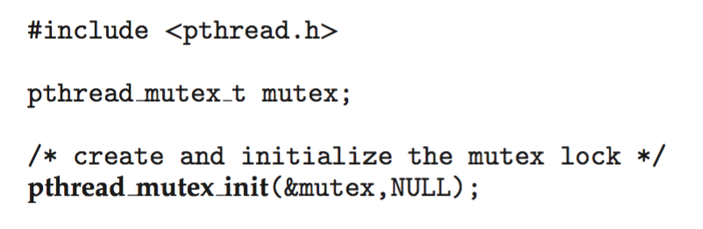
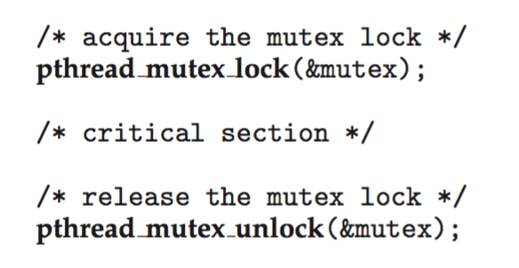
POSIX Mutex Locks
Creating and initializing the lock
Acquiring and releasing the lock

Slide 22
POSIX Semaphores
POSIX provides two versions – named and unnamed.
Named semaphores can be used by unrelated processes, unnamed cannot.

Slide 23
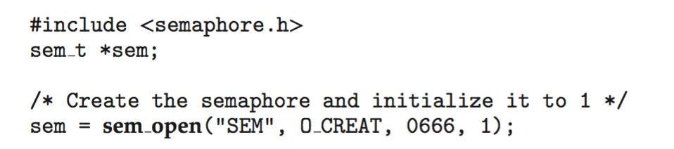
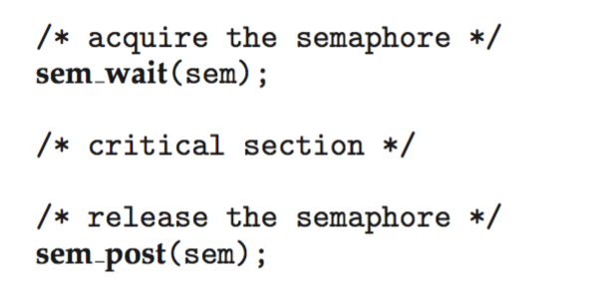
POSIX Named Semaphores
Creating an initializing the semaphore:
Another process can access the semaphore by referring to its name SEM.
Acquiring and releasing the semaphore:

Slide 24
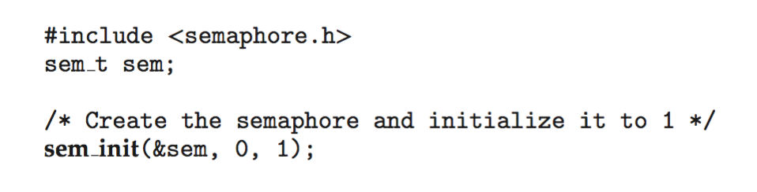
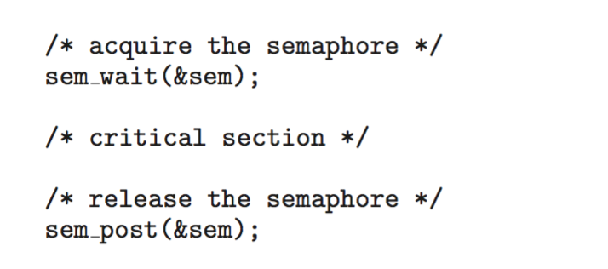
POSIX Unnamed Semaphores
Creating an initializing the semaphore:
Acquiring and releasing the semaphore:

Slide 25
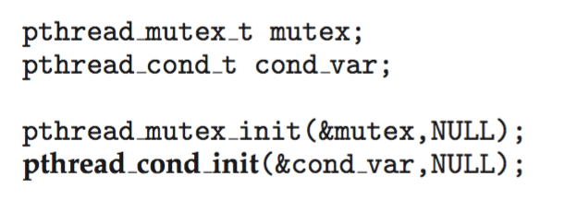
POSIX Condition Variables
Since POSIX is typically used in C/C++ and these languages do not provide a monitor, POSIX condition variables are associated with a POSIX mutex lock to provide mutual exclusion: Creating and initializing the condition variable:

Slide 26
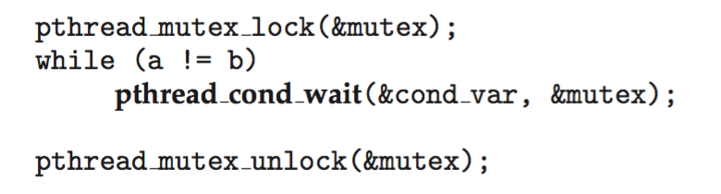
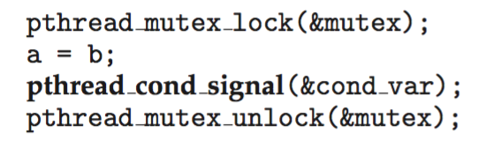
POSIX Condition Variables
Thread waiting for the condition a == b to become true:
Thread signaling another thread waiting on the condition variable:

Slide 27
Alternative Approaches
Transactional Memory
OpenMP
Functional Programming Languages

Slide 28
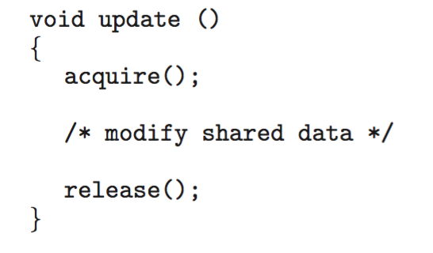
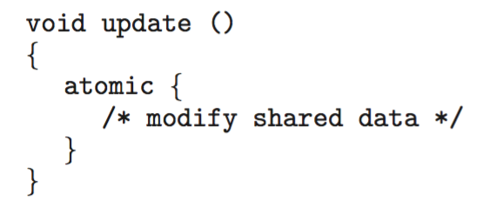
Transactional Memory
Consider a function update() that must be called atomically. One option is to use mutex locks:
A memory transaction is a sequence of read-write operations to memory that are performed atomically. A transaction can be completed by adding atomic{S} which ensure statements in S are executed atomically:

Slide 29
OpenMP
OpenMP is a set of compiler directives and API that support parallel progamming.
void update(int value)
{
#pragma omp critical
{
count += value
}
}
The code contained within the #pragma omp critical directive is treated as a critical section and performed atomically.

Slide 30
End of Chapter 7

