Slide 1
Chapter 8: Deadlocks

Slide 2
Chapter 8: Deadlocks
System Model
Deadlock in Multi-threaded Applications
Deadlock Characterization
Methods for Handling Deadlocks
Deadlock Prevention
Deadlock Avoidance
Deadlock Detection
Recovery from Deadlock

Slide 3
Chapter Objectives
Illustrate how deadlock can occur when mutex locks are used
Define the four necessary conditions that characterize deadlock
Identify a deadlock situation in a resource allocation graph
Evaluate the four different approaches for preventing deadlocks
Apply the banker’s algorithm for deadlock avoidance
Apply the deadlock detection algorithm
Evaluate approaches for recovering from deadlock

Slide 4
System Model
System consists of a collection of m resource types and n processes
  Resource types R₁, R₂, . . ., R_{m}
    CPU cycles, memory space, I/O devices
Each resource type R_{i} has W_{i} instances.
Each process utilizes a resource by executing a sequence of three actions:
  request it
  use it
  release it

Slide 5
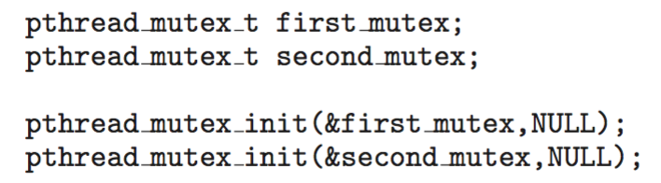
Deadlock in Multithreaded Application
Two mutex locks are created an initialized:

Slide 6

Deadlock in Multithreaded Application

Slide 7
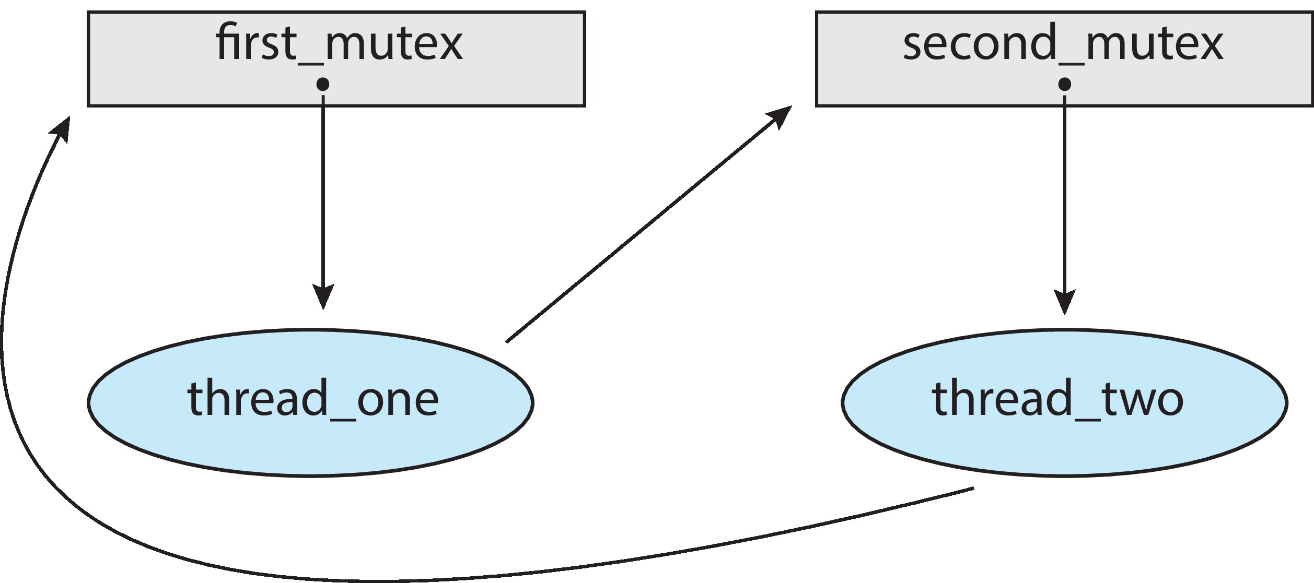
Deadlock in Multithreaded Application
Deadlock is possible if thread 1 acquires first_mutex and thread 2 acquires second_mutex. Thread 1 then waits for second_mutex and thread 2 waits for first_mutex.
Can be illustrated with a resource allocation graph:

Slide 8
Deadlock Characterization
Deadlock can arise if four conditions hold simultaneously.
Mutual exclusion: only one process at a time can use a resource
Hold and wait: a process holding at least one resource is waiting to acquire additional resources held by other processes
No preemption: a resource can be released only voluntarily by the process holding it, after that process has completed its task
Circular wait: there exists a set {P₀, P₁, …, P_{n}} of waiting processes such that P₀ is waiting for a resource that is held by P₁, P₁ is waiting for a resource that is held by P₂, …, P_{n–1} is waiting for a resource that is held by P_{n}, and P_{n} is waiting for a resource that is held by P₀.

Slide 9
Resource-Allocation Graph
A resource allocation graph is a set of vertices V and a set of edges E
such that:
V is partitioned into two types:
  P = {P₁, P₂, …, P_{n}}, the set consisting of all the processes in the system
  R = {R₁, R₂, …, R_{m}}, the set consisting of all resource types in the system
request edge – directed edge P_{i} → R_{j} indicates P_{i} has requested a unit of R_{j}
assignment edge – directed edge R_{j} → P_{i}

Slide 10

Resource Allocation Graph Example
One instance of R1
Two instances of R2
One instance of R3
Three instance of R4
T1 holds one instance of R2 and is waiting for an instance of R1
T2 holds one instance of R1, one instance of R2, and is waiting for an instance of R3
T3 is holds one instance of R3

Slide 11

Resource Allocation Graph With A Deadlock
T₃ requests one unit of R₂
resulting in deadlock

Slide 12

Graph With A Cycle But No Deadlock
Although this graph has a cycle, it is not the graph of a deadlock state.
T₂ holds a unit of R₁ and is not waiting for another resource, so it can release it when it is finished with it and T₁ can acquire the unit.

Slide 13
Resource Allocation Graph Facts
If graph contains no cycles ⇒ no deadlock
If graph contains a cycle ⇒
  If each resource type has just a single instance of the resource, then a cycle implies deadlock
  If there is at least one resource type that has multiple instances, a cycle does not necessarily imply deadlock.

Slide 14
Methods for Handling Deadlocks
Ensure that the system will never enter a deadlock state:
  Deadlock prevention
  Deadlock avoidance
Allow the system to enter a deadlock state and then recover
Ignore the problem and pretend that deadlocks never occur in the system.

Slide 15
Deadlock Prevention
Invalidate one of the four necessary conditions for deadlock:
Mutual Exclusion – not required for shareable resources (e.g., read-only files); must hold for non-shareable resources. Cannot remove mutual exclusion for reusable resources so this is not an option.
Hold and Wait – must guarantee that whenever a process requests a resource, it does not hold any other resources. Two choices:
  Require process to request and be allocated all of its resources before it begins execution.
  Allow process to request resources only when the process has none allocated to it.
  Poor resource utilization; starvation possible

Slide 16
Deadlock Prevention (Cont.)
No Preemption – forcibly taking resources away from processes.
  If a process that is holding some resources requests another resource that cannot be allocated immediately to it, then all resources currently being held by that process are released.
  Preempted resources are added to the list of resources for which the process is waiting
  Process will be restarted only when it can regain its old resources, as well as the new ones that it is requesting.
  On request, if unavailable, we preempt resources from a process that holds them if that process is in a waiting state; if the requested resources are not available or held only by ready processes, the requesting process waits. Process may lose resources while it waits. Process gets restarted only when it is allocated new resources and recovers the preempted ones.

Slide 17
Deadlock Prevention (Cont.)
Circular Wait – impose a total ordering of all resource types, and require that each process requests resources in an increasing order of enumeration.
  Proposed by Havender:
    A process can request resources only in increasing order of its resource number.
    If process holds R_{i} it can only request R_{j} if j > i.
    If process wants R_{j}, it must first release all R_{i} such that i >= j.
    If a process violates these rules, it is terminated.
  This makes circular waiting impossible, so deadlock impossible.
  But results in poor resource utilization.

Slide 18
Circular Wait
Invalidating the circular wait condition is most common.
Simply assign each resource (i.e. mutex locks) a unique number.
Resources must be acquired in order.
If:
first_mutex = 1
second_mutex = 5
code for thread_two could not be
written as follows:

Slide 19
Deadlock Avoidance
In deadlock prevention schemes, requests are constrained resulting in poor utilization and throughput.
Alternative is to use additional information to allow systems to decide when and whether to grant requests. This is called deadlock avoidance.
Avoidance is a dynamic strategy.
Requires that each process’s maximum claim for each resource type is known in advance. A request is granted only if the resulting system state is a safe state, meaning that there is a way to avoid deadlock in this state while still continuing to allocate resources to each process.

Slide 20
Deadlock Avoidance
Requires that the system has some additional a priori information
available
Simplest and most useful model requires that each process declare the maximum number of resources of each type that it may need
The deadlock-avoidance algorithm dynamically examines the resource-allocation state to ensure that there can never be a circular-wait condition
Resource-allocation state is defined by the number of available and allocated resources, and the maximum demands of the processes

Slide 21
Safe State
When a process requests an available resource, system must decide if immediate allocation leaves the system in a safe state
System is in safe state if there exists a sequence <P₁, P₂, …, P_{n}> of ALL the processes in the systems such that for each P_{i}, the resources that P_{i} can still request can be satisfied by currently available resources + resources held by all the P_{j}, with j < i
That is:
  If P_{i} ‘s resource needs are not immediately available, then P_{i} can wait until all P_{j} have finished
  When P_{j} is finished, P_{i} can obtain needed resources, execute, return allocated resources, and terminate
  When P_{i} terminates, P_{i +1} can obtain its needed resources, and so on

Slide 22
Safe States and Unsafe States
If a system is in safe state ⇒ it cannot be a deadlock state, i.e., there is no deadlock in the current state.
If a system is in unsafe state ⇒ possibility of deadlock – it may not be possible to avoid deadlock.
Avoidance algorithm ⇒ ensure that a system will never enter an unsafe state.

Slide 23
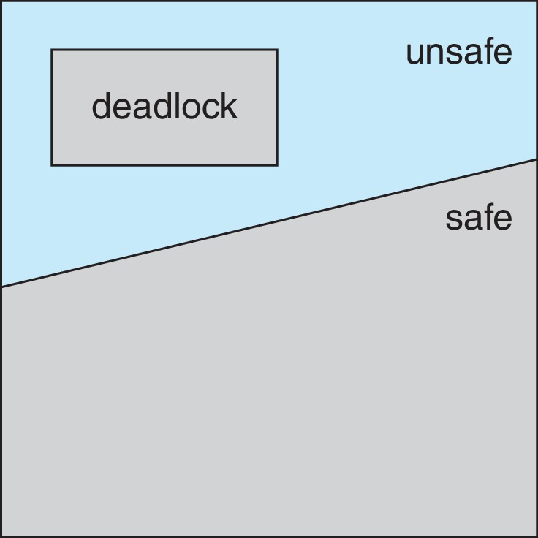
Safe, Unsafe, Deadlock State

Slide 24
Avoidance Algorithms
Single instance of a resource type
  Use a resource-allocation graph
Multiple instances of a resource type
  Use the Banker’s Algorithm

Slide 25
Resource-Allocation Graph Scheme
Claim edge P_{i} → R_{j} indicated that process P_{j} may request resource R_{j}; represented by a dashed line
Claim edge converts to request edge when a process requests a resource
Request edge converted to an assignment edge when the resource is allocated to the process
When a resource is released by a process, assignment edge reconverts to a claim edge
Resources must be claimed a priori in the system

Slide 26
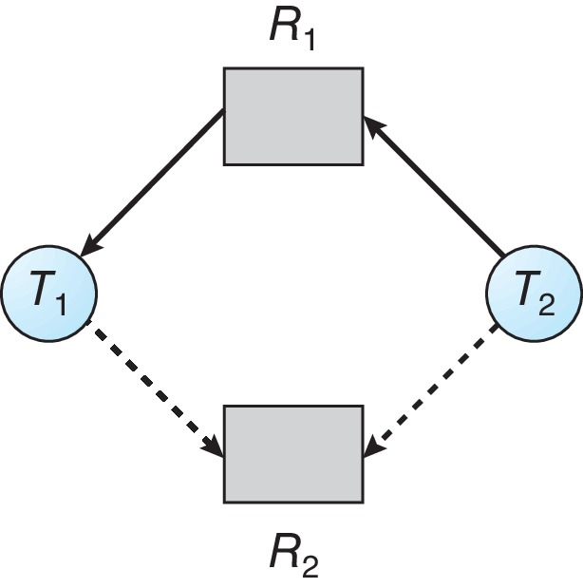
Resource-Allocation Graph

Slide 27
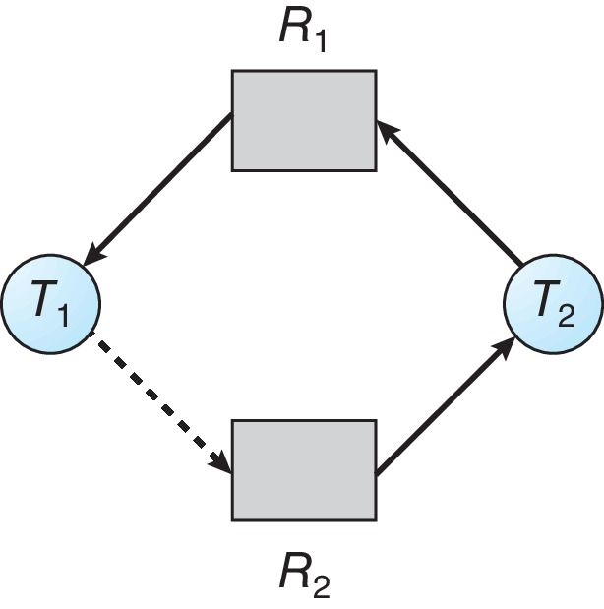
Unsafe State In Resource-Allocation Graph

Slide 28
Resource-Allocation Graph Algorithm
Suppose that process P_{i} requests a resource R_{j}
The request can be granted only if converting the request edge to an assignment edge does not result in the formation of a cycle in the resource allocation graph

Slide 29
Banker’s Algorithm
Multiple instances of resources
Each process must a priori claim maximum use
When a process requests a resource it may have to wait
When a process gets all its resources it must return them in a finite amount of time

Slide 30
Data Structures for the Banker’s Algorithm
Let n = number of processes, and m = number of resources types.
Available: Vector of length m. If available [j] = k, there are k instances of resource type R_{j} available
Max: n x m matrix. If Max [i,j] = k, then process P_{i} may hold at most k instances of resource type R_{j}
Allocation: n x m matrix. If Allocation[i,j] = k then P_{i} is currently allocated k instances of R_{j}
Need: n x m matrix. If Need[i,j] = k, then P_{i} may need k more instances of R_{j} to complete its task
    Need [i,j] = Max[i,j] – Allocation [i,j]

Slide 31
Safety Algorithm
1. Let Work and Finish be vectors of length m and n, respectively. Initialize:
      Work = Available
      Finish [i] = false for i = 0, 1, …, n- 1
2. Find an i such that both:
  (a) Finish [i] = false
  (b) Need_{i} ≤ Work
  If no such i exists, go to step 4
3. Work = Work + Allocation_{i}
Finish[i] = true
go to step 2
4. If Finish [i] == true for all i, then the system is in a safe state

Slide 32
Resource-Request Algorithm for Process P_{i}
Request_{i} = request vector for process P_{i}. If Request_{i} [j] = k then process P_{i} wants k instances of resource type R_{j}
  1. If Request_{i} ≤ Need_{i} go to step 2. Otherwise, raise error condition, since process has exceeded its maximum claim
  2. If Request_{i} ≤ Available, go to step 3. Otherwise P_{i} must wait, since resources are not available
  3. Pretend to allocate requested resources to P_{i} by modifying the state as follows:
      Available = Available – Request_{i};
      Allocation_{i} = Allocation_{i} + Request_{i};
      Need_{i} = Need_{i} – Request_{i};
    If safe ⇒ the resources are allocated to P_{i}
    If unsafe ⇒ P_{i} must wait, and the old resource-allocation state is restored

Slide 33
Example of Banker’s Algorithm
5 processes P₀ through P₄;
3 resource types:
A (10 instances), B (5instances), and C (7 instances)
Snapshot at time T₀:
Allocation Max Available
A B C A B C A B C
P₀ 0 1 0 7 5 3 3 3 2
P₁ 2 0 0 3 2 2
P₂ 3 0 2 9 0 2
P₃ 2 1 1 2 2 2
P₄ 0 0 2 4 3 3

Slide 34
Example (Cont.)
The content of the matrix Need is defined to be Max – Allocation
Need
A B C
P₀ 7 4 3
P₁ 1 2 2
P₂ 6 0 0
P₃ 0 1 1
P₄ 4 3 1
The system is in a safe state since the sequence < P₁, P₃, P₄, P₂, P₀> satisfies safety criteria

Slide 35
Example: P₁ Request (1,0,2)
Check that Request ≤ Available (that is, (1,0,2) ≤ (3,3,2) ⇒ true
Allocation Need Available
A B C A B C A B C
P₀ 0 1 0 7 4 3 2 3 0
P₁ 3 0 2 0 2 0
P₂ 3 0 2 6 0 0
P₃ 2 1 1 0 1 1
P₄ 0 0 2 4 3 1
Executing safety algorithm shows that sequence < P₁, P₃, P₄, P₀, P₂> satisfies safety requirement
Can request for (3,3,0) by P₄ be granted?
Can request for (0,2,0) by P₀ be granted?

Slide 36
Deadlock Detection
Allow system to enter deadlock state
Detection algorithm
Recovery scheme

Slide 37
Single Instance of Each Resource Type
Maintain wait-for graph
  Nodes are processes
  P_{i} → P_{j} if P_{i} is waiting for P_{j}
Periodically invoke an algorithm that searches for a cycle in the graph. If there is a cycle, there exists a deadlock
An algorithm to detect a cycle in a graph requires an order of n² operations, where n is the number of vertices in the graph

Slide 38
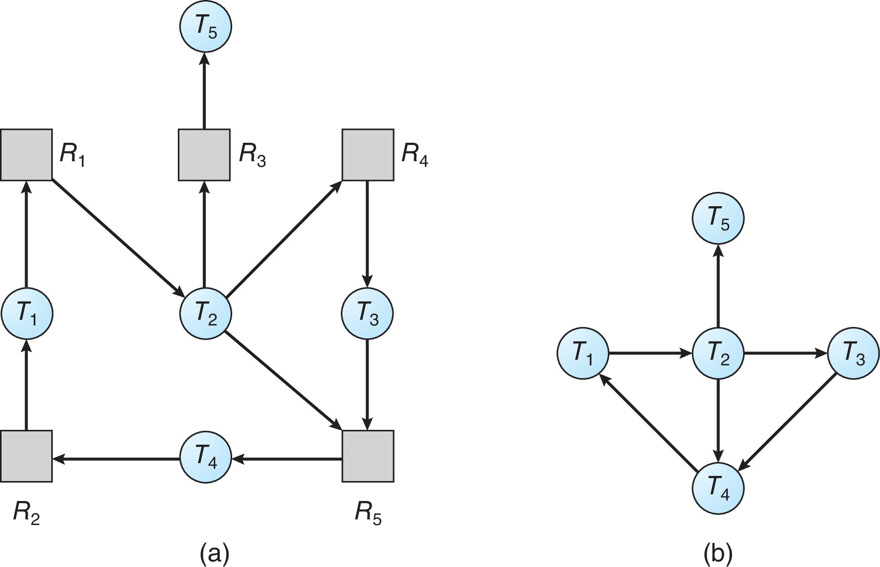
Resource-Allocation Graph and Wait-for Graph
Resource-Allocation Graph
Corresponding wait-for graph

Slide 39
Several Instances of a Resource Type
Available: A vector of length m indicates the number of available resources of each type
Allocation: An n x m matrix defines the number of resources of each type currently allocated to each process
Request: An n x m matrix indicates the current request of each process. If Request [i][j] = k, then process P_{i} is requesting k more instances of resource type R_{j}.

Slide 40
Detection Algorithm
1. Let Work and Finish be vectors of length m and n, respectively Initialize:
  (a) Work = Available
  (b) For i = 1,2, …, n, if Allocation_{i} ≠ 0, then
  Finish[i] = false; otherwise, Finish[i] = true
2. Find an index i such that both:
  (a) Finish[i] == false
  (b) Request_{i} ≤ Work
  If no such i exists, go to step 4

Slide 41
Detection Algorithm (Cont.)
3. Work = Work + Allocation_{i}
Finish[i] = true
go to step 2
4. If Finish[i] == false, for some i, 1 ≤ i ≤ n, then the system is in deadlock state. Moreover, if Finish[i] == false, then P_{i} is deadlocked
Algorithm requires an order of O(m x n²) operations to detect whether the system is in deadlocked state

Slide 42
Example of Detection Algorithm
Five processes P₀ through P₄; three resource types
A (7 instances), B (2 instances), and C (6 instances)
Snapshot at time T₀:
Allocation Request Available
A B C A B C A B C
P₀ 0 1 0 0 0 0 0 0 0
P₁ 2 0 0 2 0 2
P₂ 3 0 3 0 0 0
P₃ 2 1 1 1 0 0
P₄ 0 0 2 0 0 2
Sequence <P₀, P₂, P₃, P₁, P₄> will result in Finish[i] = true for all i

Slide 43
Example (Cont.)
P₂ requests an additional instance of type C
Request
A B C
P₀ 0 0 0
P₁ 2 0 2
P₂ 0 0 1
P₃ 1 0 0
P₄ 0 0 2
State of system?
  Can reclaim resources held by process P₀, but insufficient resources to fulfill other processes; requests
  Deadlock exists, consisting of processes P₁, P₂, P₃, and P₄

Slide 44
Detection-Algorithm Usage
When, and how often, to invoke depends on:
  How often a deadlock is likely to occur?
  How many processes will need to be rolled back?
    one for each disjoint cycle
If detection algorithm is invoked arbitrarily, there may be many cycles in the resource graph and so we would not be able to tell which of the many deadlocked processes “caused” the deadlock.

Slide 45
Recovery from Deadlock: Process Termination
Abort all deadlocked processes
Abort one process at a time until the deadlock cycle is eliminated
In which order should we choose to abort?
  Priority of the process
  How long process has computed, and how much longer to completion
  Resources the process has used
  Resources process needs to complete
  How many processes will need to be terminated
  Is process interactive or batch?

Slide 46
Recovery from Deadlock: Resource Preemption
Selecting a victim – minimize cost
Rollback – return to some safe state, restart process for that state
Starvation – same process may always be picked as victim, include number of rollback in cost factor

Slide 47
End of Chapter 8

