Slide 1
Clustering in Natural Language Processing & Text Mining
CpE 6330 Deep Dives
Stuart Miller
Master’s Student in Computer Engineering

Slide 2
Outline
Preliminary Steps
Preprocessing
Stemming Algorithms
Bag of Word Model
Term Frequency – Inverse Document Frequency
Zipf’s Law
Latent Dirichlet Allocation
Latent Semantic Analysis
Conclusions

Slide 3
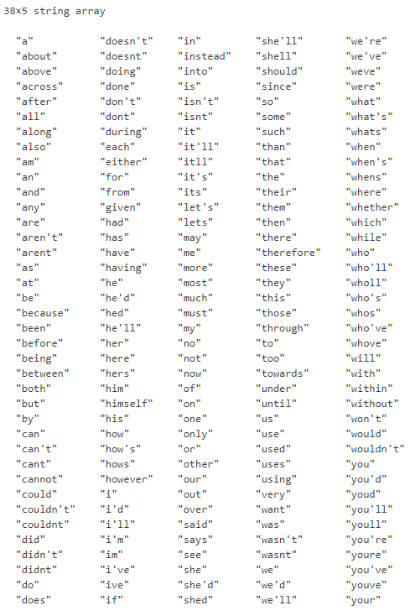
Text Preprocessing
Capitalization
Change all letters to lowercase
Misc. Removal
Remove numbers, punctuation, symbols, and various other unnecessary entities
Stopwords
Remove all insignificant words
Tokenization
Split into a list of individual words
Stemming
MATLAB’s default stopwords

Slide 4
Stemming Algorithms
Aims to reduce all similar words to a common form
Ex. “revival” -> “reviv”, “defensible" -> “defens”
First proposed as an aid for a library cataloguing system at MIT
J. B. Lovins, “Development of a Stemming Algorithm”, Mechanical Translation and Computational Linguistics, vol. 11, nos. 1 and 2, pp. 22-31, 1968
Porter stemmer is the current standard
M. F. Porter, “An Algorithm for Suffix Stripping”, Program, vol. 14, no. 3, pp. 130-137, 1980
Freely available at https://tartarus.org/martin/PorterStemmer/
Open source encoding for most programming languages

Slide 5

Examples of Stemming Issues
Complexities of the English language propose many problems
produc | er : product | ion invert | ed : invers | ion
induc | ed : induct | ion adher | e : adhes | ion
induct | ed : induct | ion register | ing : registr | ation
consum | ed : consumpt | ion resolv | ed : resolut | ion
absorb | ing : absorpt | ion admitt | ed : admiss | ion
attend | ing : attent | ion circl | e : circul | ar
expand | ing : expans | ion matrix | : matric | es
respond | : respons | ive lattic | e : lattic | es
exclud | e : exclus | ion index | : indic | es
collid | ing : collis | ion hypothes | ized : hypothet | ical
analys | is : analyt | ic
A stemming algorithm essentially just becomes a set of rules to accommodate all these exceptions

Slide 6

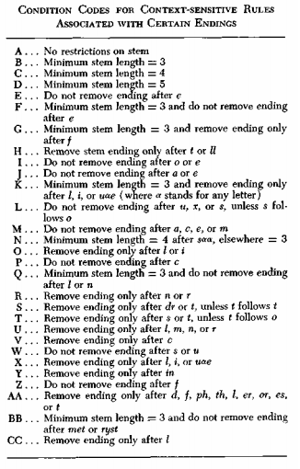
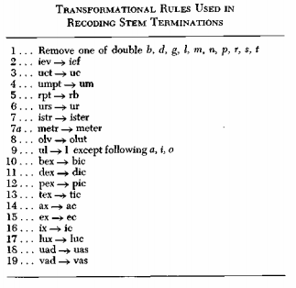
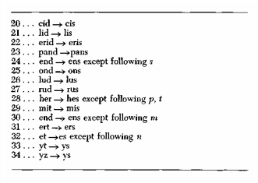
Lovins Stemming Algorithm

Slide 7
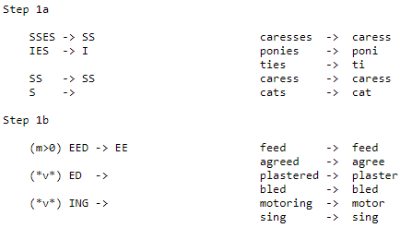
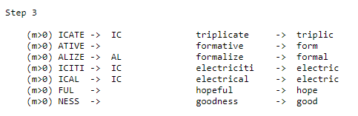
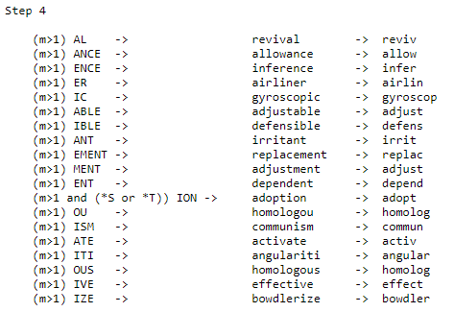
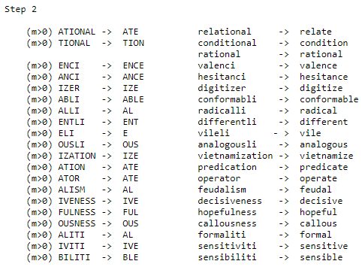
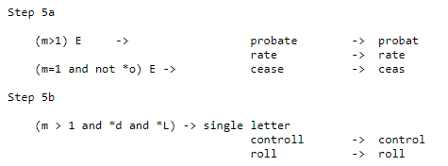
Porter Stemming Algorithm

Slide 8

Bag-of-Words Model
A unifying data structure used across natural language processing to represent textual information
First referred to as a ”bag” in 1954
Z. S. Harris, “Distributional Structure”, Word, vol. 10, issues 2 and 3, pp. 146-162, 1954
Consists of…
Vocabulary (list of words)
Frequency list
Features…
Orderless
Easy to count, sort, and filter frequencies
“It was the best of times, it was the worst of times, it was the age of wisdom, it was the age of foolishness,”
it | was | the | best | of | times | worst | age | wisdom | foolishness
4 | 4 | 4 | 1 | 4 | 2 | 1 | 2 | 1 | 1
Notes:
Add more rows to the bag for more documents; this example only shows for one document

Slide 9
Outline
Preliminary Steps
Preprocessing
Stemming Algorithms
Bag of Word Model
Term Frequency – Inverse Document Frequency
Zipf’s Law
Latent Dirichlet Allocation
Latent Semantic Analysis
Conclusions

Slide 10

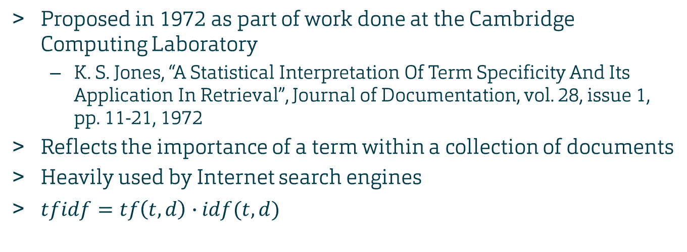
Term Frequency-Inverse Document Frequency
Proposed in 1972 as part of work done at the Cambridge Computing Laboratory
K. S. Jones, “A Statistical Interpretation Of Term Specificity And Its Application In Retrieval”, Journal of Documentation, vol. 28, issue 1, pp. 11-21, 1972
Reflects the importance of a term within a collection of documents
Heavily used by Internet search engines
$tfidf=tf\left(t,d\right)∙idf(t,d)$
Notes:
3222 citations

Slide 11
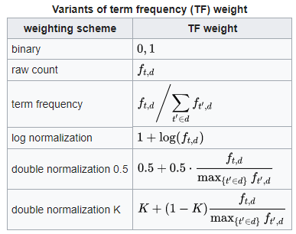
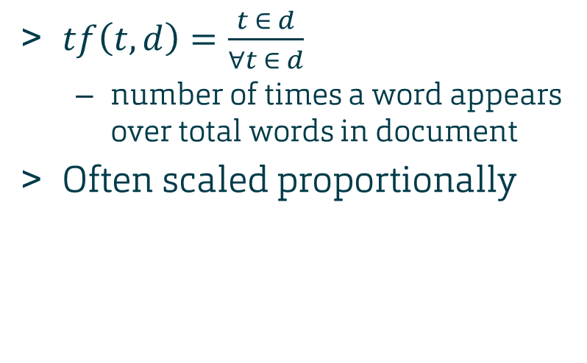
Term Frequency
$tf\left(t,d\right)=\frac{t ∈ d}{∀t ∈ d}$
number of times a word appears over total words in document
Often scaled proportionally

Slide 12
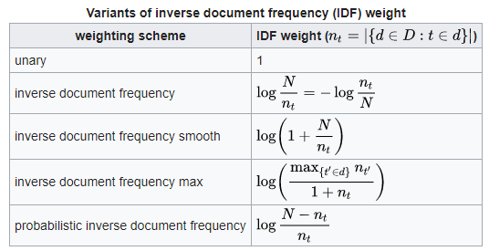
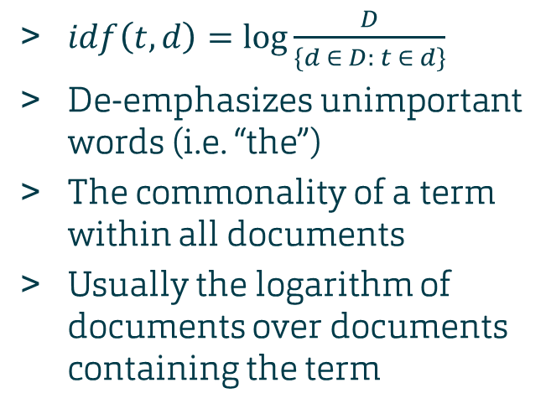
Inverse Document Frequency
$idf\left(t,d\right)=\log{\frac{D}{\{d ∈ D: t ∈ d\}}}$
De-emphasizes unimportant words (i.e. “the”)
The commonality of a term within all documents
Usually the logarithm of documents over documents containing the term

Slide 13
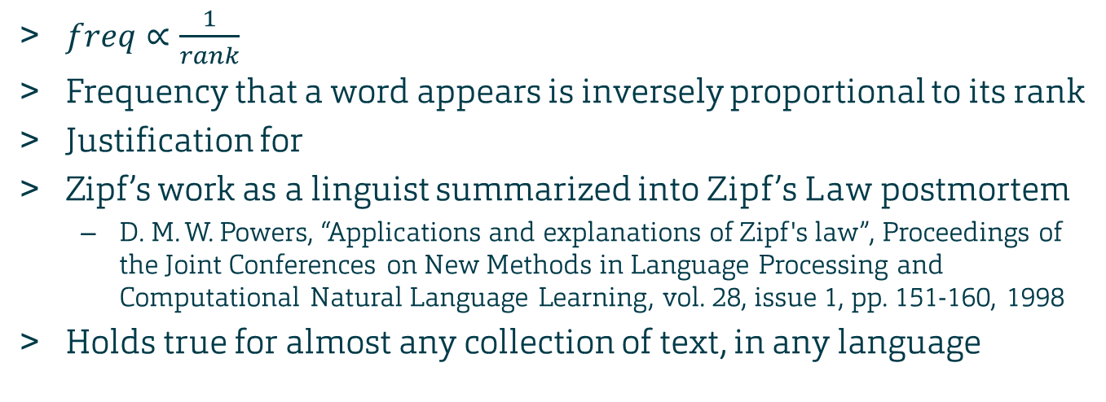
Zipf’s Law and Term Frequency
$freq∝\frac{1}{rank}$
Frequency that a word appears is inversely proportional to its rank
Justification for
Zipf’s work as a linguist summarized into Zipf’s Law postmortem
D. M. W. Powers, “Applications and explanations of Zipf's law”, Proceedings of the Joint Conferences on New Methods in Language Processing and Computational Natural Language Learning, vol. 28, issue 1, pp. 151-160, 1998
Holds true for almost any collection of text, in any language
Notes:
Important to note that distribution is regular and proportional; of course the rank is higher for more common words, the distribution is what the law emphasizes

Slide 14
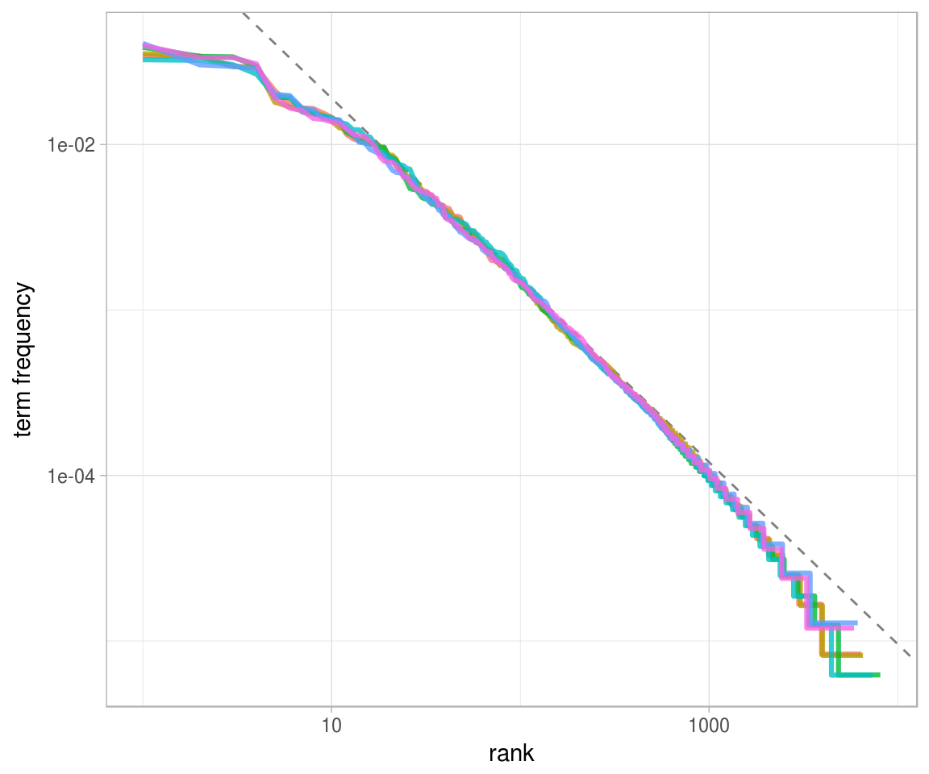
Zipf’s Law Illustrated
Source: https://www.tidytextmining.com/tfidf.html#zipfs-law
Notes:
Zipf distribution for all of Jane Austin’s novels

Slide 15
How do we use all this?
Quick and dirty method for NLP
Can easily group or partition documents relevant to a term
Term relevance = one dimension, easy to analyze
Limited to one term at a time
Not too useful for looking for overall document similarity
Will make a return later
Stay tuned for it’s use in latent semantic analysis!

Slide 16
Outline
Preliminary Steps
Preprocessing
Stemming Algorithms
Bag of Word Model
Term Frequency – Inverse Document Frequency
Zipf’s Law
Latent Dirichlet Allocation
Latent Semantic Analysis
Conclusions

Slide 17
Latent Dirichlet Allocation
Independently discovered by two groups
D. M. Blei, A. Y. Ng, and M. I. Jordan, “Latent Dirichlet Allocation,” Journal of Machine Learning Research, vol. 3, pp. 993–1022, Jan. 2003.
J. K. Pritchard, M. Stephens, and P. Donnelly, “Inference of population structure using multilocus genotype data,” Genetics, vol. 155, no. 2, pp. 945–959, Jun. 2000.
Aims to assign documents to topics
Need to decide on number of topics ahead of time
Topics not necessarily strongly defined
Addresses shortcomings of TF-IDF
TF-IDF fails to reveal “big picture” trends
TF-IDF limited to just singular words
Notes:
LDA - 21946 citations
Genetics - 21778 citations

Slide 18
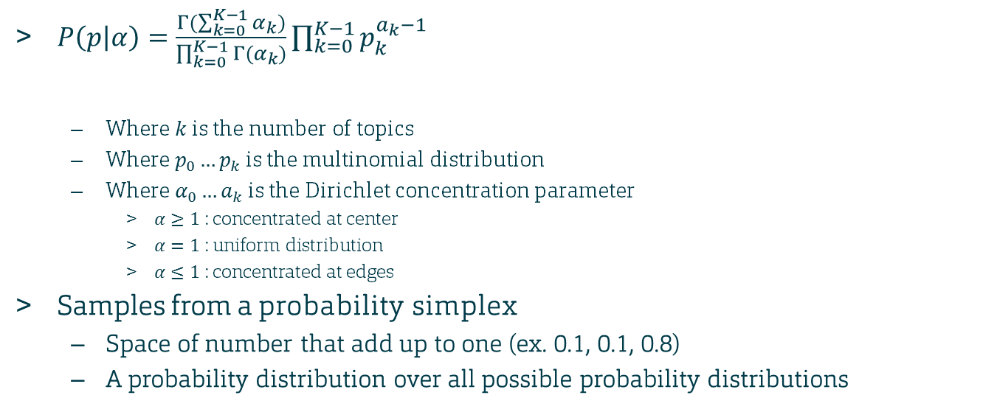
Dirichlet Distribution
$P\left(p | α\right)=\frac{Γ(\sum_{k=0}^{K−1}{α_{k}})}{\prod_{k=0}^{K−1}{Γ(α_{k}})}\prod_{k=0}^{K−1}{p_{k}^{a_{k}−1} }$
Where $k$ is the number of topics
Where $p_{0}…p_{k}$ is the multinomial distribution
Where $α_{0}…a_{k}$ is the Dirichlet concentration parameter
$α≥1$ : concentrated at center
$α=1$ : uniform distribution
$α≤1$ : concentrated at edges
Samples from a probability simplex
Space of number that add up to one (ex. 0.1, 0.1, 0.8)
A probability distribution over all possible probability distributions
normalizing constant
probability density
function
Notes:
Normalizing constant keeps all distribution sums to 1

Slide 19
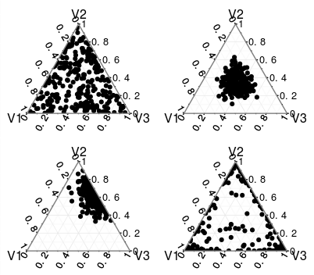





Dirichlet Distributions with $k=3$
$$α_{1}=1$$
$$α_{2}=1$$
$$α_{3}=1$$
$$α_{1}=10$$
$$α_{2}=10$$
$$α_{3}=10$$
$$α_{1}=1$$
$$α_{2}=10$$
$$α_{3}=5$$
$$α_{1}=0.2$$
$$α_{2}=0.2$$
$$α_{3}=0.2$$
Source: https://stats.stackexchange.com/a/244946
Notes:
Dimensions higher than 3 aren’t really possible to visualize
Remember software tools Andrea mentioned last week

Slide 20
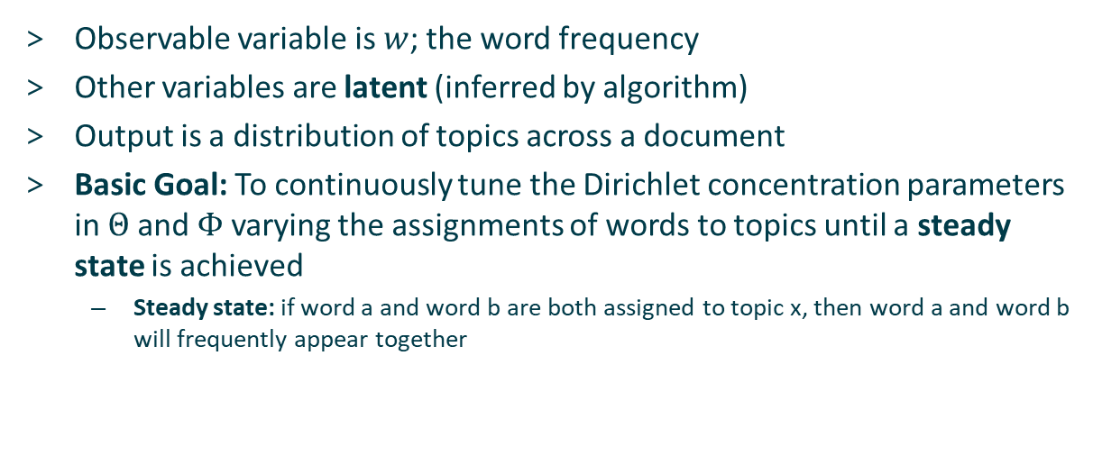
How Does this Relate to Text Analysis?
Observable variable is $w$; the word frequency
Other variables are latent (inferred by algorithm)
Output is a distribution of topics across a document
Basic Goal: To continuously tune the Dirichlet concentration parameters in $Θ$ and $Φ$ varying the assignments of words to topics until a steady state is achieved
Steady state: if word a and word b are both assigned to topic x, then word a and word b will frequently appear together
Notes:
Figure is a plate model; each rectangle is a repeating section

Slide 21
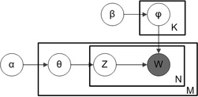
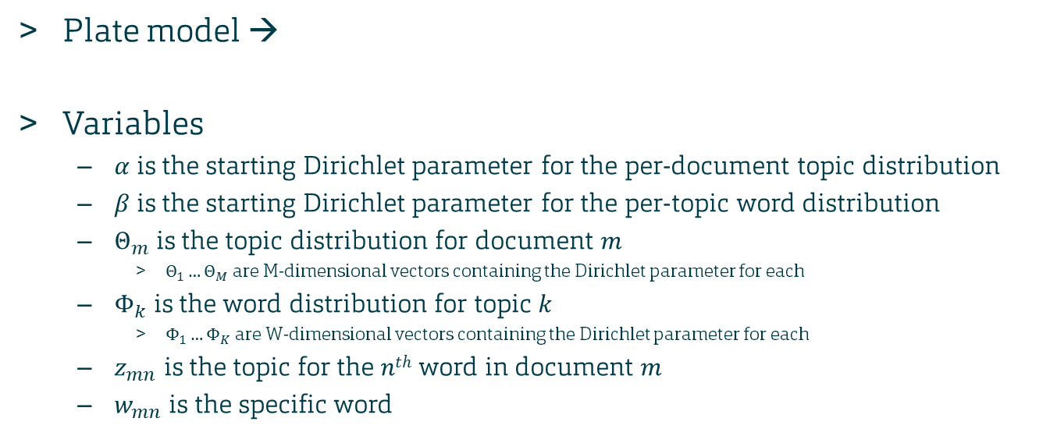
LDA Mechanics
Plate model →
Variables
$α$ is the starting Dirichlet parameter for the per-document topic distribution
$β$ is the starting Dirichlet parameter for the per-topic word distribution
$Θ_{m}$ is the topic distribution for document $m$
$Θ_{1}…Θ_{M}$ are M-dimensional vectors containing the Dirichlet parameter for each
$Φ_{k}$ is the word distribution for topic $k$
$Φ_{1}…Φ_{K}$ are W-dimensional vectors containing the Dirichlet parameter for each
$z_{mn}$ is the topic for the $nth$ word in document $m$
$w_{mn}$is the specific word
Source: Blei “Latent Dirichlet Allocation”
Notes:
Plate model: method of graphically representing repeating variables

Slide 22
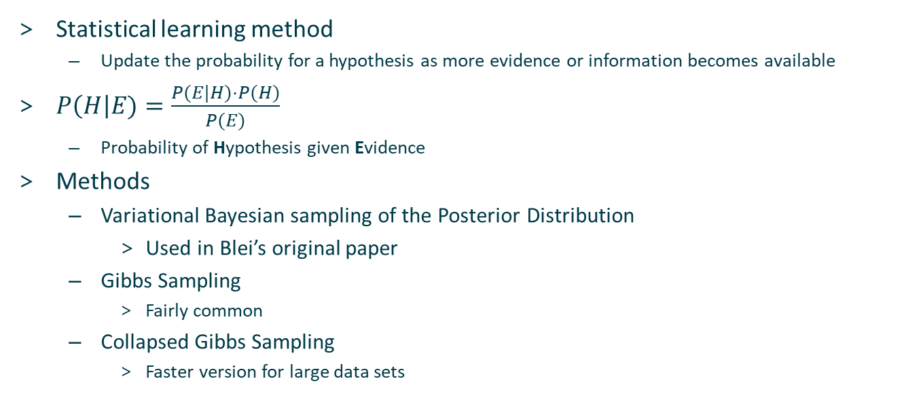
Bayesian Inference
Statistical learning method
Update the probability for a hypothesis as more evidence or information becomes available
$P\left(H\right|E)=\frac{P(E|H)⋅P(H)}{P(E)}$
Probability of Hypothesis given Evidence
Methods
Variational Bayesian sampling of the Posterior Distribution
Used in Blei’s original paper
Gibbs Sampling
Fairly common
Collapsed Gibbs Sampling
Faster version for large data sets
Notes:
Hypothesis is the chosen dirichlet parameter
Evidence is the calculation of that parameter across the body of documents

Slide 23
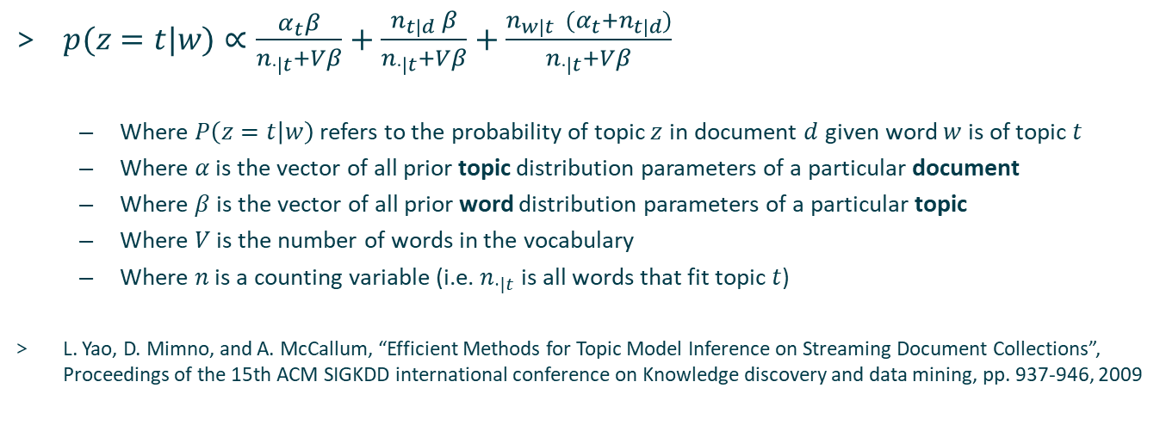
Collapsed Gibbs Sampling
$p(z=t|w)∝\frac{α_{t}β}{n_{⋅|t}+Vβ}+\frac{n_{t|d} β}{n_{⋅|t}+Vβ}+\frac{n_{w|t} (α_{t}+n_{t|d})}{n_{⋅|t}+Vβ}$
Where $P\left(z=t | w\right)$ refers to the probability of topic $z$ in document $d$ given word $w$ is of topic $t$
Where $α$ is the vector of all prior topic distribution parameters of a particular document
Where $β$ is the vector of all prior word distribution parameters of a particular topic
Where $V$ is the number of words in the vocabulary
Where $n$ is a counting variable (i.e. $n_{⋅|t}$ is all words that fit topic $t$)
L. Yao, D. Mimno, and A. McCallum, “Efficient Methods for Topic Model Inference on Streaming Document Collections”, Proceedings of the 15th ACM SIGKDD international conference on Knowledge discovery and data mining, pp. 937-946, 2009
Notes:
Collapsed Gibbs sampler shown here is from the aforementioned paper; lots of other variations of Gibbs samplers have been created and this is only one

Slide 24
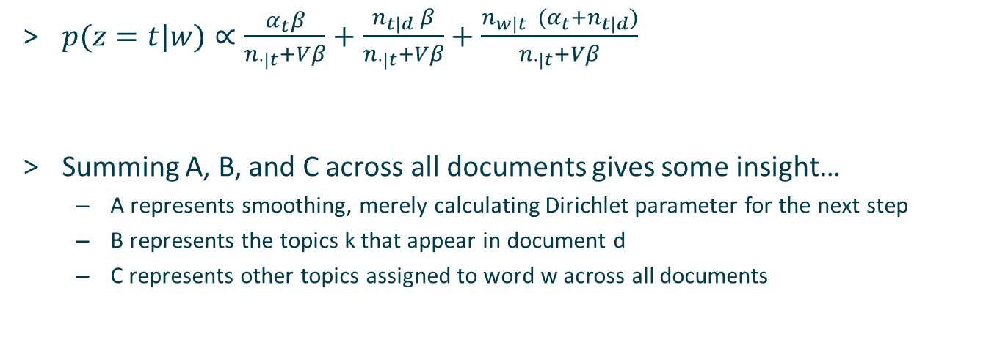
Collapsed Gibbs Sampling
$p(z=t|w)∝\frac{α_{t}β}{n_{⋅|t}+Vβ}+\frac{n_{t|d} β}{n_{⋅|t}+Vβ}+\frac{n_{w|t} (α_{t}+n_{t|d})}{n_{⋅|t}+Vβ}$
Summing A, B, and C across all documents gives some insight…
A represents smoothing, merely calculating Dirichlet parameter for the next step
B represents the topics k that appear in document d
C represents other topics assigned to word w across all documents
A
B
C
Notes:
This is collapsed Gibbs sampling (preferred for LDA)

Slide 25
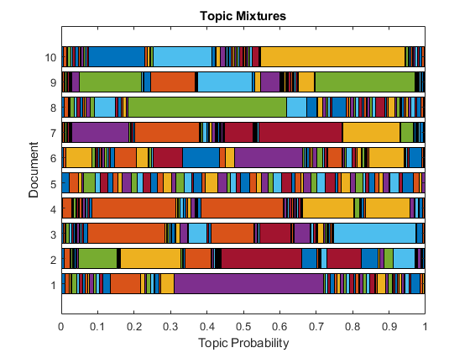
Output
Loosely defined topics
Words assigned to topics by percentages
Can extend to summing over all words in the document to give the document a topic percentage
Preprocessing to remove extraneous words helps accuracy here
Must decide on an appropriate number of topics
Source: https://www.mathworks.com/help/textanalytics/examples/analyze-text-data-using-topic-models.html
Notes:
Very important to choose numtopics correctly; too many of too few won’t be useful

Slide 26
Outline
Preliminary Steps
Preprocessing
Stemming Algorithms
Bag of Word Model
Term Frequency – Inverse Document Frequency
Zipf’s Law
Latent Dirichlet Allocation
Latent Semantic Analysis
Conclusions

Slide 27
Latent Semantic Analysis
Patented in 1988, now-expired US patent 4,839,853
S. C. Deerwester, S. T. Dumais, G. W. Furnace, R. A. Harshman, T. K. Landauer, K. E. Lochbaum, and L. A. Streeter, “Computer information retrieval using latent semantic structure ,” 13-Jun-1989.
Relies on singular value decomposition of a term-document matrix
Strictly matrix math; no learning algorithms used here
Also addresses shortcomings of simple keyword searches
Overrides synonymy (different words with similar meanings)
Overrides polysemy (similar words with different meanings)

Slide 28
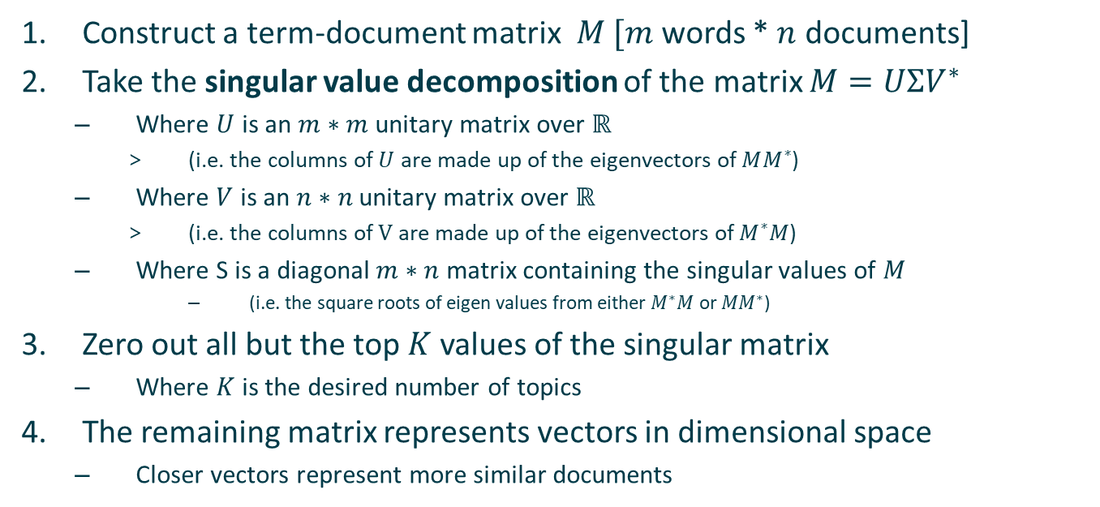
Latent Semantic Analysis Algorithm
Construct a term-document matrix $M$ $[m$ words * $n$ documents]
Take the singular value decomposition of the matrix $M=UΣV^{∗}$
Where $U$ is an $m∗m$ unitary matrix over $ℝ$
(i.e. the columns of $U$ are made up of the eigenvectors of $MM^{∗}$)
Where $V$ is an $n∗n$ unitary matrix over $ℝ$
(i.e. the columns of $V$ are made up of the eigenvectors of $M^{∗}M$)
Where S is a diagonal $m∗n$ matrix containing the singular values of $M$
(i.e. the square roots of eigen values from either $M^{∗}M$ or ${MM}^{∗}$)
Zero out all but the top $K$ values of the singular matrix
Where $K$ is the desired number of topics
The remaining matrix represents vectors in dimensional space
Closer vectors represent more similar documents
Notes:
Here * is the conjugate transpose (obtained by taking the matrix transpose and then the complex conjugate of each entry)

Slide 29
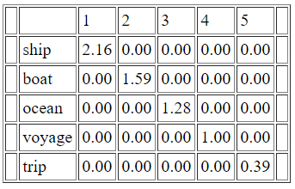
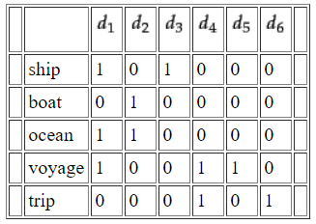
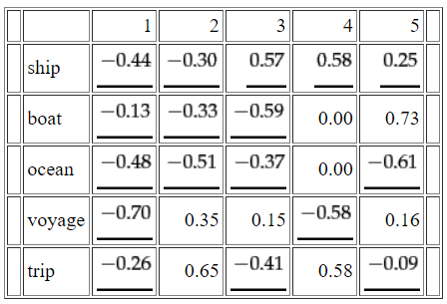
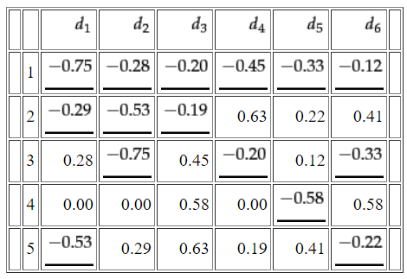



Example
$U$ Matrix
$V^{∗}$ Matrix
Term-Document Matrix
$S$ Matrix
Taken from: C. D. Manning, H. Schütze, and P. Raghavan, An introduction to Information Retrieval. Cambridge, England: Cambridge University Press, 2008.

Slide 30
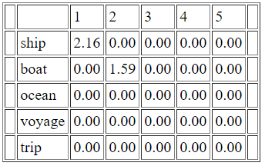
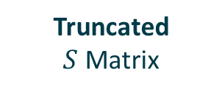
Example
$U$ Matrix
$V^{∗}$ Matrix
Term-Document Matrix
Truncated
$S$ Matrix
Taken from: C. D. Manning, H. Schütze, and P. Raghavan, An introduction to Information Retrieval. Cambridge, England: Cambridge University Press, 2008.

Slide 31
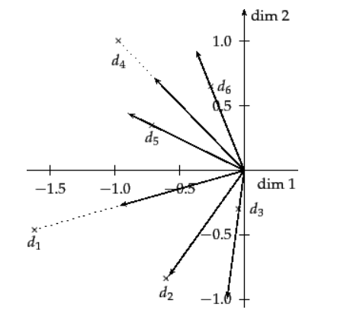
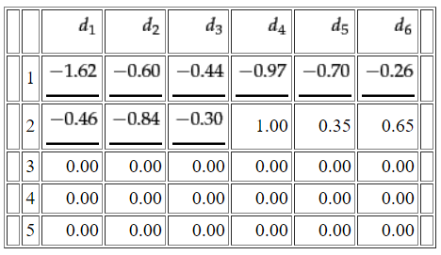
Example
Final Singular Value Decomposed Matrix
Topic Vectors Visualized
Taken from: C. D. Manning, H. Schütze, and P. Raghavan, An introduction to Information Retrieval. Cambridge, England: Cambridge University Press, 2008.
Notes:
Super simple input set so only chose two topics.
Can’t visualize in more than three dimensions, but can still compare numerically.
Can compare dot product of the normalized vectors for higher order comparison (1=similar, 0=dissimilar)

Slide 32
Outline
Preliminary Steps
Preprocessing
Stemming Algorithms
Bag of Word Model
Term Frequency – Inverse Document Frequency
Zipf’s Law
Latent Dirichlet Allocation
Latent Semantic Analysis
Conclusions

Slide 33
In Summary
Primary models for NLP/text mining
Term Frequency-Inverse Document Frequency
Gives the relevance score for each document in regards to a term
Latent Dirichlet Allocation
Learning model, uses Bayesian inference
Gives a finite topic distribution per document
Latent Semantic Analysis
Mathematical, matrix-based model
Results in topic-vectors that can be analyzed for similarity

Slide 34
Questions?

