Slide 1
Architecture Constraints
Software Architecture

Slide 2
Architecture Constraints
Constraints | Background and/or motivation
TC – cross-platform development | Should be available on multiple OS for example Android, IOS, IpadOS to be compatible with as many user devices as possible
TC –Firewall for Users Data | User’s personal and financial data must be and therefore protected from cyberattacks
OC - Configuration and version control / management | Git repository with commit history and public master branch pushed to GitHub and linked a project blog
OC - Data Security operating Figure | User’s personal and financial data must be thoroughly managed and therefore protected from cyberattacks
LC - Regulatory and Legal Compliance Variability | The application must adjust/adhere to local/national regulations such as speed regulations, driver background checks, insurance requirements

Slide 3
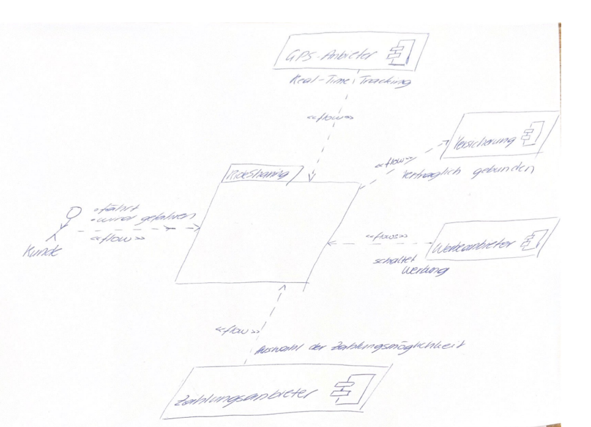
Business Context

