Slide 1


Cyber security crypto & tls
Silvio Ranise [ranise@fbk.eu]

Slide 2

contents
A quick introduction to Cryptography
Symmetric Cryptography
Asymmetric (Public Key) Cryptography
Transport Layer Security
SSL & TLS

Slide 3
Cryptography a quick introduction

Slide 4
Cryptography
Cryptography is the science and study of secret writing
Cryptanalysis is the science and study of methods of breaking ciphers
Cryptology: cryptography and cryptanalysis
Today: Cryptography is the study of mathematical techniques related to aspects of information security, such as
confidentiality
data integrity
entity authentication
data origin authentication

Slide 5
Communication security
Security services provided by cryptographic mechanisms:
Data confidentiality: encryption algorithms hide the content of messages;
Data integrity: integrity check functions provide the means to detect whether a document has been changed;
Data origin authentication: message authentication codes or digital signature algorithms provide the means to verify the source and integrity of a message

Slide 6
CAESAR cipher
Substitution cipher
Every character is replaced with the character, e.g., three slots to the right
The key is the number of characters to shift the cipher alphabet
In the case above three
Also called
ROTk
for ROTATE by k

Slide 7
Exercise on caesar cipher
Write a Python program that allows you to decode the following string
“OR GUR SBEPR JVGU LBH”
that has been encoded with ROTk
The goal is to find the appropriate value of k that turns the string into a meaningful English sentence
Implement a brute force approach in which you try to decode the string for each possible value of k from 1 to 25
Assume that the character space is unchanged by the encryption function
Assume that only capital letters are used
Recall that the ASCII encoding of the letters A-Z is 97-122 and think of using the functions ord and char
Write the encoding and decoding functions for ROTk

Slide 8
Solution
Encoding
>>> letter = ‘B’
>>> key = 3
>>> chr(((ord(letter) - 65 + key) % 26) + 65)
Decoding
>>> letter = ‘O’
>>> chr(((ord(letter) - 65 - key) % 26) + 65)
Brute force
cipher_text = "OR GUR SBEPR JVGU LBH”
for key in range(1,26):
plain_text = ""
for letter in cipher_text:
if ord(letter) == 32:
plain_text += letter
else:
plain_text += chr(((ord(letter) - 65 + key) % 26) + 65)
print str(key) + ':' + plain_text

Slide 9
Symmetric Cryptography

Slide 10
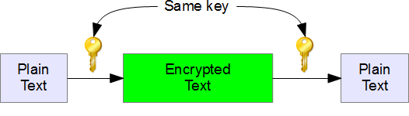
Symmetric key cryptography
Symmetric keys, where a single key (k) is used is used for E and D
D( k, E( k, p ) ) = p
All (intended) receivers have access to key
Note: Management of keys determines who has access to encrypted data

Slide 11
AES (2001)
AES is the cryptographic algorithm for use by U.S. government organizations to protect sensitive, unclassified information
Commercial and other non-federal organizations are invited-but not required-to adopt and implement DES
No one can be sure how long the AES-or any other cryptographic algorithm-will remain secure. However, NIST's DES was a U.S. government standard for approximately 20 years before it became practical to mount a brute force attack with specialized hardware. The AES supports significantly larger key sizes than what DES supports. Barring any attacks against AES that are faster than key exhaustion, and even with future advances in technology, AES has the potential to remain secure well beyond 20 years
In AES, there are approximately: 2¹²⁸ =3.4 x 10³⁸ possible 128-bit keys; 2¹⁹² = 6.2 x 10⁵⁷ possible 192-bit keys; and 2²⁵⁶ = 1.1 x 10⁷⁷ possible 256-bit keys.
In DES, there are approximately 7.2 x 10¹⁶ possible DES keys
There are on the order of 10²¹ times more AES 128-bit keys than DES 56-bit keys
Notes:
http://ktana.eu/html/theRijndaelPage.htm

Slide 12
Exercise on AES
Install the PyCrypto library (available at https://www.dlitz.net/software/pycrypto/)
Try and understand the following commands
>>> from Crypto.Cipher import AES
Encryption
>>> encryption_suite = AES.new('This is a key123', AES.MODE_CBC, 'This is an IV456')
>>> cipher_text = encryption_suite.encrypt("A really secret message. Not for prying eyes.")
>>> print(cipher_text)
Decryption
>>> decryption_suite = AES.new('This is a key123', AES.MODE_CBC, 'This is an IV456')
>>> plain_text = decryption_suite.decrypt(cipher_text)
>>> print(plain_text)

Slide 13
Exercise on AES
Probably you need padding the input string in order to have a length which is a multiple of 16 (the block size). This can be done by, e.g., the following code
>>> l = 1
>>> max = len(string)
>>> while 16*l < max: l += 1
>>> string.ljust(16*l)
Install the PyCrypto library (available at https://www.dlitz.net/software/pycrypto/)
Try and understand the following commands
>>> from Crypto.Cipher import AES
Encryption
>>> encryption_suite = AES.new('This is a key123', AES.MODE_CBC, 'This is an IV456')
>>> cipher_text = encryption_suite.encrypt("A really secret message. Not for prying eyes.")
>>> print(cipher_text)
Decryption
>>> decryption_suite = AES.new('This is a key123', AES.MODE_CBC, 'This is an IV456')
>>> plain_text = decryption_suite.decrypt(cipher_text)
>>> print(plain_text)
You need to generate a random key (it is not a good idea to use a fixed one!). This can be done by, e.g.,
>>> import os
>>> os.urandom(16)

Slide 14
ASymmetric Cryptography
Public Key Cryptography (PKC)

Slide 15
What is the main problem of symmetric cryptography?
What is the main advantage of symmetric cryptography?

Slide 16
What is the main problem of symmetric cryptography?
Key distribution!
What is the main advantage of symmetric cryptography?

Slide 17
What is the main problem of symmetric cryptography?
Key distribution!
What is the main advantage of symmetric cryptography?
Very fast!

Slide 18
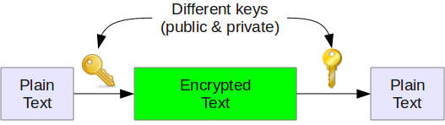
Asymmetric Key cryptography
Also called
Public Key Cryptography
(PKC)
Use two keys: one to encode and the other to decode s.t. they are…
… mathematically related although knowledge of one key does not allow someone to easily determine the other key
It does not matter which key is applied first, but that both keys are required for the process to work

Slide 19
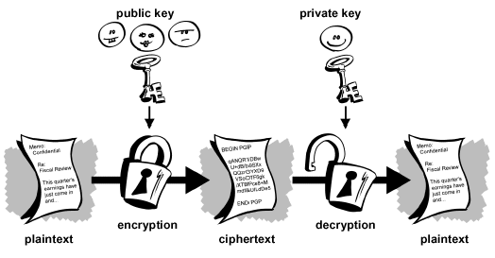
PKC: Encrypt & decrypt

Slide 20
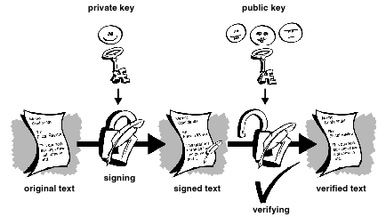
PKC: sign & verify
Only sender could have signed
Like handwritten signature… only more difficult to fake
A digital signature gives a recipient reason to believe that
a message was created by a known sender (authentication),
the sender cannot deny having sent the message (non-repudiation), and
the message was not altered in transit (integrity)

Slide 21
RSA
Rivest, Shamir, Adleman
Used in hundreds of software products
RSA uses a variable size encryption block and a variable size key
Key-pair is derived from a very large number, n, that is the product of two prime numbers chosen according to special rules
Primes may be 100 or more digits in length each, yielding an n with roughly twice as many digits as the prime factors
An attacker cannot determine the prime factors of n (and, therefore, the private key) from this information alone and that is what makes the RSA algorithm so secure
The ability for computers to factor large numbers, and therefore attack RSA scheme, is rapidly improving and systems today can find the prime factors of numbers with more than 200 digits
Nevertheless, if a large number is created from two prime factors that are roughly the same size, there is no known factorization algorithm that will solve the problem in a reasonable amount of time; a 2005 test to factor a 200-digit number took 1.5 years and over 50 years of compute time

Slide 22
Exercise on PKC
Install the PyCrypto library (available at https://www.dlitz.net/software/pycrypto/)
Try and understand the following commands
Generating a public-private keys pair
>>> from Crypto.PublicKey import RSA
>>> from Crypto import Random
>>> random_generator = Random.new().read
>>> key_pair = RSA.generate(1024, random_generator)
Encrypting
>>> public_key = key_pair.publickey()
>>> enc_data = public_key.encrypt('data', 32)
Decrypting
>>> key_pair.decrypt(enc_data)

Slide 23
Exercise on PKC
Install the PyCrypto library (available at https://www.dlitz.net/software/pycrypto/)
Try and understand the following commands
Generating a public-private keys pair
>>> from Crypto.PublicKey import RSA
>>> from Crypto import Random
>>> random_generator = Random.new().read
>>> key_pair = RSA.generate(1024, random_generator)
Encrypting
>>> public_key = key_pair.publickey()
>>> enc_data = public_key.encrypt('data', 32)
Decrypting
>>> key_pair.decrypt(enc_data)
NOTE THAT encrypt performs "textbook" RSA encryption, which is insecure due to the lack of padding!!!
You should instead look to use either Crypto.Cipher.PKCS1_OAEP or Crypto.Cipher.PKCS1_v1_5.
Try to understand how these work

Slide 24
What is the main problem of asymmetric cryptography?
What is the main advantage of asymmetric cryptography?

Slide 25
What is the main problem of asymmetric cryptography?
Slow!
What is the main advantage of asymmetric cryptography?

Slide 26
What is the main problem of asymmetric cryptography?
Slow!
What is the main advantage of asymmetric cryptography?
Ease of key distribution!

Slide 27
Symmetric vs asymmetric crypto
What is the main problem of symmetric cryptography?
Key distribution!
What is the main advantage of symmetric cryptography?
Very fast!
What is the main problem of asymmetric cryptography?
Slow!
What is the main advantage of asymmetric cryptography?
Ease of key distribution!

Slide 28
Symmetric vs asymmetric crypto
What is the main problem of symmetric cryptography?
Key distribution!
What is the main advantage of symmetric cryptography?
Very fast!
What is the main problem of asymmetric cryptography?
Slow!
What is the main advantage of asymmetric cryptography?
Ease of key distribution!
Can we take the best of both worlds?

Slide 29
DH
Diffie-Hellman
After the RSA algorithm was published, Diffie and Hellman came up with their own algorithm
DH is used for secret-key key exchange only, not for authentication or digital signatures

Slide 30
Transport layer security

Slide 31
SSL & TLS
SSL = Secure Sockets Layer.
Developed by Netscape in mid 1990s.
SSLv2 now deprecated; SSLv3 still widely supported
TLS = Transport Layer Security.
IETF-standardised version of SSL.
TLS 1.0 = SSLv3 with minor tweaks, RFC 2246 (1999)
TLS 1.1 = TLS 1.0 + tweaks, RFC 4346 (2006)
TLS 1.2 = TLS 1.1 + more tweaks, RFC 5246 (2008)
TLS 1.3 = major changes + removed insecure features, RFC 8446 (2018)
SSL = Secure Sockets Layer.
Originally shipped in Netscape Navigator 1.1
Developed as a way to secure communications between the client and server on the web
TLS = Transport Layer Security.
De facto standard for Internet security
Same SSL protocol design, different algorithms
“The primary goal of the TLS protocol is to provide privacy and data integrity between two communicating applications”
In practice, used to protect information transmitted between browsers and Web servers
Notes:
https://www.sans.org/reading-room/whitepapers/protocols/ssl-tls-beginners-guide-1029
https://www.owasp.org/index.php/File:OWASPLondon20180125_TLSv1.3_Andy_Brodie.pdf

Slide 32
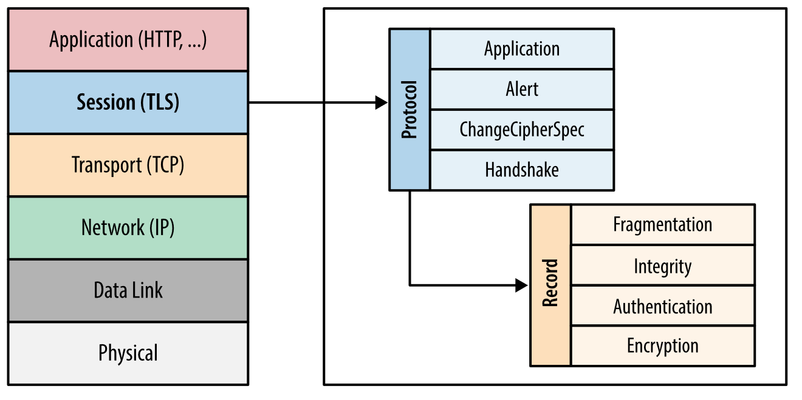
TLS basics
TLS consists of two protocols
Handshake protocol
Use public-key cryptography to establish a shared secret key between the client and the server
Record protocol
Use the secret key established in the handshake protocol to protect communication between the client and the server

Slide 33
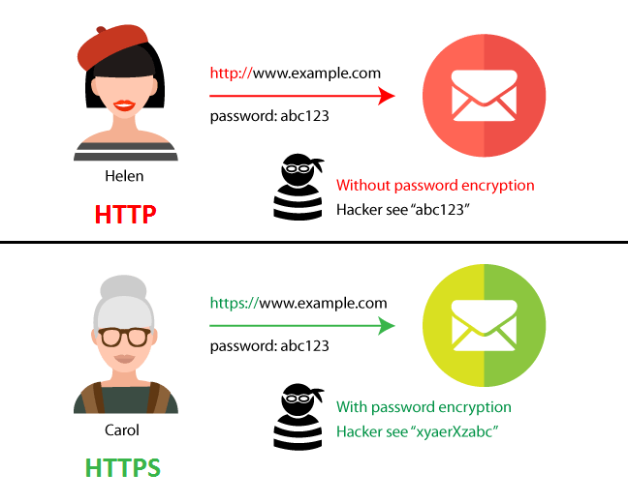
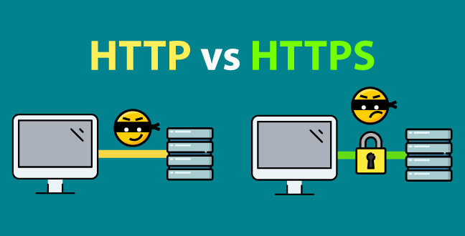
seopressor.com/blog/http-vs-https/

Slide 34
Ssl & tls in the real world (i.e. in the browser)
The lock icon is the SSL indicator
Intended goal:
Provide user with identity of page origin
Indicate to user that page contents were not viewed or modified by a network attacker
HTTPS provides
authentication of the website and associated web server with which one is communicating
Protection against man-in-the-middle attacks
bidirectional encryption of communications between a client and server
Protection against eavesdropping and tampering with or forging the contents of the communication
HTTP = HyperText Transfer Protocol
HTTPS = HTTP over TLS/SSL or HTTP Secure
Main motivations for HTTPS:
authentication of the visited website
protection of the privacy and integrity of the exchanged data

Slide 35
SSL/TLS: authenticity
For server authentication, the client uses the server's public key to encrypt the data that is used to compute the secret key. The server can generate the secret key only if it can decrypt that data with the correct private key.
For client authentication, the server uses the public key in the client certificate to decrypt the data the client sends during step 5 of the handshake. The exchange of finished messages that are encrypted with the secret key (steps 7 and) confirms that authentication is complete.
If any of the authentication steps fail, the handshake fails and the session terminates.
The exchange of digital certificates during the SSL or TLS handshake is part of the authentication process.

Slide 36
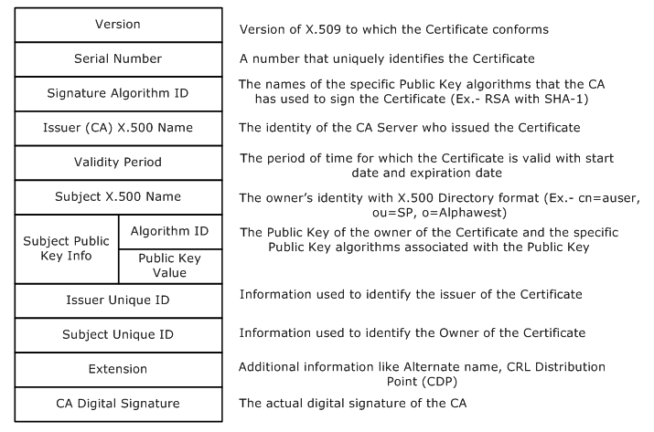
x.509: a standard for certificates

Slide 37
SSL/TLS: confidentiality
SSL and TLS use a combination of symmetric and asymmetric encryption to ensure message privacy.
During the SSL or TLS handshake, the SSL or TLS client and server agree an encryption algorithm and a shared secret key to be used for one session only.
All messages transmitted between the SSL or TLS client and server are encrypted using that algorithm and key, ensuring that the message remains private even if it is intercepted.
SSL supports a wide range of cryptographic algorithms.
Because SSL and TLS use asymmetric encryption when transporting the shared secret key, there is no key distribution problem.

Slide 38
SSL/TLS: integrity
SSL and TLS provide data integrity by calculating a message digest
Recall cryptographic hash functions
Use of SSL or TLS does ensure data integrity, provided that the CipherSpec in the channel definition uses a suitable hash algorithm
Use of MD5 is also strongly discouraged as this is now very old and no longer secure for most practical purposes.

Slide 39
tls: details

Slide 40
TLS handshake protocol: step by step

Slide 41
TLS handshake protocol: step by step
Step 1
The Client Hello message contains:
the version of the protocol that the client wants to use;
random value;
session ID: a freshly-generated value that will identify the new session;
list of supported cipher suite;
list of supported compression methods
TLS_<KeyExchange>_WITH_<Cipher>_<Mac>

Slide 42
TLS handshake protocol: step by step
Step 2
The server hello message contains
chosen protocol (supported by both parties);
random value;
session ID: a freshly-generated value that will identify the new session;
chosen cipher suite (supported by both parties);

Slide 43
TLS handshake protocol: step by step
Step 3
Certificate = If the client requested an authenticated connection, the server must send a X.509 certificate
Server Key Exchange = message sets the premaster secret that will be later used to generate the Master Secret
Certificate Request = a non-anonymous server can send this message if it requires the client to be authenticated
Diffie-Hellman

Slide 44
TLS handshake protocol: step by step
Step 4
Certificate = if the client has received a CertificateRequest message, it must send a X.509 certificate
Client Key Exchange = message sets the premaster secret that will be later used to generate the Master Secret
Certificate Verify = message that provides explicit verification of the client certificate

Slide 45
TLS handshake protocol: step by step
Step 5
Change Cipher Spec = message (consisting of a single byte of value 1) sent by both parties. Once received, the participant transitions to the agreed cipher suite.
Finished = generated by hashing the entire handshake and sent by both parties. It is used to signal the completion of the algorithm.

Slide 46
TLS handshake protocol: step by step
Steps 6-7
From the reception of the Change Cipher Spec message onward, every message sent (both by server and client) will be encrypted using the shared key

Slide 47
Recap questions
What is a symmetric cryptography?
What is Public Key Cryptography?
What is SSL/TLS?

Slide 48
tls: Vulnerabilities

Slide 49



Cookie authentication
The client logs in using its credentials
The server authenticates the client
The server generates and delivers a cookie
The client includes the cookie in every request
Server
Server
Client
Client
Delivery
Authentication
*= Daniele De Santis @ iconfinder.com (CC-3)
Notes:
https://stackoverflow.com/questions/17769011/how-does-cookie-based-authentication-work

Slide 50
BE careful!
TLS (up to v1.2) suffers from some security issues for a few reasons
Backward compatibility
The protocol still supports weak cipher suites and broken hash functions
Logical flaws
A set of logical loopholes can be used to “trick” both client and server
The set of viable attacks can be structured as a tree

Slide 51
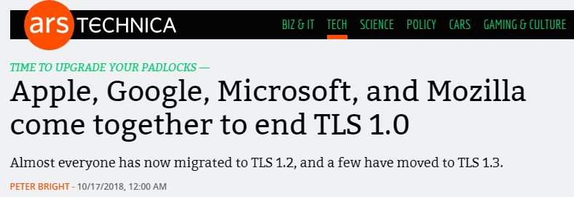
BE careful!
TLS (up to v1.2) suffers from some security issues for a few reasons

Slide 52
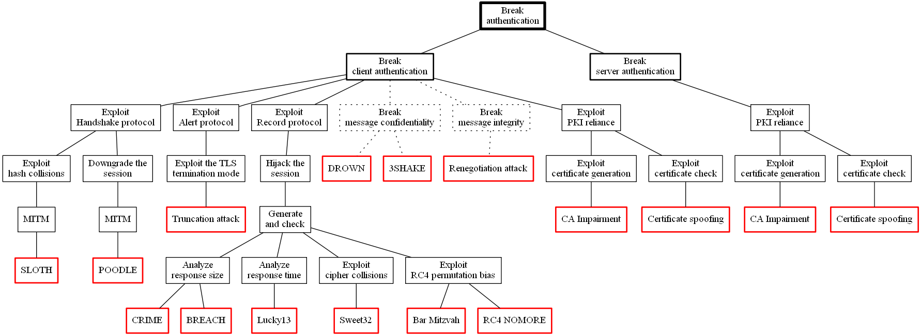
TLS 1.2 Attack tree
Notes:
https://www.schneier.com/academic/archives/1999/12/attack_trees.html

Slide 53
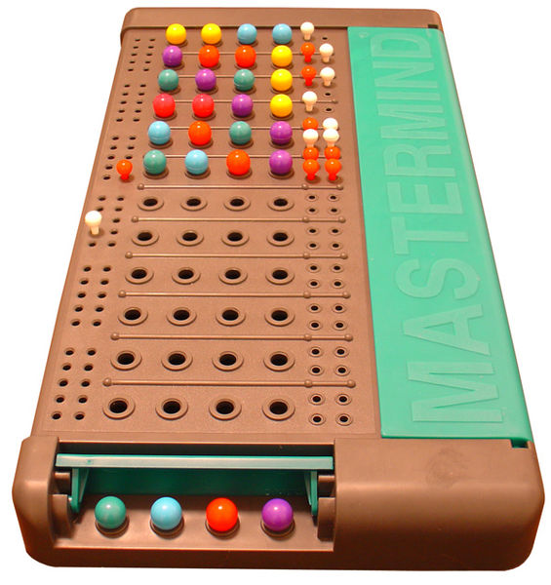
Mastermind – Code-Breaking
Invented in 1970
2 players
Codemaker - decides the secret code
Codebreaker - tries to guess it
6 code pegs
2 key pegs (red/white)
Notes:
http://www.webgamesonline.com/mastermind/

Slide 54

CRIME – Information leakage
Acronym: Compression Ratio Info-leak Mass Exploitation
Weakness: DEFLATE compression
replaces duplicate string with a reference to the last occurrence
the higher the redundancy, the shorter the output
Googling the googles
Googling the g(-13,4)es
Notes:
http://cve.mitre.org/cgi-bin/cvename.cgi?name=cve-2012-4929

Slide 55

CRIME – Information leakage
TLS does not hide request/response length
The attacker injects different characters into the victim’s requests trying to guess the content
if the guess is wrong, the server’s response will be bigger
if the guess is right, the attacker can recover sensitive information
Server
Client
Notes:
http://cve.mitre.org/cgi-bin/cvename.cgi?name=cve-2012-4929

Slide 56
BREACH – Information leakage v2
Acronym: Browser Reconnaissance and Exfiltration via Adaptive Compression of Hypertext
Weakness: HTTP compression
replaces duplicate string with a reference to the last occurrence
the higher the redundancy, the shorter the output
HTTP does not hide request/response length
The attacker injects different characters into the victim’s requests trying to guess the content
if the guess is wrong, the server’s response will be bigger
if the guess is right, the attacker can recover sensitive information
Notes:
http://cve.mitre.org/cgi-bin/cvename.cgi?name=cve-2012-4929

Slide 57
Beware of the birthday paradox
It concerns the probability that, in a set of n randomly chosen people, some pair of them will have the same birthday:
the probability reaches 100% when the number of people reaches 367 (since there are only 366 possible birthdays, including February 29)
99.9% probability is reached with just 70 people
50% probability with 23 people
Based on the assumption that each day of the year is equally probable for a birthday
Birthday attack: given an n-bit hash function h, we expect to identify a pair (x,x’) of distinct arguments for which there is a collision (i.e. h(x)=h(x’)) after evaluating the function for about 1.25*2^{n/2} different argument on average
Notes:
https://betterexplained.com/articles/understanding-the-birthday-paradox/

Slide 58
Sweet32 – Birthday attack
Given the birthday paradox
“after 2^{n/2} message blocks encrypted with the same key, a collision between two ciphertext blocks (ci = cj) is expected”
Weakness: TLS 1.2 hosts can negotiate a cipher called 3DES (triple DES) with a block size of 64 bits
given that the birthday bound corresponds to 2³², the first collision will appear when reaching 32 GB of encrypted data
Nowadays, an attacker can easily generate that amount of data by using a beastly attack scenario
basically controlling a malicious JavaScript within the victim’s browser
Fix: 3DES can be disabled and has been removed from TLS 1.3
Notes:
https://sweet32.info

Slide 59
Training: TLS configuration

Slide 60
Scenario
You are a sysadmin, responsible to maintain a server that hosts a website. Given that the website contains sensitive information, you need to ensure the highest possible level of security.
This VM is the server you have to keep secure, it contains a customized version of Apache web server (v2.4.37) that somebody else set up.
Notes:
http://cve.mitre.org/cgi-bin/cvename.cgi?name=cve-2012-4929

Slide 61
Hands-on

Slide 62
Tool
Features | sslscan | ssl-enum-ciphers | TLSSLed | TLS-Attacker | 3SHAKE checker | testssl
SSLv3, TLS 1.0, 1.1 and 1.2, RC4 | ✔ | ✔ | ✔ | ✔ |  | ✔
Weak ciphers |  |  | ✔ |  |  | ✔
SSLv2, Secure renegotiation | ✔ |  | ✔ | ✔ |  | ✔
CBC-mode cipher | ✔ | ✔ |  | ✔ |  | ✔
MD5/SHA1 signature alert | ✔ | ✔ | ✔ |  |  | ✔
Sweet32 | ✔ |  |  |  |  | ✔
Certificate expiration | ✔ |  | ✔ |  |  | ✔
Weak DH parameters | ✔ | ✔ |  |  |  | ✔
Heartbleed, TLS compression | ✔ |  |  | ✔ |  | ✔
BEAST |  |  | ✔ |  |  | ✔
TLS 1.3, DROWN |  |  |  | ✔ |  | ✔
3SHAKE |  |  |  |  | ✔
Notes:
http://cve.mitre.org/cgi-bin/cvename.cgi?name=cve-2012-4929

Slide 63
Exercise 1
Show the IP address
hostname -i
Steps
Start the “[Pro]M shared” VM
Log in (password: osboxes.org)
Run
sudo /usr/local/apache2/bin/apachectl -k start
bash TLSAssistant/TLSAssistant.sh -s <WEBSITE_IP> -v 2
Read the report stored in ~/Desktop/TLSAssistant/raw_reports/testssl_report.html
Task
Fix CRIME using the information provided in the report and on Internet
Notes:
http://cve.mitre.org/cgi-bin/cvename.cgi?name=cve-2012-4929

Slide 64
Exercise 1: bash commands
Steps
Start the VM
Log in (password: osboxes.org)
Run
sudo /usr/local/apache2/bin/apachectl -k start
bash TLSAssistant/TLSAssistant.sh -s <WEBSITE_IP> -v 2
Read the report stored in ~/Desktop/TLSAssistant/raw_reports/testssl_report.html
Task
Fix CRIME using the information provided in the report and on Internet
Open a text file using root permissions
sudo featherpad <PATH_TO_THE_FILE>
Show the IP address
hostname -i
Restart the Apache server
sudo /usr/local/apache2/bin/apachectl -k restart
Run the tool
bash TLSAssistant/TLSAssistant.sh -s <WEBSITE_IP> -v 2
Notes:
http://cve.mitre.org/cgi-bin/cvename.cgi?name=cve-2012-4929

Slide 65
Exercise 2
Show the IP address
hostname -i
Steps
Run
sudo /usr/local/apache2/bin/apachectl -k restart
bash TLSAssistant/TLSAssistant.sh -s <WEBSITE_IP> -v 1
Read the report stored in ~/Desktop/TLSAssistant/Report.md
Task
Fix CRIME/BREACH using the information provided in the report and on Internet
Notes:
http://cve.mitre.org/cgi-bin/cvename.cgi?name=cve-2012-4929

Slide 66
Exercise 1: bash commands
Steps
Start the VM
Log in (password: osboxes.org)
Run
sudo /usr/local/apache2/bin/apachectl -k start
bash TLSAssistant/TLSAssistant.sh -s <WEBSITE_IP> -v 2
Read the report stored in ~/Desktop/TLSAssistant/raw_reports/testssl_report.html
Task
Fix CRIME/BREACH using the information provided in the report and on Internet
Open a text file using root permissions
sudo featherpad <PATH_TO_THE_FILE>
Show the IP address
hostname -i
Restart the Apache server
sudo /usr/local/apache2/bin/apachectl -k restart
Run the tool
bash TLSAssistant/TLSAssistant.sh -s <WEBSITE_IP> -v 1
Notes:
http://cve.mitre.org/cgi-bin/cvename.cgi?name=cve-2012-4929

