Slide 1



MQTT: introduction and security issues
MQTT
Umberto Morelli - Security & Trust Research Unit
umorelli@fbk.eu / http://st.fbk.eu/people/profile/umorelli

Slide 2




MQTT
MQTT is a lightweight publish/subscribe messaging protocol designed for constrained devices communicating with low bandwidth over unreliable networks (e.g., high latency).
Suitable for the M2M (machine to machine) telemetry
Released royalty-free in 2010, standardized by OASIS in 2014 (v3.1.1)
Development flexibility
4 types of messages (Connect, Subscribe, Unsubscribe, Publish)
Quality of Service & session (clean/persistent)
Command & acknowledgment (Over TCP or WebSockets)
+ Control Packets
Notes:
More information on MQTT entities: https://www.hivemq.com/blog/mqtt-essentials-part-3-client-broker-connection-establishment/
More information on the persistance of MQTT messages: https://www.hivemq.com/blog/mqtt-essentials-part-7-persistent-session-queuing-messages/

Slide 3
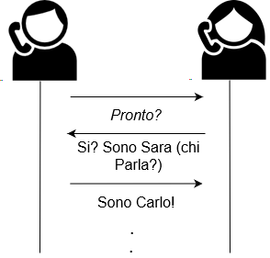
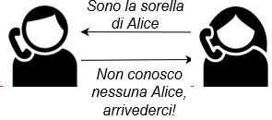

What is a message protocol?
Notes:
More information on the SSL/TLS handshake: https://www.websecurity.symantec.com/it/it/security-topics/how-does-ssl-handshake-work

Slide 4
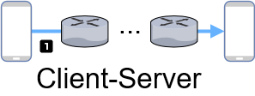
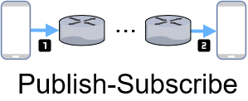
Publish/subscribE over client/server
The devices should
know the location of each other
be online at the same time
be available for communication (should not be blocked by other communication actions)
Space decoupling (e.g., no exchange of IP address and port)
Time decoupling: publisher and subscriber do not need to run at the same time
Synchronization decoupling: operations on both components do not need to be interrupted during publishing or receiving (asynchronously libraries)
Notes:
Maggiori informazioni sulla differenza qui: https://www.hivemq.com/blog/mqtt-essentials-part2-publish-subscribe/

Slide 5
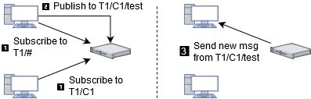

What is a Topic?
A dinamically-created queue that can store messages or process them on-fly messages depending on the Qualiy of Service that a client specified during subscription. Can be of User (/..) or System ($SYS/) types.
Hirarchical
Case sensitive (UTF-8 strings)
Support wildcards (# for any, + for a single character)
Must consist of at least one character to be valid.
Follow topic best practices!
Notes:
More information on MQTT Topics: https://www.hivemq.com/blog/mqtt-essentials-part2-publish-subscribe/

Slide 6
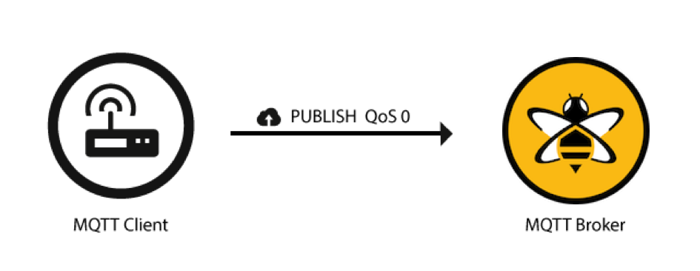
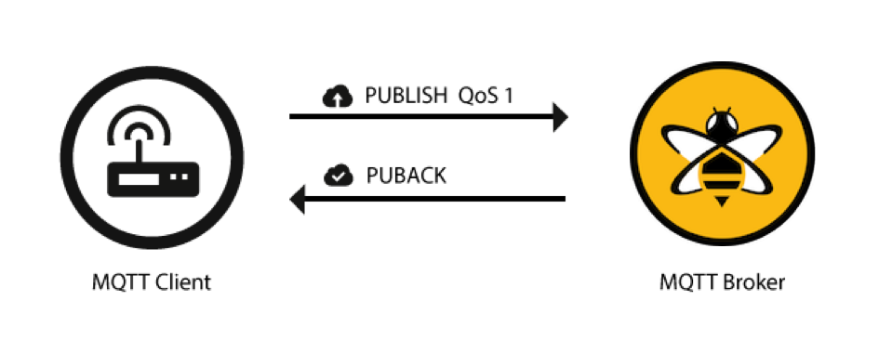
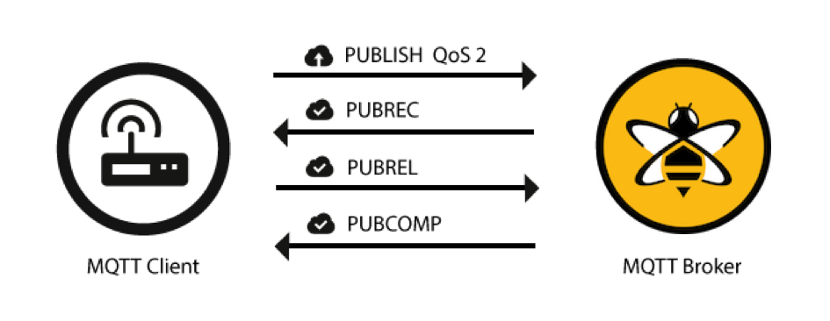
MQTT – Quality of Service (QoS)
QoS 0 when:
Stable connection (e.g. wired)
Don't care for messages loss
No message queuing in case of disconnections
QoS 1 when:
Don't care for duplicates but messages loss
Can’t bear the overhead of QoS 2
QoS 2 when:
Critical to receive exactly one copy of each message
0 - At most once
1 - At least once
Synchronise via PacketID and DUPlicate tags
Queuing (with persistent session)
2 - Exactly once
QoS downgrade
Notes:
More information on QoS of MQTT messages: https://www.hivemq.com/blog/mqtt-essentials-part-6-mqtt-quality-of-service-levels/

Slide 7
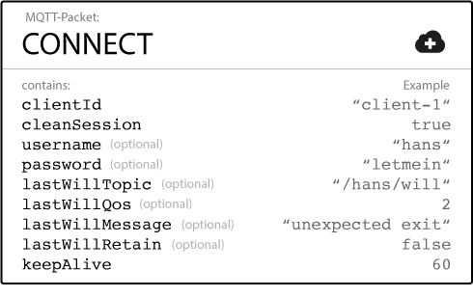
Client - Connect packet
ClientId - Uniques, identifies the MQTT client and its state
MQTT 3.1.1 supports an empty value (cleanSession must be false)
CleanSession - whether the client wants to establish a persistent session or not -> broker will store subscriptions and missed messages for QoS 1/2 subscription.
Usename/Password - if not encrypted or hashed is sent in plaintext
Will Message (LWT) - If the client disconnects ungracefully, the broker sends the LWT message on behalf of the client
KeepAlive - longest period of time that the broker and client can endure without sending a message (max > 18h); client sends PING requests, broker sends back PING responses.
The problem of Half-open connections
Notes:
More information on the keepalive functionality: https://www.hivemq.com/blog/mqtt-essentials-part-10-alive-client-take-over/

Slide 8
Hands-on with python
Paho-mqtt library

Slide 9
How to initialize a client and connect with Paho
Install the python library (pip install paho-mqtt)
Create an empty file and import the library components
import paho.mqtt.client as mqtt
Create a Client
client = mqtt.Client(client_id="", clean_session=True, userdata=None, protocol=mqtt.MQTTv311, transport="tcp")
Connect
client.connect(host="", port=1883, keepalive=60, bind_address="")
Paho reference Guide

Slide 10
How to process Events
on_connect(client, userdata, flags, rc)
on_disconnect(client, userdata, rc)
on_message(client, userdata, message*)
message_callback_add(sub, callback)
message_callback_remove(sub)
on_publish(client, userdata, mid)
on_subscribe(client, userdata, mid, granted_qos)
on_unsubscribe(client, userdata, mid)
on_log(client, userdata, level, buf)
# | Return codes (session present)
0 | Connection successful
1 | Connection refused - incorrect protocol version
2 | Connection refused - invalid client identifier
3 | Connection refused - server unavailable
4 | Connection refused - bad username or password
5 | Connection refused - not authorised 6-
255 | Currently unused
< topic, payload, qos, retain >*
Notes:
List of Paho functions: https://www.eclipse.org/paho/clients/python/docs/

Slide 11
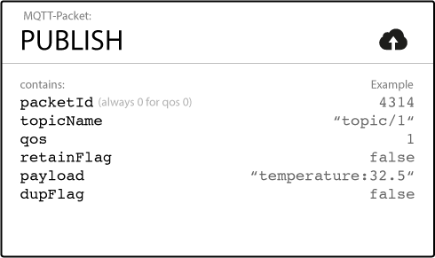
Client - Publish packet
Topic Name - hierarchically structured with forward slashes Retain Flag - the last known good value for a specified topic: when a new client subscribes to that topic, they will receive it. QoS (0,1,2) / packetId / DUP flag (message is a duplicate) Payload (images, encoded text, any binary data)
In Eclispe Paho:
client.publish(topic, payload=None, qos=0, retain=False) or one-line commands: single(..), multiple(..)
Notes:
List of Paho functions: https://www.eclipse.org/paho/clients/python/docs/

Slide 12
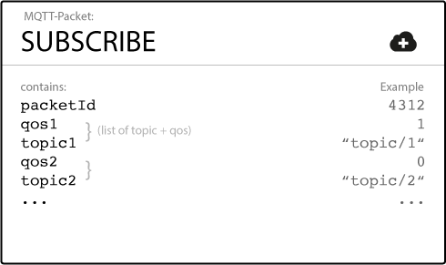
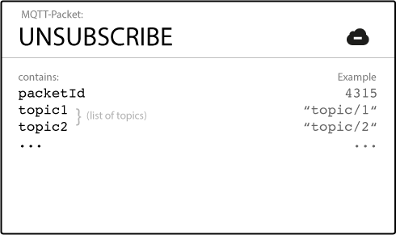
Client - Subscribe/Unsubscribe packets
QoS (0,1,2) - Topic couples
broker acknowledges each topic and shows granted QoS
Topics
broker acknowledges messages and return packetID
In Eclispe Paho:
client.subscribe(topic, qos=0) or simple(..) client.unsubscribe(topic)
Notes:
List of Paho functions: https://www.eclipse.org/paho/clients/python/docs/

Slide 13
Code Snippet 1
import paho.mqtt.client as mqtt
import time
def on_disconnect(client, userdata,rc):
client.loop_stop()
def on_message(client, userdata, message):
print ('message received '+ message.payload.decode("utf-8"))
def on_connect(client, userdata, flags, rc):
print("MQTT Client connection results: {}".format(mqtt.connack_string(rc)))
client = mqtt.Client(client_id="TestClient3243423", clean_session=True, userdata=None, protocol=mqtt.MQTTv311, transport="tcp")
client.on_connect = on_connect
client.on_disconnect = on_disconnect
client.on_message = on_message
client.connect(host="iot.eclipse.org", port=1883, keepalive=60, bind_address="")
client.loop_start()
client.subscribe('TestTopic')
time.sleep(60)

Slide 14


Assignment 1
Acquire data from the vibration sensor each 2 seconds and transmit it on the "Sensor-promcampXY" Topic of the broker test.mosquitto.org (port 1883)
15 minutes

Slide 15
Assignment 2
Acquire data from the vibration sensor each second and transmit it on the "Sensor-promcampXY" Topic of the local broker (port 1883)
+ If the sensor returns 1 publish also on topic "Alarm-promcampXY"
10 minutes

Slide 16


MQTTSA (demo session)
RECAP
Tool
Reports

Slide 17
Assignment 4
Secure the local broker with username/password and re-run MQTTSA
15 minutes

Slide 18
Assignment 5
Secure the local broker with certificate-based Authentication
30 minutes

