Slide 1



NodE-RED: Creating a dashboard for measurements
MQTT
Umberto Morelli - Security & Trust Research Unit
umorelli@fbk.eu / http://st.fbk.eu/people/profile/umorelli

Slide 2
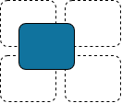




Node-RED
A flow-based visual programming tool that allows to wire together data generators, processing elements and output blocks to simplify the interaction with real-word events and IoT devices.
Messages representing events flow between nodes, triggering processing that results in output
Modular approach
Easy to import and export flows
Huge community
(~2100 modules available)
Multi-platform
Browser-oriented and cloud-supported

Slide 3
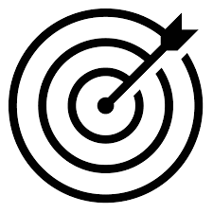
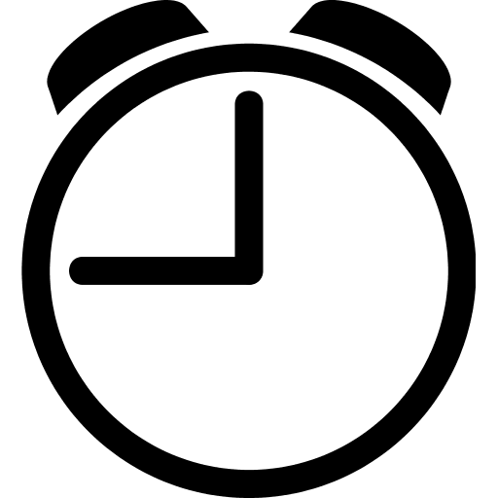
Assignment 1
1. Install NodeRED with NPM (npm install -g node-red) or follow the local-running guidelines.
2. Install the OpenWeather and Dashboard nodes (Menu->Manage Palette->Install).
3. Print the local weather in the UI. As alternative, use the inject and output nodes.
30 minutes

Slide 4
Assignment 2
Acquire the temperature from Arduino (Grove sensor) and compare the value with your local temperature (by using the OpenWeather service).
40 minutes

