Slide 1

Towards Performance Portability in GungHo and GOcean
M. Ashworth, R. Ford, M. Glover, D. Ham, M. Hobson, J. Holt, H. Liu, C. Maynard, T. Melvin, L. Mitchell, E. Mueller, S. Pickles, A. Porter, M. Rezny, G. Riley, P. Slavin, N. Wood

Slide 2
GungHo
Globally Uniform, Next Generation, Highly Optimised
“To research, design and develop a new dynamical core suitable for operational, global and regional, weather and climate simulation on massively parallel computers of the size envisaged over the coming 20 years.”
Remove the pole problem (replace lat-lon grid)
Aimed at massively parallel computers – 10^6 way parallel → petaflop
Split into two phases:
  2 years “research” (2011-13)
  3 years “development” (2013-2016)
Met Office, STFC, NERC funding Universities of: Bath, Exeter, Imperial, Leeds, Manchester, Reading

Slide 3
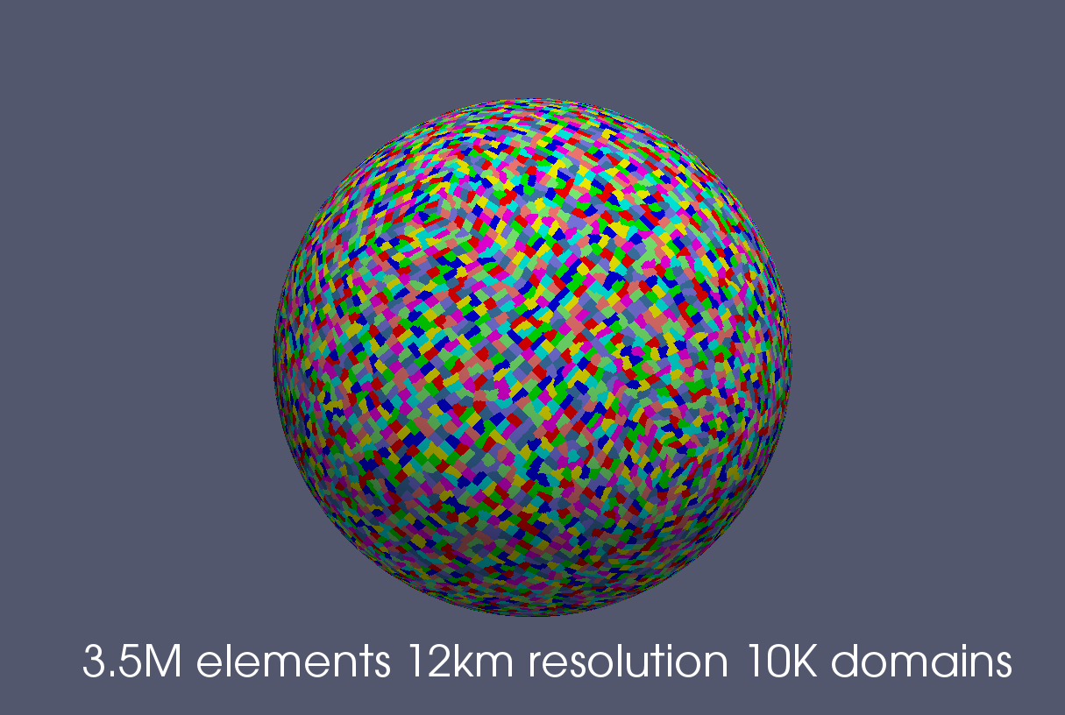
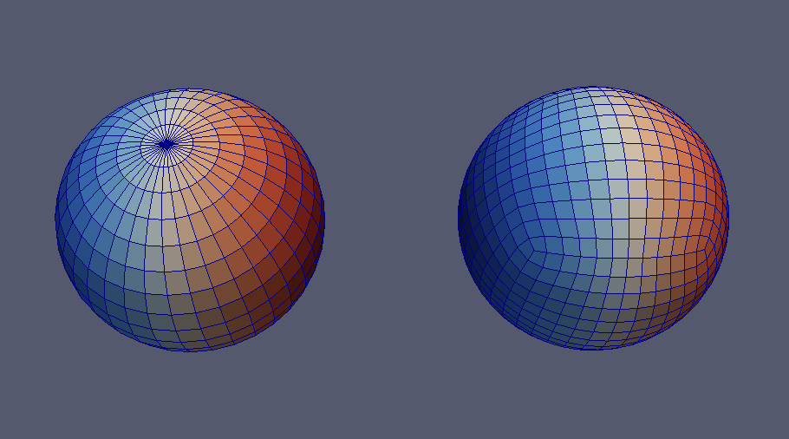
GungHo Status
(Most likely) Cubed Sphere
  Extruded (columnar) mesh (2d+1d)
Multi-grid
Finite element approach
Dynamo implementation

Slide 4
PSyKAl
Science
Algorithm
PSy
Performance
Kernels

Slide 5
GH Algorithm
Hand written (conforming to Fortran 2003)
Use Field objects
Logically operate on global fields
Invoke approach
  Algorithm layer specifies what the PSy layer has to do
  Algorithm layer “specifications” will be pre-processed to specific calls which replace original
  Invocation can take a 'list' of kernel specs
call invoke(kern(field1,field2,field3)...)

Slide 6
Illustration : Alg
...
call invoke(&
rhs_v3_type(rhs)&
)
...
...
use psy, only: invoke_rhs_v3
...
call invoke_rhs_v3(rhs)
...

Slide 7
Multi-function Illustration : Alg
...
call invoke(&
set(res_norm, 0.0), &
galerkin_action(x, Mu, u), &
galerkin_matrix_free_update(u, Mu, b, M_l, res_norm) &
)
...
...
USE psy, ONLY: invoke_2
...
CALL invoke_2(b, m_l, mu, u, x, res_norm)
...

Slide 8
GH Kernel
Hand written conforming to the GungHo PSyKAl API
Scientific
  There will also be library routines e.g. linear algebra
Column based (written assuming k-inner)
Access raw data (not field objects)
Associated metadata (required for code generation) e.g.
  Intents (extending fortran's in and out)
  The function space a field is on (v0, v1, v2, ...)
  what the kernel iterates over (cells, edges, ...)

Slide 9
Illustration GH0.1 API
module rhs_v3_mod
…
type, public, extends(kernel_type) :: rhs_v3_type
private
type(arg_type) :: meta_args(1) = [ &
arg_type(gh_rw,v3,fe,.true.,.false.,.true.) &
]
integer :: iterates_over = cells
contains
procedure, nopass :: rhs_v3_code
end type
...
subroutine rhs_v3_code(nlayers,ndf,map,v3_basis,x,gq)
...
end subroutine rhs_v3_code
end module rhs_v3_mod

Slide 10
GH PSy
The Optimised PSy may be generated
  Manual “reference/vanilla” version
  Should be easily debuggable
Functional responsibility
  iterating over columns
  Mapping of algorithm fields types/objects to data required by kernel
    Number of arguments may not be the same (e.g. dof information)
  Halo exchange
Performance responsibility
  Optimise for particular architectures → portable performance
  Threading: OpenMP, OpenACC, …, Kernel re-ordering, Fusion, Inlining, ...

Slide 11
Illustration GH0.1 API
module psy
...
subroutine invoke_rhs_v3(rhs)
use rhs_v3_mod, only : rhs_v3_code
...
nlayers=rhs%get_nlayers()
ndf = rhs%vspace%get_ndf()
call rhs%vspace%get_basis(v3_basis)
do cell = 1, rhs%get_ncell()
call rhs%vspace%get_cell_dofmap(cell,map)
call rhs_v3_code(nlayers,ndf,map,v3_basis,rhs%data,rhs%gaussian_quadrature)
end do
end subroutine invoke_rhs_v3
…
end module psy

Slide 12
PSyclone Code Generation
Code generation requires, Alg API, Kern API, Kernel metadata
Code generation can help with
  optimisation – labourious and error prone by hand
  changes in interfaces
PSyclone:
  Taking an interactive optimisation approach to support the expert
  Could also offer full automation option at a later date
  Generates correct sequential code for GH 0.1 API
  4,113 lines of Python code
  Following optimisations are available:
    Loop fusion
    OMP loop parallelisation
    Loop colouring
    Kernel inlining

Slide 13
PSyclone
Algorithm
Generator
Alg
Code
Alg
Code
Parser
psy
PSy
Generator
PSy
Code
Kernel
Codes

Slide 14
PSyclone
> python generate.py -oalg alg.f90 -opsy psy.f90 -api dynamo0.1 example.f90
>>> from generator import generate
>>> psy, alg = generate("example.f90", api=”dynamo0.1”)
>>> print str(psy.gen)
>>> print str(alg.gen)
>>> from algGen import Alg
>>> from parser import parse
>>> from psyGen import PSyFactory
>>> ast, info = parse(“example.f90”, api=”dynamo0.1”)
>>> psy = PSyFactory(“dynamo0.1”).create(info)
>>> alg = Alg(ast,psy)
>>> print str(psy.gen)
>>> print str(alg.gen)

Slide 15
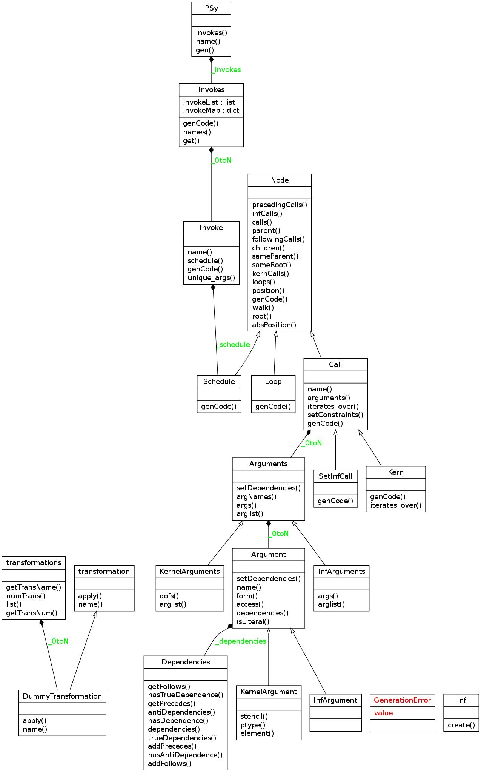
PSy Schedule
>>> psy = PSyFactory(“dynamo0.1”).create(info)
>>> invokes = psy.invokes
>>> invokes.names
>>> invoke = invokes.get("name")
>>> schedule = invoke.schedule
>>> schedule.view()

Slide 16
Schedule Illustration
...
call invoke(&
set(res_norm, 0.0), &
galerkin_action(x, Mu, u), &
galerkin_matrix_free_update(u, Mu, b, M_l, res_norm)&
)
...
schedule
loop
loop
loop
Inf:set
kern
kern

Slide 17
PSy Transformations
>>> from psyGen import transformations
>>> t=transformations()
>>> print t.list
There are 2 transformations available:
1: LoopFuse: Fuse two adjacent loops together
2: SwapTrans: A test transformation that swaps to adjacent elements in a schedule
>>> lf=t.getTransName("LoopFuse")

Slide 18
Transform PSy Schedule
>>> lf = LoopFuseTrans()
>>> loop1 = schedule.children[0]
>>> loop2 = schedule.children[1]
>>> new_schedule, memento = lf.apply(loop1, loop2)
>>> invoke._schedule = new_schedule

Slide 19
GOcean
NERC funded Proof-of-principle 1 year project
STFC & NOC + advice from GungHo colleagues
Can GungHo PSyKAl approach be applied to Ocean Models?
Finite Difference
2+1 test codes: shallow, NEMO-lite-2D, NEMO-lite-3D

Slide 20
GOcean
T, P, U, V metadata to describe staggering
API: Point-wise kernels, direct addressing
Manual shallow and NEMO-lite-2D using GOcean PSyKAl
PSyclone correct sequential code for 0.1 API
Loop fusion, OpenMP loop parallel, inlining supported
Nearly 90% of PSyclone is common

Slide 21
Original Shallow
...
DO J=1,N
DO I=1,M
CU(I+1,J) = .5*(P(I+1,J)+P(I,J))*U(I+1,J)
CV(I,J+1) = .5*(P(I,J+1)+P(I,J))*V(I,J+1)
Z(I+1,J+1) =(FSDX*(V(I+1,J+1)-V(I,J+1))-FSDY*(U(I+1,J+1) &
-U(I+1,J)))/(P(I,J)+P(I+1,J)+P(I+1,J+1)+P(I,J+1))
H(I,J) = P(I,J)+.25*(U(I+1,J)*U(I+1,J)+U(I,J)*U(I,J) &
+V(I,J+1)*V(I,J+1)+V(I,J)*V(I,J))
END DO
END DO
...

Slide 22
Shallow Alg
...
call invoke( compute_cu_type(CU, P, U), &
compute_cv_type(CV, P, V), &
compute_z_type(Z, P, U, V), &
compute_h_type(H, P, U, V) )
...
...
USE psy_shallow, ONLY: invoke_0
...
CALL invoke_0(cu, p, u, cv, v, z, h)
...

Slide 23
Example
>>> schedule.view()
Schedule[invoke='invoke_0']
Loop[type='outer',field_space='cu',it_space='dofs']
Loop[type='inner',field_space='cu',it_space='dofs']
Call compute_cu_code(cu_1,p,u)
Loop[type='outer',field_space='cv',it_space='dofs']
Loop[type='inner',field_space='cv',it_space='dofs']
Call compute_cv_code(cv_1,p,v)
Loop[type='outer',field_space='cf',it_space='dofs']
Loop[type='inner',field_space='cf',it_space='dofs']
Call compute_z_code(z,p,u,v)
Loop[type='outer',field_space='ct',it_space='dofs']
Loop[type='inner',field_space='ct',it_space='dofs']
Call compute_h_code(h,p,u,v)

Slide 24
Shallow Kern
module compute_cu_mod
use kind_params_mod
...
type, extends(kernel_type) :: compute_cu_type
type(arg), dimension(3) :: meta_args = &
(/ arg(WRITE, CU, POINTWISE), & ! cu
arg(READ, CT, POINTWISE), & ! p
arg(READ, CU, POINTWISE) & ! u
/)
integer :: ITERATES_OVER = DOFS
contains
procedure, nopass :: code => compute_cu_code
end type compute_cu_type
...
subroutine compute_cu_code(i, j, cu, p, u)
...
CU(I,J) = .5*(P(I,J)+P(I-1,J))*U(I,J)
end subroutine compute_cu_code
end module compute_cu_mod

Slide 25
Example
SUBROUTINE invoke_0(cu_1, p, u, cv_1, v, z, h)
...
DO j=cu%jstart,cu%jstop
DO i=cu%istart,cu%istop
CALL compute_cu_code(i, j, cu_1, p, u)
END DO
END DO
DO j=cv%jstart,cv%jstop
DO i=cv%istart,cv%istop
CALL compute_cv_code(i, j, cv_1, p, v)
END DO
END DO
...
END SUBROUTINE invoke_0

Slide 26
GOcean shallow 128
Compiler: | Cray 8.3.3 | Intel 14.0.1 | Gnu 4.8.2 | Intel 14.0.0
Hardware: | IvyBridge | IvyBridge | Haswell | Haswell
Original | 0.29 | 0.40 | 0.37 | 0.37
Vanilla | 0.41 | 0.49 | 6.30 | 0.42
Explicit bounds | 0.34 | 0.47 | 6.34 | 0.43
In-lined kernels | 0.35 | 0.47 | 0.55 | 0.42
Loop fused | 0.34 | 0.43 | 0.53 | 0.39
In-lined copy | 0.34 | 0.43 | 0.54 | 0.39
Fused copy | 0.31 | 0.51 | 0.54 | 0.45
Fastest | 0.31 | 0.43 | 0.53 | 0.39
% slower | 4.26 | 7.30 | 42.25 | 5.43

Slide 27
GOcean shallow sizes with Cray compiler
Problem size | 64 | 128 | 256 | 512 | 1024
Original | 0.008 | 0.29 | 1.21 | 5.70 | 44.12
Fastest | 0.008 | 0.31 | 1.3 | 5.88 | 42.77
% slower | -.23 | 4.26 | 7.78 | 3.18 | -3.06

Slide 28
Summary
PSyKAl approach shows promise
Code Generation shows promise
Initial results show promise
Can promise become practice?

Slide 29
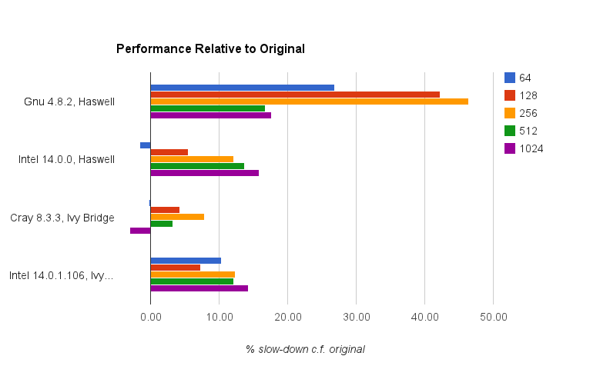
Gocean shallow

Slide 30
GungHo Data Model
15
10
Unstructured mesh format in horizontal, direct in the vertical
“K-inner” for performance
Separate mesh and location of data on a mesh (function space)
Vertically aligned degrees of freedom are contiguous
Dofmap references base element (1,2,6,7,11,12,16,17)
Designed to support different mesh and element types
20
5
14
9
19
4
13
8
18
3
12
7
17
2
11
6
16
1

Slide 31
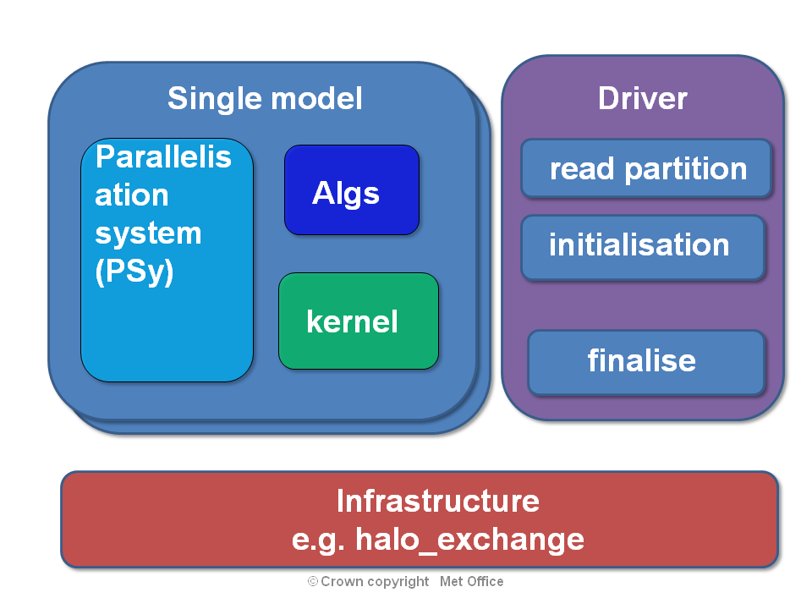
PSyKAl

Slide 32
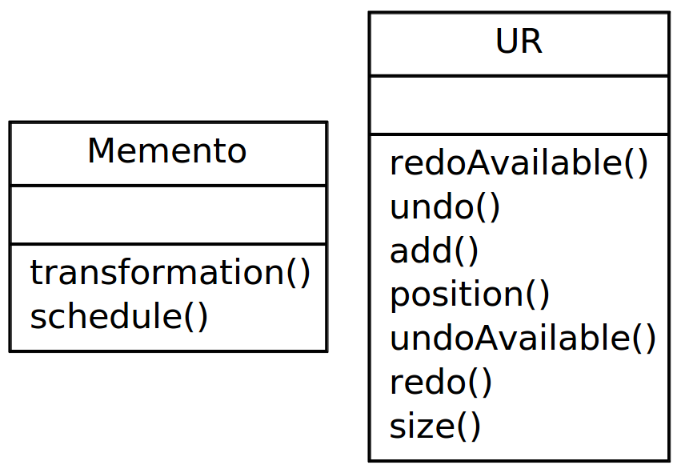
Undo/Redo PSy Transformations
>>> newSchedule,memento=lf.apply(loop1,loop2)
>>> ur=UR()
>>> ur.add(memento)
>>> invoke.schedule=newSchedule
>>> print invoke.schedule
>>> invoke.schedule=ur.undo.schedule
>>> print invoke.schedule
>>> invoke.schedule=ur.redo.schedule

Slide 33
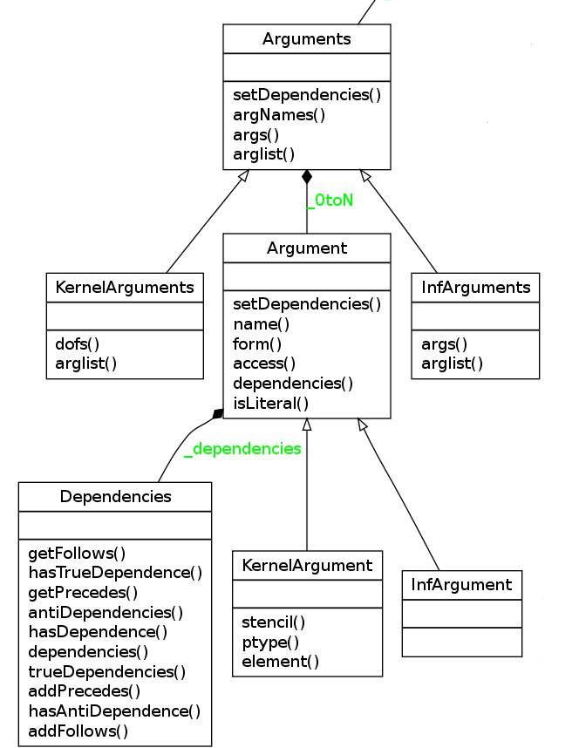
Dependencies
schedule
set(res_norm, 0.0)
galerkin_action(x, Mu, u)
galerkin_matrix_free_update(u, Mu, b, M_l, res_norm)
loop
loop
loop
Inf:set
kern
kern

Slide 34
Summary
PSyclone : PSy layer code generation system
Written in Python
Designed to support interactive optimisation
Extensible transformations
Each PSy invocation has a schedule. The schedule consists of (infrastructure or kernel) calls and loops
Dependencies are between arguments in the calls and constrain validity of transformations
Transformations in a separate package. These produce a new schedule and a “memento” object
Undo/redo package uses mementos for its functionality

Slide 35
Next
Sequential code generation for dynamo examples
Complete dependencies support
OpenMP transformation
Improved documentation
Internal release scheduled end of May

