Slide 1

Performance optimization for modern many-core architectures using PSyclone embedded-DSL.
Sergi Siso (sergi.siso@stfc.ac.uk)
High-Performance Software Engineer
IPCC @ Hartree, STFC Daresbury Laboratory, United Kingdom
Work done with: Rupert Ford, Andrew Porter, Christopher Maynard

Slide 2
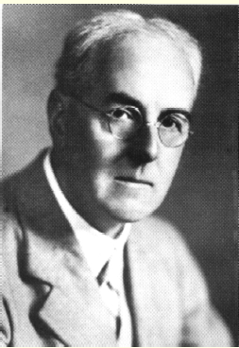
Project Background
LFRic project
Gungho project
Met Office (UK) project to develop a replacement for the Unified Model.
Developed in a collaboration between MetOffice and STFC (Hartree Centre)
Named in honour of Lewis Fry Richardson (first numerical weather ‘prediction’)
MetOffice, NERC and STFC initial investigation and design for next-generation model. They produced a set or recommendations for LFRic.
New dynamical core more scalable and without the singularity on the poles:
Mixed finite-element scheme with a cubed-sphere mesh.
Good software abstraction and separation of concerns.
Achieve good performance on current and future supercomputers.
Notes:
Optimising UM is very labour intensive

Slide 3
Separation of concerns
Natural Science Knowledge
Computational Science Knowledge
Finite element/volume/difference-specific
Time-stepping
Operations over a mesh
Typically same operation at each element/volume/point
Parallelism
Data decomposition
Data locality
Architecture/platform dependent optimizations
Domain Scientists
HPC Specialists
Notes:
Data parallel (typically independent operations)
Nearest neighbour communications for stencils
Global reduction(s) for convergence and/or conservation

Slide 4

PSyclone
Operates on full fields
Algorithm
Natural Science
Computational Science
Parallel System
Kernel
Operates on local elements or columns
Given domain-specific knowledge and information about the Algorithm and Kernels, the Parallel System layer can be generated by ...
Notes:
A domain-specific source-to-source (Fortran -> Fortran) compiler for embedded DSL(s)
Supports distributed- and shared-memory parallelism
Reduces programmer errors (both correctness and performance) in implementing parallel code
Optimisations encoded as a ‘recipe’ rather than baked into the scientific source code
Different recipes for different architectures

Slide 5


Hartree IPCC Contribution to PSyclone / LFRic
Hartree – Intel PCC
PSyKAl
Exploration on KNL platform
input science
feedback
optimisations
generates parallel system
LFRic
Other platforms Other HPC experts
Explore the performance characteristics of LFRic / PSyclone on many-core architectures (Intel Xeon Phi x200)
Feedback the obtained knowledge to PSyclone and LFRic projects

Slide 6
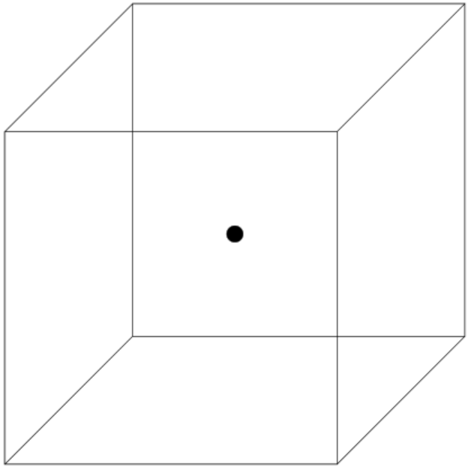
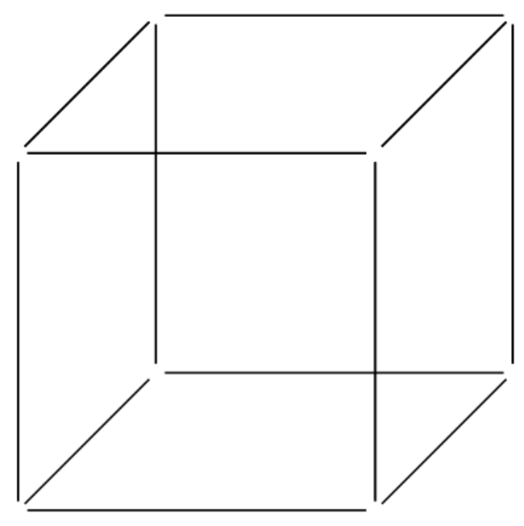
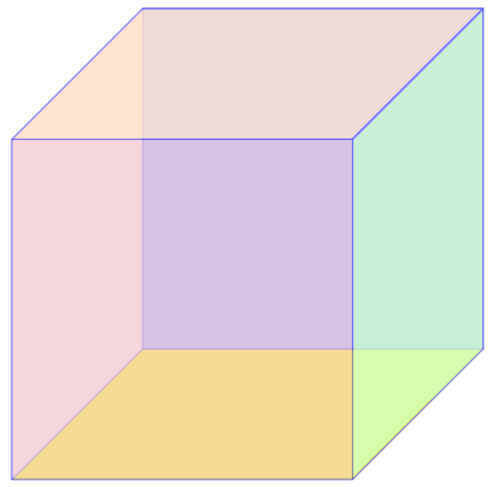
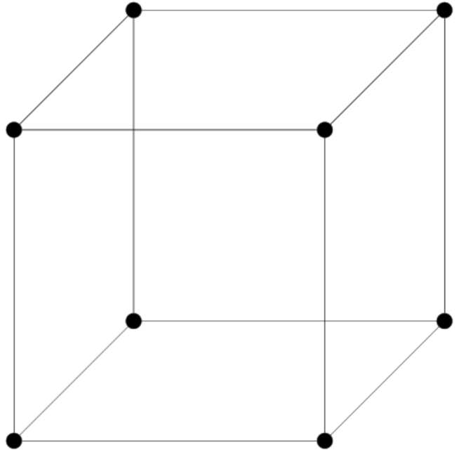
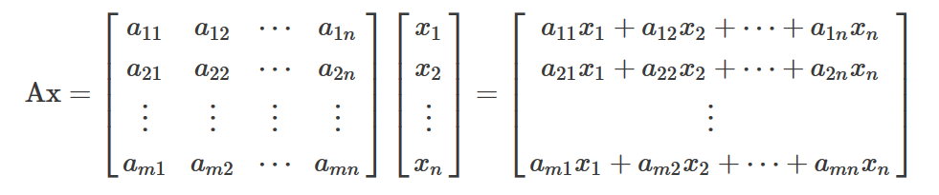
Matrix Vector Multiplication Kernel (hotspot and representative kernel)
LFRic uses multiple FEM fields:
Operations are encoded in LMA (local matrix assembly) and are designed to transform from one field to another.
Very Small matrix-vector multiplication – difficult to optimise...
but we have many to do (horizontal and extruded dims) and they share data

Slide 7
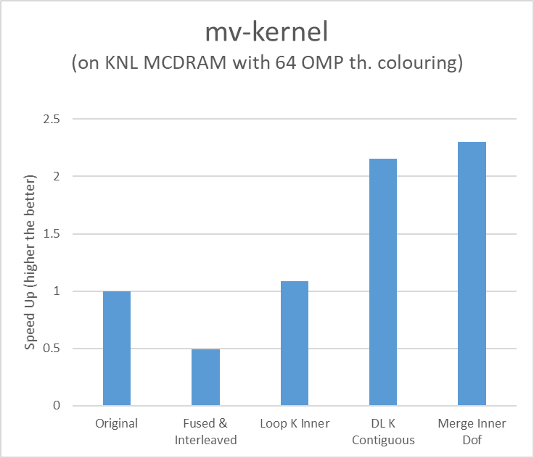
Original: LFRic current implementation. VTune pinpoints L2 Misses and SIMD-to-L2 ratio issues.
Fused & Interleaved: Fuse gathers, computation and scatters, do each FMA interleaved with next mv.
Loop K Inner: Refactor loops to go through vertical domain first.
DL K Contiguous: Refactor data layout.
Merge Inner Dofs: Update top dof of i layer at the same time as the bottom dofs i+1 layer.
(mkl and libxsmm couldn’t improve the performance of manual implementation)

Slide 8
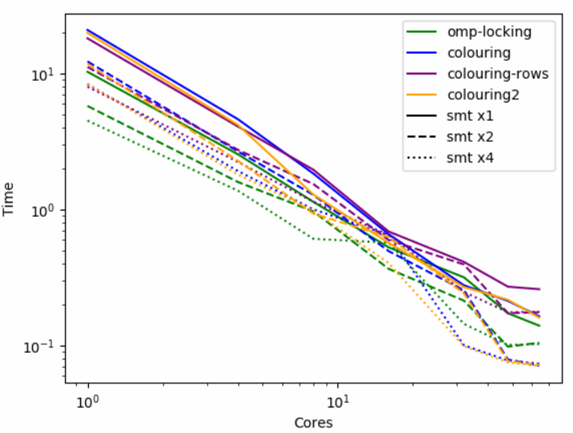
OpenMP Implementations
gungho-mv ‘DL K Contiguous’ implementation
Problem size: 32x32 (x16)
OMP Schedule: Static
OMP Affinity: Scattered
KNL: cache-quadrant
Thread oversubscribing helps across all implementations.
Colouring beats Locking for more than 10 threads.

Slide 9
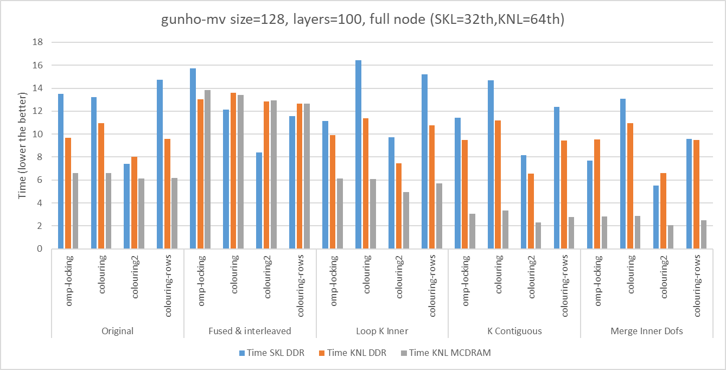
Skylake vs KNL vs KNL with MCDRAM
Best Performance
Vector Efficiency is ~ x2

Slide 10
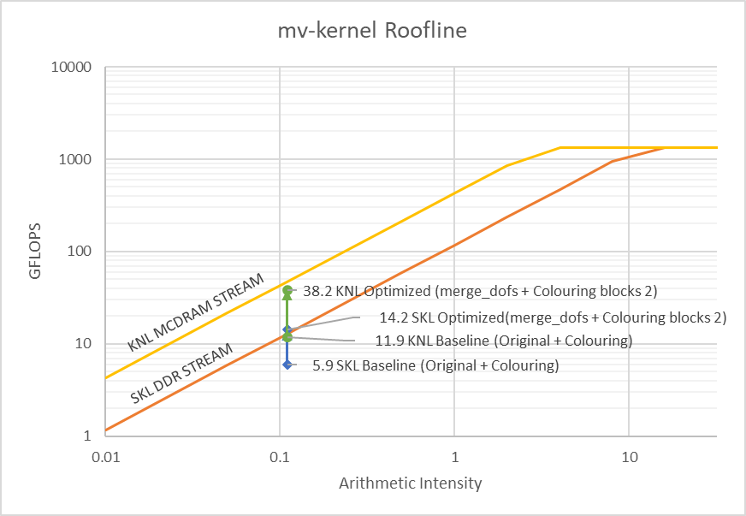
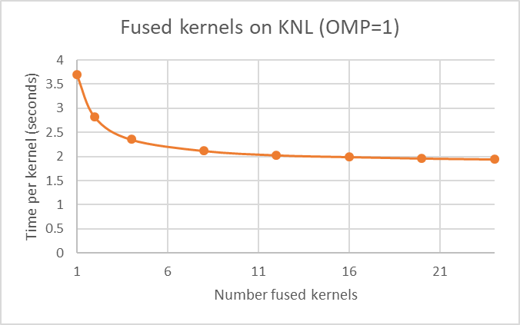
Skylake and KNL Rooflines
Full node mv-kernel for:
Skylake is at the DDR STREAM Triad boundary.
KNL is at 76% of MCDRAM STREAM Triad boundary.
Next step could be kernel-fusing:

Slide 11
MPI Efficiency

Slide 12
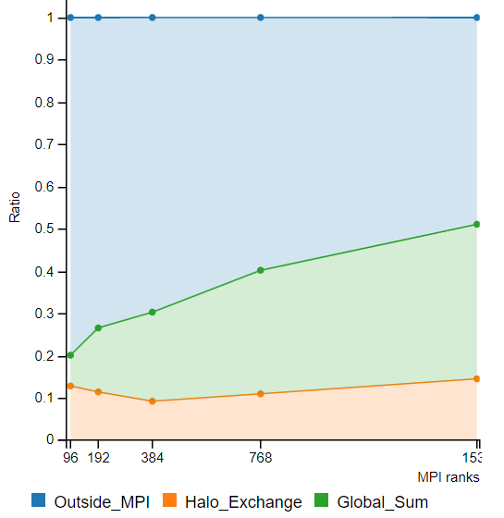
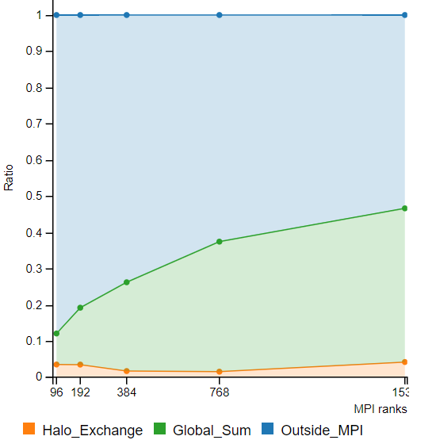
Transparently apply PSyclone optimizations to Halo Exchanges
Original Optimized

Slide 13
Future work
OpenMP strategies, loop fusions, halo exchange optimisations, … can be extended to the whole code with PSyclone.
However, changing the data layout and refactoring the loops is a manual process at the moment.
IPCC recommends that PSyclone explores mechanisms to abstract the data layout (and/or loop structure).
This is essential for achieving optimal performance.
LFRic is still in development: column matrix assembly, multi-grid and other features are coming.

Slide 14

Thanks for your attention
Hartree Evaluation Access Programme
Sergi Siso : sergi.siso@stfc.ac.uk
http://www.hartree.stfc.ac.uk

Slide 15
Annex Slides

Slide 16

Hartree Centre Scafell Pike Systems
ATOS Sequana x1000
840 – 2 x Intel Xeon Gold E5-6142 v5 (formerly Skylake) 16 core up to 3.7GHz
840 – self-hosted Intel Xeon Phi KNL 7210 nodes 64 cores up to 1.5 GHz
27000 + 54144 cores
Mellanox EDR Infiniband

Slide 17
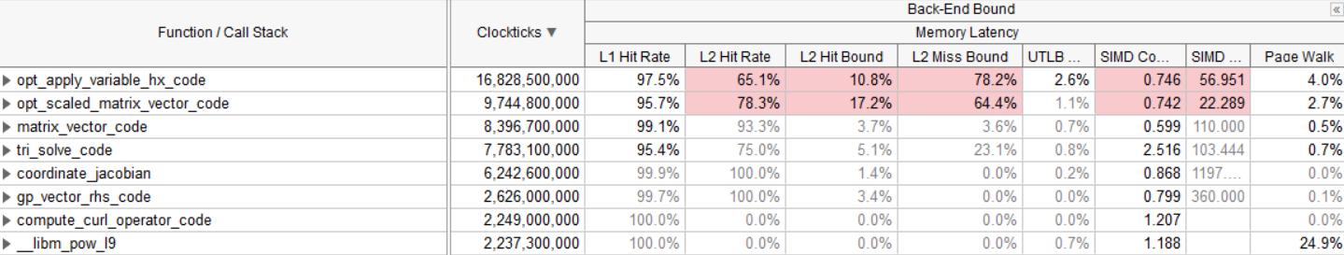
LFRic KNL VTune Analysis
Poor L2 usage
Poor Simd-to-L1/L2 ratios

Slide 18
PSyclone architecture
Algorithm
Generator
Alg
Code
AST
f90
Alg
Code
Parser
psy
PSy
Generator
PSy
Code
Kernel
Codes
info
f90
Transforms
Transformation
schedule

Slide 19
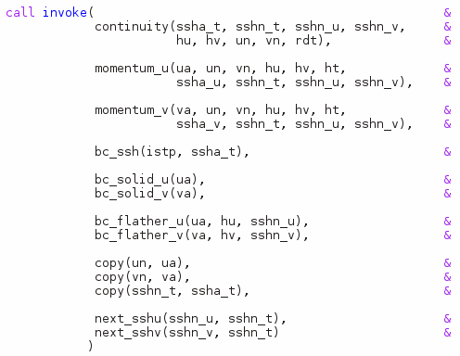
Algorithm Layer example

Slide 20
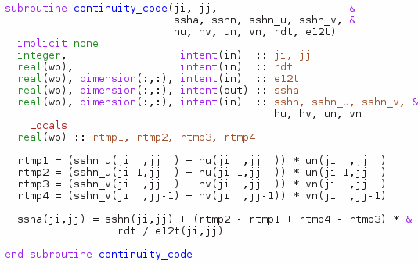
Kernel Layer Example

Slide 21
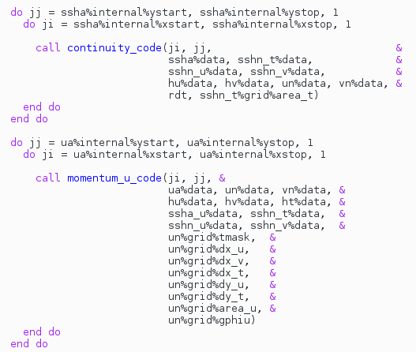
PSy generated code

