Slide 1
GOcean
Mike Ashworth
Rupert Ford
Stephen Pickles
Andy Porter
Graham Riley
STFC Daresbury

Slide 2
Overview
Intro to GungHo
Current status of GungHo
Example
Adding a FD structured code to GungHo
Adding a FV unstructured code to GungHo
  Just use existing approach?

Slide 3
GungHo
Globally Uniform, Next Generation, Highly Optimised
“To research, design and develop a new dynamical core suitable for operational, global and regional, weather and climate simulation on massively parallel computers of the size envisaged over the coming 20 years.”
Remove the pole problem (replace lat-lon grid)
aimed at massively parallel computers – 10^6 way parallel → petaflop
Split into two phases:
  2 years “research” (2011-13)
  3 years “development” (2013-2016)
Met Office, STFC, Universities of: Bath, Exeter, Imperial, Leeds, Manchester, Reading, Warwick
shun

Slide 4
Current Status of GungHo
Numerics (Nigel Wood + ...)
Algorithm and Kernel (David Ham + ...)
Distributed Memory (Mike Hobson + …)
Code Generation and Optimisation (Psy Layer)
  Rupert Ford, Chris Maynard, Graham Riley, Lawrence Mitchell

Slide 5
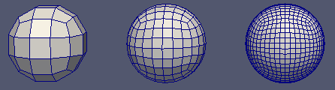
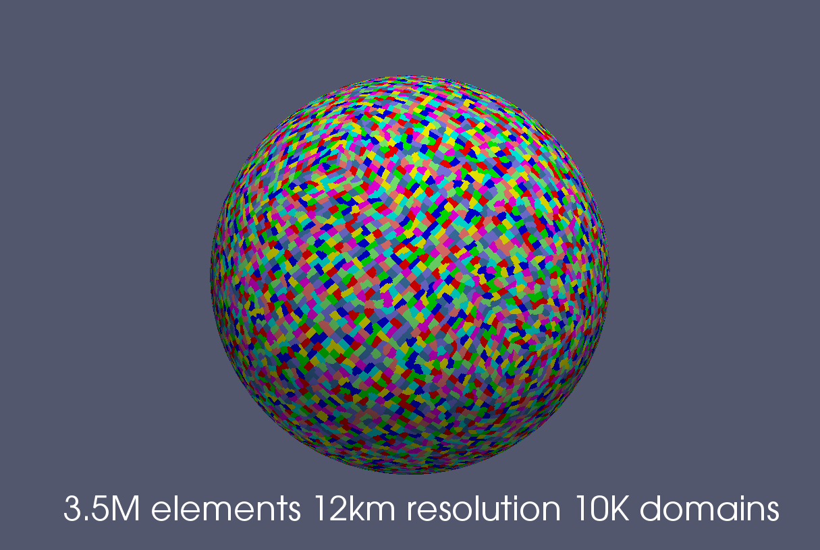
Current Status of GungHo
(Most likely) Cubed Sphere
  Extruded (columnar) mesh (2d+1d)
Low order finite element approach
  rt0, rt1, bdfm
  Dofs
shun

Slide 6
Data model
Unstructured mesh format in horizontal, direct in the vertical
“K-inner” for performance
Separate mesh and location of data on a mesh (function space)
Vertically aligned degrees of freedom are contiguous
Dofmap references base element (1,2,6,7,11,12,16,17)
Designed to support different mesh and element types
15
10
20
5
14
9
19
4
13
8
18
3
12
7
17
2
11
6
16
1
shun

Slide 7
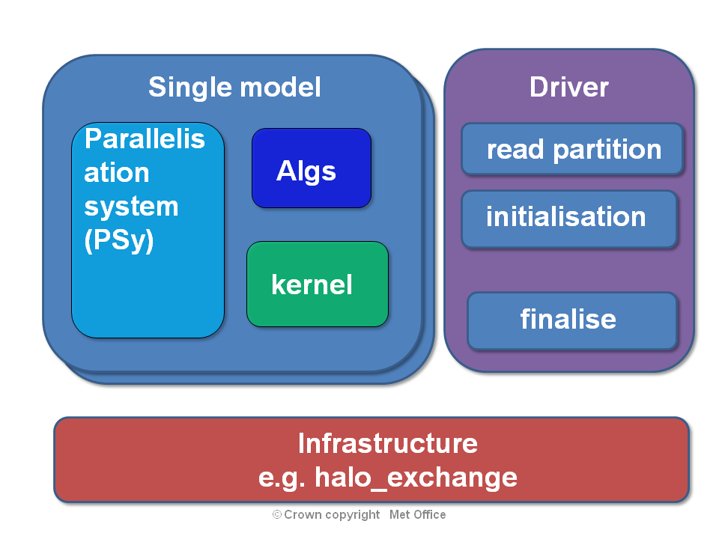
Separation of Concerns
PSy-Kern-Alg-Inf separation (PSyKAl)
Manual and/or Generated PSy layer

Slide 8
Kernels
Kernels will be hand written conforming to some standard
Kernels will be scientific
  There will also be library routines e.g. linear algebra
Kernels will have metadata associated with them e.g.
  Intents (extending fortran's in and out)
  Halo access information
  what the kernel iterates over
Kernels are column based : caveat, iterate over all dofs
  Work with single columns to start with

Slide 9
Algorithm
Algorithm layer will be hand written and conform to fortran 2003
Invoke approach
  Algorithm layer will (fully?) specify what the PSy layer has to do
    Should be in a way that is “obvious” to the programmer
  Algorithm layer engine “specifications” will be pre-processed to specific calls which replace original
  Invocation should take a 'list' of kernel specs
call invoke(func(arg1,arg2,arg3),...)

Slide 10
PSy
The Optimised PSy may be generated
  Manual “reference” version
  Should be easily debuggable (and modifiable??)
Functional responsibility
  iterating over columns
  Mapping of algorithm fields types/objects to data required by kernel
    Number of arguments may not be the same (e.g. dof information)
  Halo exchange
Performance responsibility
  Threading
  Kernel re-ordering (including halo replacement)
  Fusion
  Inlining
  ...

Slide 11
Alg to PSy API : single call
What do scientists write?
Specific or Generic call
  Compute engine or not?
    Dynamo
call psy_func(arg1,arg2,arg3,...)
call invoke(kern_type(arg1,arg2,arg3),...)

Slide 12
Alg to PSy API : single call
Code transformation from generic to specific (or vice versa?)
use psy_x, only : psy_func
...
call psy_func(arg1,arg2,arg3,...)
?
use kern, only : kern_type
...
call invoke(kern_type(arg1,arg2,arg3),...)
tree=fparser.api.parse(fileName,ignore_comments=False)
for stmt, depth in api.walk(tree, -1):
if isinstance(stmt,fparser.statements.Call):
use=getuse(stmt.parent,onlyname=stmt.designator)
if use.name==options.psy:
name=stmt.designator
stmt.designator=options.engine
stmt.items.insert(0,name)
appenduse(use,options.engine)
removeuse(use,name)
kernuse=getuse(use.parent,usename=options.kernel)
if kernuse==None:
adduse(options.kernel,use.parent,only=True,funcnames=[name])
else:
appenduse(kernuse,name)
extended f2py parser

Slide 13
Example 1: Algorithm code content
...
type(ConstantFunctionSpace_type), pointer :: R_space
type(state_type) :: state
type(field_type), pointer :: integral, x
integer :: i
call read_triangle(state, "../data/unitsquare.1",&
& layer_heights=[real(dp) :: (i/1000., i=0,1000)])
x => state%extract_field("Coordinate")
R_space => new_ConstantFunctionSpace("R_space")
integral => new_Field("integral", R_space)
call invoke(integrate_one_kernel(x, integral))
...

Slide 14
Example 1: Transformed Algorithm
program main
...
use integrate_one_module, only : integrate_one_kernel
...
call invoke(integrate_one_kernel(x, integral))
...
end program main
PROGRAM main
...
USE psy_main, ONLY: invoke_integrate_one_kernel
...
CALL invoke_integrate_one_kernel(x, integral)
…
END PROGRAM main

Slide 15
Example 1: Kernel code content
subroutine integrate_one_code(layers, p1dofm, X, R)
integer, intent(in) :: layers
integer, intent(in) :: p1dofm(6)
real(dp), intent(in) :: X(3,*)
real(dp), intent(inout) :: R
real(dp) :: dx1(2), dx2(2), area
integer :: k
dx1 = X(1:2, p1dofm(3))-X(1:2, p1dofm(1))
dx2 = X(1:2, p1dofm(5))-X(1:2, p1dofm(1))
area = 0.5*abs(dx1(2)*dx2(1)-dx1(1)*dx2(2))
do k = 0, layers-1
R=R + area*(X(3, p1dofm(2) + k)-X(3, p1dofm(1) + k))
end do
end subroutine integrate_one_code

Slide 16
Example 1: Kernel code
module integrate_one_module
use kernel_mod
implicit none
private
public integrate_one_kernel
public integrate_one_code
type, extends(kernel_type) :: integrate_one_kernel
type(arg) :: meta_args(2) = (/&
arg(READ, (CG(1)*CG(1))**3, FE), &
arg(SUM, R, FE)/)
integer :: ITERATES_OVER = CELLS
contains
procedure, nopass :: code => integrate_one_code
end type integrate_one_kernel
contains
subroutine integrate_one_code(layers, p1dofm, X, R)
...

Slide 17
Example 1: Generated PSy
MODULE psy_main
USE integrate_one_module, ONLY: integrate_one_code
USE lfric
IMPLICIT NONE
CONTAINS
SUBROUTINE invoke_integrate_one_kernel(x, integral)
...
SELECT TYPE ( x_space=>x%function_space )
TYPE IS ( FunctionSpace_type )
topology => x_space%topology
nlayers = topology%layer_count()
p1dofmap => x_space%dof_map(cells, fe)
END SELECT
DO column=1,topology%entity_counts(cells)
CALL integrate_one_code(nLayers, p1dofmap(:,column), x%data, integral%data(1))
END DO
END SUBROUTINE invoke_integrate_one_kernel
END MODULE psy_main

Slide 18
Support for finite difference in GungHo
Could use current indirect addressing model as-is
Investigate extending GungHo to support direct addressing
  Simpler, more intuitive kernels?
  Better performance?

Slide 19
Shallow example
...
DO J=1,N
DO I=1,M
CU(I+1,J) = .5*(P(I+1,J)+P(I,J))*U(I+1,J)
CV(I,J+1) = .5*(P(I,J+1)+P(I,J))*V(I,J+1)
Z(I+1,J+1) =(FSDX*(V(I+1,J+1)-V(I,J+1))-FSDY*(U(I+1,J+1) &
-U(I+1,J)))/(P(I,J)+P(I+1,J)+P(I+1,J+1)+P(I,J+1))
H(I,J) = P(I,J)+.25*(U(I+1,J)*U(I+1,J)+U(I,J)*U(I,J) &
+V(I,J+1)*V(I,J+1)+V(I,J)*V(I,J))
END DO
END DO
...

Slide 20
Algorithm layer : extreme splitting
...
call invoke(calcCU(cu,p,u), &
calcCV(cv,p,v), &
calcZ(z,v,u,p), &
calcH(h,p,u,v))
...

Slide 21
Vanilla PSy layer : extreme splitting
module psy
contains
subroutine invoke_0(cu,cv,p,u,v,...)
Do j=1,n
Do i=1,m
Call calcCUKern(K,i,j,cu%data,p%data,u%data)
End do
End do
Do j=1,n
Do i=1,m
Call calcCVKern(K,i,j,cv%data,p%data,v%data)
End do
End do
...

Slide 22
Vanilla PSy layer : extreme splitting
module calcCUmod
contains
subroutine calcCUKern(K,i,j,cu,p,u)
! metadata about arguments and kernel implementation
...
CU(I,J) = .5*(P(I,J)+P(I-1,J))*U(I,J)
End subroutine calcCUKern
End module calcCUmod

