Slide 1
Aero
Chris, Jin Wei, Tong

Slide 2
hypothesis
We expect more developed and populated countries to have generally more airports and airlines
Bigger countries also tend to have more airports, solely for domestic travelling and what not
Prevalence of more routes on countries between popular destinations

Slide 3
What was our main objective
Heat map of number of airports in the world
We wanted to see how the routes, airlines and airports are related
Population vs number of airports
Number of airlines vs number of airports
The amount of routes from each country
Is tourism the main culprit for more destinations to the particular country

Slide 4
Problem
Missing data
Convert from .data and .csv to .sql file
Airport data not extremely telling, was hard to find interesting correlations

Slide 5
Dataset
Tables:
Airport
Airline
Route
Country
Country name
Population
Area

Slide 6


Dataset
2. Clean dataset
Unuseful and missing data columns : For airport: IATA, ICAO, Latitude, Longitude, Altitude, Time Zone, DST( daylight savings time), TZ database time zone type (types of the airport)
Remove all the rows with primary key is NULL
Remove inactive airlines- Delete all activity is ‘N’

Slide 7
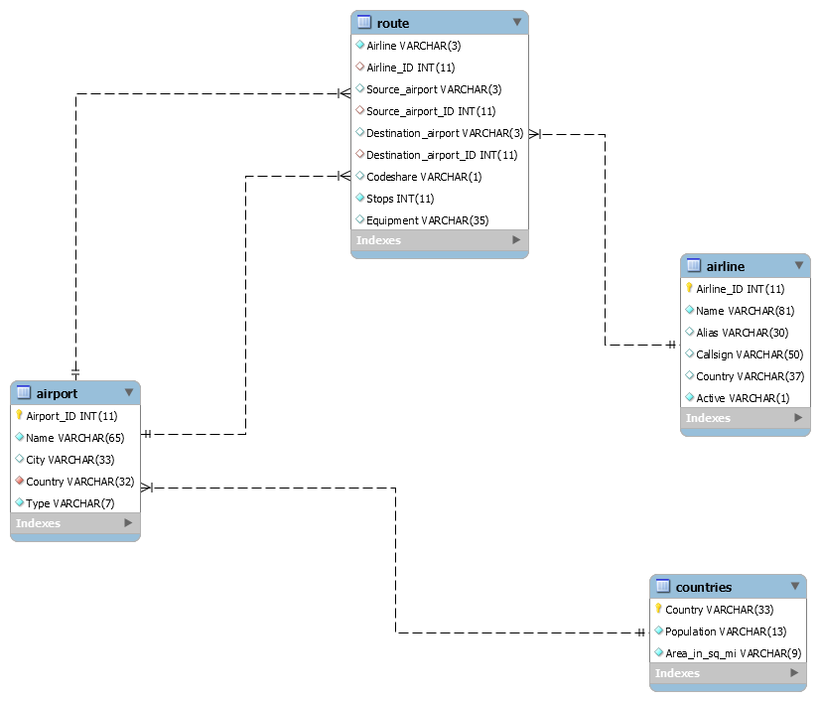
Dataset
3. Build mysql database model

Slide 8
What we used
Used mysql to store data
Used pandas to filter and sort the data
Used flask to show webpage
Used flask-bootstrap to create the webpage layout and styling, with some custom css.
Used Javascript to draw graphs

Slide 9
Our pivot table - Data flow
Flask serves page, with bootstrap and css used for styling.
When user selects database, jQuery/AJAX is used to fetch table attributes. These are returned in JSON format ( http://localhost:5000/fetchattributes?table=airport )
When data is submitted, the data is pulled from our MySQL database
Pandas is then used to filter & create a pivot table from the data
Currently, pandas is used to export a HTML table, however we will manually iterate over data and apply coloring with CSS for our final submission.

Slide 10
Pivot table Functionality
Supports multiple tables
Dynamically fetches attributes
Supports many aggregation functions (Count, Unique count, min, max…)
Supports filtering

Slide 11
Pivot Table Issues
Because there is very little numeric data in the airport dataset, there aren’t many interesting pivot tables we could create. We chose the
Large amount of data - this means that there is a huge delay in creating some tables.This can be addressed by using javascript to show a loading screen
Single, 1D filter - can’t search for values in a range, or add multiple filters

Slide 12
Pivot table example
Nice query: count of airline_id by airline/destination
Bad query: max stops by source/destination
http://localhost:5000/

Slide 13
Design Choices
Segmented design navigation, css styling, etc are in seperate files, and are combined to create the final page view
Error handling - bootstrap alerts are used to show errors by passing the error to the template

Slide 14
Thanks

